Slide 1
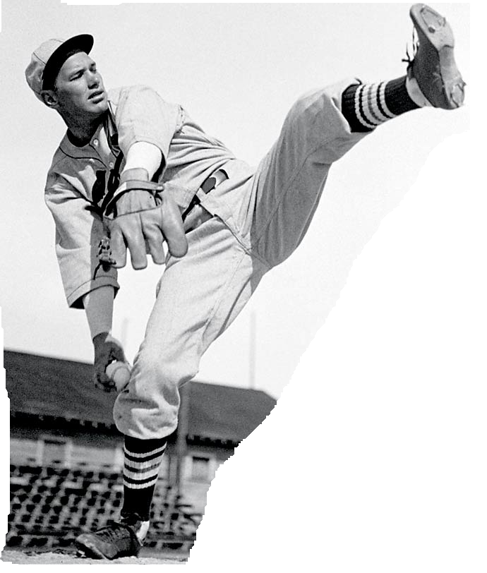
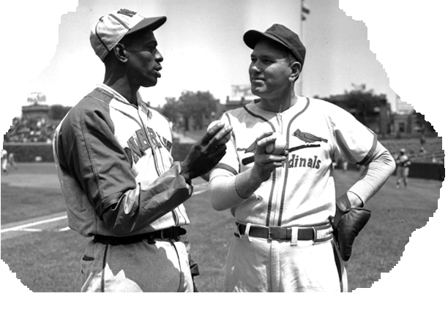
Dizzy Dean
Diz quotes about syntax and Satchell Paige.
Sin Tax? Those fellers in Washington will tax anything.
If Satch and I were pitching on the same team, we would clinch the pennant by July fourth and go fishing until World Series time.

Slide 2
Dizzy
Having fun with HTML and javascript.

Slide 3
HTML template engines
1
JSP
angular
mustache.js
handlebars.js
These tools mark up html with custom syntax and expressions.
<div> <c:forEach var="i" begin="1" end="20">
Player Name
<span id=firstName><c:out value="${player[i].firstName}"/></span>
<span id=lastName><c:out value="${player[i].lastName}"/></span>
Position
<c:forEach var="j" begin="1" end="5">
<span id=position><c:out value="${player[i].position[j]}"/></span>
</c:forEach>
</div>

Slide 4
HTML template engines
2
JSP
angular
mustache.js
handlebars.js
These tools mark up html with custom syntax and expressions.
<div> <c:forEach var="i" begin="1" end="20">
Player Name
<span id=firstName><c:out value="${player[i].firstName}"/></span>
<span id=lastName><c:out value="${player[i].lastName}"/></span>
Position
<c:forEach var="j" begin="1" end="5">
<span id=position><c:out value="${player[i].position[j]}"/></span>
</c:forEach>
</div>

Slide 5
HTML template engines
3
JSP
angular
mustache.js
handlebas.js
These tools mark up html with custom syntax and expressions.
<div> <c:forEach var="i" begin="1" end="20">
Player Name
<span id=firstName><c:out value="${player[i].firstName}"/></span>
<span id=lastName><c:out value="${player[i].lastName}"/></span>
Position
<c:forEach var="j" begin="1" end="5">
<span id=position><c:out value="${player[i].position[j]}"/></span>
</c:forEach>
</div>

Slide 6

HTML template engines
4
JSP
angular
mustache.js
handlebas.js
These tools mark up html with custom syntax and expressions.
<div> <c:forEach var="i" begin="1" end="20">
Player Name
<span id=firstName><c:out value="${player[i].firstName}"/></span>
<span id=lastName><c:out value="${player[i].lastName}"/></span>
Position
<c:forEach var="j" begin="1" end="5">
<span id=position><c:out value="${player[i].position[j]}"/></span>
</c:forEach>
</div>

Slide 7
HTML
5
<div>
Player Name
<span id=firstName></span>
<span id=lastName></span>
Position
<span id=position></span>
</c:forEach>
</div>

Slide 8
HTML
6
<div>
Player Name <span id=firstName></span><span id=lastName></span>
Position <span id=position></span>
</div>
A player may play multiple positions, but id should be unique.
HTML can handle that. We will use another attribute. For now, we will use dizid. That attribute name can be changed to name, data-id, etc.

Slide 9
HTML
6
<div>
Player Name <span dizid=firstName></span><span dizid=lastName></span>
Position <span dizid=position></span>
</div>
A player may play multiple positions, but id should be unique.
HTML can handle that. We will use another attribute. For now, we will use dizid. That attribute name can be changed to name, data-id, etc.

Slide 10
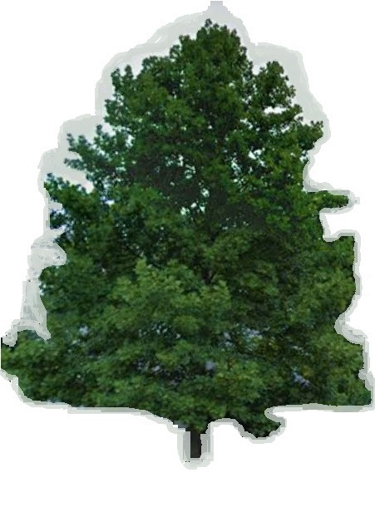
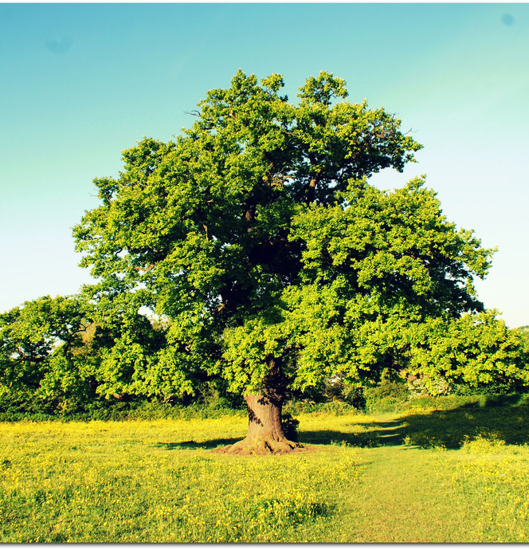
What is more lovely than a tree?
Two trees

Slide 11
Tree in javascript and HTML
player
firstName Dizzy
lastName Dean
position Pitcher
{ player:
{ firstName: "Dizzy",
lastName: "Dean",
position: "Pitcher"
}
}
for member in parameter
html.querySelectorAll("[dizid= "+member +"]")
html.innerText = parameter
<h1> Baseball </h1>
<div id=player>
<div><label>First Name</label><span dizid=firstName> </span></div>
<div><label>Last Name</label><span dizid=lastName>Dean</span></div>
<div><label>Position</label><span dizid=position>Pitcher</span></div>
</div>
Dizzy

Slide 12
dizzy.js
HTML and javascript are expressive.
dizzy does not need to define another syntax or expression language.
It is javascript and HTML. That's it.
diz(target, source) does everything.

Slide 13
API
diz(target, source) ==> modified target
diz( html, object) ==> modified html
diz(object, html) ==> modified object
Instead of source, You might say …
diz(
arrow.
)
target,
arrow

Slide 14
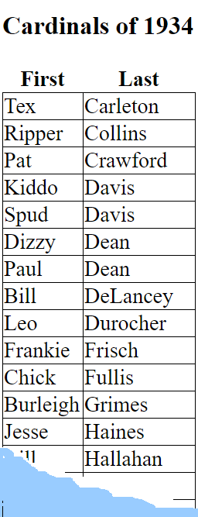
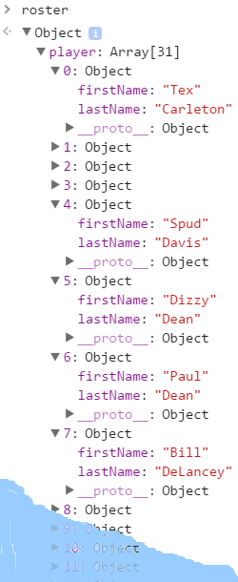
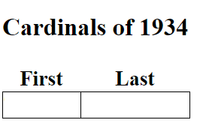
Example

Slide 15
Unit Test1: Empty Test
var test1Title = "test1 says that an empty html template and with no parameters produces an empty document"
function test1() {
expect(diz(null, null)).toBe("");
}
html
javascript

Slide 16
Version 1
var diz = function (){
return "";
}

Slide 17
Unit Test 2
Hello World
Hello World
var test2Title = "test2 says that a <span></span> + 'Hello World' ==> <span>Hello World</span> "
function test2() {
var div = document.createElement('div');
var span = document.createElement('span');
div.appendChild(span);
diz(span,"Hello World")
expect(div.innerHTML).toBe("<span>Hello World</span>");
}

Slide 18
Unit Test 2
Hello World
Hello World
var test2Title = "test2 says that a <span></span> + 'Hello World' ==> <span>Hello World</span> "
function test2() {
var div = document.createElement('div');
var span = document.createElement('span');
div.appendChild(span);
diz(span,"Hello World")
expect(div.innerHTML).toBe("<span>Hello World</span>");
}

Slide 19
Version 2
diz = function (htmlElement, parameter){
if(htmlElement == null) {
return '';
}
htmlElement.innerText = parameter;
}

Slide 20
Unit Test3
Hello World
Hello World
Hello World
var test3Title = "test3 says that a <span></span><span></span> + 'Hello World' ==> <span>Hello World</span><span>Hello World</span> "
function test3() {
var div = document.createElement('div');
var span1 = document.createElement('span');
var span2 = document.createElement('span');
div.appendChild(span1);
div.appendChild(span2);
var spans = div.querySelctorAll("span");
diz(spans,"Hello World");
expect(div.innerHTML).toBe("<span>Hello World</span><span>Hello World</span>");
}

Slide 21
Version 3
// search "javascript test type of object" http://javascript.info/tutorial/type-detection
// search "NodeList" https://developer.mozilla.org/en-US/docs/Web/API/NodeList
diz = function (html, parameter){
if(html == null) {
return '';
}
if(html instanceof NodeList){
var nodeList = html;
for(var i = 0; i < nodeList.length; i++ ){
var node = nodeList[i];
diz(node,parameter);
}
} else {
html.innerText = parameter;
}
}

Slide 22
Unit Test 4
firstName
firstName
firstName
firstName
Dizzy
Dizzy
var test4Title = "test4 'HTML Tree ,Object' says <span dizid=firstName/> {firstName: Dizzy} ==> <span dizid=firstName>Dizzy</span> "
function test4() {
var div = document.createElement('div');
div.innerHTML = '<span dizid=firstName></span>';
diz(div,{firstName: 'Dizzy'} );
var check = div.innerHTML.toString();
expect(div.innerHTML.toString()).toBe("<span dizid=\"firstName\">Dizzy</span>");
}

Slide 23
Version 4
diz = function (html, parameter){
if(html == null) {
return '';
}
if(html instanceof NodeList){
var nodeList = html;
for(var i = 0; i < nodeList.length; i++ ){
var node = nodeList[i];
diz(node,parameter);
}
} else if(typeof parameter == "object" ){
for(var member in parameter ){
var list = html.querySelectorAll("[dizid= "+member +"]");
if(list.length > 0){
diz(list, parameter[member]);
}
}
} else {
html.innerText = parameter;
}
}

Slide 24
Unit Test 5
Hello
Hello
Goodbye
Goodbye
var test5Title = "test5 'Single Element, Array' says that a <span> + ['Hello', 'GoodBye'] ==> <span>Hello</span><span>Goodbye</span> "
function test5() {
var div = document.createElement('div');
var span = document.createElement('span');
div.appendChild(span);
diz(span,["Hello","Goodbye"])
expect(div.innerHTML).toBe("<span>Hello</span><span>Goodbye</span>");
}

Slide 25
Version 5
diz = function (html, parameter){
if(html == null) {
return '';
}
if(html instanceof NodeList){
var nodeList = html;
for(var i = 0; i < nodeList.length; i++ ){
var node = nodeList[i];
diz(node,parameter);
}
}else if(Array.isArray(parameter) && parameter.length >0){
var parameters = parameter;
var parentElement = html.parentElement;
var insertionPoint = html.nextSibling;
for(var i = 1; i < parameters.length; i++){
var sib = html.cloneNode(true);
diz(sib,parameters[i]);
if(insertionPoint == null){
parentElement.appendChild(sib);
} else {
parentElement.insertBefore(sib, insertionPoint);
}
}
diz(html,parameters[0]);
}else if(typeof parameter == "object" ){
for(var member in parameter ){
var list = html.querySelectorAll("[dizid= "+member +"]");
if(list.length > 0){
diz(list, parameter[member]);
}
}
} else {
html.innerText = parameter;
}
}

Slide 26

Unit Test 6
firstName
firstName
firstName
Dizzy
firstName
firstName
firstName
firstName
Dizzy
Dizzy
Dizzy
Dizzy
Dizzy
firstName
firstName
Paul
firstName
firstName
firstName
firstName
Paul
Paul
Paul
Paul
Paul
firstName
Paul
firstName
Joe
Joe
firstName
Joe
firstName
Dizzy
firstName
Paul
Paul
firstName
Joe
var test6Title = "test6 'Add 3 Players, Remove 3 Players"
function test6() {
var div = document.createElement('div');
div.innerHTML = '<div dizid=players><span dizid=firstName></span></div>';
diz(div,{players:[{firstName: 'Dizzy'}]} );
expect(div.innerHTML.toString()).toBe('<div dizid="players"><span dizid="firstName">Dizzy</span></div>');
diz(div,{players:[{firstName: 'Dizzy'},{firstName: 'Paul'}]} );
expect(div.innerHTML.toString()).toBe('
<div dizid="players"><span dizid="firstName">Dizzy</span></div>
<div dizid="players"><span dizid="firstName">Paul</span></div>');
diz(div,{players:[{firstName: 'Dizzy'},{firstName: 'Paul'},{firstName: 'Joe'}]} );
expect(div.innerHTML.toString()).toBe('
<div dizid="players"><span dizid="firstName">Dizzy</span></div>
<div dizid="players"><span dizid="firstName">Paul</span></div>
<div dizid="players"><span dizid="firstName">Joe</span></div>');
}

Slide 27
What went wrong?
There are two types of duplication.
Every html element in a Node List is duplicated.
Every element in an Array is duplicated.

Slide 28
What went wrong?
There are two types of duplication.
Every html element in a Node List is duplicated.
Every element in an Array is duplicated.
Hello World
Hello World
Hello World
Hello
Hello
Goodbye
Goodbye

Slide 29
Back to the Drawing Board

Slide 30
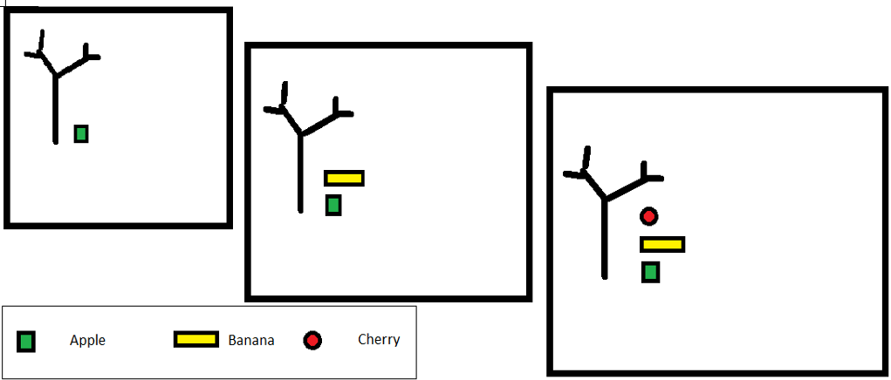
How to make an Apple, Banana, and Cherry Tree

Slide 31
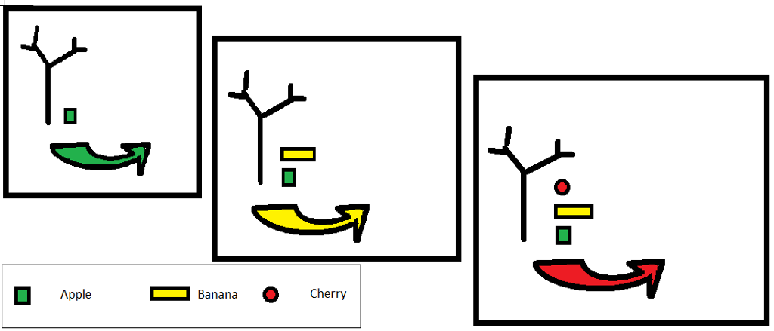
How to make an Apple, Banana, and Cherry Tree

Slide 32
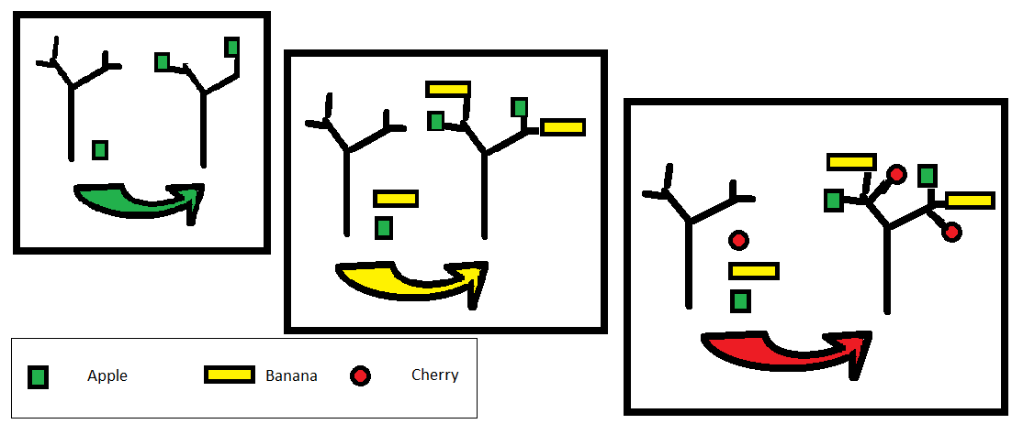
How to make an Apple, Banana, and Cherry Tree

Slide 33
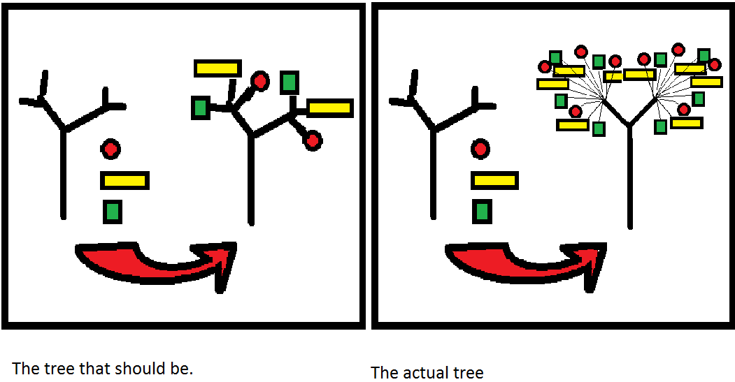
Compare Trees

Slide 34
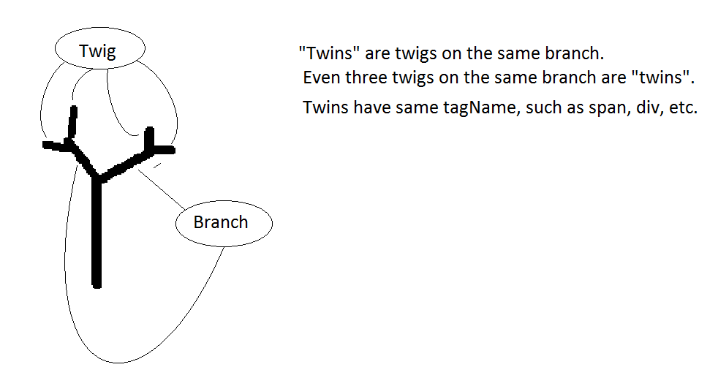
Tree Anatomy

Slide 35
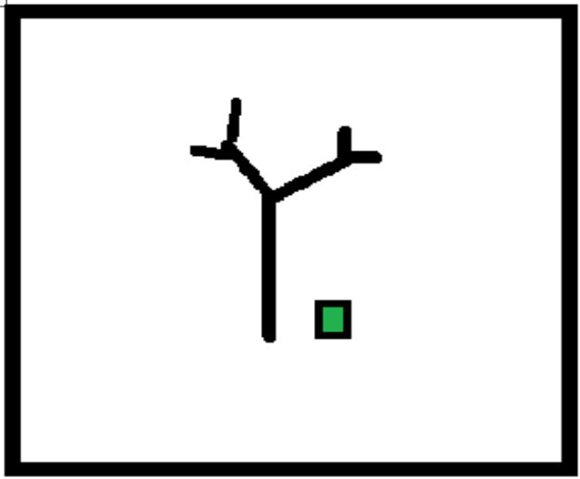
Remove extra twin

Slide 36
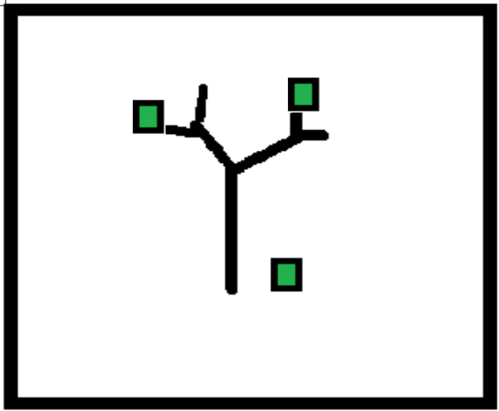
Remove extra twin

Slide 37

Remove extra twin

Slide 38
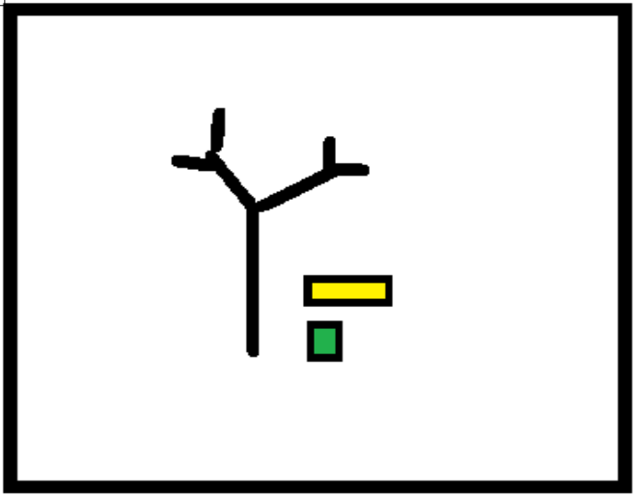
Use both twins

Slide 39
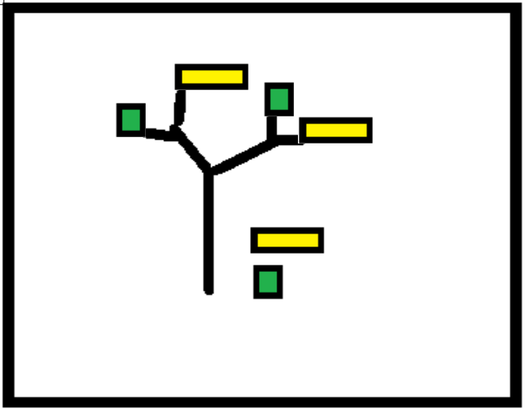
Use both twins

Slide 40
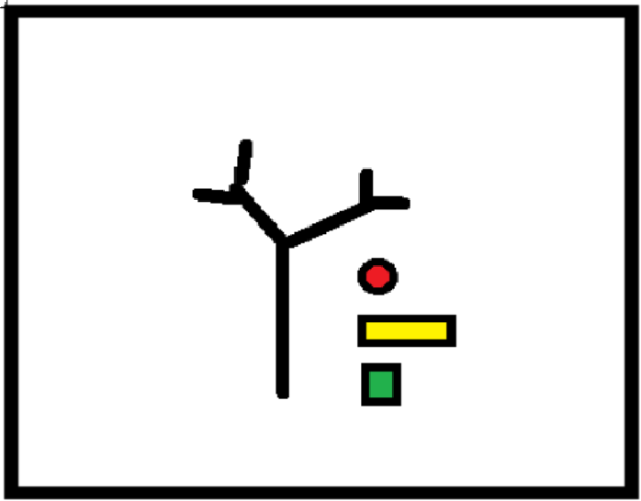
Add third twin

Slide 41
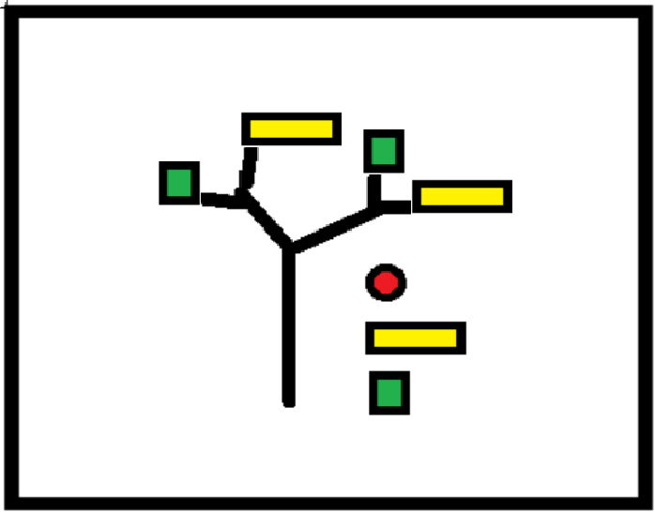
Add third twin

Slide 42

Add third twin

Slide 43
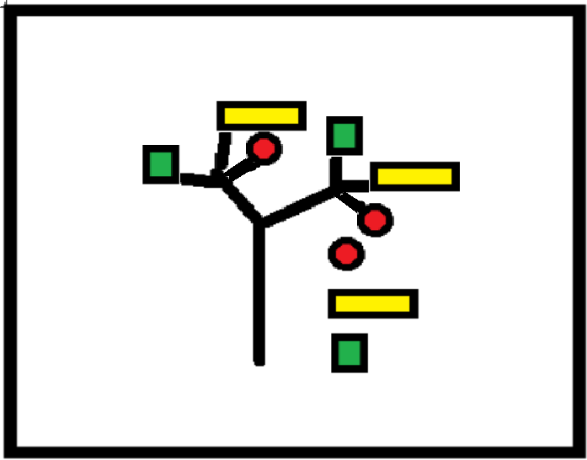
Add third twin

Slide 44
Unit Test 7
var test7Title = "test7 'Apple, Banana, Cherry Tree"
function test7() {
var div = document.createElement('div');
div.innerHTML = '<trunk><branch><twig></twig><twig></twig></branch><branch><twig></twig><twig></twig></branch></trunk>';
var twigs = div.querySelectorAll('twig');
diz(twigs,['apple', 'banana', 'cherry'] );
var fruitTwigs = div.querySelectorAll('twig');
expect(div.innerHTML.toString()).toBe('<trunk><branch><twig>apple</twig><twig>banana</twig><twig>cherry</twig></branch>
<branch><twig>apple</twig><twig>banana</twig><twig>cherry</twig></branch></trunk>');
}
Note: This example uses elements trunk, branch and twig.
They are not HTML tags.

Slide 45
Version 7
html in this case is a Nodelist with four 'twigs'. We divide the twigs into setsOfTwins, one for each branch.
diz = function (html, parameter){
…
…
if(html instanceof NodeList && Array.isArray(parameter) && parameter.length >0){
var nodeList = html;
var setsOfTwins =[];
// build sets of twins
for(var i = 0; i < nodeList.length; i++ ){
var node = nodeList[i];
var isMatchingTwin = false;
for(var j = 0; j< setsOfTwins.length && isMatchingTwin == false; j++){
var twins = setsOfTwins[j];
var firstTwin = twins[0];
if(node.tagName == firstTwin.tagName
&& node.parentElement == firstTwin.parentElement ){
twins.push(node);
isMatchingTwin = true;
}
}
if(isMatchingTwin == false){
setsOfTwins.push([node]);
}
}
…
… to be continued …
Test for twin is same tagName & parent
Unmatched twin triggers the creation of a new set of Twins

Slide 46
Version 7 part 2
The outer loop repeats twice. Once for each branch.
…
… from previous slide …
for(var k = 0; k < setsOfTwins.length; k++){
var twins = setsOfTwins[k];
while(twins.length > parameter.length){
var lastTwin = twins.pop();
lastTwin.parentElement.removeChild(lastTwin);
}
var firstTwin = twins[0];
var lastTwin = twins[twins.length - 1];
while(twins.length < parameter.length){
var clone = firstTwin.cloneNode(true);
lastTwin.insertAdjacentElement("afterend",clone);
twins.push(clone);
lastTwin = clone;
}
for(var l = 0; l < parameter.length; l++){
diz(twins[l],parameter[l]);
}
}
The apple tree has extra twigs, that need to be pruned.
The apple, banana, cherry tree needs an extra twig for the cherry.
There's a twig for every piece of fruit. Put the fruit on the tree.

Slide 47
Unit Tests with Jasmine
var test1Title = "test1 says that an empty html template and with no parameters produces an empty document"
function test1() {
expect(diz(null, null)).toBe("");
}

Slide 48
Chat with Peggy
I wanted to tell Peggy how far I have come, but she is a biologist not a computer scientist.
If we play 20 questions and you ask "Is it an animal?" and the reply is "yes", then there are millions of possibilities. Those possibilities are your population.
What's your next question? "Does it have a spinal chord?"

Slide 49
Chat with Peggy
I wanted to tell Peggy how far I have come, but she is a biologist not a computer scientist.
If we play 20 questions and you ask "Is it an animal?" and the reply is "yes", then there are millions of possibilities. Those possibilities are your population.
What's your next question? "Does it have a spinal chord?"

Slide 50
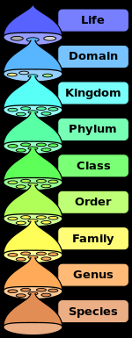
Chordata is the phylum with spinal chords.
https://en.wikipedia.org/wiki/Phylum

Slide 51
Different Question
Does it have eyes?

Slide 52
What do questions do?
Questions
Dimensions
Description
Groups/Sets/Categories/Classes
Relationships of GSCC
Measurement
Possibilities
Population
Volume/Size of Universe

Slide 53
I am glad that I have you
To see the world through.

Slide 54
Version 1
var diz = function (){
return "";
}

Slide 55
Unit Tests with Jasmine
var test1Title = "test1 says that an empty html template and with no parameters produces an empty document"
function test1() {
expect(diz(null, null)).toBe("");
}

Slide 56
Version 1
var diz = function (){
return "";
}

