Slide 1
SSDKeeper: Self-Adapting Channel Allocation to Improve the Performance of SSD Devices
Renping Liu, Xianzhang Chen, Yujuan Tan, Runyu Zhang, Liang Liang, DuoLiu
Published: 18-22 May 2020
2020 IEEE International Parallel and Distributed Processing Symposium (IPDPS)

Slide 2
Outline
Introduction
SSDKeeper Design
Evaluation
conclusion

Slide 3
Introduction (1/2)
Multiple tenants usually share the same hardware, within inappropriate channel allocation, it may lead to numerous access conflicts and SSDs performance degradation.
By collecting multi-tenant access patterns and training a model, SSDKeeper selects an optimal channel allocation strategy for multiple tenants with the lowest overall response latency.
Notes:
Tenant 就是租客 不同區的人在使用的情況

Slide 4
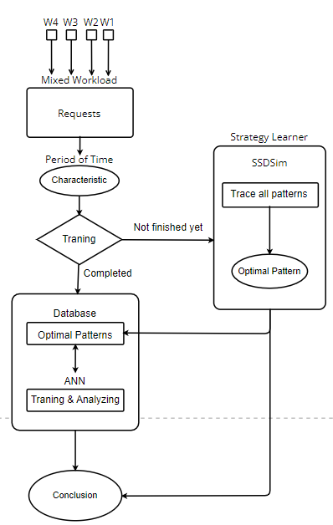
Introduction (2/2)
Different workloads are combined as a mixed workload, containing all of their requests. After period of time, it frames some of the requests and gets the characteristic of the dataset. By tracing the dataset within all patterns off-line (based on 4 tenants and 8 channels), we can find the optimal one and place it into database.
After the training be experienced iteratively, the new dataset can now get an appropriate allocation pattern by ANN.
The experimental results shows that the SSDkeeper can improve the overall performance by 24% and the accuracy can approach to 94.5%.

Slide 5
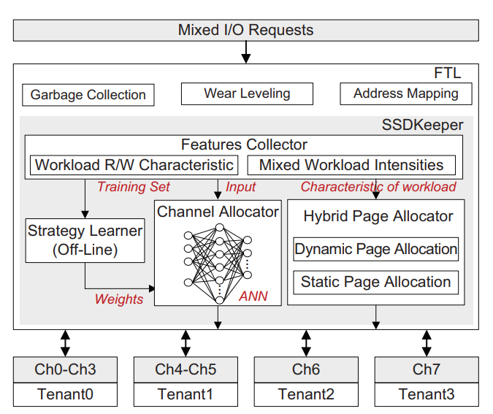
SSDKeeper Design
Features collector: Designed to collect training data set and access patterns.
Strategy learner: SSDKeeper find an optimal allocation toward different patterns and mark it as a label.
Channel allocator: Based on a mass of feature-label pairs, it trains a model to cope with varying access patterns of multiple tenants.
Hybrid page allocator: Adjusts the page allocation mode based on the read/write characteristic of different tenants to further improve the overall performance of the SSD hardware.

Slide 6
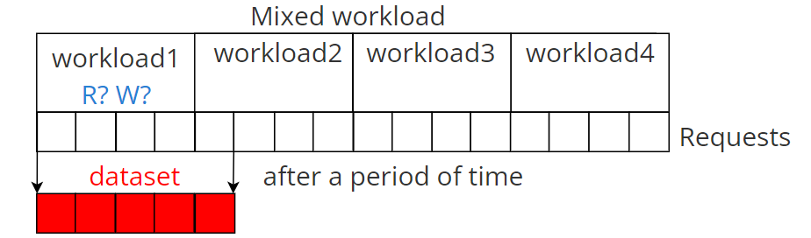
Features Collector
Level: The overall requests are divided in 20 levels, then we can define the level of the dataset according to number of requests. Higher level, higher “Overall Intensity”.
Relative Intensity: Type of each workloads.(0 as write, 1 as read.)
Read-Operation proportion toward read requests of each workload.
Notes:
Read-Operation proportion 依照比例分配 讀的加起來是1 寫的也是1 (上面記錄是讀的)

Slide 7
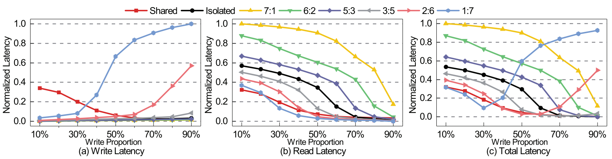
Strategy Learner
Based on 4 tenants & 8 channels, there will be 42 patterns, such as (4:2:1:1, 7:1:0:0, share…) While input the feature from last part , Strategy learner will trace the dataset with the 42 patterns in SSDSim, then records the best allocation strategy with the lowest latency as the label.
W：R
Notes:
42種原因 (5111 4!/3!=4) (4211 4!/2!=12)(3311 4!/2!2!=6)(3221 4!/2!=12)(2222=1) (71=2)(62=2)(53=2)(44=1)

Slide 8
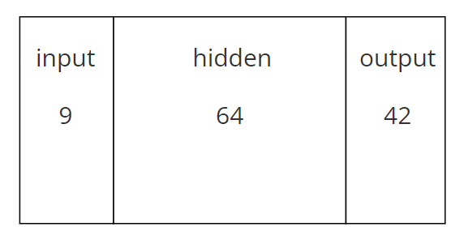


Channel Allocator (1/2)
By the outputs of Feature Collector and Strategy Learner, a neural network, ANN, can then be set.
Since there are 9 features and 42 possible allocation patterns that we mentioned before, the input and output layer contains 9 and 42 neurons.
According to the number of neurons, we can calculate the storage overhead and computational overhead, which both are negligible in this paper.
Notes:
第一個公式是計算容量
第二個公是是計算福點數量(計算量)
因為數量不多 所以這兩個的overhead都可忽略

Slide 9
Channel Allocator (2/2)
The core function of ANN is to decrease the error rate and continue iterating until the cost function converge to the minimum.
To reduce the calculation, the SGD(Stochastic Gradient Descent) algorithm is chosen. Also, the optimization module based on SGD, Adam, has been chosen, too.
We can train the model on the host side, and then send the parameter to the FTL as well as training the model when the controller is idled. This makes a advantage that the training phase does not affect the performance of the SSD hardware.
Notes:
SGD does not calculate the entire data set (which is redundant and inefficient), but only a small portion of the data sample or random selection.
隨機梯度下降
Adam 是基於SGD的優化模組，與SGD的最大差別只有樣本抽取數量多寡，Adam抽比較多(導致後面實驗結果精確度更高)。
而ANN的神經網路學習有個最大的好處是：幾乎完全不占用SSD效能。因ANN將許多的資料都數值化，所以即便在host端也可以做訓練，只要將訓練資料的parameter訓練完後送到FTL就好；或是在SSD閒置的時候做訓練。

Slide 10
Hybrid Page Allocator
Dynamic Page Allocation:
Appropriate to write requests and reduce response latency. As there is an idle channel or chip, the data that needs to be stored will be immediately written to the idle channel or chip.
Static Page Allocation:
Appropriate to read requests and improve response time. Since it enable successive logical pages to be distributed across different channels and chips.
Notes:
Therefore, SSDKeeper uses static page allocation mode for the read-dominated workload and selects dynamic page allocation mode for the write-dominated workload
動態write 有助於在寫入時盡可能寫在同一個區塊 避免碎片化
靜態read 在FTL層 就已經知道要讀取得情況 所以選擇靜態

Slide 11
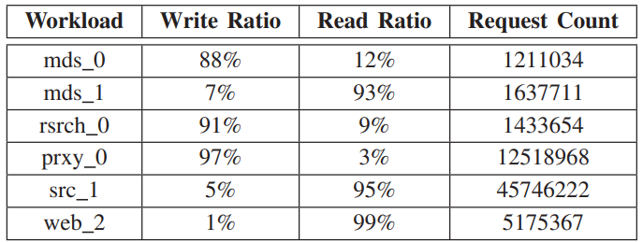
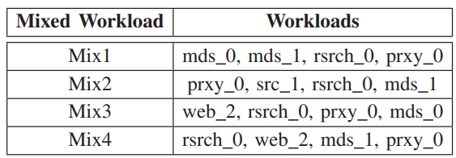
Evaluation (1/4)
Level: Fixed the overall requests to 2M, then the range of 100K requests is defined as a level.
Relative Intensity: Type of each workloads.(0 as write, 1 as read.)
Read-Operation proportion
Notes:
此論文使用的模擬器叫SSDSim 並取出這些workload
我以mix2做舉例
Feature 是9個矩陣
Read-O 做read的情況

Slide 12
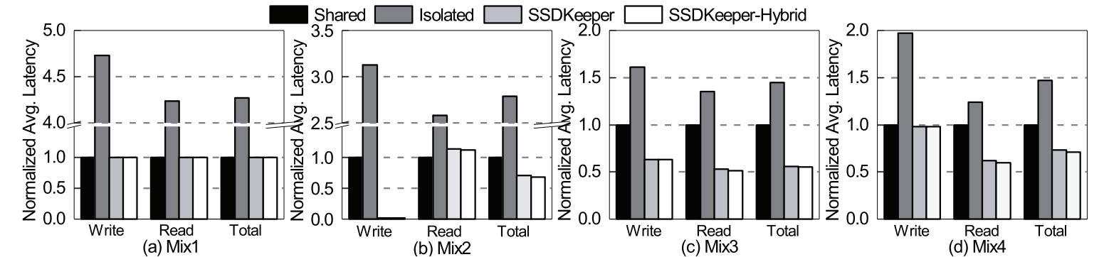
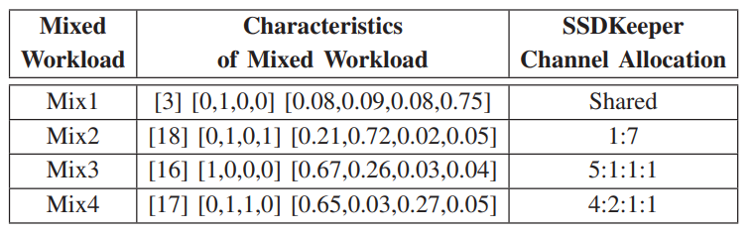
Evaluation (2/4)
Notes:
在mix1中 是選擇share 而不適其他的 因為一開始初始就是以share 來進行分配 所以如果其他方式都差不多的話 那就會以share來優先
Feature label pair
Feature 是9個矩陣 Label 最佳解
把這個丟進去Channel allocator

Slide 13
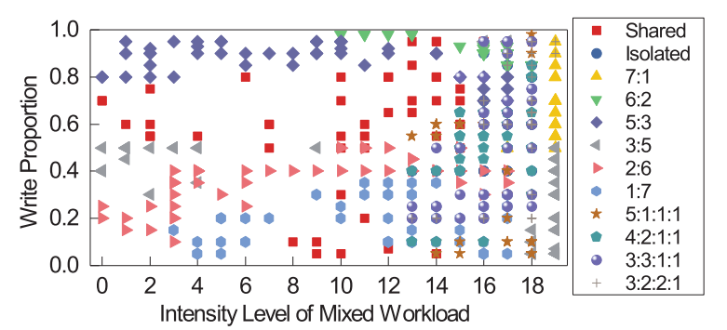
Evaluation (3/4)
W：R
Notes:
每段時間的workload 所點出來的最佳通道策略的情況

Slide 14
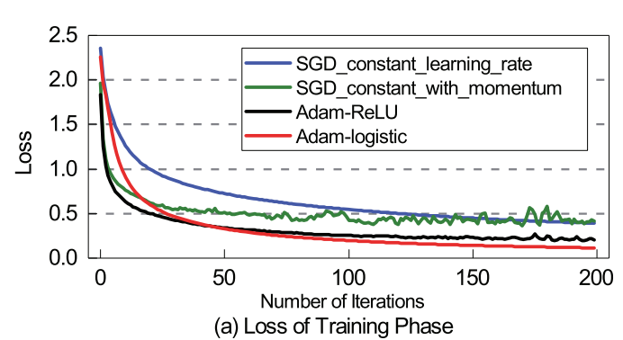
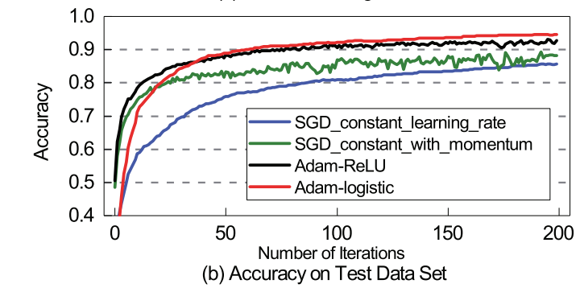
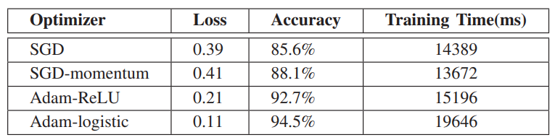
Evaluation (4/4)
Notes:
我們會有5000個mix workload 都會有個別的最佳通道分配解法 所以會有5000個最佳解 7:3 去做training 3是為了讓他去嘗試應付沒看過的data
左圖 loss 為 實際值和預測值的誤差
右圖 精準度 實際直分支預測值
SGD 過你和 因為我們只取部分的DATA(為了減少運算量和overhead) 因此我們的準確度就會比較低

Slide 15
Conclusion
This paper proposed the SSDKeeper to select an optimal channel allocation by collecting multi-tenant access patterns and access intensities.
With neural network, SSDKeeper can integrate a database to cope with newer datasets by predicting an appropriate allocation.
The experiment shows the SSDKeeper improves the overall performance(latency) by 24% and the accuracy can approach to 94.5%.
Notes:
提出SSDKeeper 為了要妥善分配通道的情況 用神經網路的方式做訓練 可以有94.5%的精準度 並降低24%的latency

