Slide 1
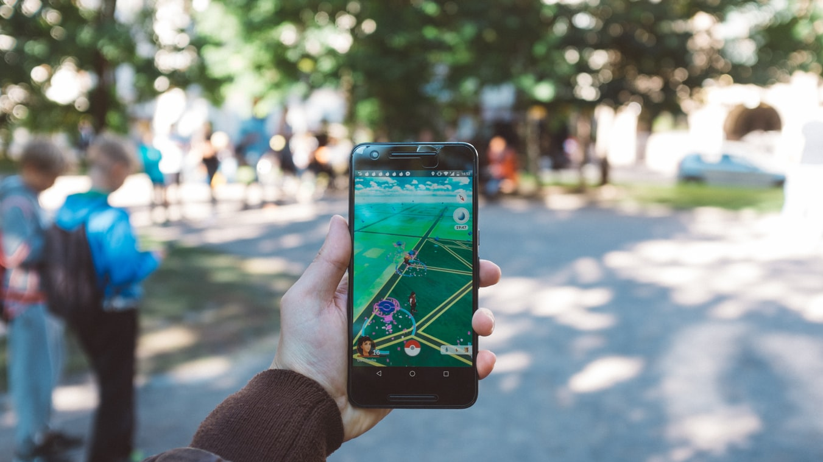
VR, AR & MR Meetup

Slide 2

