Slide 1
Domestic Auto Sales Forecast
Q4 2016 to Q1 2020
Tim Mango

Slide 2
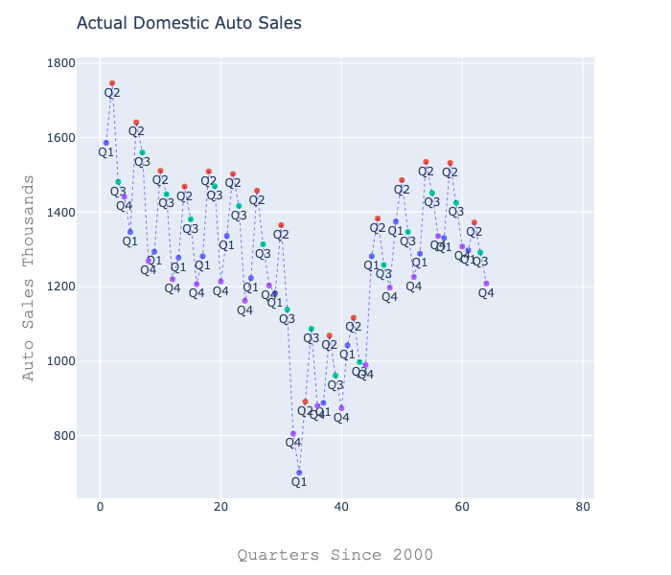

Slide 3
Forecasting Approach
Technical
Non-Technical
Perform Johanson's Cointegration Test to determine variables that have relationship with auto sales over time.
Drop variables with a negative cointegration test.
Evaluate remaining variables for Correlation.
Drop explanatory variables that are highly correlated.
Use Augmented Dickey-Fuller (ADF) Test to test stationarity of remaining variables.
Transform variables with a first difference to make them stationarity.
Repeat ADF Test to confirm stationarity of variables.
Check for optimal lag number for Vector Autoregression (VAR) model evaluated by AIC metric.
Use VAR model with optimal lags (this model used 3).
Obtain estimates from VAR model.
Transform estimates to original units.
Plot and report results.
There is a seasonal pattern in the data that needs to be removed before an optimal model can be applied.
Auto sales and relevant explanatory variables first go through a de-trending process.
A model is then fit to the data and results are reported in original units.

Slide 4
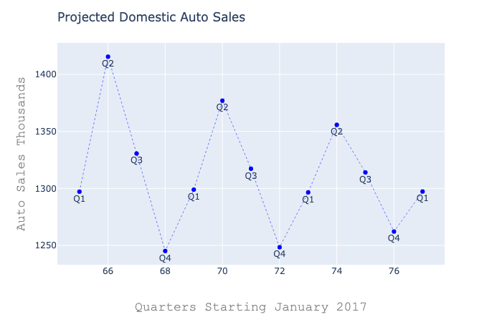

Slide 5
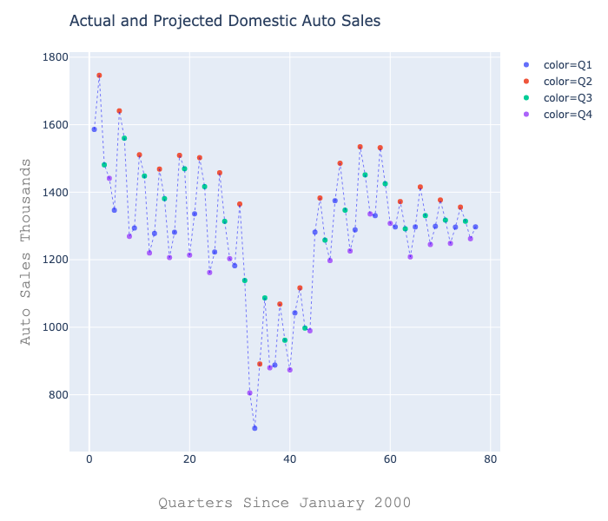

Slide 6
Appendix: Variables Used in Final Model
Domestic Auto Sales (Autos)
US Nominal GDP Growth (Var_02)
US Nominal Disposable Income Growth (Var_04)
US CPI Inflation Rate (Var_06)
US 3-month Treasury Rate (Var_07)
US Dow Jones Stock Market Index (Var_13)
*While these variables were chosen for the reported model, other variables may also affect auto sales.

