Slide 1
Bacchus Winery Database Design Project
Bellevue University
CSD-310 Database Development and Use
Group Members:
Jonathan Walmsley
Timothy Martin
Roxanne Buenaventura
Peter Ddamulira

Slide 2
Case Study Overview _______________
Background
Bacchus Winery produces several varieties of wine and manages daily operations involving suppliers, inventory, employees, production, and distributors.
The winery required a centralized database to organize business information and improve operational efficiency.
Project Objective
Design a normalized relational database that accurately represents the winery’s business processes.
Reduce duplicate data while improving data integrity and reporting capabilities.
Support informed business decisions through efficient data management and reporting.

Slide 3
Business Rules: Operations _______________
Supplier and Delivery Rules
One supplier can have many deliveries.
Each delivery comes from one supplier.
One delivery can contain many inventory items.
One inventory item can appear in many deliveries over time.
Inventory Rules
Each inventory item has one inventory record.
Each inventory item tracks the quantity received and current stock level.
Inventory items include production supplies such as bottles, corks, labels, boxes, vats, and tubing.
Wine Distribution Rules
One distributor can carry many wines.
One wine can be carried by many distributors.
Each shipment is sent to one distributor.
One shipment can contain many wines.
One wine can appear on many shipments.

Slide 4
Business Rules: Production & Distribution _______________
Employee Rules
One department can have many employees.
Each employee belongs to one department.
One employee can have many timesheets.
Each timesheet belongs to one employee.
Wine Production Rules
The winery produces multiple wines.
Each wine has a unique wine identifier.
Each wine can be included in many shipments.
Shipment Rules
One distributor can receive many shipments.
Each shipment has one shipment date and delivery status.
Each shipment contains one or more wines.

Slide 5
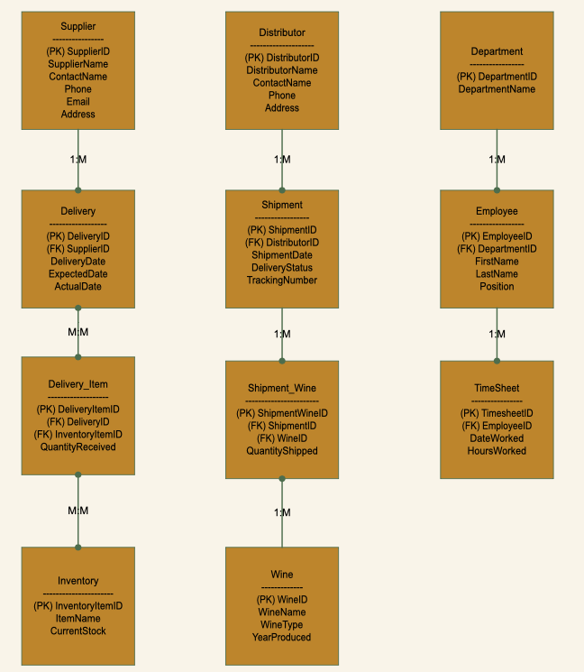
Entity Relationship Diagram _____________
Database Design Highlights
Models the core operations of Bacchus Winery, including suppliers, inventory, employees, wine production, and distribution.
Uses primary and foreign keys to maintain accurate relationships between related tables.
Implements bridge tables to support many-to-many relationships while maintaining data integrity.
Organized in Third Normal Form (3NF) to reduce redundancy and improve consistency.
Provides a scalable foundation for reporting, inventory management, and future business growth.

Slide 6
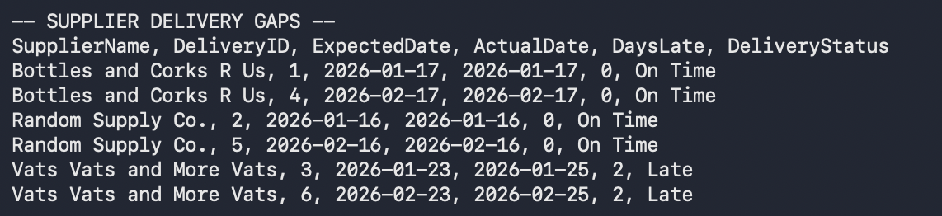
Report #1: Supplier Delivery Performance _______________
Business Purpose Monitor supplier performance to improve purchasing decisions and inventory management.
Report Highlights
Track on-time and late deliveries by supplier.
Identify suppliers with consistent delivery performance.
Support purchasing decisions based on reliability.
Reduce production delays caused by late shipments.

Slide 7
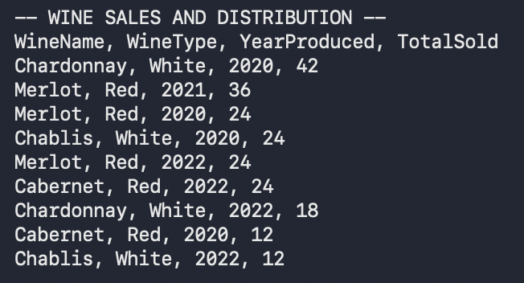
Report #2: Wine Sales & Distribution _______________
Business Purpose Analyze wine distribution to support production planning and sales strategies.
Report Highlights
Monitor which wines are shipped most frequently.
Compare distributor activity across wine varieties.
Identify high-demand and low-demand products.
Support production planning and inventory allocation.

Slide 8
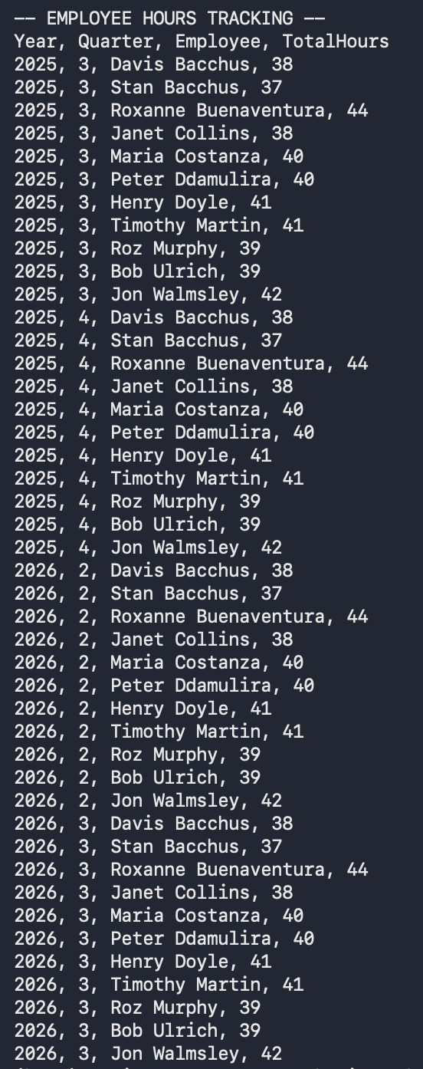
Report #3: Employee Hours Tracking _______________
Business Purpose Monitor employee work hours to improve staffing and payroll accuracy.
Report Highlights
Track hours worked by each employee.
Review workload across departments.
Support payroll processing.
Assist managers with staffing and scheduling decisions.

Slide 9
Conclusion
Designed a normalized relational database to support Bacchus Winery’s daily operations.
Developed business rules and an Entity Relationship Diagram (ERD) to accurately model the organization’s data.
Created reports that provide valuable insights into supplier performance, wine distribution, and employee hours.
Built a scalable database that improves data integrity, reduces redundancy, and supports future business growth.
Notes
Throughout this project, our team designed a relational database that addresses the operational needs of Bacchus Winery. We began by identifying the business requirements, developed business rules, and created a normalized database structure supported by our Entity Relationship Diagram. We then demonstrated how the database can generate meaningful reports that help management monitor supplier performance, analyze wine distribution, and track employee hours. Overall, our solution provides a reliable, scalable foundation that improves data accuracy and supports informed business decision-making.

