Slide 1
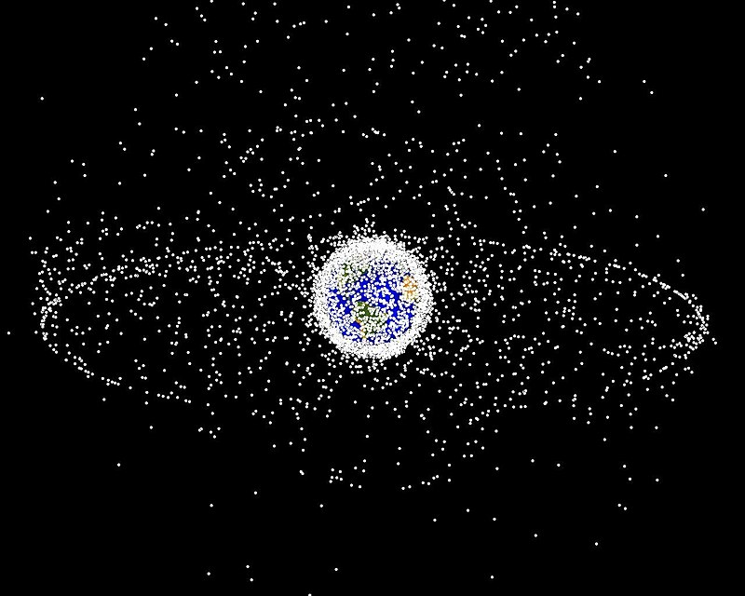
Modelling and Simulation of Kessler Syndrome in Low Earth Orbit
A determination of critical densities, time to tipping point, and risk after tip
Nasa Orbital Debris Program Office

Slide 2
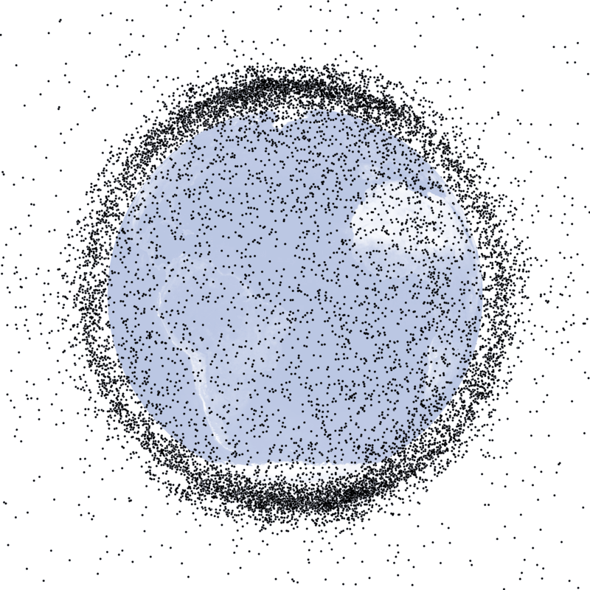
A Brief Introduction
Nonfunctional spacecraft and debris accumulate over time
Crash events between satellites and debris creates more debris
Domino effect
Iridium/Cosmos collision alone created >1500 fragments

Slide 3
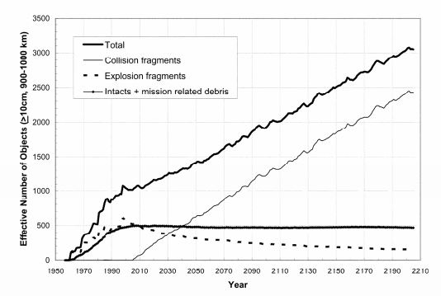
Donald J. Kessler et al. THE KESSLER SYNDROME: IMPLICATIONS TO FUTURE
SPACE OPERATIONS. 2010. (Figure 6)

Slide 4
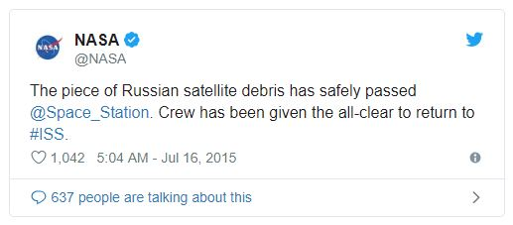
Problem Statement
When will Kessler Syndrome render LEO too risky for manned space stations?
When will it be too risky to manned spaceflight of any kind?
How will removal methods and satellite/ debris densities interact with risk?

Slide 5
Scope
Create or adapt a simulation environment that can model
The density of debris in space over time, as described in current literature
Additional satellite launches over the next 10 years, as described in literature
Danger of collision for a specific object in LEO over a specific amount of time
Simple collisions between objects
Removal methods (laser broom, netting or tentacle methods)

Slide 6
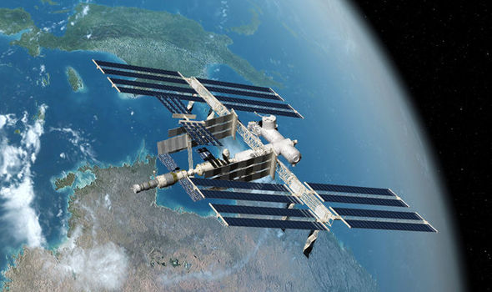
Requirements
Model accepts:
(Knowns): Beginning object density, object average size and frangibility, object distribution
(Parameters): Spacecraft launch rate, debris elimination rate (for both laser and net systems)
Model returns:
Risk of collision for a small volume (e.g. the ISS) per unit time in LEO

Slide 7
Assumptions
Relatively simple, stochastic collisions between different categories of objects
Only live objects maneuver
Objects have finite average lifetime
Simple geographic distribution of objects in orbit (more in polar orbits, etc)
New objects will obey same distribution
Most new objects deorbit after lifetime expended

Slide 8
Proposed Efforts
Use ABM to model likely future LEO scenarios
May require some system dynamics for rates of launches and/or rates of eliminations
Discrete event could be used, but loses information about orbit types and distributions
Python or MATLAB modelling environment
Vensim unlikely to have power to effectively model orbits
Depending on capabilities of ORDEM, could adapt code

Slide 9
Analysis and Exploration Activities
Test for future suitability of space for manned activities
Explore high, low, and middle of published expected rates of satellite launch
Explore high, low, and middle published rates of elimination for both removal methods
Use results to determine risk of death to astronauts for each scenario
Determine time at which risks become untenable under each system

Slide 10
Verification
Will it compile?
Do visualizations of the orbits and crash behavior make sense/agree with published models?
Several papers and books provide test cases for different subsections (Nasa’s breakup book)
Do other elements seem reasonable/agree with published values?

Slide 11
Validation
Model can be partially validated using NASA’s ORDEM model
Additional validation can be performed by turning back the clock and observing what the model predicts based on historical data
Is it believable?
Wait 10 years, check again (actually done for Kessler syndrome)

Slide 12
Work Plan
February 20: Basic satellite trajectories can be computed and modelled
March 10: Code compiles correctly, all features present
March 20: Code fully debugged. Test scenarios agree with published data.
April 1: All data gathered.
April 17: Report completed.

Slide 13
Citations
Donald J. Kessler et al. THE KESSLER SYNDROME: IMPLICATIONS TO FUTURE SPACE OPERATIONS. 2010
R L Phipps, K & B Baker, S & A Libby, D & S Liedahl, S & D Olivier, L & Pleasance, A & E Rubenchik, J & V Trebes, E & George, B & P Marcovici, Reilly & Phipps, Claude & L Baker, Kevin & Libby, Stephen & A Liedahl, Duane & Olivier, Scot & D Pleasance, Lyn & Rubenchik, Alexander & E Trebes, James & T Valley, Michael. (2012). Removing Orbital Debris with Pulsed Lasers. AIP Conference Proceedings. 1464. 10.1063/1.4739901.
H. Hakima and M. R. Emami, "Prioritizing orbital debris for active debris removal missions," 2017 IEEE Aerospace Conference, Big Sky, MT, 2017, pp. 1-11. doi: 10.1109/AERO.2017.7943788 URL: http://ieeexplore.ieee.org/stamp/stamp.jsp?tp=&arnumber=7943788&isnumber=7943554
Ireland, S. (2010). Dodging bullets: The threat of space debris to U.S. national security (Unpublished master's thesis). Thesis / Dissertation ETD.
(Others omitted for brevity, but available on request).

