Slide 1
CSS – Workshop Taster

Slide 2
Aims
Allow you to understand which of the workshops you would benefit from most.
Give you a sneak peak of some of the topics that will be covered in the workshops and presentations to follow.
Quickly give you some general CSS tips and tricks.
Get you to engage and ask questions about everything we talk about today.

Slide 3
Agenda
Modularising UI components
Selectors
Specificity
Performance
Positioning & the box model
Inheritance
BEM
OOCSS
ITCSS
Designing in isolation
Workshop Assessment Guide
Q & A

Slide 4
Modularising UI components
Avoid deviation
Identify patterns
Aim for reusability
Build in isolation
Don’t couple with use cases, e.g.
Don’t include layout in components, i.e. widths, heights. As they should not care where they are used.
Nothing is unique (e.g. .content .btn {padding: 10px} should actually be .btn—large {padding: 10px})

Slide 5
Selectors
Popular selectors:
ID
Class
Tag

Slide 6
Selector types
/* select an element by id */
#myId {}
/* select elements with a given class applied to them */
.myClass {}
/* select a html element */
body {}

Slide 7
Specificity
Used by the browser to work out what styles are most relevant to the element in question.
Calculated by adding up all the selectors.
Specificity calculator
http://specificity.keegan.st/
Method | Specificity | e.g.
id | 100 | #id {}
Classes | 10 | .class {}
Elements | 1 | a {}

Slide 8
How many classes does it take to override an ID?
#myVeryWeightedIDSelector {}
.c000.c001.c002.c003.c004.c005.c006.c007.c008.c009.c010.c011.c012.c013.c014.c015.c016.c017.c018.c019.c020.c021.c022.c023.c024.c025.c026.c027.c028.c029.c030.c031.c032.c033.c034.c035.c036.c037.c038.c039.c040.c041.c042.c043.c044.c045.c046.c047.c048.c049.c050.c051.c052.c053.c054.c055.c056.c057.c058.c059.c060.c061.c062.c063.c064.c065.c066.c067.c068.c069.c070.c071.c072.c073.c074.c075.c076.c077.c078.c079.c080.c081.c082.c083.c084.c085.c086.c087.c088.c089.c090.c091.c092.c093.c094.c095.c096.c097.c098.c099.c100.c101.c102.c103.c104.c105.c106.c107.c108.c109.c110.c111.c112.c113.c114.c115.c116.c117.c118.c119.c120.c121.c122.c123.c124.c125.c126.c127.c128.c129.c130.c131.c132.c133.c134.c135.c136.c137.c138.c139.c140.c141.c142.c143.c144.c145.c146.c147.c148.c149.c150.c151.c152.c153.c154.c155.c156.c157.c158.c159.c160.c161.c162.c163.c164.c165.c166.c167.c168.c169.c170.c171.c172.c173.c174.c175.c176.c177.c178.c179.c180.c181.c182.c183.c184.c185.c186.c187.c188.c189.c190.c191.c192.c193.c194.c195.c196.c197.c198.c199.c200.c201.c202.c203.c204.c205.c206.c207.c208.c209.c210.c211.c212.c213.c214.c215.c216.c217.c218.c219.c220.c221.c222.c223.c224.c225.c226.c227.c228.c229.c230.c231.c232.c233.c234.c235.c236.c237.c238.c239.c240.c241.c242.c243.c244.c245.c246.c247.c248.c249.c250.c251.c252.c253.c254.c255 {}

Slide 9
Why use classes over ids?
ID’s have a high specificity making them difficult to override.
ID’s are not reusable, a single class can be added to multiple elements.
A single element has one ID which means you can’t use composition to build up your styles.

Slide 10
Performance
Browsers read CSS right to left so make the last selector as specific as possible to quickly get matched.
If you know the DOM then use child selector (>) as then it only goes up one DOM level.
Use the wildcard selector sparingly as the name suggest it matches all elements.

Slide 11
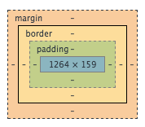
The box model

Slide 12
Margins
Used to state where an object should position itself inside its parent container.

Slide 13
Borders
Made up of a style, width and colour.
Multiple styles (dotted, dashed, solid, double, groove, ridge, inset, outset, none and hidden)
Width can be set using a unit (e.g. px, cm, em) or use one of the predefined values:
Thin
Medium
Thick

Slide 14
Padding
Used to state where elements should position themselves inside of the current element.

Slide 15
Widths
For block elements the default width is the width of the parent element.
For inline elements the default width is the total width of the content inside it.

Slide 16
Heights
The default height is always the height of the content inside the element.

Slide 17
Position types
Absolute
Relative
Fixed
Static

Slide 18
position: absolute
Positions the element relative to the closest parent with position set to relative.
Will cause the element to lose its natural width because it loses its block element status, so it effectively becomes an inline element.
Add position: relative to the parent container to make the child element if you want to use width: 100%
TOPTIP: you can use left: 0, right: 0 to make the element span 100% as an alternative to using width: 100% which might be problematic depending on what box-sizing you are using.

Slide 19
position: relative
Positions the element relative to its normal position.
E.g. adding ‘position: relative, left: 20px’ would move the element left 20px.

Slide 20
position: fixed
Positions the element relative to its viewport causing it to stay in the same position when the page is scrolled.

Slide 21
position: static
Default position.
Not affected by setting top, left, bottom or right.
Positions the element in accordance to the normal flow of the page.

Slide 22
Inheritance
Used correctly can greatly reduce the code needed to style an element.
Typical properties that get inherited (rule of thumb):
Textual properties (color, font, etc)
The Visibility
However: You can force other properties to inherit from their parent like this:
.mySelector {
background: inherit;
}
Notes:
http://codepen.io/anon/pen/RrwLpK

Slide 23
BEM
BLOCK, ELEMENT, MODIFIER.
Used to reduce specify in CSS whilst maintaining naming specificity.
Don’t use it for everything!
.person {}
.person__arm {}
.person__arm--left {}

Slide 24
OOCSS
Object orientated CSS.
Aim for reusability.
Construction of styles through composition.
Two main principals:
Separation of structure and skinning.
Separation of a container from its content.
An object should look the same no matter where you place it.

Slide 25
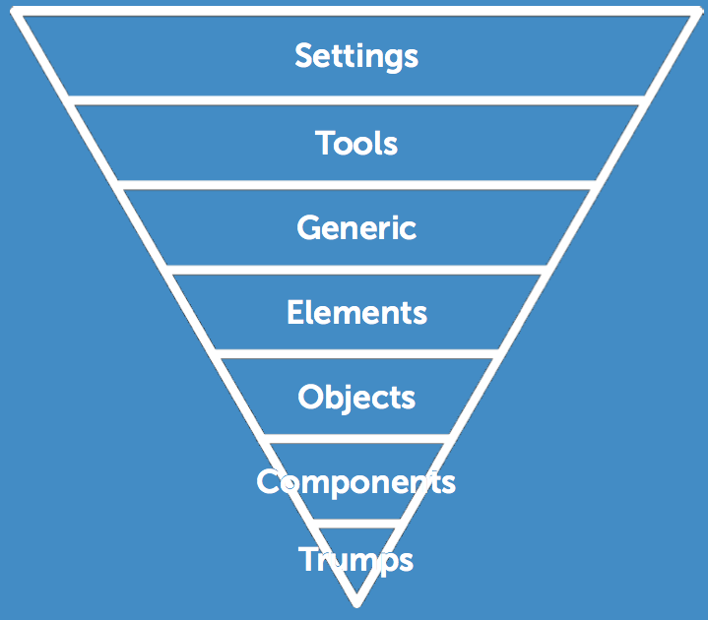
ITCSS
Inverted Triangle CSS.
Aims to allow non expert contributions.
Allow about ordering your source.
The more specific the selector the lower down the triangle.
DOM based ordering is bad.
Will only work if you are using single class selectors.

Slide 26
Designing in isolation
Use something like codepen.
Removes constrains of existing styles / system.
Which enables quickly prototyping.
Ensures you bundle in all your dependencies.

Slide 27
Workshop Assessment Guide
Introduction to CSS:
You want to cover the basics again.
You have little to no experience with CSS.
For the beginner.
Semantics and best practices for CSS
Topics like BEM, OOCSS and other naming conventions.
Will cover a wide range of topic so everyone should learn something.
For the intimidate.
Architecture in CSS
For the advanced developer.
Discuss topics like ITCSS, SMACCS in depth.
For the advanced.

Slide 28
Questions?

