Slide 1
Conclusion of Phase 1 – Object detection
Reflect group

Slide 2
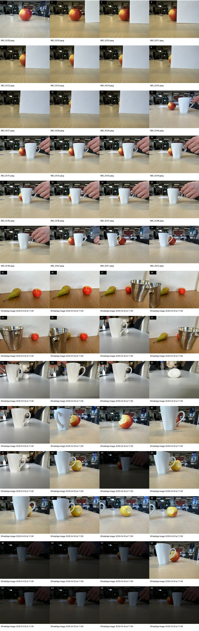
Open-vocab vs closed-vocab detector justification
Goal: test whether the selected open-vocabulary model (Grounding DINO) is still justified once strong closed-vocabulary baselines are included.
Data: 56 images with occlusion, lighting change, viewpoint change, and new object categories.
Baselines: YOLO11n, RT-DETRv2-R18, Faster R-CNN ResNet50 FPN V2.
Evaluation split: shared classes (`apple`, `cup`) for fairness, novel classes (`pear`, `bucket`, `egg`) for deployment relevance.

Slide 3
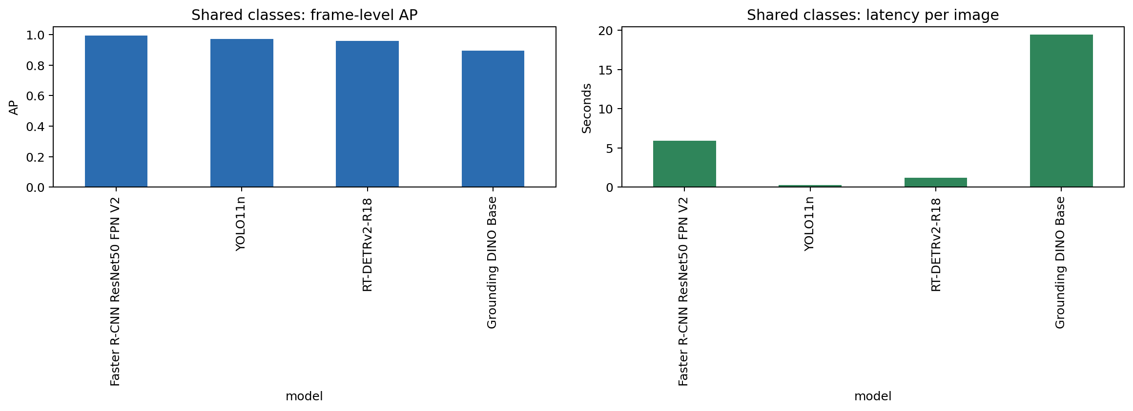
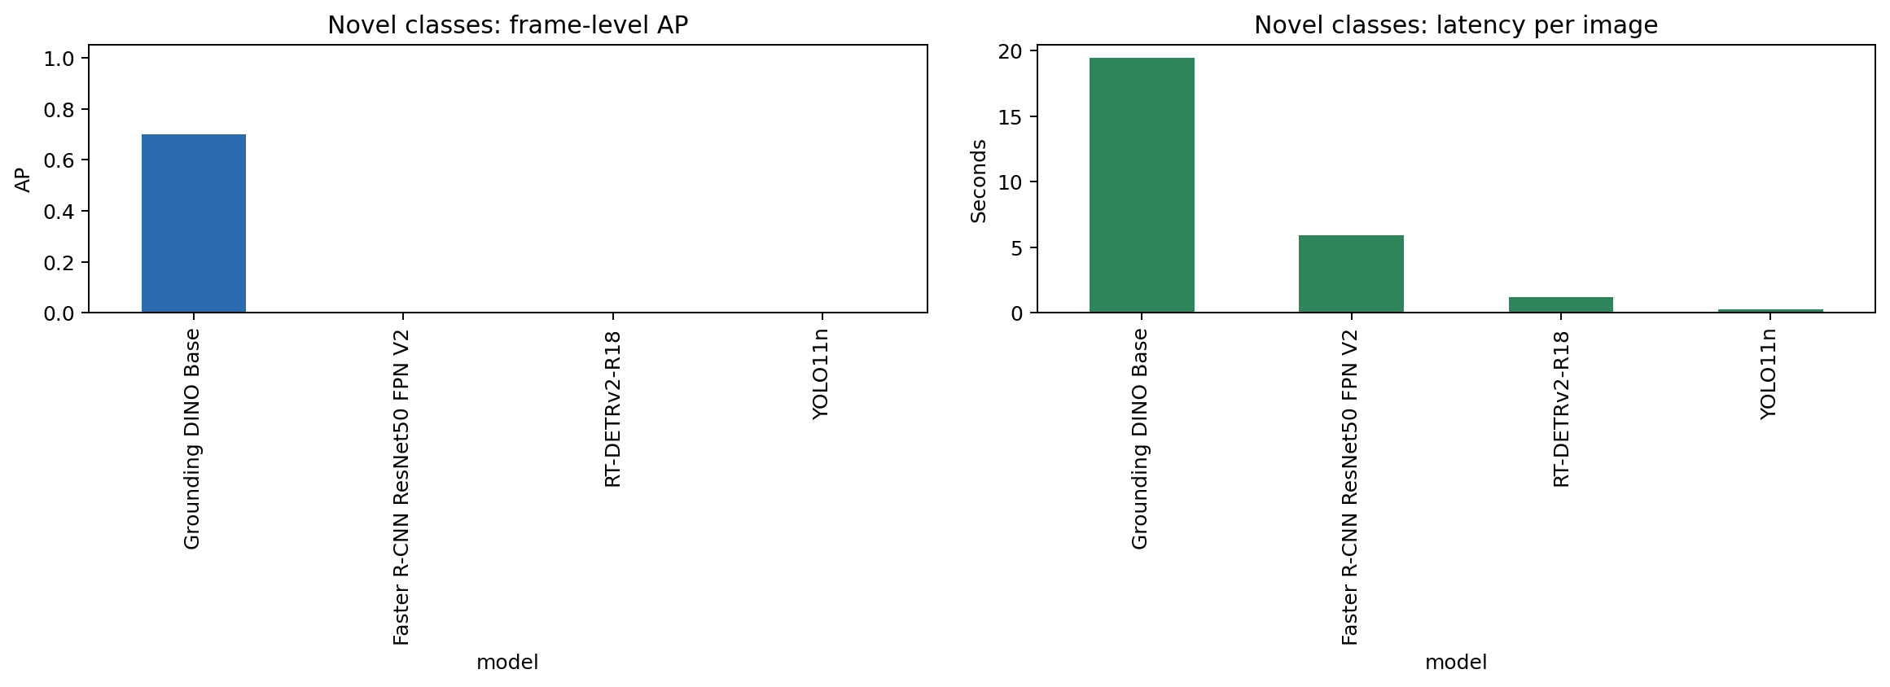
Findings
Shared-class benchmark vs novel-class stress test
Shared classes: closed-vocabulary models are competitive and can outperform Grounding DINO when the label set is fixed.
Novel classes: the closed-vocabulary baselines have zero exact label support for `pear`, `bucket`, and `egg`.
Interpretation: the closed-vocabulary models are not universally worse, they are narrower. This results in a inconsistent performance across different environments.

Slide 4
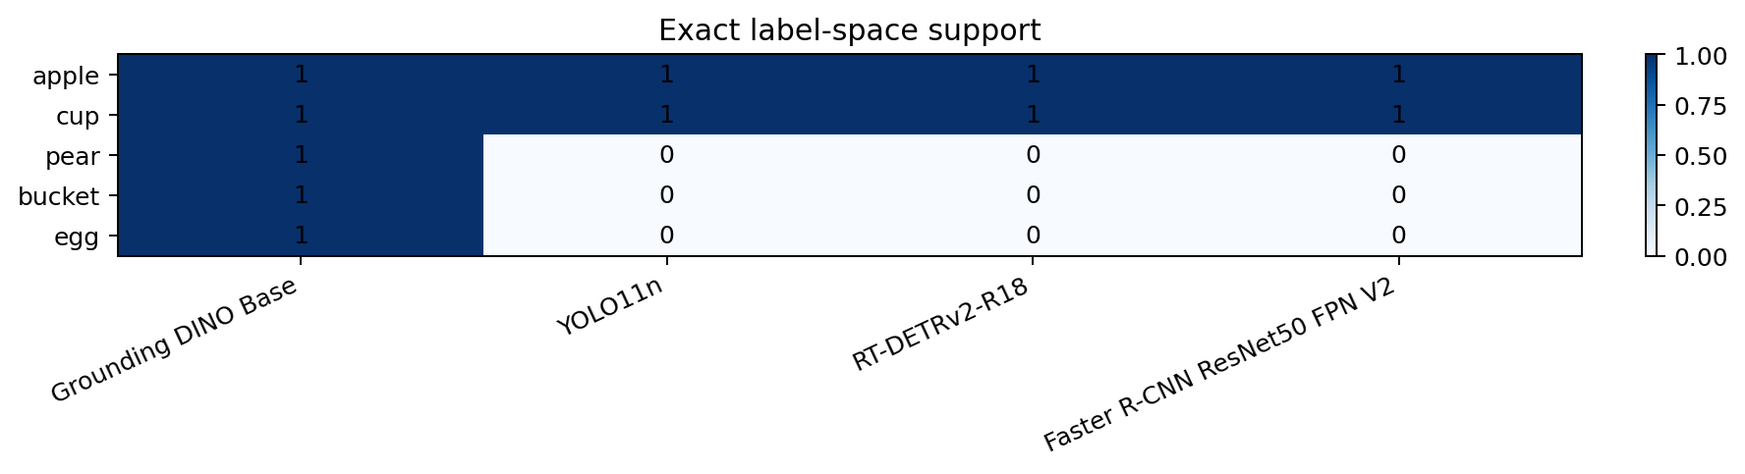
Outcome and recommendation
If the product requirement is a fixed taxonomy, a closed-vocabulary detector is a valid alternative and YOLO11n is especially attractive for speed.
If the product requirement is to handle new requested objects without retraining, Grounding DINO remains the safer deployment choice.
Recommended wording: use closed-vocabulary detectors when the class list is stable, but keep Grounding DINO for this project because the class list already changed in the updated data.
Bottom line:
the benchmark does not say closed-vocabulary models are bad;
it shows they are the wrong fit when the task vocabulary is allowed to evolve.

