Slide 1
On the Automatic Recognition of Facial Non-verbal Communication Meaning in Informal, Spontaneous Conversation
Tim Sheerman-Chase
CVSSP, University of Surrey, UK
18 Sept 2012

Slide 2
Intro Clip

Slide 3
Intro Clip

Slide 4
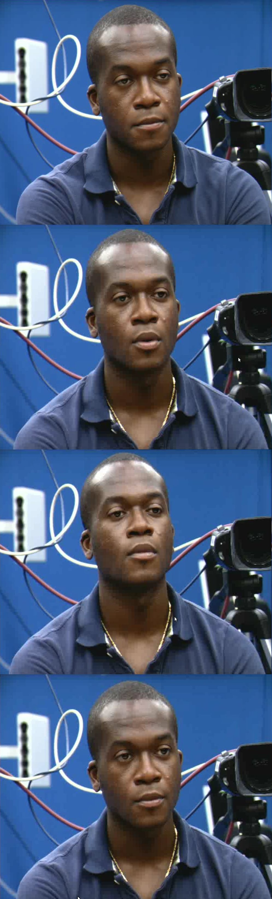
Introduction
Context in NVC Research
Creating the TwoTalk Corpus
Multi-cultural NVC Annotation
Automatic Multi-culture NVC Regression
Comparison of Features and Classifiers (briefly)
Backchannel NVC (briefly)
Feature Selection

Slide 5
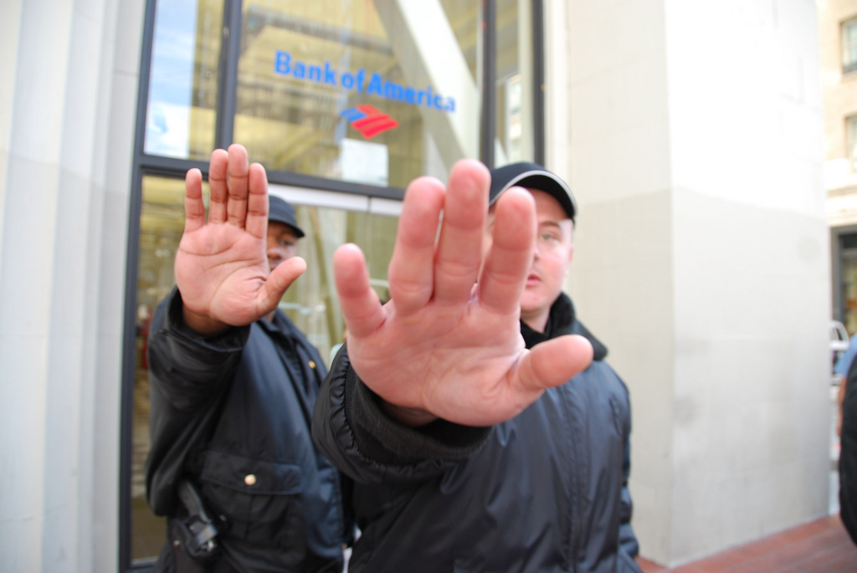

What is NVC?
Non-verbal communication is everything that conveys meaning apart from the words
NVC frequently used in social situations
Only having the verbal content can lead to misunderstanding (email, SMS)

Slide 6
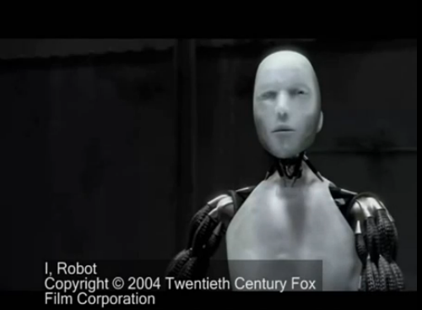
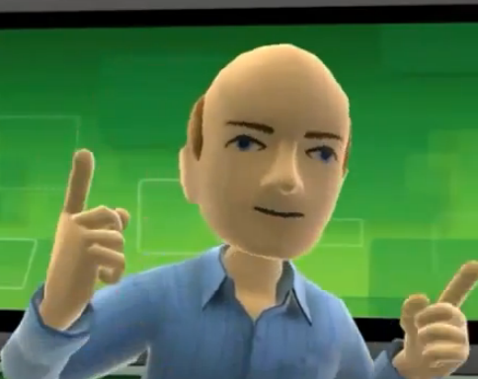
Why Study NVC?
Enables new computer interfaces
Computers are embedded into many devices, but interface often requires a learning process
  Make machines easier to use
  Computers may support human interaction
  Tools to analyse human behaviour
Kinect Avatar

Slide 7
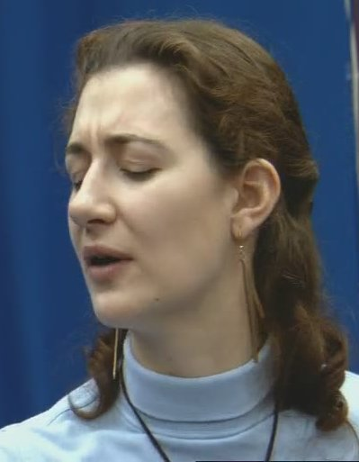
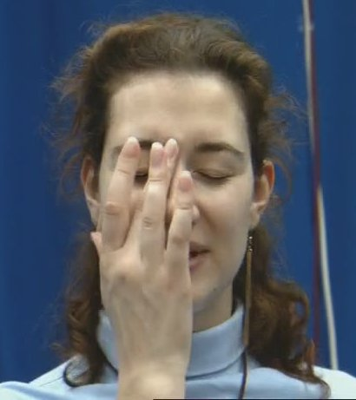
Why is it Difficult?
“The study of Expression is difficult, owing to the movements being often extremely slight, and of a fleeting nature.” Charles Darwin
Difficulty recording natural behaviour
Labelling is tedious
Difficult to quantify signals directly
Association between NVC signal and interpretation depends on many factors

Slide 8
Factors in NVC Perception
Cultural – discussed later
Personality
Gender
Nearby faces (context)
Familiarity
These factors also affect NVC expression
Terracciano el al. 2003, Matsumoto el al. 2000, Perlman el al. 2009
Vassallo el al. 2009, Buck 1979, Abrilian el al. 2006
Masuda el al. 2009
Hoque el al. 2009
Sender
encodes
Signal
decodes
Receiver
Argyle, 2004
This is the step we are trying to automate

Slide 9
TwoTalk Corpus
Aim: record a naturalistic NVC corpus
Why: existing datasets and annotation are not suitable
Contributions:
  Corpus publicly available
    Download at: http://www.ee.surrey.ac.uk/Projects/LILiR/twotalk_corpus/

Slide 10
NVC Corpus Collection
How to capture a dataset?
  “scope, naturalness, context and descriptors” Douglas-Cowie et al. 2003
Difference between acted and spontaneous (Valstar et al. 2006, Pfister et al. 2011)
  Most systems use acted emotion/NVC
  But does this transfer to outside the lab?
  Address by using spontaneous data, Cowie et al. 1999

Slide 11
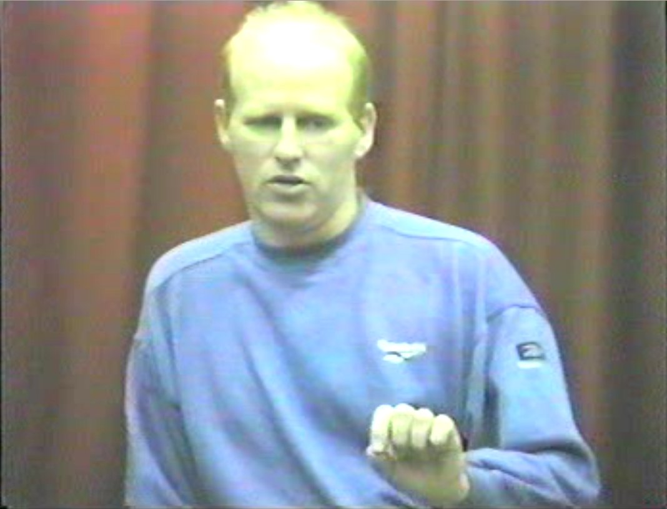
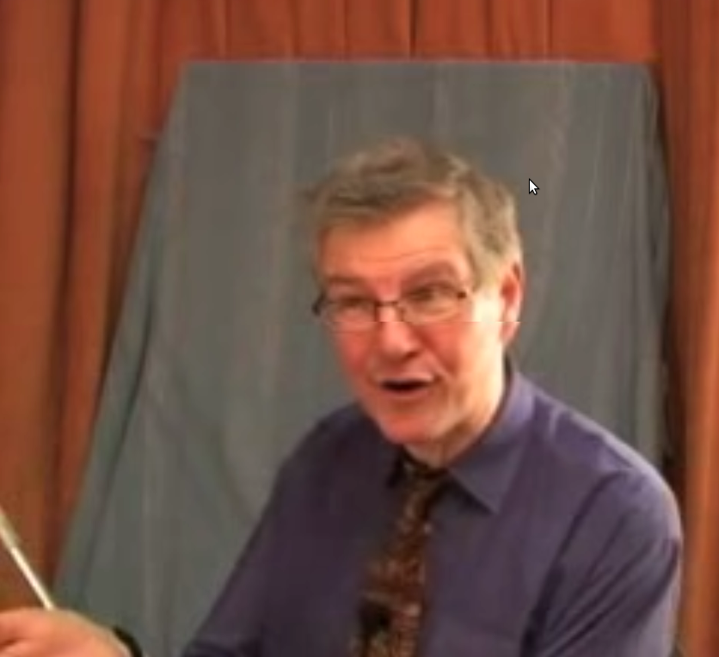
Existing NVC Data Sets
Belfast Naturalistic Emotional Database
Green Pursuasive Database
125 interview subjects
10 and 60 seconds
Only a subset is publicly available
8 two-person conversations
Both participants recorded
Role play situation
EmoTV
Not publicly available
48 subjects
TV interview
Total: 12 minutes
Clips: 4 to 43 sec
State of the art datasets:
Freetalk
D64

Slide 12
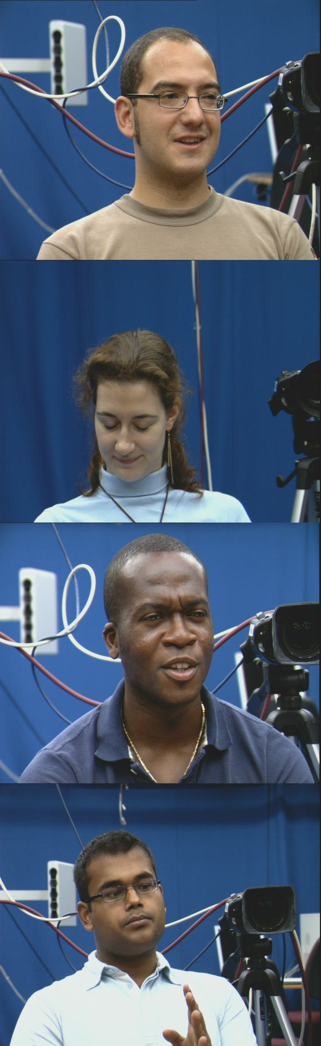
TwoTalk Corpus
Minimum constraints on natural, informal conversation (casual chat)
Two PAL cameras, two participants
Seated opposite across table
4 conversations, 12 minutes each
Manually Selected 527 clips, 37 min total
  Focus annotator effort on interesting sections

Slide 13
Example TwoTalk Clips

Slide 14
Summary of TwoTalk
A new spontaneous corpus has been collected
  Already been used by Akakın and Sankur, 2011
Suitable for training automatic recogntion systems

Slide 15
Multi-culture Annotation
Aim: to collect annotation from difference cultures
Why: each culture has differences in NVC
It is desirable to recognise NVC in a similar way to people (or groups of people)
Contribution:
  Method to filter annotation data set
  Analysis of annotation patterns

Slide 16
Culture Background
Cultural differences in expressing and perceiving NVC/emotions Marsh et al. 2003, Jack et al. 2012
Although some commonality exists Darwin 1871, Ekman 1972
Few studies consider distinct annotator groups for machine learning Reidsma 2008
These differences can significantly change perceived meaning
  Obscene gestures

Slide 17
NVC Annotation
Annotation is used to provide NVC labels
  Time consuming and tedious
Most studies use one or a few annotators
  This study collects data from many annotators
Web based video playback and survey form
What labels? Agreeing, thinking, questioning, understanding (inspired by el Kaliouby et al. 2003)
See Cowie 2008 for a review of challenges
See Reidsma 2008 for multi-annotator issues

Slide 18
Crowdsourcing
Cooper et al. 2010,
Raddick et al. 2010,
Tarasov et al. 2010
Web based, usually browser based
  Crowdflower, Mechanical Turk (Amazon), Samasource, different demographics
  Workers Motivation by money / altruism / challenge
Suitable for large tasks that can be split into simple steps
Quality control issues may exist

Slide 19
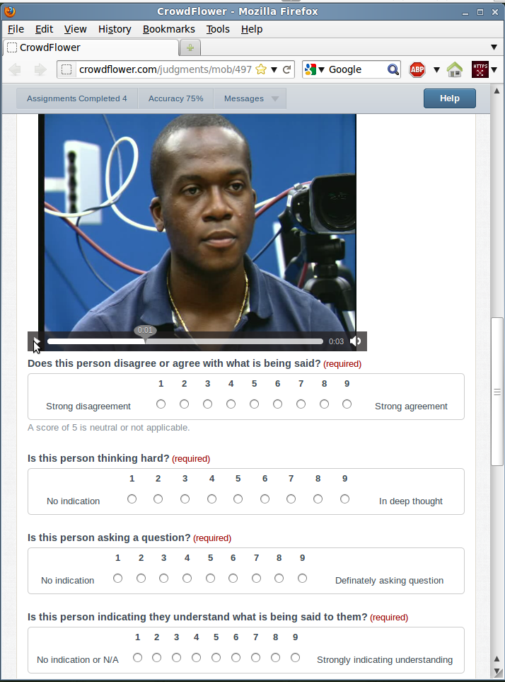

Slide 20
Annotation Results
711 annotators, 79130 questions answered
Annotations are sparse
Three main cultures identified by IP address
  India, Kenya and UK
Many annotators did not cooperate
  Random results need to be removed

Slide 21
Annotation Filtering
Identify cooperative annotators, Pearson's correlation with some ideal standard
  Use mode, being more robust to random responses
  Correlation more than 0.2
Calculate mean ratings of cooperative annotators
  Based on more ratings than mode

Slide 22
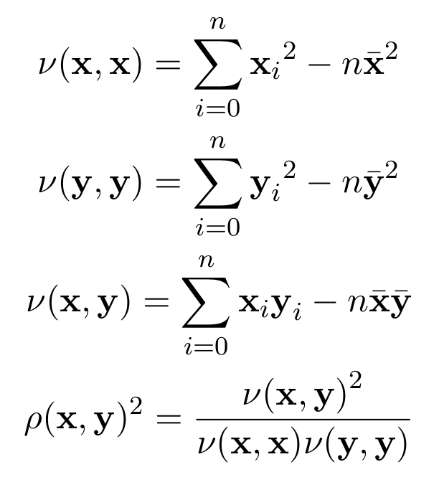
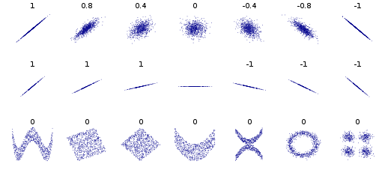
Pearson's Correlation
Find the consistency of linear relationship between two continuous variables
  1 (or -1) is perfect correlation
  0 is uncorrelated

Slide 23

Compare Annotators to Consensus
Compare filtered annotators with their culture mean consensus
Better to use specialised culture model rather than ignoring culture (global mean)
Correlation of Annotators with Mean Consensus

Slide 24
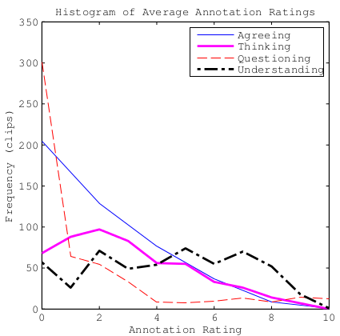
Mean Annotation Rating Frequency
Some NVC signals are rare
  Questioning
Most NVC is of medium or low intensity
  Unlike posed data sets

Slide 25
Multi-culture Conclusions
Crowd sourcing annotation data is effective if quality issues are managed
Collect a large quantity of data from multiple cultures
Impact:
  Crowd sourcing may provide valuable data in future
  Annotation is publicly available

Slide 26
Multi-culture Regression
Aim: to find an effective cultural NVC regression method
Why: this enables strong intensity and weak intensity NVC examples to be distinguished, also culturally distinct perception
Contribution:
  study of approaches
  What happens if we train on a culture, test on a different culture?

Slide 27
Existing Approaches
Borrowed from emotion recognition or related fields
el Kaliouby and Robinson, 2004
  Tracking, use heuristic geometric features
  Dynamic Bayesian framework captures facial actions, displays, mental states at different temporal scales
Petridis and Pantic, 2008
  Tracking positions
  PCA, Mean/Std Dev or Polynomial Fit
  Feature/Decision fusion, Neural Network
Mental state classification
Laughter detection
Each frame considered independently
Temporal
Is Important!
Tracking (or
other low
level features)
High level
feature
representation
Fuse/Classify

Slide 28
Overview of System
Track Facial Features
Extract features using Algorithmic Geometric Features
Train regressor, ν-SVR (Schölkopf et al. 2009)
8 fold person independent testing
Performance evaluated by Pearson's correlation

Slide 29
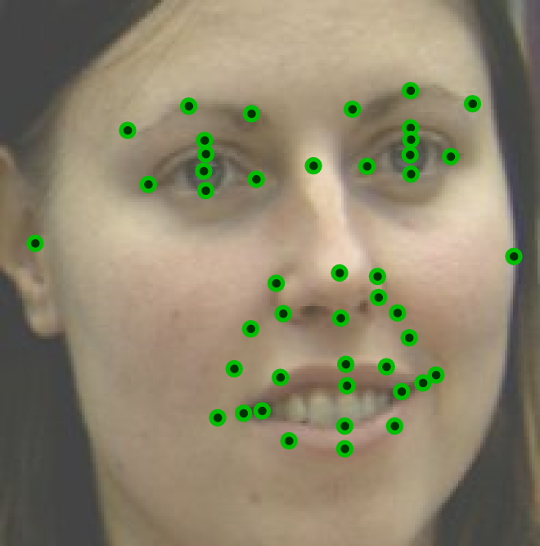
Position of Trackers
46 position
Selected because they could be consistently marked
Use existing tracking technique: linear predictor tracking, Ong et al. 2009
Currently labour intensive to train

Slide 30
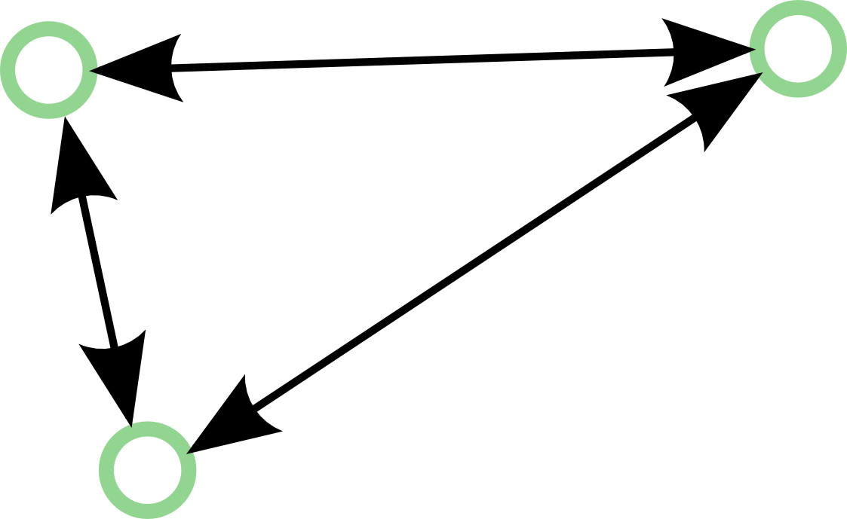
Algorithmic Geometric Features
Euclidean distance between pairs
1035 pairs between 46 trackers
Features are whitened and centred
  Removes face shape information
Encodes overall face shape
Contains redundant information

Slide 31
Algorithmic Feature Visualisation

Slide 32
High Level Feature Extraction
Consider each component of feature vector
  Take mean and variance
  Concatenate
  This has a fixed length
Encodes average shape and amount of variation, but not speed or direction
Some NVC may require speed to recognise
Similar to
Valstar et al. 2006

Slide 33
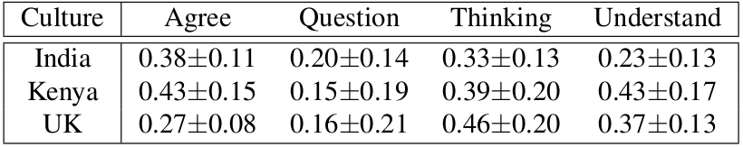
Regression Results
Train separate model for each culture
Correlation performances are relatively low
  Extreme difficulty of task
  Low inter-annotator agreement
Questioning is lowest, verbal component

Slide 34
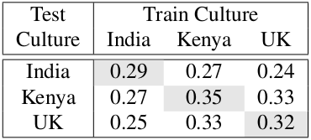
Results
Training and testing on same culture is optimal
Performance is worse if test data is different to training data

Slide 35
Demo Video

Slide 36
Regression Conclusions
Regression of Naturalistic NVC is possible
  But challenging
Specialising regressor for cultural annotations is better then ignoring culture
  Is it due to language difference or perception difference? More work needed.

Slide 37
Which Classifier, Features is Best?
Various approaches are compared
  Heuristic Geometric Features
  Algorithmic Geometric Features
  PCA and ICA
  Model based Head Pose
  Affine Head Pose
  Uniform LBPs
Adaboost and SVM compared
el Kaliouby and Robinson 2004
Valstar et al. 2006
Petridis and Pantic 2008
Liu and Zhang 2000
Madan 2005

Slide 38
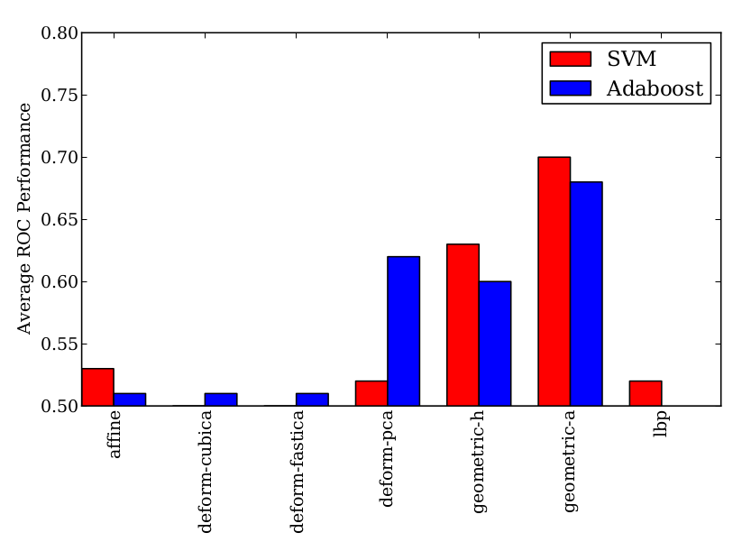
NVC Classification
Results in clear examples, binary classification, decision fusion without temporal
Only using a subset of annotations, testing is person independent
2 fold x-val
Local shape is effective
Better normalisationmay improve generalisation

Slide 39
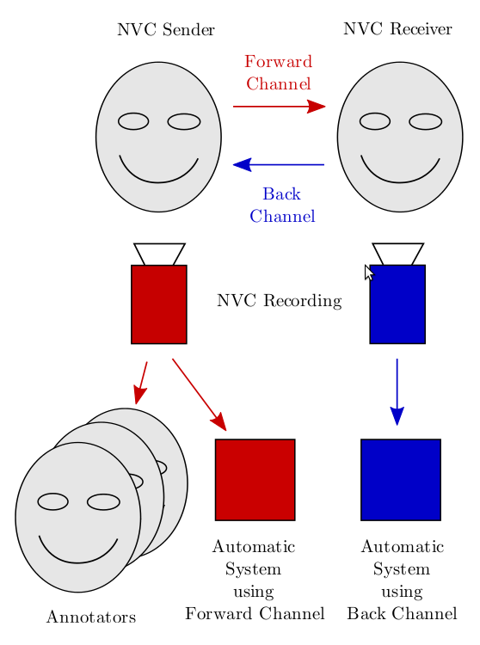
NVC Backchannel
What is “backchannel”?
Aim: To use “backchannel” signals (NVC from other person) to recognise NVC
Why: Humans often mimic behaviour during conversation
Backchannel may contain additional information: improved performance
Contributions:
  A method to find correlated areas of the face
  Study of approaches for classification based on backchannel signals
Chartrand and Bargh 1999

Slide 40
Feature Selection
Aim: to find a subset of features that are more effective at NVC regression
Why: Algorithmic geometric features contains redundant information
Contributions:
  A SBE based approach to finding a relevant feature subset
  A method of visualise the facial areas involve in NVC perception (by a computer)
Similar to el Kaliouby and Robinson, 2004

Slide 41
Method
Current set initialised to all components active
While number of features in current set > 1
  For each active feature in the current set:
    Determine performance
  Remove feature which will maximise performance
Use the feature subset with best performance (peak of graph on next slide)

Slide 42
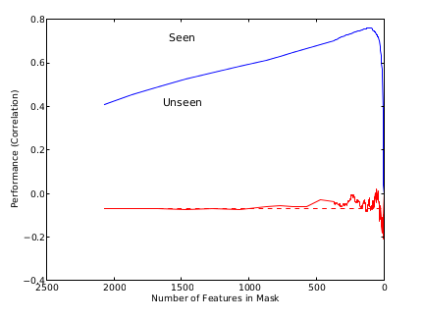
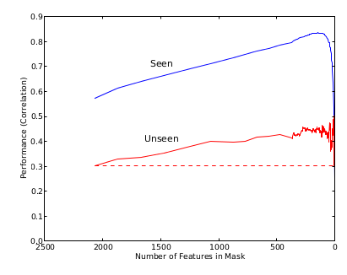
Performance During FS Process
Seen Peak
BR question
KEN agree
Unseen Peak
Probably failing
Significant increase
in performance

Slide 43
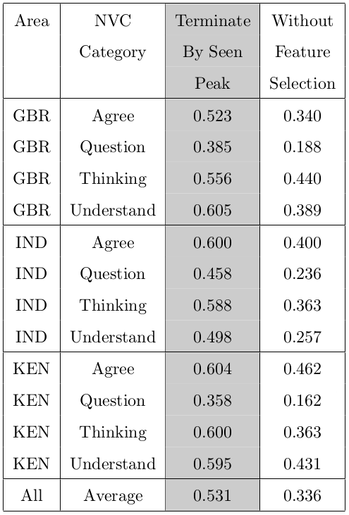
Results
Significant improvement in performance
Cultures have roughly similar performance
Questioning still the most challenging

Slide 44
Visualisation Method
Removal of some features results in performance drop (=> feature is important)
Each feature corresponds to tracker pair
Determine feature importance as the “sum of drops in performance”
Normalise to 1
Only consider flexible areas of the face

Slide 45
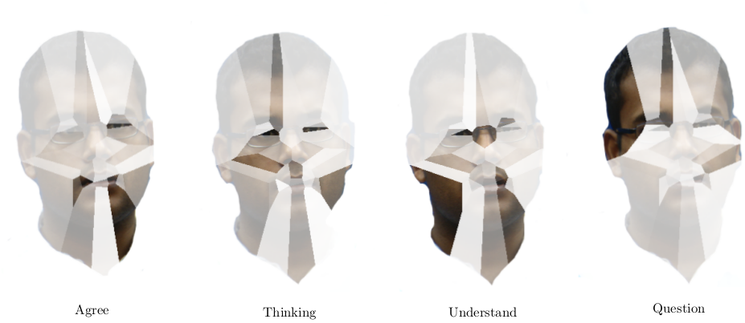
Visualisation Results
Divide face by Voronoi tessellation
Smiling?
Eyes
Unclear
Brow

Slide 46
Feature Selection Conclusions
Feature selection removes redundant information
  Increases regression performance
Feature selection identifies facial areas
  Visualisation method proposed
  Areas are used for computer perception of NVC but not necessarily human perception
  Brow region (particularly AU4) is related to questioning

Slide 47
Overall Conclusions
New corpus of informal spontaneous conversation
Annotated by three distinct cultures
A study of NVC recognition methods
Coupling of behaviour, use of backchannels (only mentioned briefly)
Visualisation of NVC facial areas

Slide 48
Main Impact
A practical NVC system needs to consider cultural factors
  much like accents in speech recognition
Facial areas involved in other NVC signals can be identified
  aiding understanding of human behaviour
Progress towards a practical NVC recognition system
  Many potential applications

Slide 49
Future Work
Better data sets, better annotation
Better temporal information
Record participants from multiple cultures then do multi-annotation, social factors
Potential applications can provide insight into labels and data sets
Multi-modal, appearance features

Slide 50
Summary
Context in NVC Research
Creating the TwoTalk Corpus
Multi-cultural NVC Annotation
Automatic Multi-culture NVC Regression
Comparison of Features and Classifiers
Backchannel NVC
Feature Selection

Slide 51
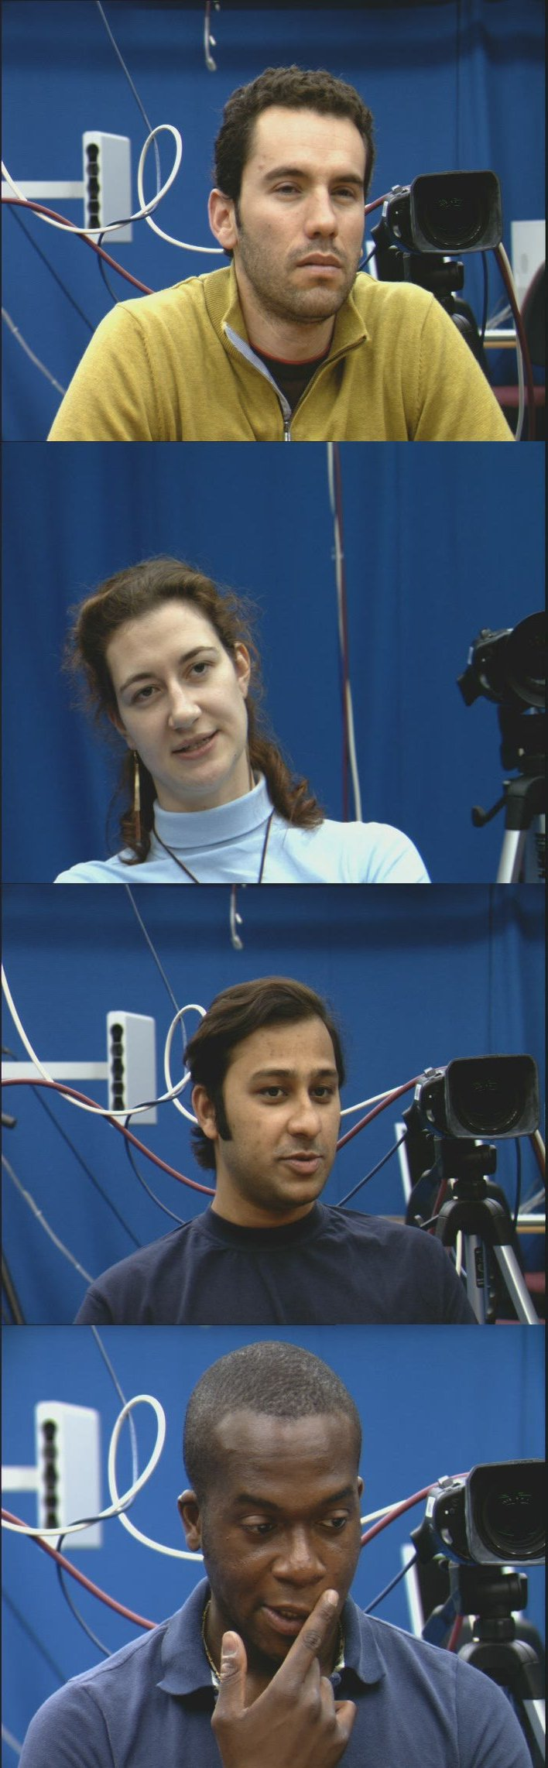
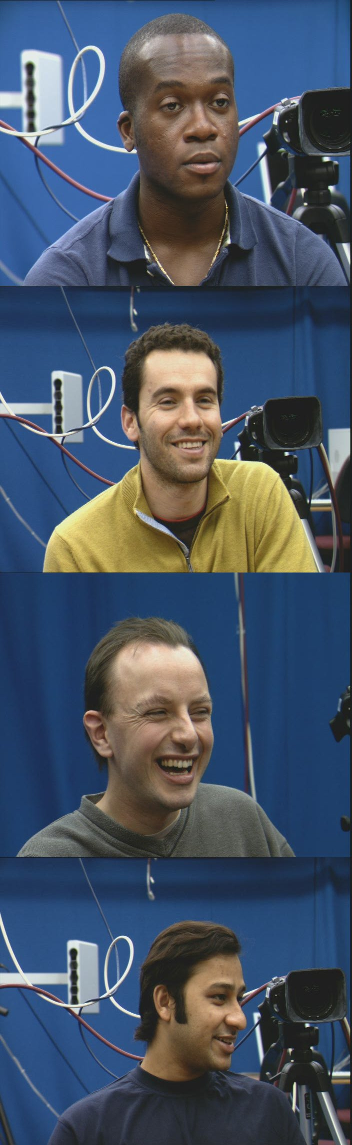
Questions?

Slide 52
References
Charles Darwin. The Expression of the Emotions in Man and Animals. Oxford University Press, 3rd edition, 2002.
A Terracciano, M Merritt, AB Zonderman, and MK Evans. Personality traits and sex differences in emotions recognition among African Americans and Caucasians. Annals of New York Academy of Sciences, 1000:309–312, 2003.
David Matsumoto, Jeff Leroux, Carinda Wilson-Cohn, Jake Raroque, Kristie Kooken, Paul Ekman, Nathan Yrizarry, Sherry Loewinger, Hideko Uchida, Albert Yee, Lisa Amo, and Angeline Goh. A new test to measure emotion recognition ability: Matsumoto and Ekmans Japanese and Caucasian brief affect recognition test (JACBART). Journal of Nonverbal Behavior, 24(3):179209, 2000.
Susan B. Perlman, James P. Morris, Brent C. Vander Wyk, Steven R. Green, Jaime L. Doyle, and Kevin A. Pelphrey. Individual differences in personality predict how people look at faces. PLoS ONE, 4(6):e5952, 06 2009.
Suzane Vassallo, Sian L. Cooper, and Jacinta M. Douglas. Visual scanning in the recognition of facial affect: Is there an observer sex difference? Journal of Vision, 9(3):1–10, 3 2009.
R Buck. Measuring individual differences in the nonverbal communication of affect: The slide-viewing paradigm. Human Communication Research, 6:47–57, 1979.
S. Abrilian, L. Devillers, and J. Martin. Annotation of emotions in real-life video interviews: Variability between coders. In Proceedings of the 5th International Conference on Language Resources and Evaluation (LREC), Genoa, Italy, 2006.
T. Masuda, P. C. Ellsworth, B. Mesquita, J. Leu, S. Tanida, and E. van de Veerdonk. Placing the face in context: Cultural differences in the perception of facial emotion. Journal of Personality and Social Psychology, 94:365–381, 2008.
Mohammed E. Hoque, Rana el Kaliouby, and Rosalind W. Picard. When human coders (and machines) disagree on the meaning of facial affect in spontaneous videos. In Proceedings of the 9th International Conference on Intelligent Virtual Agents, Boston, Massachusetts, USA, April 2009.
Michael Argyle. The Psychology of Interpersonal Behaviour. Penguin, 5th edition edition, 1994.
H. C. Akakın and B. Sankur. Robust classification of face and head gestures in video. Image and Vision Computing, 29:470–483, June 2011.
Ellen Douglas-Cowie, Nick Campbell, Roddy Cowie, and Peter Roach. Emotional speech: Towards a new generation of databases. Speech Communication, pages 33–60, 2003.
Michel F. Valstar, Maja Pantic, Zara Ambadar, and Jeffrey F. Cohn. Spontaneous vs. posed facial behavior: Automatic analysis of brow actions. In Proceedings of the 8th International Conference on Multimodal interfaces, pages 162–170, New York, NY, USA, 2006. ACM.
Tomas Pfister, Xiaobai Li, Guoying Zhao, and Matti Pietik ̈inen. Differentiating spontaneous from posed a facial expressions within a generic facial expression recognition framework. In Proceedings of the Workshop on Socially Intelligent Surveillance and Monitoring, 2011.
Roddy Cowie, Gary McKeown, and Ceire Gibney. The challenges of dealing with distributed signs of emotion: theory and empirical evidence. In Proceedings of the International Conference on Affective Computing & Intelligent Interaction (ACII), Amsterdam, Sept 2009.

Slide 53
References
Tanya L. Chartrand and John A. Bargh. The chameleon effect: The perception-behavior link and social interaction. Journal of Personality and Social Psychology, 76(6):893–910, Jun 1999.
Abigail A. Marsh, Hillary Anger Elfenbein, and Nalini Ambady. Nonverbal “accents”: Cultural differences in facial expressions of emotion. Psychological Science, 14(4):373–376, 2003.
Jack, R., Garrod, O., Yu, H., Caldara, R., & Schyns, P. G. (2012). Facial expressions of emotion are not culturally universal. Proceedings of the National Academy of Sciences.Jack et al. 2012
Dennis Reidsma. Annotations and subjective machines of annotators, embodied agents, users, and other humans. PhD thesis, University of Twente, Enschede, October 2008.
Rana el Kaliouby, Peter Robinson, and Simeon Keates. Temporal context and the recognition of emotion from facial expression. In Proceedings of HCI International Conference, June 2003.
Rana el Kaliouby and Peter Robinson. Real-time inference of complex mental states from facial expressions and head gestures. In Proceedings of the Conference on Computer Vision and Pattern Recognition Workshop, volume 10, page 154, Washington, DC, USA, 2004. IEEE Computer Society.
Stavros Petridis and Maja Pantic. Audiovisual laughter detection based on temporal features. In Proceedings of the 10th International Conference on Multimodal Interfaces, pages 37–44, New York, NY, USA, 2008. ACM.
B. Sch ̈lkopf, A. Smola, R. Williamson, and P. L. Bartlett. New support vector algorithms. Neural Computation, 12:1207–1245, 2000.
E. Ong, Y. Lan, B. Thobald, R. Harvey, and R. Bowden. Robust facial feature tracking using multiscale biased linear predictors. In Proceedings of the International Conference on Computer Vision, 2009.
Michel F. Valstar, Maja Pantic, Zara Ambadar, and Jeffrey F. Cohn. Spontaneous vs. posed facial behavior: Automatic analysis of brow actions. In Proceedings of the 8th International Conference on Multimodal interfaces, pages 162–170, New York, NY, USA, 2006. ACM.
Zicheng Liu and Zhengyou Zhang. Robust head motion computation by taking advantage of physical properties. In Proceedings of the Workshop on Human Motion, pages 73–77, 2000.
Anmol P. Madan, Ron Caneel, and Alex Pentland. Voices of attraction. In Proceedings of Augmented Cognition, HCI, Las Vegas, NV, 2005.

Slide 54
Photo Credits
“Waving goodbye after the ceremony” c Jonathan Elderfield,
  https://secure.flickr.com/photos/heatheranneulrich/3420075962/
  Used by permission, under the terms of the Creative Commons Attribution-NonCommercial-NoDerivs 2.0 Generic License
  https://creativecommons.org/licenses/by-nc-nd/2.0/
“Bank of America security trying to prevent me from taking a photo during the Iraq war protest” c Steve Rhodes
  https://secure.flickr.com/photos/ari/2347593532/
  Used by permission, under the terms of the Creative Commons Attribution-NonCommercial-ShareAlike 2.0 Generic License
  https://creativecommons.org/licenses/by-nc-sa/2.0/

