Slide 1
On the Automatic Recognition of Facial Non-verbal Communication Meaning in Informal, Spontaneous Conversation
Tim Sheerman-Chase
CVSSP, University of Surrey, UK
18 Sept 2012

Slide 2
Intro Clip

Slide 3
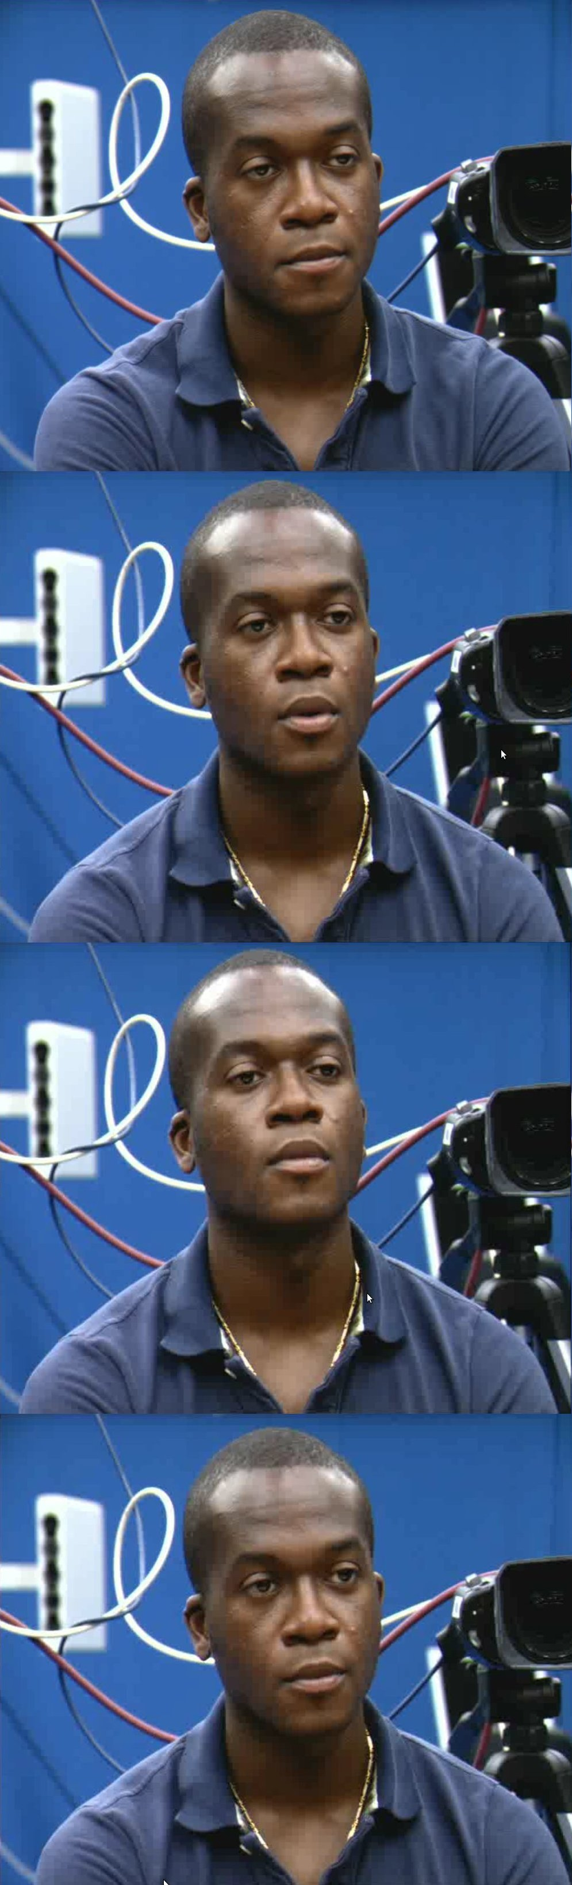
Introduction
Context in NVC Research
Creating the TwoTalk Corpus
Automatic Classification
Backchannel NVC
Multi-cultural NVC Annotation
Multi-culture NVC Regression
Feature Selection

Slide 4
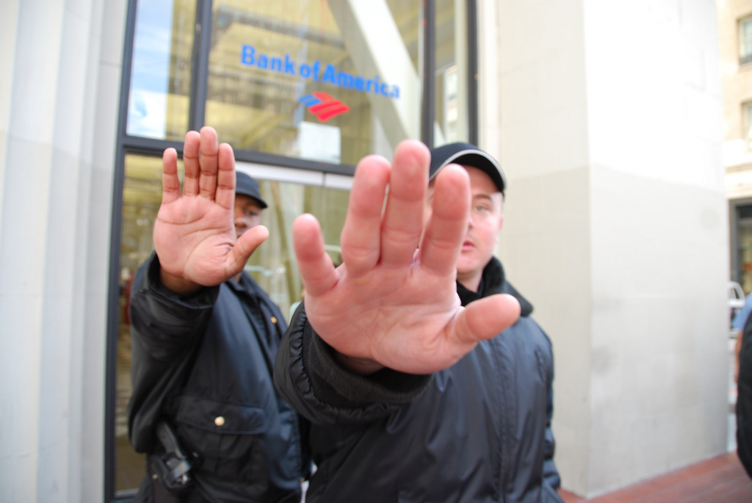

What is NVC?
Non-verbal communication is everything that conveys meaning apart from the words.
  Includes: expression, gesture, gaze, non-verbal utterances.
NVC is essential to understand other people
Can a computer recognise it?

Slide 5
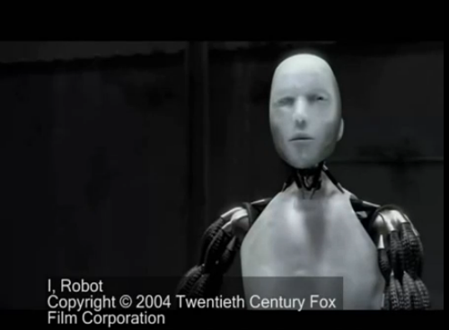
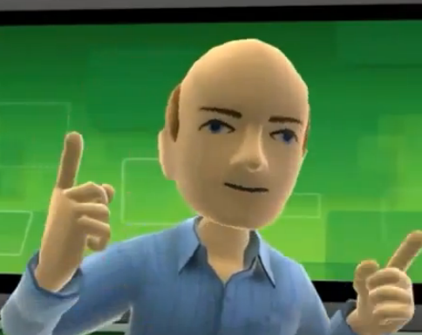
Why Study NVC?
Enables new computer interfaces
Computers are embedded into many devices
Several applications
  Make machines easier to use
  Computers may support human interaction
  Novel interfaces for new applications
Kinect Avatar

Slide 6
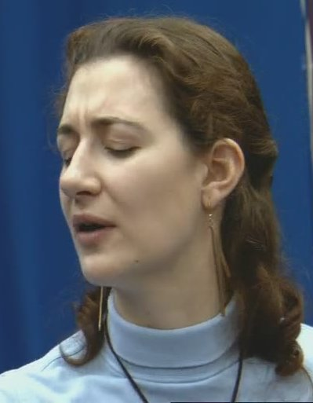
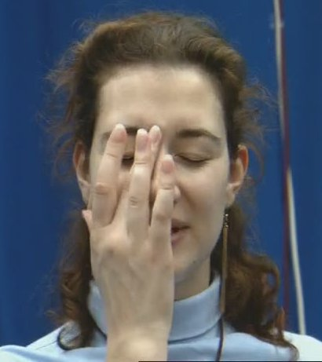
Why is it Difficult?
“The study of Expression is difficult, owing to the movements being often extremely slight, and of a fleeting nature.” Charles Darwin
Difficulty recording natural behaviour
Interpretation of NVC, labelling is tedious
Difficult to quantify NVC signals directly
  Extreme poses, occlusions, rapidly changing, etc.
Association between NVC signal and interpretation depends on many factors

Slide 7
Main Contributions
New corpus of naturalistic NVC: “TwoTalk”
Annotation based on three distinct cultures
An automatic NVC recognition system
  for 4 common NVC signals
Existence of coupling behaviour in humans confirmed and quantified
Facial areas used to recognise NVC identified

Slide 8
Main Impact
A practical NVC system needs to consider cultural factors
  much like accents in speech recognition
Facial areas involved in other NVC signals can be identified
  aiding understanding of human behaviour
Progress towards a practical NVC recognition system
  Many potential applications

Slide 9
Work Context
Many factors affect NVC expression and perception
Different labelling paradigms, datasets
Feature Extraction Techniques
Automatic recognition approaches

Slide 10
Factors in NVC Expression
Cultural – discussed later
Gender 24
Personal style 4
Personality 24
Social Situation 11
Certain medical conditions 23
Similar factors apply to non-human animals 88
Encoding rules diagram
57

Slide 11
Factors in NVC Perception
Cultural – discussed later
Personality 183 123 144
Gender 193 24 3
Nearby faces (context) 121
Familiarity 89
Decoding rules figure 11

Slide 12
TwoTalk Corpus
Aim: record a naturalistic NVC corpus and annotate it
Why: existing datasets and annotation are not suitable
Contributions:
  NVC signal interrelationships found
  Corpus publicly available
    Download at: http://www.ee.surrey.ac.uk/Projects/LILiR/twotalk_corpus/

Slide 13
NVC Corpus Collection
How to capture a dataset?
  “scope, naturalness, context and descriptors” Douglas-Cowie et al. 2003
Difference between acted and spontaneous (Valstar et al. 2006, Pfister et al. 2011)
  Most systems use acted emotion/NVC
  But does this transfer to outside the lab?
  Address by using spontaneous data 36

Slide 14
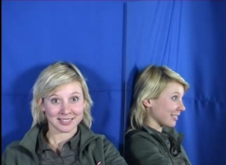
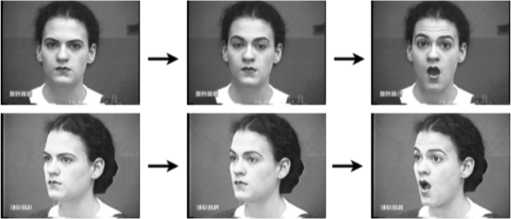
Existing Emotion Datasets
Cohn-Kanade AU-Coded Facial Expression Database
MMI Facial Expression Database
486 sequences from 97 posers
Acted
Short clips
No social context
Multi-purpose emotion database
Generally short clips
Large
Mostly acting or “wizard of oz”

Slide 15
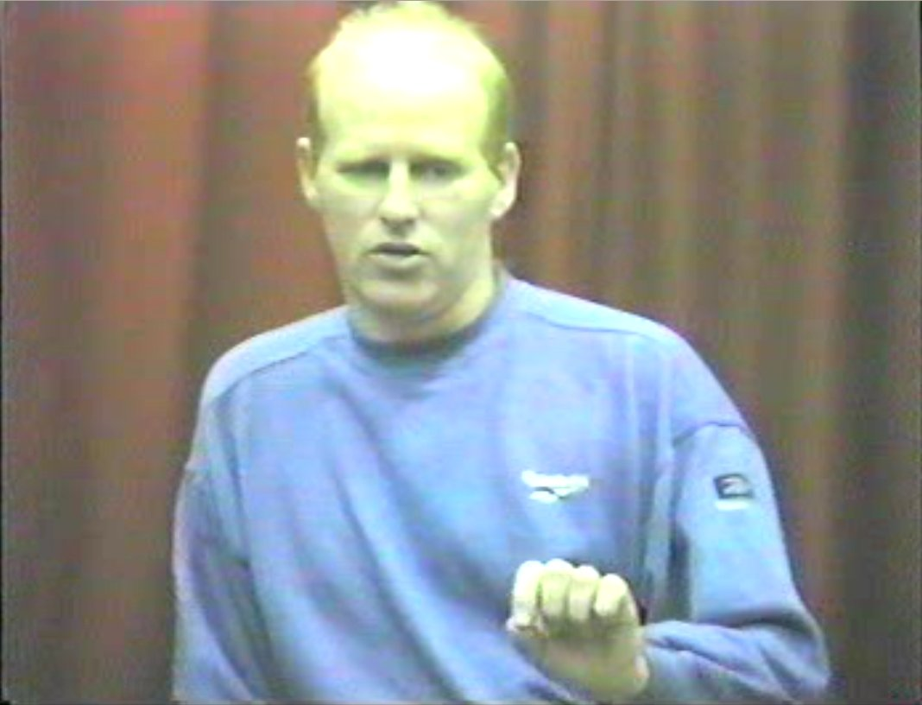
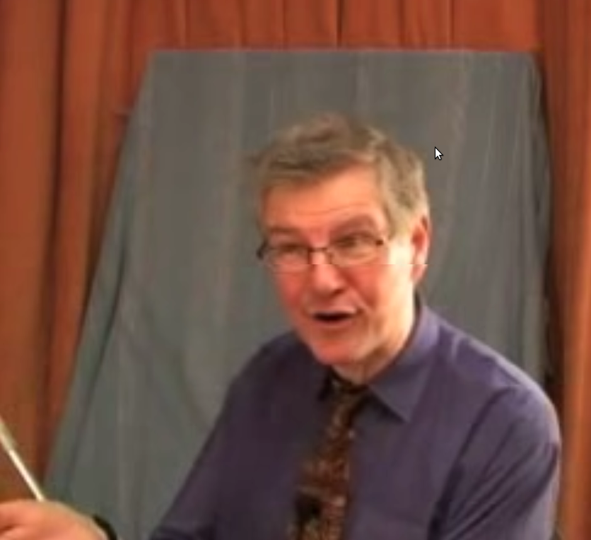
Existing NVC Data Sets
Belfast Naturalistic Emotional Database
Green Pursuasive Database
125 interview subjects
10 and 60 seconds
Only a subset is publicly available
8 two-person conversations
Both participants recorded
Role play situation
EmoTV
Not publicly available
48 subjects
TV interview
Total: 12 minutes
Clips: 4 to 43 sec

Slide 16
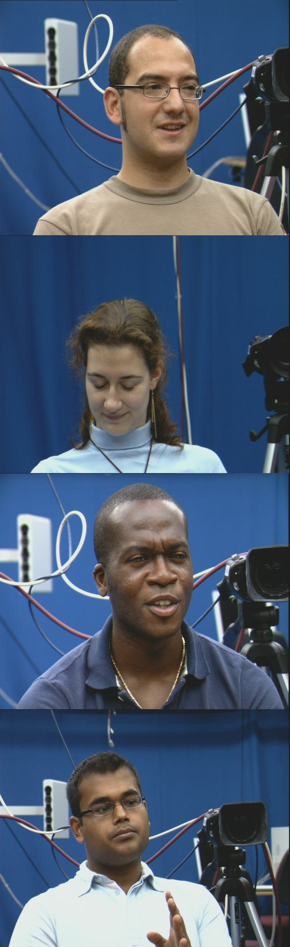
TwoTalk Corpus
Minimum constraints on natural, informal conversation (casual chat)
Two PAL cameras, two participants
Seated opposite across table
4 conversations, 12 minutes each
Manually Selected 527 clips, 37 min total
  Focus annotator effort on interesting sections

Slide 17
Example TwoTalk Video

Slide 18
NVC Annotation
Annotation is used to provide NVC labels
Time consuming and tedious
Most studies use one or a few annotators
  This study collects data from many annotators
Web based video playback and survey form
See Cowie 2008 for a review of challenges
See Reidsma 2008 for multi-annotator issues

Slide 19
NVC Questionnaire
What questions or labels to use?
Encode NVC well but easy to use
Exemplar vs. abstract dimensions
Categorical/discrete vs. continuous scale
Focus on commonly seen NVC signals
Agreeing, thinking, questioning, understanding (inspired by el Kaliouby et al., 2003)

Slide 20
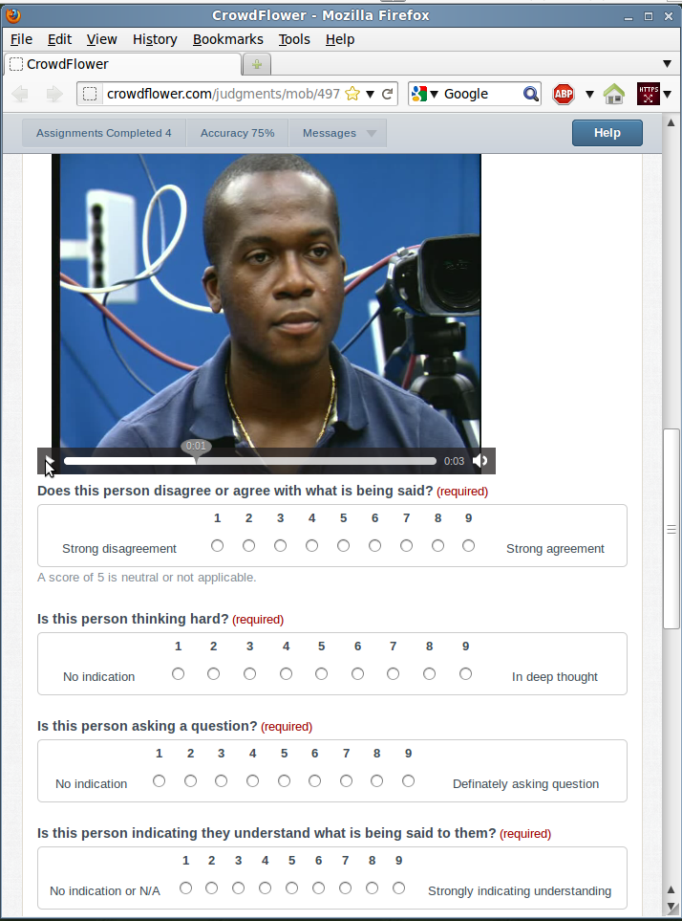

Slide 21
Survey Results
Thirty one annotators participated
Cultural differences not considered
  This is addressed later
Each annotator rated 70 clips on average

Slide 22
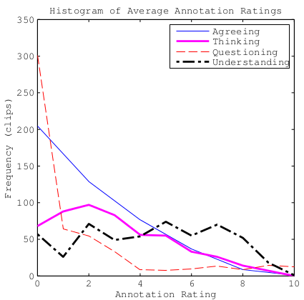
Mean Annotation Rating Frequency
Some NVC signals are rare
  Questioning
Most NVC is of medium or low intensity
  Unlike posed data sets

Slide 23
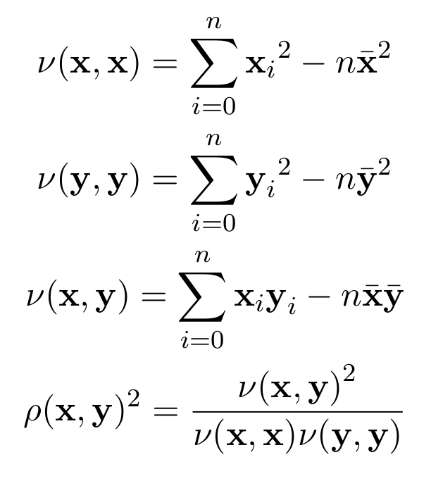
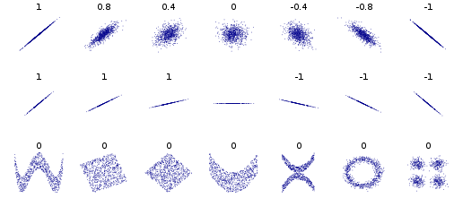
Pearson's Correlation
Find the level of linear relationship between two continuous variables
  1 (or -1) is perfect correlation
  0 is uncorrelated

Slide 24
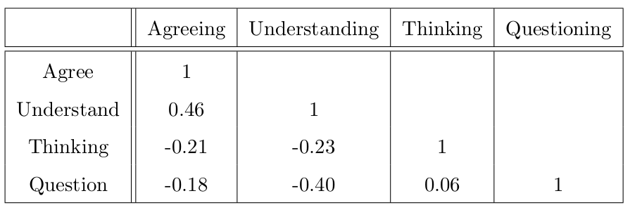
NVC Categories are Interrelated
Table shows correlation of mean NVC rating
NVC categories often co-occur
  Agree and understand
Some NVC categories are mutually exclusive
  Understand and question

Slide 25
Conclusions from TwoTalk
A new NVC corpus has been collected
  Already been used by Akakın and Sankur, 2011
Most NVC is not of a high intensity
  Posed data sets don't reflect this
NVC signals are interrelated
  More work needed to understand a larger set of NVC to fully use this effect (in future: dictionary of NVC?)

Slide 26
NVC Classification
Aim: Effective two class classification of NVC examples
Why: Better interfaces, computers assist communication
Contribution: a study of approaches to automatic classification of NVC

Slide 27
Existing Approaches
Mental state classification
el Kaliouby and Robinson, 2004
  Tracking, use heuristic geometric features
  Dynamic Bayesian framework captures facial actions, displays, mental states at different temporal scales
Petridis and Pantic, 2008
  Tracking positions
  PCA, Mean/Std Dev or Polynomial Fit
  Feature/Decision fusion, Neural Network
Laughter detection
Each frame considered independently
Temporal
Is Important!
Tracking (or
other low
level features)
High level
feature
representation
Fuse/Classify

Slide 28
Alternative Approaches
Use texture
  HOG, Gabor, LBP
Use active appearance model
Use HMMs
Use multiple instance learning
Many others
  All have advantages and disadvantages

Slide 29
Automatic Recognition Approaches
NVC often needs multiple frames to recognise
  similar to emotion 64
Combine information from multiple frames
  Concatenation 151
  Decision fusion 150, 148
  Feature fusion, “high level” features 148
  Sequence based classifier (HMM, MIL) 6

Slide 30
Classifiers
All the usual ones
What about regression?

Slide 31
Scope of Work
Face only
Visual only (multi-modal might be good)
4 categories
  agree, understand, thinking, question
Binary labels (only “clear” examples)
Clear examples
Annotator culture not considered
Addressed later

Slide 32
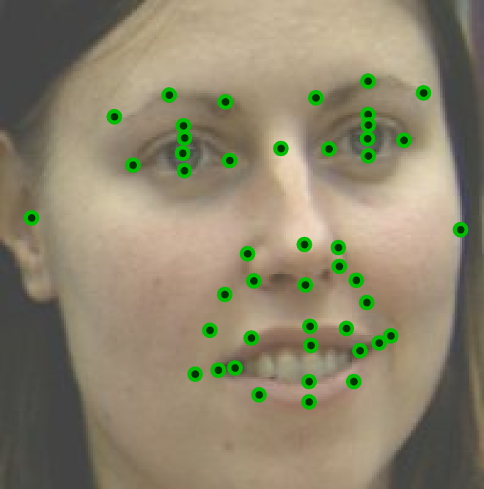
Position of Trackers
46 position
Selected because they could be consistently marked
Use existing tracking technique: linear predictor tracking, Ong et al. 2009
Currently labour intensive to train

Slide 33
Feature Extraction
Various approaches are compared
  Heuristic Geometric Features 63
  Algorithmic Geometric Features 191
  PCA and ICA 148
  Model based Head Pose 112
  Affine Head Pose
  Uniform LBPs 171

Slide 34
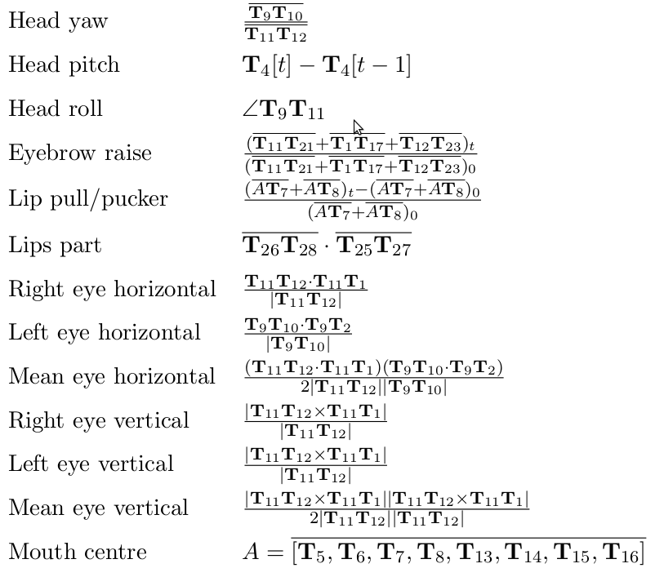
Heuristic Geometric Features
Manually designed
Encodes shape
Compact representation
Not comprehensive

Slide 35
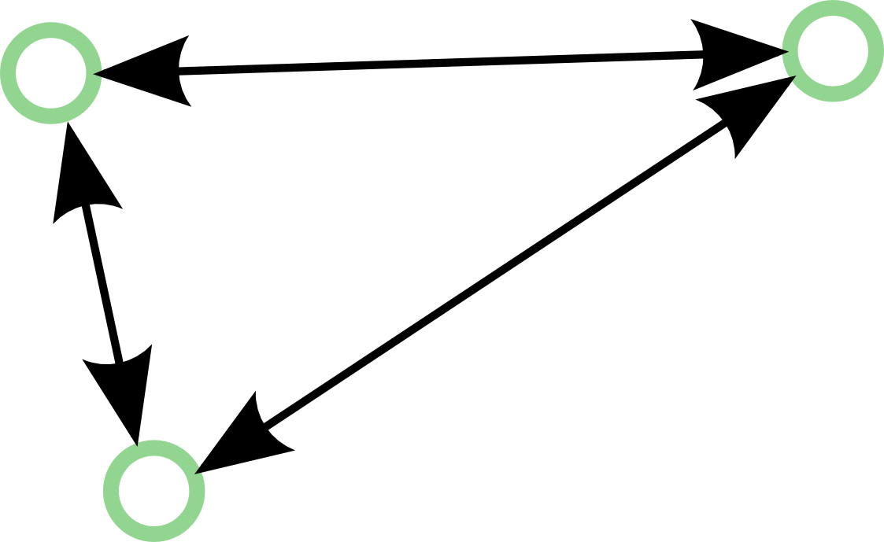
Algorithmic Geometric Features
Euclidean distance between pairs
1035 pairs between 46 trackers
Features are whitened and centred
  Removes face shape information
Encodes overall face shape
Contains redundant information

Slide 36
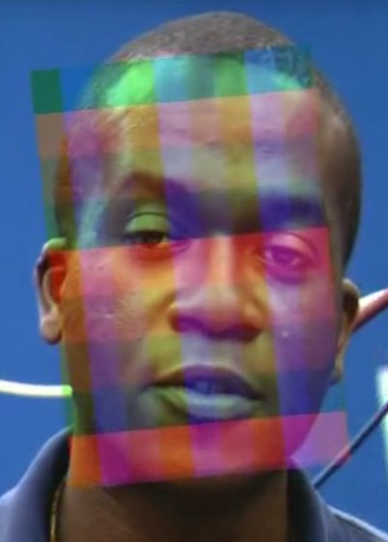
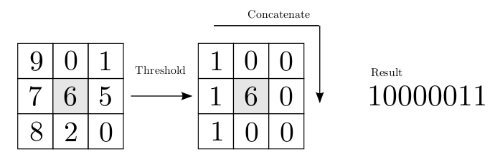
Feature Extraction
PCA and ICA of tracking
  Encodes shape holistically
  Both redundant info and non-optimal?
Head pose (model based and affine)
  Only encodes overall head motion
  Ignores expression
Local Binary Patterns
  Encode texture by histograms of LPBs
  Faces are normalised by affine transform, 10x10 grid

Slide 37
Fusion and Classification
Final label determined by decision fusion, compared to true label
Also evaluate set of frame labels by comparing directly to true label
Classification by Adaboost and SVMs
  Adaboost results in feature subset
  SVM operates on continuous variable input

Slide 38
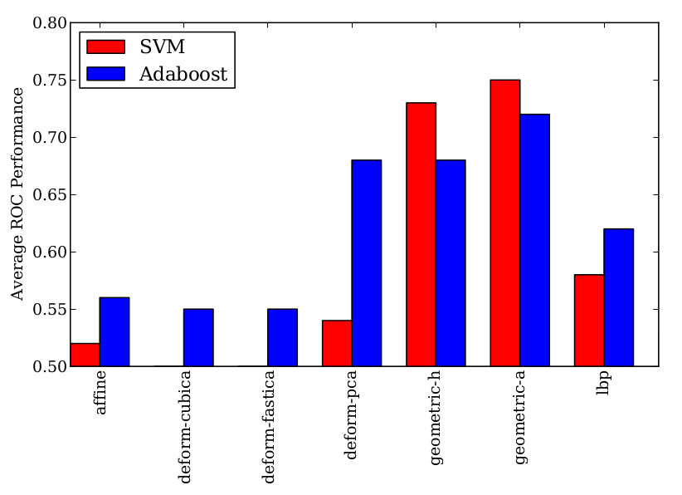
Multi-person Performance
8 fold
Train on all 8 subjects
Using decision fusion
Geometric features, SVM is effective

Slide 39
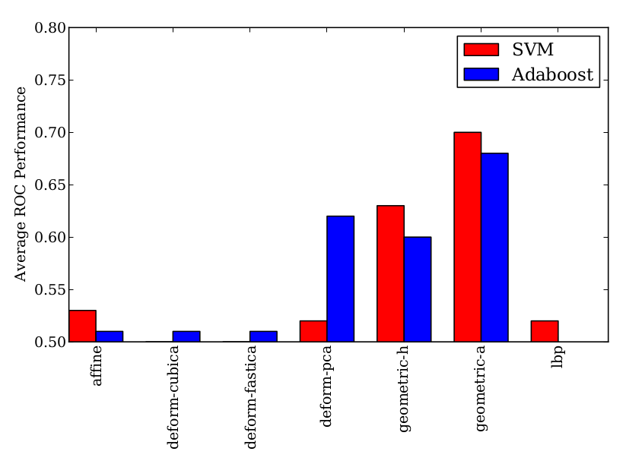
Person Independent Performance
Train on 7 subjects, test on 1
This is harder
LBP particularly effected
Better normalisation?

Slide 40
Classification Conclusions
Geometric features with SVM
Shape is effective, appearance person specific(?)
Temporal variation not modelled
  Consensus of static frames
Later study by Akakın and Sankur, 2011 improves on these results

Slide 41
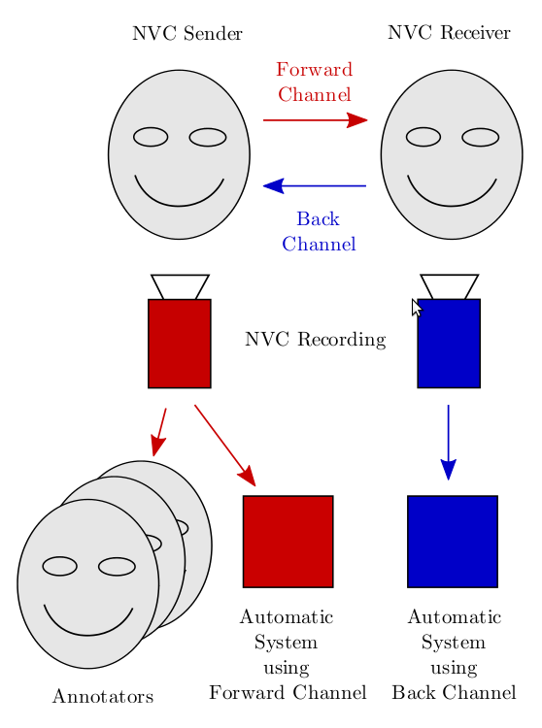
NVC Backchannel
Aim: To use “backchannel” signals (NVC from other person) to recognise NVC
Why: Humans often mimic behaviour during conversation 27
Backchannel may contain additional information: improved performance
Contributions:
  A method to find correlated areas of the face
  Study of approaches for classification based on backchannel signals

Slide 42
Multi-culture Annotation
Aim: to collect annotation from difference cultures
Why: each culture has differences in NVC
It is desirable to recognise NVC in a similar way to people (or groups of people)
Contribution:
  filtered annotation data set
  Analysis of annotation patterns

Slide 43
Culture Background
Cultural differences in expressing and perceiving NVC/emotions (Marsh et al. 2003, Jack et al. 2012)
Although some commonality exists (Darwin 1871, Ekman 1972)
Few studies consider distinct annotator groups for machine learning (Reidsma 2008)
These differences can significantly change perceived meaning
  Obscene gestures

Slide 44
Crowdsourcing
31, 154, 180
Web based, usually browser based
Crowdflower, Mechanical Turk (Amazon), Samasource, different demographics
Suitable for large tasks that can be split into simple steps
Workers Motivation by money / altruism / challenge
Quality control issues may exist

Slide 45
Annotation Results
711 annotators, 79130 questions answered
Annotations are sparse
Three main cultures identified by IP address
  India, Kenya and UK
Many annotators did not cooperate
  Random results need to be removed

Slide 46
Annotation Quality
Uncooperative workers
  Erroneous work may be rejected
Prevention
  No way to pre-screen workers
  Workers are almost anonymous (apart from IP address and timing)
  Sanity questions
  Filtering results, during work or after

Slide 47
Annotation Filtering
Identify cooperative annotators, Pearson's correlation with some ideal standard
  Correlation:
  1 (or -1) perfect correlation, 0 uncorrelated
  Use mode in culture to find robust consensus
  Remove annotators below 0.2 correlation
  Take mean of good annotators
Covariance of X w.r.t. Y
Population variance

Slide 48
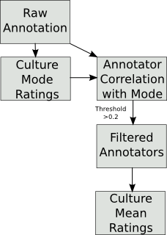
Annotation Filtering

Slide 49
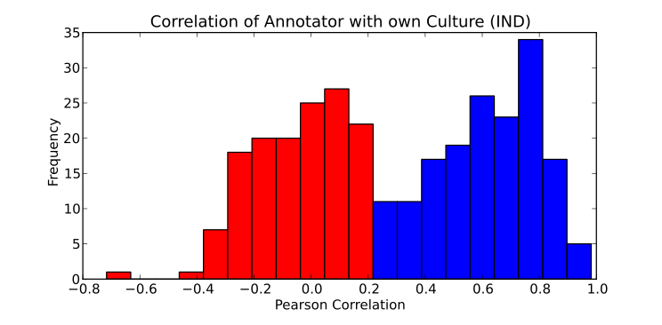
Frequency of Correlation
Correlation with own culture mode
Discard annotators with correlation < 0.2

Slide 50
Cultural Patterns in Annotation
Check for cultural differences in annotation
For each culture,
  For each clip,
    Concatenate culture consensus into one 4D vector
Flatten space into 2D using Sammon mapping
  Attempts to preserve distances

Slide 51
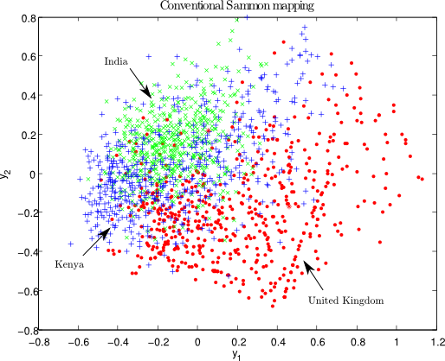
Cultural Patterns in Annotation
Cultures occupy different areas of space, caused either by
differences in perceiving NVC or
differences in using questionnaire.

Slide 52

Compare Annotators to Consensus
Compare filtered annotators with their culture mean consensus
Better to use specialised culture model rather than ignoring culture (global mean)
Correlation of Annotators with Mean Consensus

Slide 53
Muli-culture Conclusions
Crowd sourcing annotation data is effective if quality issues are managed
Differences in culture annotation are confirmed
  This may be due to differences to perception
  To what extent is this due to uncontrolled variables, such as language differences?

Slide 54
Multi-culture Regression
Aim: to find an effective cultural NVC regression method (with better temporal modelling)
Why: this enables strong intensity and weak intensity NVC examples to be distinguished, also culturally distinct perception
Contribution:
  study of approaches
  What happens if we train on a culture, test on a different culture?

Slide 55
Overview of System
LP Track Facial Features (as before)
Extract features using Algorithmic Geometric Features (as before)
Train regressor, ν-SVR (Schölkopf et al. 2009)
8 fold person independent testing
Performance evaluated by Pearson's correlation

Slide 56
High Level Feature Extraction
Consider each component of feature vector
  Take mean and variance
  Concatenate
  This has a fixed length
Encodes average shape and amount of variation, but not speed or direction
Some NVC may require speed to recognise
Similar to
Valstar et al. 2006

Slide 57
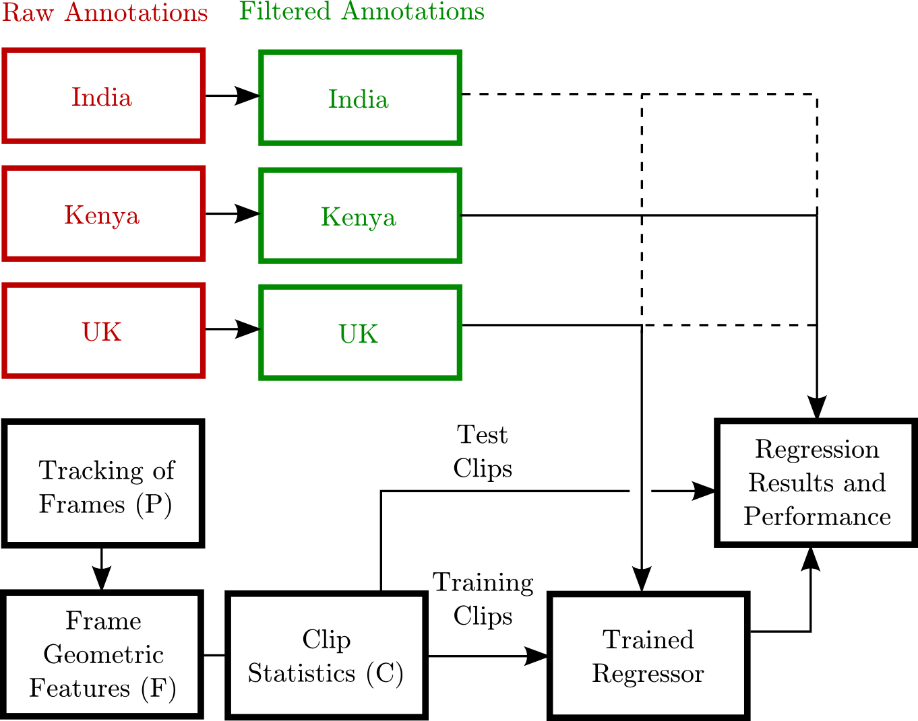
System Overview

Slide 58
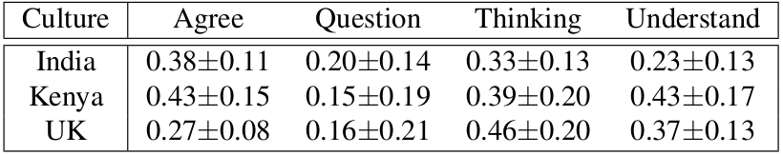
Regression Results
Correlation performances are relatively low
  Extreme difficulty of task
  Low inter-annotator agreement
Questioning is lowest, verbal component

Slide 59
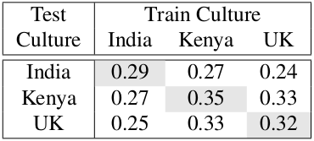
Results
Training and testing on same culture is optimal
Performance is worse if test data is different to training data

Slide 60
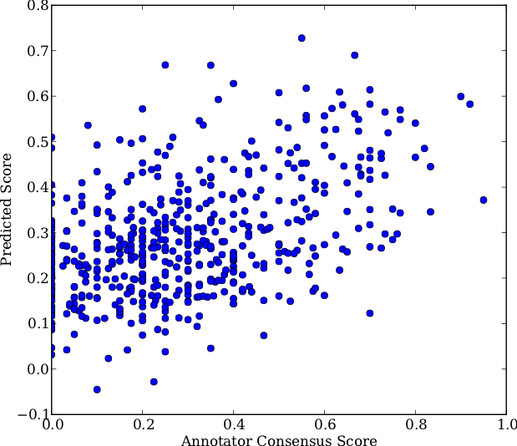
Results
Typical results for a single NVC category
Thinking, UK annotation
Correlation 0.46

Slide 61

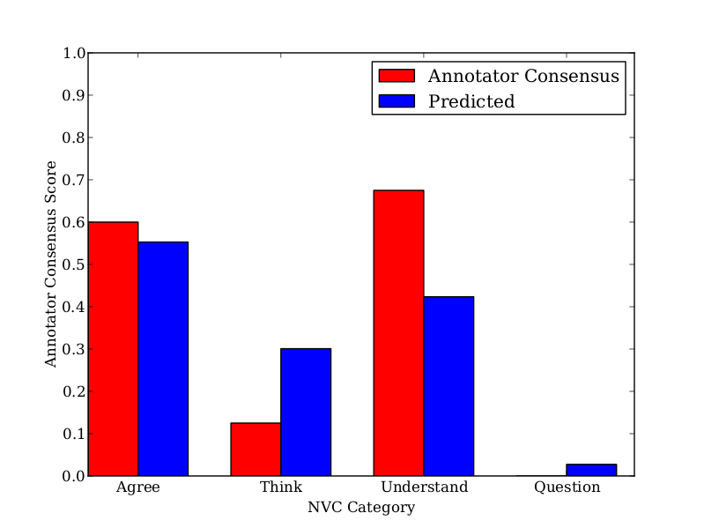
Results

Slide 62
Demo Video

Slide 63
Regression Conclusions
Regression of Naturalistic NVC is possible
  But challenging
Specialising regressor for cultural annotations is better then ignoring culture
  Is it due to language difference or perception difference? More work needed.

Slide 64
Feature Selection
Aim: to find a subset of features that are more effective at NVC regression
Why: Algorithmic geometric features contains redundant information
Contributions:
A SBE based approach to finding a relevant feature subset
A method of visualise the facial areas involve in NVC perception (by a computer)
Similar to el Kaliouby and Robinson, 2004

Slide 65
Method
Current set initialised to all components active
While number of features in current set > 1
  For each active feature in the current set:
    For 7 folds of in seen training data:
      Determine performance with test feature removed
    Determine performance
  Remove feature which will maximise performance
Use the feature subset with best performance

Slide 66
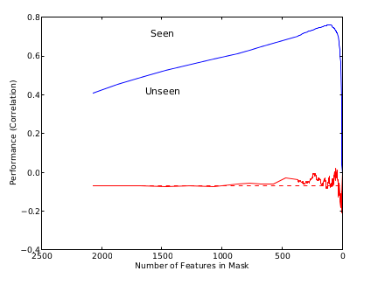
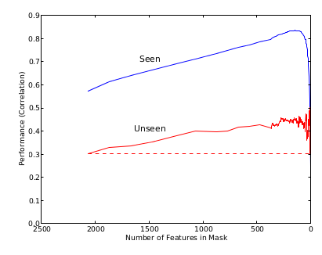
Performance During FS Process
Seen Peak
GBR question
KEN agree
Unseen Peak

Slide 67
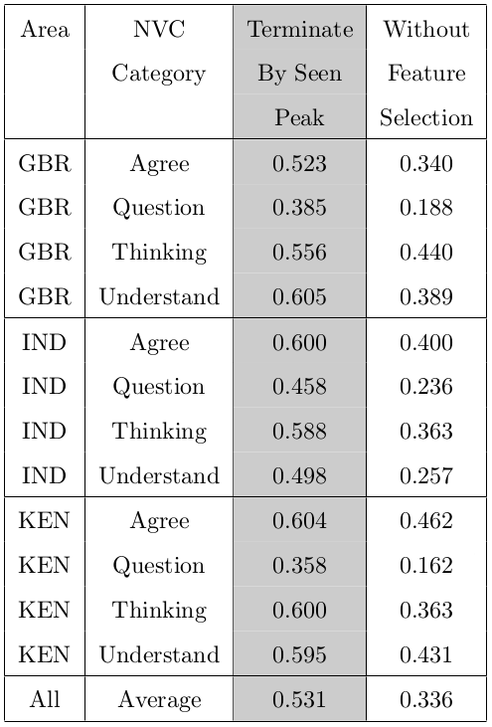
Results
Significant improvement in performance
Cultures have roughly similar performance
Questioning still the most challenging

Slide 68
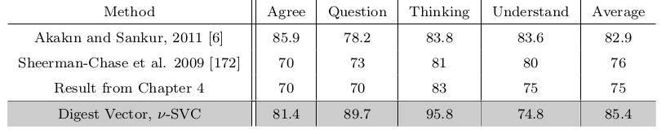
Apply to Classification
Apply idea of using mean and standard deviation
Performance exceeds Akakın and Sankur 2011
Note: unlike the previous few slide, this is on clear examples only.

Slide 69
Visualisation Method
Removal of some features results in performance drop (=> feature is important)
Each feature corresponds to tracker pair
Determine importance as the “sum of drops in performance”
Normalise to 1
Only consider flexible areas of the face

Slide 70
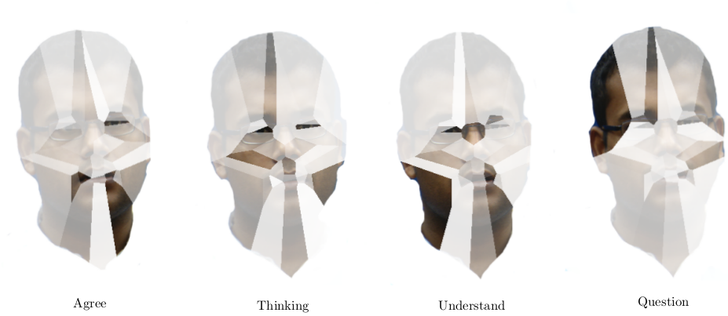
Visualisation Results
Smiling?
Eyes
Unclear
Brow

Slide 71
Feature Selection Conclusions
Feature selection removes redundant information
  Increases regression performance
Feature selection identifies facial areas
  Visualisation method proposed
  Areas are used for computer perception of NVC but not necessarily human perception

Slide 72
Overall Conclusions
New corpus of informal conversation
Annotated by three distinct cultures
A study of NVC recognition
Coupling of behaviour, use of backchannels
Visualisation of NVC facial areas

Slide 73
Future Work
Better data sets, better annotation
Using more sophisticated high level features to better capture temporal information
Record participants from multiple cultures then do multi-annotation, social factors
Potential applications can provide insight into labels and data sets
Multi-modal, appearance features

Slide 74

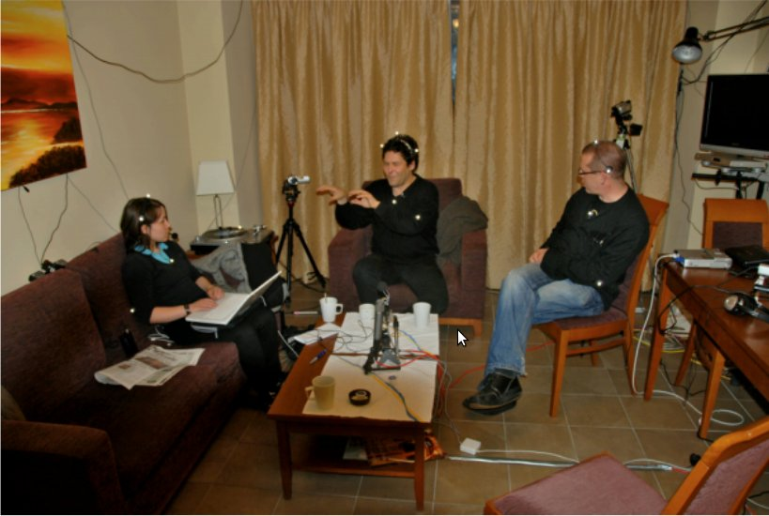
Next Gen Data Sets
FreeTalk
D64 Multimodal Conversational Corpus
Very similar to TwoTalk
4 or 5 people
In a domestic environment
People can come and go
Intrusive equipment

Slide 75
Thesis Summary
Context in NVC Research
Creating the TwoTalk Corpus
Automatic Classification
Backchannel NVC
Multi-cultural NVC Annotation
Multi-culture NVC Regression
Feature Selection

Slide 76
Questions?

Slide 77
References

Slide 78
Photo Credits
“Waving goodbye after the ceremony” c Jonathan Elderfield,
  https://secure.flickr.com/photos/heatheranneulrich/3420075962/
  Used by permission, under the terms of the Creative Commons Attribution-NonCommercial-NoDerivs 2.0 Generic License
  https://creativecommons.org/licenses/by-nc-nd/2.0/
“Bank of America security trying to prevent me from taking a photo during the Iraq war protest” c Steve Rhodes
  https://secure.flickr.com/photos/ari/2347593532/
  Used by permission, under the terms of the Creative Commons Attribution-NonCommercial-ShareAlike 2.0 Generic License
  https://creativecommons.org/licenses/by-nc-sa/2.0/

