Slide 1
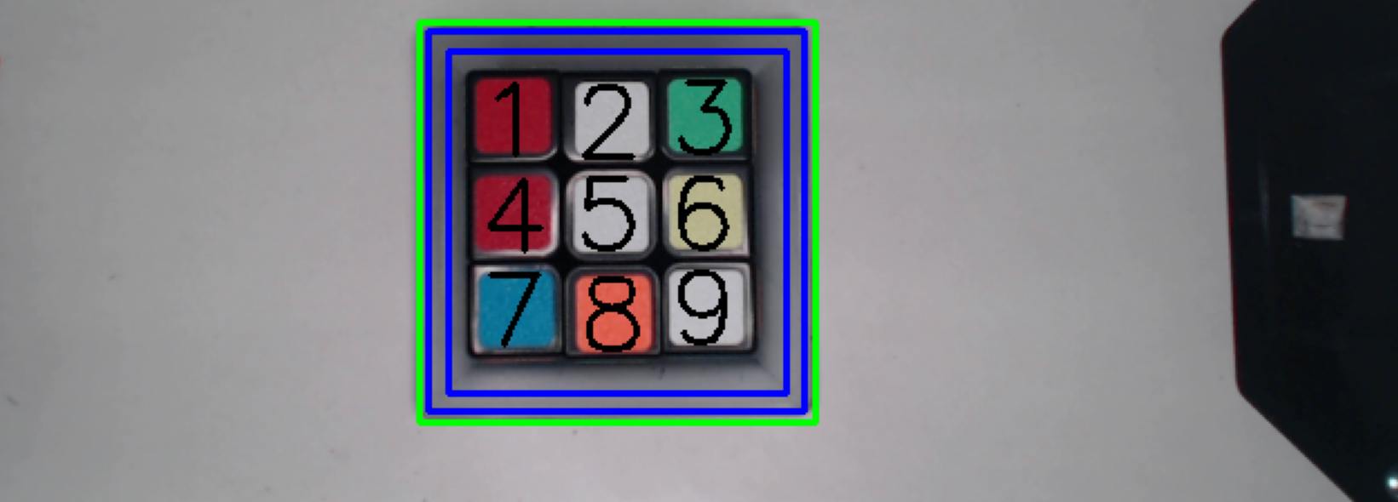
Computer and Robot vision
Rubik's Cube color detection
Gerstlauer, Lukas; Söns, Tim
Computer and Robot Vision | Automotive Systems Engineering | WS 24/25

Slide 2
Agenda
Project description
Challenges of the Project
Process description
Demo-picture
Demo-live

Slide 3
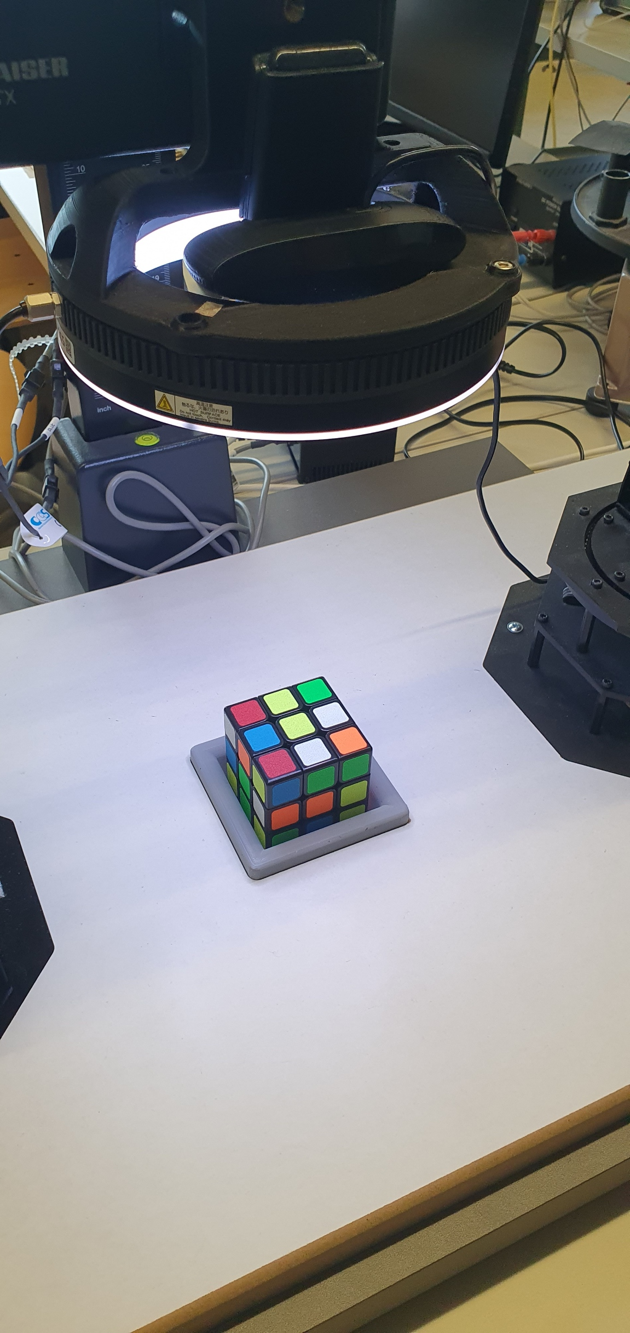
Project description
Experimental setup:
Rubiks cube in grey socket
LED-Lightsource
Webcam
The aim is to recognize the 9 coloured squares of a Rubik's cube under different lighting conditions in the lab environment

Slide 4
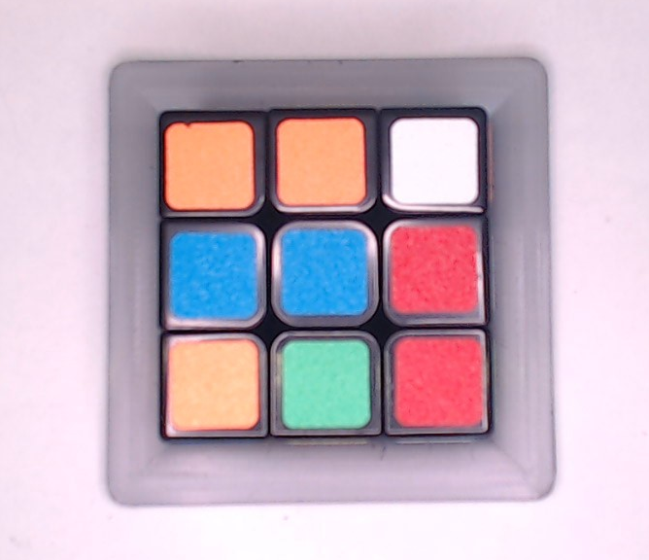
Challanges
Due to the smooth surface of the cube there a many reflections
The webcam isn‘t mounted in the center of the LED circle which interfers with the exposure
Color correction is limited to small changes in the lighting conditions

Slide 5
Process description - Flow Chart
Find segments with Edge Detection
Read in Picture/ Frame
Find grey box and crop to ROI
Color correction
Merging of findings
Compensate not detected segments via geometry
Add color information if needed
Visualize results
Find segments with color filter

Slide 6
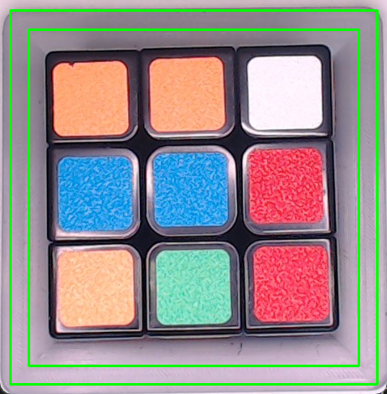
Process Description – grey frame detection
Smoothing with bilateral filter
Edge detection with Canny
Closing of edges
Search for largest square contour
Reduce size of outer contour by 5%
Get inner contour by reducing size of outer contour by 10%

Slide 7
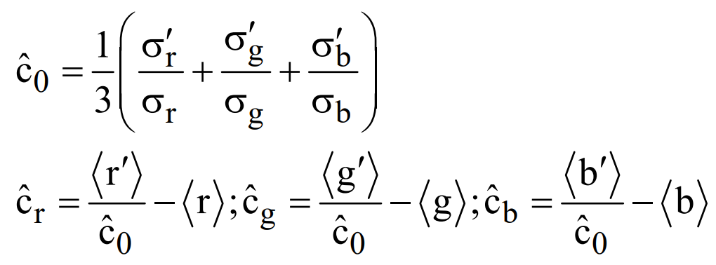
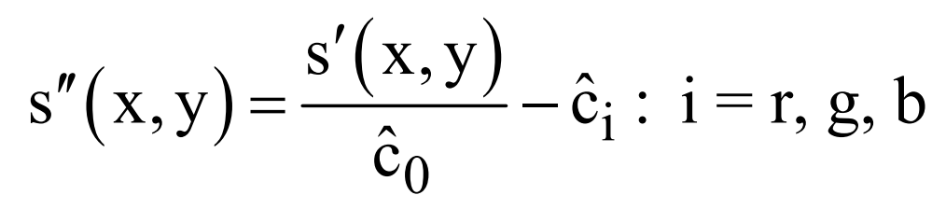
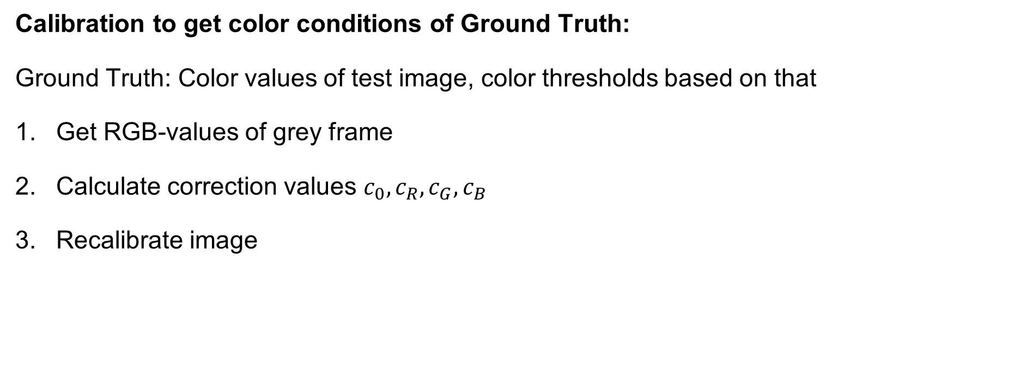
Process Description – color Correction
Calibration to get color conditions of Ground Truth:
Ground Truth: Color values of test image, color thresholds based on that
Get RGB-values of grey frame
Calculate correction values $c_{0}, c_{R}, c_{G}, c_{B}$
Recalibrate image

Slide 8
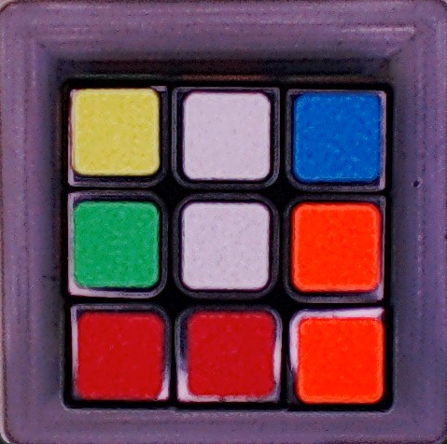
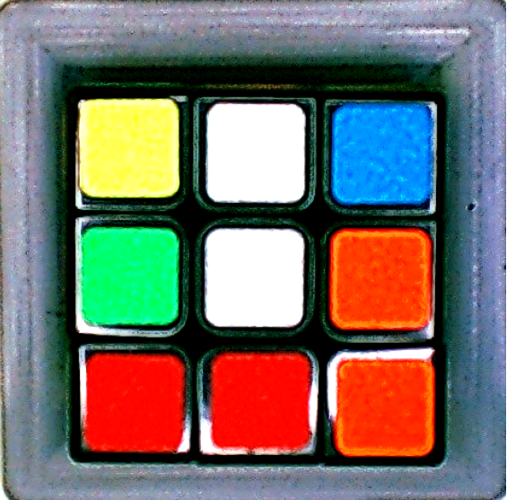
Process Description – color Correction
Before correction
After correction

Slide 9
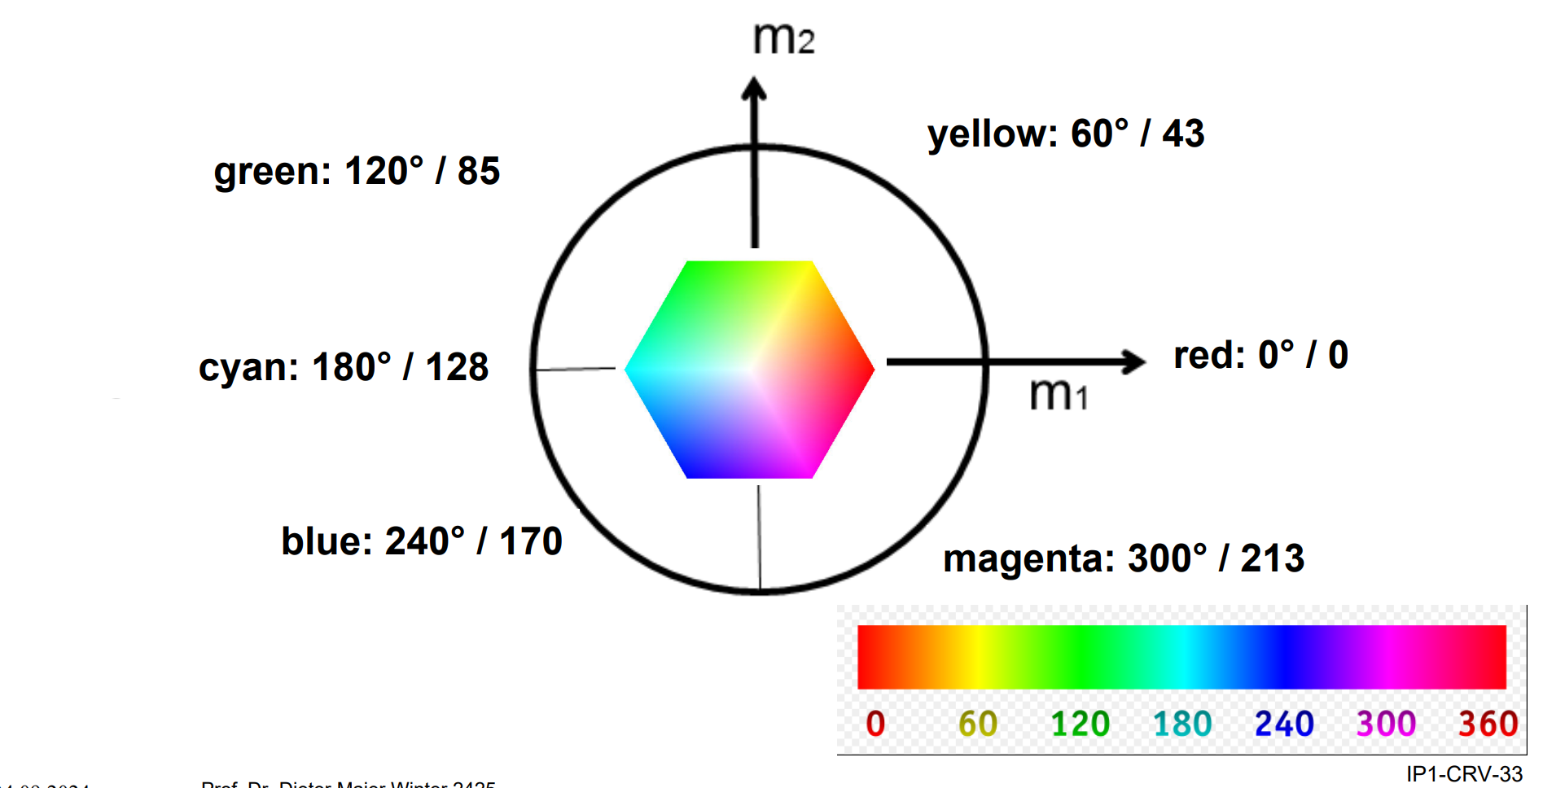
Process Description – color filtering
Transform image in HSV color space
Filter image for specified color thesholds
Get contours of object with specified color values
Filter contours based on size, filling factor, squareness
Get attributes for every found object
Notes:
Hue, Saturation, Value

Slide 10

Process Description – color filtering
Mask after color filtering and contour filtering
Notes:
Hue, Saturation, Value

Slide 11

Process Description – Edge Filtering
Get mask of black pixels
Find contours in mask image
Filter contours by area
Calculate focus point of contour
Mask after edge filtering without contour filtering

Slide 12
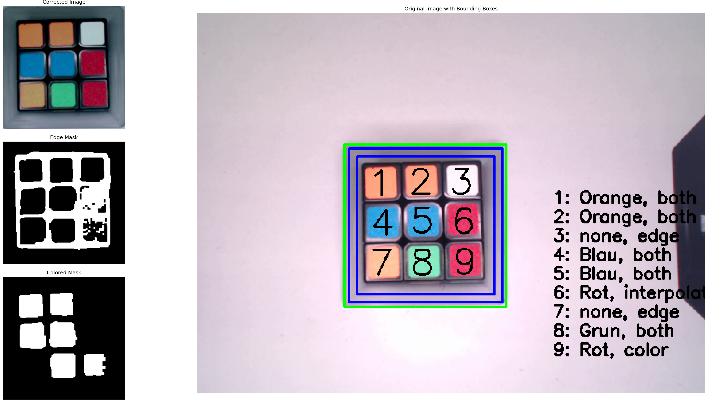
Process Description – grid position
Split x-,y-coordinate of focus points
Calculate a distance threshold besed on mean height/width of Boundingboxes
Group coordinates in groups for rows and colums
Make sure for three elements in each group
Necessary condition: One element in each row and each colum
Numbered grid with all fields

Slide 13


Process Description – Merging of results
Iterate through the grid positions and look for entries in dictionaries:
If available in both dicts: Merge with a factorized mean
If grid position only available in one dict: Take that entry
If grid position isn‘t available in any dict: compensate through geometry
Mask after color filtering with one missing object
Mask after edge filtering detection with every object

Slide 14
Process Description – compensation
Mean x and y groups with three elements each
Look for missing grid position and create dict entry based on centre points
Mask after color filtering with missing objects
Mask after edge filtering detection with missing object
Final image with all objects (compensated sixth tile)

Slide 15
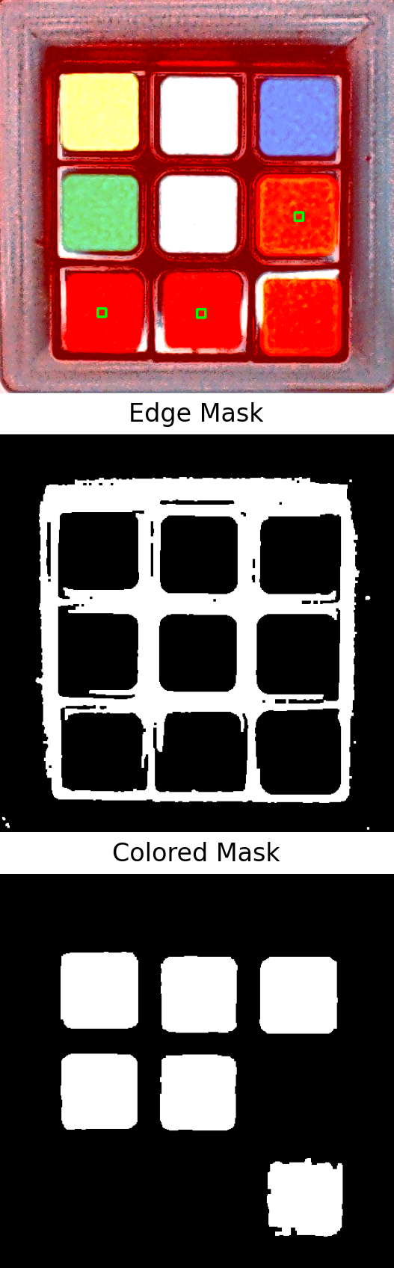
Process Description – Backwards color det.
Color detection if object detected by Edge detection or Compensation, not by color filtering
Get color values in a rectangle around the focus point of found objects
Compare to extended specified color thresholds, no more filtering by size, filling factor,…
Mask after color filtering with missing objects
Small ROIs in the middle of the tiles to detect the color

Slide 16
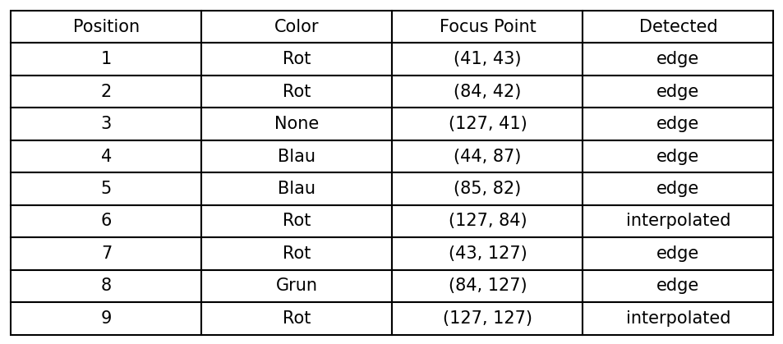
Process Description – Result / Output
Output: Merged dictionary with nine entrys with six keys each
Bounding Box
Focus point
Color
Grid position
Average hue value
Detected way

Slide 17
Limits of the system
Does not work when the cube is rotated in the image
Orange and red color areas are very close to each other, risk of confusion in the border area
Color correction reaches its limits with excessive color deviations
Detection of the grey frame not always exactly at its edge (shadows, angle to the camera) → inaccurate color correction

Slide 18
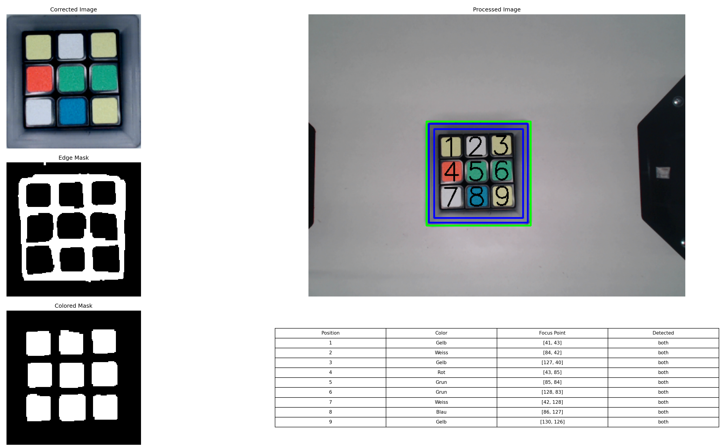
Demo via recorded Pictures

Slide 19
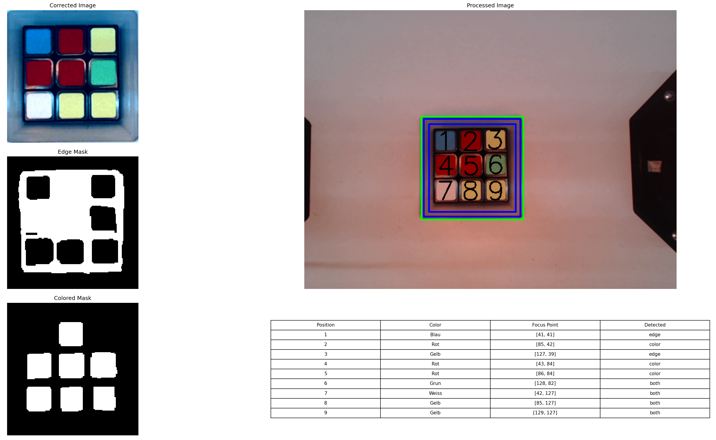
Demo via recorded Pictures

Slide 20
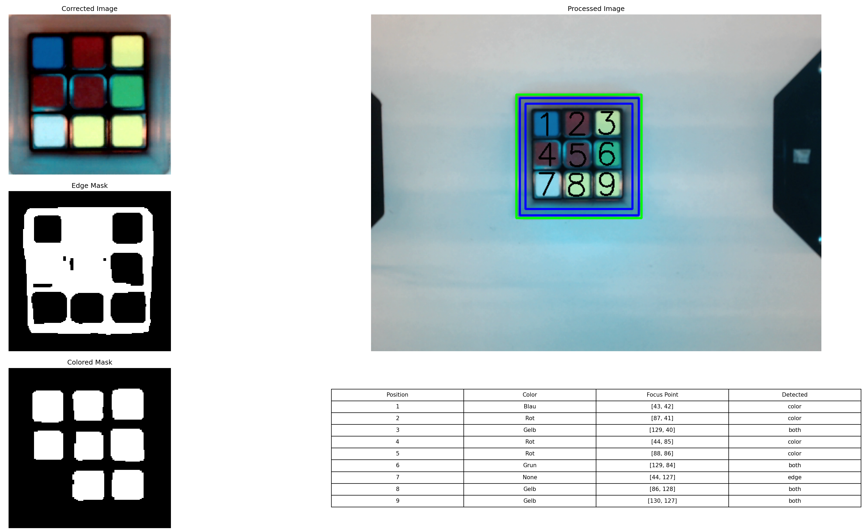
Demo via recorded Pictures

Slide 21
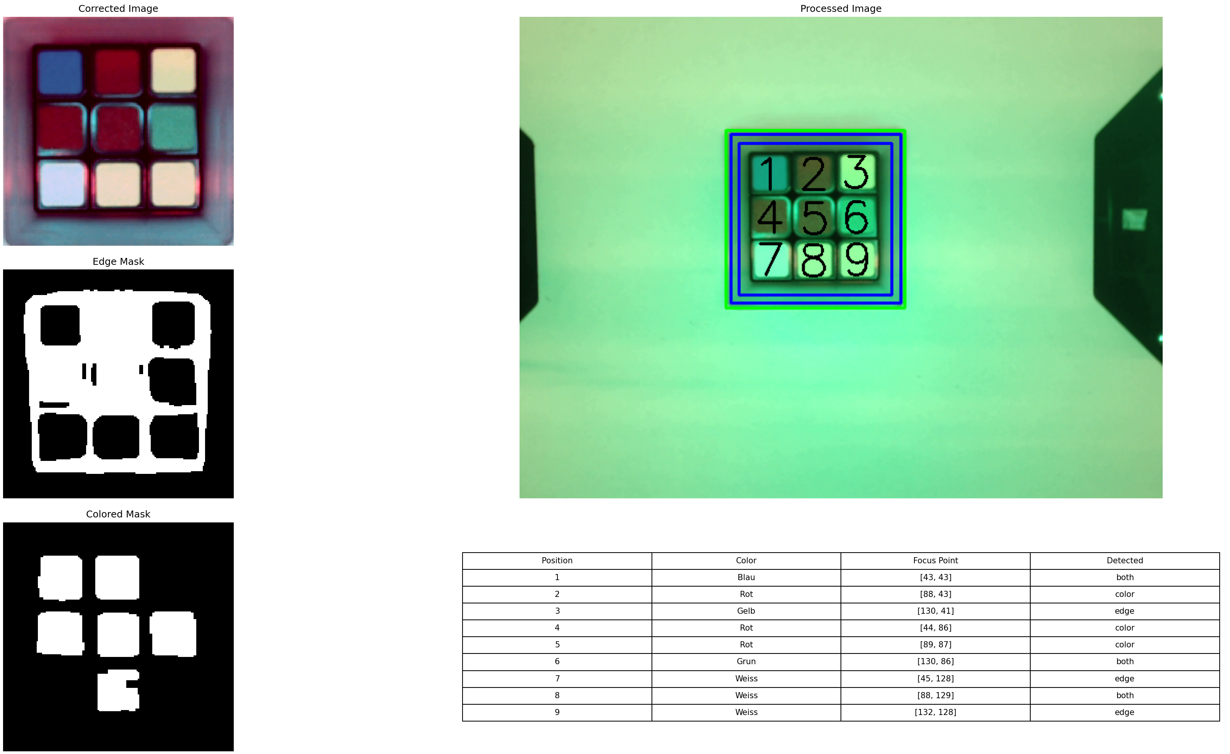
Demo via recorded Pictures

Slide 22
Thanks for your Attention

