Slide 1
DC Crime Analysis Dashboard
GW Data Analytics Bootcamp - Project 3
Reena Desai, Jimmy White, Mario Cosby, and Tim St. Onge

Slide 2
Issues
Crime data can be large, dense, and difficult to parse.
To gain insights into potential patterns of crime, we need tools that provide efficient methods for filtering and visualizing data.

Slide 3
Primary Objective
Create a dynamic, easy-to-use web application for quickly analyzing trends in DC crime data for over space and time

Slide 4
Workflow
We used five years of DC crime data (2014-2018) to better understand crime trends
Data downloaded as CSVs from Open Data DC
Data CSVs unified and loaded into a SQL database (via MySQLWorkbench)
Supplemental SQL data tables (Ward and Crime Type listings) were also created to support crime filters in final application.
We pushed SQL database to Amazon AWS for SQL Server so that final application would pull from cloud.

Slide 5
Workflow
We created our application file (app.py) with several endpoints that would receive data from AWS.
Data streams from these endpoints would feed into three visualizations created in JS:
Map of crime incidents filtered by crime type and DC ward
Time wheel charting crime times over 24-hour cycle
Line graph charting crimes by month among each ward

Slide 6
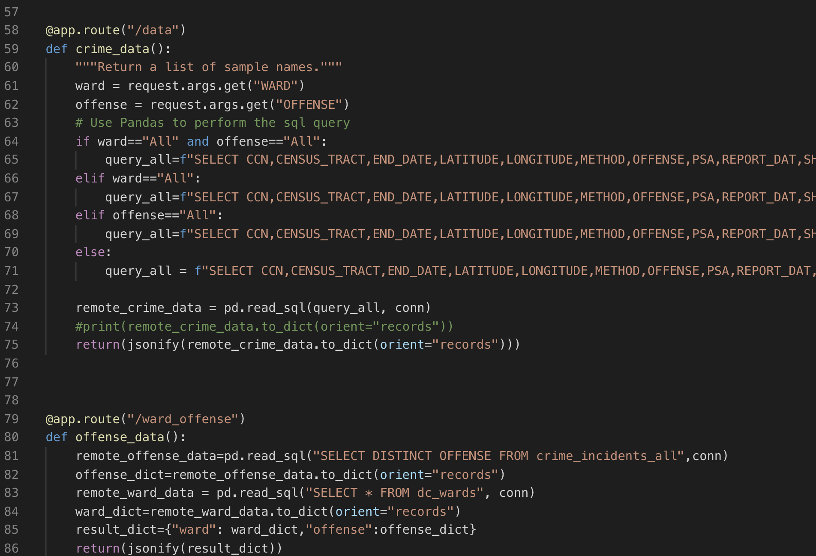

Slide 7
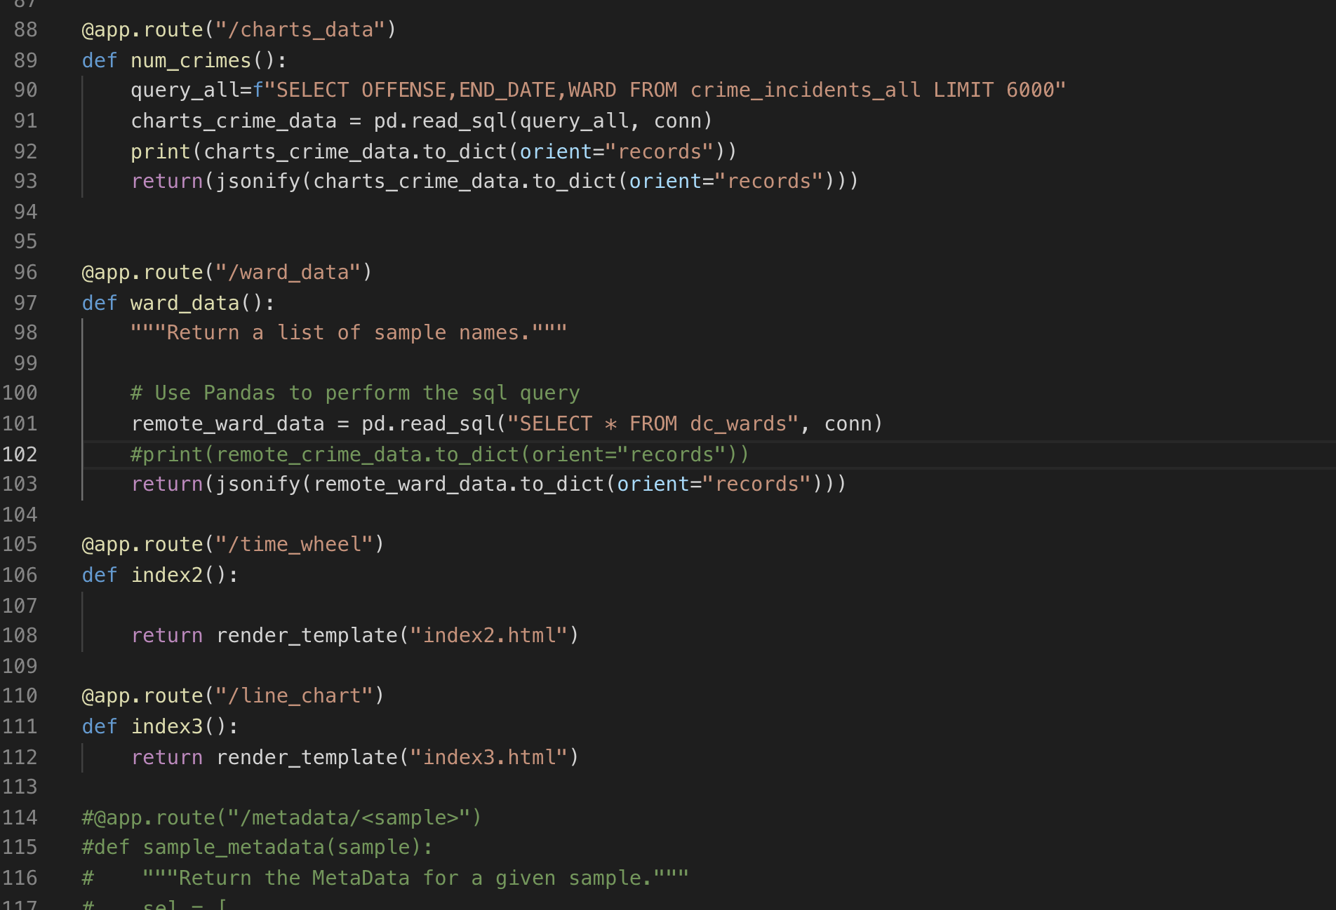

Slide 8
LET’S SEE THE THING!
https://justice-league-dc.herokuapp.com/

Slide 9
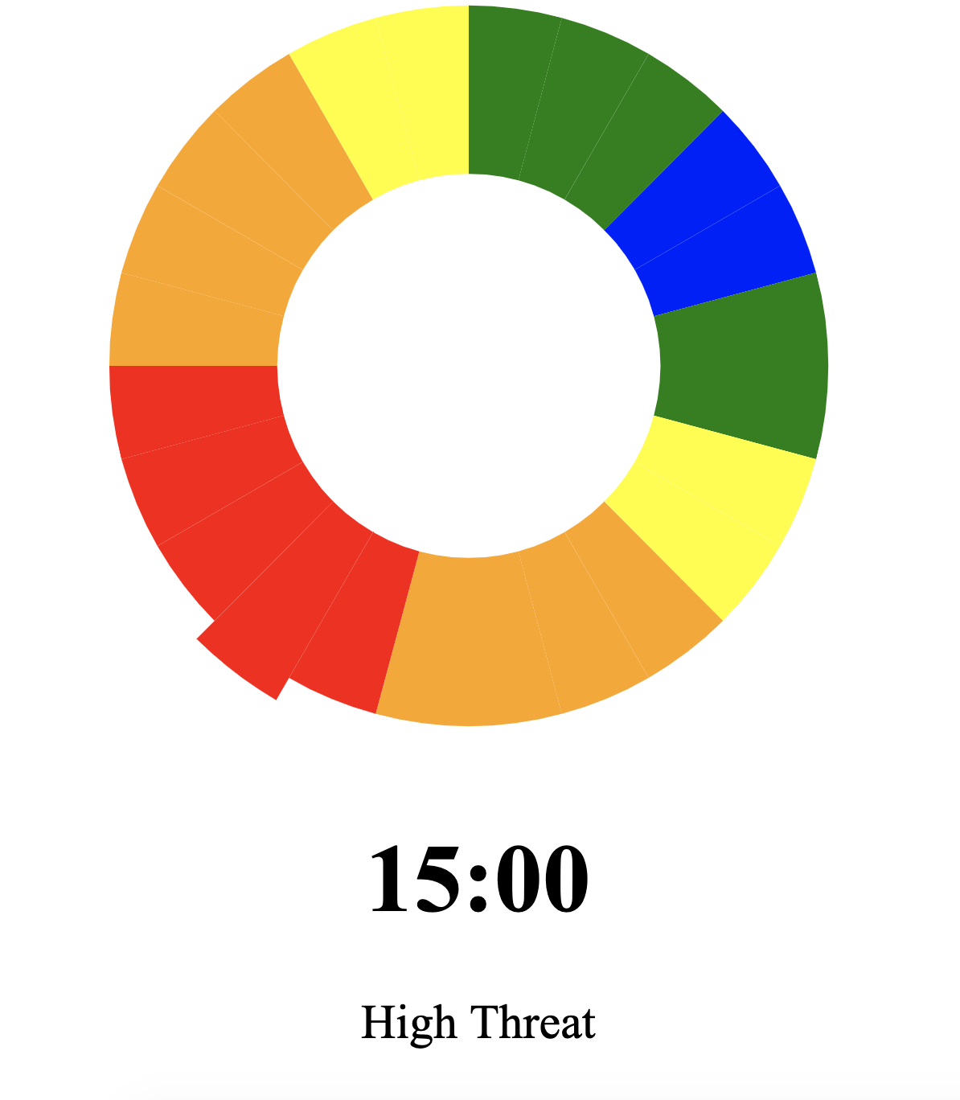

Slide 10
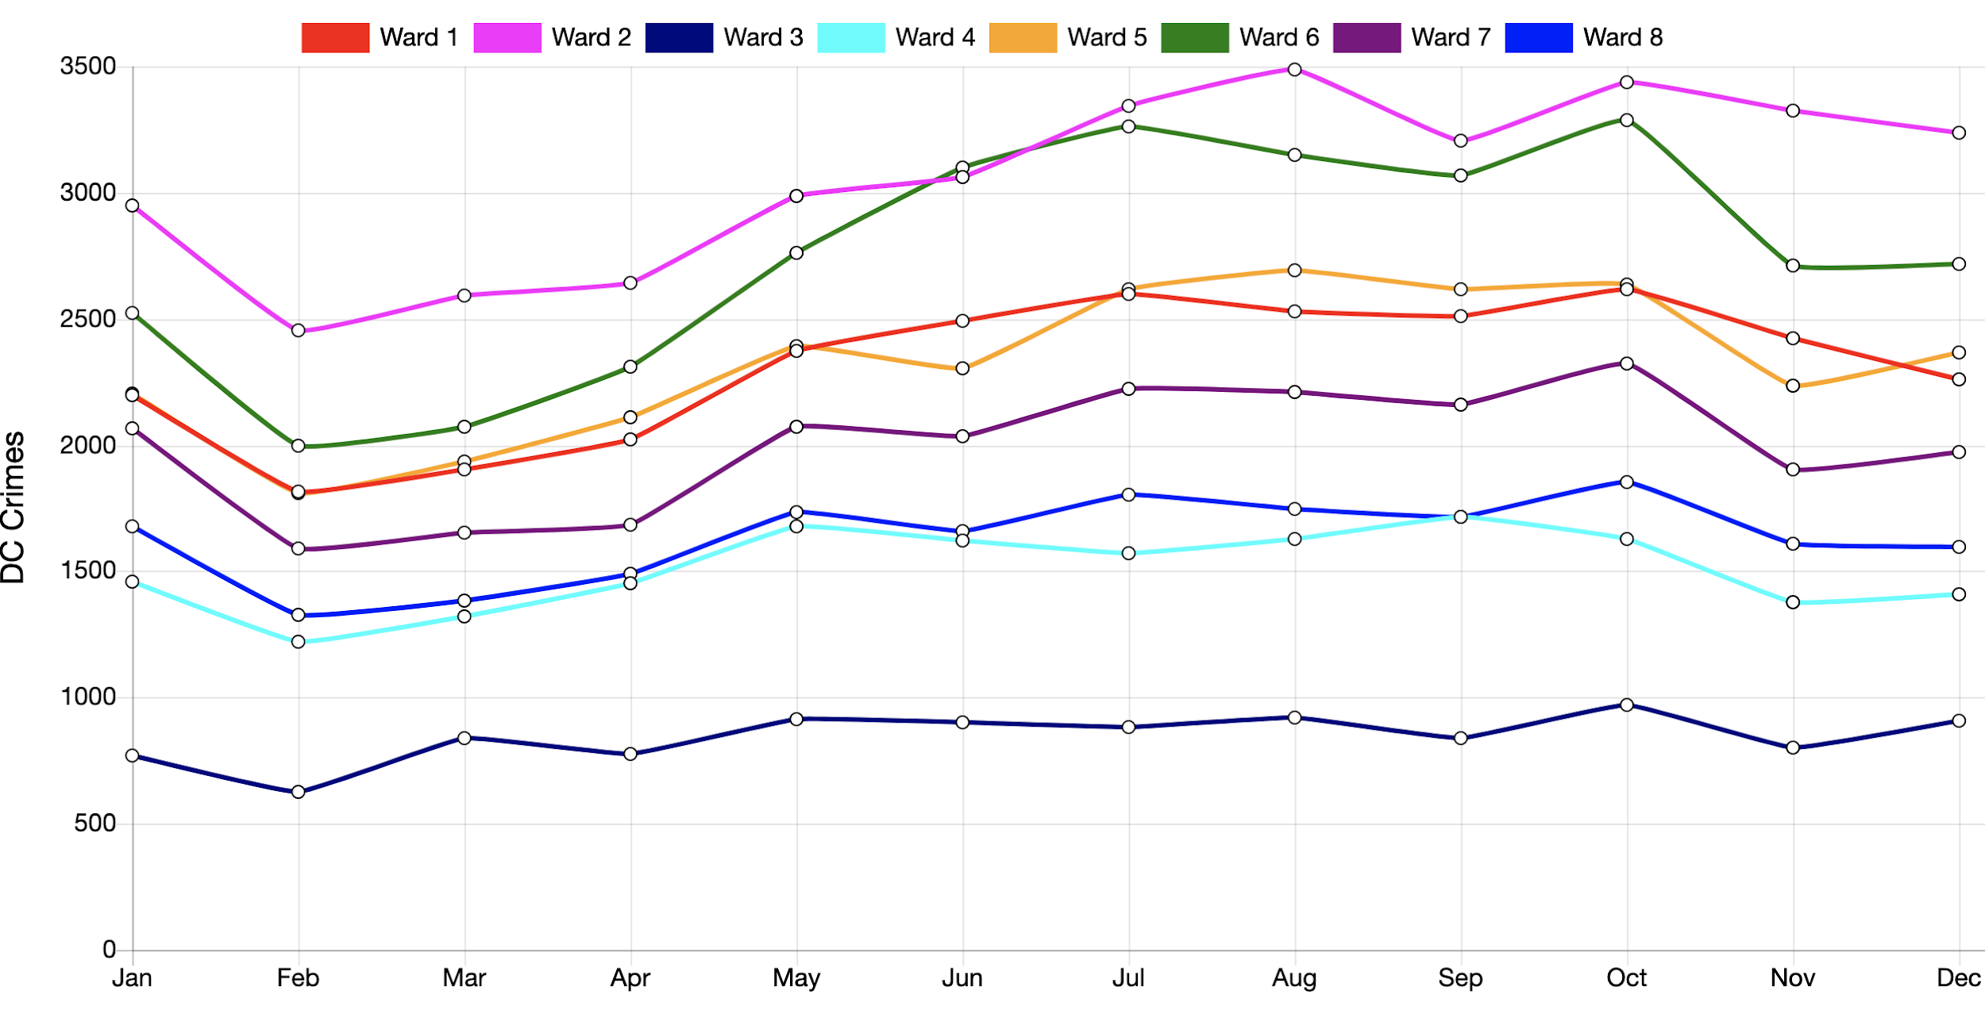

Slide 11
