Slide 1

Netflix
Aggregated metric analysis utilizing Netflix customer behavior
Ben Dieck and Tim Tieng

Slide 2
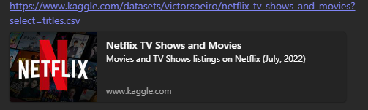
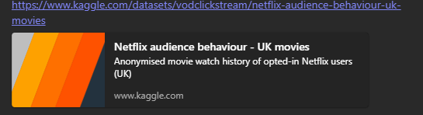
Data Sets
Netflix maintains robust metrics on programming within its database. While it will release this data, they won’t readily release their user behavior.
Fortunately, we were able to associate user experiences with the programming by performing an inside join from a UK database

Slide 3
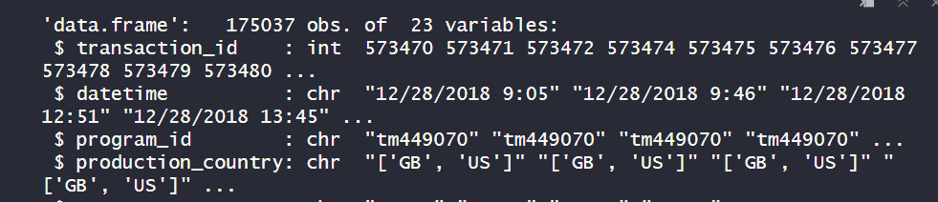
Preproccessing
Excel:
Utilize XLOOKUP to match by movies titles : LEFT JOIN
~178K Matches with some information that was NULL
NULL Information was deleted due to the high dimensionality of the set.
Matched title information (ratings, production country, etc…) to the user information so that each user transaction was a transaction with all associated metrics with the objects of that transaction.

Slide 4
DERIVED Attributes
New dataset has 175K Observations
Behavior – This is a discretized variable based on an evaluation of how much a program was watched, by ratio. This is the primary variable of interest.
Less than .01 it was skipped over - 0.
.01 to .6 it was partially watched - 1.
.7 – 1 it was fully watched – 2
More than 1.05 it was binge watched - 3.
Watch Ratio – simple ratio of time between clicks of a transaction / runtime of the program

Slide 5
DERIVED Attributes
Cat_Simpl - A simplification of the genre of a show. Fairly arbitrary, but intuitive of some of the nuances of programming.
Usually the first genre was used in a multi-genre classification.
Some genre’s became a binary classifier like western, or musical. If you are at all considered to be in this category, then the program was in that category.
The goal was to simplify the list of 175 genres into a smaller list.
Year_cat – Discretized version of year that puts year groups into categories of 10 year batches.
Anything below 1980 is considered classic.
Anything above 2010 is considered “modern”.

Slide 6
DERIVED Attributes
user_trans – The number of times the user appears within the dataset.
This was later considered to be a fairly biased metric as vast swathes of the data was deleted (~1.9 million transactions).
Times.in.set – the number of times the program in the observation was watched across the dataset.

Slide 7
Total Attribute list
Transaction_id
Datetime
Program_id
Production country
Type of program
Year Category (Modern, Classic, 80’s, 90’s)
Title
Imdb Rating
Times it has been viewed
Imdb votes
Rotten tomato popularity by positive review
Rotten tomato score
Run time in seconds
Duration watched
Ratio run time / duration
Behavior classifier
Genre
Genre Simplified
Release date
Movie id
User transactions
User id

Slide 8
Top Programming by IMDB rating

Slide 9
Highest rated by Rotten Tomatos

Slide 10
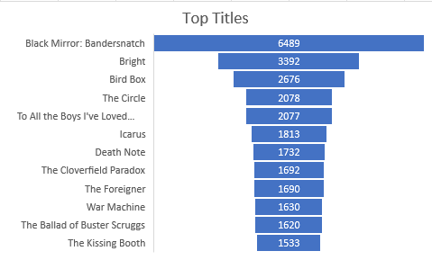
Top Titles
Top viewed by traffic
What people were actually watching the most

Slide 11
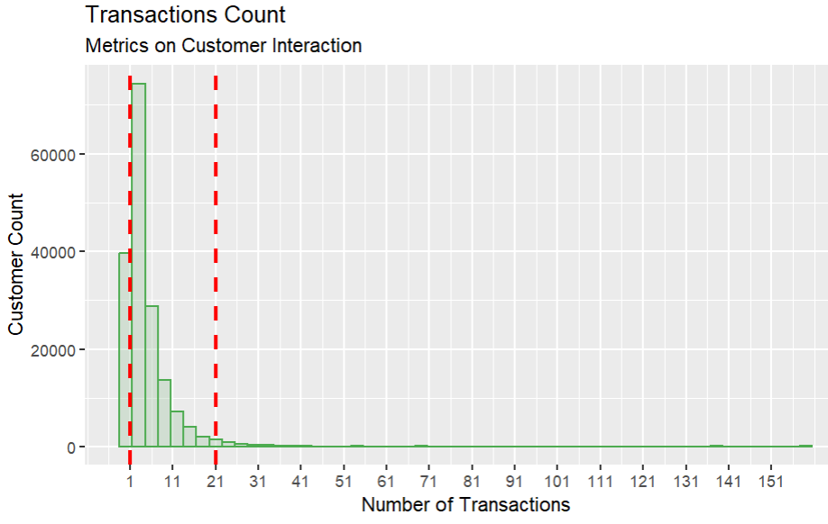
Majority of transactions
Tracked by user over the 3 year window
HDI, 95%, has less then 21 interactions represented in the set.
However we removed about 400k transactions from the set.
Might be worth going back to see what overall user behavior is

Slide 12
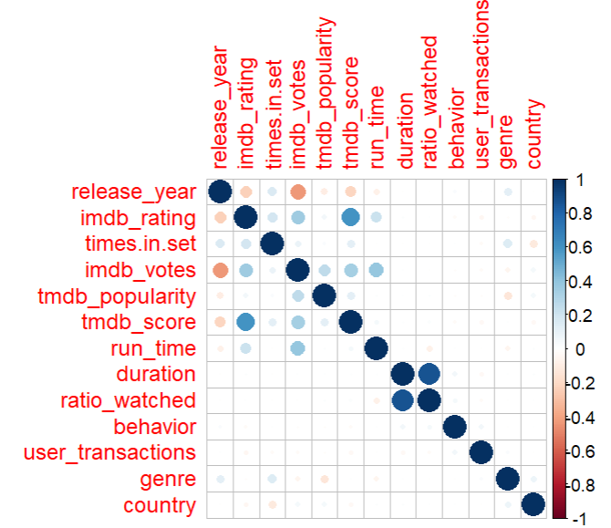
Correlation of attributes
No smoking gun that jumps out as invoking the behavior that we might like to encourage, binge watching shows.
Numerous correlations in voting, popularity, etc…

Slide 13

Business Questions
What is the key metric for keeping a users attention?
What is our viewer base trying to watch?
Are we getting the highest return of newer, mega-titles or B list older films?
What do we need to invest more in, as far as license inventory?
Can we determine popular actors by viewer behavior?
Can we duplicate a recommendation algorithm?
Could we formulaically jump start an actor’s career based on trends in data?

Slide 14
Macro-Analysis – Big Picture Tim Tieng
Notes:
This is a section that helps us understand the top-level informaiton in the data set – country user base, number of users per subscription type, monthly revenue and device breakdown.
Utilizing this type of top-level analysis approach first allows us to understand what further analysis can be conducted.

Slide 15
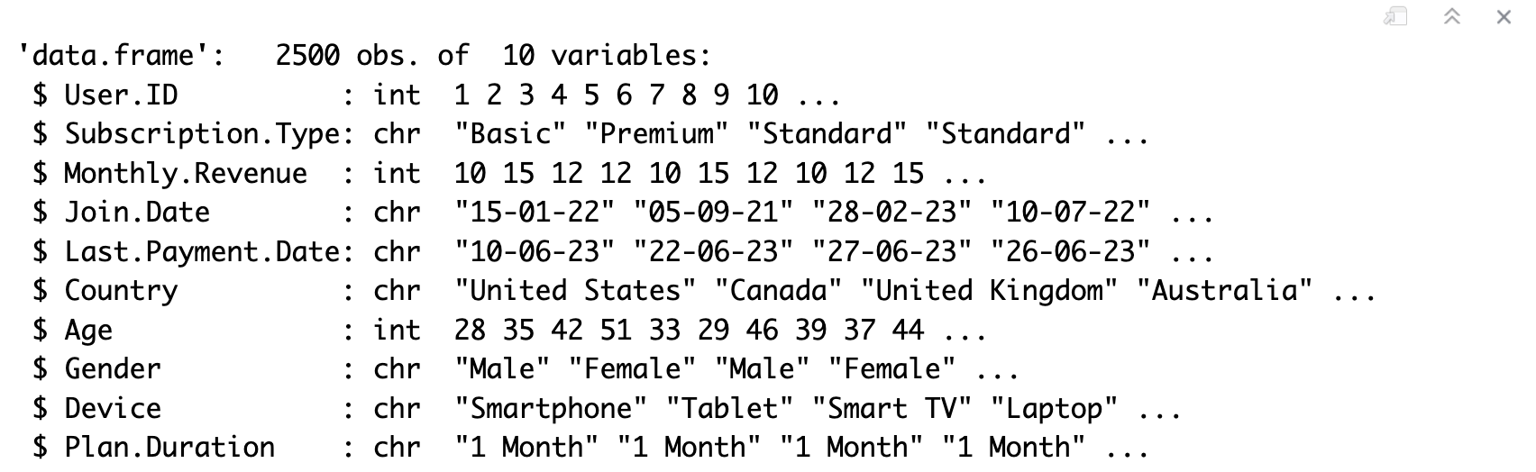
Exploratory Data Analysis – Netflix users
To provide business recommendations to Netflix, it is imperative we understand the user breakdown of their service.
Subscription Types – 3 Categorical Values ( Basic, Standard, Premium)
Country – Global view of users can help identify which parts of the world may require capacity forecasting
Device – 4x Categorical values that can help provide insights on streaming quality based on device capabilities (Tablet, Laptop, Smart TV, Device )
Notes:
Subscription Type can help identify which regions bring in the most revenue
Country – Helps us understand which areas of the world has the largest userbase. This type of insight can help netflix from an infrastructure POV, and how to ensure they have the scalability and capacity to serve all its userbase without a degradation of service quality
Device – This could help shed light on how the users are using the service. This Can help Developers understand how to format movies to make sure they are optimized for a given device

Slide 16
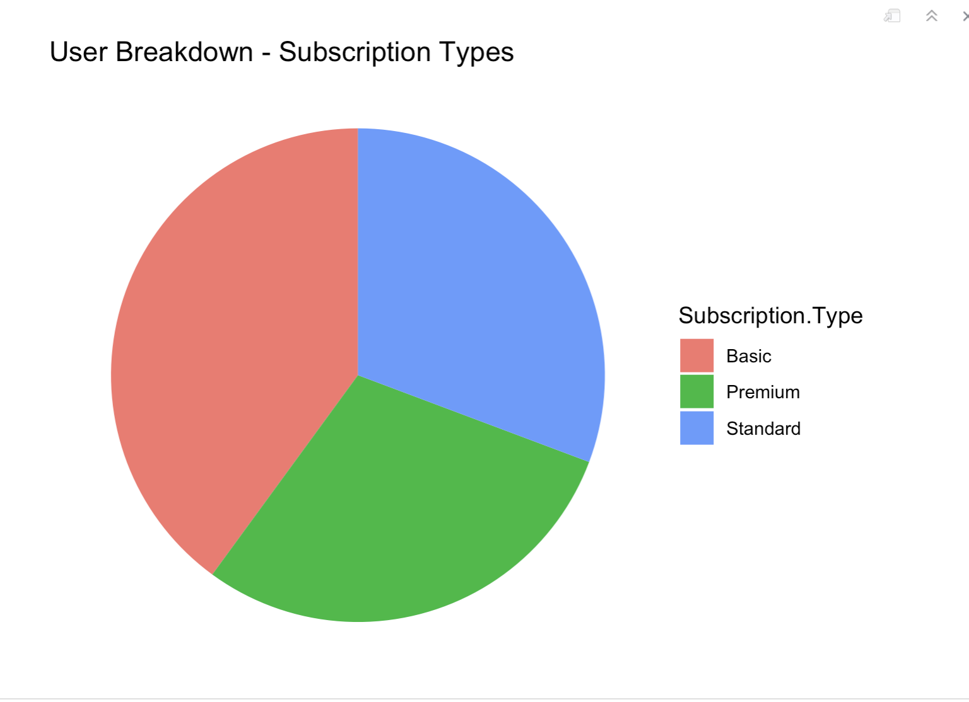
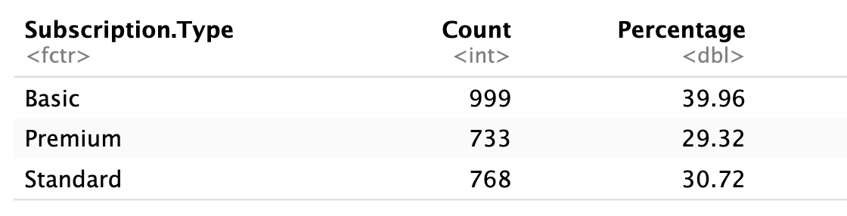
User Subscription Breakdown
Subscription type breakdown – Percentage Value

Slide 17
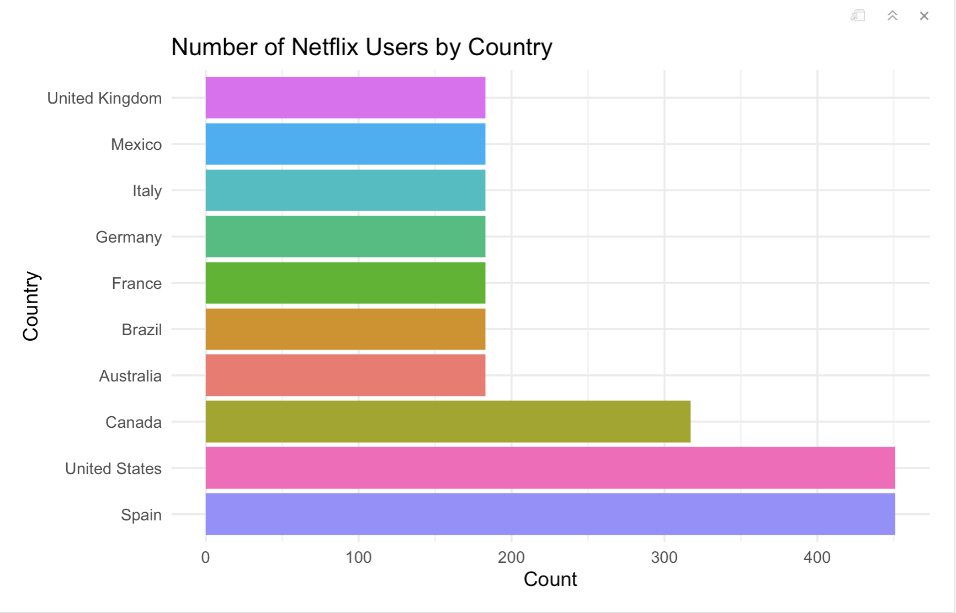
User Base Count – Country View
Observations:
Spain, U.S and Canada host the most users in the dataset.
Rest of World users in the dataset are about the same.
Thoughts – Understanding that Netflix is one of the most successful and well-known streaming services, it is imperative to assume that this dataset is incomplete. India is one of the largest human populations and it is not included in this dataset.

Slide 18
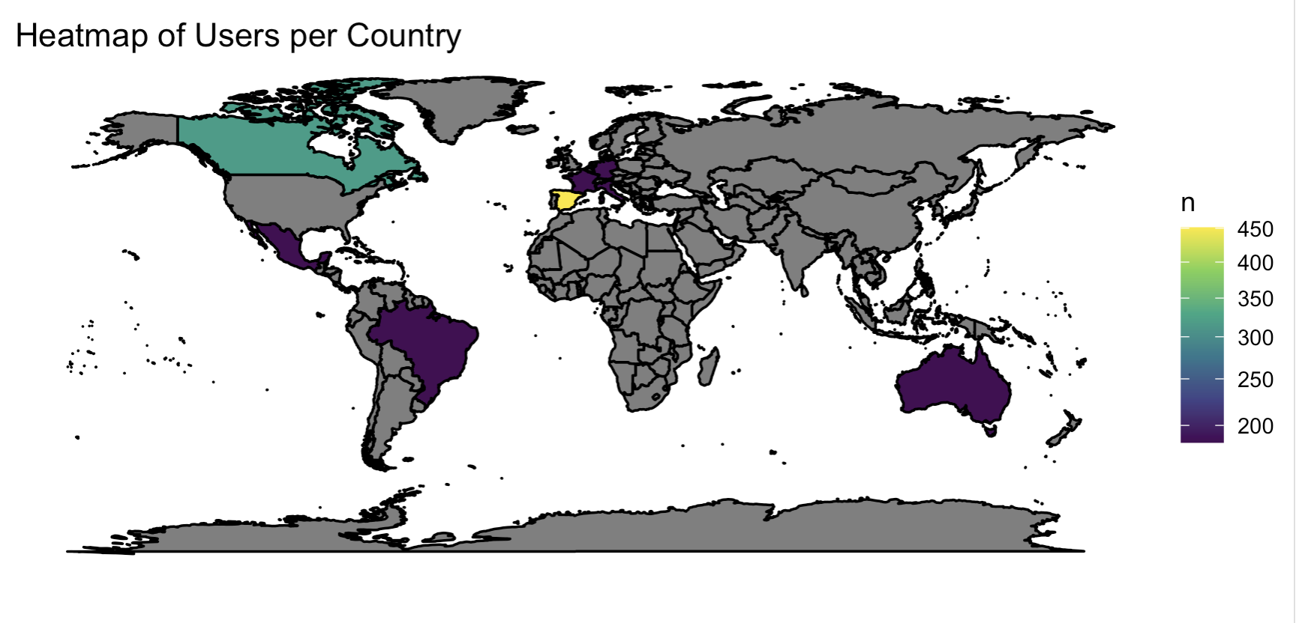
User Base Count – Global Heatmap
This heatmap was another means for the team to understand the user breakdown of the dataset.
This Heatmap shows clusters of users in a given country to potentially highlight which areas of the world has the most active users.
This is imperative when it comes to ensuring your service is highly available and fault tolerant. This type of study can help Netflix understand where to have servers to ensure there is capacity to accommodate all its users.

Slide 19
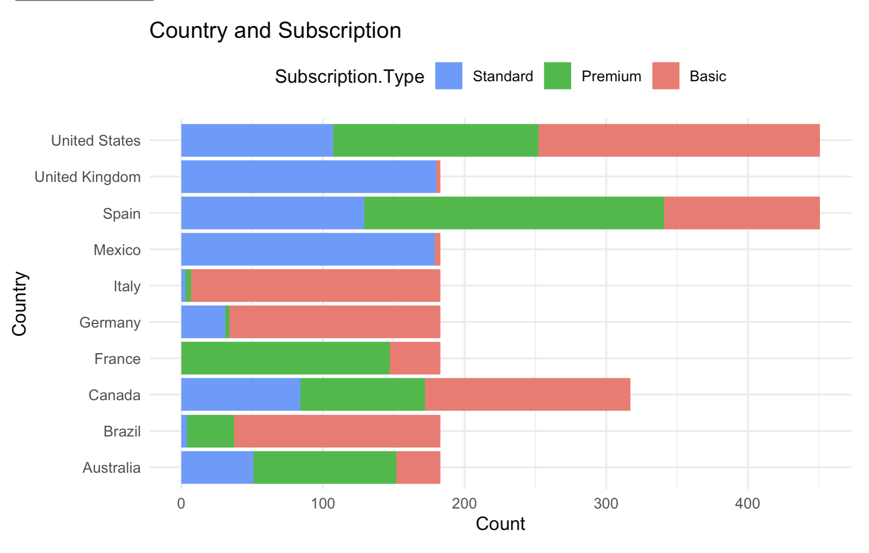
User Subscription Break Down – Geographic Analysis
Next, it is important how different users are arrayed across the globe, and to see if there is a specific region where one specific subscription type is dominant.
To accomplish this, We created a simple bar chart to highlight this information requirement.

Slide 20
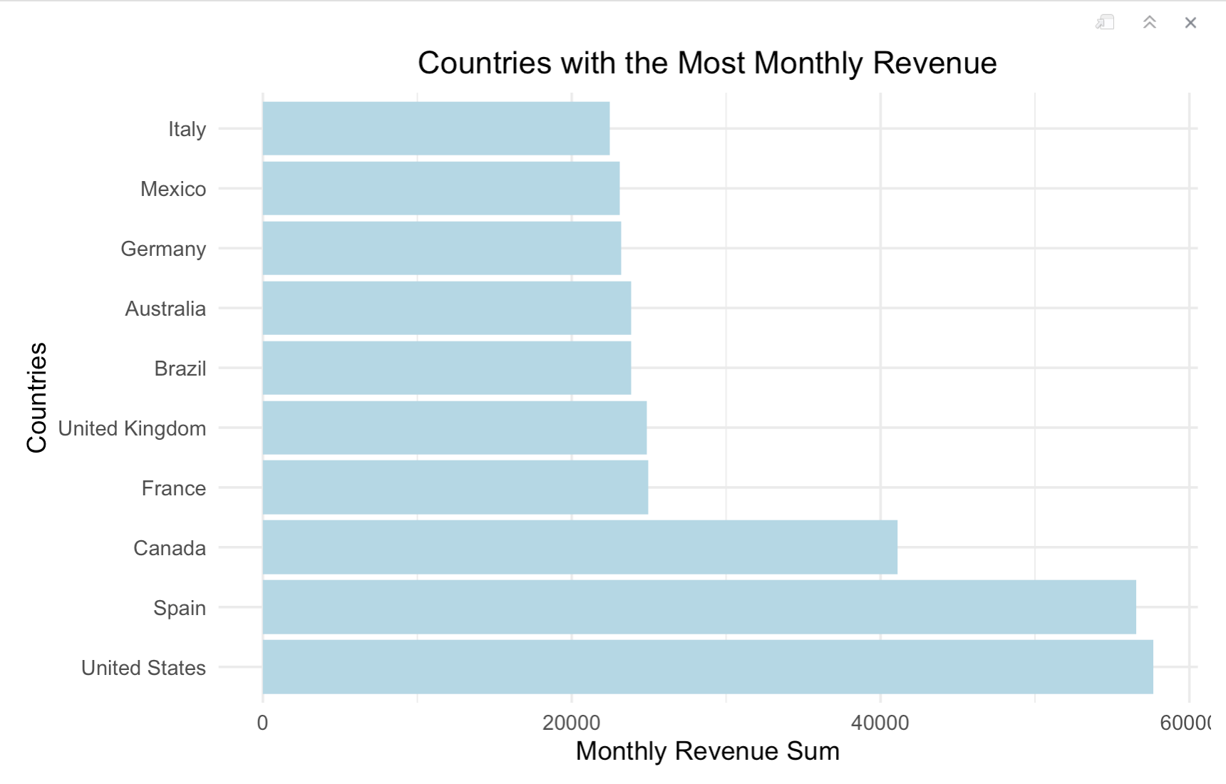
Monthly Revenue Analysis
Observations:
The top three countries are the same, but in different order. We can see that U.S generates the most revenue where it was ranked as the 2nd highest country with the most users. This can be attributed to the subscription breakdown per country.
We can also see more variance between revenue figures compared to user base.

Slide 21
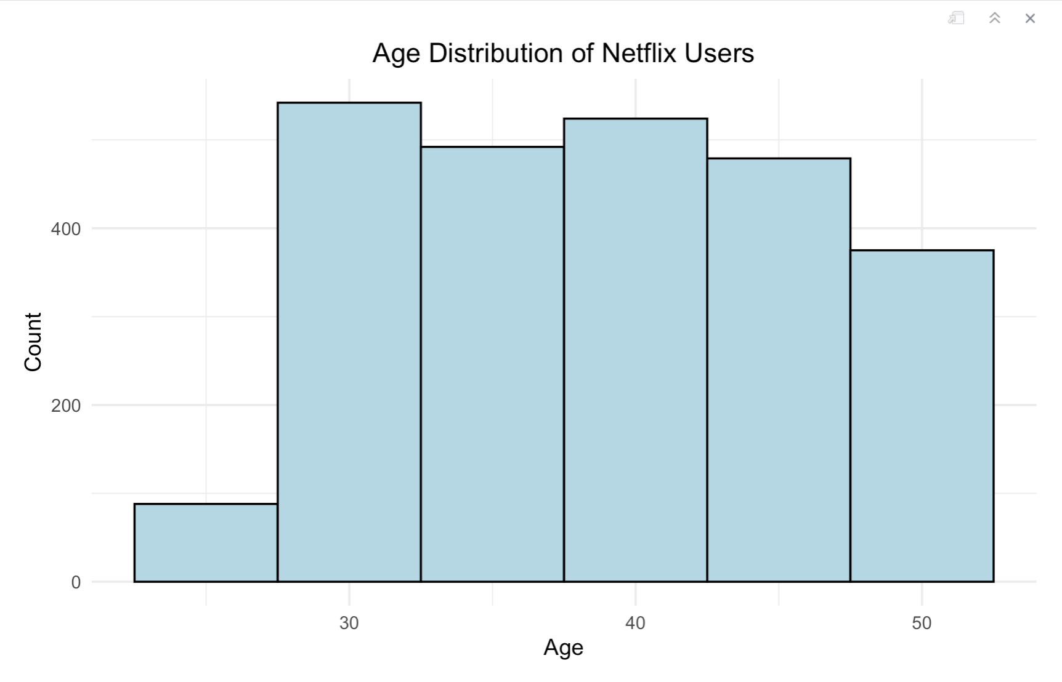
User Age Breakdown
Notes:
This can be used to make sure we are curating age appropriate titles. It can be a follow-on study to see if people who are above 45 prefer titles from their childhood, alluding to a nostalgic title preference. This type of study could show that Pop-culture hits may be worth on-boarding to the streaming service.

Slide 22
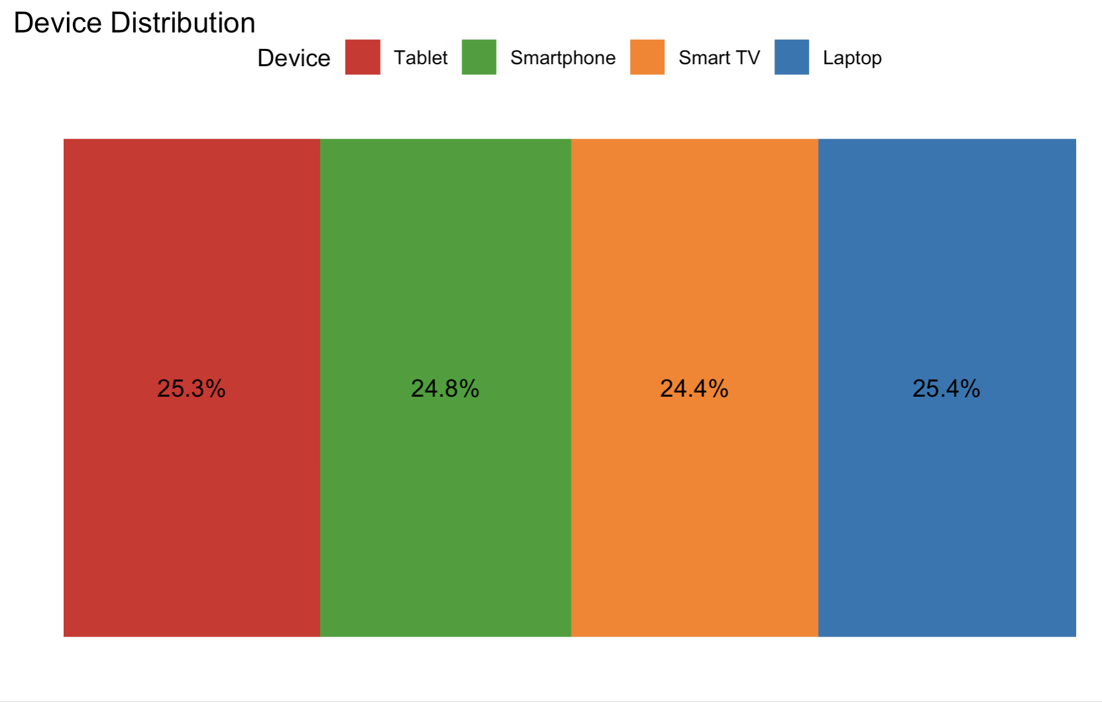
Device breakdown

Slide 23
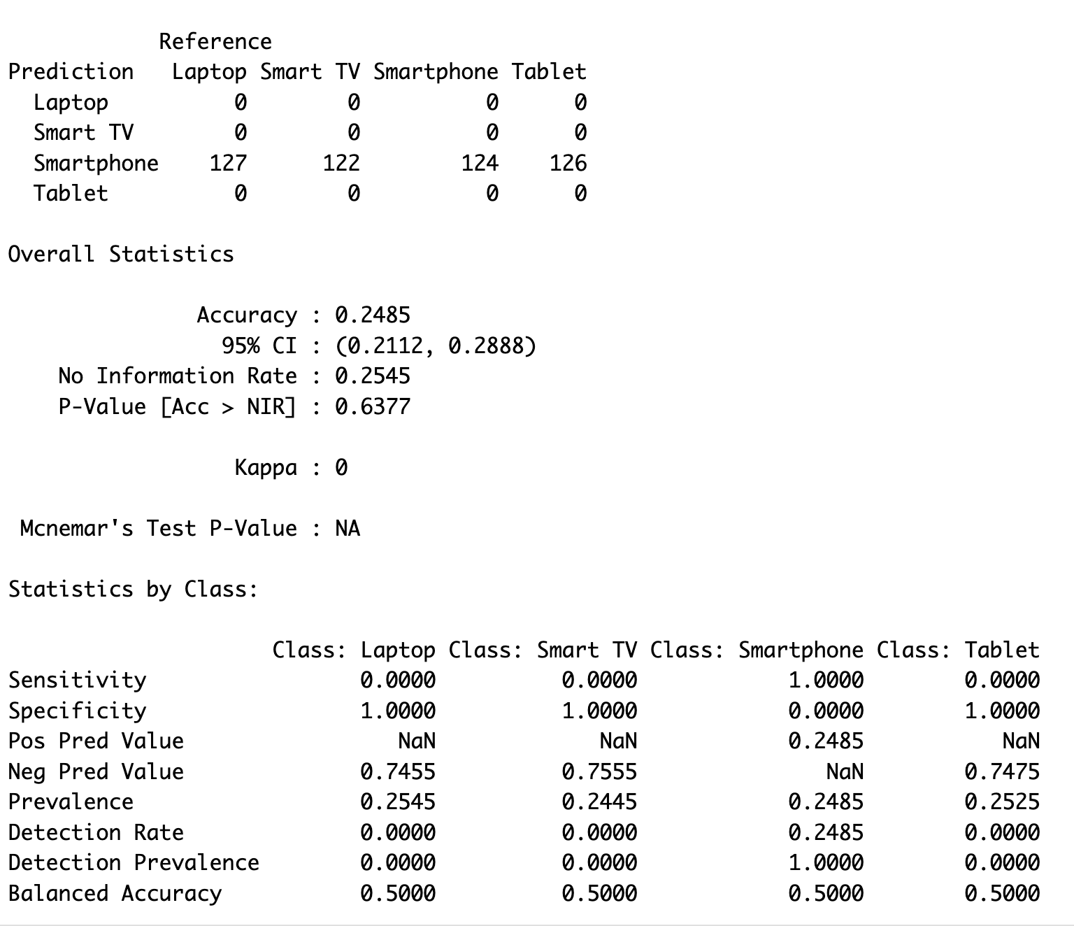
Device Breakdown – Model
Accuracy: This is the overall accuracy of the model, which measures the proportion of correctly classified instances. In this case, the accuracy is 0.2485, which is quite low.
95% CI: The 95% confidence interval for accuracy.
No Information Rate (NIR): The accuracy that would be achieved by predicting the majority class for all instances. In this case, it's 0.2545.
P-Value [Acc > NIR]: The p-value associated with comparing the model's accuracy to the No Information Rate. It suggests whether the model performs significantly better than random guessing.
Notes:
Created a classification model to predict device as a function of subscription type, Country, Gender and Age.
Overall, the confusion matrix and associated statistics indicate how well the model is performing for each class. In this case, the model is struggling to correctly classify instances into most classes, which may require further model tuning or data preprocessing.

Slide 24
Derived insight from User Behavior
Notes:
This is a section that helps us understand the top-level informaiton in the data set – country user base, number of users per subscription type, monthly revenue and device breakdown.
Utilizing this type of top-level analysis approach first allows us to understand what further analysis can be conducted.

Slide 25
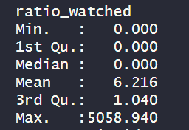
Majority are not watched fully
Majority of programs are skipped over not to be watched, ~50%
Not until the 3rd Quartile are programs fully consumed
Binge watched to the point of health concern

Slide 26
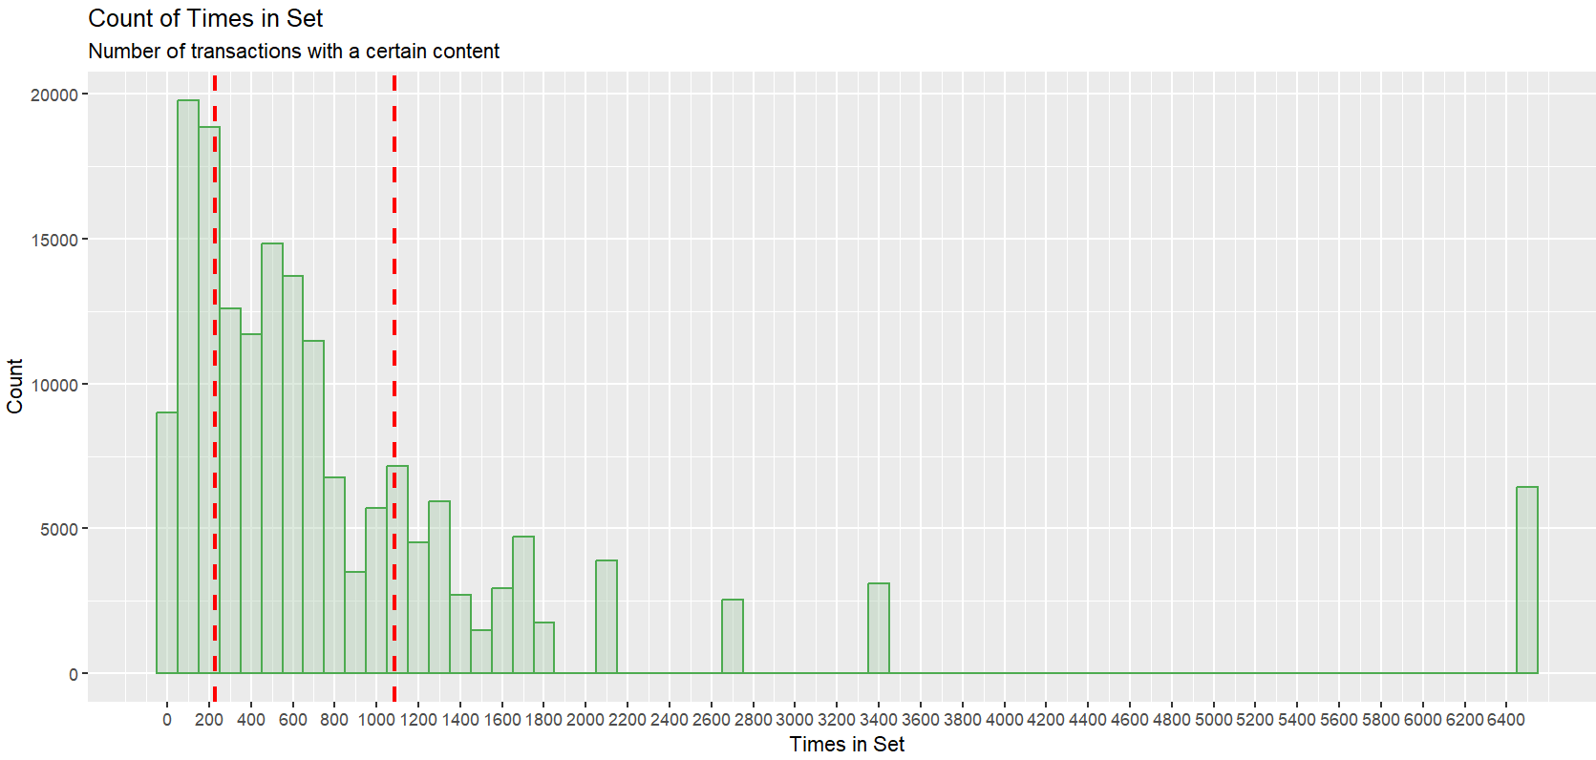
Associative Rules Mining – Pre-Process
Initial Dataset – 175037 observations of 10 variables.
Most variables are character information
Information must be transformed into factorial information, then to transactions.
Some variables have to be discretized.

Slide 27
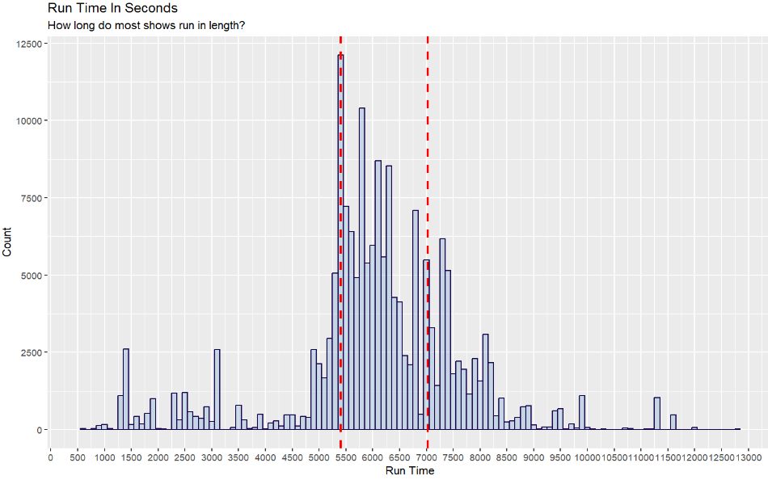
Associative Rules Mining – Pre-Process
Times.in.set
Tmdb_popularity
Ratings scores
Run_time –
Less than 1 HR
1-2 HR
2-3 Hour Extended Cut
I live here now
Release year
Most programming is running between 1.5 to 2 hours in length.

Slide 28
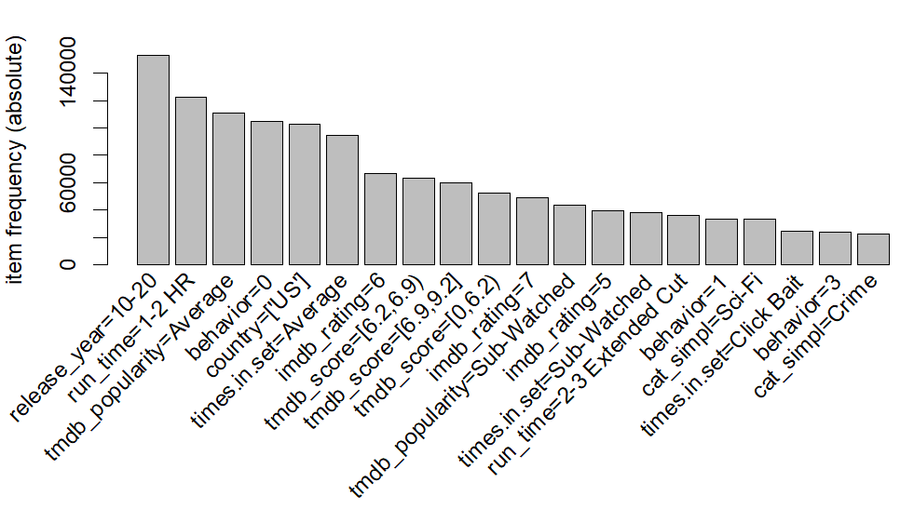
Associative Rules Mining – Changes to the Question
Highly dimensional dataset, provides few clear results
Most programs are skipped over.
Most content is between 3-13 years old.
Rotten tomatoes database, tmdb is more likely to predict a skipped program with a low score than imdb.
Most clicked on programming is currently in the Sci-Fi or Crime realms.
Most common factors for a given transaction – Full data set..

Slide 29
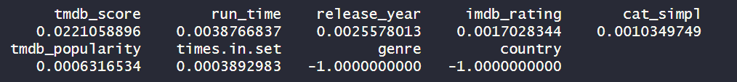
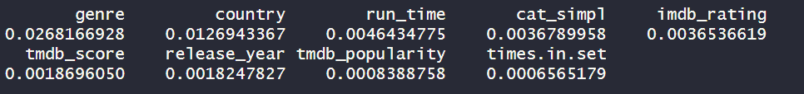
Associative Rules Mining – CORElearn Changes to the Question
Using attribute evaluation we found that the most influential variable that provided the highest information gain ratio was the Rotten Tomato database score. All other variables seemed to provide only a fraction of a perfect.
Raw information gain had influence from genre and country of production with exponentially less from run_time.
Most common factors for a given transaction – Full data set..

Slide 30
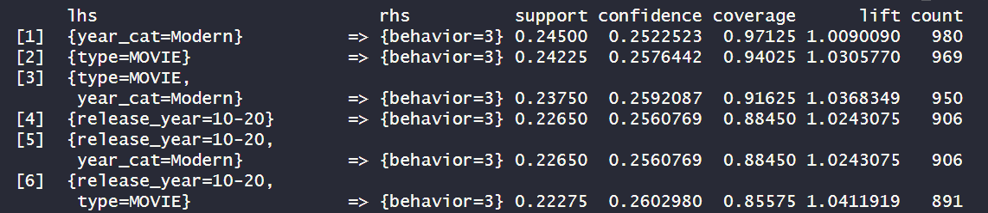
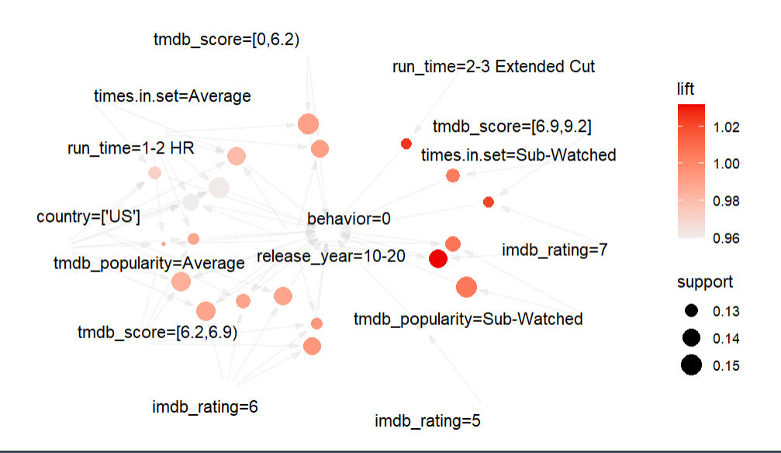
Associative Rules Mining – Initial Problems
Looking at high confidence, high support transactions for the whole set only provides a glimpse of the most common characteristics of transactions.
Not what factors are most contributing to behavior – cat 3

Slide 31
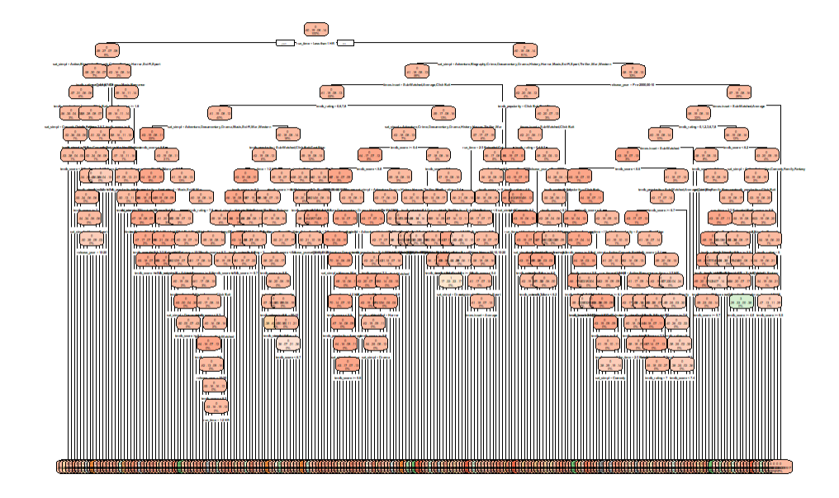
Associative Rules Mining – Quick Note
Decision tree modeling also became unreadable, and unusable in this format.
It became over modeled.

Slide 32
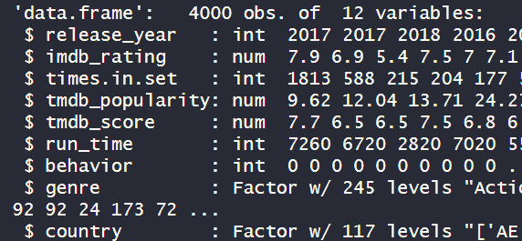
Associative Rules Mining – Redesign Data
Generated a much friendlier data set of 1000 observations of each type of behavior. (0,1,2,3).
Sample were generated randomly using the sample.int() function.
This created the abbreviated dataset that was referred to as “short_flix”.

Slide 33
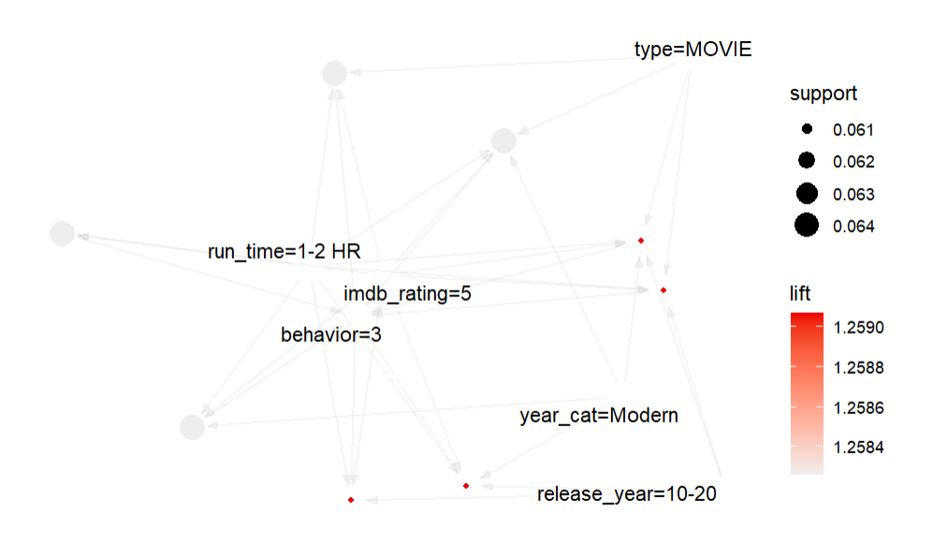
Associative Rules Mining – Shortflix
Shortflix brought significantly more identifiable results, and conclusive results.
The highest rules of note indicated that “binge watching behavior” (3) were more common with older, less acclaimed programming.
Modern movies between 3 and 13 years old between 1-2 hours of runtime, and rated with middling score. Rules with highest support, and lift.

Slide 34
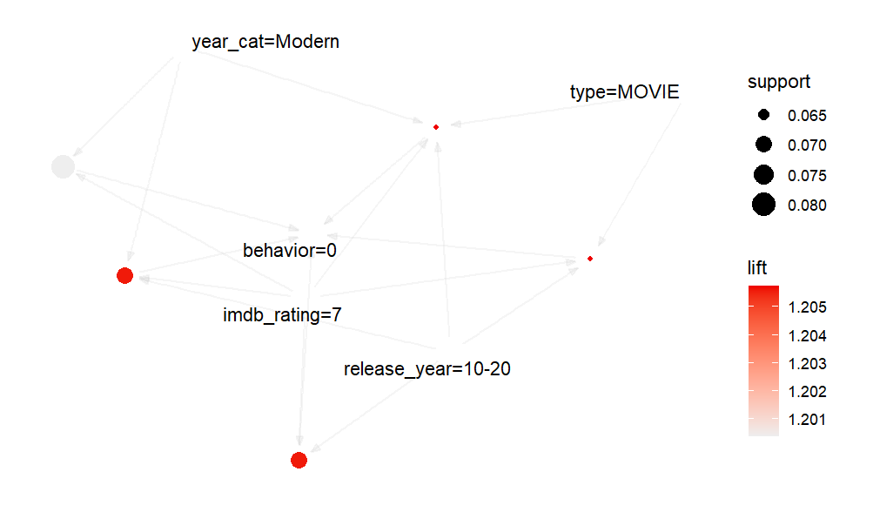
Associative Rules Mining – Skipped
Programming that was most likely to be skipped over were the higher rated movies on IMDB.
The IMDB score clearly does not seem to reflect what an audience wants.
Rules for watched behavior (2) showed higher influence from the rotten tomato, with both higher lift and support (>1 and >.15 respectively) for movies made in the US.

Slide 35
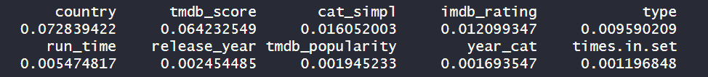
Associative Rules Mining – Information Gain
Greatest information gain was generated through the determination of the country of origin and Rotten Tomato score

Slide 36
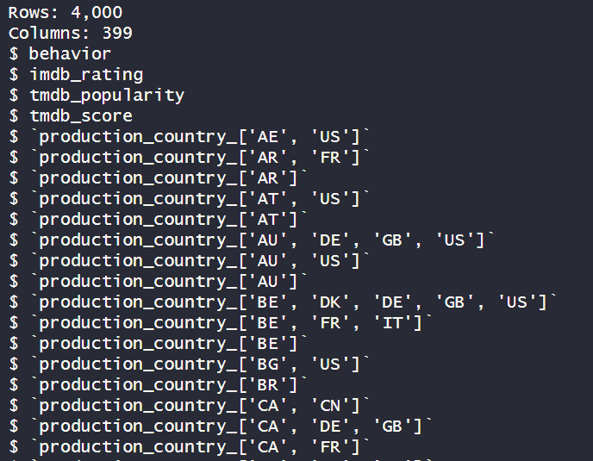
kNN Modeling – Re-Design 2
Attempts to use the factoral dataset in other models failed to produce meaningful results.
IOT utilize other models, the data had to be rebuilt to utilize numeric architecture.
Rebuilt short_flix to utilize dummy variables IOT assess categorical, discrete, information in a continuous way.

Slide 37
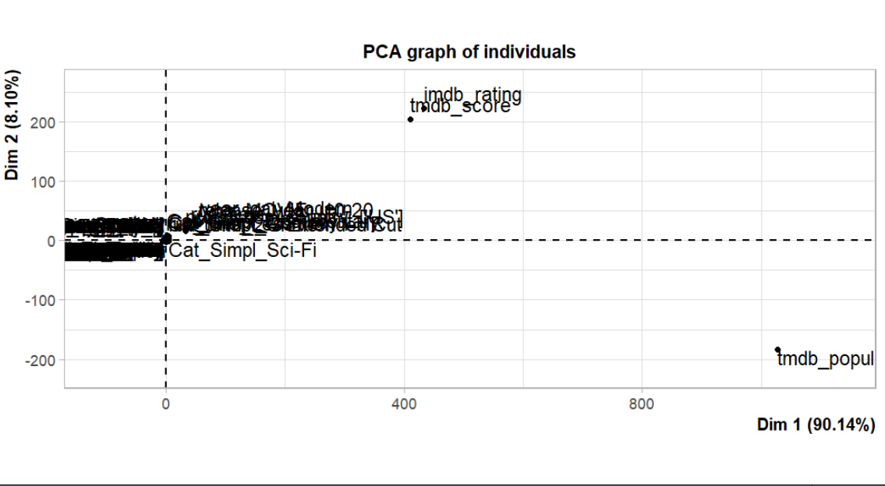
kNN Modeling – Re-Design 2
Primary component analysis failed to provide actionable results as the function obfuscates variable names.
Some outlier attributes did manage to leave the word jumble as being significant towards prediction.
Looking back, it is curious what the results would have been on a four attribute dataset.

Slide 38
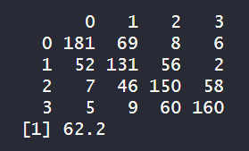
kNN Modeling – Results
Utilizing 17 closest neighboring datapoints, the predictive algorithm topped out for optimization at 62.2 percent accuracy.
This is better than randomly guessing, but may not be business accurate in identifying whether or not someone would binge watch a show.
SVM Models were not successful suggesting a further redesign of the data structure would be needed.

Slide 39
Conclusions
Many factors, including social ones, that influence audience behavior to streaming content.
Seems definitive that older content gets rewatched more than newer content.
RTDB was a better leading predictor of audience behavior than the IMDB database.

