Slide 1
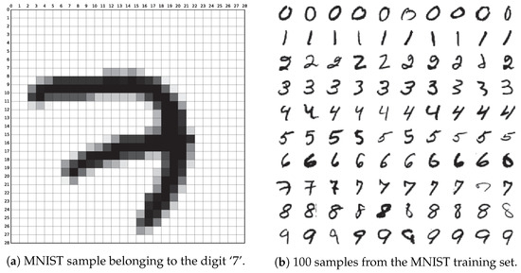
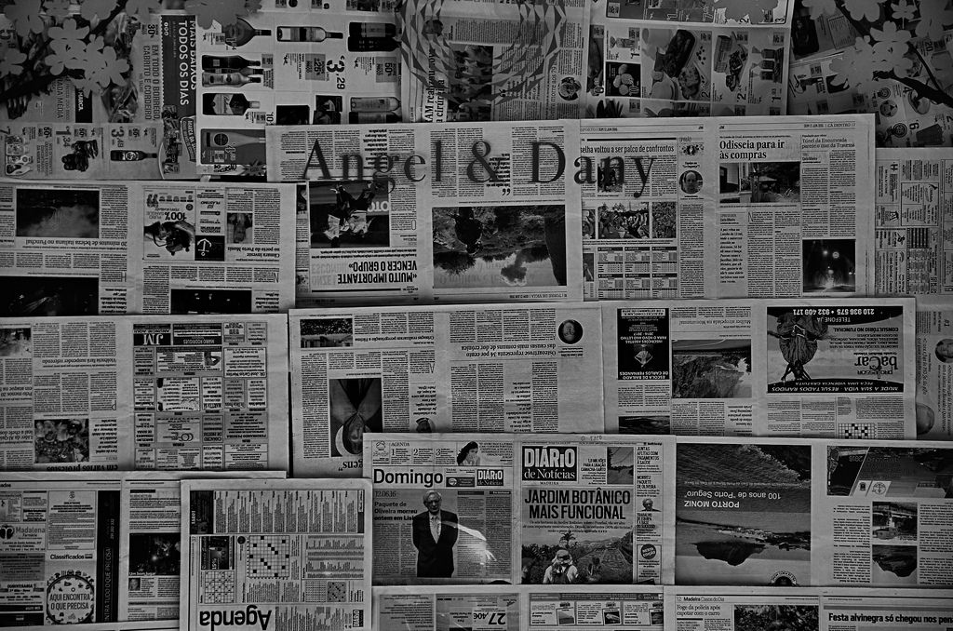
Application of the Lottery Ticket Hypothesis in NLP and Early Pruning
Intermission
Source:
https://www.mdpi.com/applsci/applsci-09-03169/article_deploy/html/images/applsci-09-03169-g001-550.jpg
Source:
https://www.bonaccorso.eu/wp-content/uploads/2016/07/28019400581_e1eb13ccc8_b.jpg
Tim Unverzagt

Slide 2
Structure
Introduction
Motivation
Related Work
Task Definition
Progress
Remaining Work

Slide 3
Structure
Introduction
Motivation
Context of the thesis
Related Work
Task Definition
Progress
Content of the thesis
Remaining Work

Slide 4
Introduction – Lottery Tickets
Int
Context of Deep Learning
Good reasons to initialize & train neural networks with many parameters
Most networks can be reduced after training while maintaining performance
"Pruning"
Mot
Rel
Task
Pro
Rem

Slide 5
Introduction – Lottery Tickets
Int
Context of Deep Learning
Good reasons to initialize & train neural networks with many parameters
Most networks can be reduced after training while maintaining performance
"Pruning"
Main Question:
"How important are the pruned weights during training?"
Mot
Rel
Task
Pro
Rem

Slide 6
Introduction – Lottery Tickets
Int
Hypothesis
Sheer number of subnetworks results in subnetworks with favorable initialization
Mot
Rel
Task
Pro
Rem

Slide 7
Introduction – Lottery Tickets
Int
Hypothesis
Sheer number of subnetworks results in subnetworks with favorable initialization
Extraction of "lottery-ticket" after the full network is trained
Pruning weights based on magnitude finds a lottery ticket
Mot
Rel
Task
Pro
Rem

Slide 8
Introduction – Lottery Tickets
Int
Hypothesis
Sheer number of subnetworks results in subnetworks with favorable initialization
Extraction of "lottery-ticket" after the full network is trained
Pruning weights based on magnitude finds a lottery ticket
Train a subnetwork with initial parameters
Similar performance ==> "lottery ticket"
Mot
Rel
Task
Pro
Rem

Slide 9
Motivation
Int
Mot
Rel
Task
Pro
Rem

Slide 10
Motivation
Int
Time & Memory
Speedup during execution just as regular pruning
But remarkable compression rate: up to ~50x
Decrease in memory usage during execution
Possible speedup during development
There might be a way to identify lottery tickets early
Mot
Rel
Task
Pro
Rem

Slide 11
Motivation
Int
Time & Memory
Speedup during execution just as regular pruning
But remarkable compression rate: up to ~50x
Decrease in memory usage during execution
Possible speedup during development
There might be a way to identify lottery tickets early
Theory of Neural Networks
"Lottery-tickets" contain weights necessary for training
Identification of "lottery-tickets" might explain importance of weights
Mot
Rel
Task
Pro
Rem

Slide 12
Related Work
Int
Mot
Rel
Task
Pro
Rem

Slide 13
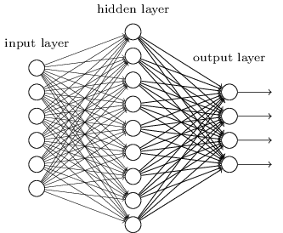
Related Work – Background
Int
Fully Connected Neural Network
Mot
Rel
Task
Pro
Rem
Source:
https://hackernoon.com/hn-images/1*Kdnux0Kw1yQ4D8dq__mYCA.png

Slide 14
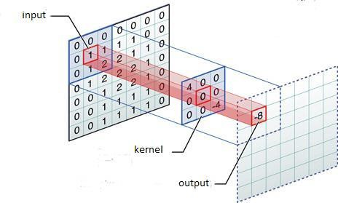
Related Work – Background
Int
Convolution in Neural Networks
Mot
Rel
Task
Pro
Rem
Source:
https://miro.medium.com/proxy/0*dRD6PhKOnnCIhz15.jpg

Slide 15
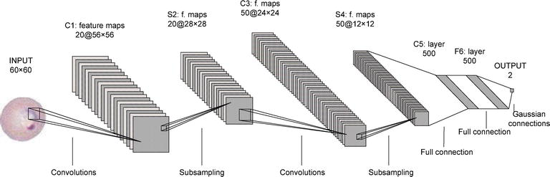
Related Work – Background
Int
Convolutional Neural Network Architecture (Lenet-5)
Mot
Rel
Task
Pro
Source:
https://api.intechopen.com/media/chapter/58989/media/F4.png
Rem

Slide 16
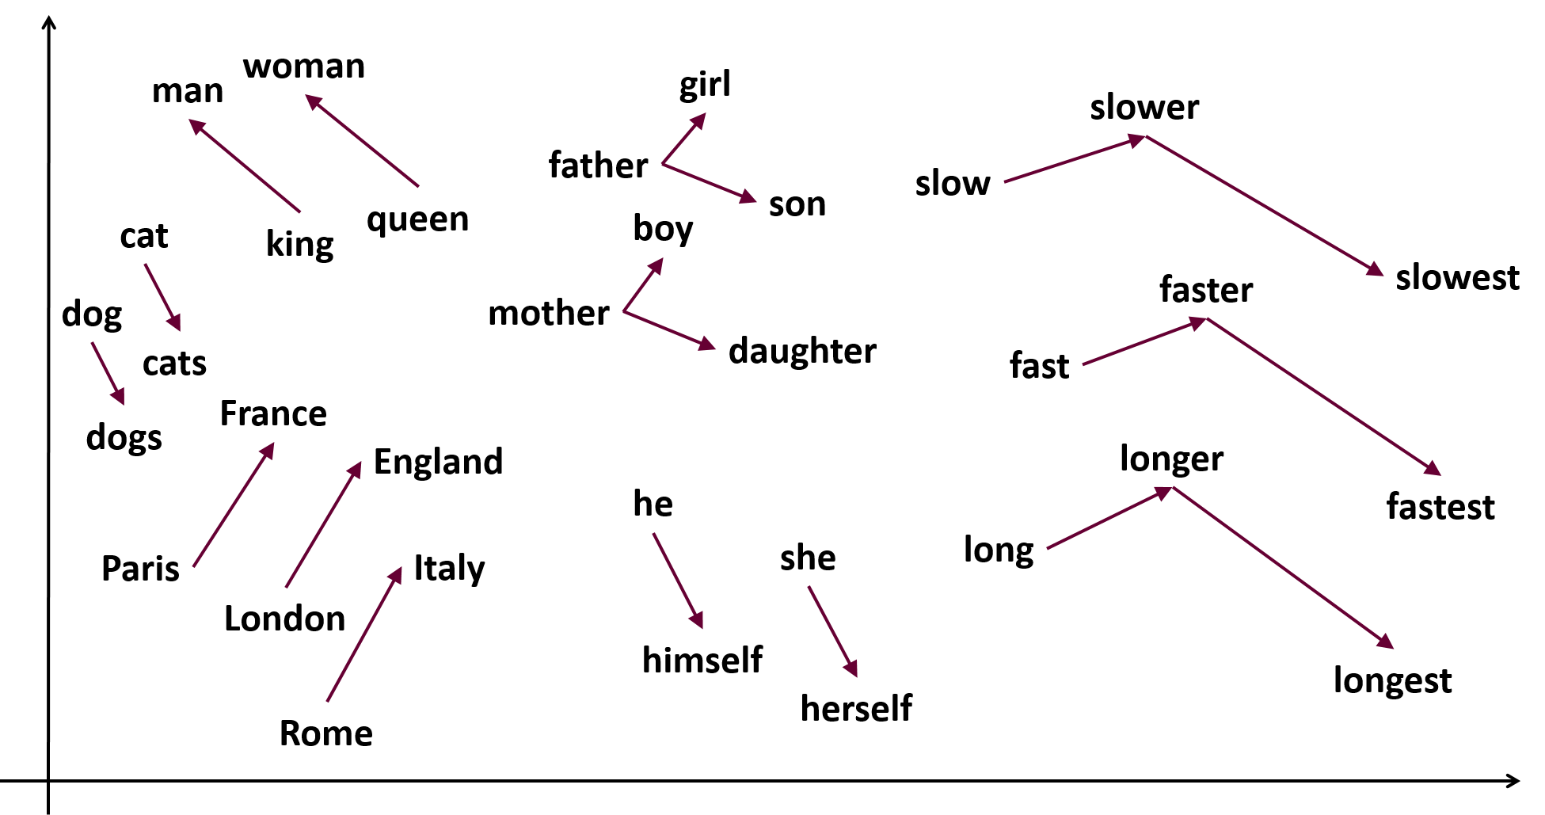
Related Work – Background
Int
Language Models
Mot
Rel
Task
Pro
Rem
Source:
https://samyzaf.com/ML/nlp/word2vec2.png

Slide 17
Related Work – Background
Int
Language Models
Mot
Rel
Task
Pro
Rem
Source:
https://samyzaf.com/ML/nlp/word2vec2.png

Slide 18
Related Work – CNN in NLP
Int
"Convolutional Neural Networks for Sentence Classification"
2014
Task:
Varying Classifications
Datasets:
Movie reviews
SST-1, SST-2
Subjectivity dataset
TREC question dataset
Customer reviews
MPQA
Mot
Rel
Task
Pro
Rem

Slide 19
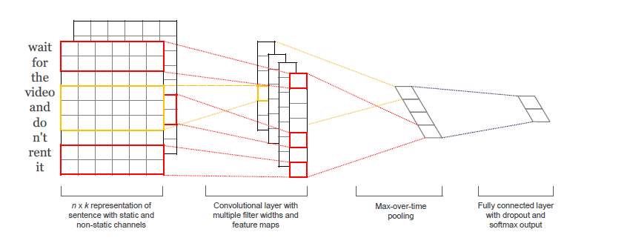
Related Work – CNN in NLP
Int
"Convolutional Neural Networks for Sentence Classification"
Mot
Rel
Task
Pro
Rem
Source:
"Convolutional Neural Networks for Sentence Classification"
Figure 1

Slide 20
Related Work – Background
Int
Mot
Rel
Task
Pro
Rem

Slide 21
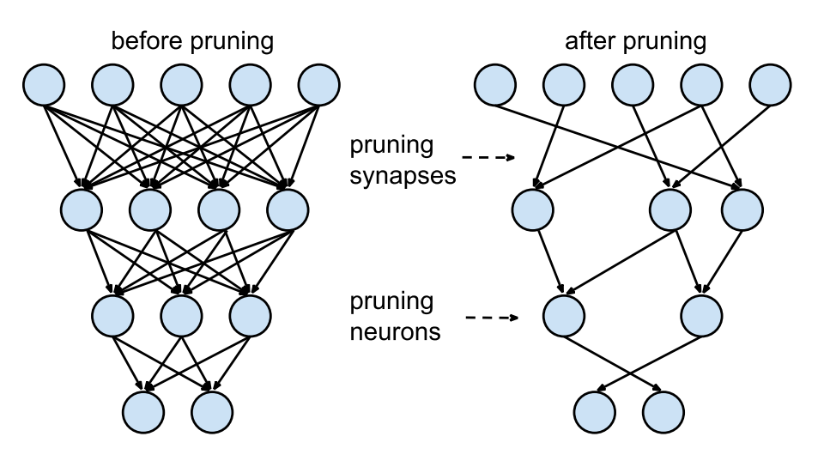
Related Work – Background
Int
Mot
Rel
Task
Pro
Rem
Source:
https://www.mdpi.com/applsci/applsci-09-03169/article_deploy/html/images/applsci-09-03169-g001-550.jpg
"Learning both Weights and Connections for Efficient Neural Networks"
Figure.3

Slide 22
Related Work – Pruning
Int
"Learning both Weights and Connections for efficient Neural Networks"
2015 | Song Han et. al.
Task:
Image Classification (ImageNet)
Architectures:
LeNet (300-100-FC, 5-CNN)
AlexNet
VGG-16
Compression:
9x to 13x
Mot
Rel
Task
Pro
Rem

Slide 23
Related Work – Pruning
Int
"ThiNet: A Filter Level Pruning Method for Deep Neural Network Compression"
2017 | Jian-Hao Luo et. al.
Task:
Image Classification (ImageNet)
Architectures:
VGG-16
ResNet-50
Compression:
Up to ~17x
Mot
Rel
Task
Pro
Rem

Slide 24
Related Work – Pruning
Int
"The Lottery Ticket Hypothesis: Finding Sparse, Trainable Neural Networks"
2019 | J. Frankle & M. Carbin
Task:
Image Classification (MNIST)
Architectures:
Lenet-FCN (300-100-FCN)
Simple CNN (Conv-2, Conv-4, Conv-6)
VGG-19
ResNet-18
Compression: ~20x to ~50x
Mot
Rel
Task
Pro
Rem

Slide 25
Related Work – Early Pruning
Int
"Really should we pruning after model be totally trained? Pruning based on a small amount of training"
2019 | Yue Li et. Al.
Task:
Image Classification (MNIST, CIFAR-10)
Architectures:
Unspecified CNN
VGG-19
Compression --- Training Speed-Up:
~10x --- 10x
Mot
Rel
Task
Pro
Rem

Slide 26
Related Work – Network Architecture Search
Int
Mot
Rel
Task
Pro
Rem

Slide 27
Related Work – Network Architecture Search
Int
"Rethinking the Value of Network Pruning"
2018 | Anonymous Author
Observations:
Randomizing weights does not worsen a pruned network
Weights are not essential to the quality of pruned network
Pruning at its core is about finding suitable network architectures
Mot
Rel
Task
Pro
Rem

Slide 28
Related Work – Network Architecture Search
Int
"Network Architecture Search: A Survey"
2019 | Thomas Elsken et. al.
Categorization of NAS-Algorithms:
Search Space:
Space of possible architectures
Search Strategy:
Policy while traversing the space
Performance Estimation Strategy:
Without knowledge of the "full" network
Mot
Rel
Task
Pro
Rem

Slide 29
Related Work – Network Architecture Search
Int
"Deconstructing Lottery Tickets: Zeros, Signs, and the Supermask"
2019 | Hattie Zhou et. al.
Alteration of the Search Strategy (based on Magnitude):
large final (original strategy)
small final
large initial
small initial
large init & large final
small initial & small final
magnitude increase
movement
random (baseline strategy)
Mot
Rel
Task
Pro
Rem

Slide 30
Related Work – Network Architecture Search
Int
"Deconstructing Lottery Tickets: Zeros, Signs, and the Supermask"
2019 | Hattie Zhou et. al.
Alteration of the Search Strategy (based on Magnitude):
large final (original strategy)
small final
large initial
small initial
large init & large final
small initial & small final
magnitude increase
movement
random (baseline strategy)
Mot
Rel
Task
Pro
Rem

Slide 31
Related Work – Network Architecture Search
Int
"Deconstructing Lottery Tickets: Zeros, Signs, and the Supermask"
2019 | Hattie Zhou et. al.
Alteration of the Search Strategy (based on Magnitude):
large final (original strategy)
small final
large initial
small initial
large init & large final
small initial & small final
magnitude increase
movement
random (baseline strategy)
Mot
Rel
large final & same sign
Task
Pro
Rem

Slide 32
Structure
Introduction
Motivation
Context of the thesis
Related Work
Task Definition
Progress
Content of the thesis
Remaining Work

Slide 33
Task I
Int
Reproduction
No source-code available
Produce own source-code
Verify source-code by running experiments from the paper
Lenet-FCN
CNN-4
VGG-18
Mot
Rel
Task
Pro
Rem

Slide 34
Task II
Int
Transfer to NLP
Original context for the paper
Task: Image Classification
Dataset: "MNIST"
Model: Varying FCN and CNN
Find comparable context in NLP
Task: Topic Classification
Dataset: "Reuters-21578"
Model: TBD
Check if the Lottery-Ticket-Hypothesis holds
Mot
Rel
Task
Pro
Rem

Slide 35
Task III
Int
Early Retrieval of Lottery Tickets
Original method
Keep all weights with large final weights
Reset weights to original initial value
Retrain network
Repeat (Optional)
Adaptation
"Select" weights earlier ~ develop early stopping criteria
Keep weights based on other metrics (Optional)
Mot
Rel
Task
Pro
Rem

Slide 36
Progress – Python-project
Int
Experiments
Mot
datapoints
mask weights
Dataset-I/O
build
&
train
Masking
build
&
train
save
Rel
Network Wrapper
Results-I/O
Task
plot
Custom-Layers
Visualization
Pro
Rem

Slide 37
Progress – Backend
Int
Experiments
Mot
Dataset-I/O
Masking
Rel
Network Wrapper
Results-I/O
Task
Custom-Layers
Visualization
Pro
nltk
Rem
Gensim
Pickle
Tensorflow 2.0
Pickle
Pyplot

Slide 38
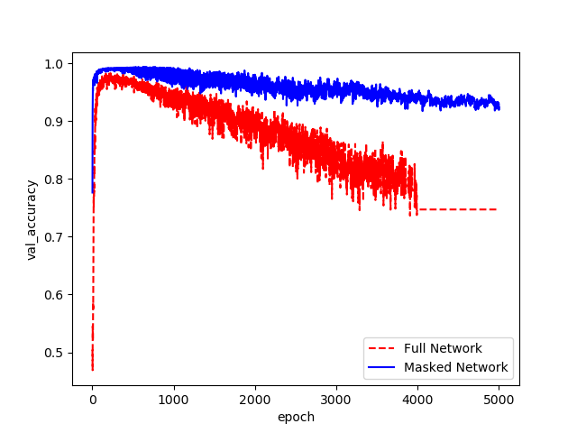
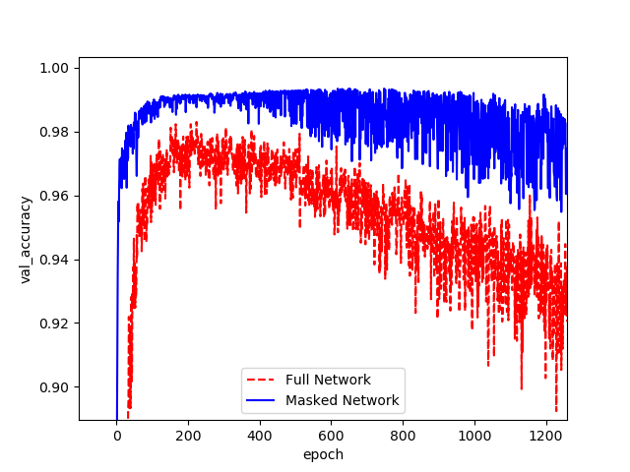
Progress – Experiments
Int
Lenet-FCN-MNIST
Validation-Accuracy
20% pruned weights
Mot
Rel
Task
Pro
Rem
Source:
Produced by the author
Source:
Produced by the author

Slide 39
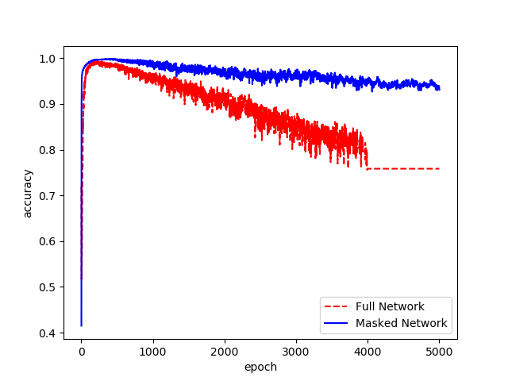
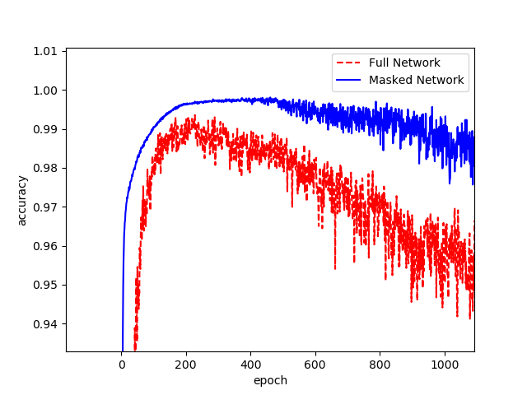
Progress – Experiments
Int
Lenet-FCN-MNIST
Training-Accuracy
Mot
Rel
Task
Pro
Rem
Source:
Produced by the author
Source:
Produced by the author

Slide 40
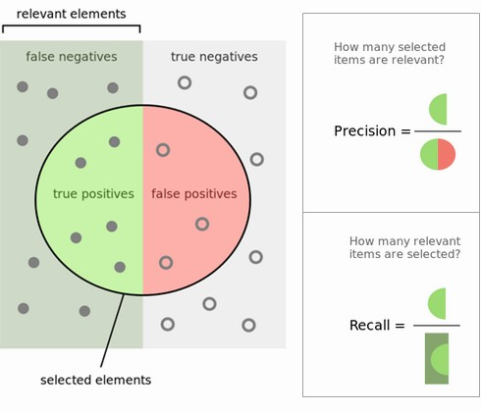
Progress – Background
Int
Mot
Rel
Task
Pro
Rem
Source:
https://www.kdnuggets.com/images/precision-recall-relevant-selected.jpg

Slide 41
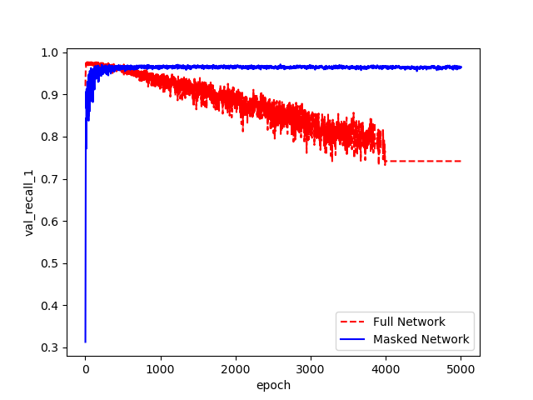
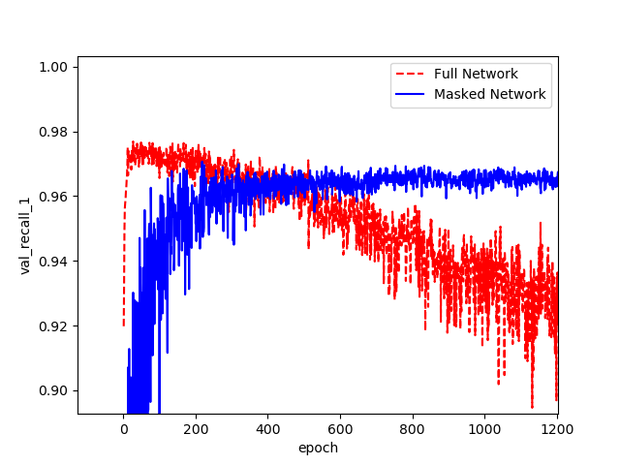
Progress – Experiments
Int
Lenet-FCN-MNIST
Validation-Recall
Mot
Rel
Task
Pro
Rem
Source:
Produced by the author
Source:
Produced by the author

Slide 42
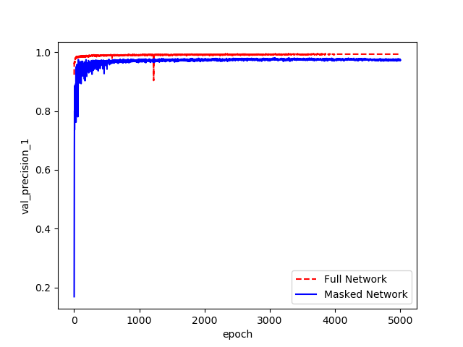
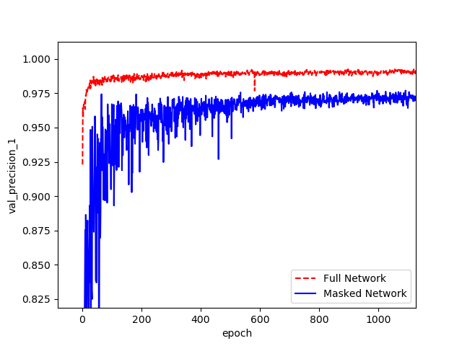
Progress – Experiments
Int
Lenet-FCN-MNIST
Validation-Precision
Mot
Rel
Task
Pro
Rem
Source:
Produced by the author
Source:
Produced by the author

Slide 43
Remaining Work
Int
Remaining parts of the framework
Custom Convolutional Layer
Support for iterative Pruning
More experiments
MNIST / CNN-4
MNIST / VGG-18
Reuters / TBD
MNIST / Lenet-FCN / Early Pruning
Mot
Rel
Task
Pro
Rem

Slide 44

Thank you for your attention! Questions?

