Slide 1
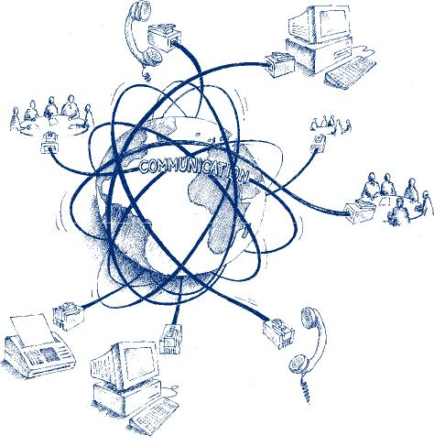
Seamless …….
……… @ KOM
Tim Unverzagt
Source: http://www.sycor-asia.com/opencms/as/products_services/complementary_services/Telecommunication/

Slide 2
Structure
Introduction
Motivation
Background & Related Work
Task Definition
Progress
Outlook

Slide 3
Structure
Introduction
Motivation
Context of the thesis
Background & Related Work
Task Definition
Progress
Content of the thesis
Outlook

Slide 4
Introduction I
Int
Neural Networks
Successful
Computationally expensive
In Execution (due to many weights)
Even more so in training
Lottery Ticket Hypothesis
Many networks in use atm are overloaded (too many weights)
From the moment of initialization there are smaller subnetworks that perform similar given the same amount of training
These subnetworks can be deduced from the weights of the main network after it has concluded its training
Mot
B&R
Task
Pro
Out

Slide 5
Motivation I
Int
Executability
During Use
Trainability
During Development
Mot
B&R
Task
Pro
Out

Slide 6
Background I
Int
Feed-forward Neural Networks
...
Convolutional Neural Networks
...
Image Classification
...
Mot
B&R
Task
Pro
Out

Slide 7
Related Work I
Int
Pruning
...
Network Arichtecture
...
Mot
B&R
Task
Pro
Out

Slide 8
Task I
Int
Reproduction
On MNIST
Transfer
To Reuters-???
Find Sensible model in using FFNN or CNN
Mot
B&R
Task
Pro
Out

Slide 9
Progress I
Int
Python-project
Data-flow
Find Sensible model in using FFNN or CNN
Experiments
...
...
Mot
B&R
Task
Pro
Out

Slide 10
Progress I
Int
More custom-layers
CNN!
...
More experiments
...
...
Mot
B&R
Task
Pro
Out

Slide 11

Thank you for your attention! Questions?

