Slide 1
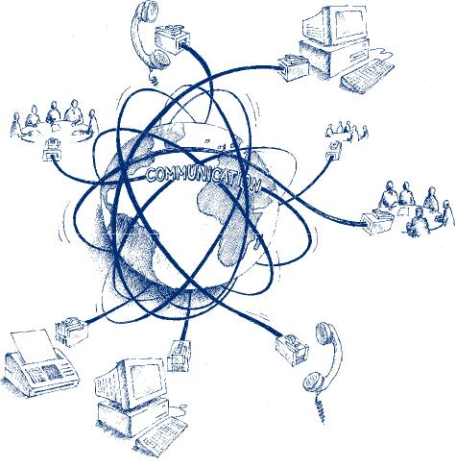
Seamless …….
……… @ KOM
Tim Unverzagt
Source: http://www.sycor-asia.com/opencms/as/products_services/complementary_services/Telecommunication/

Slide 2
Structure
Introduction
Motivation
Background & Related Work
Task Definition
Progress
Outlook

Slide 3
Structure
Introduction
Motivation
Context of the thesis
Background & Related Work
Task Definition
Progress
Content of the thesis
Outlook

Slide 4
Introduction I
Int
Lottery Ticket Hypothesis
Many networks in use atm are overloaded (too many weights)
From the moment of initialization there are smaller subnetworks that perform similar given the same amount of training
These subnetworks can be deduced from the weights of the main network after it has concluded its training
Mot
B&R
Task
Pro
Out

Slide 5
Motivation I
Int
Executability
During Use
Trainability
During Development
Mot
B&R
Task
Pro
Out

Slide 6
Background
Int
Feed-forward Neural Networks
...
Convolutional Neural Networks
...
Image Classification
...
Mot
B&R
Task
Pro
Out

Slide 7
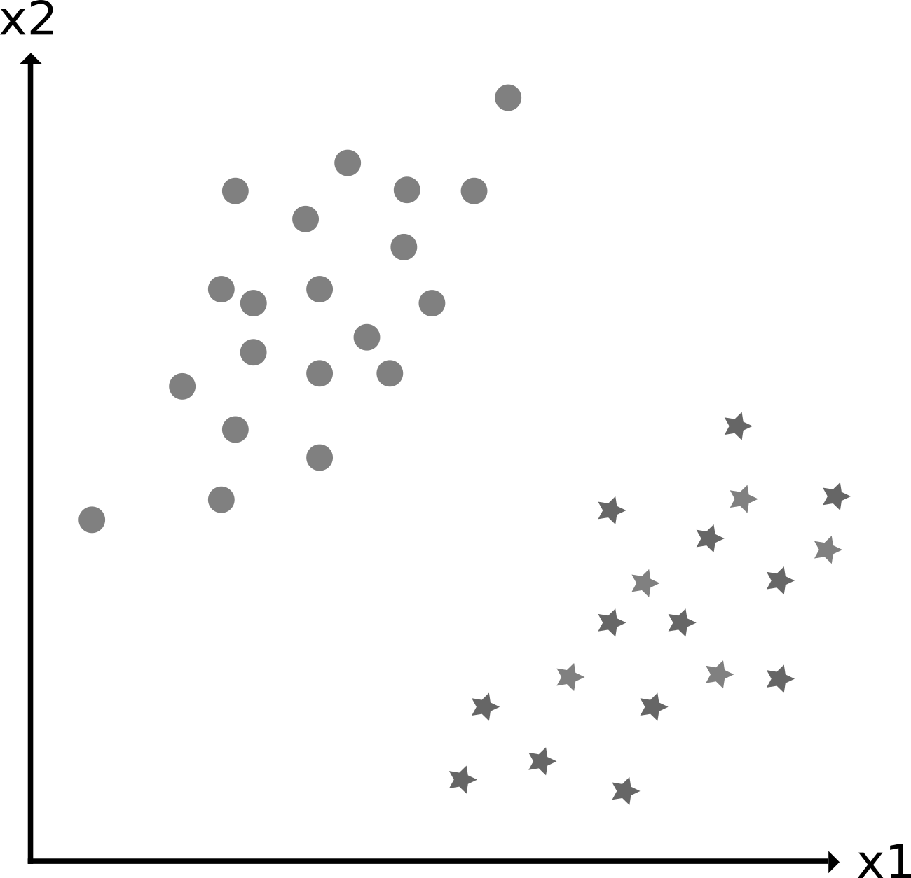
Background – Unsupervised Learning
Int
Mot
B&R
Task
Pro
Out
Source: Produced by the author

Slide 8
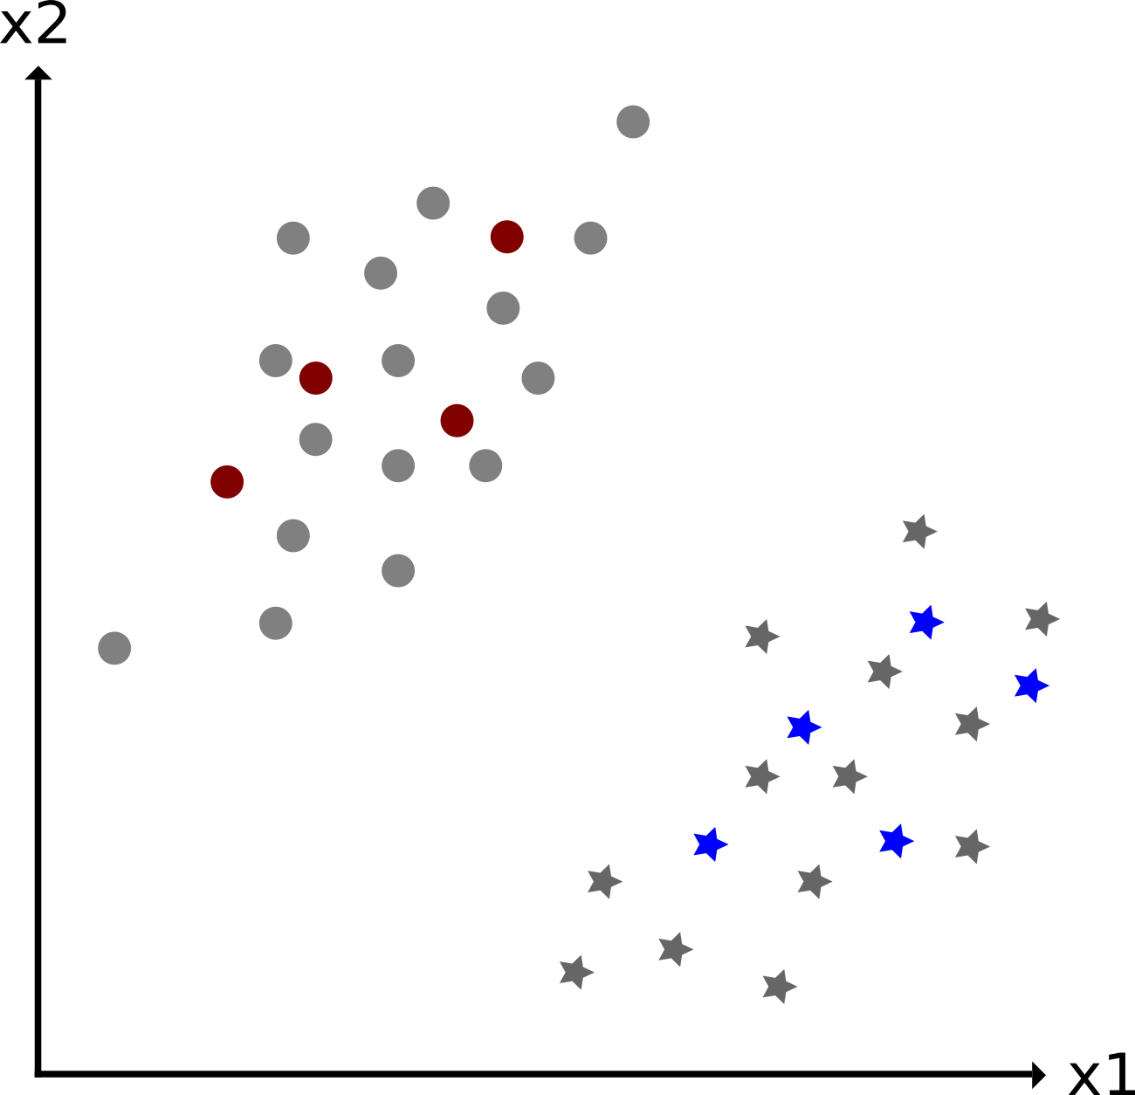
Background – Unsupervised Learning
Int
Mot
B&R
Task
Pro
Out
Source: Produced by the author

Slide 9

Background – Unsupervised Learning
Int
Mot
B&R
Task
Pro
Out
Source: Produced by the author

Slide 10
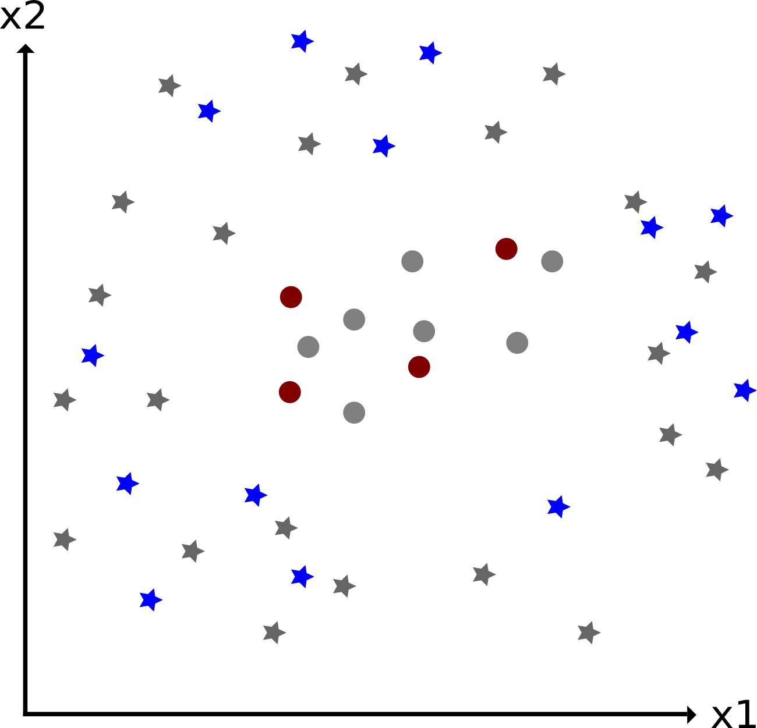
Background – Unsupervised Learning
Int
Mot
B&R
Task
Pro
Out
Source: Produced by the author
Source: Produced by the author

Slide 11
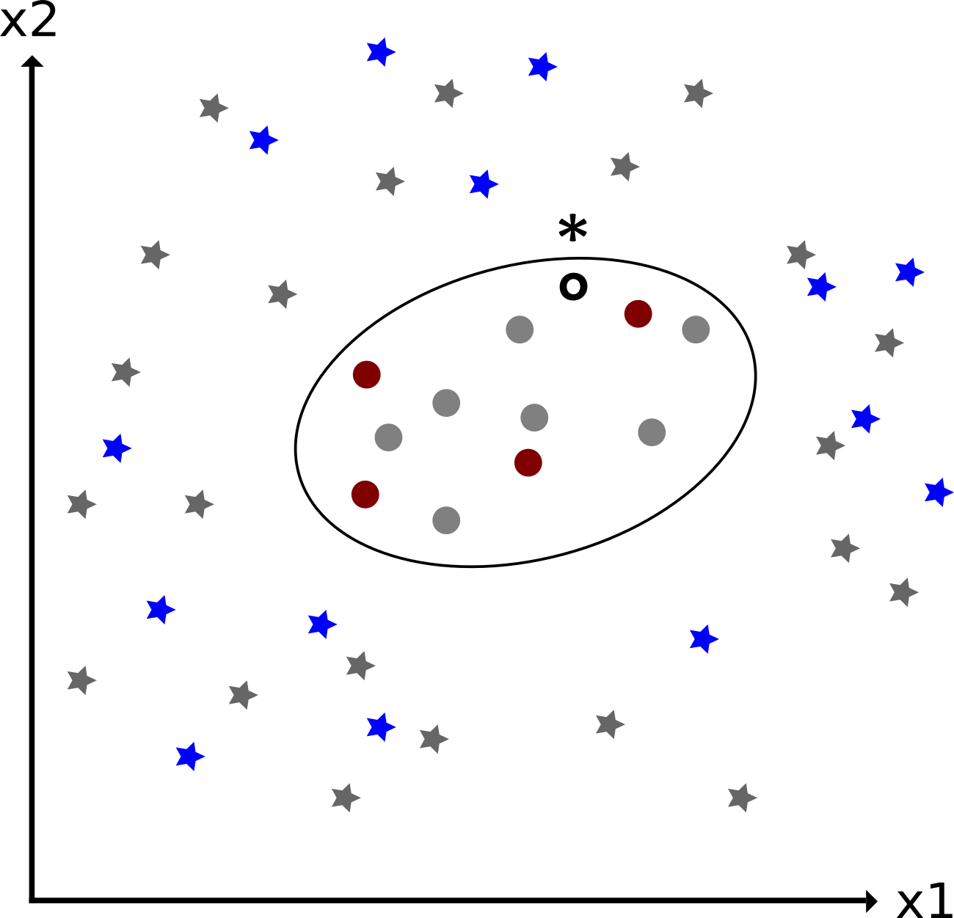
Background – Unsupervised Learning
Int
Mot
B&R
Task
Pro
Out
Source: Produced by the author
Source: Produced by the author

Slide 12
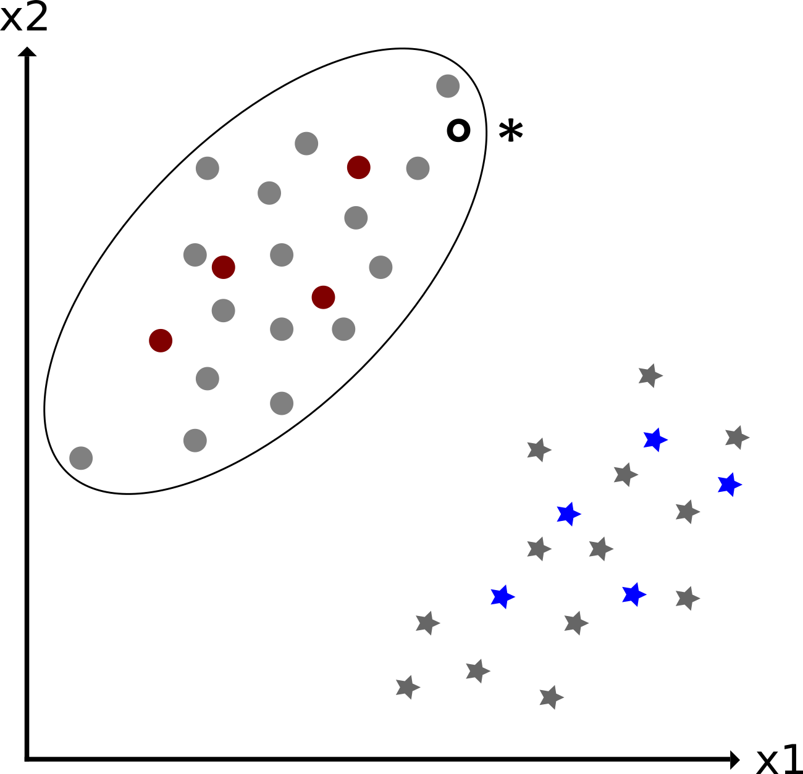
Background – Unsupervised Learning
Int
Mot
B&R
Task
Pro
Out
Source: Produced by the author
Source: Produced by the author

Slide 13
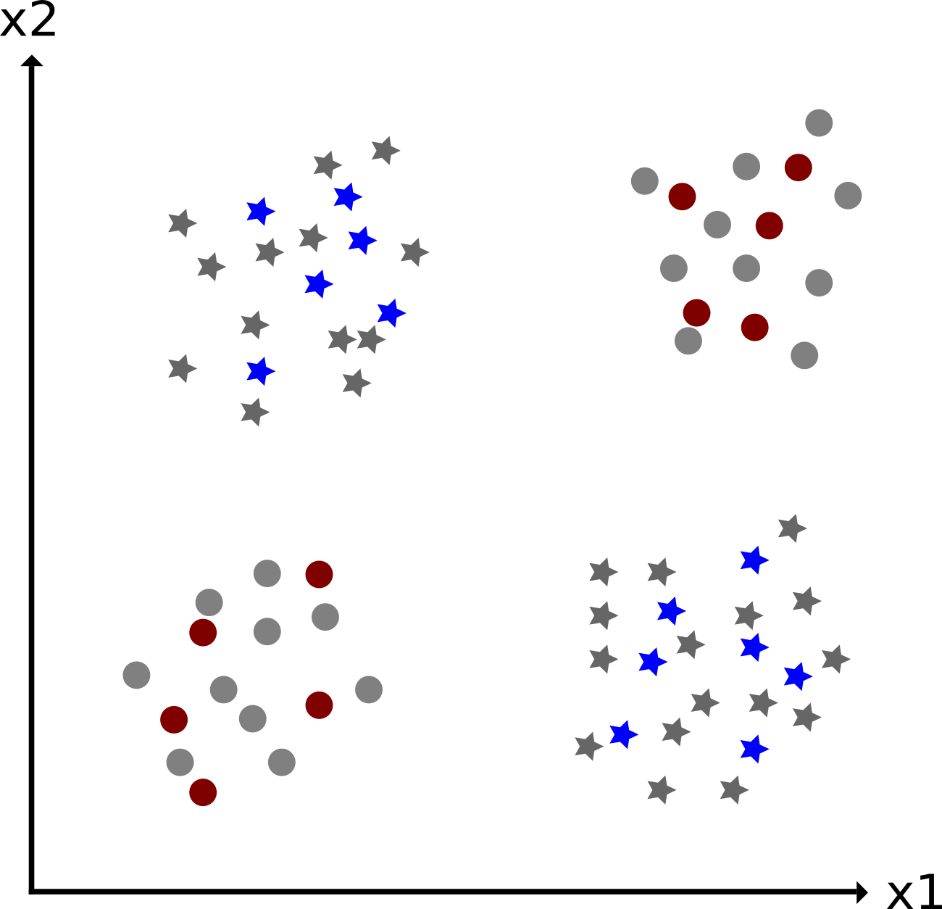
Background – Unsupervised Learning
Int
Mot
B&R
Task
Pro
Out
Source: Produced by the author

Slide 14
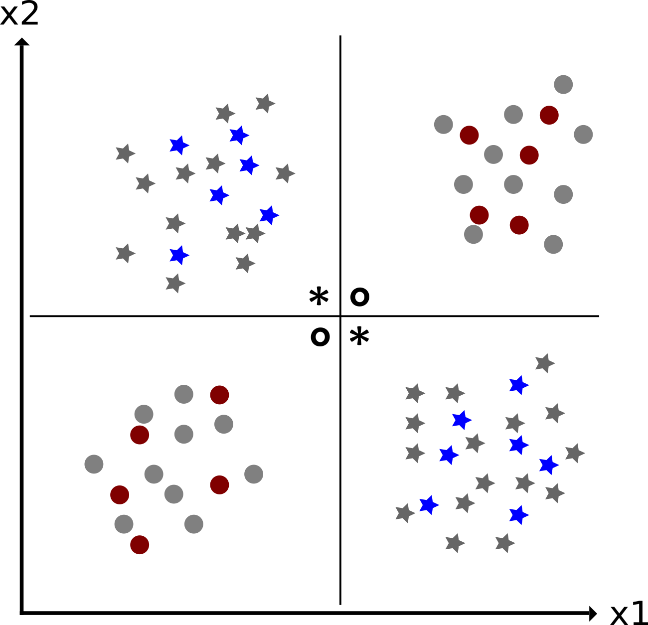
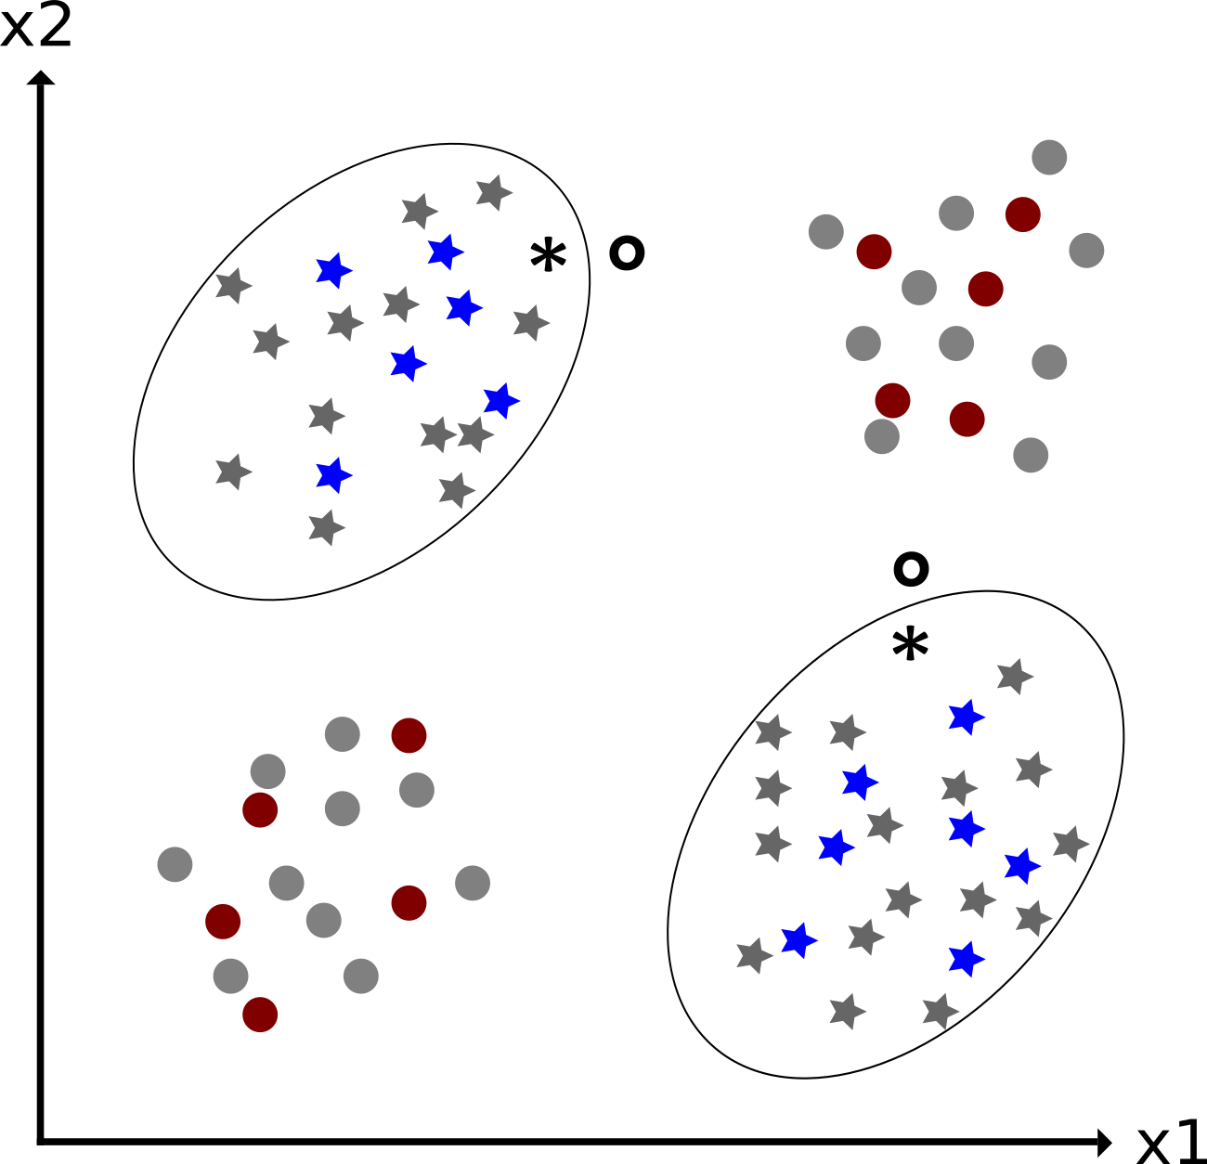
Background – Unsupervised Learning
Int
Mot
B&R
Task
Pro
Out
Source: Produced by the author
Source: Produced by the author

Slide 15
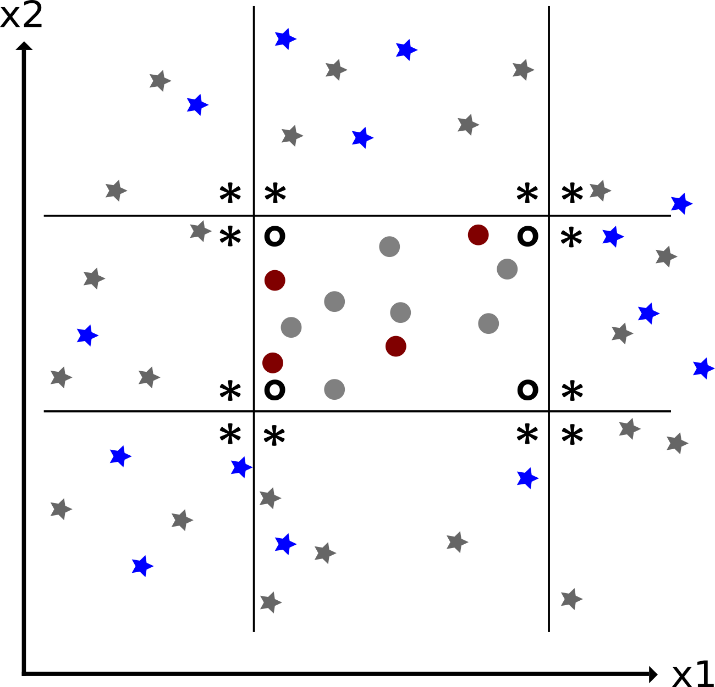
Background – Unsupervised Learning
Int
Mot
B&R
Task
Pro
Out
Source: Produced by the author
Source: Produced by the author

Slide 16
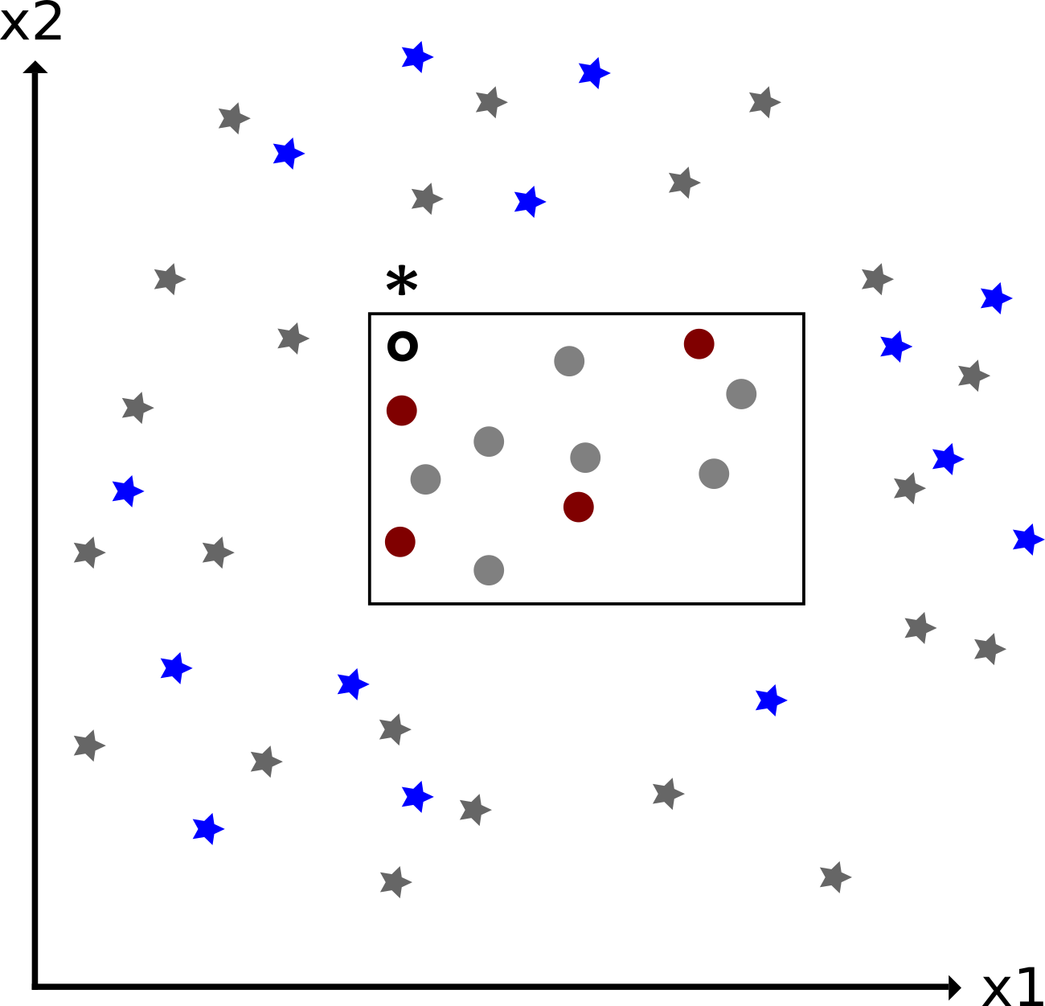
Background – Unsupervised Learning
Int
Mot
B&R
Task
Pro
Out
Source: Produced by the author
Source: Produced by the author

Slide 17
Background – Neural Networks
Int
Mot
B&R
Task
Pro
Out

Slide 18
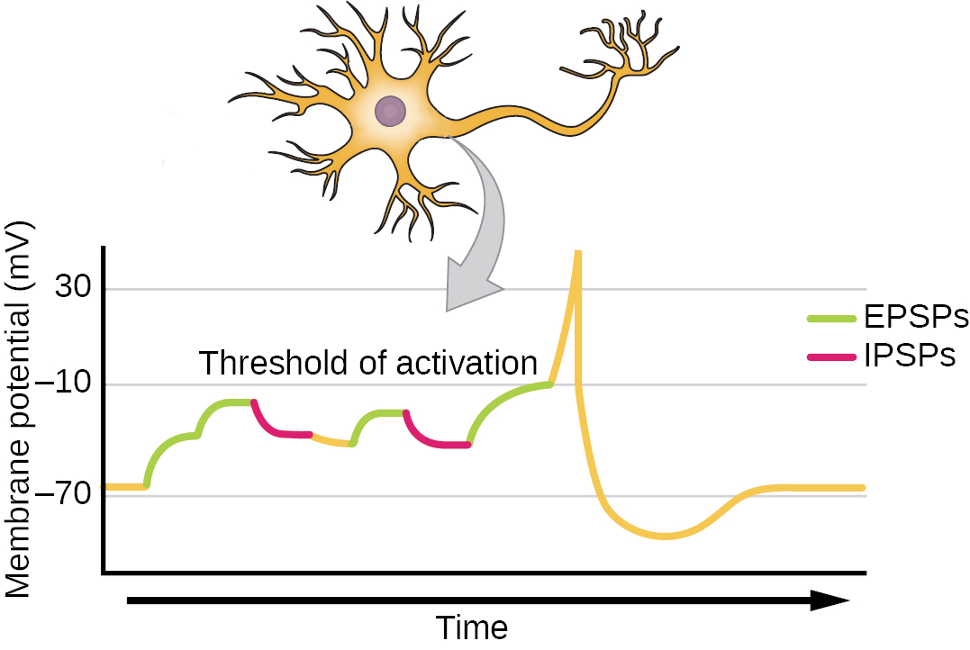
Background – Neural Networks
Int
Mot
B&R
Task
Pro
Source: "Biology 2e" OpenStax
Sec.35 .2
Out

Slide 19
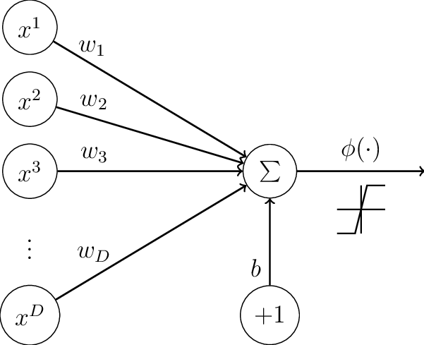
Background – Neural Networks
Int
Mot
B&R
Task
Pro
Source: "Biology 2e" OpenStax
Sec.35 .2
Source: "Neural Networks Regularization Trough Representation Learning"
p. 17
Out

Slide 20
Background – Neural Networks
Int
Out = ϕ((Σ_{i}x_{i}) + b)
Mot
B&R
Task
Pro
Source: "Biology 2e" OpenStax
Sec.35 .2
Source: "Neural Networks Regularization Trough Representation Learning"
p. 17
Out

Slide 21
Related Work I
Int
Pruning
...
Network Arichtecture
...
Mot
B&R
Task
Pro
Out

Slide 22
Task I
Int
Reproduction
On MNIST
Transfer
To Reuters-???
Find Sensible model in using FFNN or CNN
Mot
B&R
Task
Pro
Out

Slide 23
Progress I
Int
Python-project
Data-flow
Find Sensible model in using FFNN or CNN
Experiments
...
...
Mot
B&R
Task
Pro
Out

Slide 24
Outlook I
Int
More custom-layers
CNN!
...
More experiments
...
...
Mot
B&R
Task
Pro
Out

Slide 25

Thank you for your attention! Questions?

