Slide 1
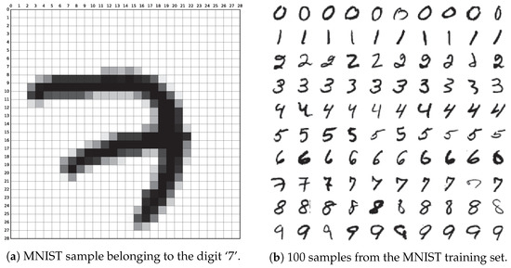
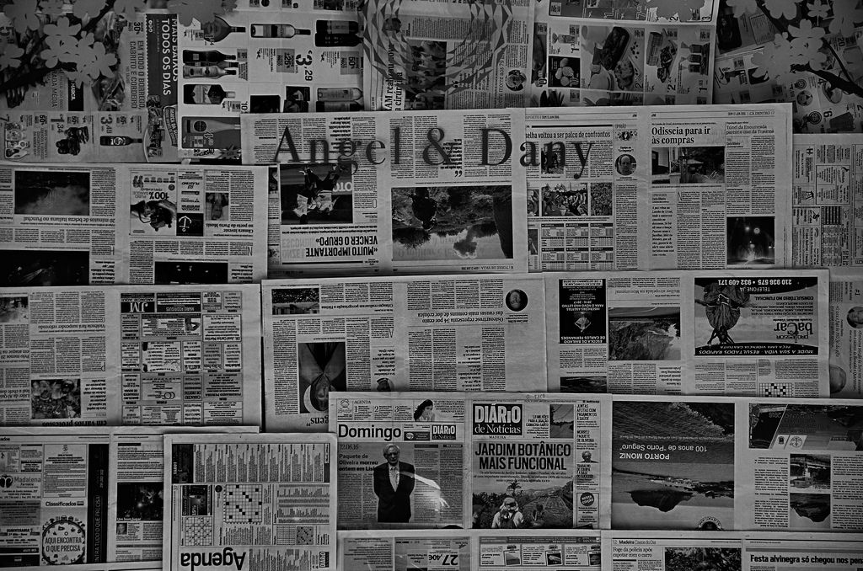
Application of the Lottery Ticket Hypothesis in NLP and Early Pruning
Intermission
Source:
https://www.mdpi.com/applsci/applsci-09-03169/article_deploy/html/images/applsci-09-03169-g001-550.jpg
Source:
https://www.bonaccorso.eu/wp-content/uploads/2016/07/28019400581_e1eb13ccc8_b.jpg
Tim Unverzagt

Slide 2
Structure
Introduction
Motivation
Background
Related Work
Task Definition
Progress
Outlook

Slide 3
Structure
Introduction
Motivation
Context of the thesis
Background
Related Work
Task Definition
Progress
Content of the thesis
Outlook

Slide 4
Introduction
Int
Initial Thoughts
Many good reasons to initialize & train neural networks with many parameters
Empirical evidence that many networks can be reduced after training while maintaining performance
aka. "Pruning"
Desirable due to bias towards small models (Ockham's razor)
Mot
Back
Task
Pro
Out

Slide 5
Introduction
Int
Initial Thoughts
Many good reasons to initialize & train neural networks with many parameters
Empirical evidence that many networks can be reduced after training while maintaining performance
aka. "Pruning"
Desirable due to bias towards small models (Ockham's razor)
Main Question:
"How important are the pruned weights during training?"
Mot
Back
Task
Pro
Out

Slide 6
Introduction
Int
Lottery Ticket Hypothesis
Due to the sheer number of "small" subnetworks in a "huge" network at least one such subnetwork has been initialized favorably for the given task
Name said subnetwork "lottery-ticket"
Mot
Back
Task
Pro
Out

Slide 7
Introduction
Int
Lottery Ticket Hypothesis
Due to the sheer number of "small" subnetworks in a "huge" network at least one such subnetwork has been initialized favorably for the given task
Name said subnetwork "lottery-ticket"
The lottery-ticket can be trained as a standalone-network achieving a similar performance to the original
Mot
Back
Task
Pro
Out

Slide 8
Introduction
Int
Lottery Ticket Hypothesis
Due to the sheer number of "small" subnetworks in a "huge" network at least one such subnetwork has been initialized favorably for the given task
Name said subnetwork "lottery-ticket"
The lottery-ticket can be trained as a standalone-network achieving a similar performance to the original
A lottery-ticket can be identified by analysis of the fully trained original network
e.g. keeping only the weights of the largest magnitude finds a lottery ticket
Mot
Back
Task
Pro
Out

Slide 9
Motivation
Int
Mot
Back
Task
Pro
Out

Slide 10
Motivation
Int
Time & Memory
Speedup during execution just as regular pruning
But remarkable compression rate: up to ~50x
Decrease in memory usage during execution
Possible speedup during development
There might be a way to identify lottery tickets early
Mot
Back
Task
Pro
Out

Slide 11
Motivation
Int
Time & Memory
Speedup during execution just as regular pruning
Decrease in memory usage during execution
Possible speedup during development
There might be a way to identify lottery tickets early
Interpretability
Understanding lottery-tickets might enhance our knowledge of neural networks in general
Finding a way to identify a lottery-ticket might help understanding how exactly neural networks learn
Mot
Back
Task
Pro
Out

Slide 12
Background – Unsupervised Learning
Int
Mot
Back
Task
Pro
Out

Slide 13
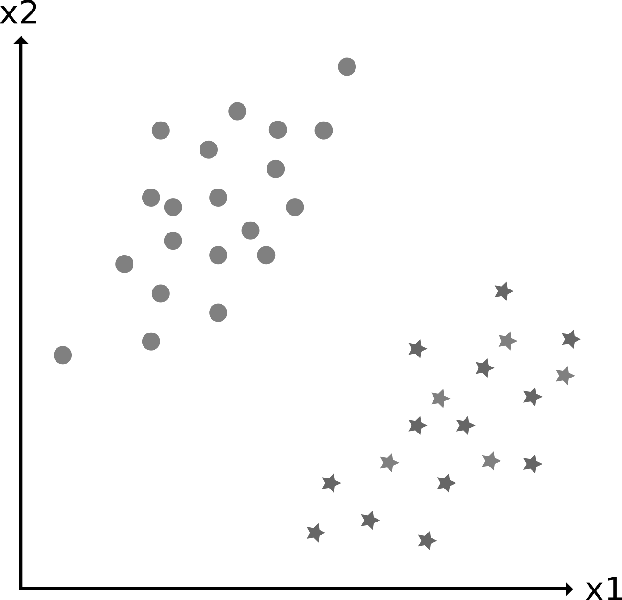
Background – Unsupervised Learning
Int
Mot
Back
Task
Pro
Out
Source: Produced by the author

Slide 14
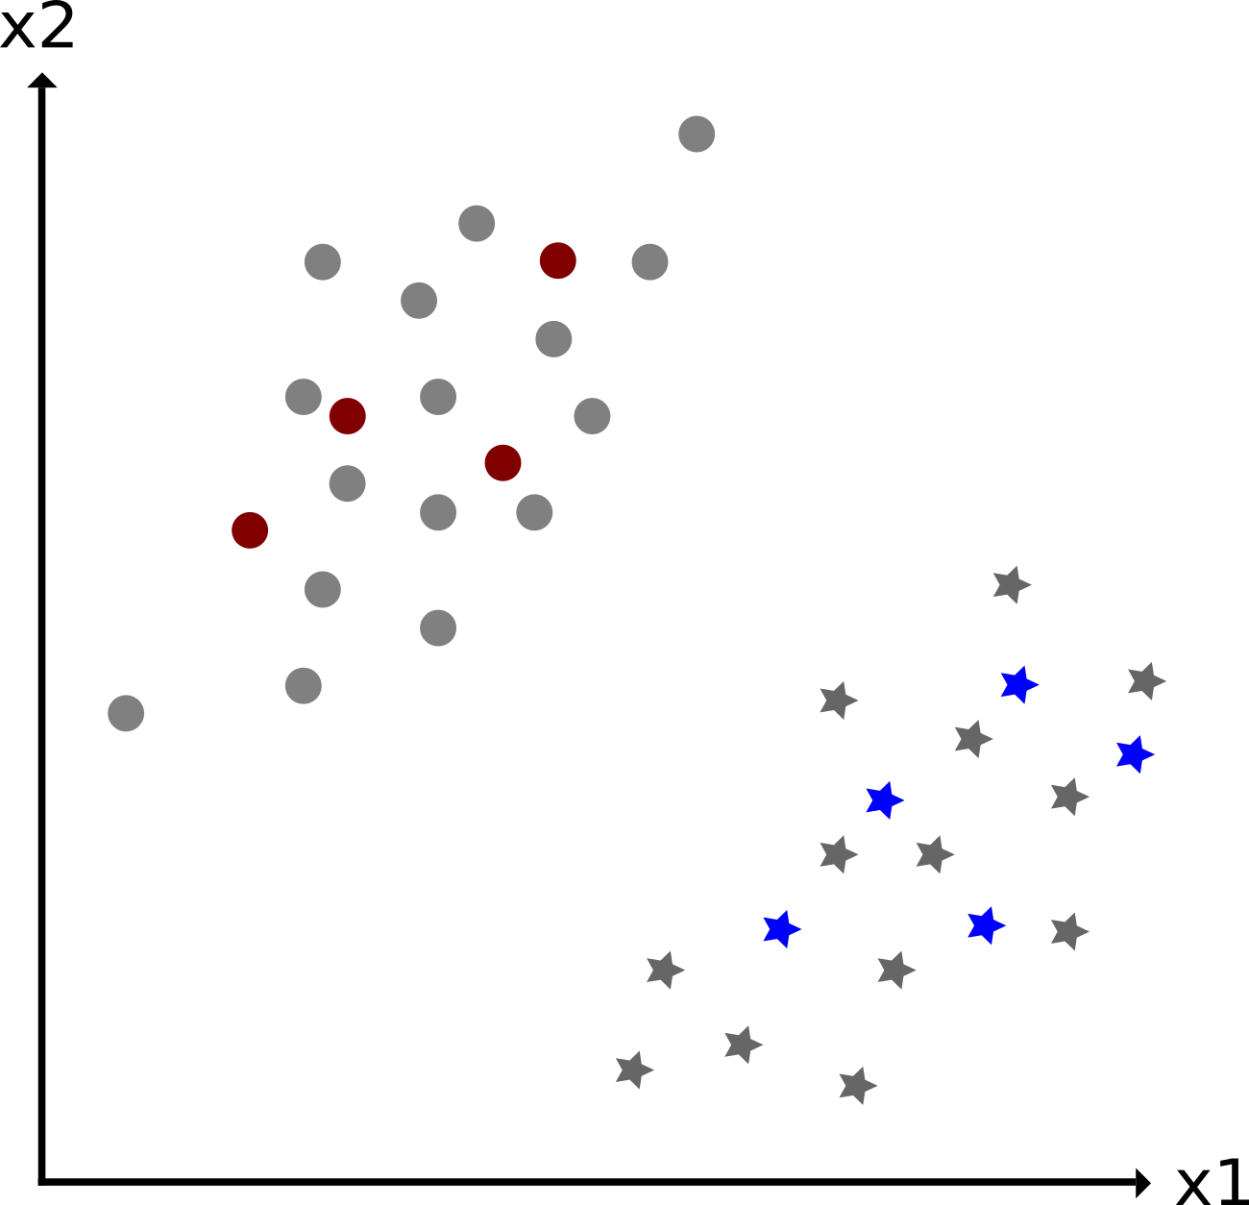
Background – Unsupervised Learning
Int
Mot
Back
Task
Pro
Out
Source: Produced by the author

Slide 15

Background – Unsupervised Learning
Int
Mot
Back
Task
Pro
Out
Source: Produced by the author

Slide 16
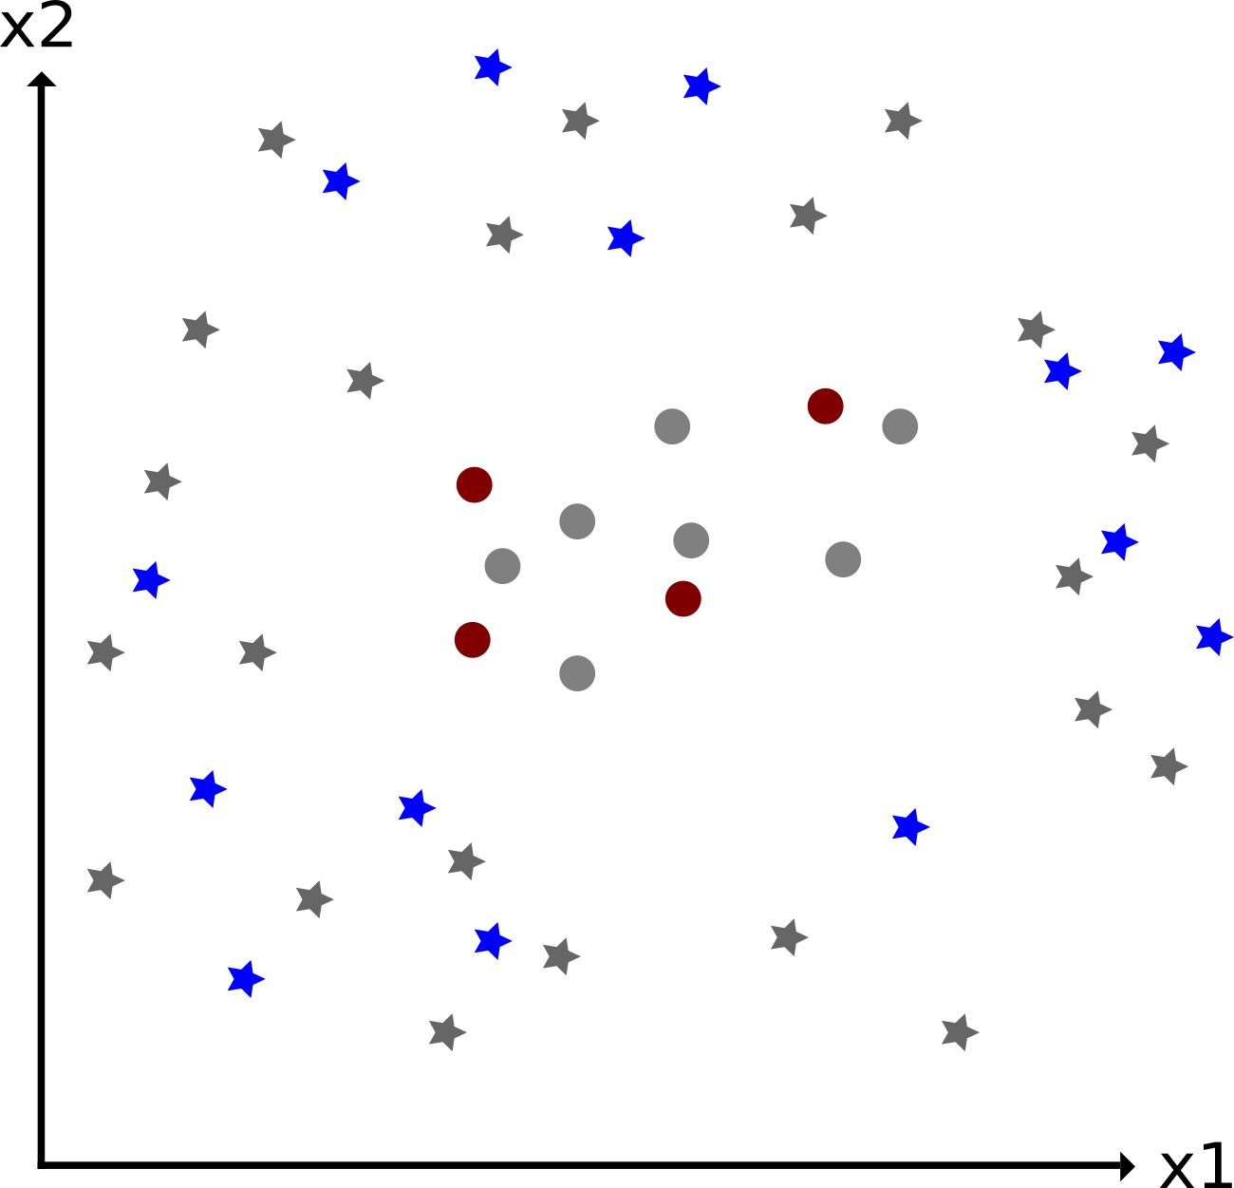
Background – Unsupervised Learning
Int
Mot
Back
Task
Pro
Out
Source: Produced by the author
Source: Produced by the author

Slide 17
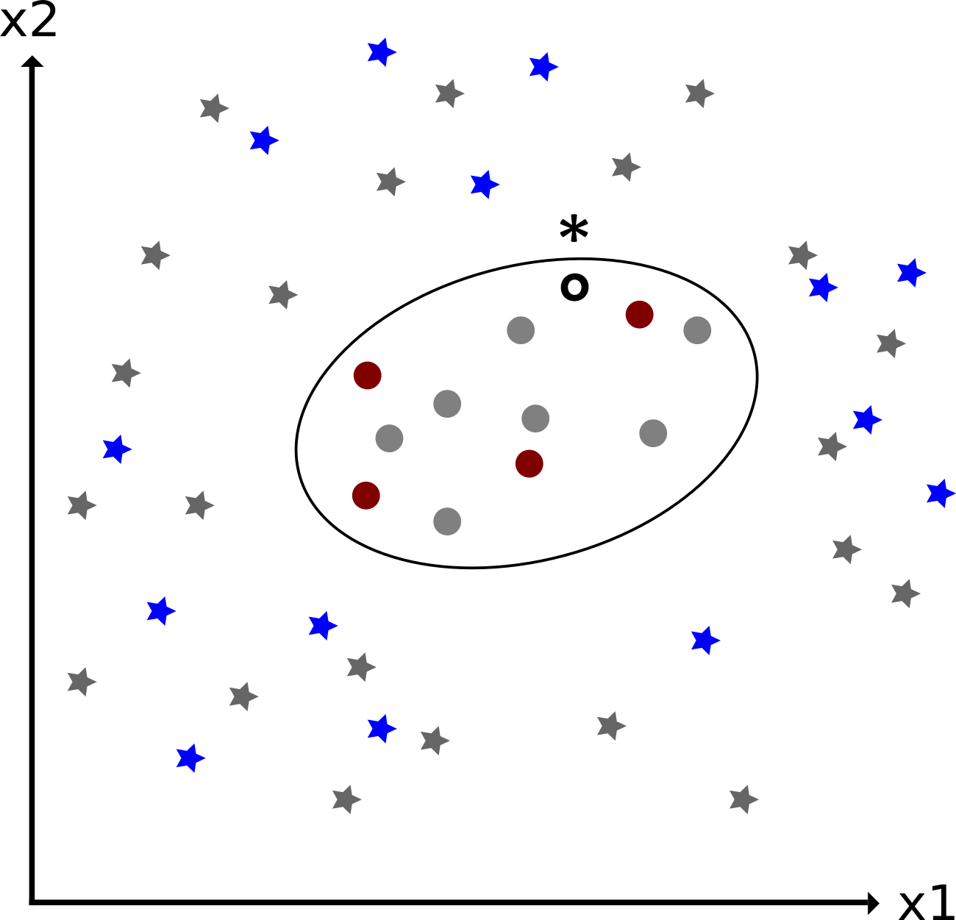
Background – Unsupervised Learning
Int
Mot
Back
Task
Pro
Out
Source: Produced by the author
Source: Produced by the author

Slide 18
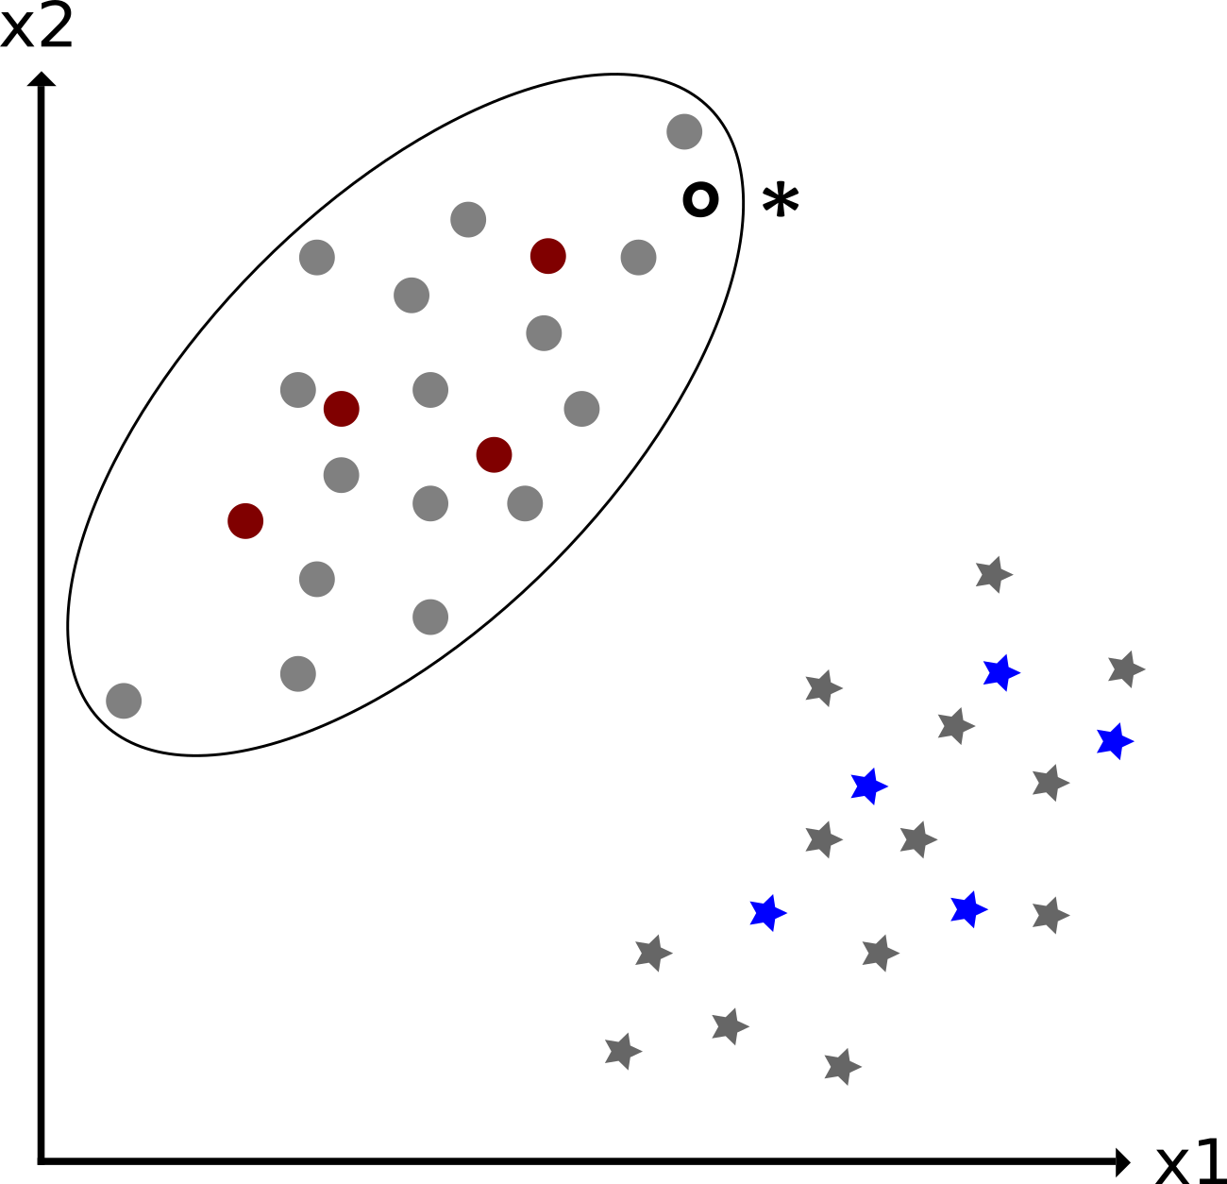
Background – Unsupervised Learning
Int
Mot
Back
Task
Pro
Out
Source: Produced by the author
Source: Produced by the author

Slide 19
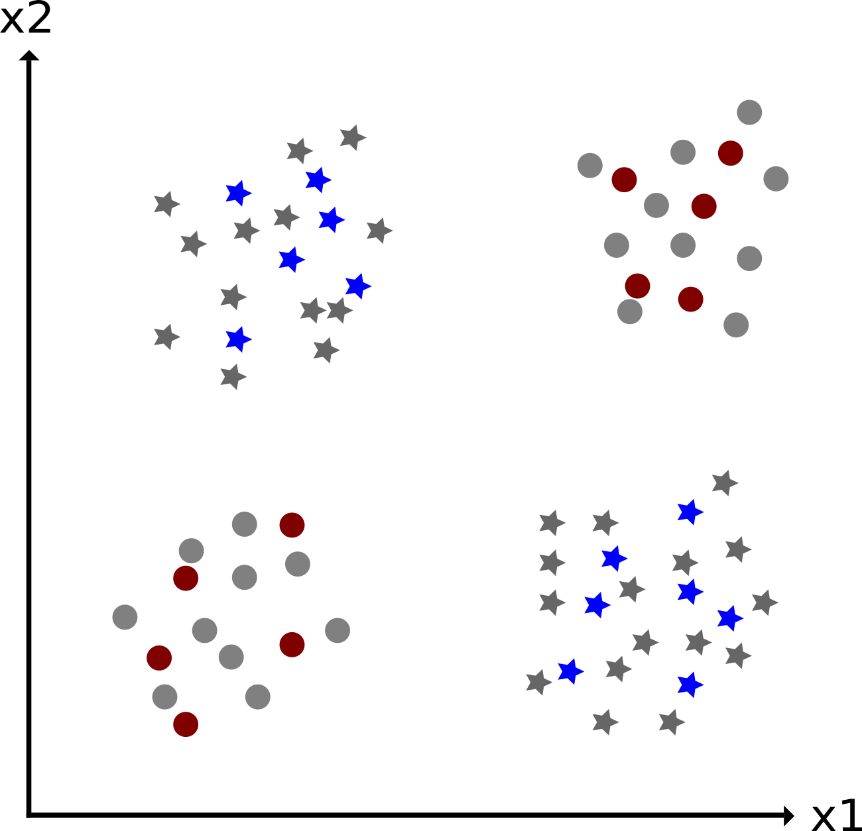
Background – Unsupervised Learning
Int
Mot
Back
Task
Pro
Out
Source: Produced by the author

Slide 20
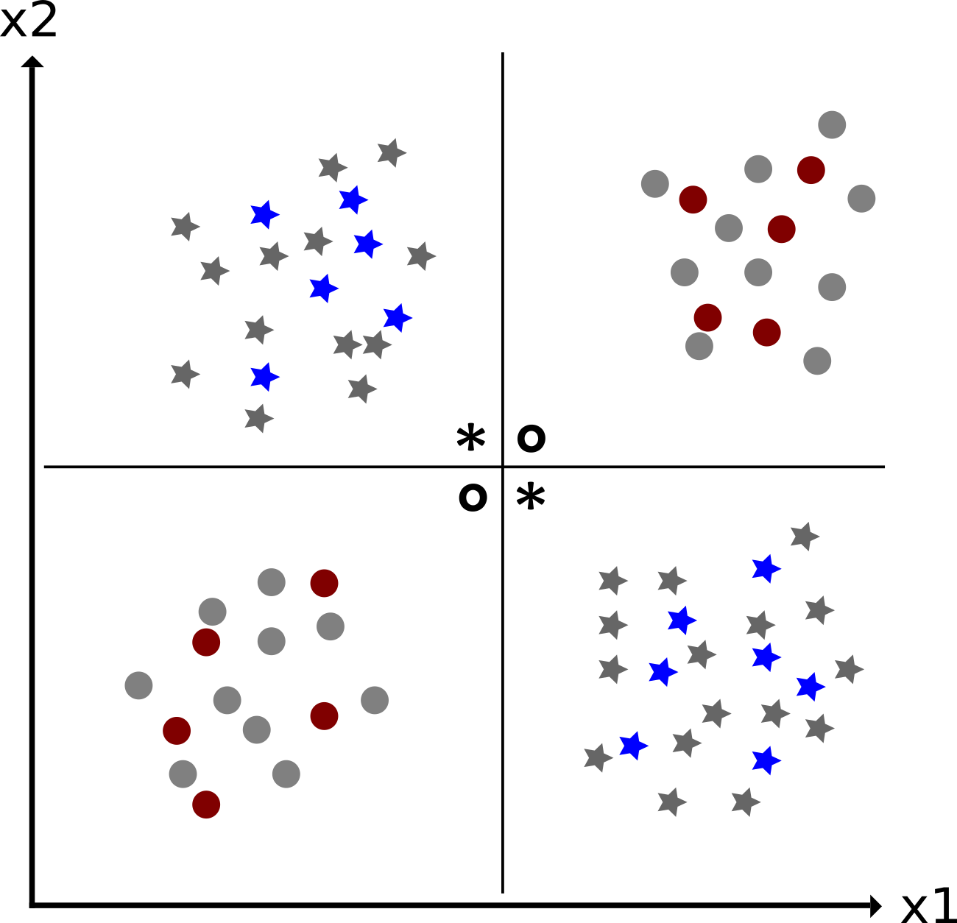
Background – Unsupervised Learning
Int
Mot
Back
Task
Pro
Out
Source: Produced by the author

Slide 21
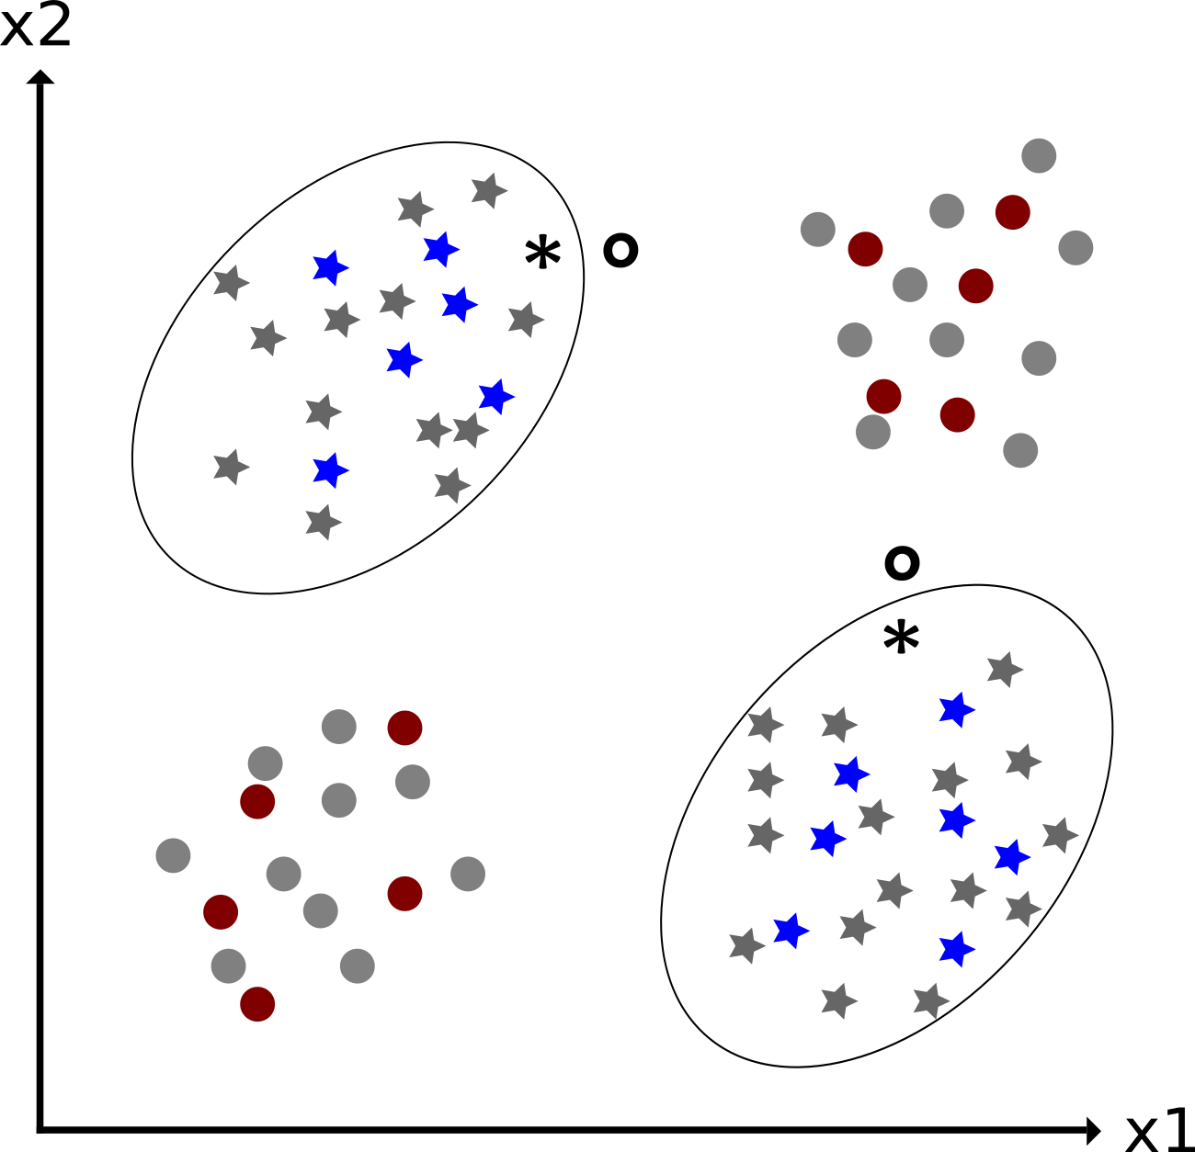
Background – Unsupervised Learning
Int
Mot
Back
Task
Pro
Out
Source: Produced by the author
Source: Produced by the author

Slide 22
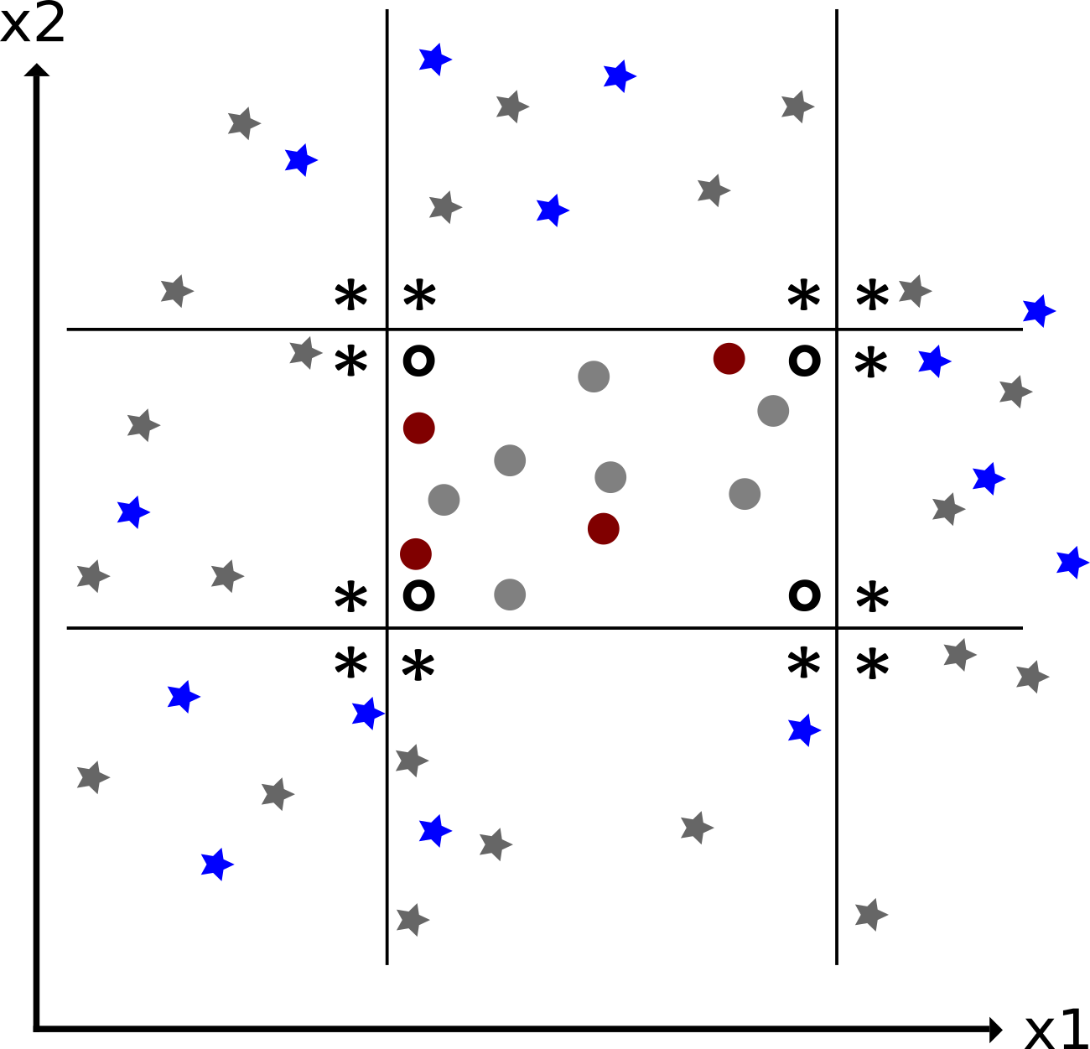
Background – Unsupervised Learning
Int
Mot
Back
Task
Pro
Out
Source: Produced by the author
Source: Produced by the author

Slide 23
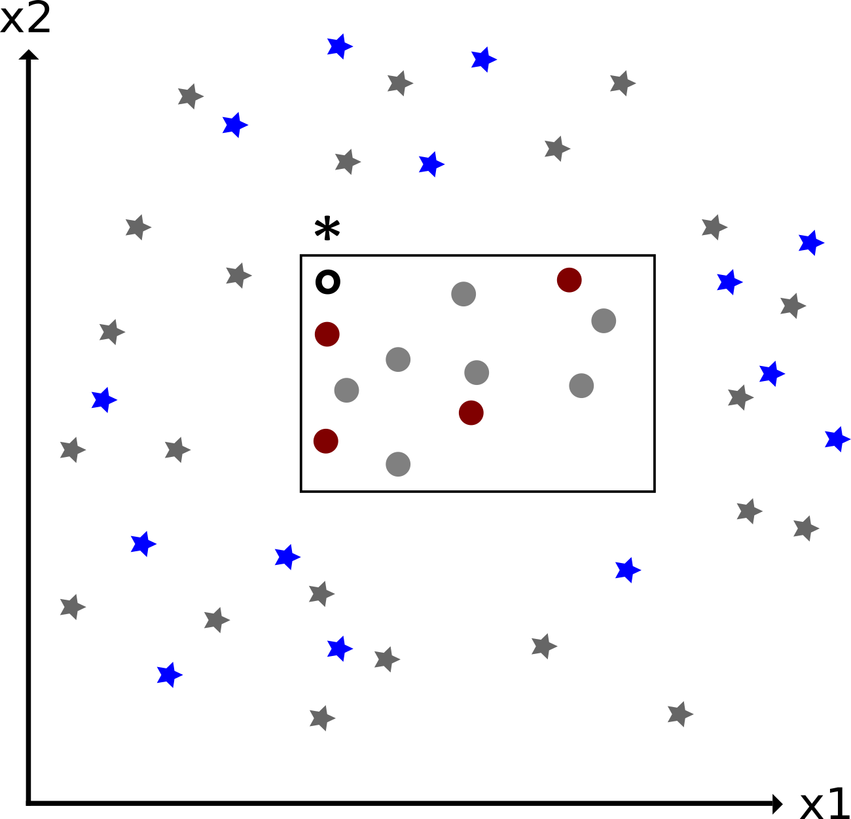
Background – Unsupervised Learning
Int
Mot
Back
Task
Pro
Out
Source: Produced by the author
Source: Produced by the author

Slide 24
Background – Neural Networks Basics
Int
Mot
Back
Task
Pro
Source: "Biology 2e" OpenStax
Sec.35 .2
Out

Slide 25
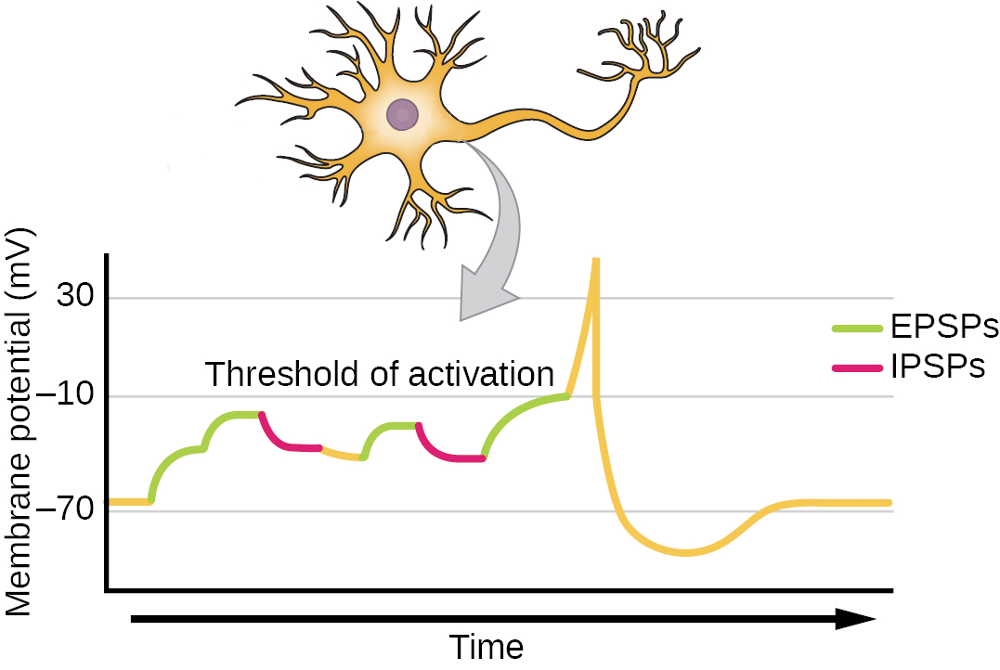
Background – Neural Networks Basics
Int
Mot
Back
Task
Pro
Source: "Biology 2e" OpenStax
Sec.35 .2
Out

Slide 26
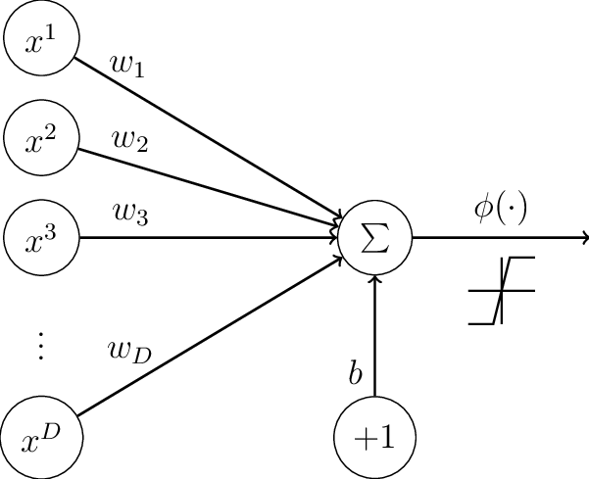
Background – Neural Networks
Int
Mot
Back
Task
Pro
Source: "Biology 2e" OpenStax
Sec.35 .2
Source: "Neural Networks Regularization Trough Representation Learning"
p. 17
Out

Slide 27
Background – Neural Networks Basics
Int
Out = ϕ((Σ_{i}x_{i}) + b)
Mot
Back
Task
Pro
Source:
https://openstax.org/resources/ee34862d28dde2838ca58b4ff73225a93afbee38
"Biology 2e" OpenStax
Sec.35 .2
Source:
https://www.researchgate.net/profile/Soufiane_Belharbi/publication/326439111/figure/fig2/AS:669487372181508@1536629636103/Perceptron-model-Notation-x-i-is-the-i-th-component-of-x-the-same-as-x-i-in-Eq116.png
"Neural Networks Regularization Trough Representation Learning"
p. 17
Out

Slide 28
Related Work
Int
Mot
Rel
Task
Pro
Out

Slide 29
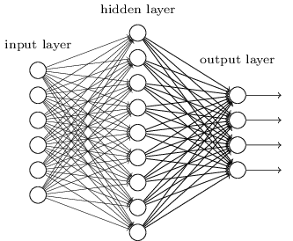
Related Work – Background
Int
Fully Connected Neural Network
Mot
Rel
Task
Pro
Out
Source:
https://hackernoon.com/hn-images/1*Kdnux0Kw1yQ4D8dq__mYCA.png

Slide 30
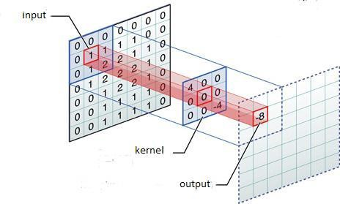
Related Work – Background
Int
Convolution in Neural Networks
Mot
Back
Task
Pro
Out
Source:
https://miro.medium.com/proxy/0*dRD6PhKOnnCIhz15.jpg

Slide 31
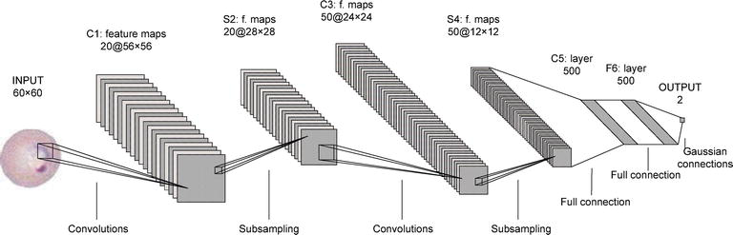
Related Work – Background
Int
Convolutional Neural Network Architecture (Lenet-5)
Mot
Back
Task
Pro
Source:
https://api.intechopen.com/media/chapter/58989/media/F4.png
Out

Slide 32
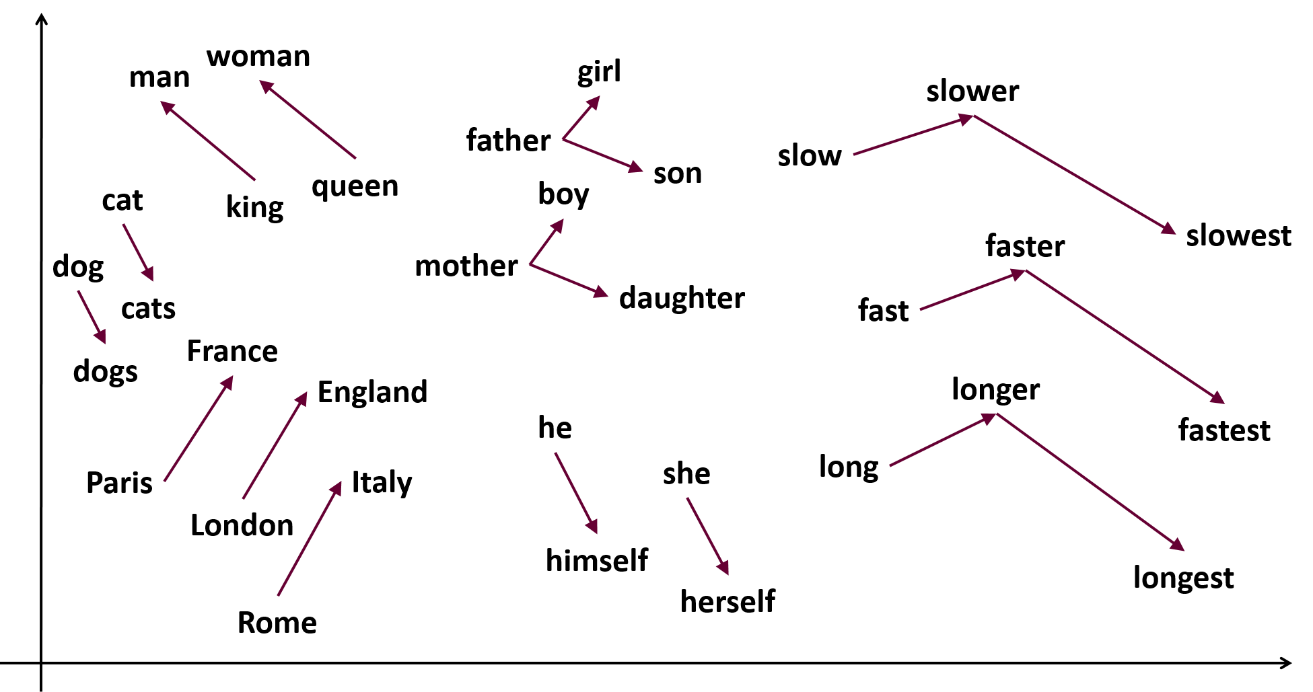
Related Work – Background
Int
Language Models
Mot
Back
Task
Pro
Out
Source:
https://samyzaf.com/ML/nlp/word2vec2.png

Slide 33
Related Work – CNN in NLP
Int
"Convolutional Neural Networks for Sentence Classification"
2014
Task:
Varying Classifications
Datasets:
Movie reviews
SST-1, SST-2
Subjectivity dataset
TREC question dataset
Customer reviews
MPQA
Mot
Back
Task
Pro
Out

Slide 34
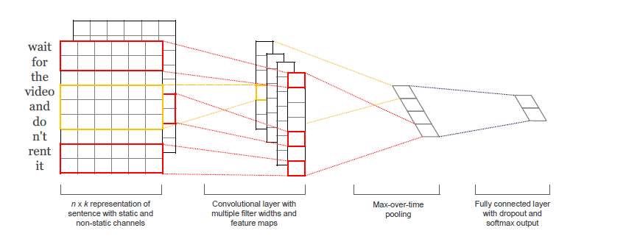
Related Work – CNN in NLP
Int
"Convolutional Neural Networks for Sentence Classification"
Mot
Back
Task
Pro
Out
Source:
"Convolutional Neural Networks for Sentence Classification"
Figure 1

Slide 35
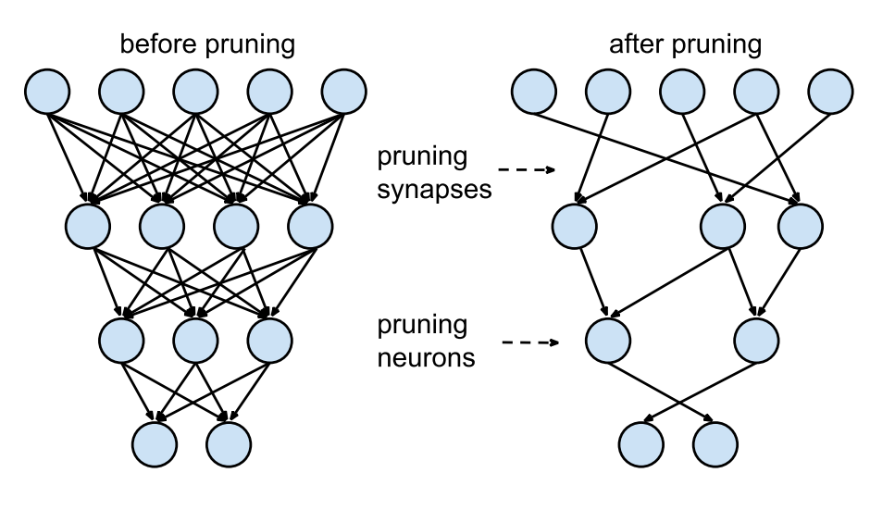
Related Work - Pruning
Int
Mot
Rel
Task
Pro
Out
Source:
https://www.mdpi.com/applsci/applsci-09-03169/article_deploy/html/images/applsci-09-03169-g001-550.jpg
"Learning both Weights and Connections for Efficient Neural Networks"
Figure.3

Slide 36
Related Work – Pruning
Int
"Learning both Weights and Connections for efficient Neural Networks"
2015
Task:
Image Classification (ImageNet)
Architectures:
LeNet (300-100-FC, 5-CNN)
AlexNet
VGG-16
Compression:
9x to 13x
Mot
Rel
Task
Pro
Out

Slide 37
Related Work – Pruning
Int
"ThiNet: A Filter Level Pruning Method for Deep Neural Network Compression"
2017
Task:
Image Classification (ImageNet)
Architectures:
VGG-16
ResNet-50
Compression:
Up to ~17x
Mot
Rel
Task
Pro
Out

Slide 38
Related Work – Pruning
Int
"The Lottery Ticket Hypothesis: Finding Sparse, Trainable Neural Networks"
2019
Task:
Image Classification (MNIST)
Architectures:
Lenet (300-100-FC, Conv-2, Conv-4, Conv-6)
VGG-19
ResNet-18
Compression:
~20x to ~50x
Mot
Rel
Task
Pro
Out

Slide 39
Related Work – Early Pruning
Int
"Really should we pruning after model be totally trained? Pruning based on a small amount of training"
2019
Task:
Image Classification (MNIST, CIFAR-10)
Architectures:
Unspecified CNN
VGG-19
Compression --- Training Speed-Up:
~10x --- 10x
Mot
Rel
Task
Pro
Out

Slide 40
Related Work – Network Architecture Search
Int
"Rethinking the Value of Network Pruning"
2018
Observation:
Randomizing weights does not worsen a pruned network
Weights are not essential to the quality of pruned network
Pruning at its core is about finding suitable network architectures
Mot
Rel
Task
Pro
Out

Slide 41
Related Work – Network Architecture Search
Int
"Network Architecture Search: A Survey"
2019
[...]
Mot
Rel
Task
Pro
Out

Slide 42
Task I
Int
Reproduction
No source-code available
Produce own source-code for the experiments in the paper
Verify source-code by running experiments
Mot
Back
Task
Pro
Out

Slide 43
Task II
Int
Transfer to NLP
Original context for the paper
Task: Image Classification
Dataset: "MNIST"
Model: Varying FCNN and CNN
Find comparable context in NLP
Task: Topic Classification
Dataset: "Reuters-21578"
Model: TBD
Check if the Lottery-Ticket-Hypothesis holds
Mot
Back
Task
Pro
Out

Slide 44
Task III
Int
Early Retrieval of Lottery Tickets
Original method
"Select" all weights of the "fully trained" network over a certain percentile
Reset weights to original intial value
Retrain network
Repeat (Optional)
Adaptation
"Select" weights earlier / develop early stopping criteria
"Select" weights based on other metrics (Optional)
Mot
Back
Task
Pro
Out

Slide 45
Progress – Python-project
Int
Experiments
Mot
datapoints
mask weights
Dataset-I/O
build
&
train
Masking
build
&
train
save
Back
Network Wrapper
Results-I/O
Task
plot
Custom-Layers
Visualization
Pro
Out

Slide 46
Progress – Backend
Int
Experiments
Mot
Dataset-I/O
Masking
Back
Network Wrapper
Results-I/O
Task
Custom-Layers
Visualization
Pro
nltk
Out
Gensim
Pickle
Tensorflow 2.0
Pickle
Pyplot

Slide 47
Progress – Experiment(s)
Int
Mot
Back
Task
Pro
Out

Slide 48
Remaining Work
Int
Remaining parts of the framework
Custom Convolutional Layer
Support for iterative Pruning
More experiments
MNIST / Lenet-CNN-6
MNIST / VGG-18
Reuters / TBD
MNIST / Lenet-FCN / Early Pruning
Mot
Back
Task
Pro
Out

Slide 49

Thank you for your attention! Questions?

