Slide 1







An Analysis of Computer Coding Job Trends
Timothy Wanless
7/17/2023

Slide 2



OUTLINE
Executive Summary
Introduction
Methodology
Results
Visualization – Charts
Dashboard
Discussion
Findings & Implications
Conclusion
Appendix

Slide 3

EXECUTIVE SUMMARY
This report looks at computer coding job trends using an API and Webscraping to acquire data acquired from a survey of coders and their payment info and trends in computer coding. The data was cleaned, analyzed, and visualized to find trends.

Slide 4
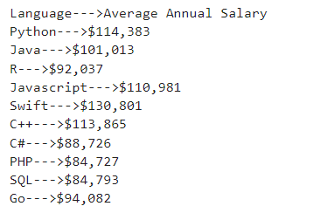


INTRODUCTION
Data was gathered from a variety of different coders and their information. By analyzing the data, it will be possible to gain insights into the demographics of coders and their perceptions of current and future technologies in order to predict the usefulness of languages, platforms and webframes.

Slide 5

METHODOLOGY
Data was gathered about computer coders and computing trends through an API and Webscraping
The data was cleaned
The dataset was put through exploratory analytics
The data was visualized through a various use of graphs and dashboards

Slide 6
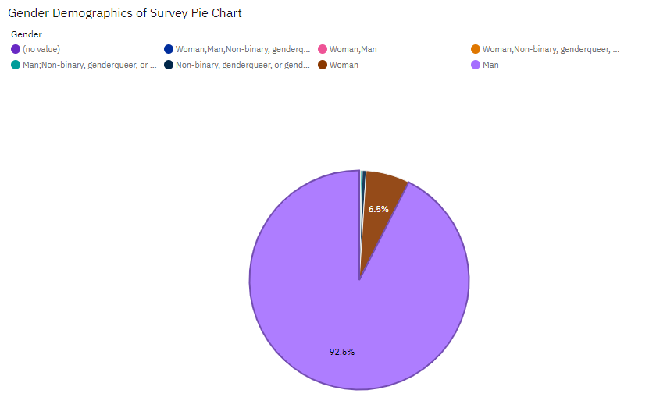
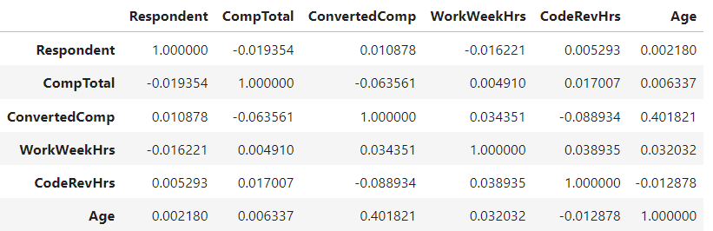
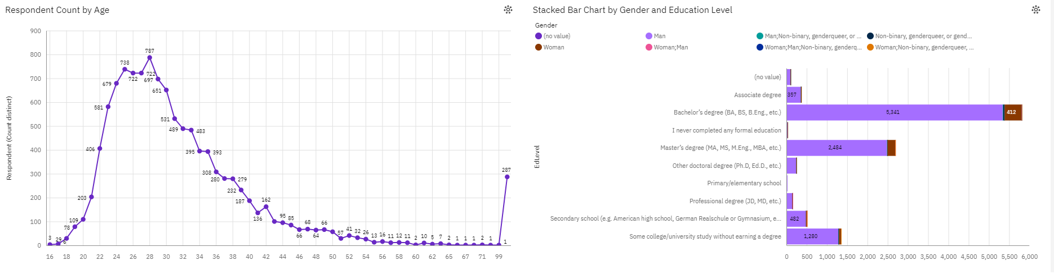
RESULTS
There is a positive correlation between age and compensation and work week hours, and there is a negative correlation between age and coding review hours.
This infers that as people get older they become better paid and work more, but they review less as they become more competent.
Per the data, the average coder is a man in their 20s with a bachelors.
The most popular current coding language and future coding language is Javascript.

Slide 7
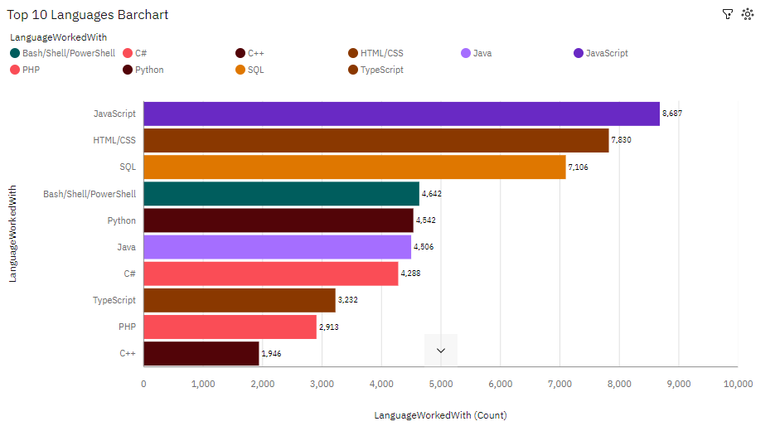
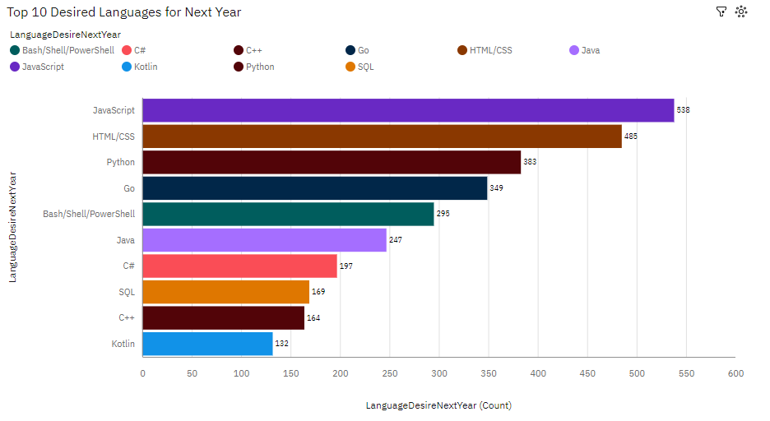
PROGRAMMING LANGUAGE TRENDS
Current Year
Next Year

Slide 8
PROGRAMMING LANGUAGE TRENDS - FINDINGS & IMPLICATIONS
Findings
JavaScript is the #1 coding language in current and future trends
Python is believed to move up to #3 in future languages.
TypeScript is believed to move up several spaces from current to future
Implications
JavaScript will remain a relevant force in the future development of coding technologies according to the perceptions of coders.
Python is believed to grow in relevance.
TypeScript is believed to become more relevant

Slide 9
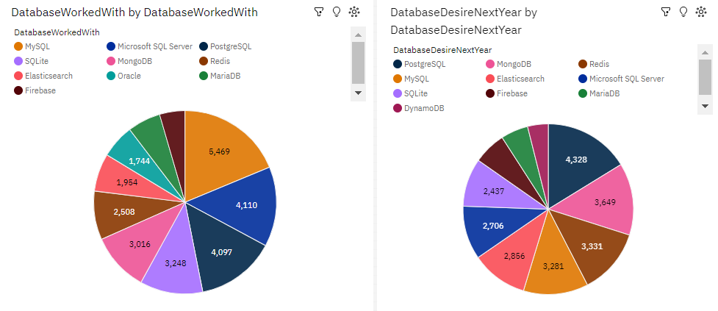
DATABASE TRENDS
Current Year
Next Year

Slide 10
DATABASE TRENDS - FINDINGS & IMPLICATIONS
Findings
MySQL is believed to drop from #1 to #4 in the future by coders
PostgreSQL and MongoDB are believed to become increasingly popular databases.
Implications
MySQL has features that cause coders to believe it will be irrelevant in the future.
PostgreSQL and MongoDB have features that cause coders to believe they will be relevant in the future.

Slide 11

DASHBOARD
Below is a link to the active dashboard that goes over coding language trends and statistics.
https://us1.ca.analytics.ibm.com/bi/?perspective=dashboard&pathRef=.my_folders%2FIBM_DA_Dashboard&action=view&mode=dashboard&subView=model0000018961ab0eba_00000000

Slide 12
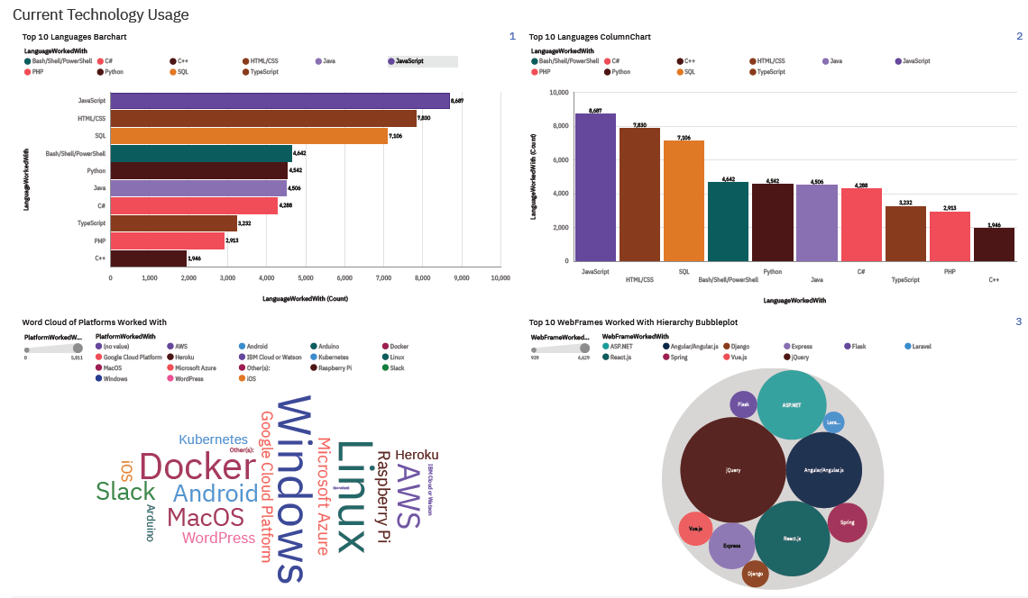
Current Technology Trends Dashboard

Slide 13
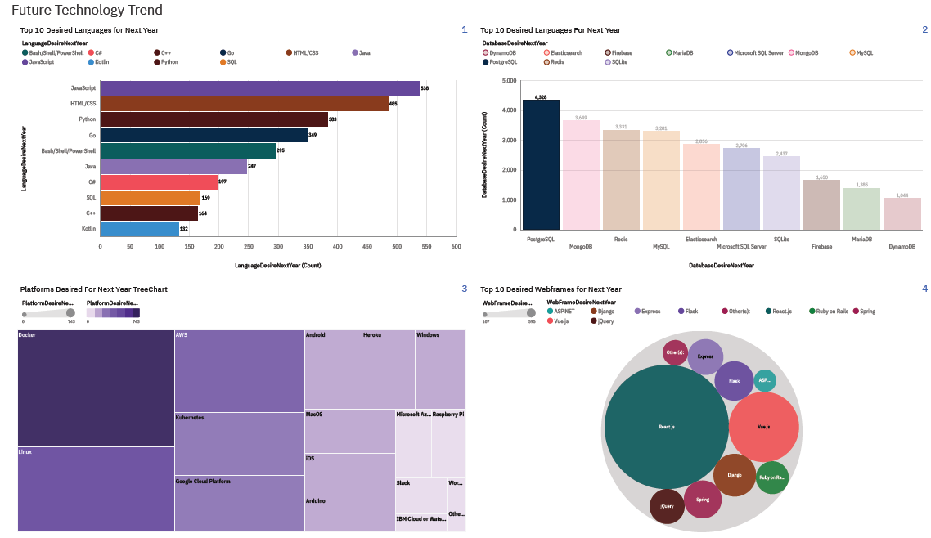
Future Technology Trends Dashboard

Slide 14
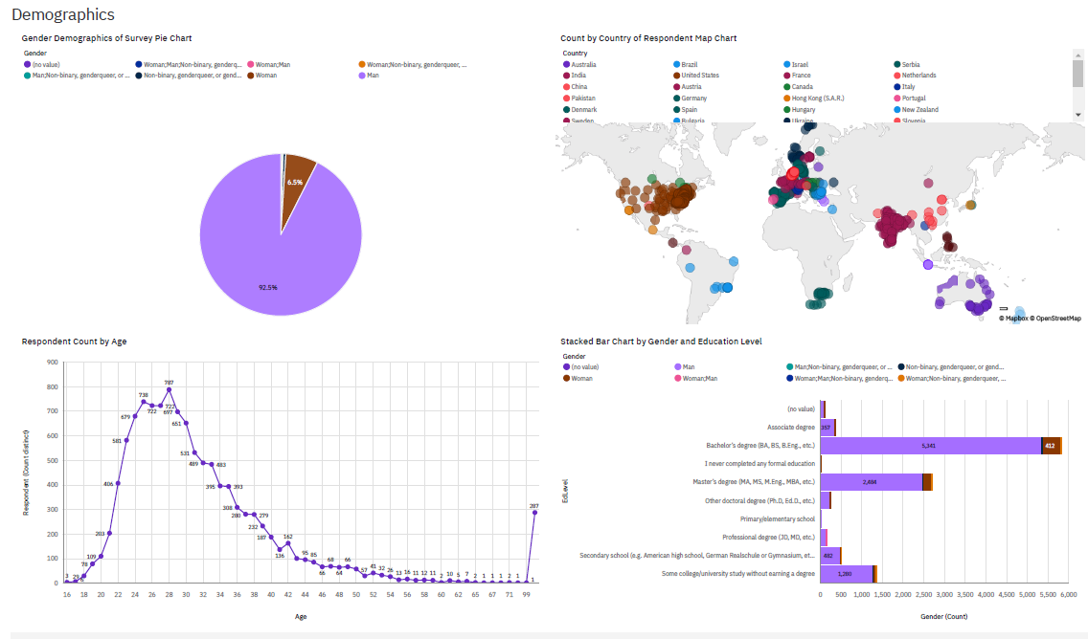
Demographics Dashboard

Slide 15
DISCUSSION
What does the future hold?
Coding Languages
Databases
Platforms
Coder Demographics

Slide 16
OVERALL FINDINGS & IMPLICATIONS
Findings
The Average coder is a man with a bachelor's degree in their 20s.
PostgreSQL and MongoDB are potential future database technologies
Python and Typescript are believed to grow and Javascript and HTML are believed to remain the most popular coding languages
Implications
This could be a useful stat in determining recruitment and implications in the hiring process.
Investment in training and infrastructure using PostgreSQL and MongoDB could be useful.
Training and coders in these languages are believed to remain relevant into the future.

Slide 17

CONCLUSION
It is useful to look at the current demographics to predict future job candidates
Certain coding languages (Python & Typescript) and databases(MongoDB and PostgreSQL) have useful features that coders believe will have relevance moving into the future. It may inspire future investment.

Slide 18

APPENDIX
Github:
https://github.com/TimWanless/DataAnalysisCapstone

Slide 19
JOB POSTINGS

Slide 20
POPULAR LANGUAGES

