Slide 1
2D Anime Image Tag Detecting with Machine Learning
Ruozhou Zhang, X152437
timzhangrz98@gmail.com

Slide 2
Project Object
In this project, I am focusing on giving a model for detecting 2D anime images.
The expected outcome is that all the valid elements (contained in the element dictionary) will be recognized
Develop Tools:
Visual Studio Code
TensorFlow 1.12.0
Tensorboard 1.12.2

Slide 3
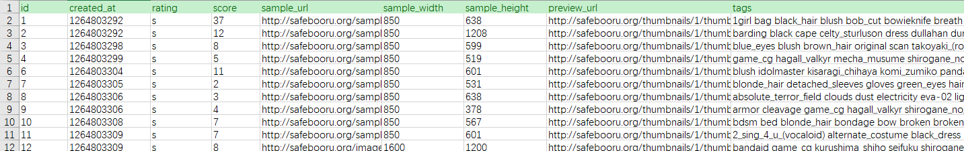
Raw Data
Safebooru - Anime Image Metadata (Alexander Lamson, Kaggle) https://www.kaggle.com/alamson/safebooru/
all_data.csv
tag: dividing image into different groups
preview_url: downloading small size image

Slide 4
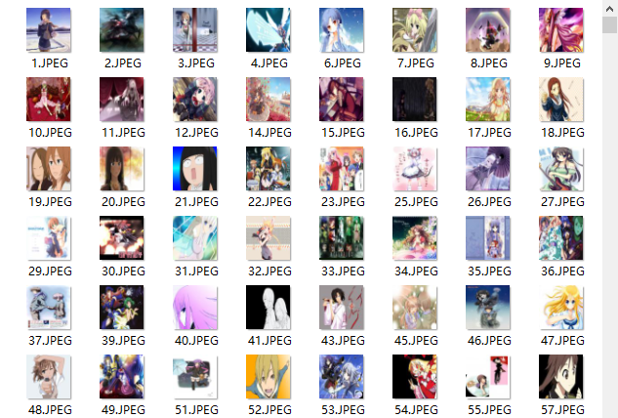
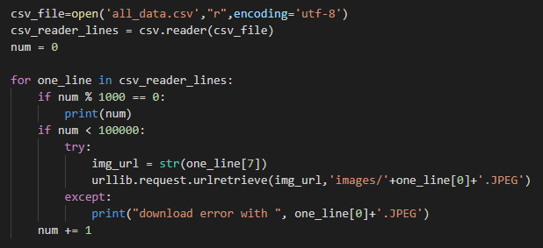
Data Pre-process 1
Downloading images using “download.py”.

Slide 5
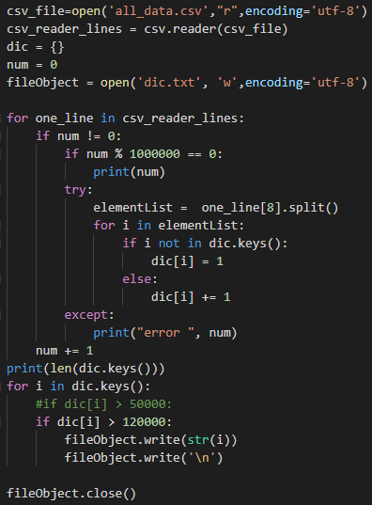
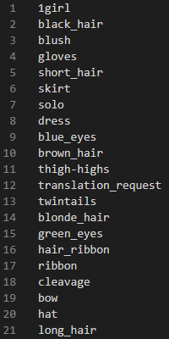
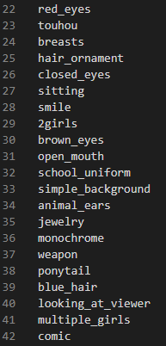
Data Pre-process 2
Generating group name dictionary using “set_dic.py”.
38 groups in total.
Saved in “dic.txt”

Slide 6
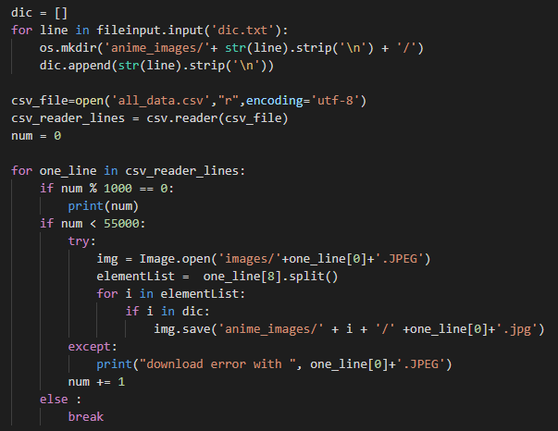

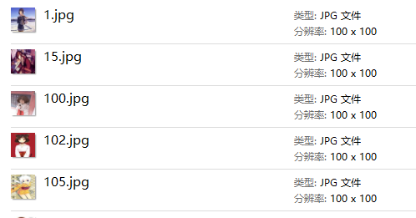
Data Pre-process 3
Resizing and grouping image using “deal.py”
acc_t
Resizing to
100 x 100

Slide 7
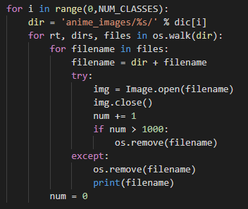
Data Pre-process 4
Checking the validation of image using “check.py”. (Significant)
Training process will break if the input image is invalid.
This function set 1000 as the maximum number of each group.

Slide 8
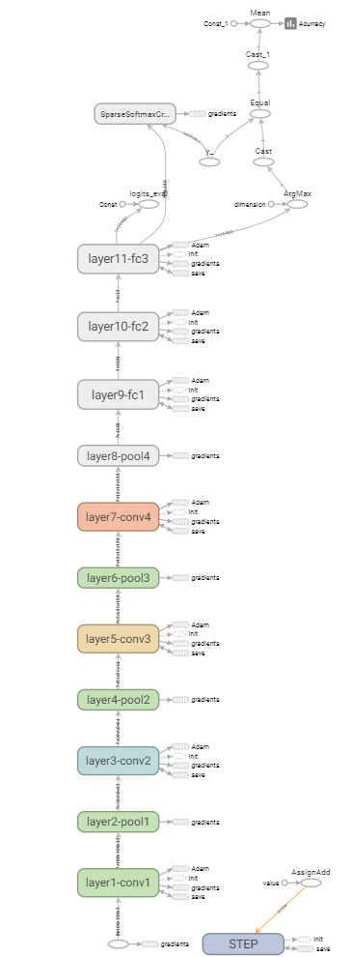
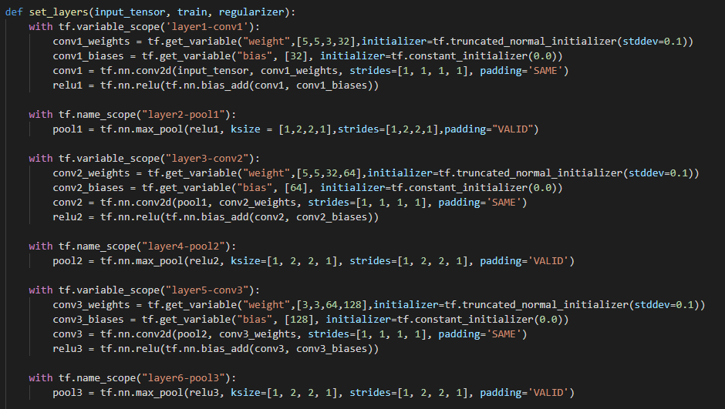
Training Model 1
11 Layers CNN

Slide 9
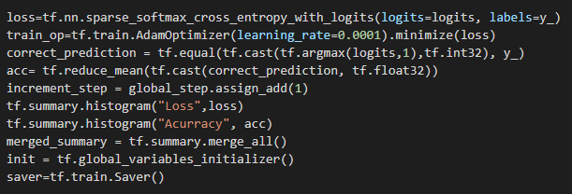
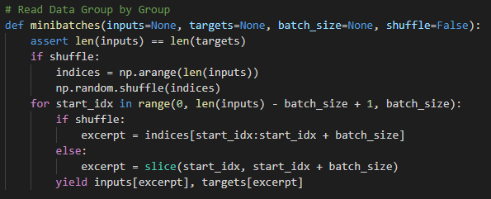
Training Model 2
Calculating Accuracy, Loss and Prediction
Read Data Group by Group using “minibatches”

Slide 10
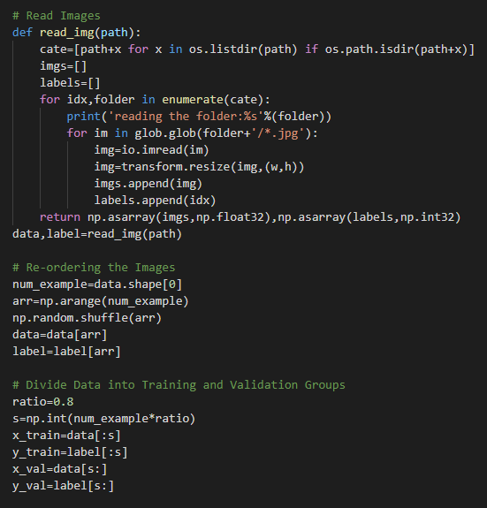
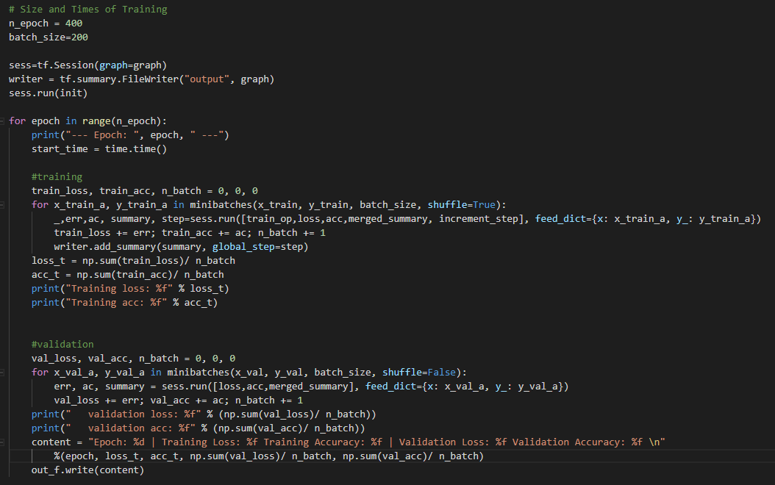
Training Process
Import Data
Import image files
Check size again
Set Training Model
Set the training model
Start Training
Run the training model
Divide Training and Validation set
Save the training result

Slide 11
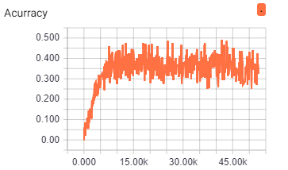
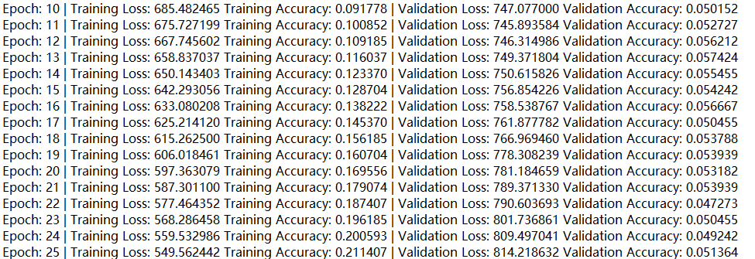
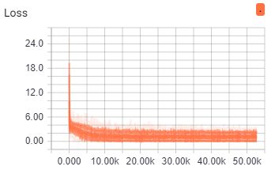
Training Result
38 groups, 1000 images per group (max)
rate: 0.0001, epoch: 400, batch size: 200
maximum accuracy: 0.48
maximum avg accuracy: 0.37

Slide 12
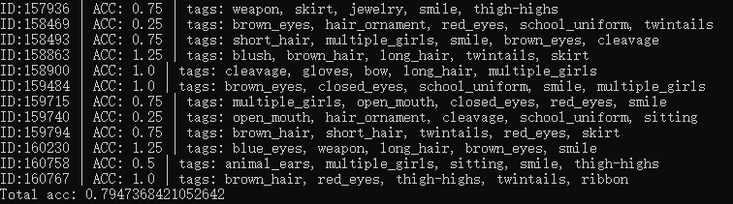
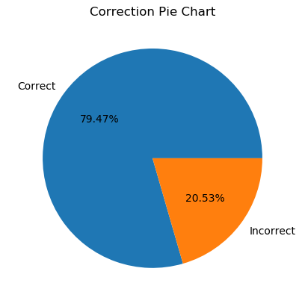
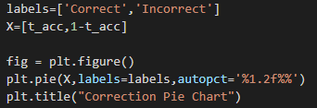
Test 1
Pictures in raw data but out of training set
Share more than 15 common tags compared with training tags
Pick 6 highest prediction, each correct prediction provide 0.25 acc
95 images meet the criteria
Accuracy: 0.7947

Slide 13
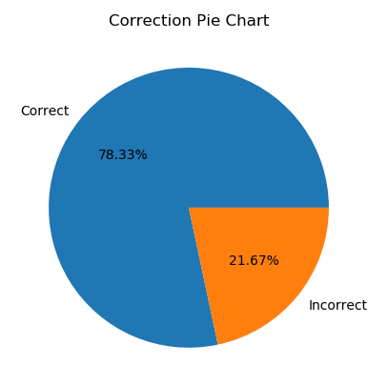
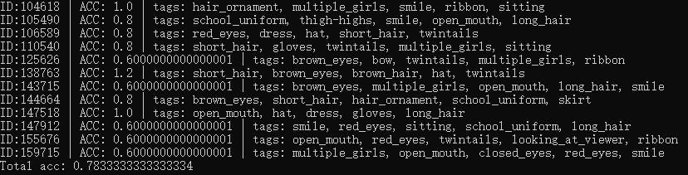
Test 2
Pictures in raw data but out of training set
Share more than 20 common tags compared with training tags
Pick 6 highest prediction, each correct prediction provide 0.2 acc
12 images meet the criteria
Accuracy: 0.7833

Slide 14
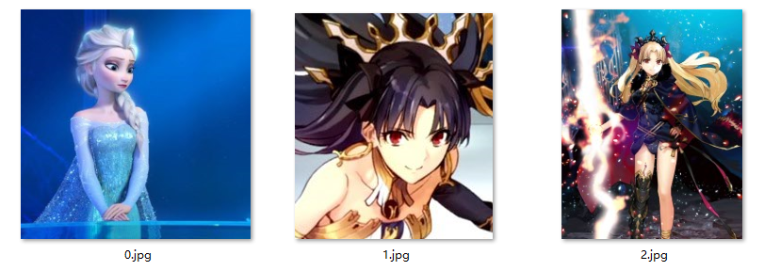
Test 3
Some tests with other screenshot out of database

Slide 15
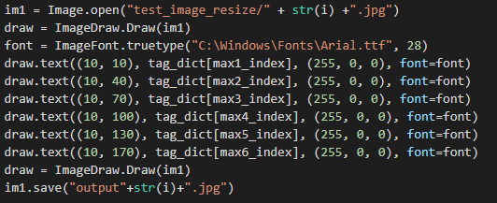
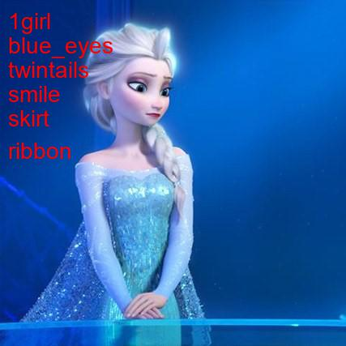


Advanced
Add tag to the image using “Draw”

