Slide 1

2018
SOC SUMMER WORKSHOP
Facial Expression Recognition
> Cloud Computing & Big-Data<
Team members: Zhang Jialun Zhao Chao Zhu Zhenhao Shi Yukang
2018.7.23

Slide 2
CONTENT
1
Research
2
Development Tools
3
Functions
4
Future Arrangement
1

Slide 3
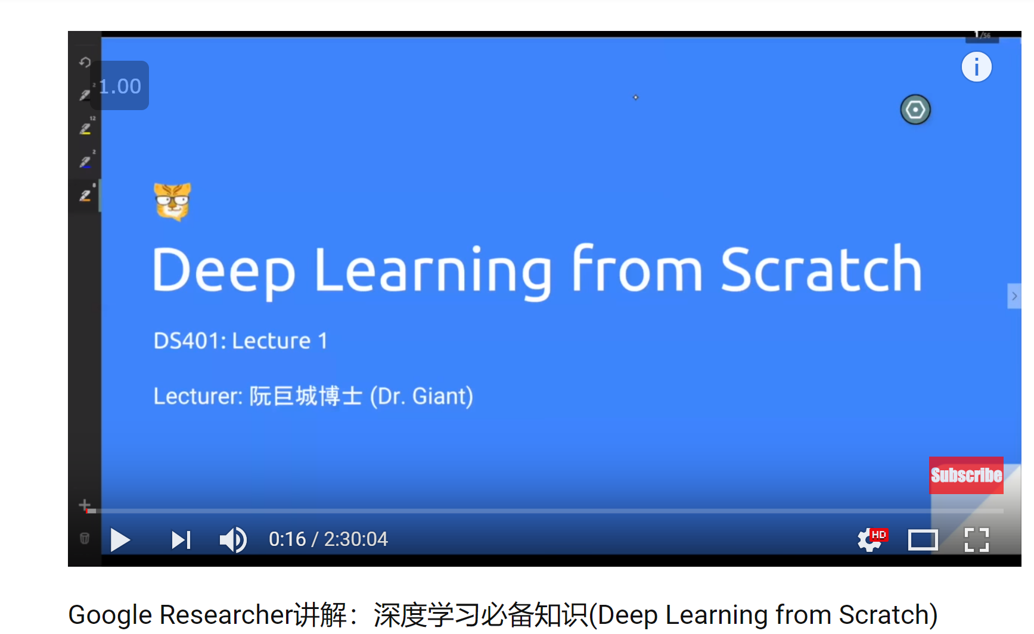
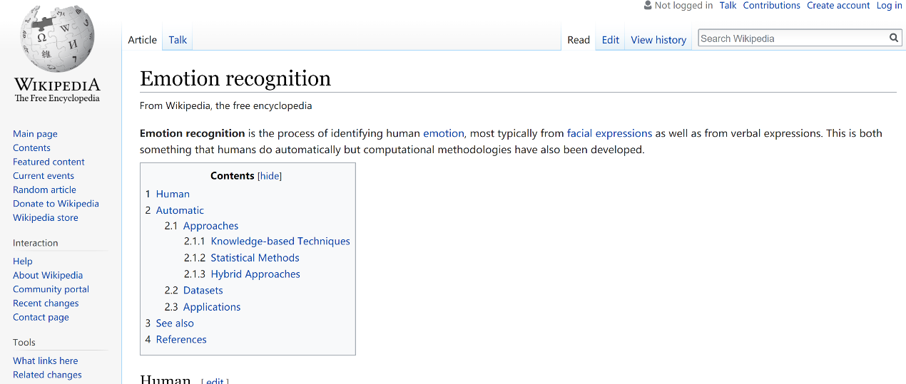

Research
Research:
Facial expression recognition based on deep learning
https://blog.csdn.net/darlingwood2013/article/details/54845625?locationNum=11&fps=1
2

Slide 4




Development Tools
Language
Database
back-end
front-end
IBM DB2
Python
Node.JS
Jade
3

Slide 5



Development Tools
OpenCV---Processing Images
OpenCV, Open Source Computer Vision Library, is a cross-platform computer vision library. It has C++, Python and Java interfaces and supports Windows, Linux, Mac OS, iOS and Android.
IBM Watson---Visual Recognition
demonstration---https://dataplatform.cloud.ibm.com/studio/watson-vision-combined/DefaultCustomModel_7153695/view?project_id=44c0ce14-dabf-483b-9689-e5ae0d6c2ce9&training_definition_id=9542c471-3fec-43b7-bddd-bba9e0281ff6
TensorFlow---Machine Learning
An open source machine learning framework for everyone.
Numpy, Pandas---Data Container
4

Slide 6
Production Functions
Image acquisition
Use camera to gain the image of one person/ Upload the image of one person
Face recognition
Use API of face recognition from IBM Watson
Emotion presentation
Read the person’s expression and show a emoji to match it
Functions
Gender identification
Recognize the person’s gender
Age prediction
Estimate an accurate range of the person’s age
5

Slide 7
Future Arrangement
Implement Application
Deploy in the Cloud
User Interface
6

Slide 8
THANKS
2018.7.23

