Slide 1





Facial Expression Recognition
> Cloud Computing & Big-Data<
TEAM 30
Team members: Zhang Jialun Zhao Chao
Zhu Zhenhao Shi Yukang

Slide 2
Introduction
Approach
· Background
· Objective
· Functions
· Cognitive computing model
· Development tools
· Overall design
03
Use cases
01
Introduction
Implementation
Conclusions
02
· Architecture
· Web application
· Use cases
· Model shortcomings
· Model Improvement
· Our growth
Implementation
04
Conclusions
1

Slide 3
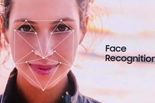

Background
Why we choose to recognize facial expression?
Why we use emoji?
Introduction
Why Bemoji?
2

Slide 4
Objective
Use camera to take a photo or upload a picture
The picture are transmitted to the IBM Watson service including the face detect and expression recognition
This model with the algorithms of deep learning and machine learning is trained by the datasets of KDEF
Use Node.js to implement the interactions between front-end and back-end interactions
An Emoji and other animation will be rendered based on the different expression detected
Introduction
3

Slide 5
Functions
Image acquisition
Upload a image from user or take a photo in real time
Face recognition
Use API of face recognition from IBM Watson
Emotion presentation
Read the person’s expression and show an related Emoji
Introduction
Functions
Gender identification
Recognize the person’s gender
Age prediction
Estimate an accurate range of the person’s age
4

Slide 6
Cognitive computing model
CLOUD & BIG DATA & API
ARTIFICIAL INTELLIGENCE
Approach
COGNITION COMPUTING
PEOPLE & TASK
The basement we used to build this model
5

Slide 7





Development tools
Language
Database
Front-end
Back-end
Approach
IBM DB2
Html
Java script
CSS
Node.JS
6

Slide 8


Overall design
STAGE ONE
STAGE TWO
STAGE THREE
STAGE FOUR
Approach
Send a photo
Face detect
Facial expression
recognition
Match a emoji
Use camera to gain the image of one person/ Upload the image of one person from user.
Detect whether a face is included in the photo, if so cut the part of face and transmit it to the next part.
Recognize the face’s expression and output the result.
Match a emoji with the same expression to the face detected according to the result.
7

Slide 9





Architecture
Front-end
Back-end
External
Share on
social platforms
Gain data
Face detect
&
Expression recognition
Java script
Implementation
CSS
Bluemix
Cloud Foundry
Retraining
Html
Feedback
Machine
learning process
Training
8

Slide 10

Web application
Implementation
9

Slide 11

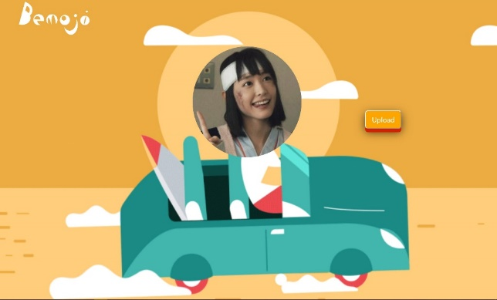

Example one
HOMEPAGE
UPLOAD A PICTURE
RESULT ANALYSIS
Implementation
10

Slide 12
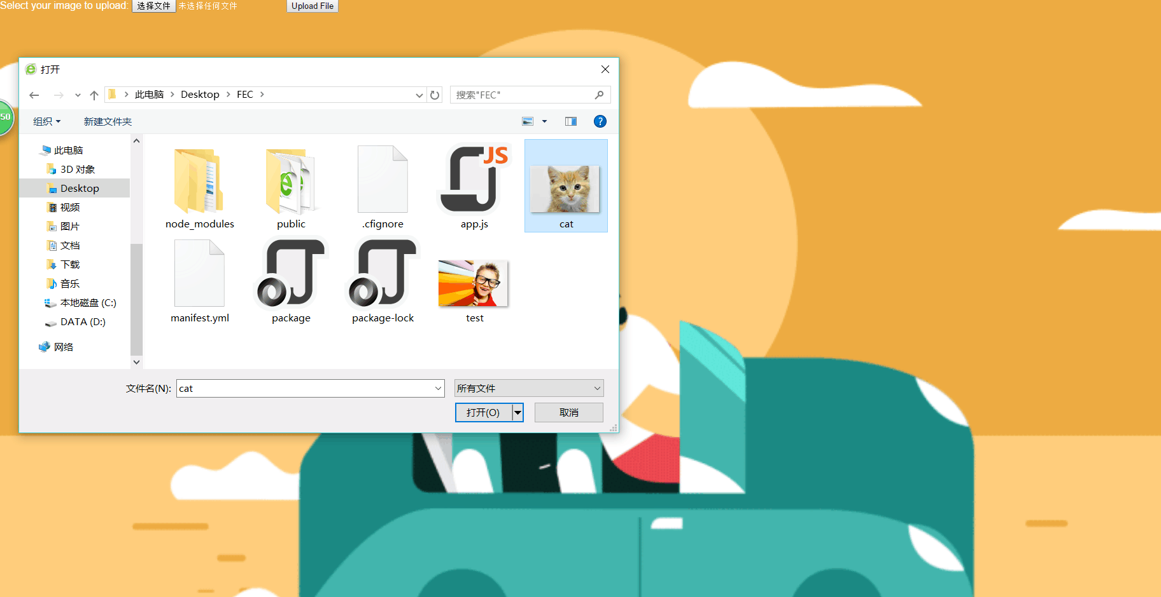

Example two
Implementation
11

Slide 13



More use cases
Mental Health
Implementation
Business
& Ads
Intelligent Voice System
12

Slide 14
Model shortcomings
IBM
Service
Datasets
Accuracy
Limitation
Conclusions
The cloud service
maybe interrupted sometimes
Dataset is not big enough
The trained model’s accuracy is not very high
Use cases are limited
13

Slide 15
Model improvement
We can share our emoji to social platform to accomplish more functions
Improve front-end and back-end interactions for more stable services
More functions
Conclusions
Stable service
We can train with larger datasets to get more accurate results
Bigger datasets
14

Slide 16
Our growth
Learned more about cloud computing
Learned more knowledge in programming
Learned how to work as a team
Conclusions
15

Slide 17

T h a n k y o u
TEAM 30

