Slide 1
Remixing Metadata from Libraries and Archives with the RAMP Editor
May 30, 2014
WikiConference USA
Timothy A. Thompson (@timathom)
Princeton University Library
Mairelys Lemus-Rojas (@mlemusrojas)
University of Miami Libraries

Slide 2
Outline
Background of the project (an ongoing experiment)
Origins
Pilot project
EAC-CPF metadata standard
Overview of the RAMP editor
Demo? Discussion? Workshop?

Slide 3
Origins
Digital collections at the University of Miami
Role of archives and special collections
Archival metadata standards
Encoded Archival Description (EAD) for finding aids
Encoded Archival Context–Corporate Bodies, Persons, and Families (EAC-CPF) for creator records

Slide 4
Goal
To expand the audience for information about archives, manuscript, and other special collections by using existing archival metadata to create stub- or start-class pages on Wikipedia.
Archivists have a strong tradition of contextual description: why not expand its reach?

Slide 5
Pilot Project with the Cuban Heritage Collection (CHC)
Theater collections in the CHC
http://libguides.miami.edu/chctheater
32 collections
Network of relationships
Cultural genealogy

Slide 6
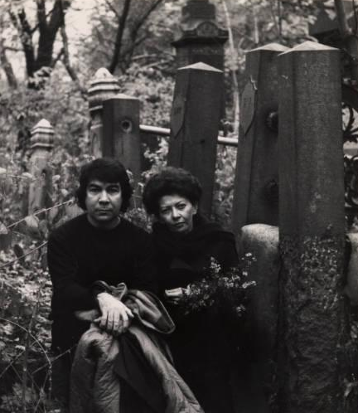
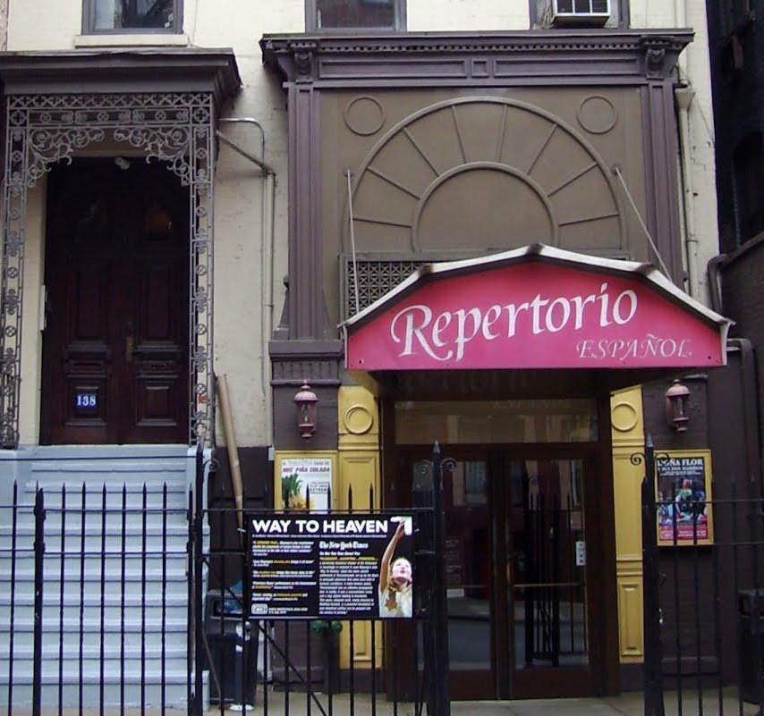
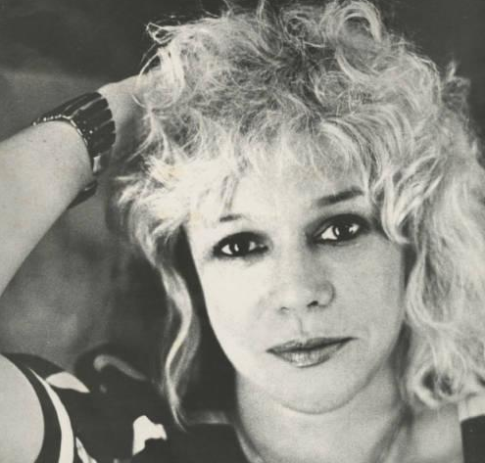
Left to right (clockwise):
Herberto Dumé and Eloisa Castellanos
(UM Digital Collections)
138 East 27th St theatre
(WikiMedia Commons)
Portfolio, "Teresa María Rojas"
(UM Digital Collections)

Slide 7
Introduction to EAC-CPF
(Encoded Archival Context–Corporate Bodies, Persons, and Families)

Slide 8
An Encoding Schema
Designed to encode information about:
People and organizations associated with archival collections
The social context and networks of those people and organizations
Explicit encoding of relationships.
EAC-CPF homepage | Tag Library

Slide 9
Encoding Relationships
Studying networks of influence and exchange
Static visualization (Gephi) http://demo.rampeditor.info/viz/ramp.png
Dynamic visualization (D3.js) http://demo.rampeditor.info/viz/ramp-chc-2.html
Linked Data 101: Things, Not Strings!

Slide 10
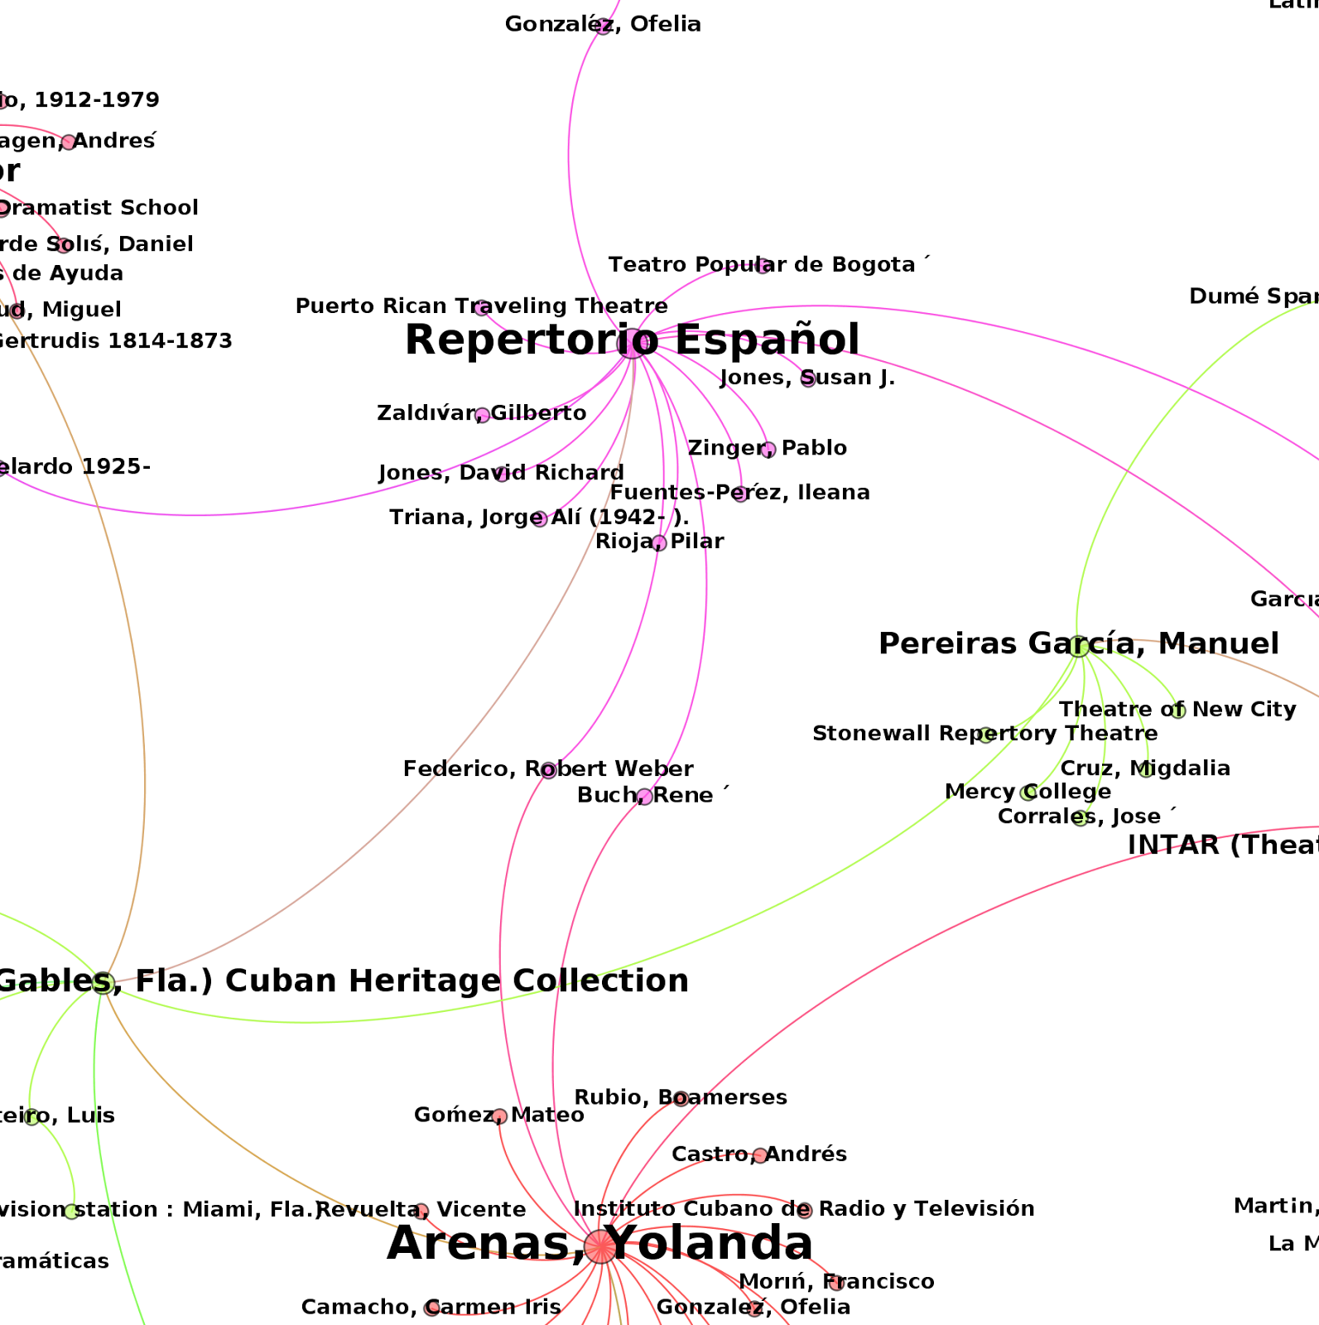

Slide 11
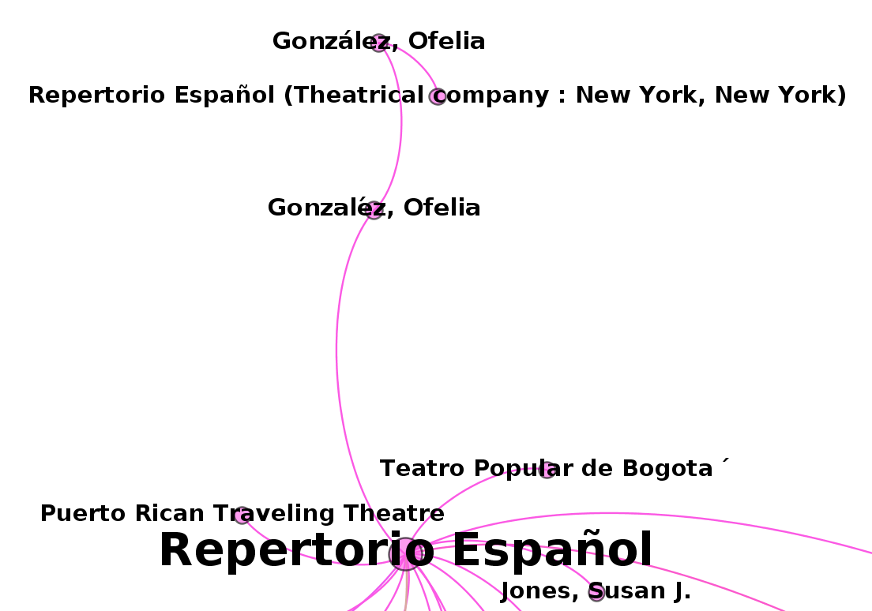
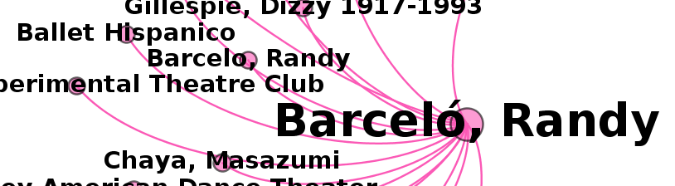

Slide 12
Overview of the RAMP editor
EAD
EAC-CPF
Wiki Markup

Slide 13
Browser-Based Tool
Easy to install and run from your desktop
Derives, creates, and enhances EAC-CPF records
Extracts relevant data from EAD files
Pulls in external data from OCLC APIs:
Virtual International Authority File (VIAF)
WorldCat Identities
Transforms EAC-CPF records into wiki markup
Direct publication to English Wikipedia through its API
Detailed installation instructions on GitHub:
https://github.com/UMiamiLibraries/RAMP

Slide 14
RAMP & Wikipedia

Slide 15
Workflow
Create EAC-CPF record (from finding aid or from scratch)
Add external data (WorldCat Identities and VIAF)
Transform to wiki markup
Merge with existing Wikipedia page or create a new page (userspace or article namespace)

Slide 17
New Wikipedia Templates
{{Cite_RAMP}}
{{RAMP_release}}
{{RAMP_release_PD}}
{{Cite_open_archival_metadata}}
{{Cite_LOC_finding_aid}}

Slide 18
Outcomes of Pilot Project with CHC Theater Collections
17 new pages were created and 1 existing page was expanded
New categories were added as appropriate
Links were added to and from existing pages

Slide 19
Reflections and Issues
Concerns about branding (see RAMP templates)
Concerns about notability
Orphan pages or pages with few links (contrary to what we expected)

Slide 20
Lessons and Questions
An opportunity to move beyond the limits of traditional library/archival standards
Finding-aid bios are not written with Wikipedia in mind
What about WP:NOR? Is there a gray area here?
How do you represent a “social network” on Wikipedia?

Slide 21
Next Steps…
Adding images from digital collections or content from the Cuban Theater Digital Archive
Extending the pilot project with another set of articles
Creating documentation or tutorials
Analyzing Web traffic from Wikipedia to local webpages
Improving the RAMP code base, adding new APIs (Wikidata, GeoNames)
Continuing to experiment

Slide 22
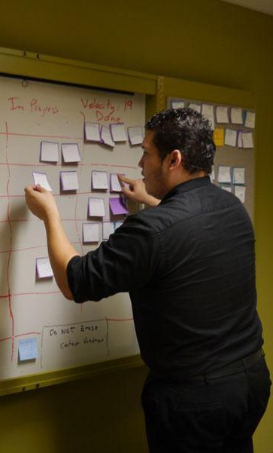
Credits
University of Miami Libraries
Cataloging & Metadata Services
Timothy Thompson
Matthew Carruthers
Web & Emerging Technologies
Andrew Darby
James Little
David Gonzalez
Cuban Heritage Collection
Special Collections Division
University Archives

Slide 23
Thank
you!
Timothy A. Thompson
tat2@princeton.edu
(@timathom)
Mairelys Lemus-Rojas
m.lemusrojas@miami.edu
@mlemusrojas

Slide 24
Demo? Discussion? Workshop?

