Slide 1
Consumer Analytics
bike sharing

Slide 2
Slide Title
Data set
Variables
Research question
Target attribute
Methode

Slide 3
Data set
bikesharing_data.csv
poi_data.json
weather_data.csv

Slide 4
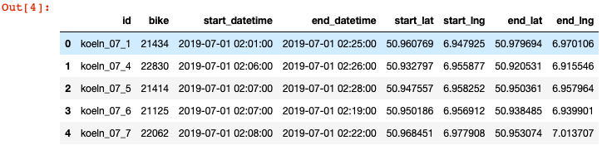
bikesharing_data.csv

Slide 5
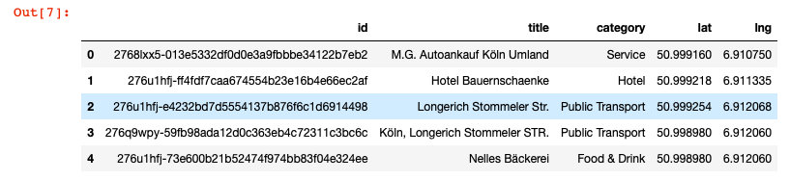
poi_data.json

Slide 6
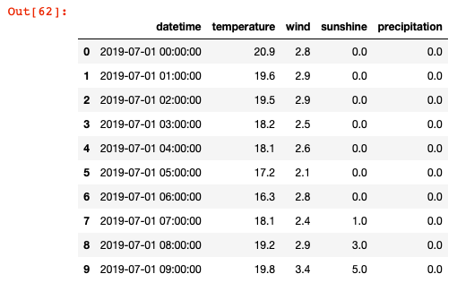
weather_data.csv

Slide 7
Supervised Regression Model
idea: model the linear relationship between two continuous variables 𝑥 and 𝑦
task: given an arbitrary value for 𝑥 (independent variable), predict the value of 𝑦 (dependent variable)
goal: find a line that provides the best fit

Slide 8
Research question
What is the probability that a certain category will be approached?
A model is developed, which should give the user relevant POI suggestions.

Slide 9
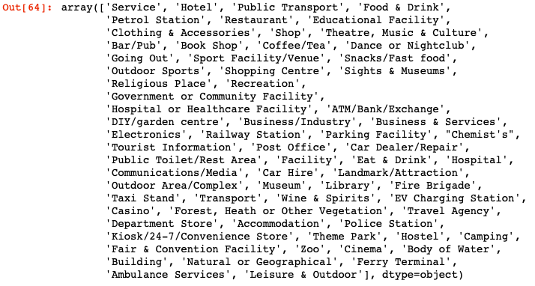
Target Attribute

Slide 10
Target Attribute
69 categories
Hotel, public transport, etc.
69 dummy variables?
69 target attributes?

Slide 11
Target Attribute
Categories counts from 1 to 2894
Using the most countet categories
Example: just categories > 200 counts

Slide 12
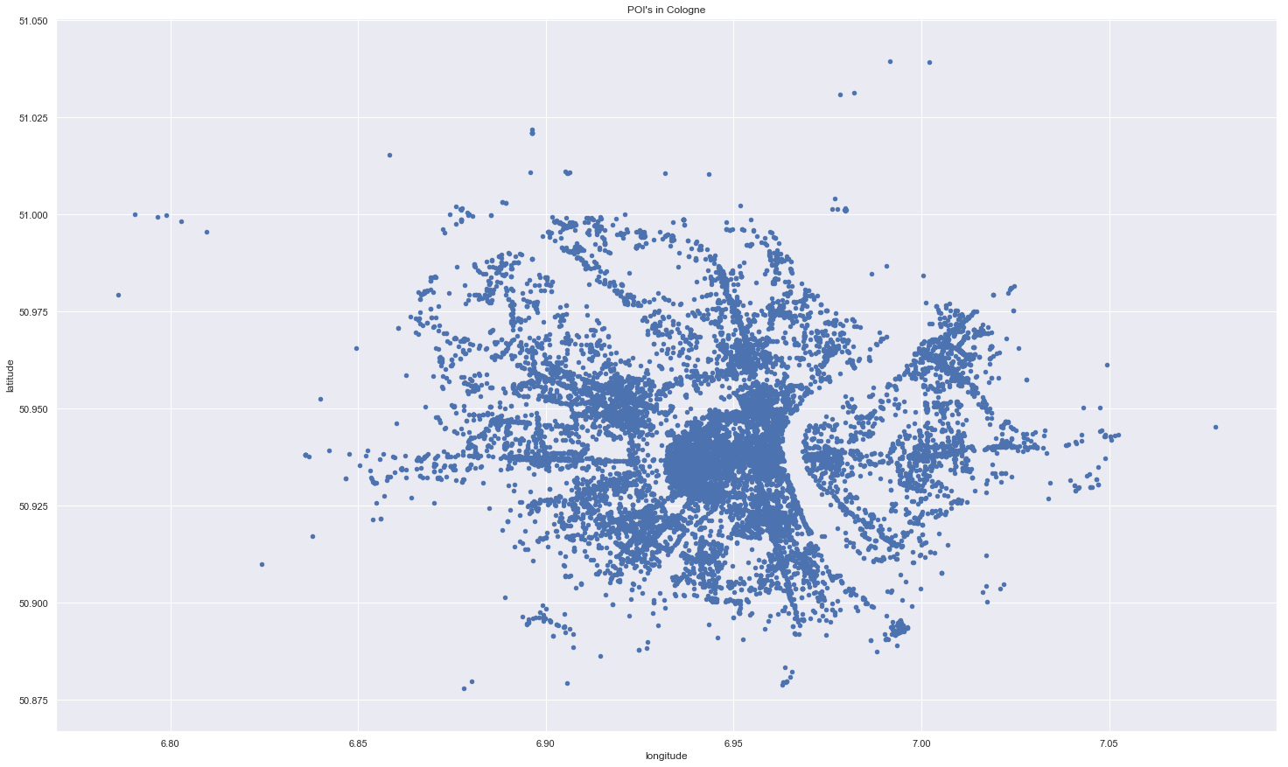

Slide 13
Methode
Supervised Linea Regression
Depended variables:
Prediction of a categorie
Independed variables:
Time
Day
Weather
(start point?)

