Slide 1
Activei App
Collects data from immobility, exercise and sleep
Directed to both casual users and to researchers

Slide 2
Idea
Shows your activities after a day and also includes weekly and monthly views
Includes alarm for recording sleep
The data is collected to a database as anonyms and can be used for example in school projects

Slide 3
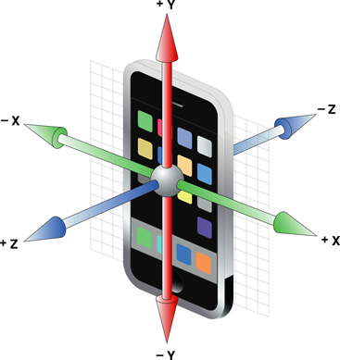
Accelerometer
3- Axis accelerometer
Also measures gravity
Only sensor used

Slide 4
What we have made
Accelerometer listener
Just reads values and saves some
Calculated total vector from 3 Axis

Slide 5
Whats still on the list
Making the actual logger with graphic views of your daily activity & data calculations
Database with online sync and social plugins
Better user interface, logo and splashscreen

Slide 6
Co-operation
Different people worked on the project without success at first (no working version)
Tim only worked 2 weeks at this App
Never had contact before coming to Belgium

Slide 7
Final Product
DEMO TIME

