Slide 1
Suricata安裝

Slide 2
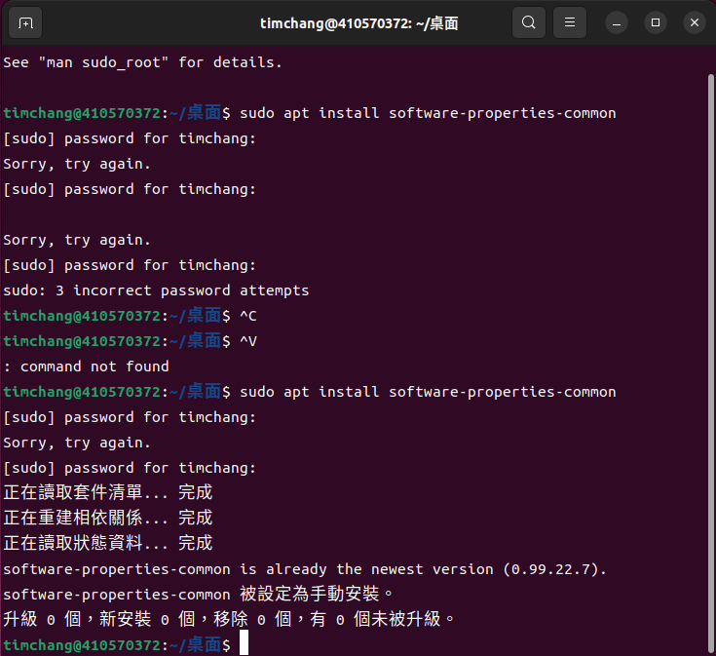
sudo apt install softwareproperties-com

Slide 3
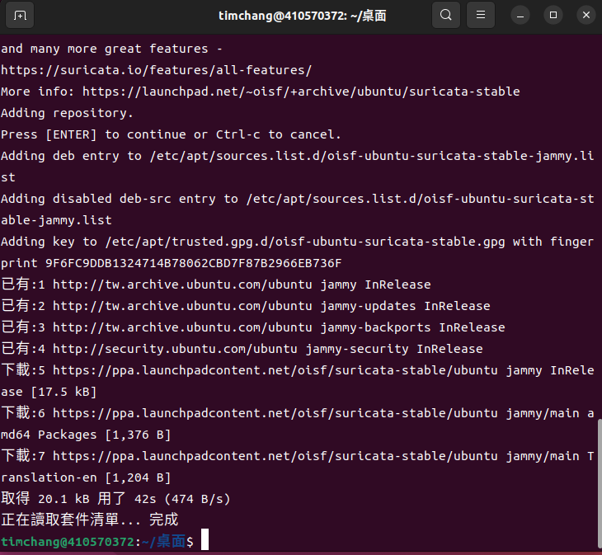
sudo add-apt-repository ppa:oisf/suricata-stable

Slide 4
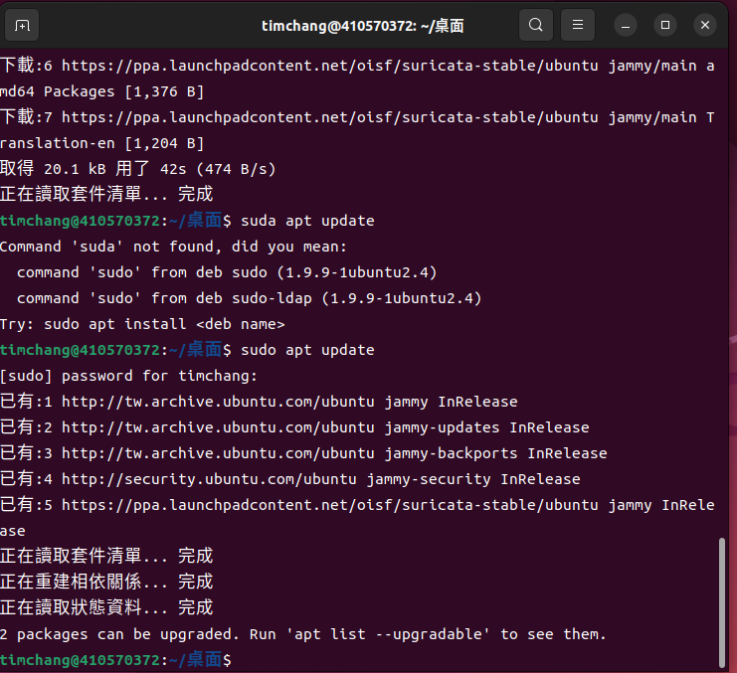
• sudo apt update

Slide 5
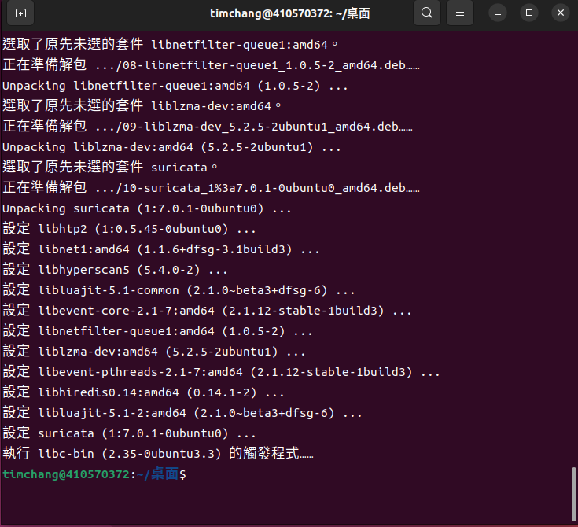
sudo apt install suricata •Y

Slide 6
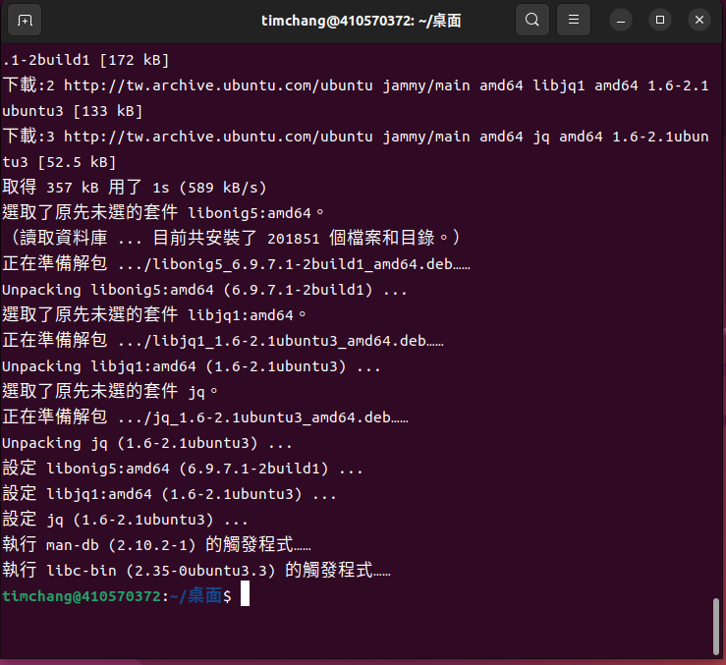
• sudo apt install jq •Y

Slide 7
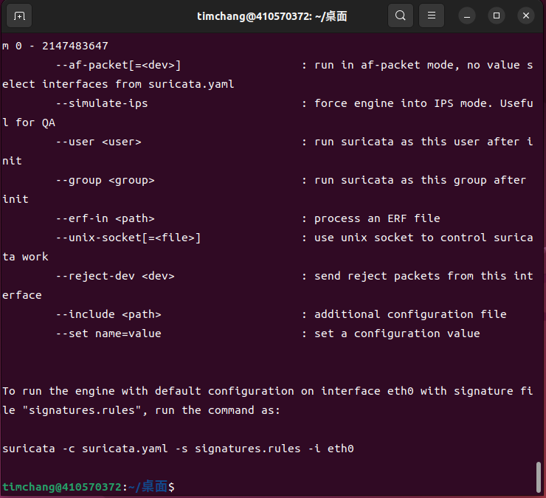
• sudo suricata –build-info

Slide 8
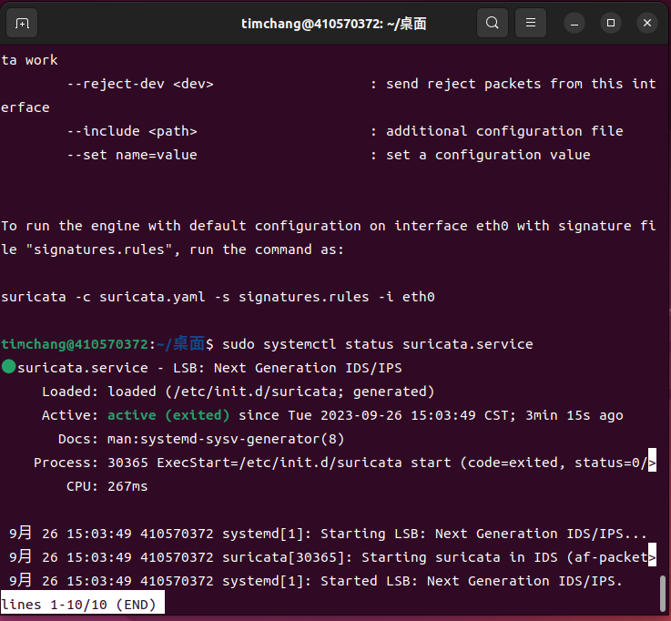
sudo systemctl status suricata.service

Slide 9
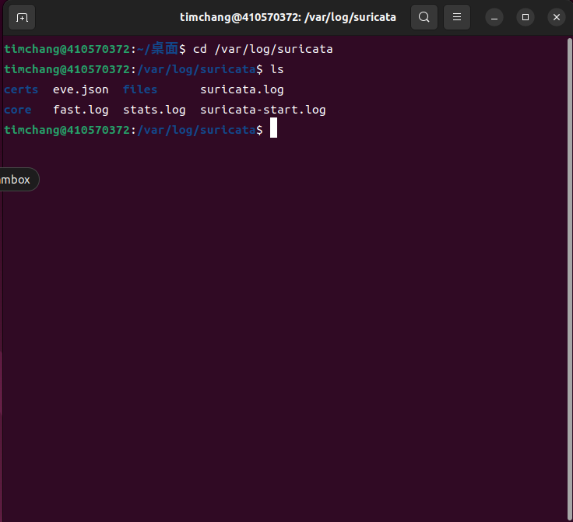
cd /var/log/suricata

Slide 10
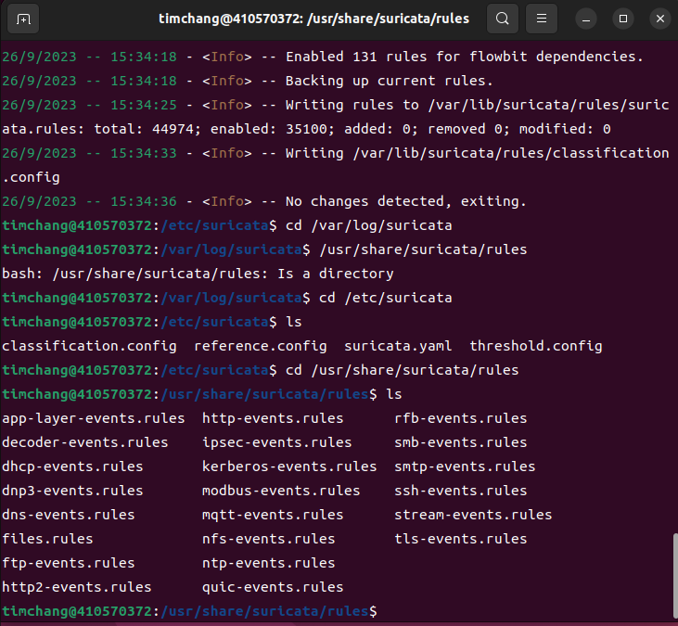
cd /etc/suricata/rules

Slide 11
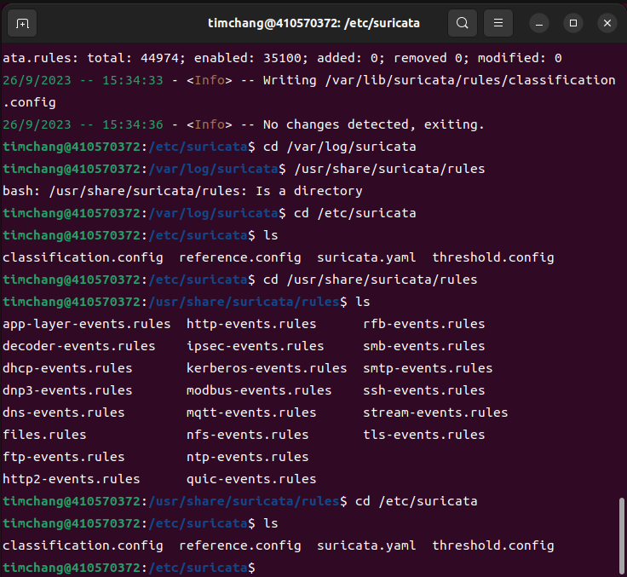
cd /etc/suricata

Slide 12
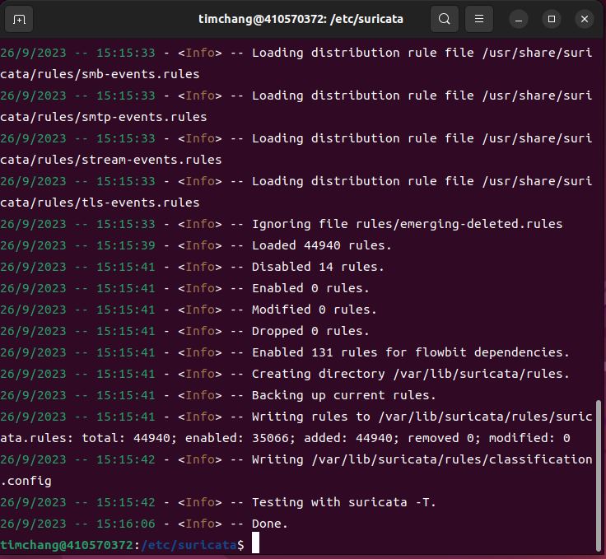
$ cd /etc/suricata $ sudo suricata-update

Slide 13
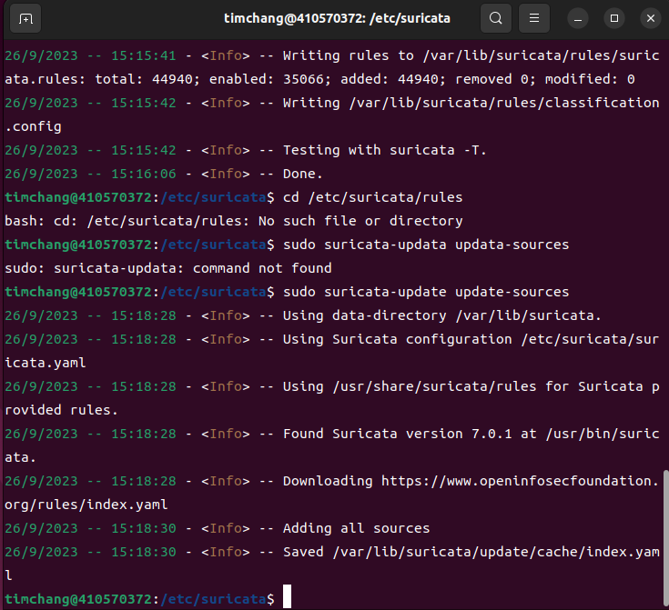
sudo suricata-update update-sources

Slide 14
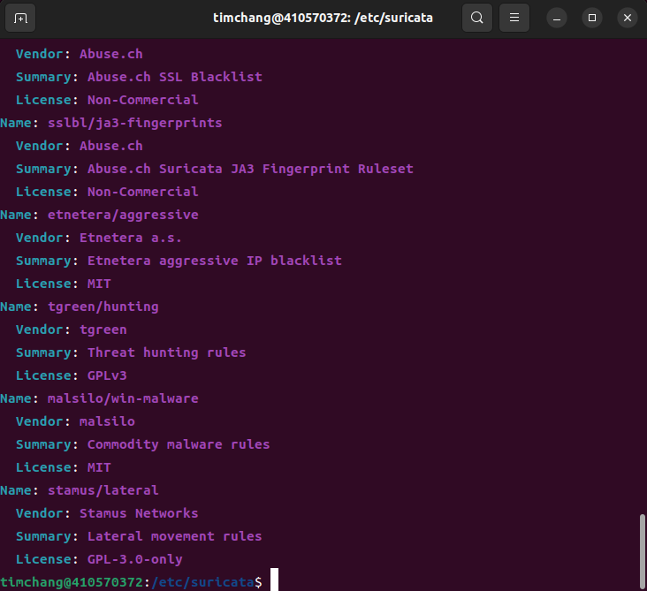
$ sudo suricata-update list-sources

Slide 15
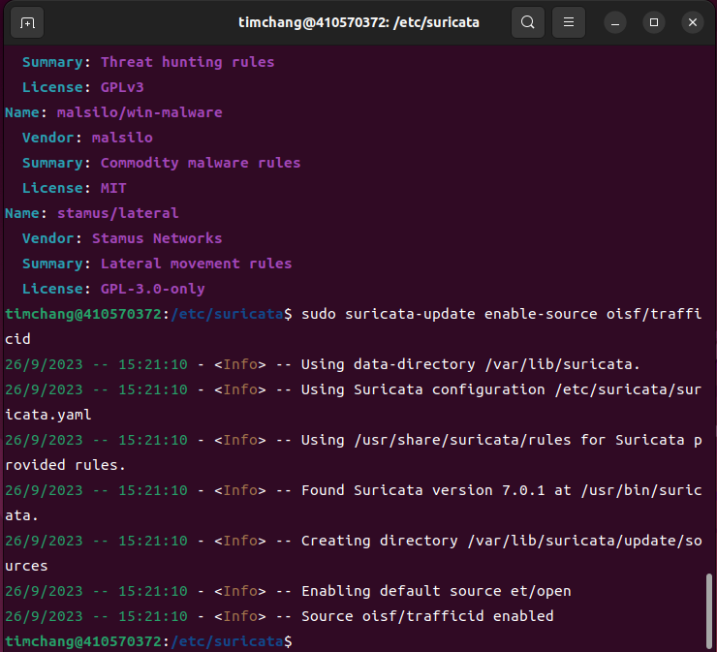
$ sudo suricata-update enable-source oisf/trafficid $ sudo suricata-update

Slide 16
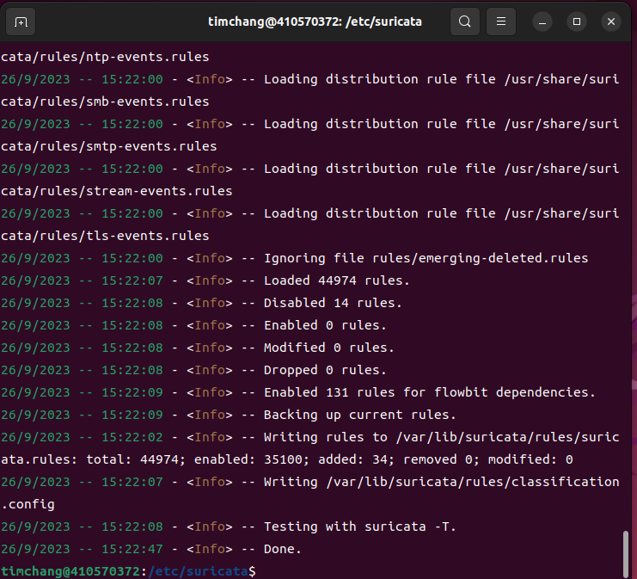
$ sudo suricata-update enable-source oisf/trafficid $ sudo suricata-update

Slide 17
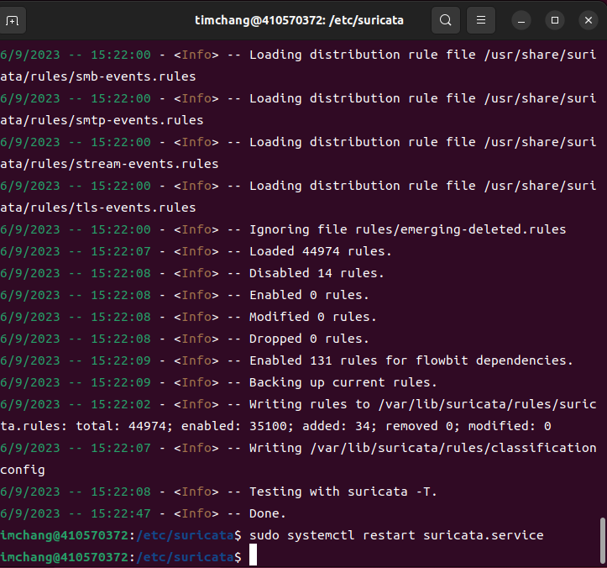
sudo systemctl restart suricata.service

Slide 18
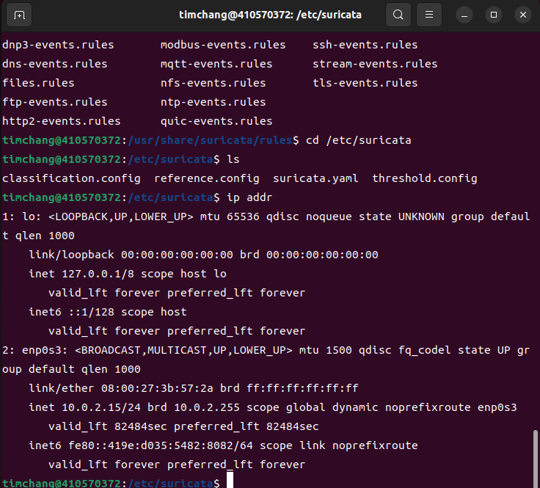
ip addr

Slide 19
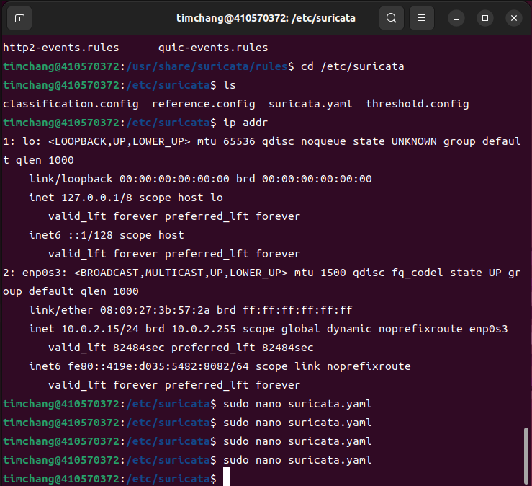
$ sudo nano suricata.yaml

Slide 20
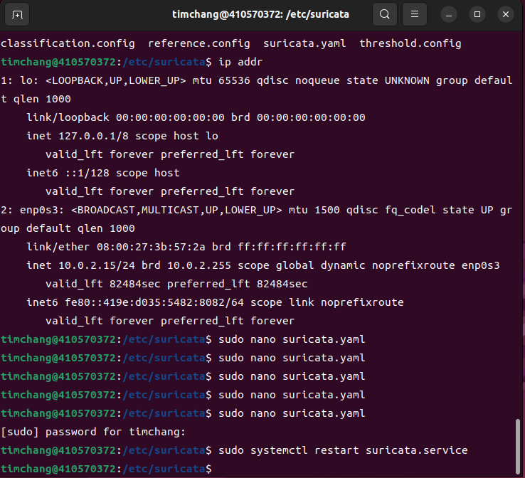
$ sudo systemctl restart suricata.service

Slide 21
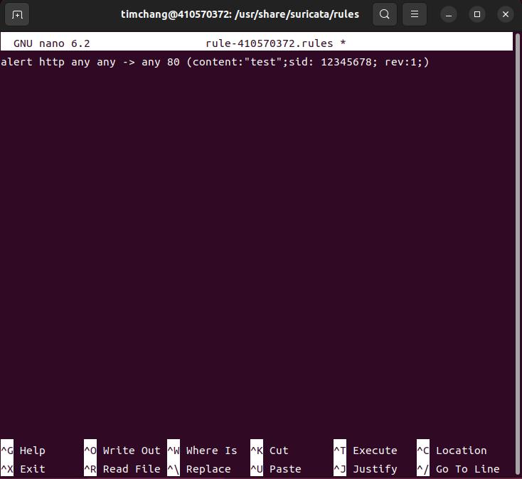
$ sudo nano rule-學 號.rules

Slide 22
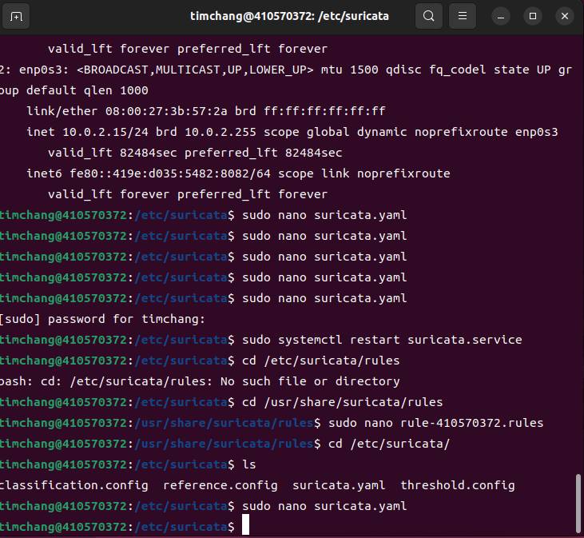
• cd /etc/suricata/ •sudo nano suricata.yaml

Slide 23
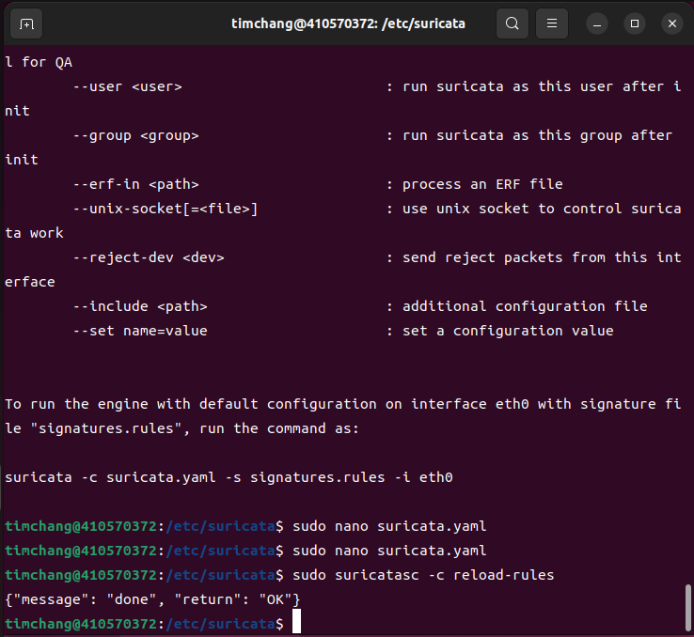
新增自訂規則檔到設 定檔

Slide 24
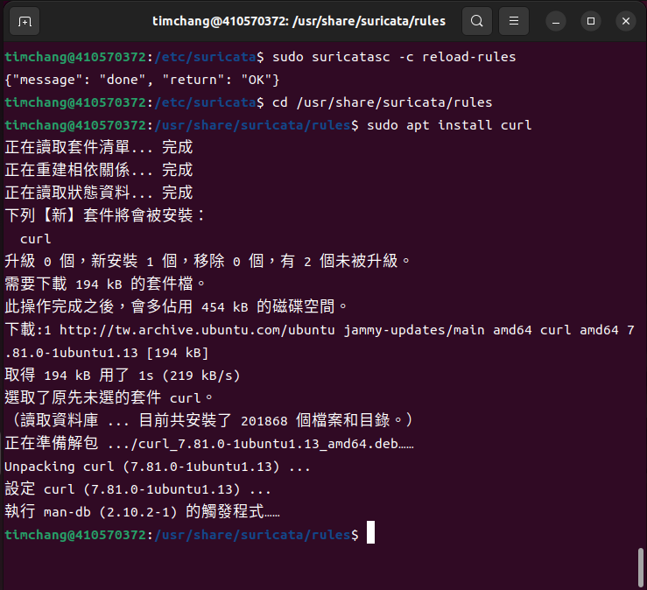
$sudo apt install curl

Slide 25
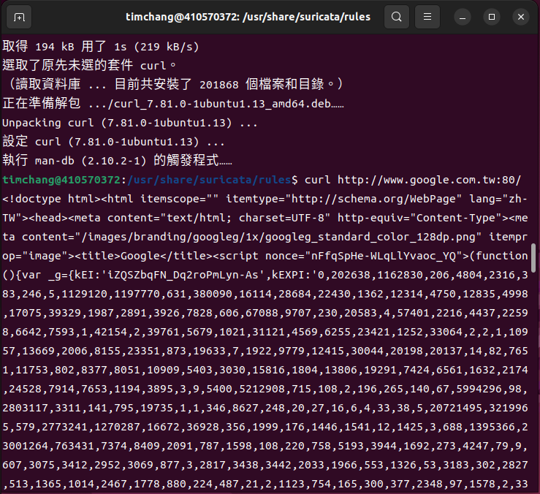
curl http://www.google.com.tw:80/

Slide 26
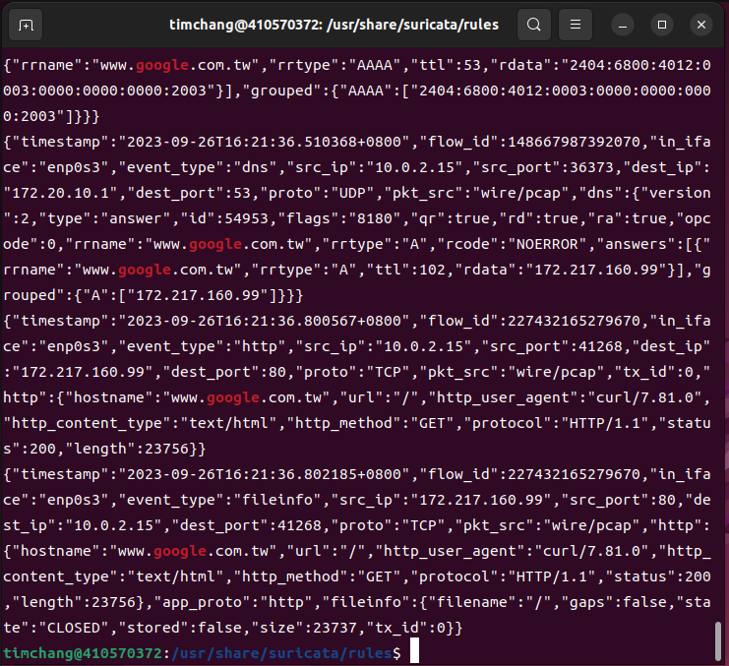
• sudo cat /var/log/suricata/eve.json | grep “google

