Slide 1

Tools
Door Pim, Noah, Tim en Mo

Slide 2
Tools
Some examples of DS tools
-PowerBI
- D3.js
-Python/R (with jupyter notebook)
- Matlab

Slide 3
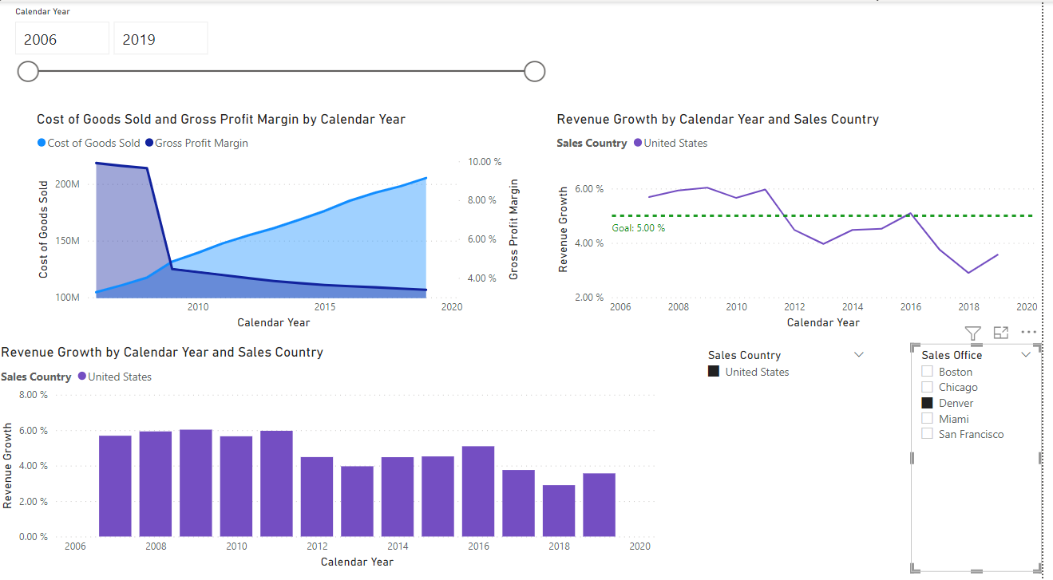
PowerBI
Gui program, lets you easily add widgets to represent data.

Slide 4
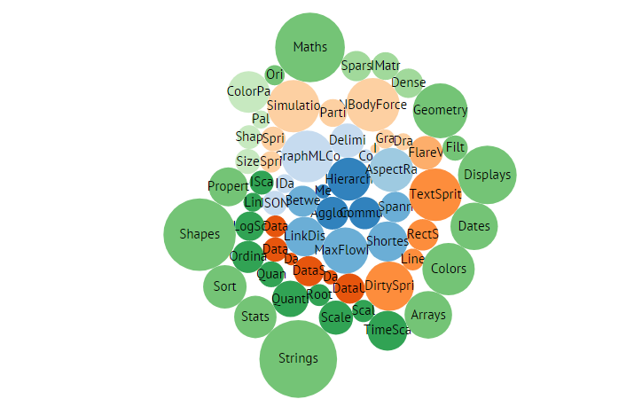
D3.js
Tool based on Javascript, lets you change css.
Makes sense if you need to change the styling to represent something.

Slide 5
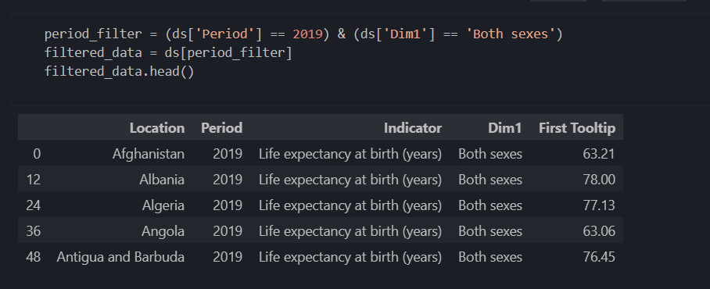
Python/R
(with jupyter notebook)
Interpreted programming languages.
They have a lot of useful libraries for data science.
With Jupyter notebook we can put code snippets in a portfolio and add texts for documentation or explanation.

Slide 6
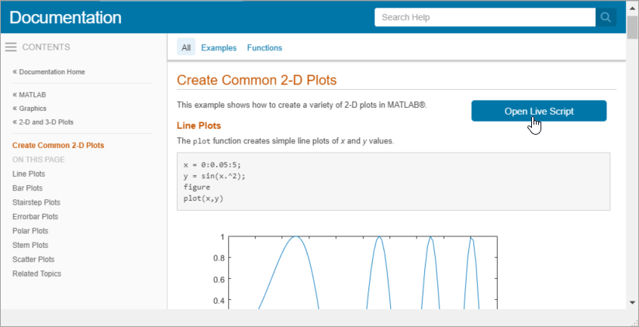
Matlab
Matlab is a programming language used for:
Computation of numeric data,
creating graphics for scientific use,
modeling and simulating data,
analyzing data.
These things can be done in Python and R too, but these require libraries, Matlab is more focused on these aspects.

