Slide 1

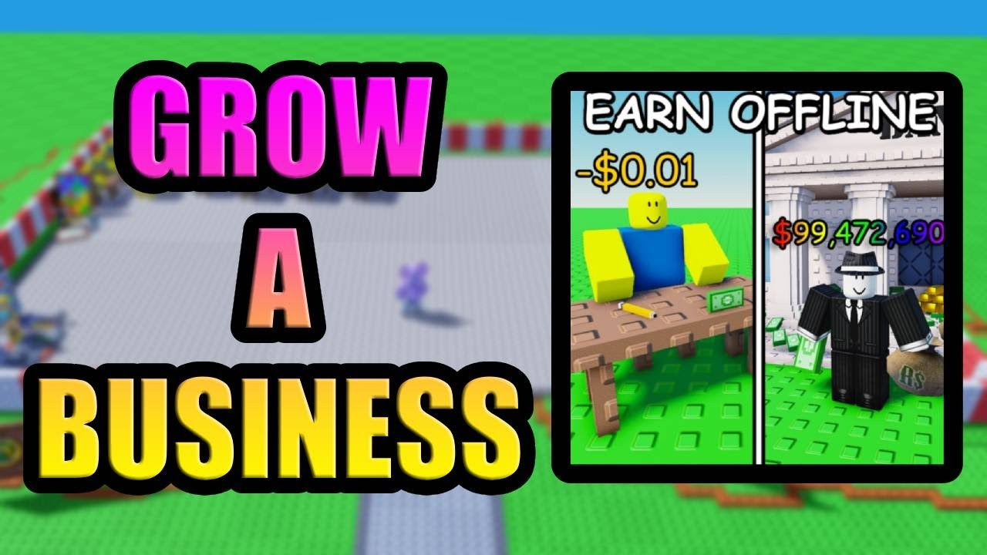
GROW A BUISNESS – AI-DRIVSN ROBLOX SIMULATOR FOR LIFE SKILLS
Theme 1: AI in Education & Community Well-being • Ideas & Innovations Competition By: ~Sujeet Raut and ~Lavya Patil Notes: Open with the problem — students need engaging, practical life-skills learning. Introduce the AI-powered Roblox game that teaches budgeting, planning, and ethics.

Slide 2
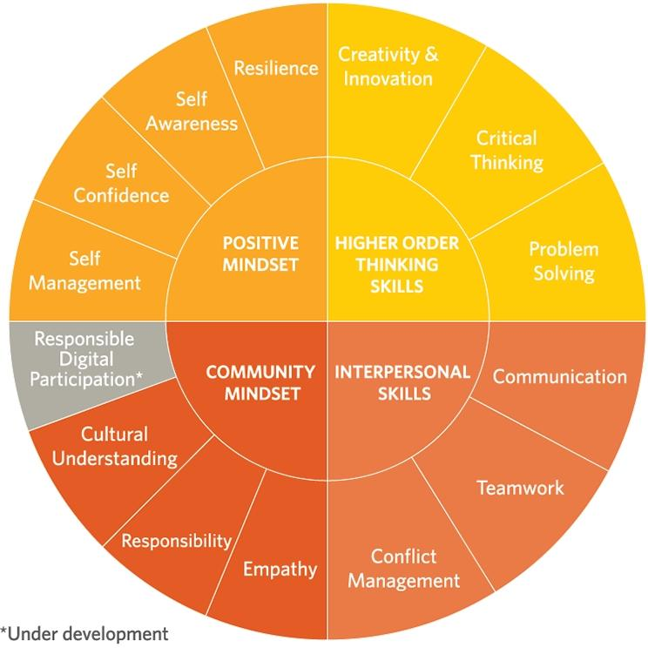
— The Challenge: Learning Gaps & Engagement:
Life skills (budgeting, planning, teamwork, ethics) are under-taught or taught abstractly. Traditional lessons lack practice and motivation; learners need safe spaces to experiment. Access & equity: many students only have mobile devices; solutions must be low-cost and scalable. Notes: Emphasize that life skills need repeated, contextualized practice — not just lectures.---

Slide 3
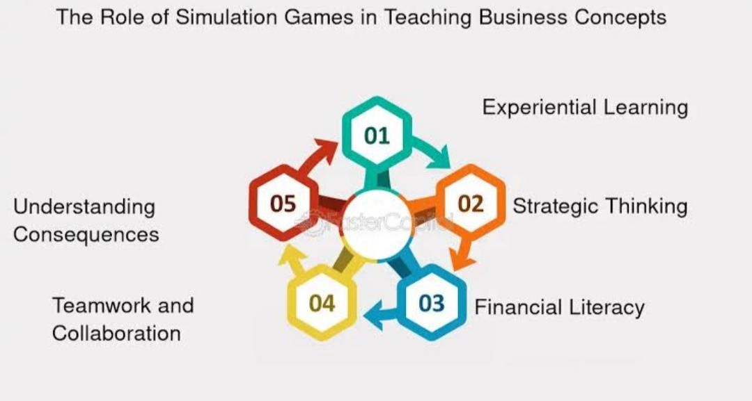
— The Solution: “Grow a Business”
Roblox Simulator Game-based learning where players start and scale a virtual business. Built-in AI mentor personalizes quests, feedback, and pacing inside the game world. Teaches budgeting, pricing, hiring, negotiation, ethics, and resilience through play. Mobile-friendly; fun-first design increases time-on-task and retention. Notes: Highlight why Roblox: familiar, social, and available on phones and low-spec devices.---

Slide 4
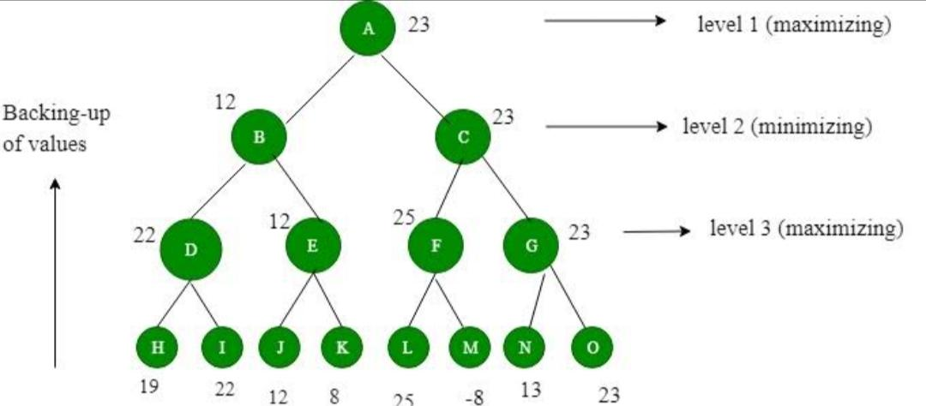
— How the AI Works (Inside the Game)
Learner Model — Tracks skills (budgeting, planning, teamwork, grit) & misconceptions. Recommendation Engine — Adaptively assigns quests to target gaps. Conversational Coach — Context-aware hints, Socratic questions, reflective prompts. Assessment & Feedback — Scenario-based rubrics, formative checks, debriefs. Safety & Fair Play — Content filters, anti-toxicity, anti-cheat features. Notes: Explain personalization simply and stress safety.---

Slide 5

— What’s Innovative
AI tutor lives inside a social game world — not a separate chat window. Real-time personalization from in-game decisions (risk, timing, collaboration).Competency-based progression; supports multilingual prompts and low-bandwidth mode. Bridges education and community well-being via financial literacy and ethical decision-making. Notes: Differentiate from typical ed-tech apps.---

Slide 6

— Feasibility & Implementation Plan Stack:
Roblox (Lua) for gameplay, lightweight API (Python/Node) for AI.MVP Scope: Core economy loop, AI mentor v1, 10 skill-aligned quests, analytics dashboard. Privacy & Cost: No PII, anonymous analytics, cached prompts to control costs. Notes: Show that it’s realistic and privacy-first.---

Slide 7
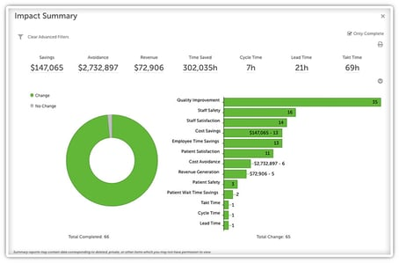
— Impact & Measurement Education Outcomes:
Pre/post quizzes, in-game mastery milestones. Community Well-being: Confidence in financial decisions, ethical choices, teamwork. Key Metrics: Retention, quest mastery, quality of reflections/decisions. Notes: Promise measurable results.--

Slide 8
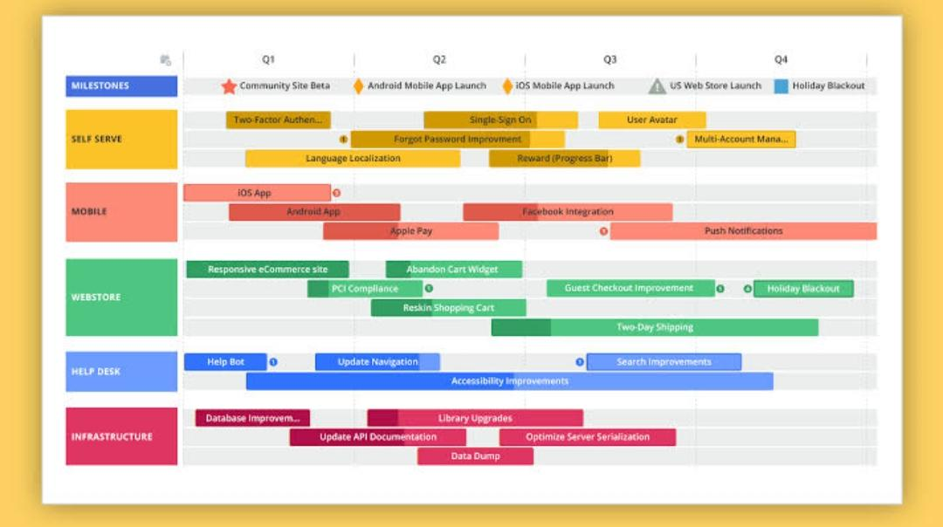
— Roadmap & AskPilot (4–6 weeks):
Co-design with the Developer and Owner, collect feedback. Next Modules: Disaster preparedness, digital safety, mental well-being lessons. What We Need: Mentorship, pilot access, feedback partners. Notes: End with a clear plan and call-to-action.--

Slide 9


