Slide 1
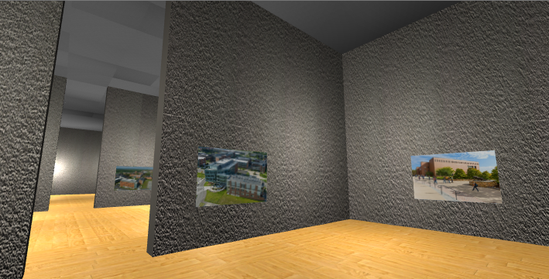
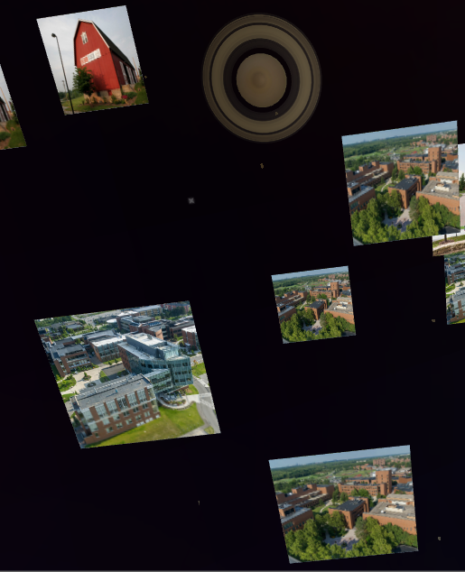
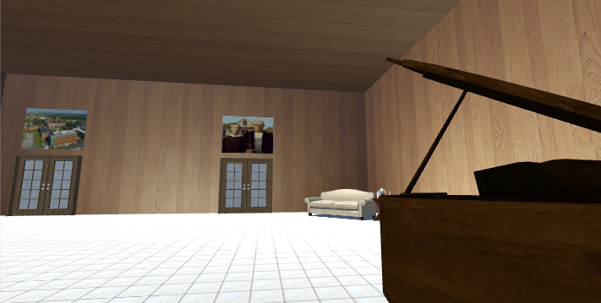
VR Photo Album
This VR app showcases a user's digital photo collection overlaid in a procedurally generated art gallery. For a more relaxed experience, it also features a planetarium that gives a slideshow of those photos.

