Slide 1
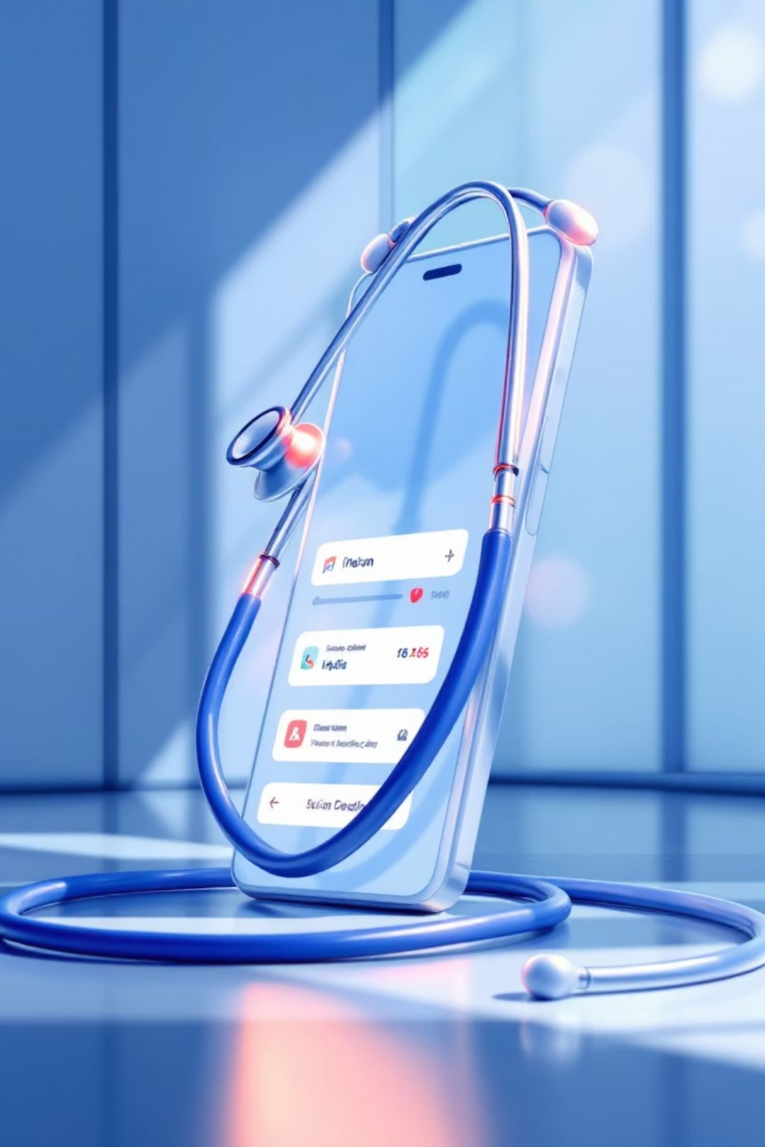
MediConnect: Revolutionising Online Doctor Appointments in India
Transforming the way patients connect with healthcare professionals through seamless digital innovation. Access quality healthcare anytime, anywhere across India.

Slide 2
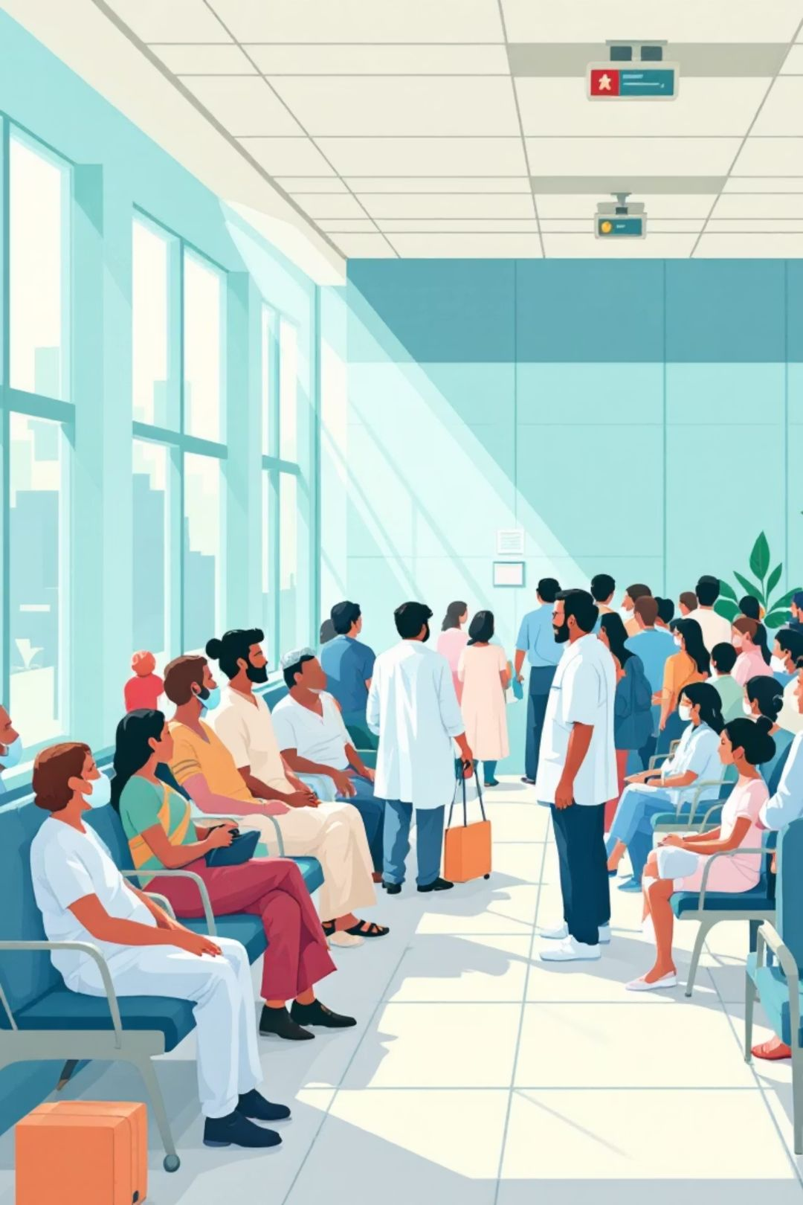
The Challenge: Traditional Healthcare Access Barriers
Long Waiting Times
Limited Doctor Availability
Patients spend hours in crowded waiting rooms, often taking entire days off work for simple consultations.
Finding the right specialist at convenient times remains challenging, especially in tier-2 and tier-3 cities.
Booking Complexity
Multiple phone calls, unclear timings, and manual appointment scheduling create frustration for both patients and doctors.

Slide 3
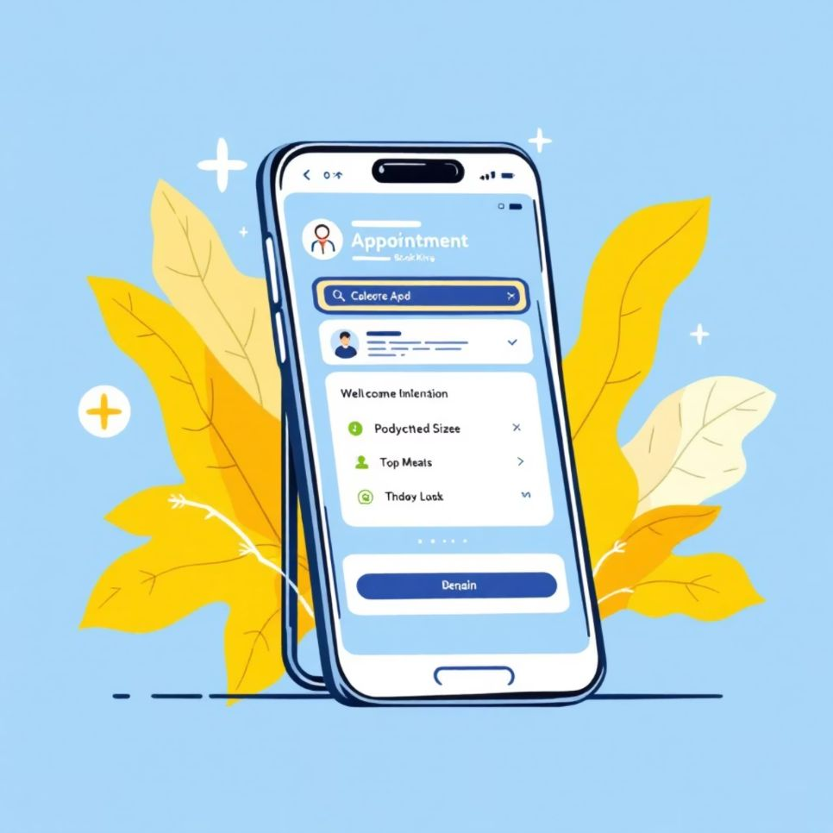
Introducing MediConnect: Your Digital Healthcare Companion
MediConnect is India's comprehensive online platform connecting patients with verified doctors across specialties. Book appointments, manage schedules, and access healthcare with just a few taps.
Built for Indian Healthcare: Designed specifically for India's diverse healthcare ecosystem, supporting multiple languages and regional healthcare practices.
Connect with 10,000+ verified doctors nationwide
Available across 500+ cities and towns
Support for 12 Indian languages
24/7 platform accessibility

Slide 4
Key Features: Doctor Discovery and Profile Management
Comprehensive Doctor Profiles
Smart Search and Filters
Verified Credentials
Detailed information including qualifications, specialisations, experience, patient reviews, and consultation fees at your fingertips.
Find doctors by specialty, location, availability, languages spoken, and ratings. Advanced filters ensure you find the perfect match.
Every doctor undergoes thorough verification. View MCI registration, degrees, hospital affiliations, and authentic patient testimonials.

Slide 5

Seamless Appointment Booking System
01
02
Select Your Doctor
Choose Date and Time
Browse through verified profiles, compare doctors, and choose based on specialty, location, ratings, and availability.
View real-time availability with colour-coded slots. Select morning, afternoon, or evening appointments that fit your schedule.
03
04
Confirm and Pay
Receive Reminders
Secure payment gateway with multiple options including UPI, cards, and wallets. Instant booking confirmation via SMS and email.
Automated notifications 24 hours and 1 hour before your appointment. Never miss a consultation again.

Slide 6
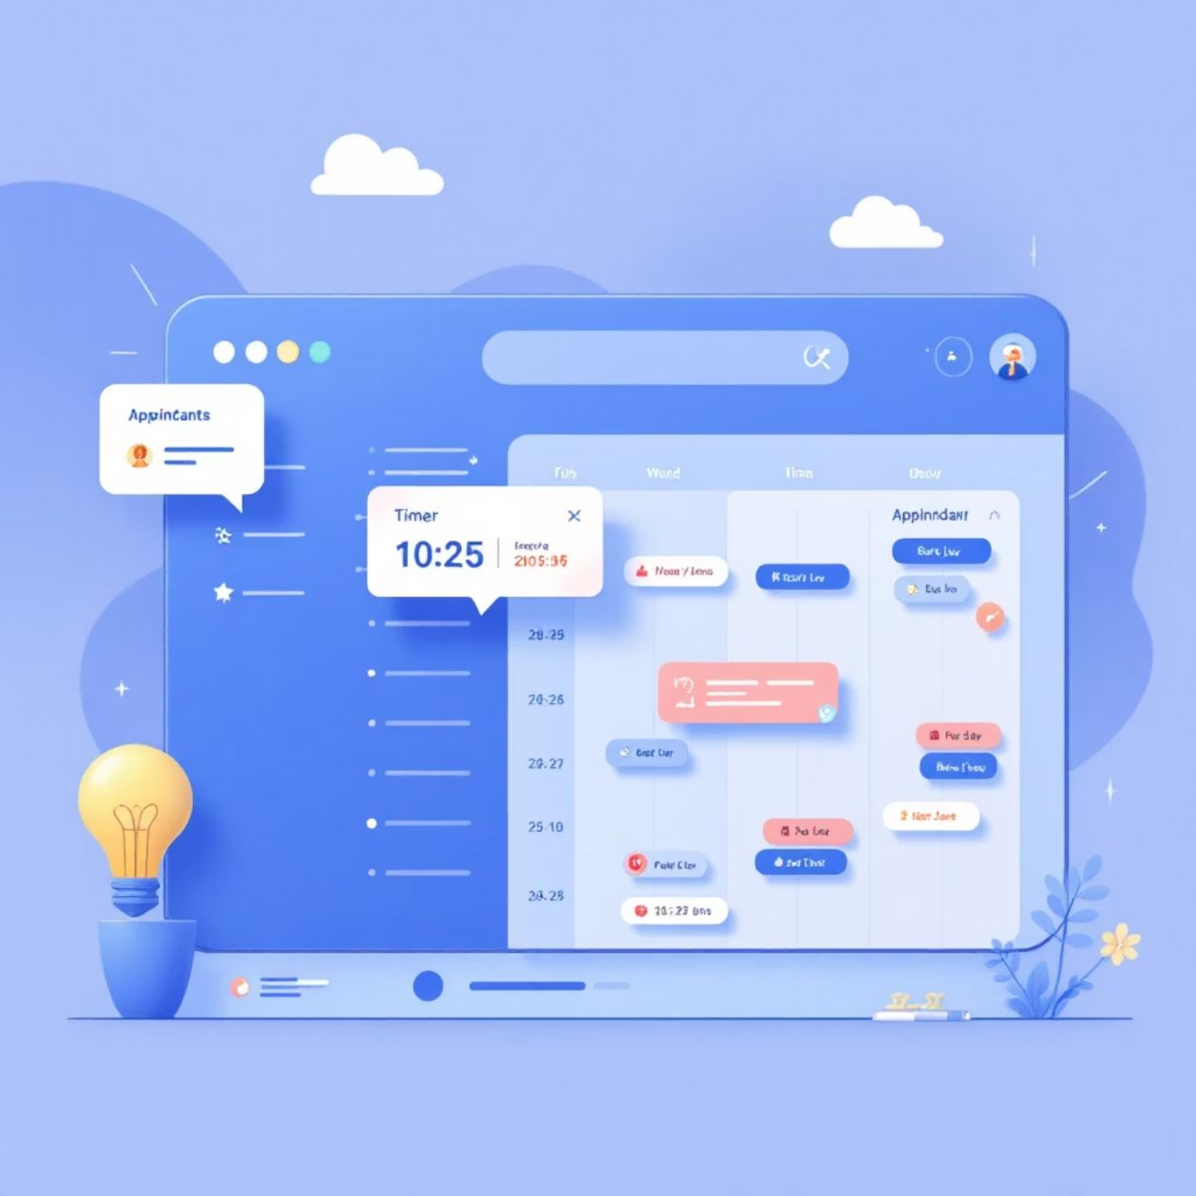
Real-time Schedule Management and Timing Coordination
For Doctors
Set custom availability schedules across multiple clinics
Define consultation duration and buffer times
Block dates for holidays and personal time
Real-time dashboard shows today's appointments
One-click rescheduling and cancellation management
For Patients
Live availability updates prevent double bookings
Easy rescheduling up to 2 hours before appointment
Queue position tracking on appointment day
Estimated waiting time notifications

Slide 7



Patient Registration and Profile Creation Process
Quick Sign-up
Health Profile
Family Accounts
Register using mobile number with OTP verification. Link Aadhaar for instant identity verification (optional).
Add medical history, current medications, allergies, and chronic conditions. Store health records securely in one place.
Manage appointments for entire family under one account. Add dependents with individual health profiles easily.
Your data is encrypted and protected with bank-level security. Complete privacy guaranteed with HIPAA-compliant infrastructure.

Slide 8

Doctor Onboarding and Verification Procedures
1
Application Submission
Doctors submit registration with MCI number, medical degree certificates, and clinic details. Initial review completed within 24 hours.
2
Document Verification
Our verification team validates credentials with Medical Council of India database, checks hospital affiliations, and reviews practice history thoroughly.
3
Profile Setup
Create comprehensive profile with specialisations, consultation fees, clinic locations, and availability schedules. Add profile photo and clinic images.
4
Training and Go-Live
Complete platform training covering appointment management, patient interaction protocols, and technical support. Start accepting appointments within 48 hours.

Slide 9

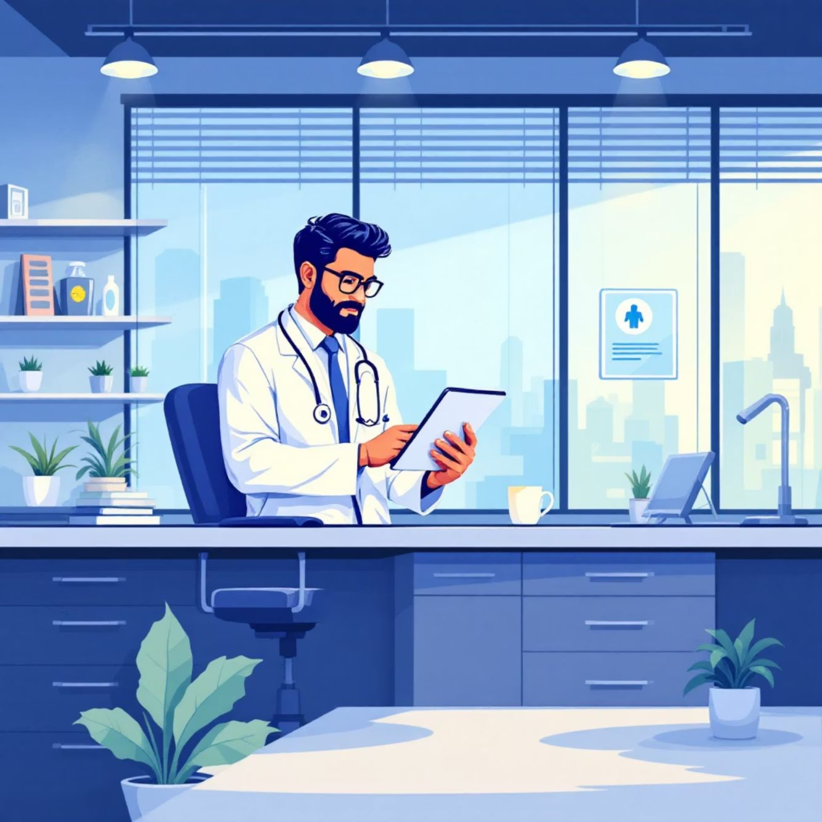
Benefits for Patients and Healthcare Providers
For Patients
For Doctors
Time Savings
Reduced No-shows
Book appointments in under 2 minutes. No more phone calls or long waits.
Automated reminders reduce missed appointments by 60%. Better time utilisation.
Better Choices
Practice Growth
Compare doctors, read genuine reviews, and make informed healthcare decisions.
Reach thousands of new patients. Enhanced visibility across India.
Cost Transparency
Efficient Management
View consultation fees upfront. No hidden charges or surprises.
Digital appointment tracking, payment reconciliation, and patient records in one dashboard.

Slide 10






Next Steps: Getting Started with MediConnect Today
Download the App
Create Your Profile
Book Your Appointment
Available on Google Play Store and Apple App Store. Web version accessible at www.mediconnect.in
Quick 2-minute registration. Add family members and medical history for personalised care.
Find your doctor, select a convenient time, and confirm. Healthcare made simple!
Join 5 Lakh+ Happy Users
Experience the future of healthcare access in India. Whether you're a patient seeking quality care or a doctor looking to expand your practice, MediConnect is your trusted partner.

