Slide 1

Searching and Mining Trillions of Time Series Subsequences under Dynamic Time Warping
Thanawin (Art) Rakthanmanon, Bilson Campana, Abdullah Mueen, Gustavo Batista, Qiang Zhu,
Brandon Westover, Jesin Zakaria, Eamonn Keogh

Slide 2
What is a Trillion?
A trillion is simply one million million.
Up to 2011 there have been 1,709 papers. If every such paper was on time series, and each had looked at five hundred million objects, this would still not add up to the size of the data we consider here.
However, large time series data considered in a SIGKDD paper was a “mere” one hundred million objects.

Slide 3
Dynamic Time Warping
Similar but out of phase peaks.
C
Q
Q
C
Q
C
R (Warping Windows)

Slide 4
Motivation
Similarity search is the bottleneck for most time series data mining algorithms.
The difficulty of scaling search to large datasets explains why most academic work considered at few millions of time series objects.

Slide 5
Objective
Search and mine really big time series.
Allow us to solve higher-level time series data mining problem such as motif discovery and clustering at scales that would otherwise be untenable.

Slide 6
Assumptions (1)
Time Series Subsequences must be Z-Normalized
  In order to make meaningful comparisons between two time series, both must be normalized.
  Offset invariance.
  Scale/Amplitude invariance.
Dynamic Time Warping is the Best Measure (for almost everything)
  Recent empirical evidence strongly suggests that none of the published alternatives routinely beats DTW.
B
C
A

Slide 7
Assumptions (2)
Arbitrary Query Lengths cannot be Indexed
  If we are interested in tackling a trillion data objects we clearly cannot fit even a small footprint index in the main memory, much less the much larger index suggested for arbitrary length queries.
There Exists Data Mining Problems that we are Willing to Wait Some Hours to Answer
  a team of entomologists has spent three years gathering 0.2 trillion datapoints
  astronomers have spent billions dollars to launch a satellite to collect one trillion datapoints of star-light curve data per day
  a hospital charges $34,000 for a daylong EEG session to collect 0.3 trillion datapoints

Slide 8
Proposed Method: UCR Suite
An algorithm for searching nearest neighbor
Support both ED and DTW search
Combination of various optimizations
  Known Optimizations
  New Optimizations

Slide 9
Known Optimizations (1)
Using the Squared Distance
Exploiting Multicores
  More cores, more speed
Lower Bounding
  LB_Yi
  LB_Kim
  LB_Keogh
2
LB_Keogh
C
U
L
Q

Slide 10
Known Optimizations (2)
Early Abandoning of ED
Early Abandoning of LB_Keogh
U, L is an envelope of Q

Slide 11
Known Optimizations (3)
Early Abandoning of DTW
Earlier Early Abandoning of DTW using LB_Keogh
Stop if dtw_dist +lb_keogh ≥ bsf
C
Stop if dtw_dist ≥ bsf
Q
(partial)
lb_keogh
dtw_dist
(partial)
dtw_dist
R (Warping Windows)

Slide 12
UCR Suite
Known Optimizations
  Early Abandoning of ED
  Early Abandoning of LB_Keogh
  Early Abandoning of DTW
  Multicores
New Optimizations

Slide 13
UCR Suite: New Optimizations (1)
Early Abandoning Z-Normalization
  Do normalization only when needed (just in time).
  Small but non-trivial.
  This step can break O(n) time complexity for ED (and, as we shall see, DTW).
  Online mean and std calculation is needed.

Slide 14
UCR Suite: New Optimizations (2)
Reordering Early Abandoning
  We don’t have to compute ED or LB from left to right.
  Order points by expected contribution.
Idea
- Order by the absolute height of the query point.
- This step only can save about 30%-50% of calculations.

Slide 15
UCR Suite: New Optimizations (3)
Reversing the Query/Data Role in LB_Keogh
  Make LB_Keogh tighter.
  Much cheaper than DTW.
  Triple the data.
  -------------------
  Online envelope calculation.
Envelop on Q
Envelop on C

Slide 16
UCR Suite: New Optimizations (4)
Cascading Lower Bounds
  At least 18 lower bounds of DTW was proposed.
  Use some lower bounds only on the Skyline.
Tightness of LB
(LB/DTW)

Slide 17
UCR Suite
Known Optimizations
  Early Abandoning of ED
  Early Abandoning of LB_Keogh
  Early Abandoning of DTW
  Multicores
New Optimizations
  Just-in-time Z-normalizations
  Reordering Early Abandoning
  Reversing LB_Keogh
  Cascading Lower Bounds

Slide 18
UCR Suite
State-of-the-art*
Known Optimizations
  Early Abandoning of ED
  Early Abandoning of LB_Keogh
  Early Abandoning of DTW
  Multicores
New Optimizations
  Just-in-time Z-normalizations
  Reordering Early Abandoning
  Reversing LB_Keogh
  Cascading Lower Bounds
*We implemented the State-of-the-art (SOTA) as well as we could.
SOTA is simply the UCR Suite without new optimizations.

Slide 19
Experimental Result: Random Walk
Random Walk: Varying size of the data
 | Million (Seconds) | Billion (Minutes) | Trillion (Hours)
UCR-ED | 0.034 | 0.22 | 3.16
SOTA-ED | 0.243 | 2.40 | 39.80
UCR-DTW | 0.159 | 1.83 | 34.09
SOTA-DTW | 2.447 | 38.14 | 472.80
Code and data is available at:
www.cs.ucr.edu/~eamonn/UCRsuite.html

Slide 20
Experimental Result: Random Walk
Random Walk: Varying size of the query

Slide 21
Experimental Result: DNA
Query: Human Chromosome 2 of length 72,500 bps
Data: Chimp Genome 2.9 billion bps
Time: UCR Suite 14.6 hours, SOTA 34.6 days (830 hours)

Slide 22
Experimental Result: EEG
Data: 0.3 trillion points of brain wave
Query: Prototypical Epileptic Spike of 7,000 points (2.3 seconds)
Time: UCR-ED 3.4 hours, SOTA-ED 20.6 days (~500 hours)

Slide 23
Experimental Result: ECG
Data: One year of Electrocardiograms 8.5 billion data points.
Query: Idealized Premature Ventricular Contraction (PVC) of length 421 (R=21=5%).
PVC (aka. skipped beat)
 | UCR-ED | SOTA-ED | UCR-DTW | SOTA-DTW
ECG | 4.1 minutes | 66.6 minutes | 18.0 minutes | 49.2 hours
~30,000X faster than real time!

Slide 24
Speeding Up Existing Algorithm
Time Series Shapelets:
  SOTA 18.9 minutes, UCR Suite 12.5 minutes
Online Time Series Motifs:
  SOTA 436 seconds, UCR Suite 156 seconds
Classification of Historical Musical Scores:
  SOTA 142.4 hours, UCR Suite 720 minutes
Classification of Ancient Coins:
  SOTA 12.8 seconds , UCR Suite 0.8 seconds
Clustering of Star Light Curves:
  SOTA 24.8 hours, UCR Suite 2.2 hours

Slide 25
Conclusion
UCR Suite …
is an ultra-fast algorithm for finding nearest neighbor.
is the first algorithm that exactly mines trillion real-valued objects in a day or two with a "off-the-shelf machine".
uses a combination of various optimizations.
can be used as a subroutine to speed up other algorithms.
Probably close to optimal ;-)

Slide 26



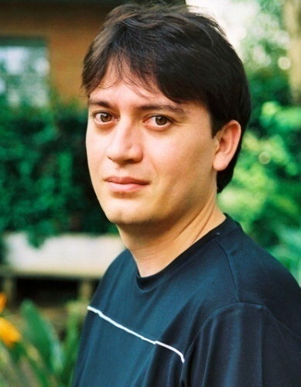
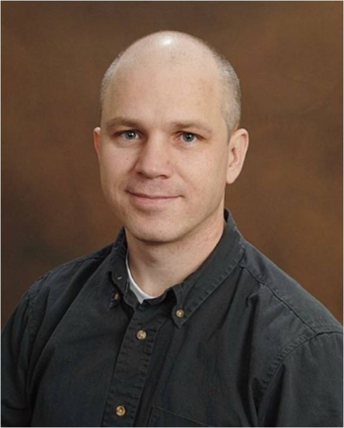
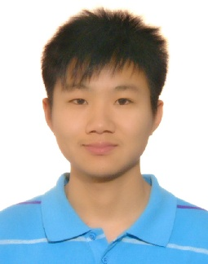

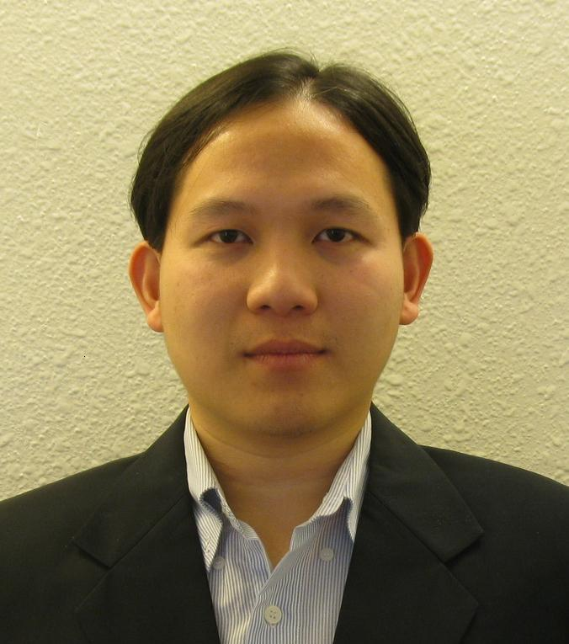
Authors’ Photo ☺
Eamonn Keogh
Bilson Campana
Abdullah Mueen
Gustavo Batista
Brandon Westover
Qiang Zhu
Jesin Zakaria
Thanawin Rakthanmanon

Slide 27
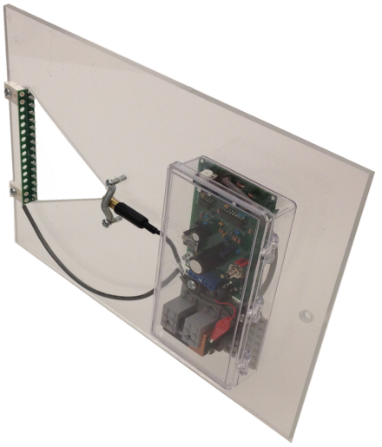
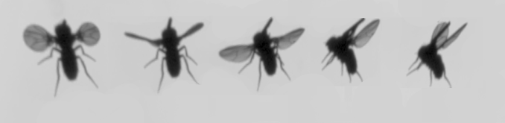

Acknowledgements
NSF grants 0803410 and 0808770
FAPESP award 2009/06349-0
Royal Thai Government Scholarship
As an aside: Cool Insect Contest!
Classify insects from wing beat sounds
0.2
0.1
0
Background noise
Bee begins to cross laser
Bee has past though the laser
-0.1
-0.2
0
0.5
1
1.5
2
2.5
3
3.5
4
4.5
x 10
4
http://www.cs.ucr.edu/~eamonn/CE

Slide 28




Thank you for
your attention
Question?
☺ Register Today : Cool Insect Contest! ☺
0.2
0.1
0
Background noise
Bee begins to cross laser
Bee has past though the laser
-0.1
-0.2
0
0.5
1
1.5
2
2.5
3
3.5
4
4.5
x 10
4
http://www.cs.ucr.edu/~eamonn/CE

Slide 29
Backup Slides

Slide 30
LB_Keogh
C
Q
R (Warping Windows)
U_{i} = max(q_{i-r} : q_{i+r})
L_{i} = min(q_{i-r} : q_{i+r})
C
U
Q
L

Slide 31
Known Optimizations
Lower Bounding
  LB_Yi
  LB_Kim
  LB_Keogh
max(Q)
min(Q)
C
A
D
B
C
U
Q
L

Slide 32
Ordering
This step only can save
about 50% of calculations

Slide 33
UCR Suite
New Optimizations
  Just-in-time Z-normalizations
  Reordering Early Abandoning
  Reversing LB_Keogh
  Cascading Lower Bounds
Known Optimizations
  Early Abandoning of ED/LB_Keogh/DTW
  Use Square Distance
  Multicores

Slide 34

Authors’ Photo ☺
Eamonn Keogh
Bilson Campana
Abdullah Mueen
Gustavo Batista
Brandon Westover
Qiang Zhu
Jesin Zakaria
Thanawin Rakthanmanon

