Slide 1
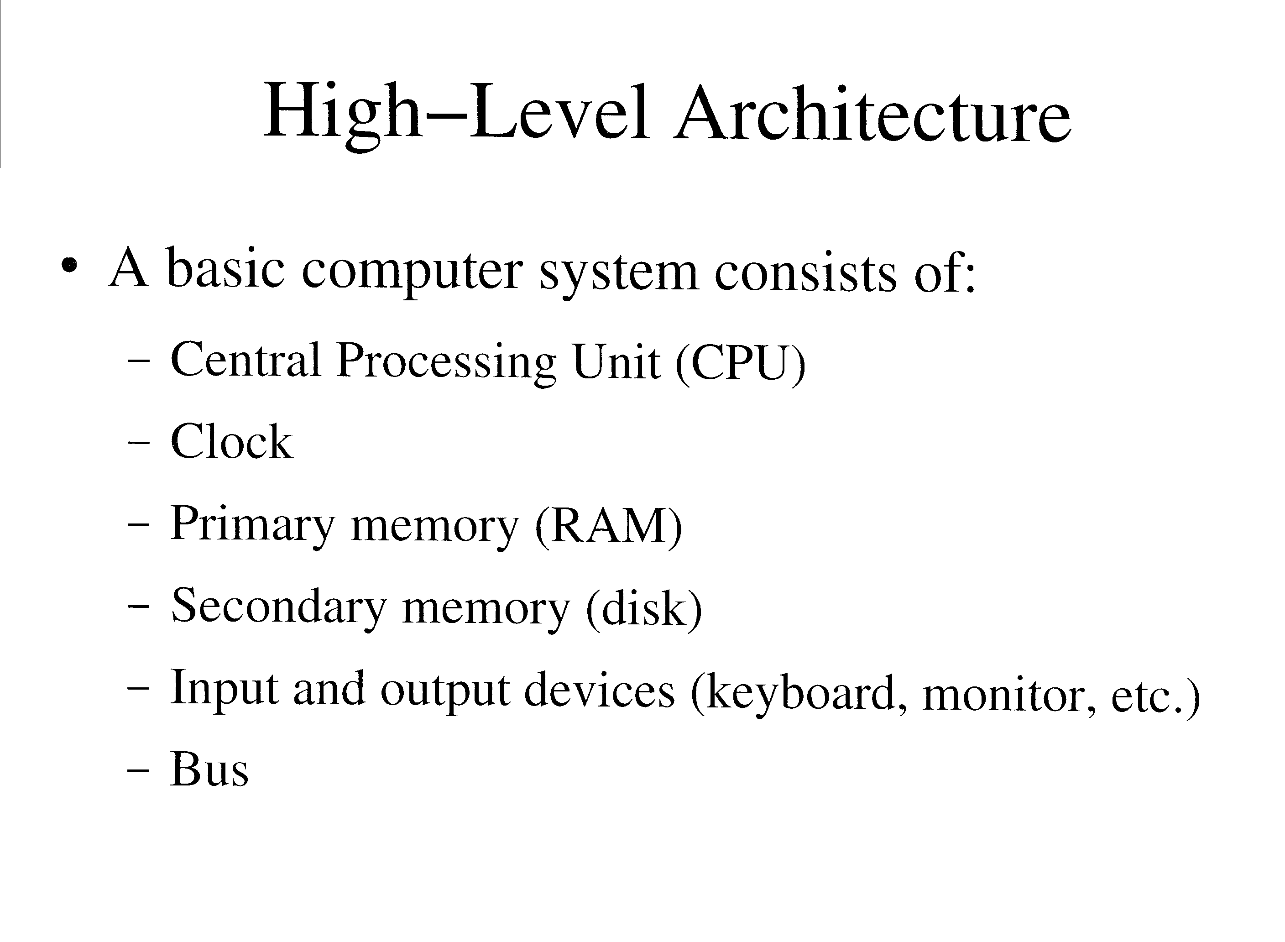

Slide 2
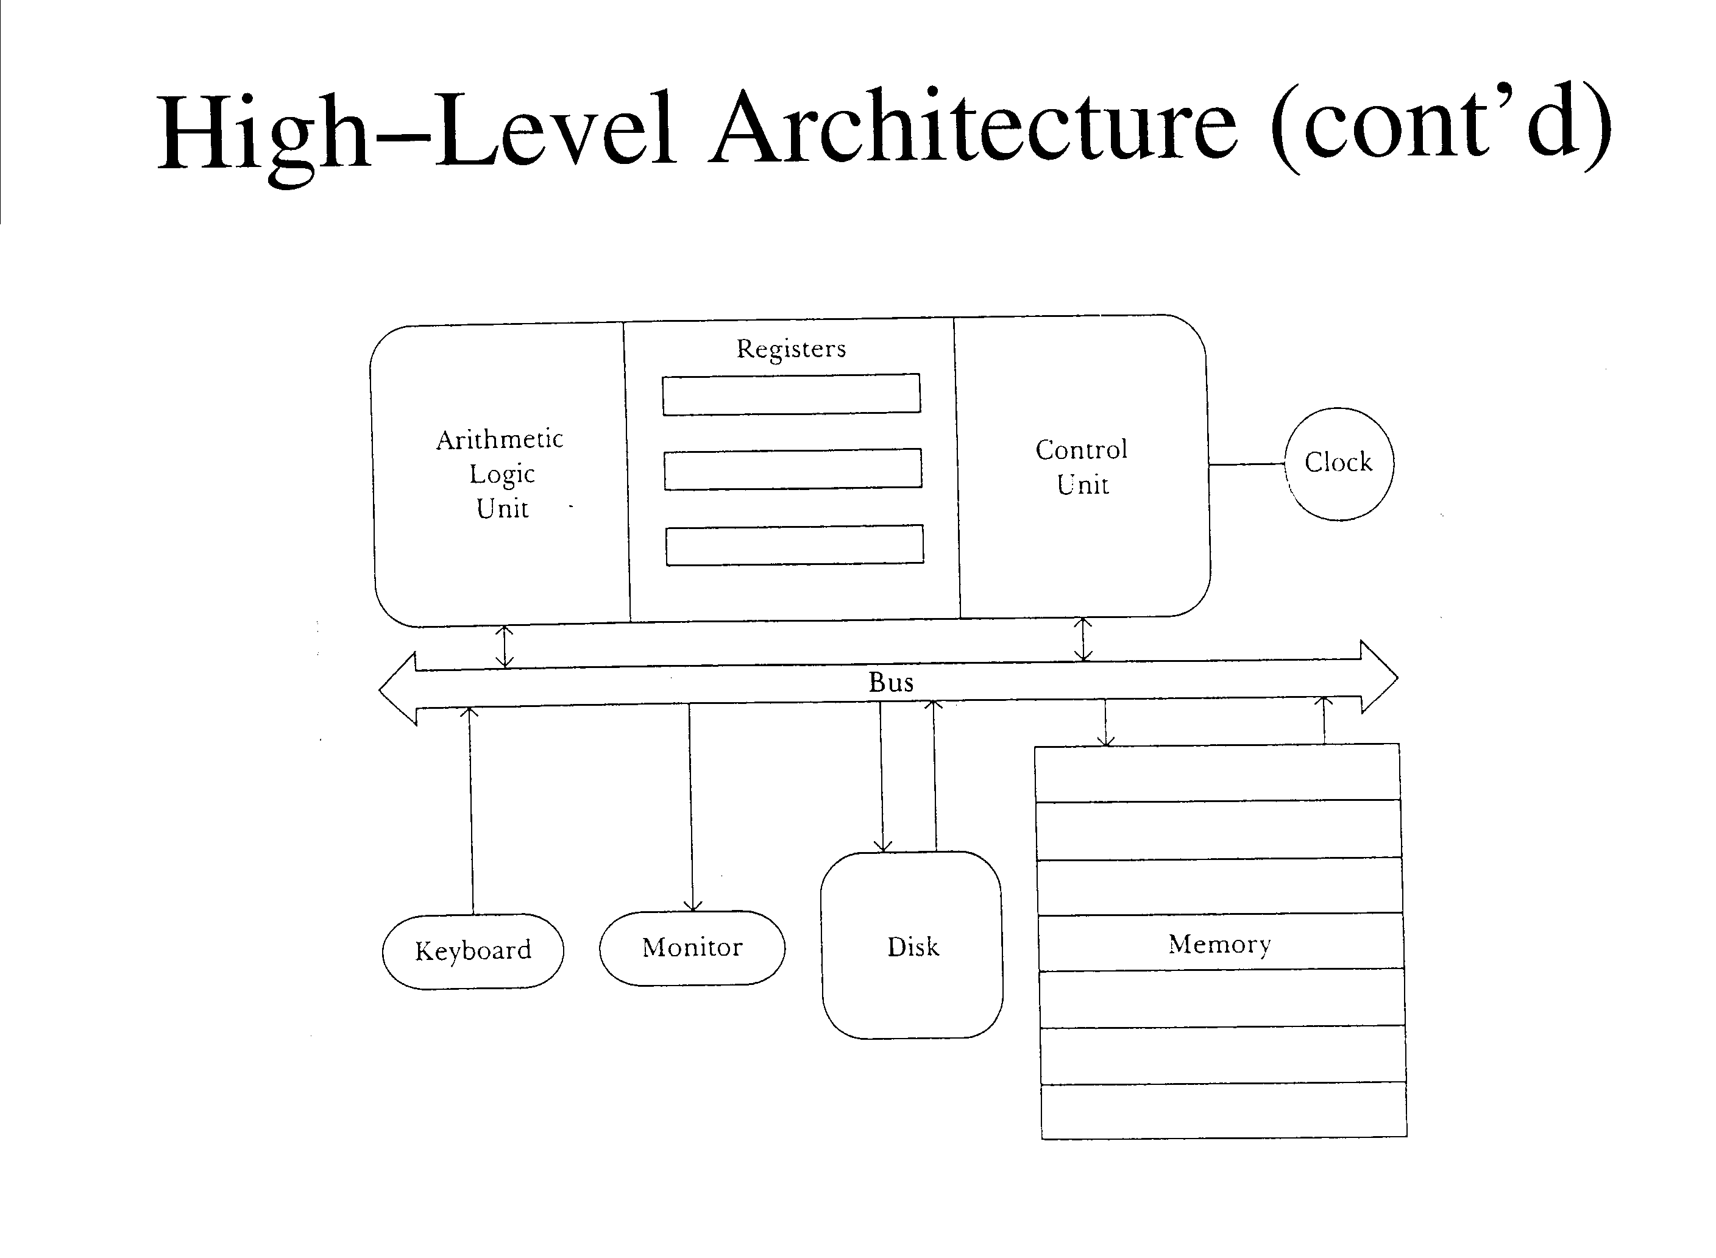

Slide 3
CPU
The “brains” of the computer system
Is usually contained on a single microprocessor chip
  Eg: Sun SPARC, Intel Pentium
Executes instructions (i.e. a program)
Controls the transfer of data across the bus

Slide 4
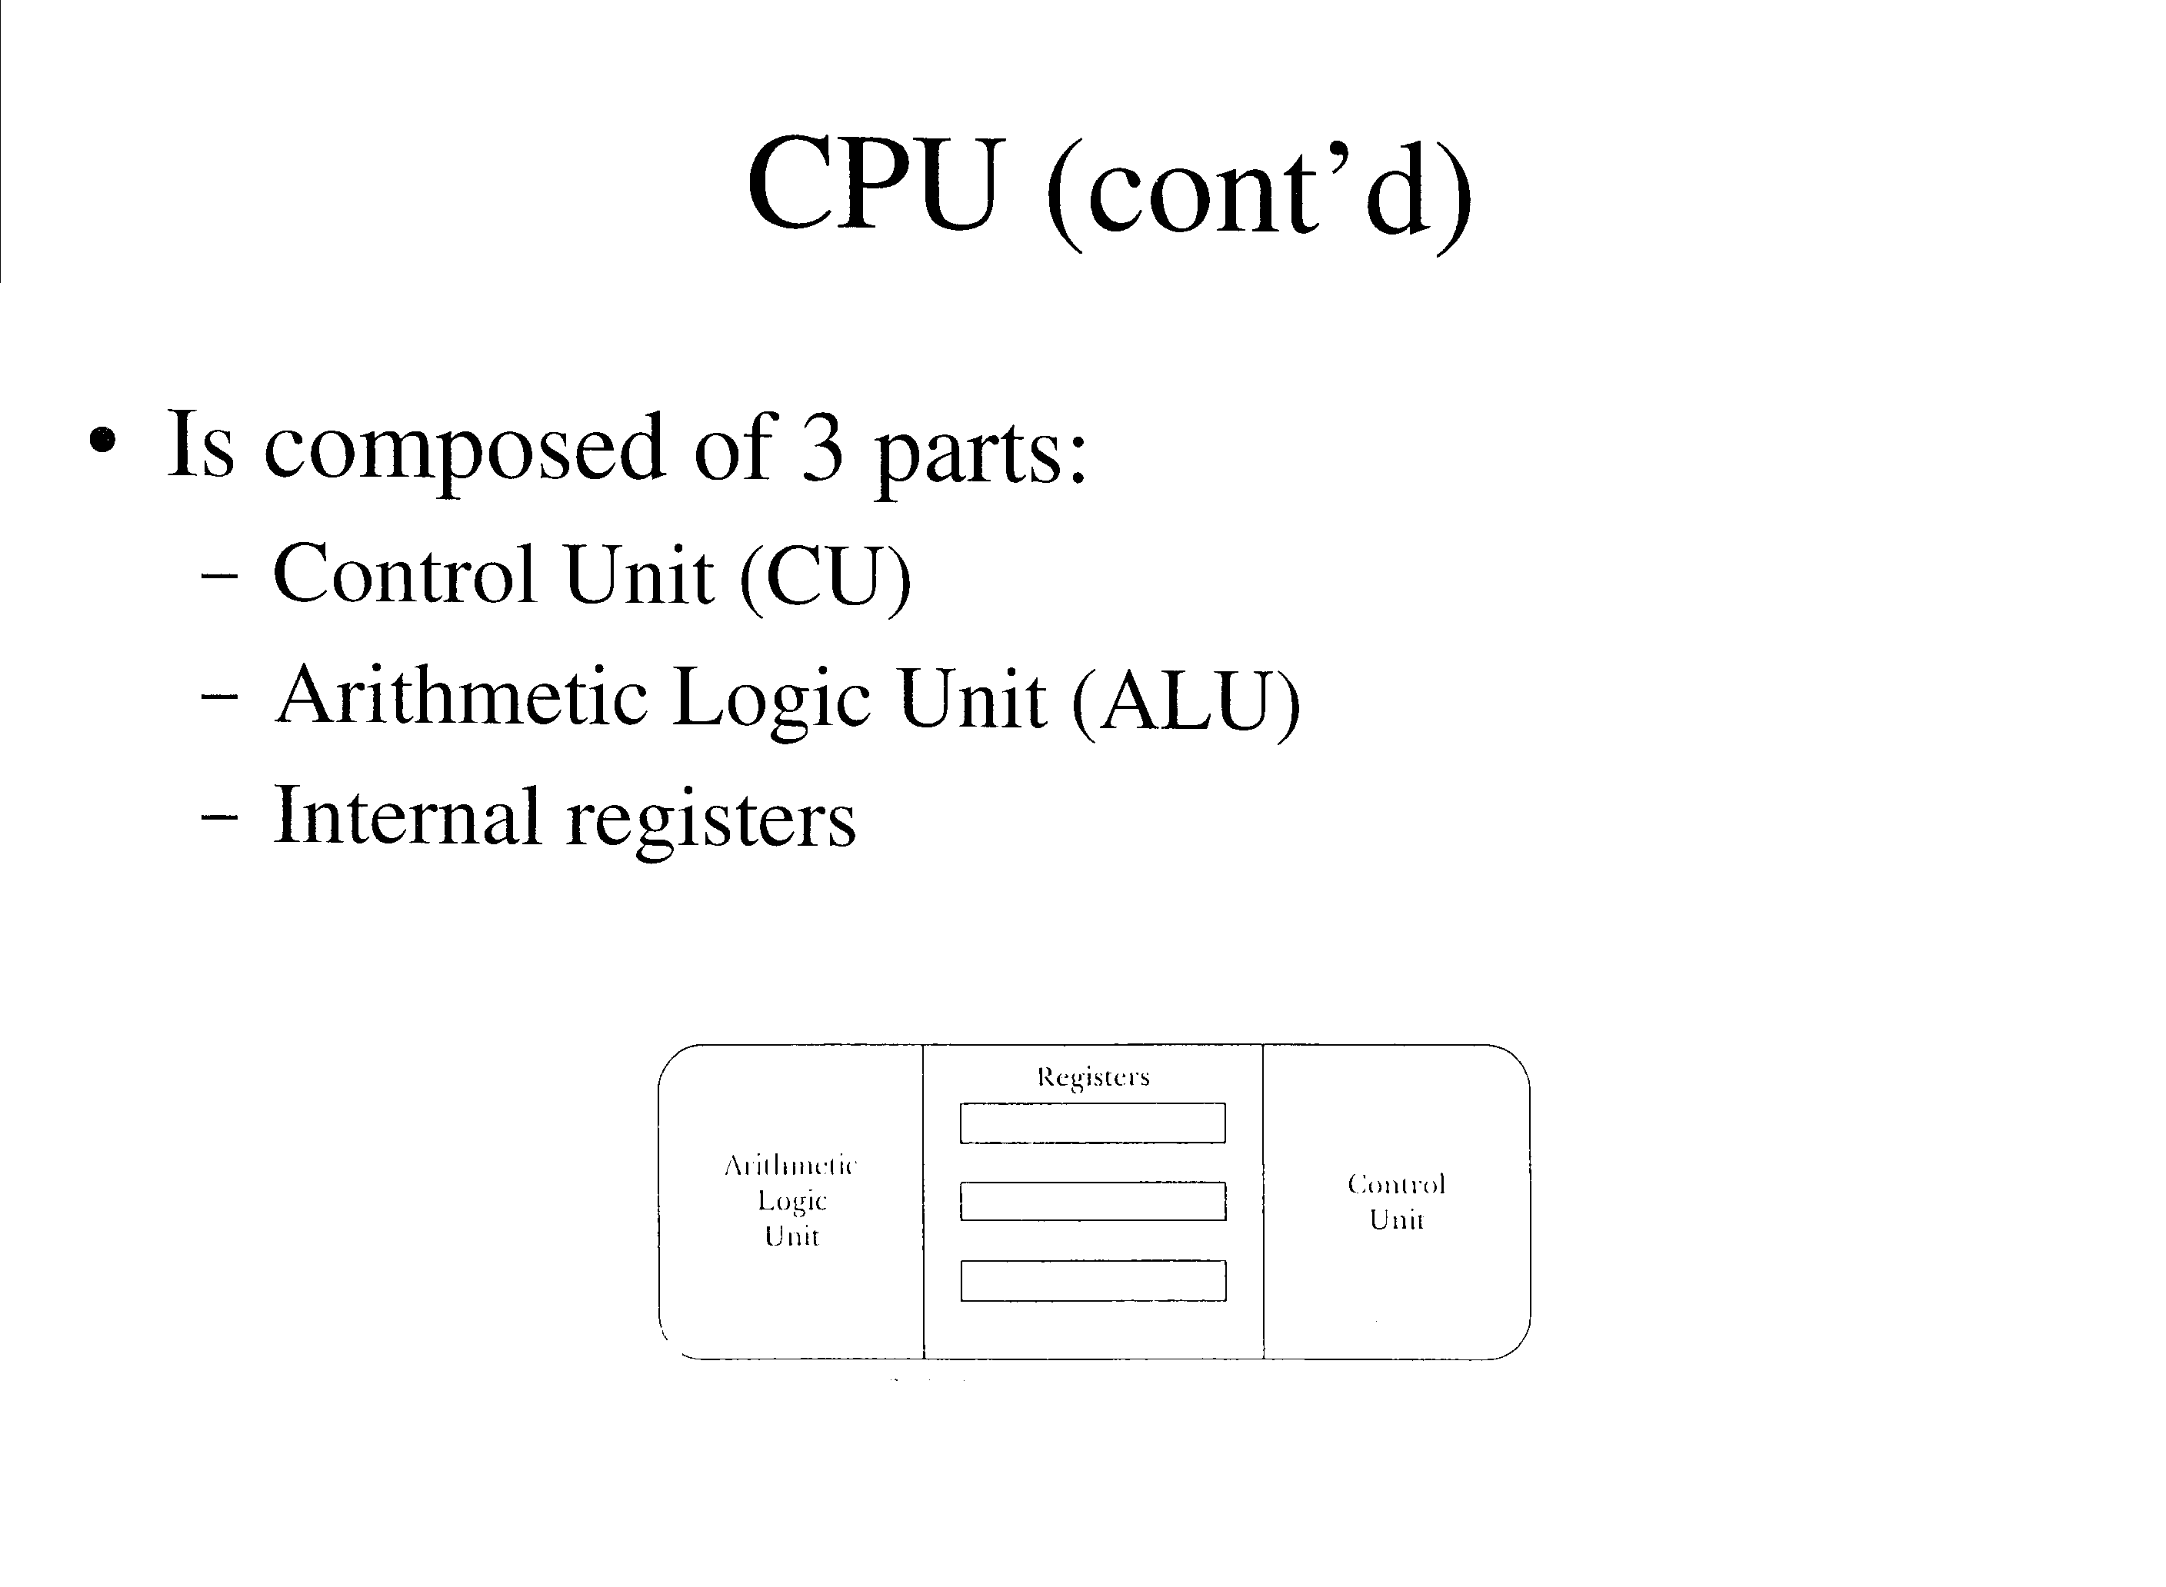

Slide 5
CPU (cont’d)
The control unit directs the execution of instructions
  Loads an operation code (opcode) from memory into an instruction register
  Decodes the opcode to identify the operation
  If necessary, transfers data between the memory and registers
  If necessary, directs the ALU to manipulate data in registers
The ALU performs arithmetic and logical operations on data stored in registers
  Eg: Add numbers stored in 2 source registers, and store the result in a destination register
  Eg: Do a bitwise AND using data in 2 registers

Slide 6
CPU (cont’d)
Internal registers are binary storage units within the CPU
  May contain:
    Data
    Addresses
    Instructions
    Status information
  Eg: The program counter (PC) contains the address in RAM of the current instruction
  Eg: The status register (SR) contains information about the result of the previous instruction
    Eg: overflow or carry

Slide 7
System Clock
Generates a clock signal to synchronize the CPU and other clock devices
Typical rate: 3 GHz

Slide 8
Random Access Memory (RAM)
Acts as a primary memory for the computer
  Can be read from and written to
  Is volatile (data disappears when powered off)
  Is used to store program instructions and program input, output, and temporary (scratch) values
Consists of a sequence of addressable memory locations
  Each location is typically one byte long
Typical size is 2 GB
In a von Neumann architecture, RAM contains both data and programs (instructions)
  A Harvard architecture uses separate memories for data and programs

Slide 9
Bus
Is a set of parallel data/signal lines
Is used to transfer information between computer components
Often subdivided into address, data, and control buses

Slide 10
Bus (cont’d)
Address Bus
  Specifies a memory location in RAM, or a memory-mapped I/O device
  Typical size is 32 or 64 bits
Data Bus
  Used for bidirectional transfer
  Typical size is 32 or 64 bits

Slide 11
Bus (cont’d)
Control Bus
  Used to control or monitor devices connected to the bus
    Eg: Read/write signal for RAM
An expansion bus may be connected to the computer’s local bus
  Make’s it easy to connect additional I/O devices to the computer
  Example bus standards: SCSI, Firewire, SATA

Slide 12
Secondary Memory
Is non-volatile, read/write memory
Used for semi-permeable storage of data and programs
Usually hard disk drives are used for secondary storage

Slide 13
Peripheral Devices
Allow communication between the computer and the external environment
Input devices
  Keyboard
  Pointing Devices (mouse, trackball, joystick, etc.)
  Microphone
  Scanner
Output devices
  Monitor
  Speakers
  Printer
I/O devices
  Hard disk drive
  CD drive
  Modem
  Network card

Slide 14
Basic CPU Architectures
Stack Machine (See fig 1.3 of text)
  Operands for an instruction are popped from the top of the stack
  Results are pushed to the top of the stack
  Memory can be loaded through the MDR to the top of the stack, and vice versa
  Operands for an instruction come from the ACC and from a single location in RAM
  Results are always put into the ACC
  The ACC can be loaded or stored into memory

Slide 15
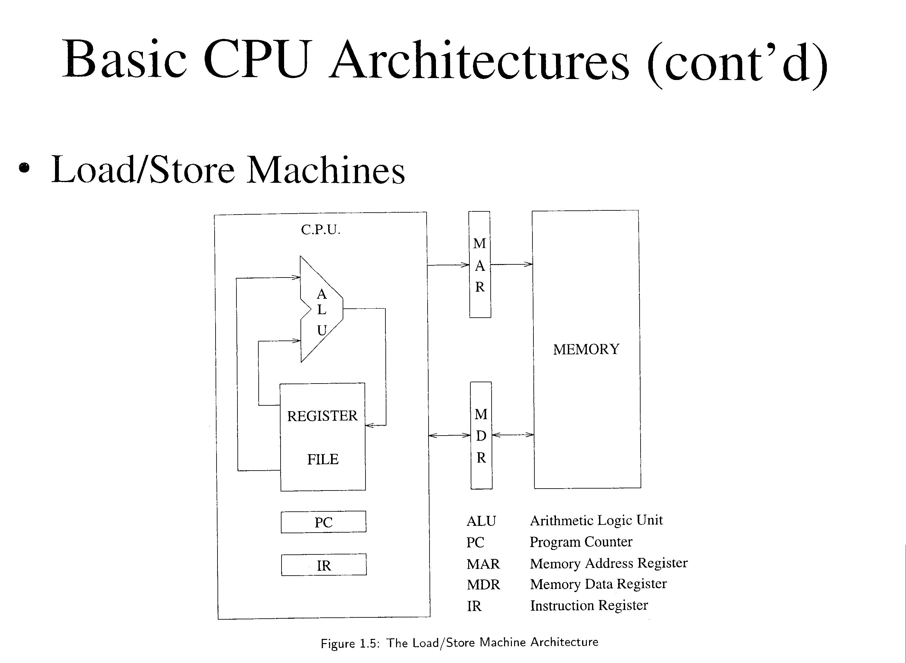

Slide 16
Basic CPU Architectures
Load/Store Machines
  Most instructions operate on registers, not RAM
    Registers are more quickly accessed than RAM
Typical Sequence:
  Load registers from memory
  Execute an instruction using two source registers, putting the result into a destination register
  Store results back into memory

Slide 17
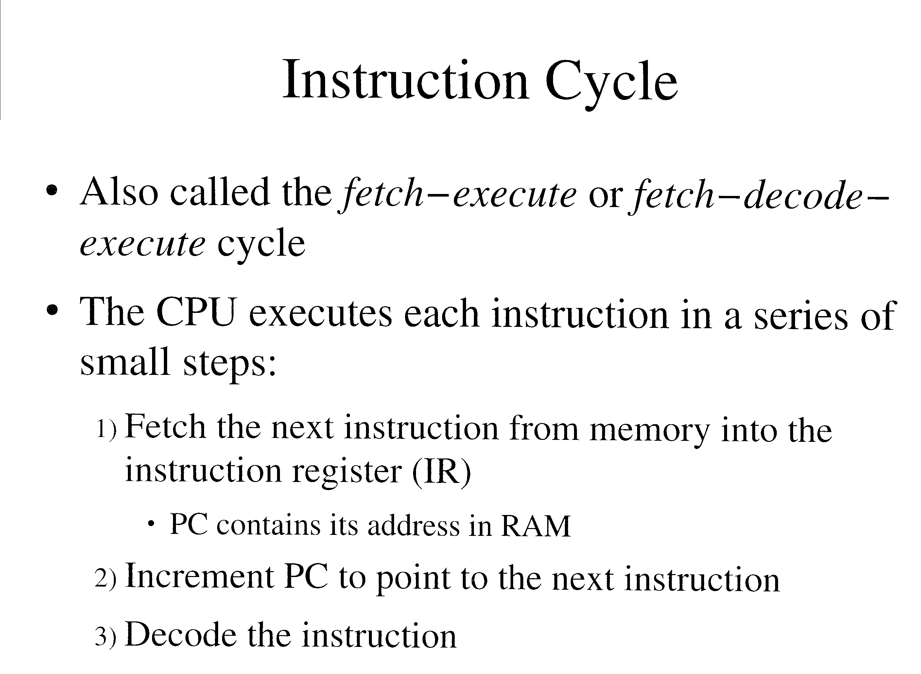

Slide 18
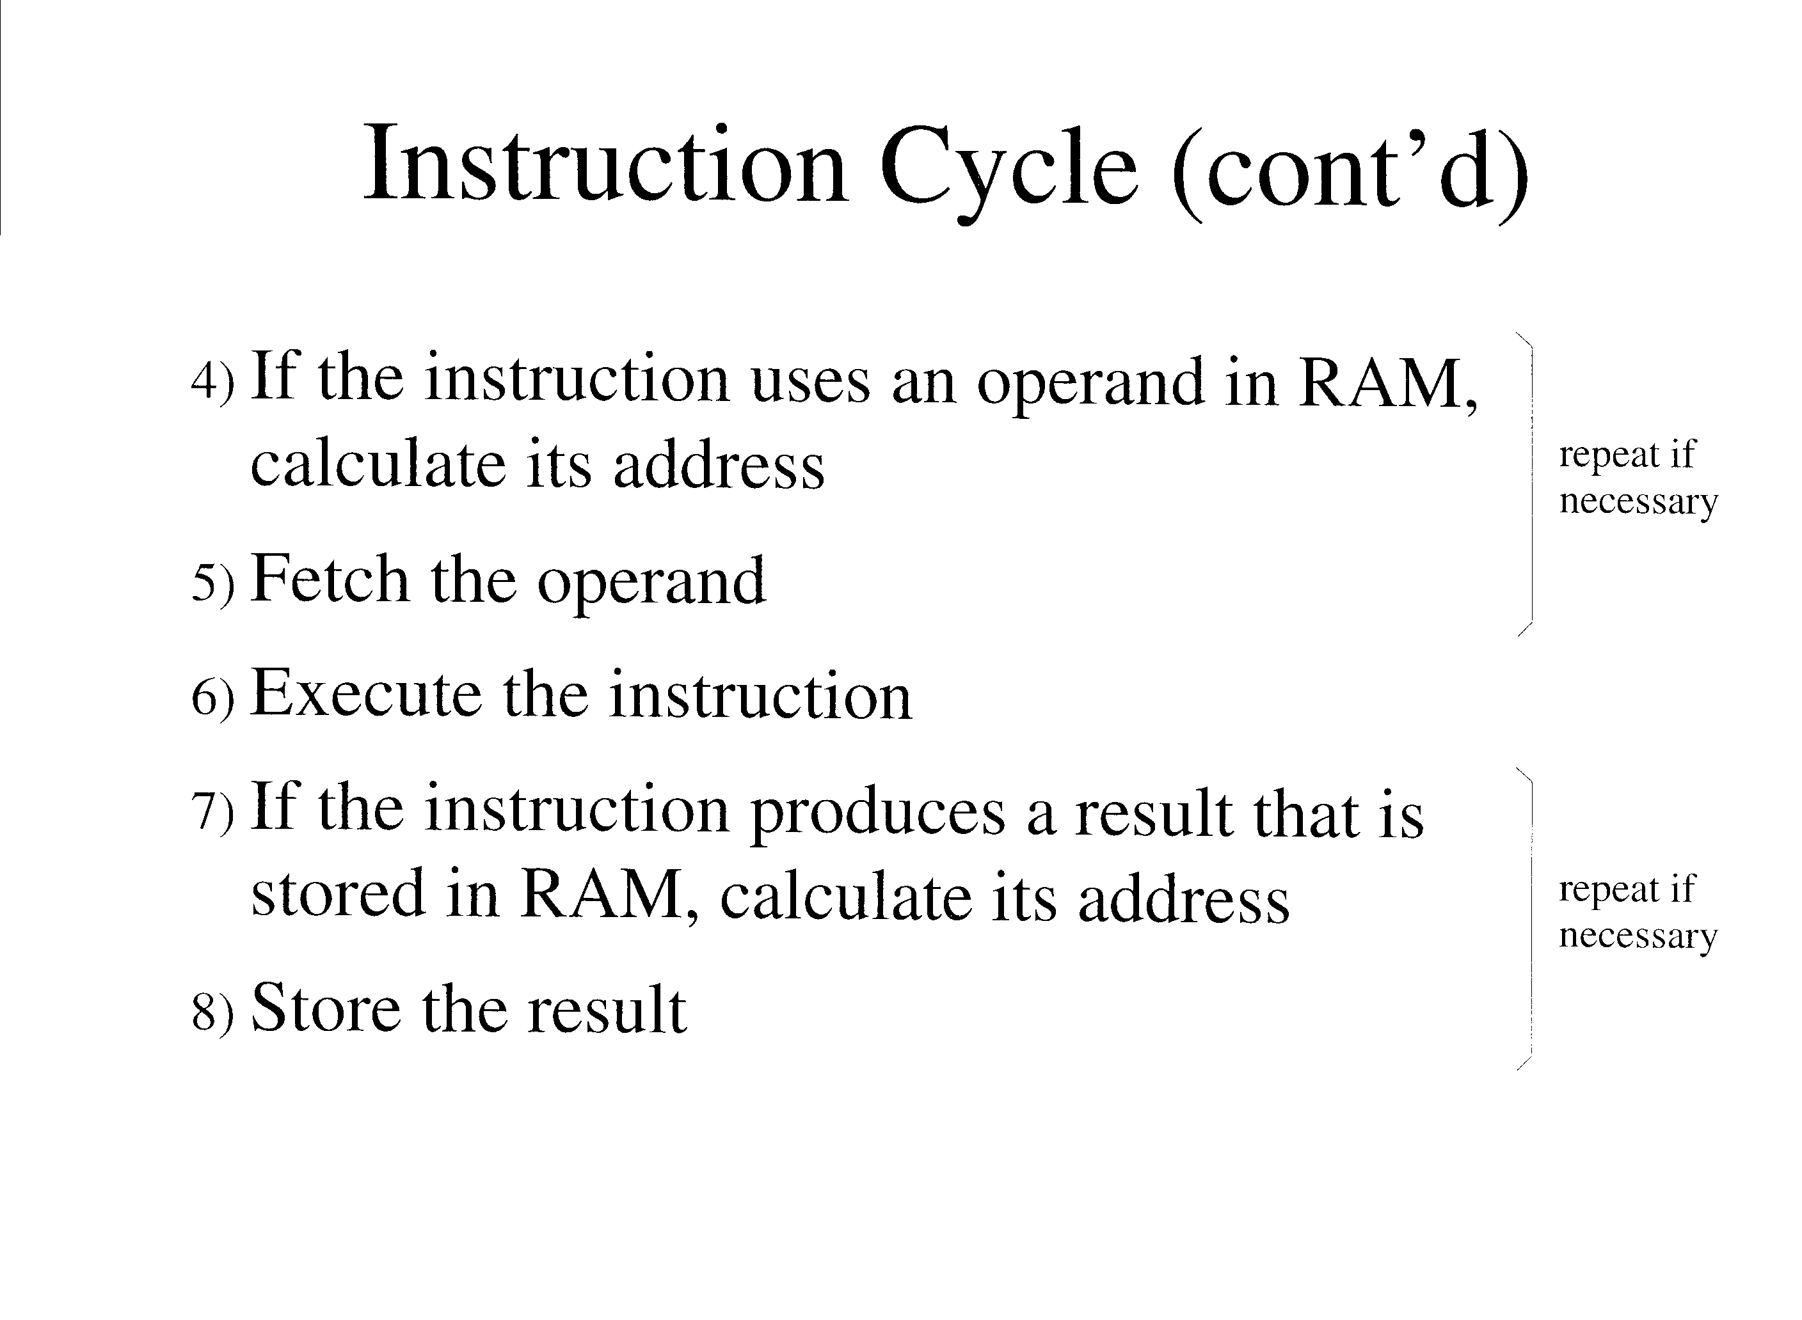

Slide 19
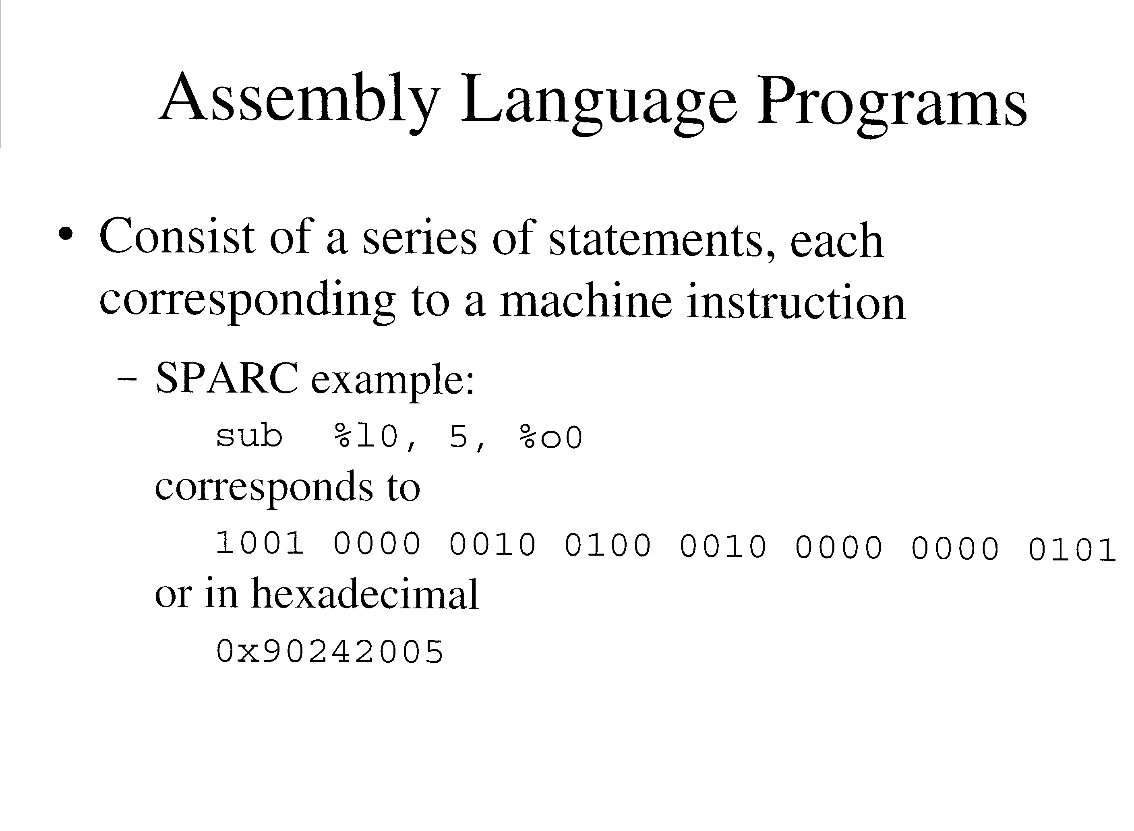

Slide 20
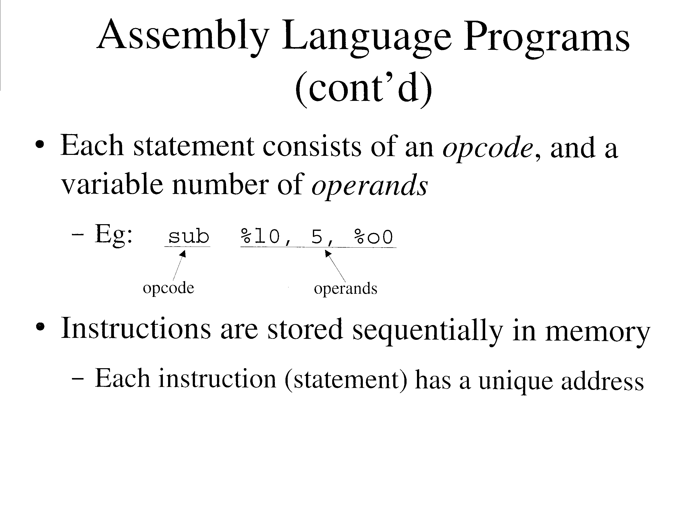

Slide 21
Assembly Language Programs (cont’d)
A label may be prepended to any statement
  Form: label: staement
  Eg: start: sub %l0, 5, %o0
  Is a symbol whose value is the address of the machine instruction
    May be used as a target for a branch instruction
Pseudo-ops do not generate machine instructions, but give the assembler extra information
  Form: .pseudo-op
  Eg: .global start
Comments may be appended to the end of a statement
  In SPARC, after a !
  Eg: start: sub %l0, 5, %o0 ! A comment
  Comments should be placed on every line of assembly code

Slide 22
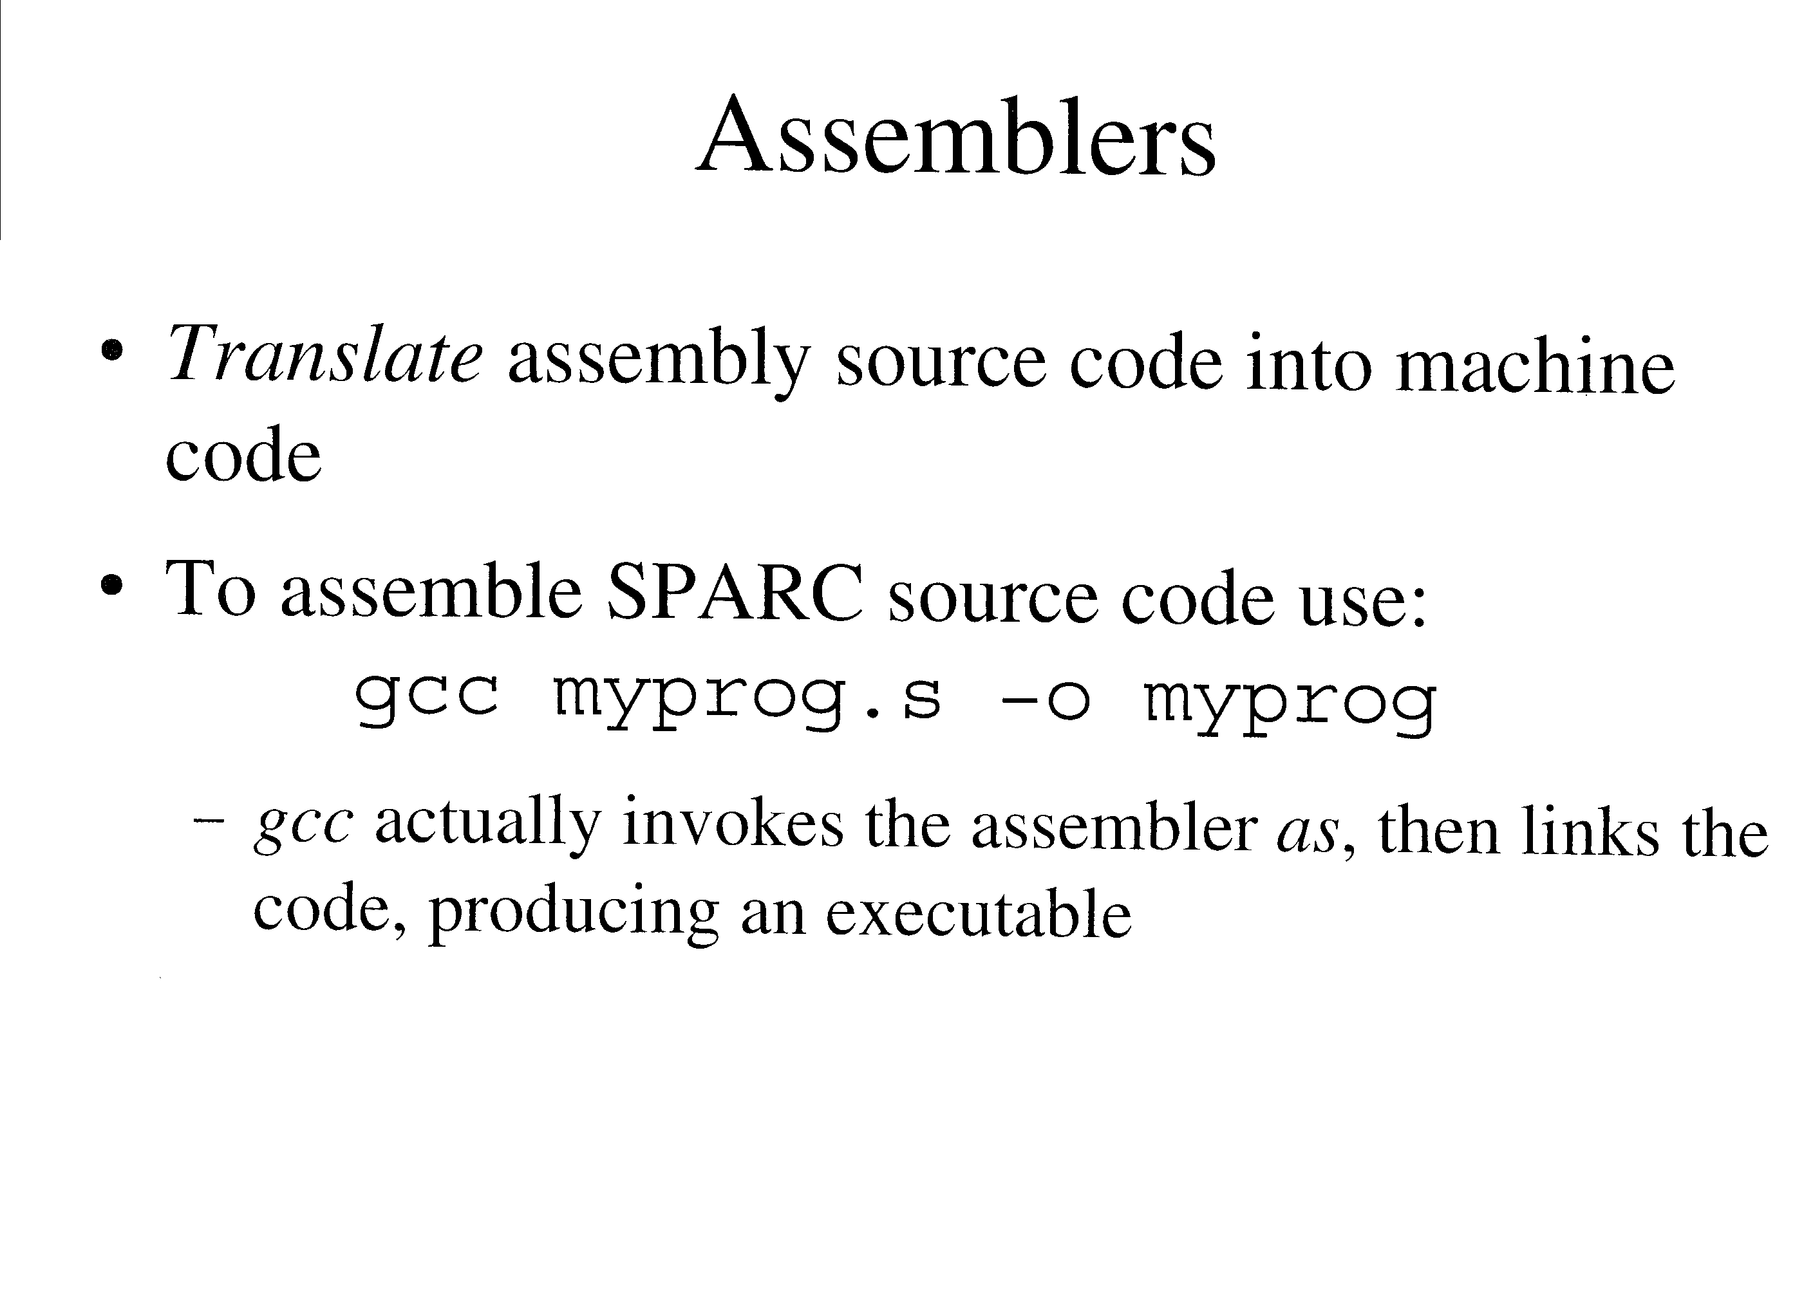

Slide 23
Macro Preprocessors
Many assemblers support macros
  Allows you to define a piece of text with a name
    Parameters are often allowed
  The text will be substituted inline wherever invoked
    Called macro expansion
  Provided as a convenience for the programmer
gcc (actually as) does not support macros
  We use m4 instead, before invoking gcc

Slide 24
Macro Preprocessors (cont’d)
Eg:
  define(x1, 14)
  define(x_r, l0)
  …
  sub %x_r, x1, %o0
  Is expanded to
  sub %l0, x1, %o0

Slide 25
Macro Preprocessors (cont’d)
General procedure
  Put your source code containing macros into a file ending in .m
  Invoke m4, redirecting output to a file ending in .s
  Eg: m4 myprog.m > myprog.s
  Run gcc as usual on the output file

Slide 26
SPARC Architecture
Introduction

Slide 27
SPARC Architecture (cont’d)
SPARC: Scalable Processor ARChitecture
  Created by SPARC International, a consortium of computer makers
  May be implemented by any company if licensed
The textbook (and this course) covers SPARC version 8
  32-bit registers and addressing
  V8 programs execute compatibility on Ultra SPARC machines (SPARC V9)
    64-bit wide registers and addressing
    Adds new instructions and other improvements

Slide 28
SPARC Architecture (cont’d)
SPARC is a Load/Store architecture
  Most instructions operate on registers
SPARC is a Reduced Instruction Set Computer (RISC)
  Uses only simple instructions that can be executed in one clock cycle
    Enables faster clock rates
    Makes programs larger, more complex
Complex Instruction Set Computers (CISC) have instructions taking many cycles to execute
  Sacrifices speed for programmer convenience

Slide 29
SPARC Architecture (cont’d)
SPARC has two execution modes:
  User (non-privileged) mode
    Restricts access to a limited set of instructions and registers, and to certain parts of memory
    Most programs will work in this mode
  Supervisor (privileged) mode
    Is used by the operating system
    Has unrestricted access to all resources
      All memory, privileged instructions, and privileged registers
    Can be accessed indirectly by user programs using a trap

Slide 30
SPARC Architecture (cont’d)
The SPARC processor is organized into 2 main parts:
  Integer Unit (IU)
    Contains general-purpose and control/status registers
    Contains overall operation of the CPU, including the FPU
    Executes integer arithmetic and logic instructions
    Computes addresses for load and stores
  Floating-Point Unit (FPU)
    Contains floating-point registers
    Executes floating-point arithmetic and comparison instructions

Slide 31
Registers
The IU has 32 32-bit wide general purpose r registers
  Page 52 of the text

Slide 32
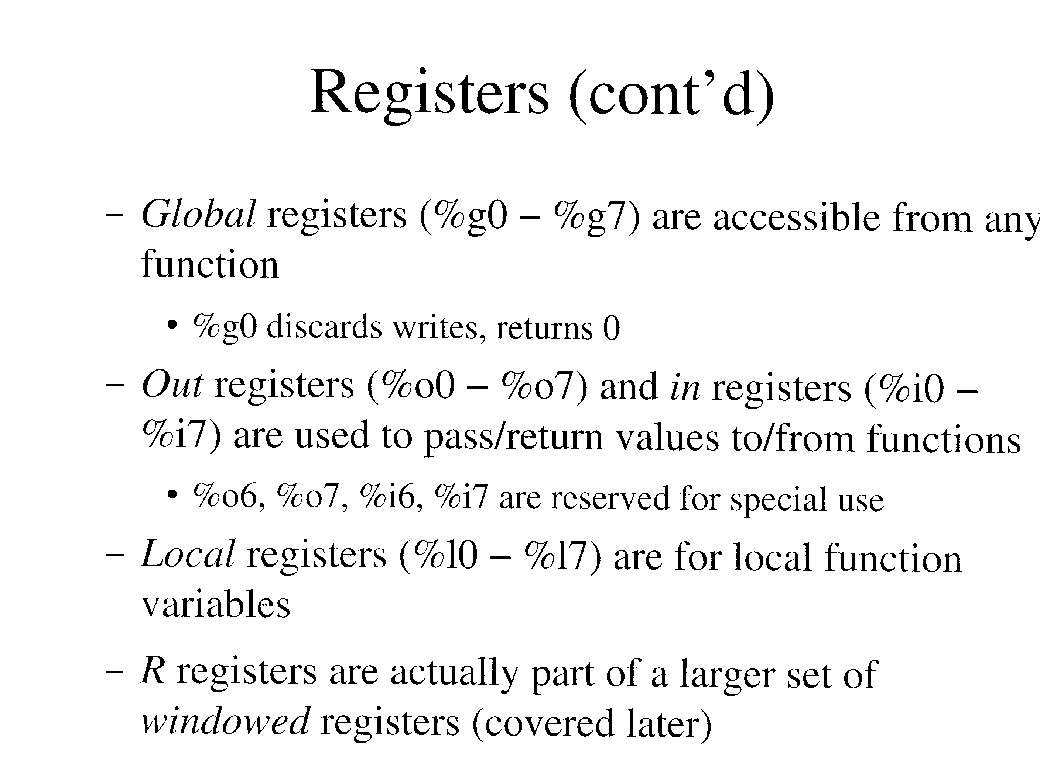

Slide 33
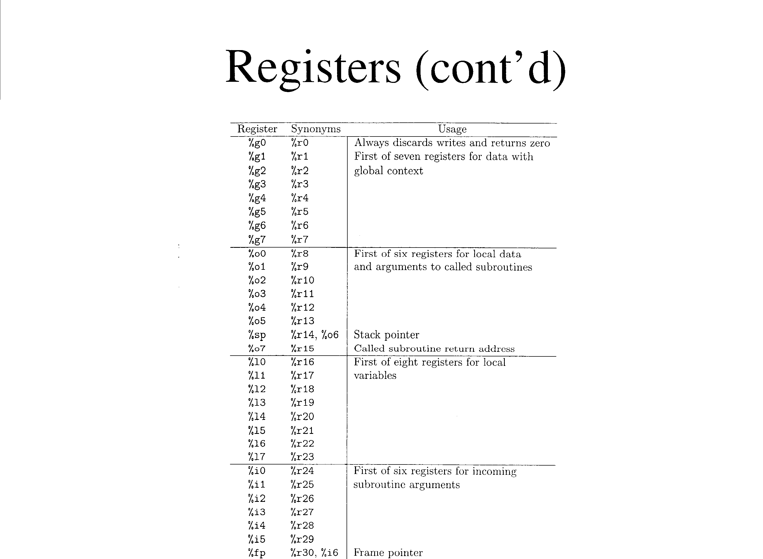

Slide 34
Registers (cont’d)
The IU has numerous control/status registers
  Eg: Program Counter (PC)
  Eg: Condition Codes Register (CCR)
The FPU has 32 floating-point registers

Slide 35
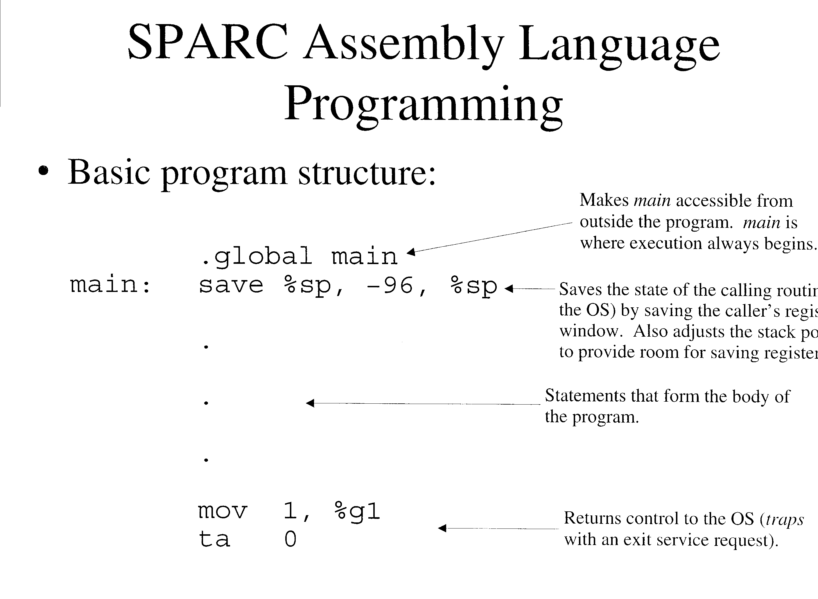

Slide 36
SPARC Assembly Language Programming (cont’d)
Most instructions use 3 operands
  Form: opcode op1, op2, op3
    op1: source register
    op2: a source register or signed 13-bit constant (-4096 to 4095)
    op3: Destination register (%g0 to %i7)
  Eg: sub %l0, 5, %o0
Use mov to copy a register or signed 13-bit constant into another register
  Form: mov op1, op2
  Eg: mov 13, %l0
  Note: this is actually a synthetic instruction
    Actually maps to:
      or %g0, op1, op2

Slide 37
SPARC Assembly Language Programming (cont’d)
Use clr to clear a register
  Form: clr op1
  Eg: clr %l1
  Note: this is a synthetic instruction
    Actually maps to:
      or %g0, %g0, op1
Use call to invoke a function
  Form: call label
  Eg: call .div
  The delay slot should be filled with a “nop” for now
    We will optimize this later

Slide 38
SPARC Assembly Language Programming (cont’d)
Eg:
  mov 5, %o0 ! arg1
  mov 10, %o1 ! arg2
  call .mul ! arg1 * arg2 must be in %o0, %o1
  nop
  Early versions of SPARC had no multiply or divide functions
    Called .mul or .div instead

Slide 39
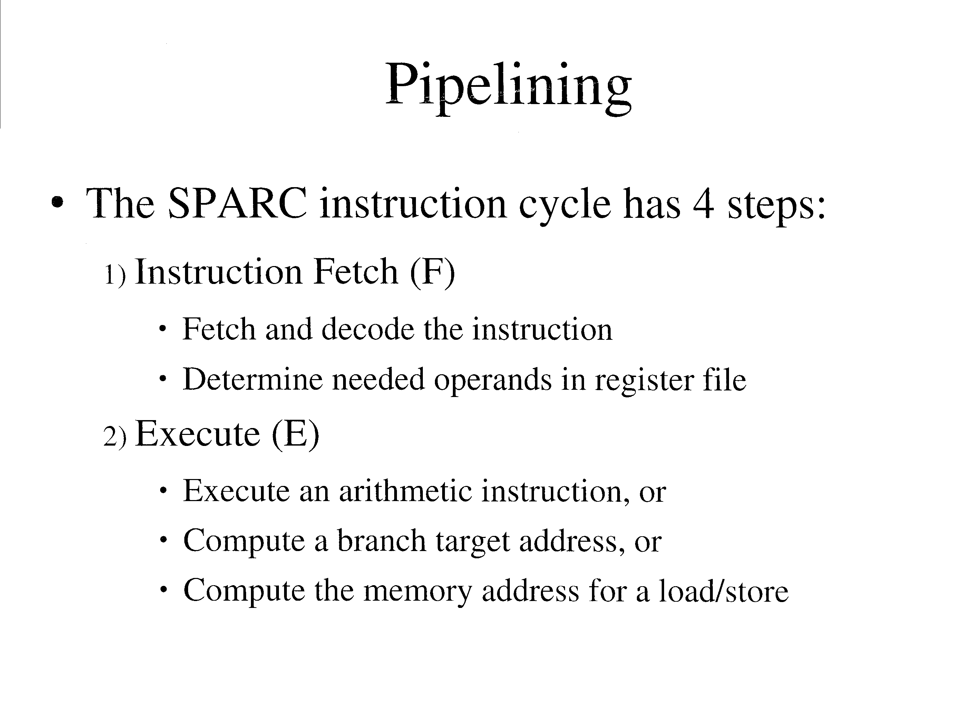

Slide 40
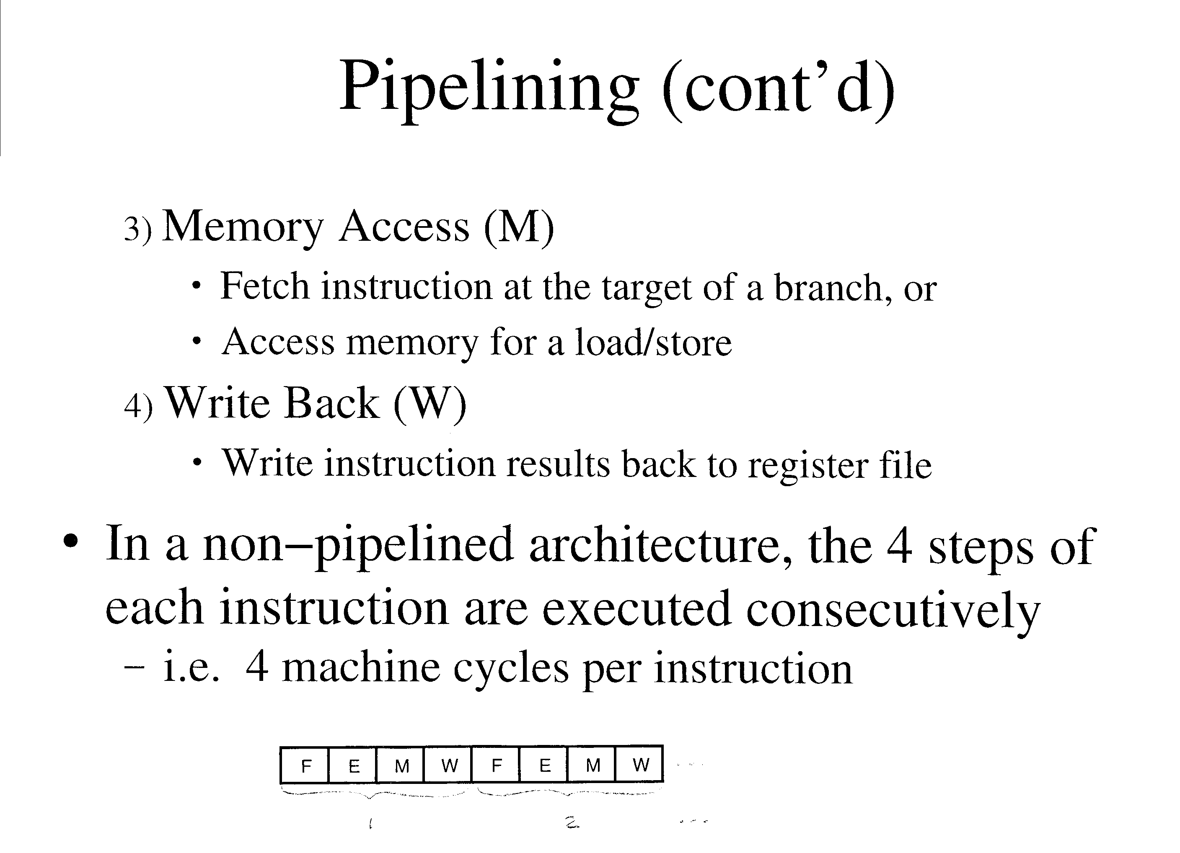

Slide 41
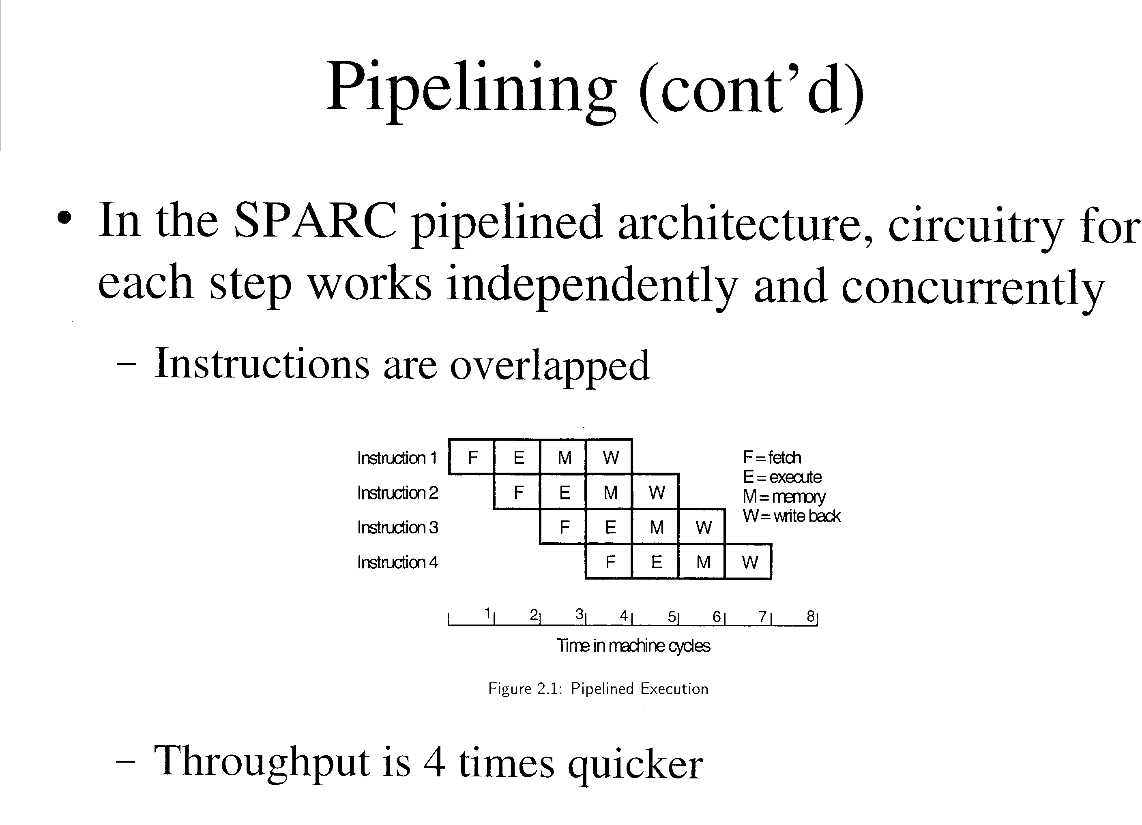

Slide 42
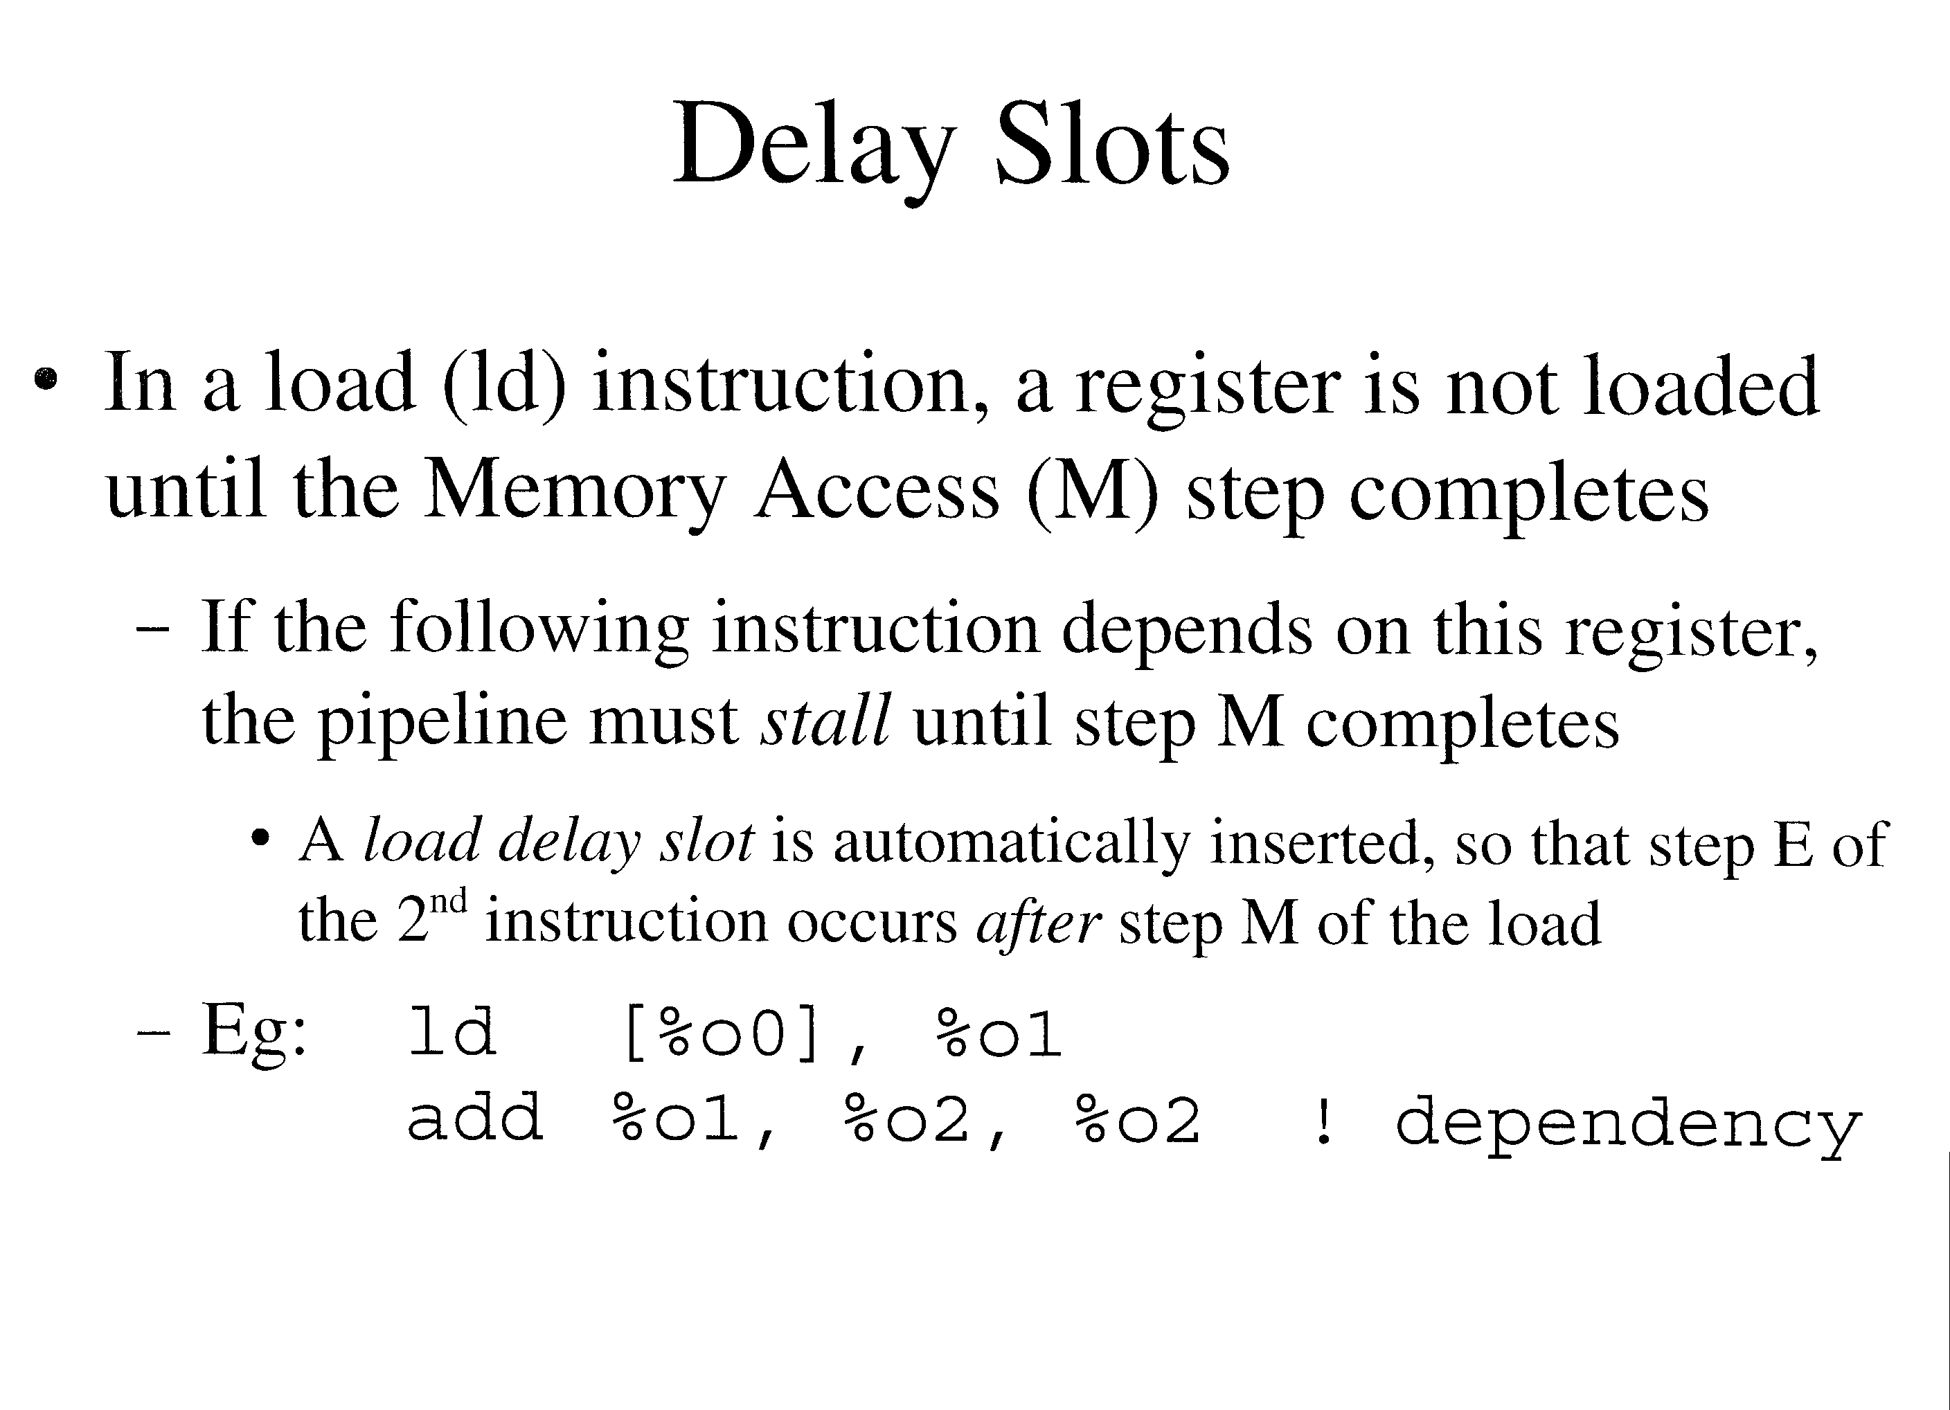

Slide 43
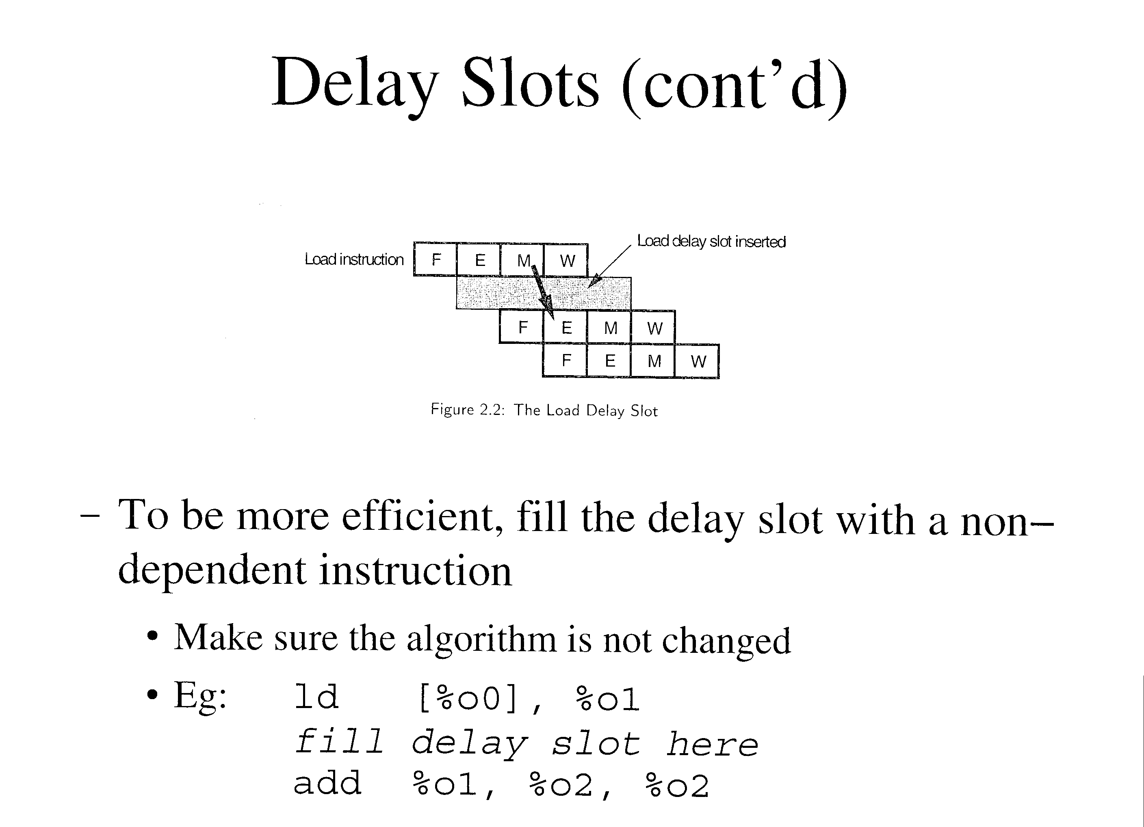

Slide 44
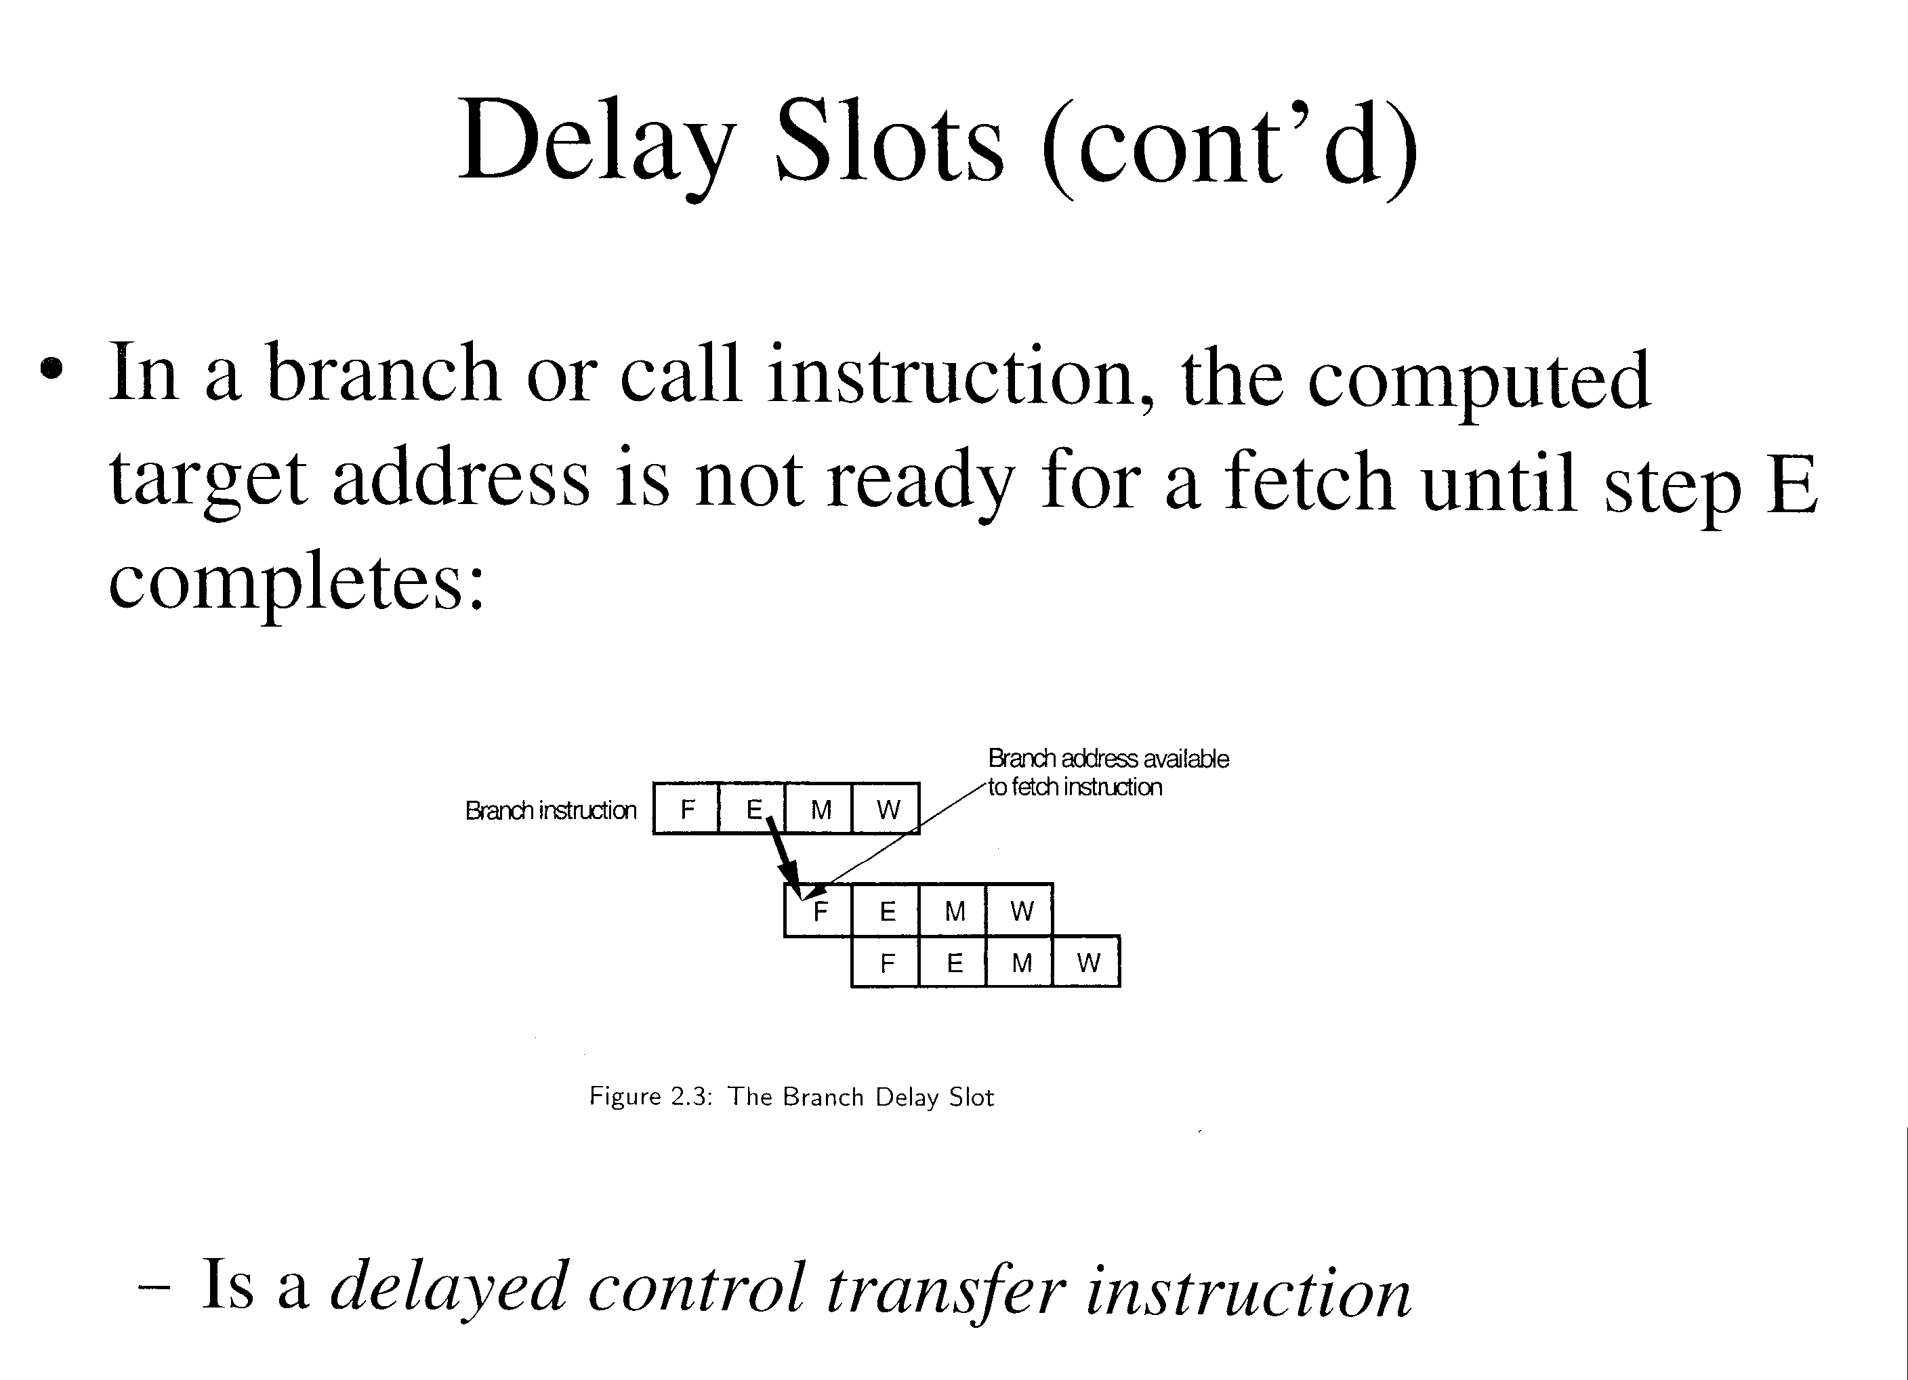

Slide 45
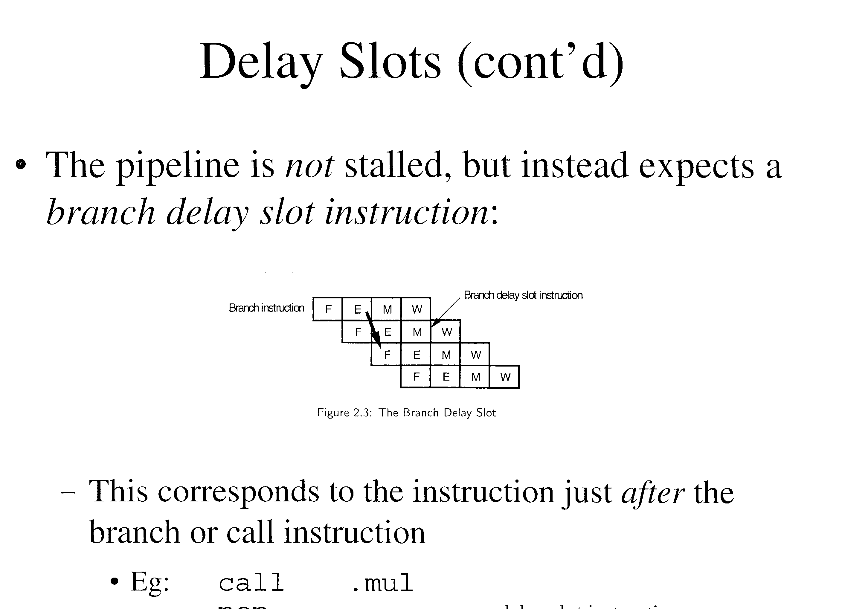

Slide 46
Delay Slots (cont’d)
This corresponds to the instruction just after the branch or call instruction
  Eg: call .mul
  nop
This instruction executes after the call instruction, and before the first instruction of the subroutine

Slide 47
Branching
A branch instruction transfer control to another part of a program
  Like goto in the C language
  PC register is not incremented as usual, but is set to a computed address for an instruction
    Corresponds to the value of a label
  General form: bxx label
  Eg: ba top

Slide 48
Branching (cont’d)
Branches are delayed control transfer instructions
  The delay slot is executed before the actual transfer of control occurs
  Exception: annulled branches (covered later)
  Restriction: branch instructions are not allowed in the delay slot of a conditional branch
Unconditional branches are always taken
  ba instruction (branch always)

Slide 49
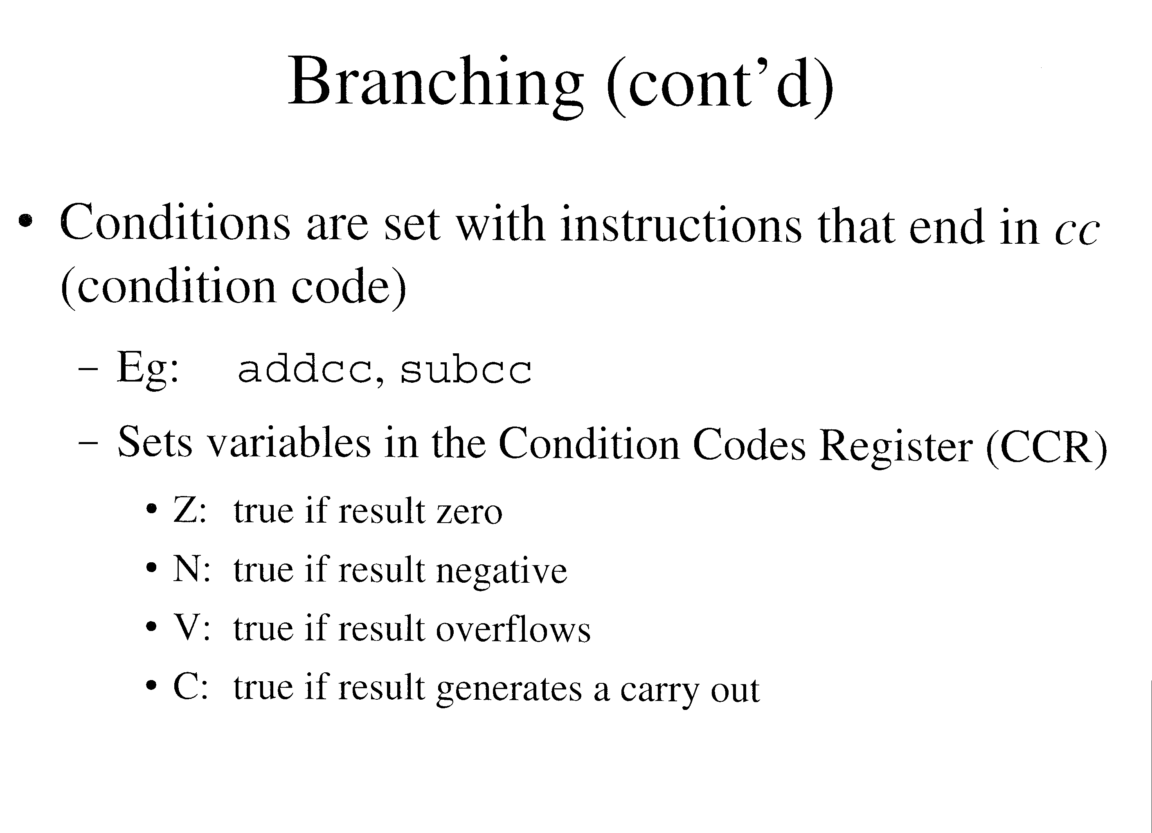

Slide 50
Branching (cont’d)
Conditional branches are taken only if certain condition codes are true
  ie) examines the content of the CCR
  Eg: bl top
    Branches if N is true

Slide 51
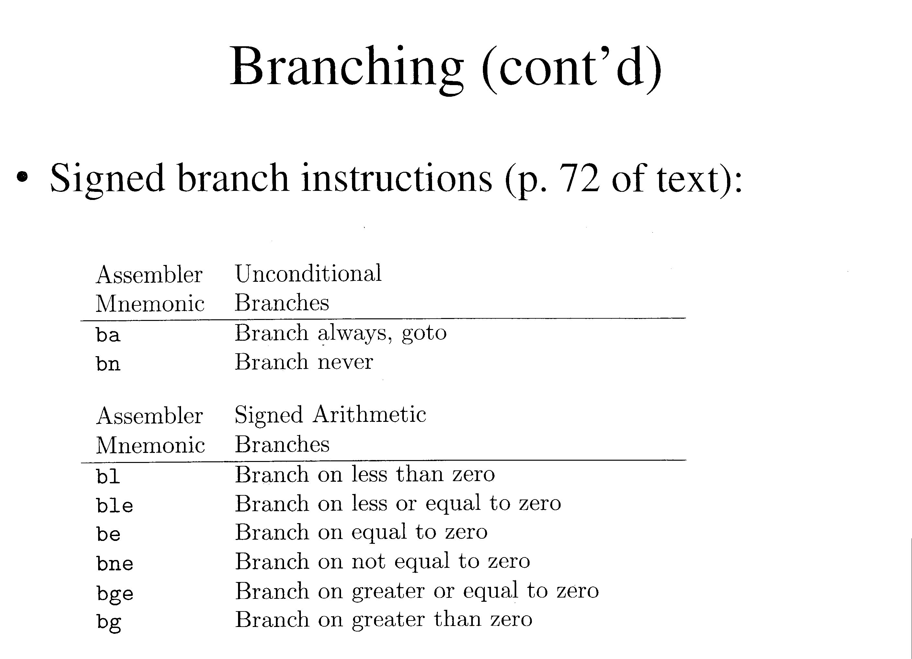

Slide 52
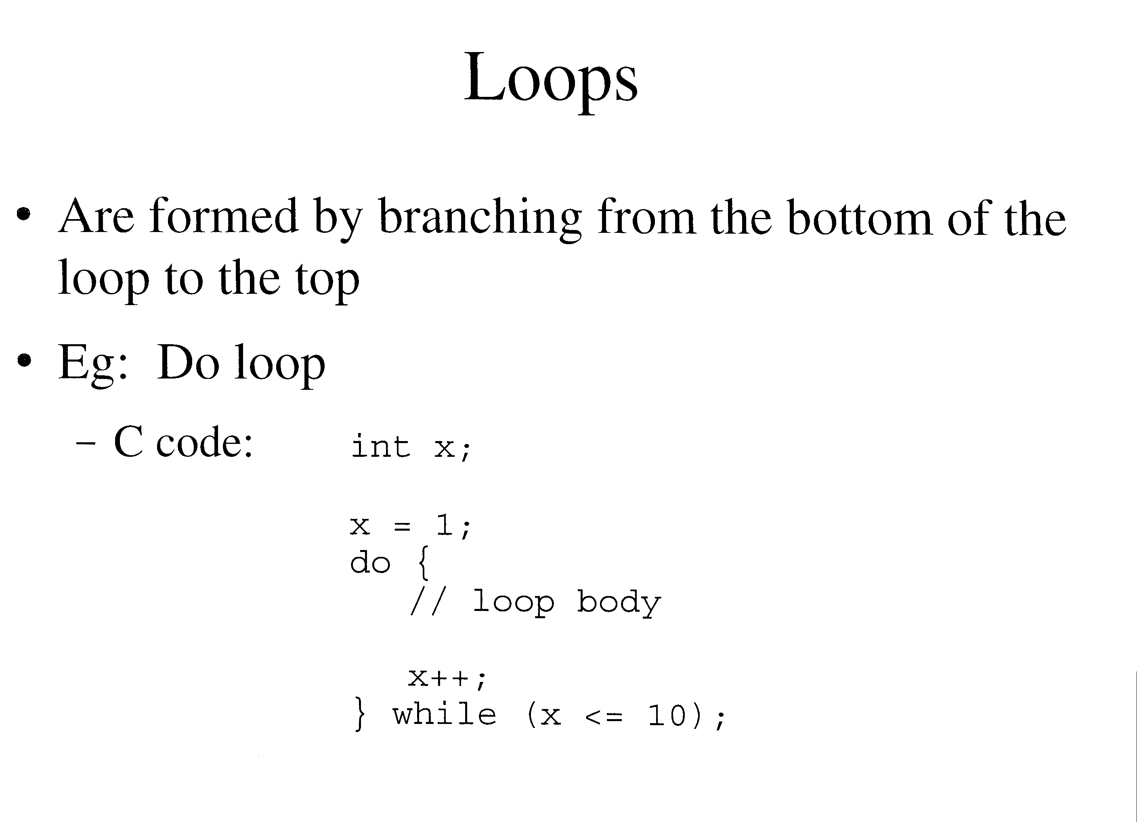

Slide 53
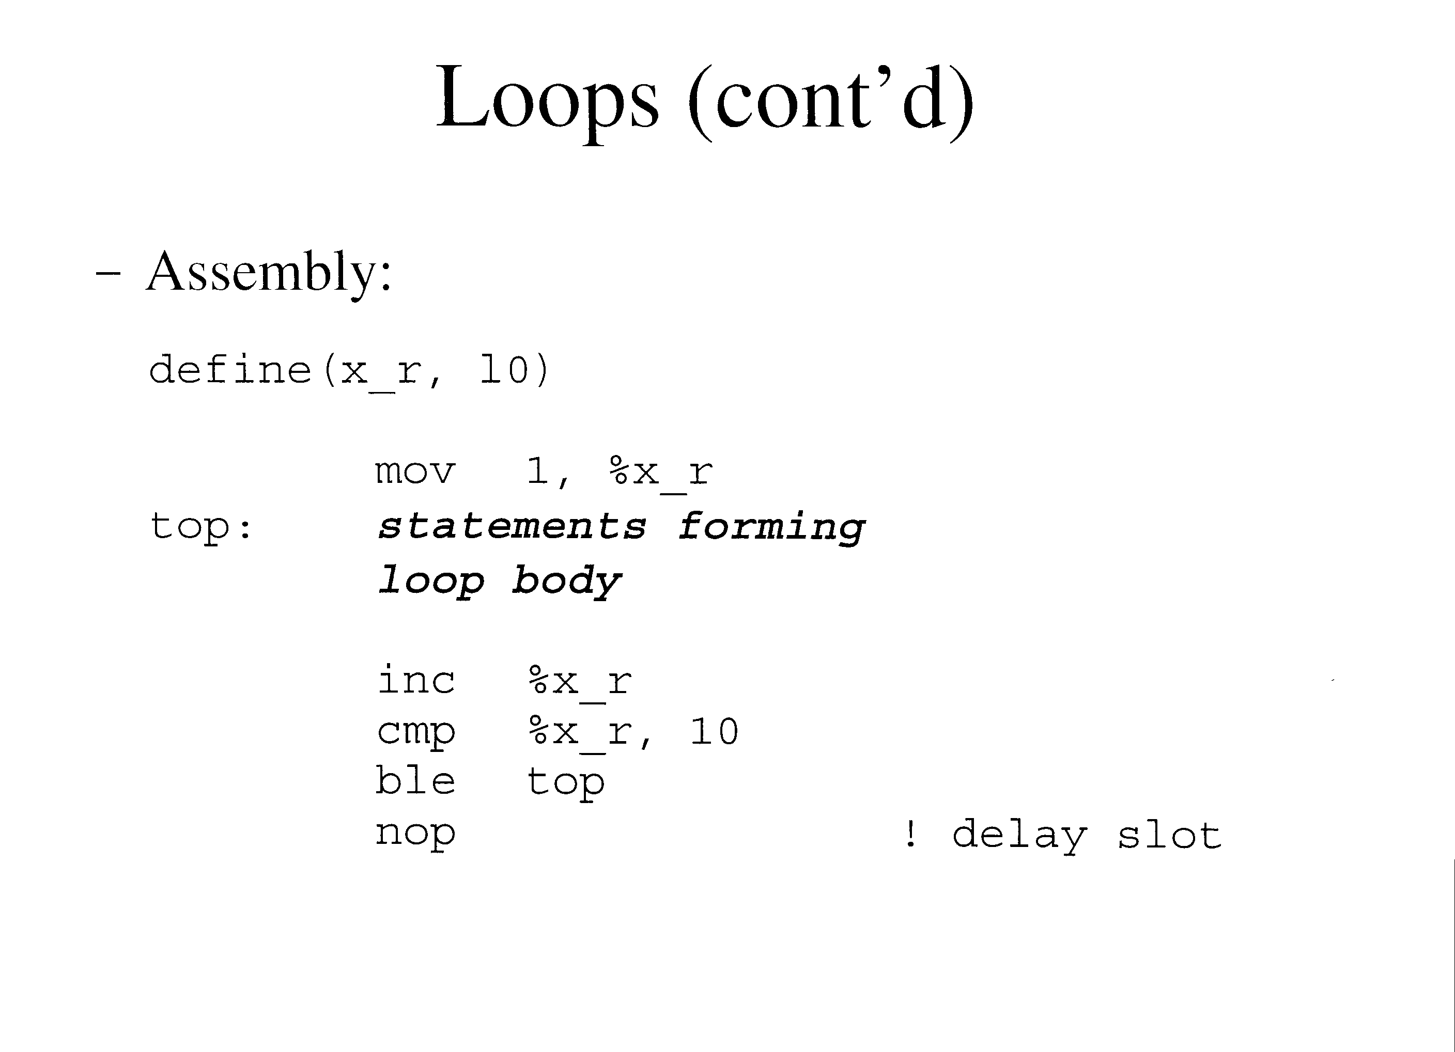

Slide 54
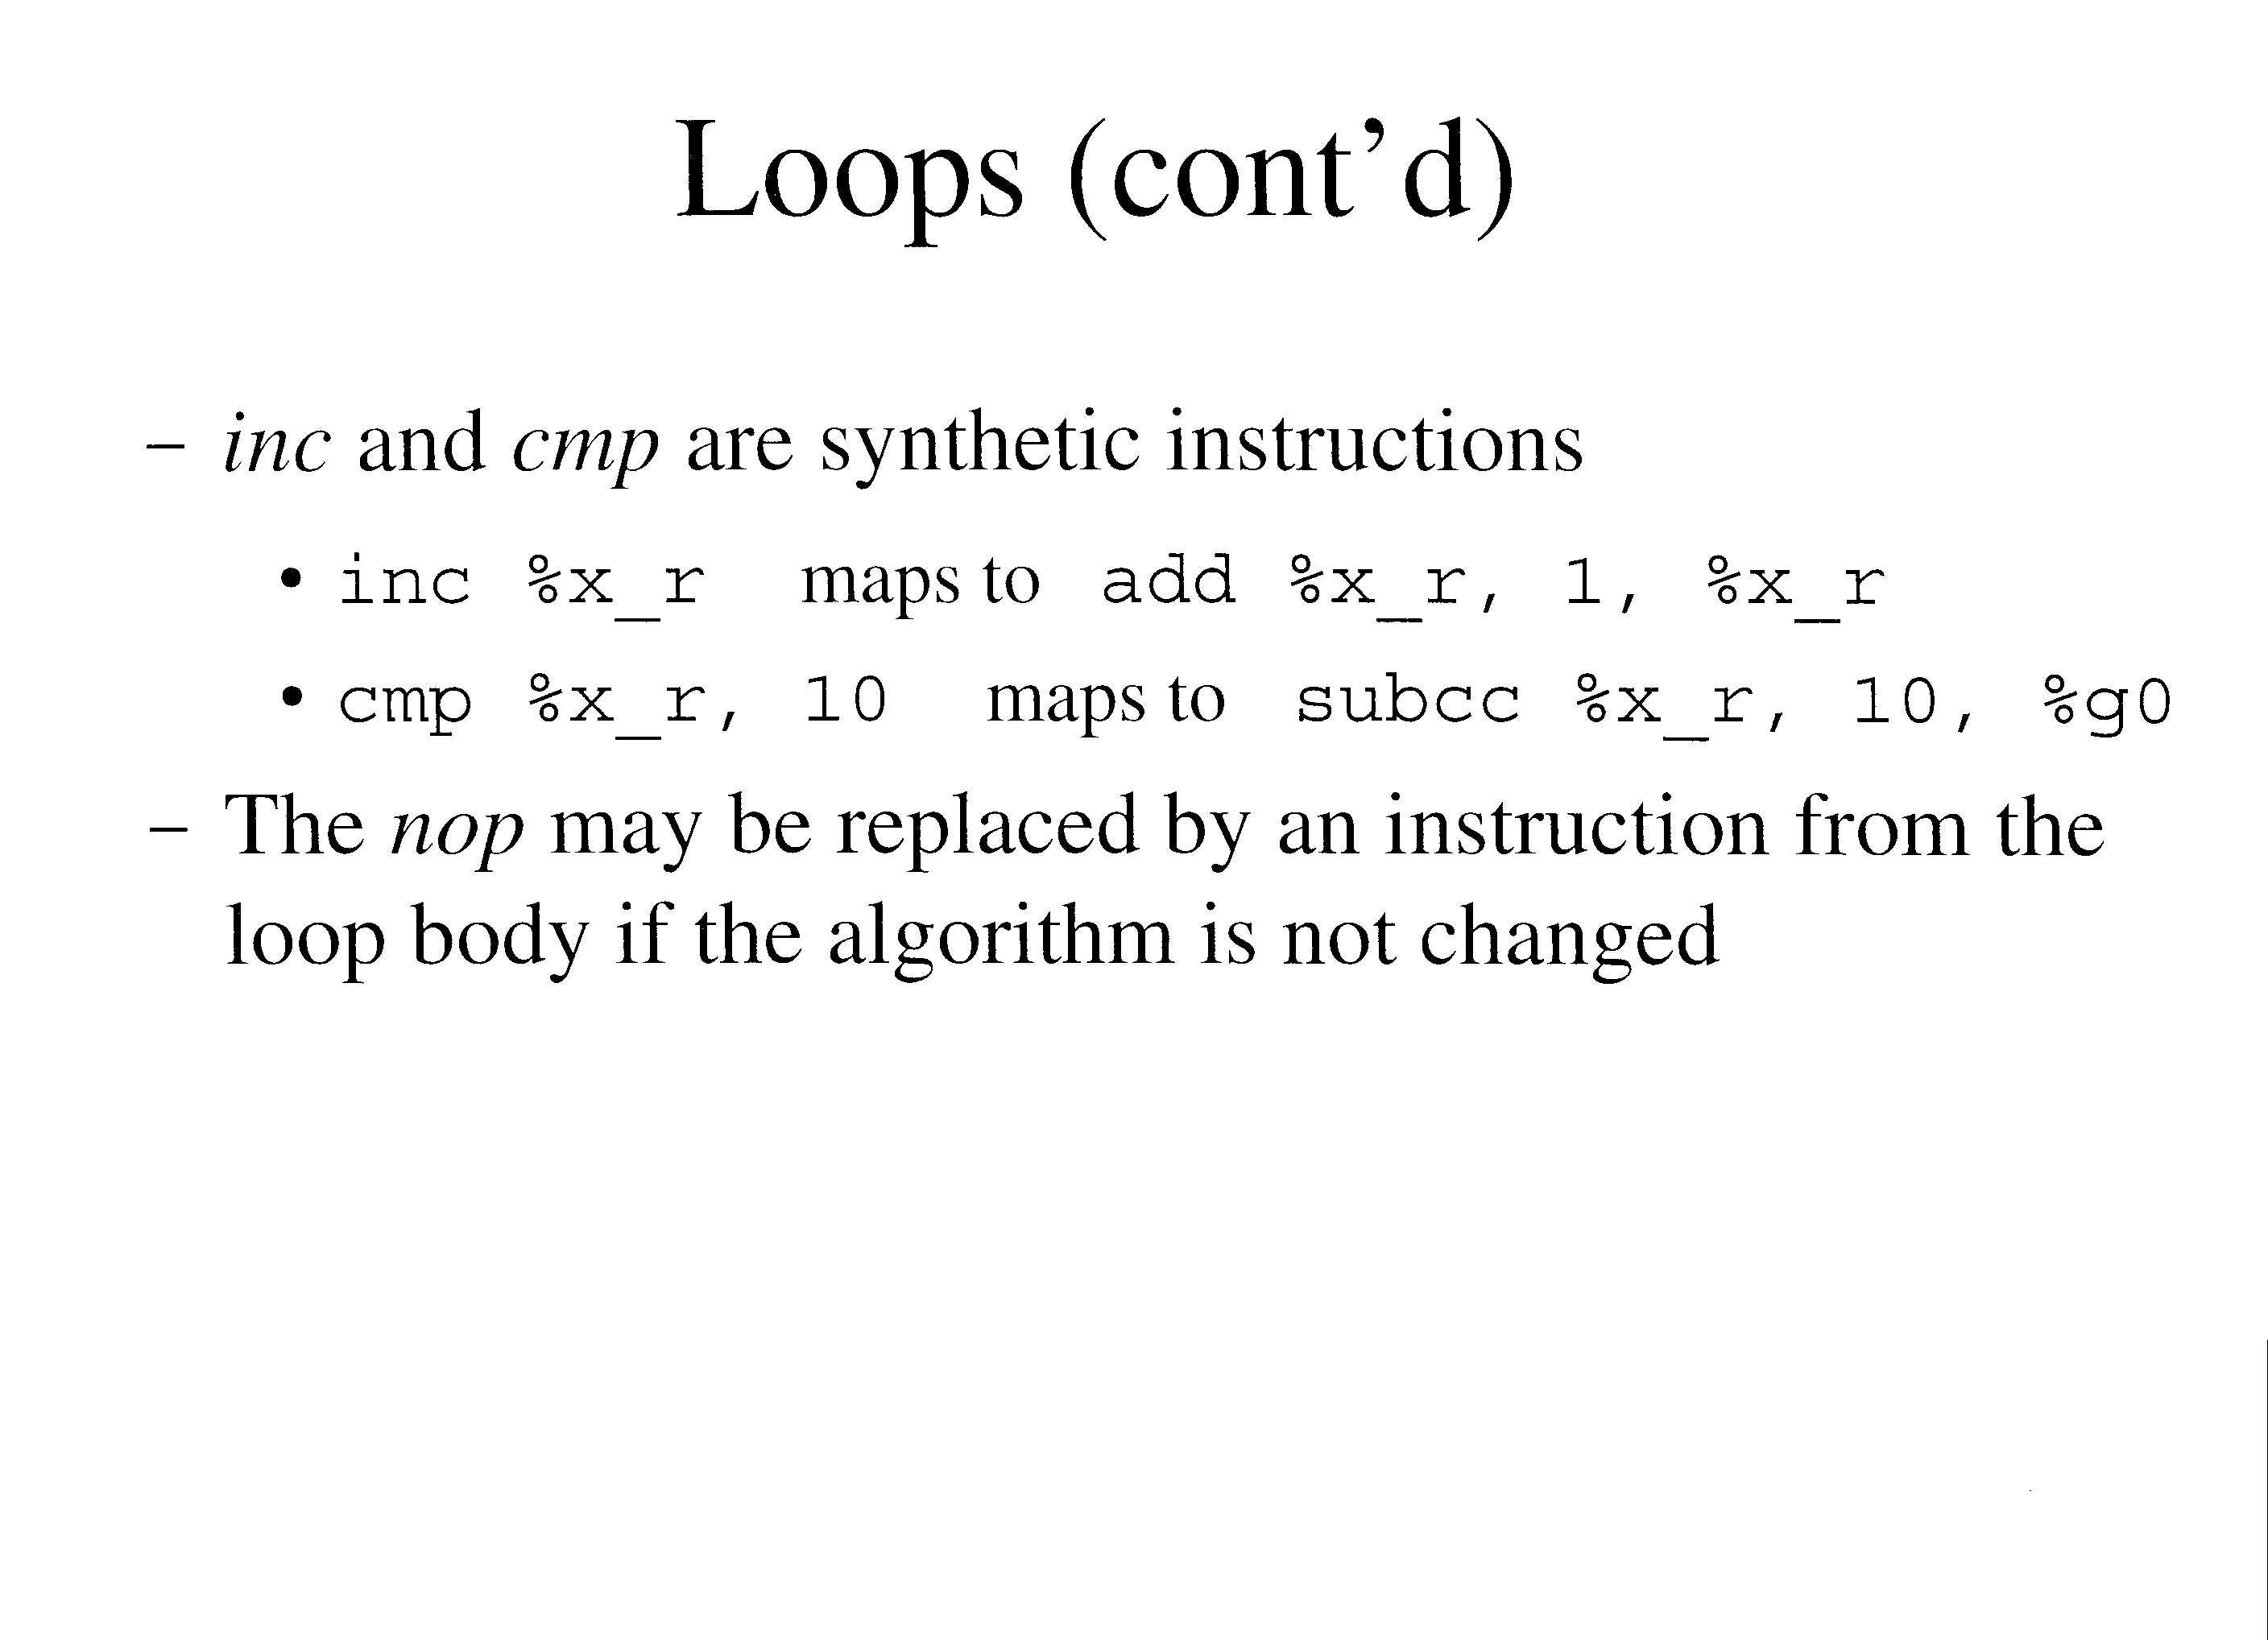

Slide 55
Loops (cont’d)
While loops are similar, except they are pre-test loop
  C code:
    int x;
    x = 0;
    While (x < 10) {
    // loop body
    x++;
    }

Slide 56
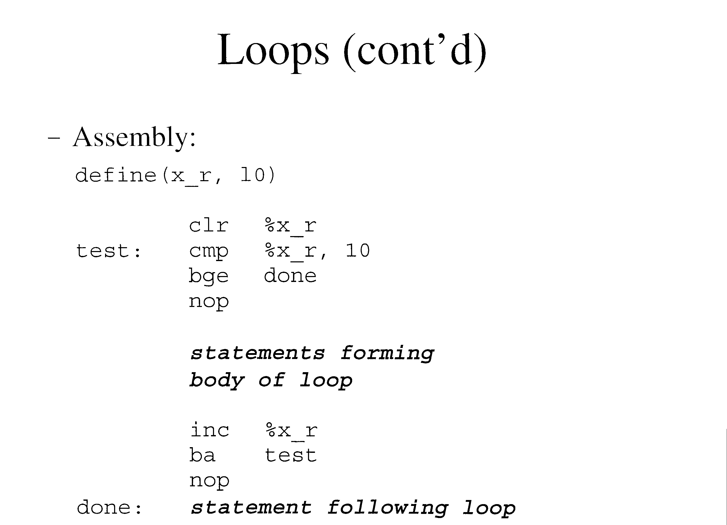

Slide 57
Loops (cont’d)
This code can be optimized by putting the test at the end of the loop
  Loop reduced by two instructions
A code branch can be annulled by apending ,a
  Eg: bl,a top
  The delay slot instruction is executed only when the branch is taken
    If the branch “falls through”, the instruction is not executed (wastes one cycle)
  The loop can be optimized by putting the first statement of the loop body into the delay slot

Slide 58
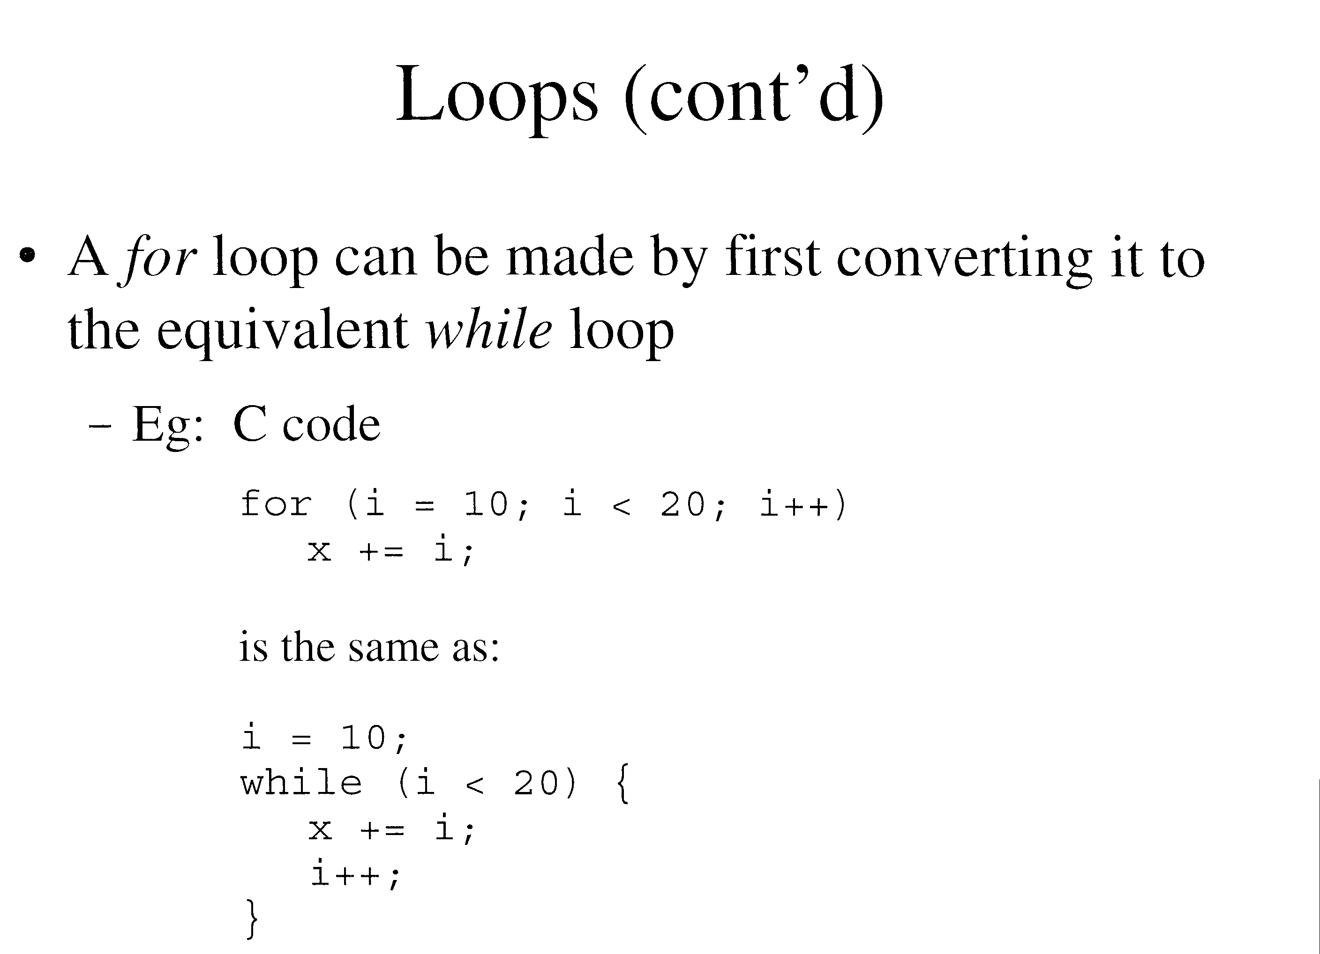

Slide 59
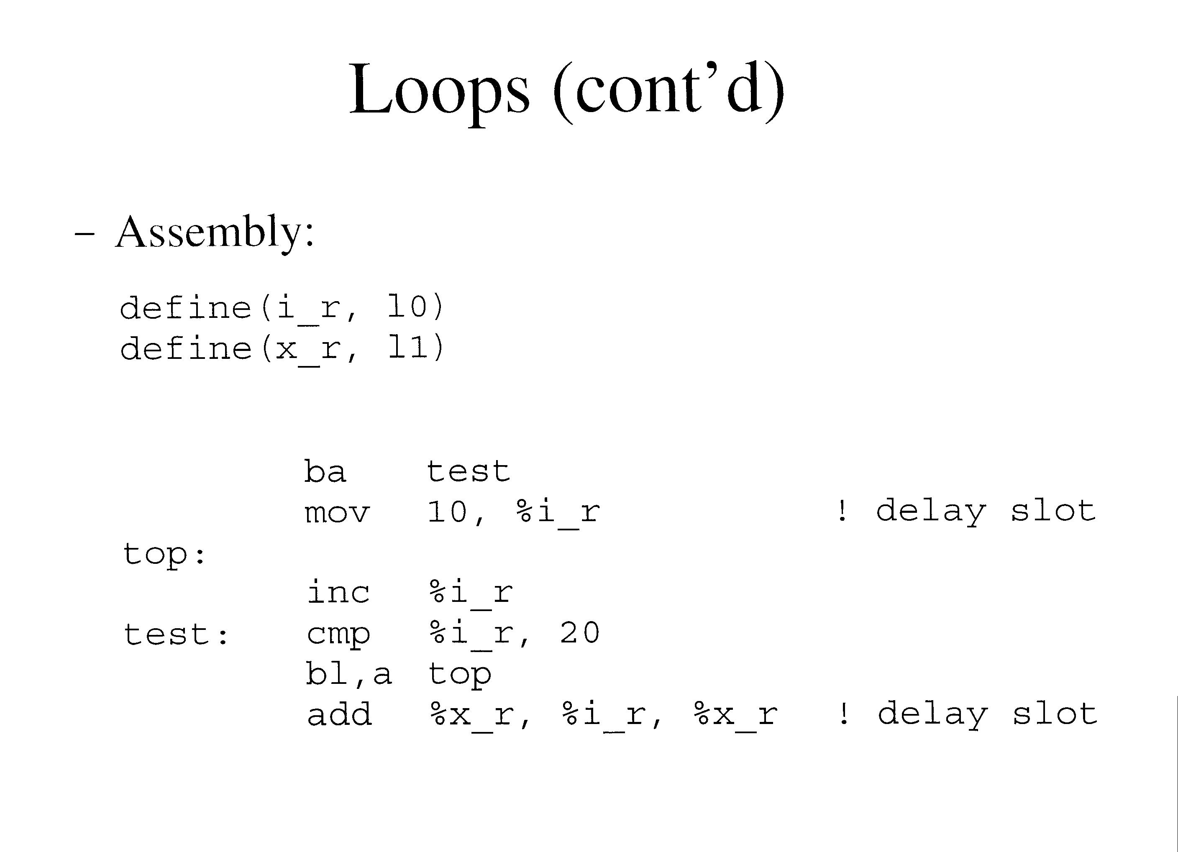

Slide 60
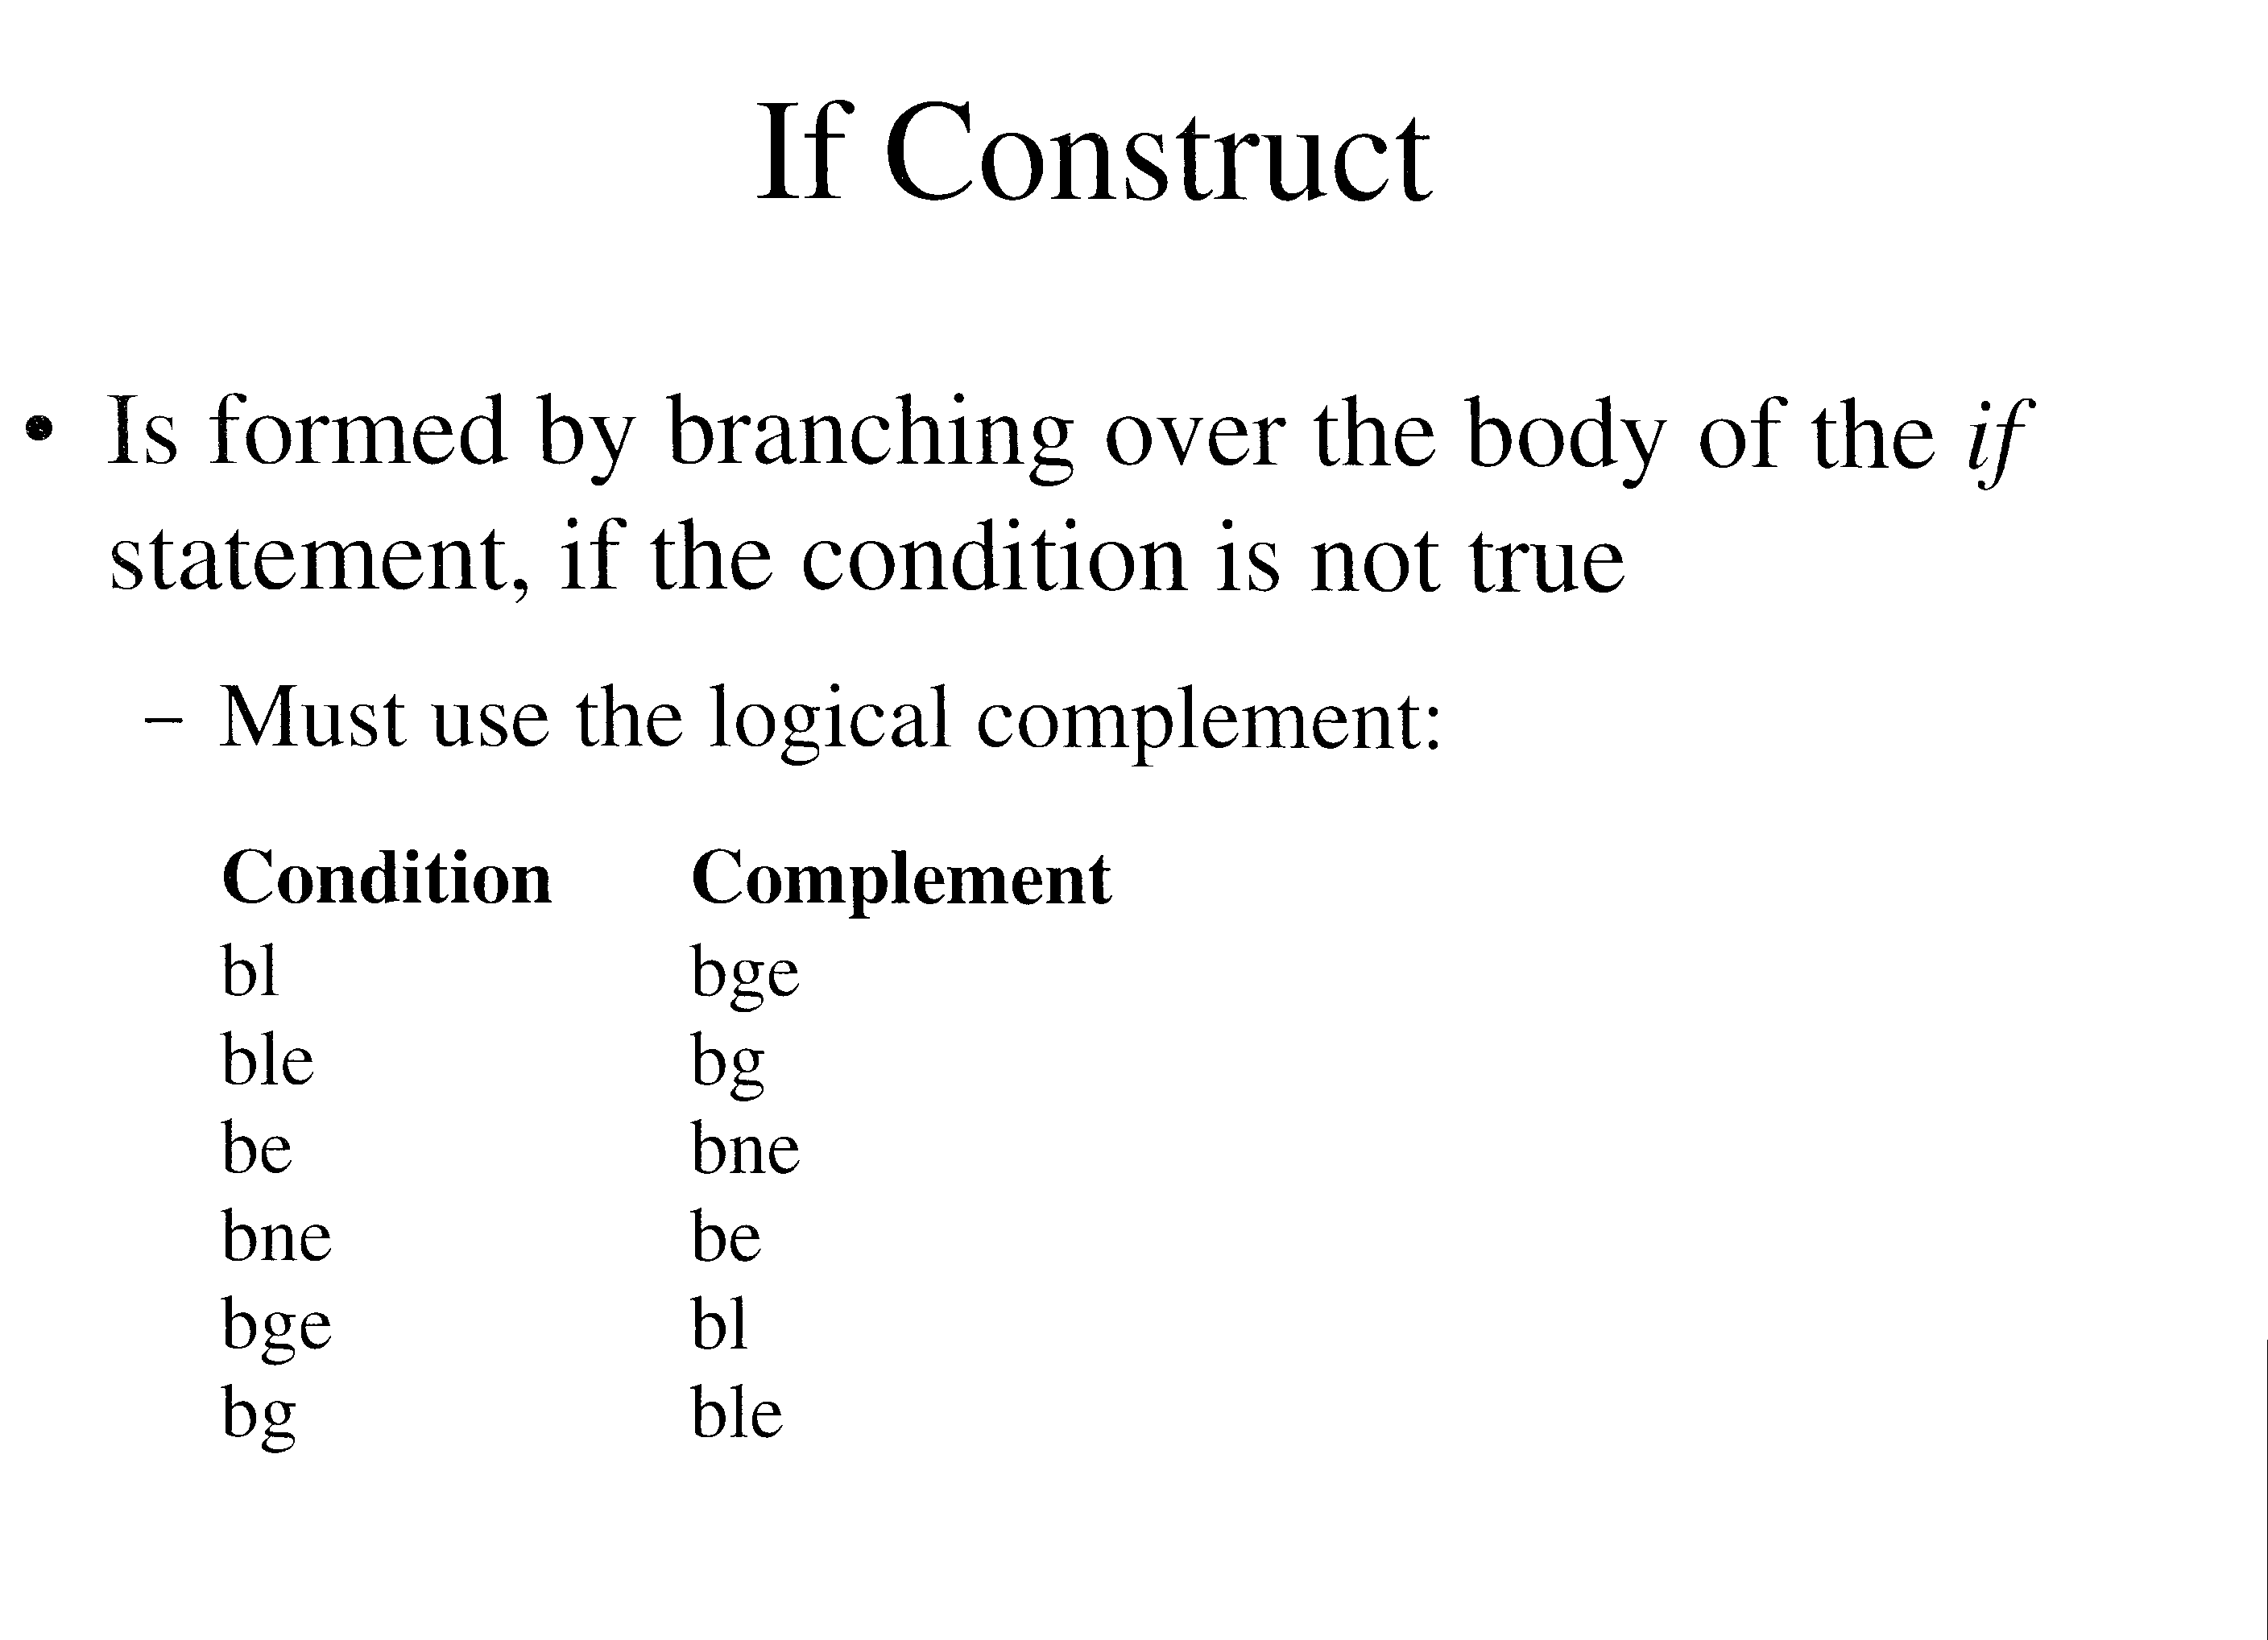

Slide 61
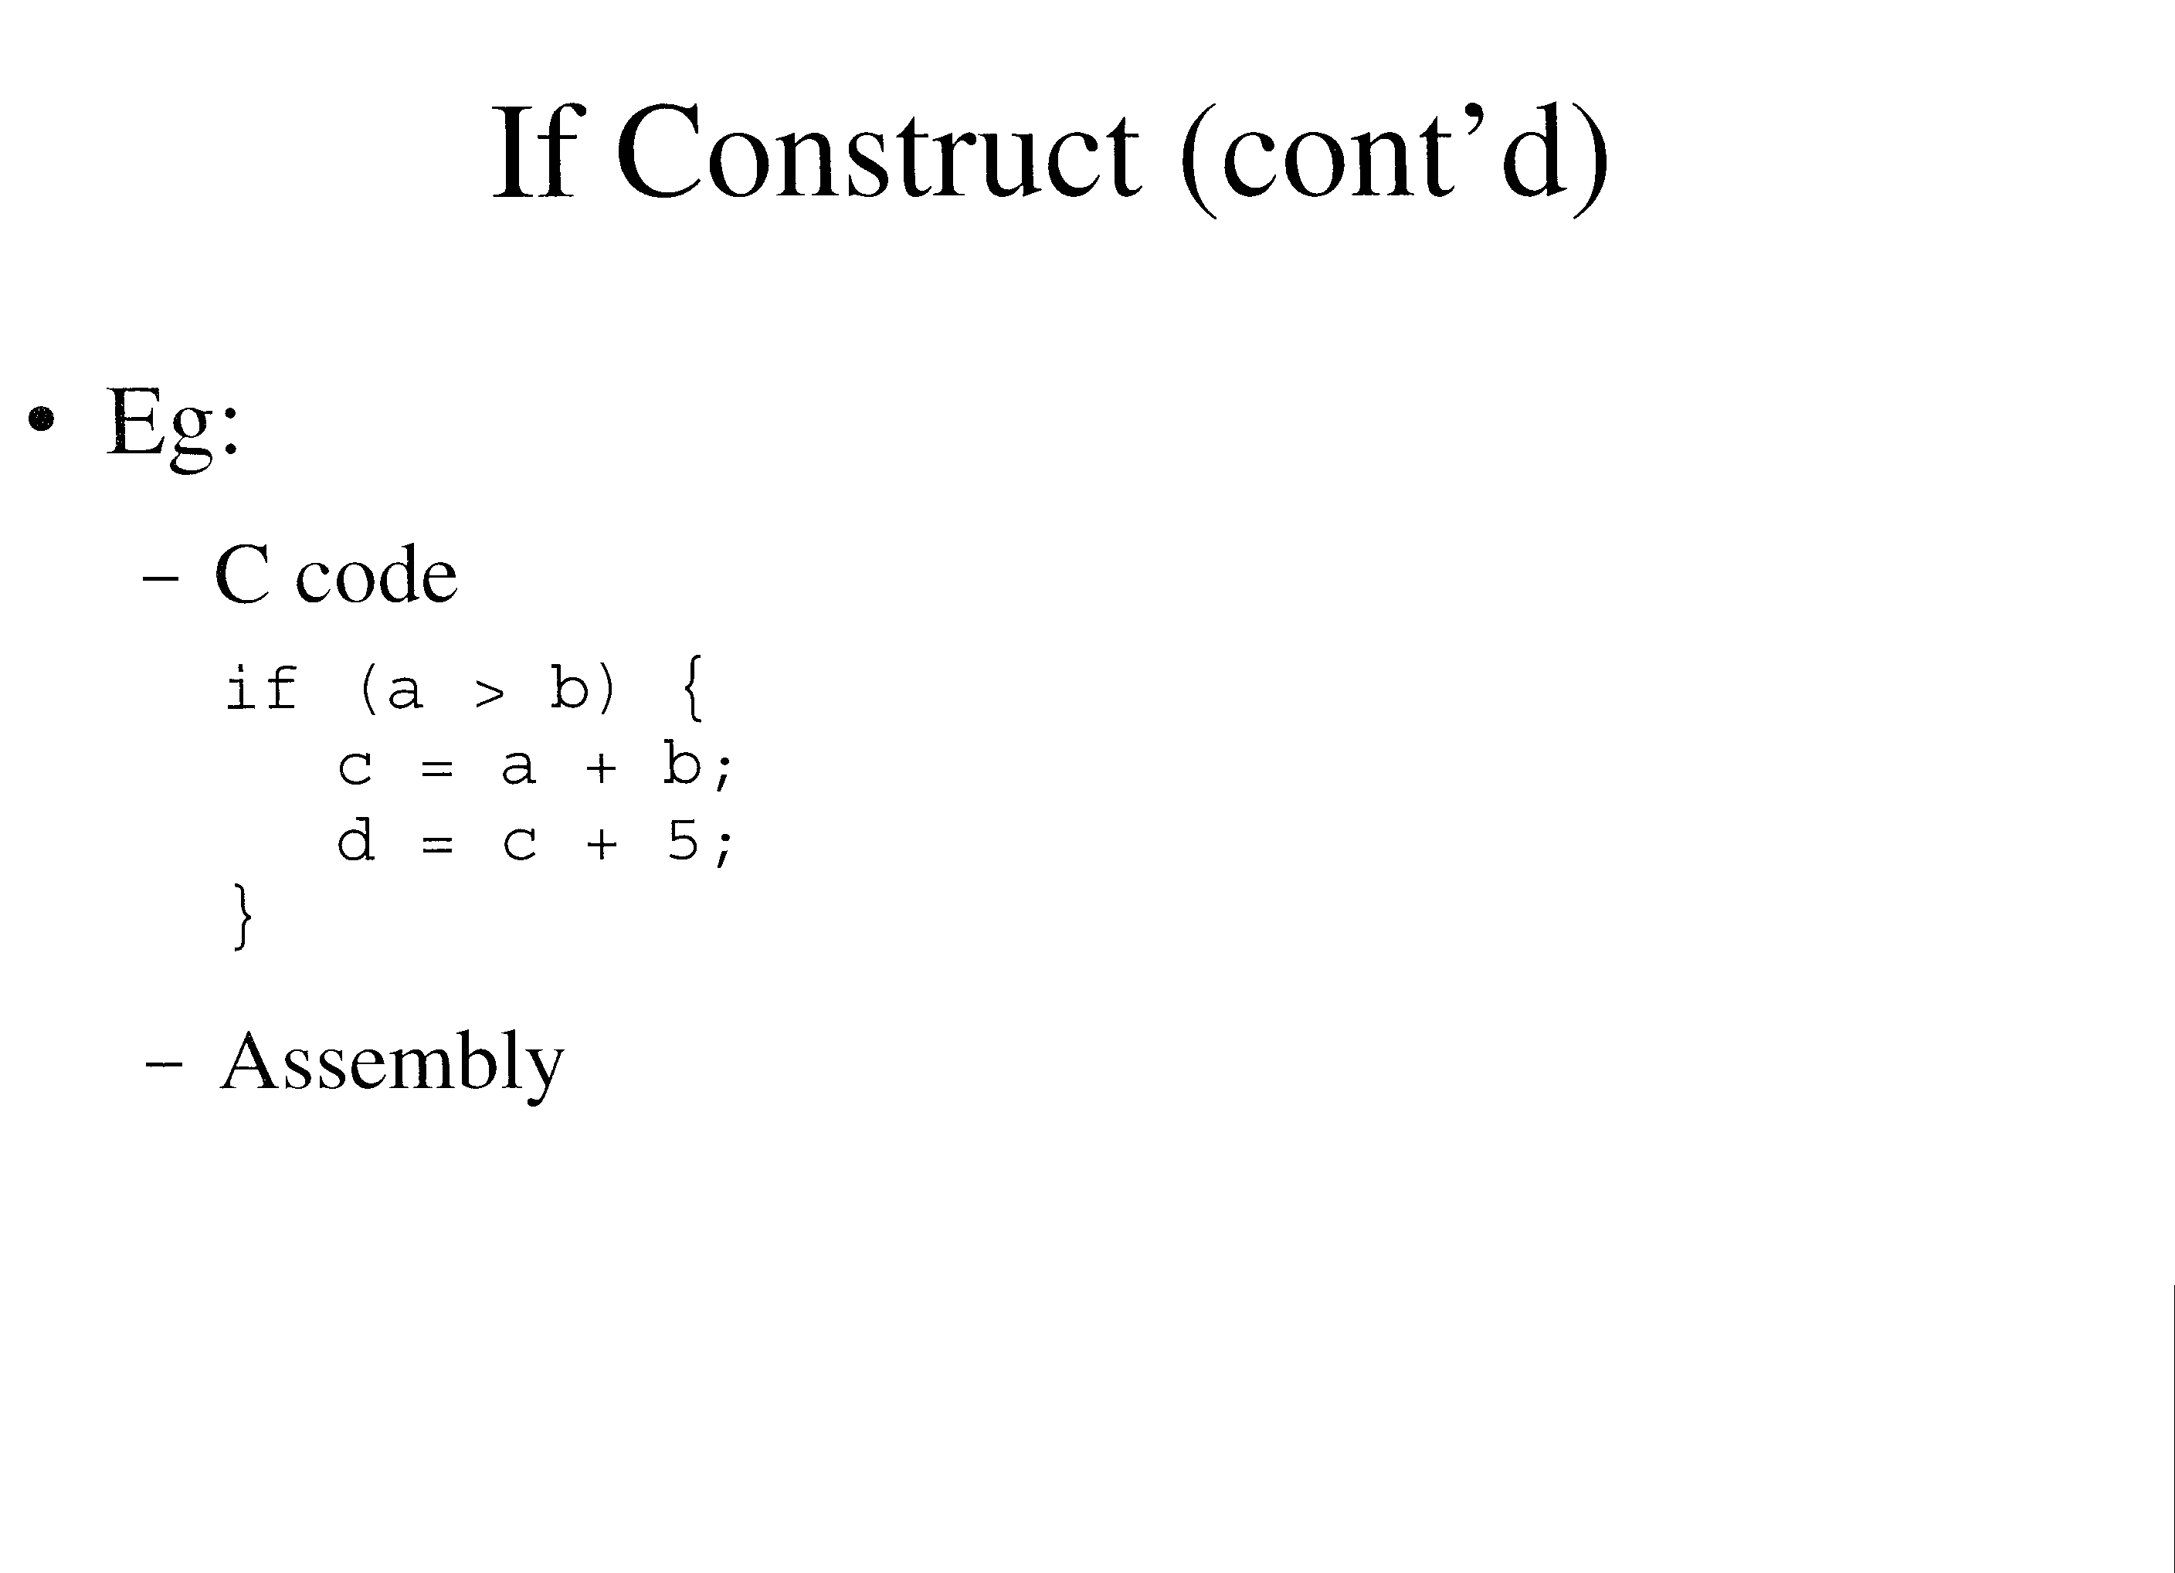

Slide 62
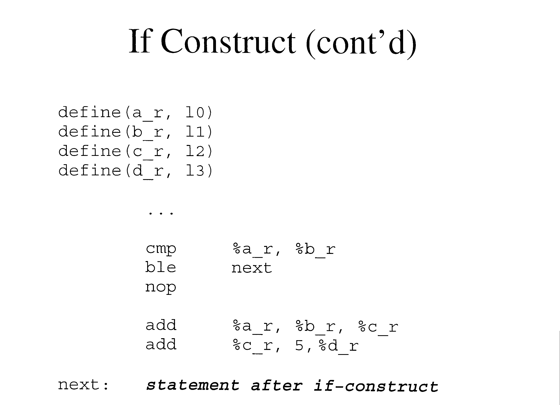

Slide 63
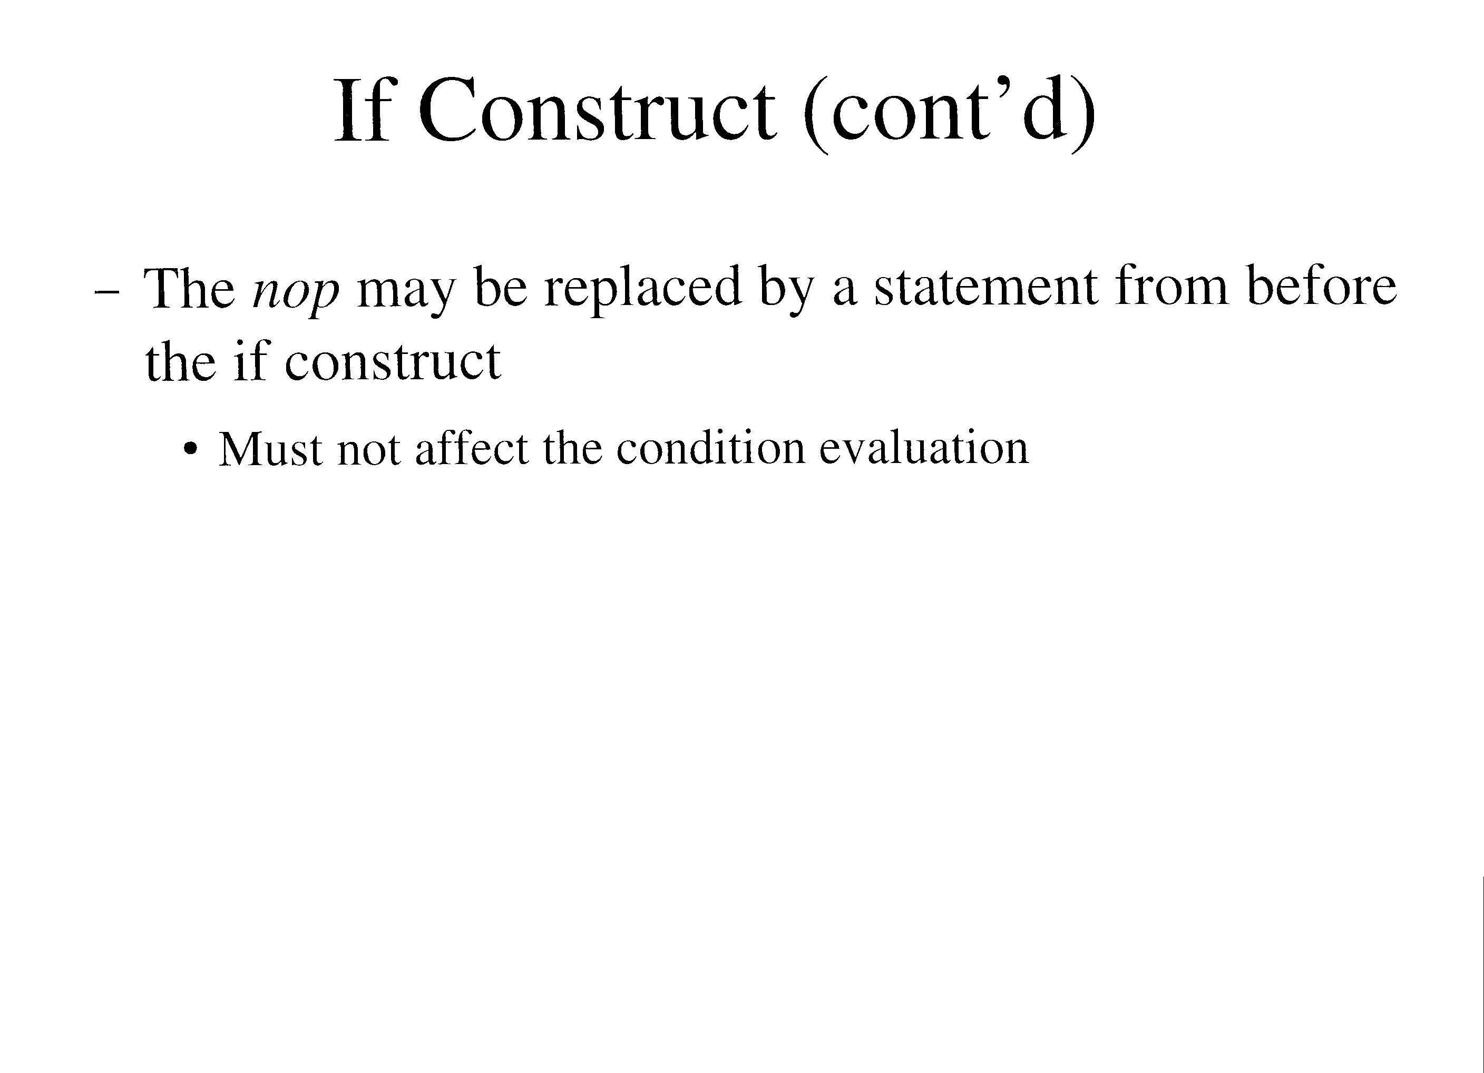

Slide 64
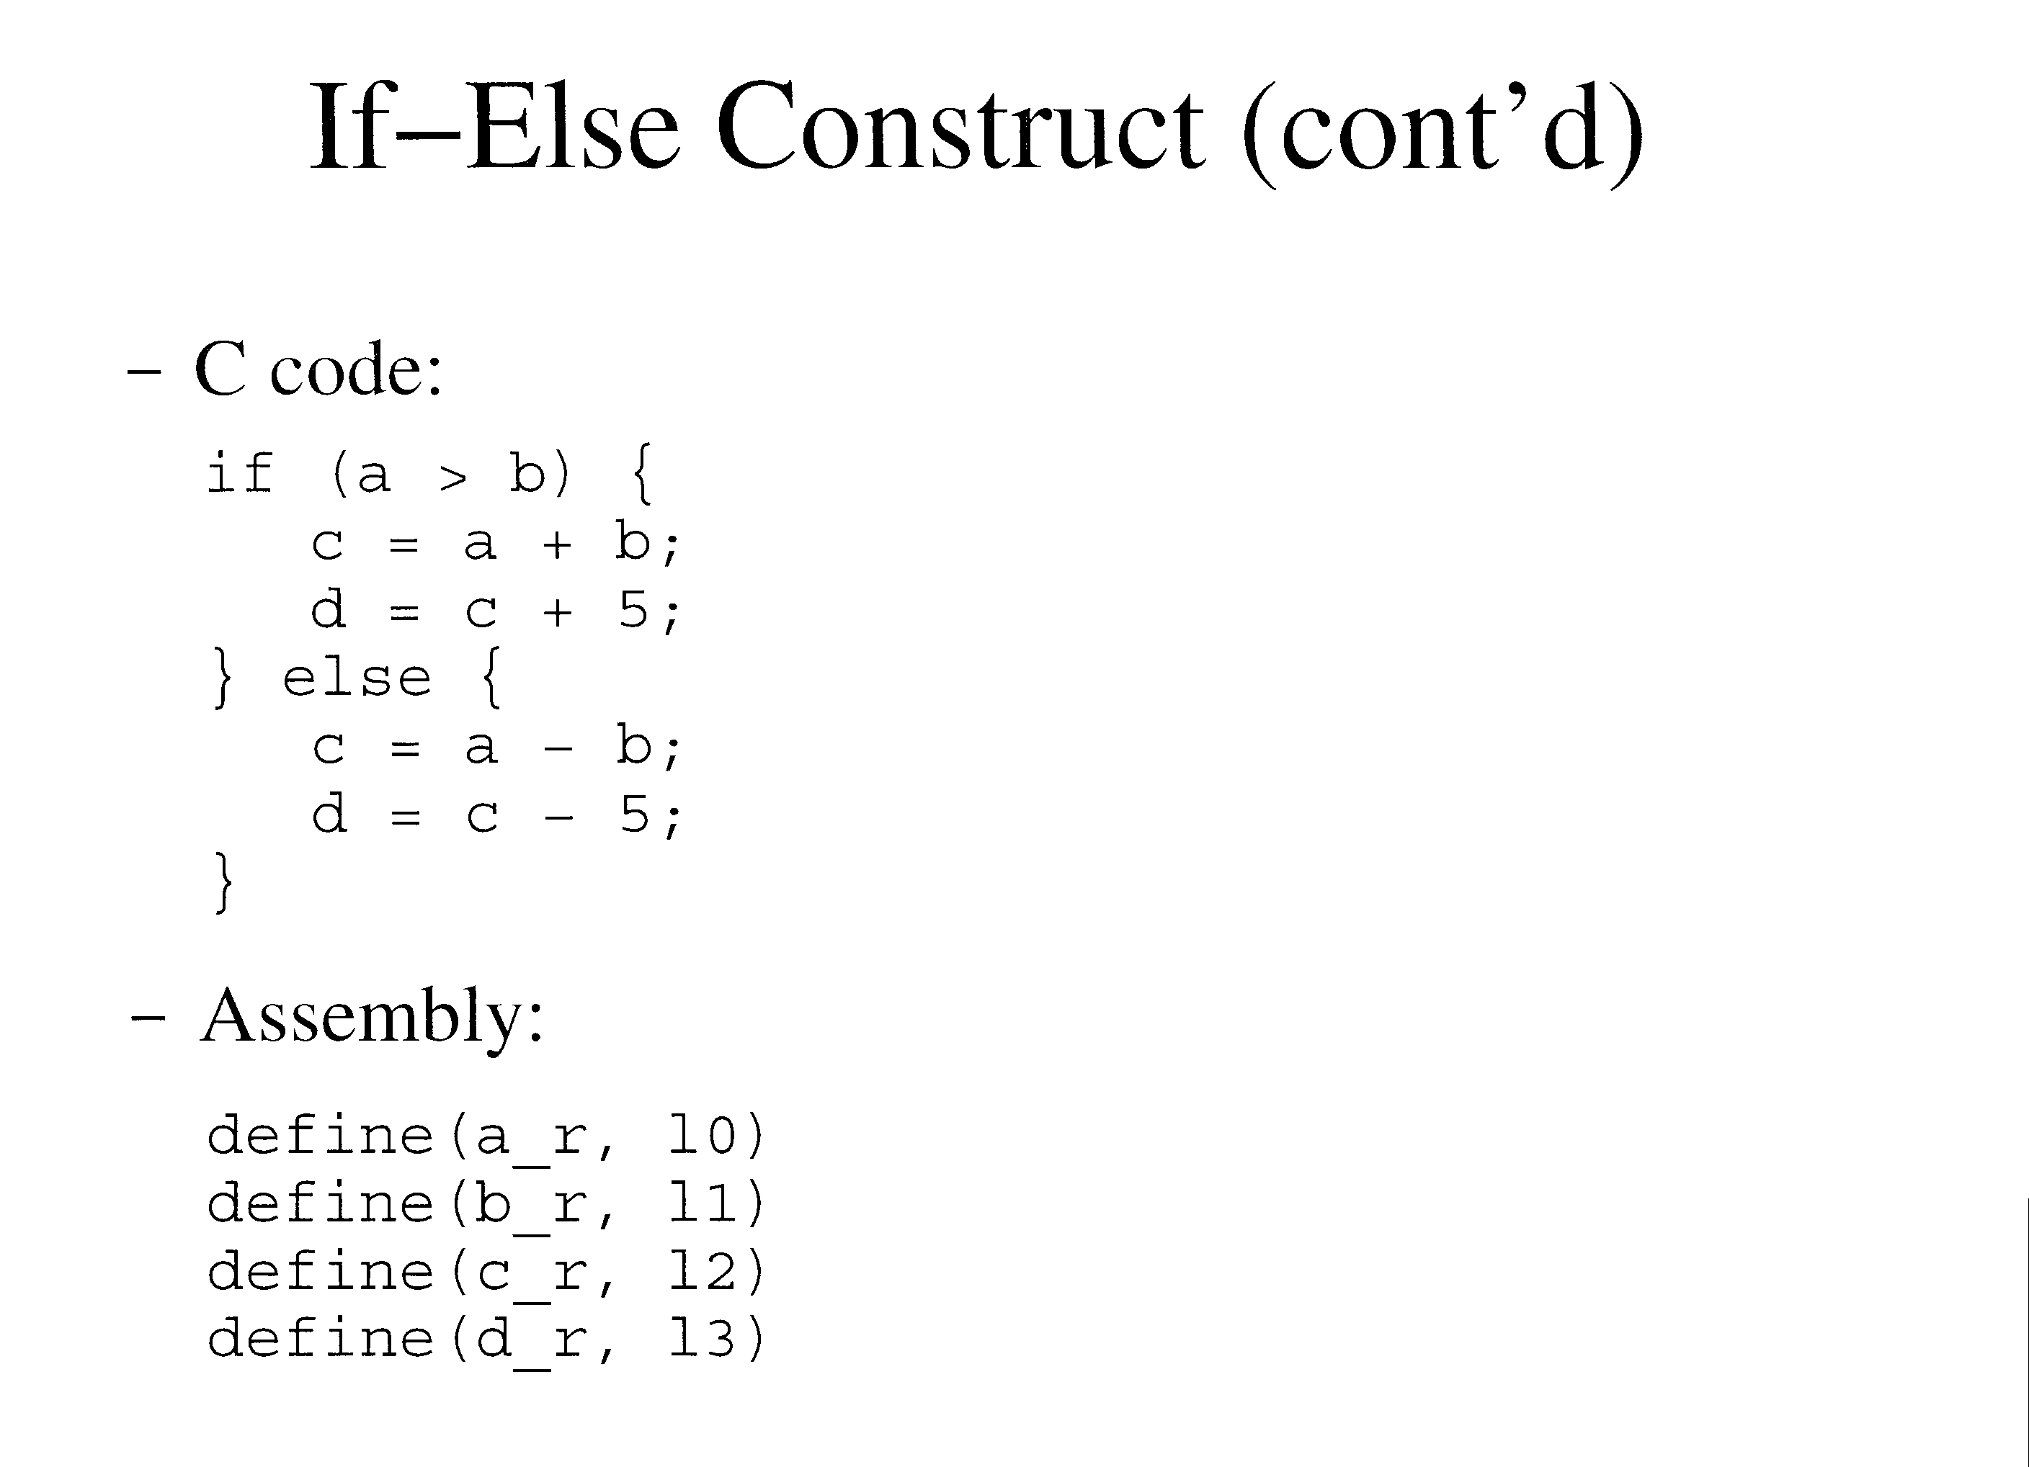

Slide 65
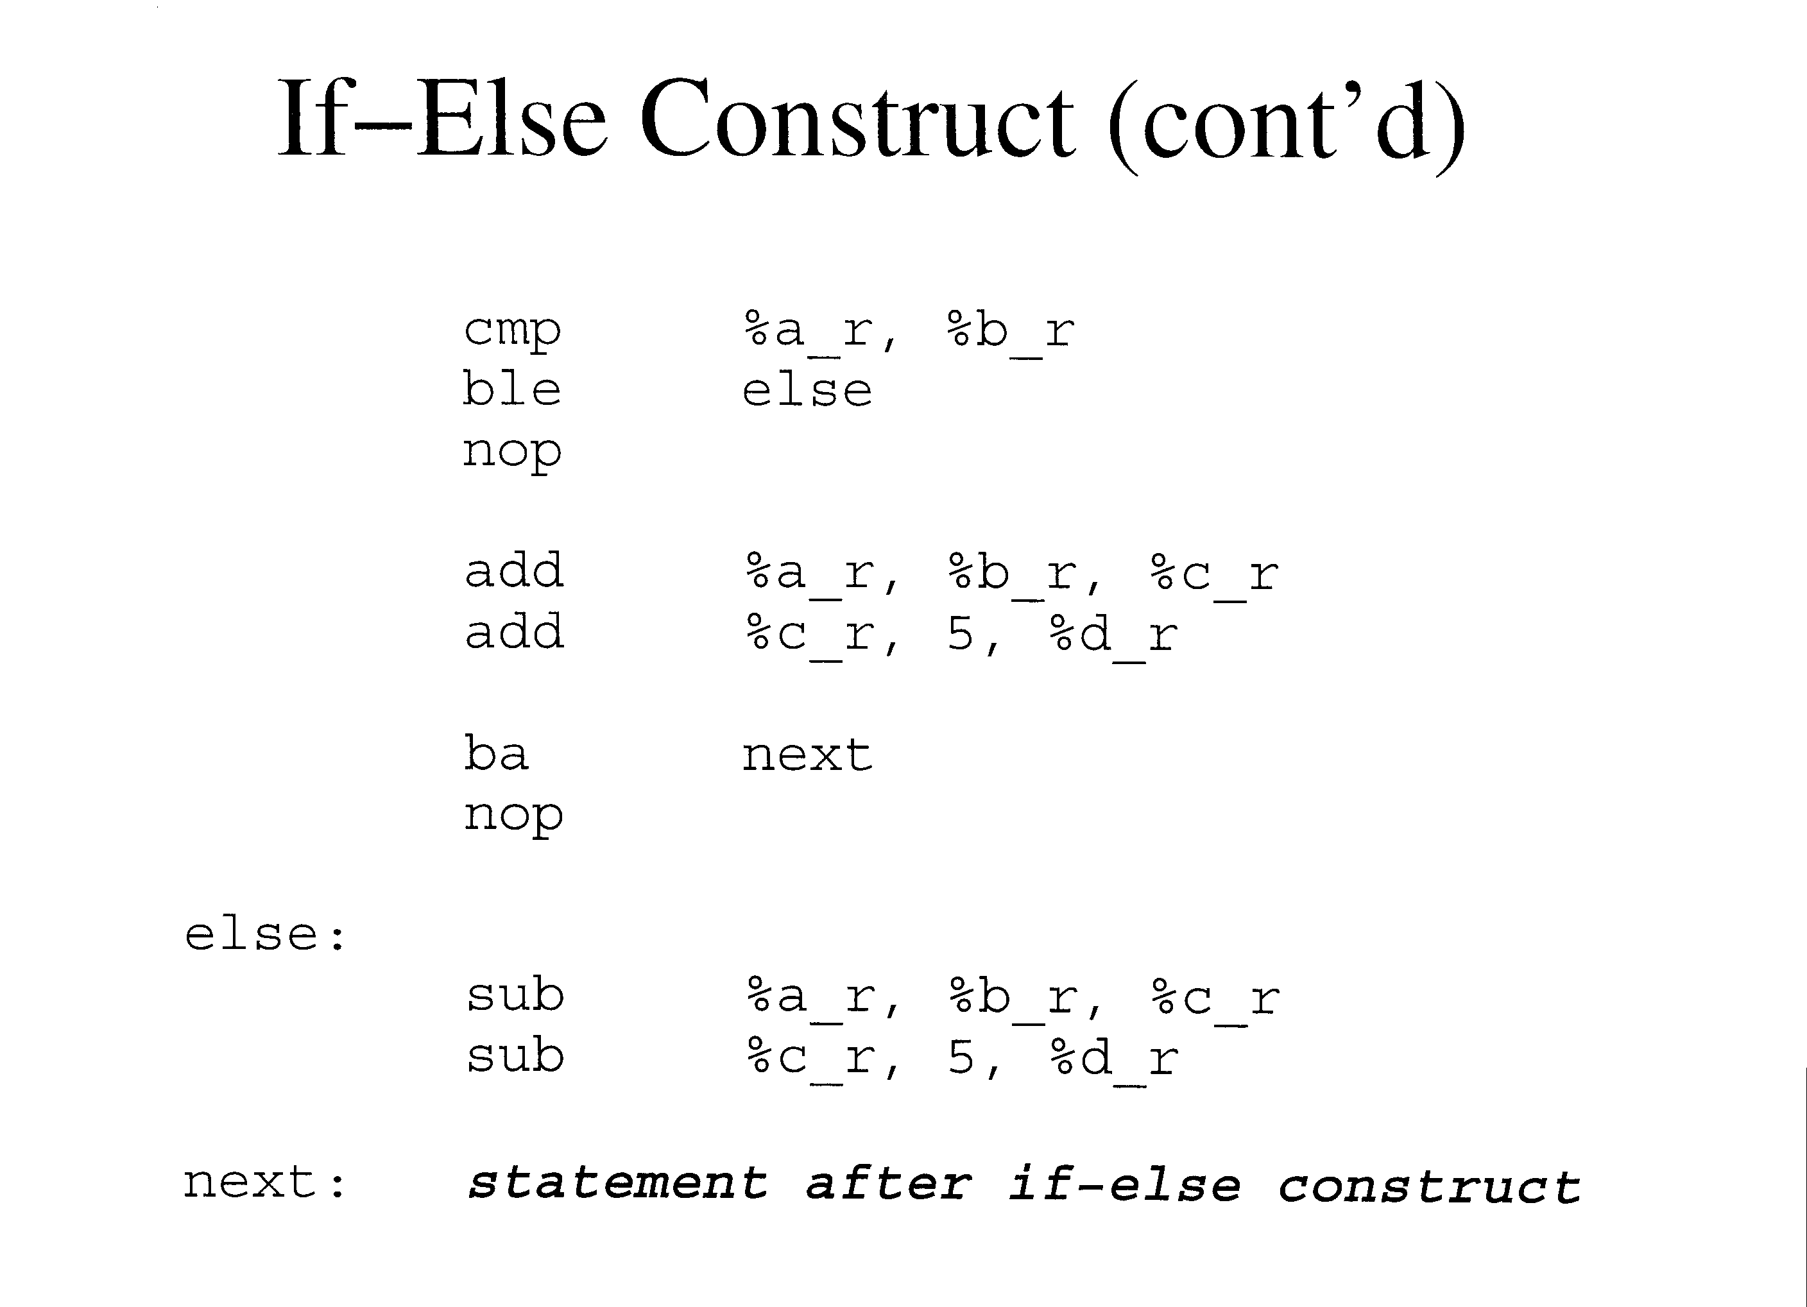

Slide 66
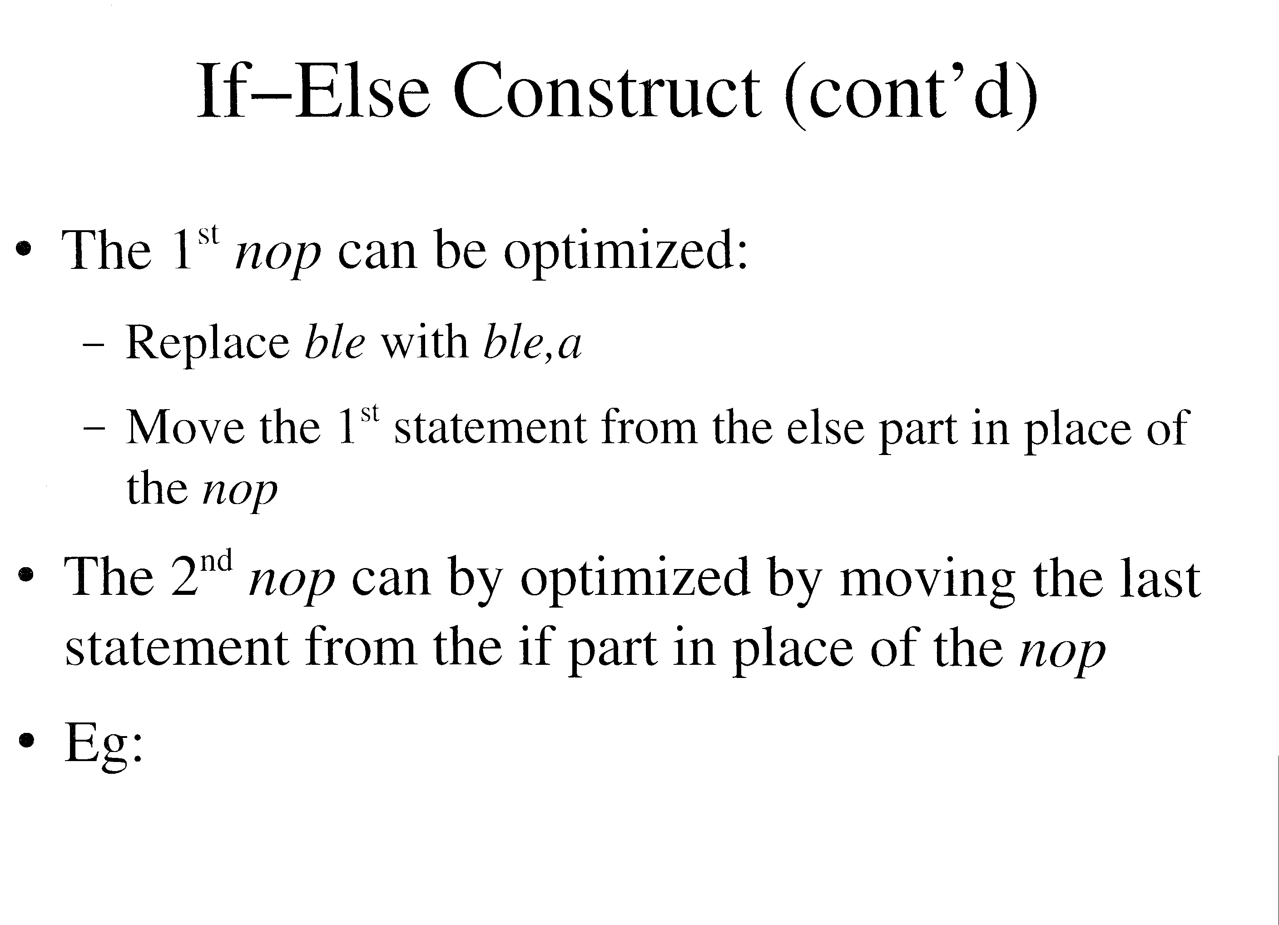

Slide 67
