Slide 1
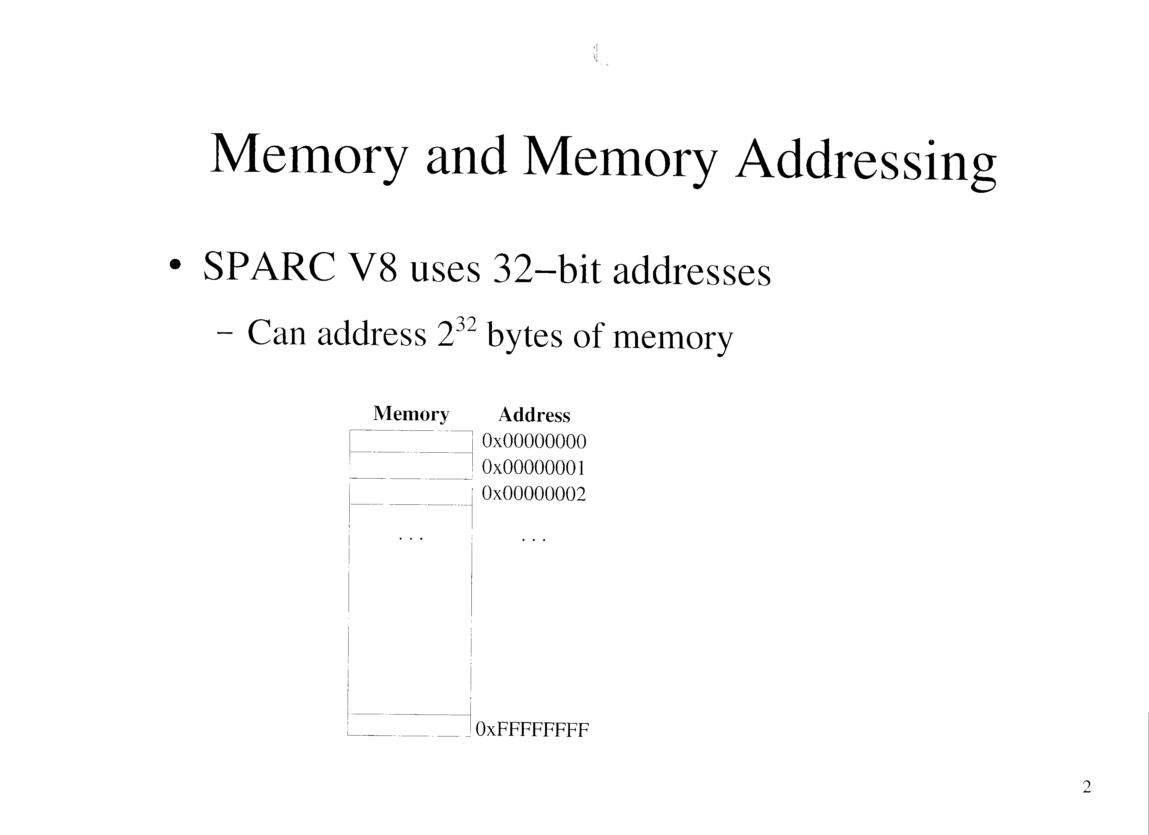

Slide 2
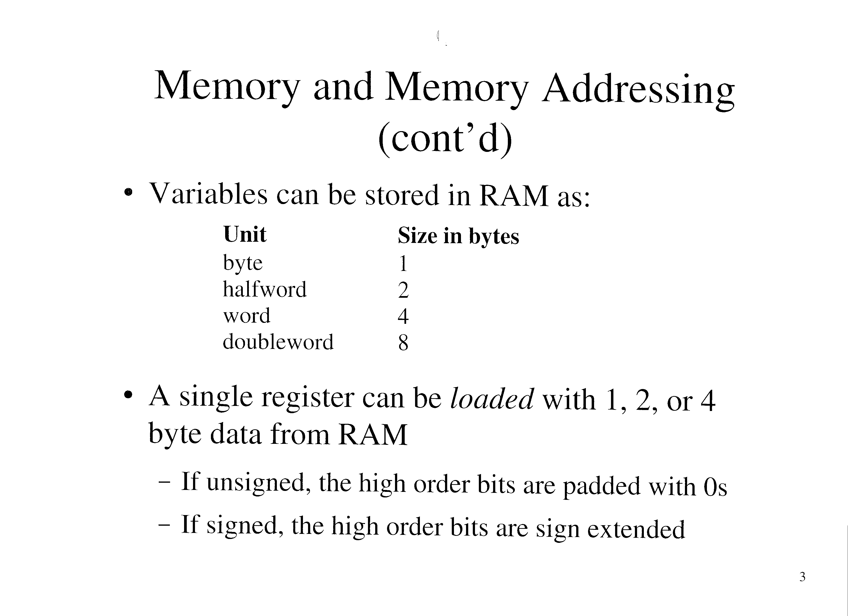

Slide 3
Memory and Memory Addressing (cont’d)
Byte, halfword, and word data in a register can be stored in RAM
  Low order bits of register for byte and halfword
Doubleword data is loaded/stored using two registers
  Are pairs, where the first has an even number, and the 2nd is the number +1
    Eg: %o0, %o1
Memory references must be aligned
  2 byte data can only be stored at addresses evenly divisible by 2
  4 byte data at addresses divisible by 4
  8 byte data at addresses divisible by 8

Slide 4
Stack Memory
Is space in RAM provided by the OS to store data for functions
  A stack frame is pushed onto the stack when a function is called
    Holds the functions parameters, automatic variables, and return values
  The frame is popped when the function returns

Slide 5
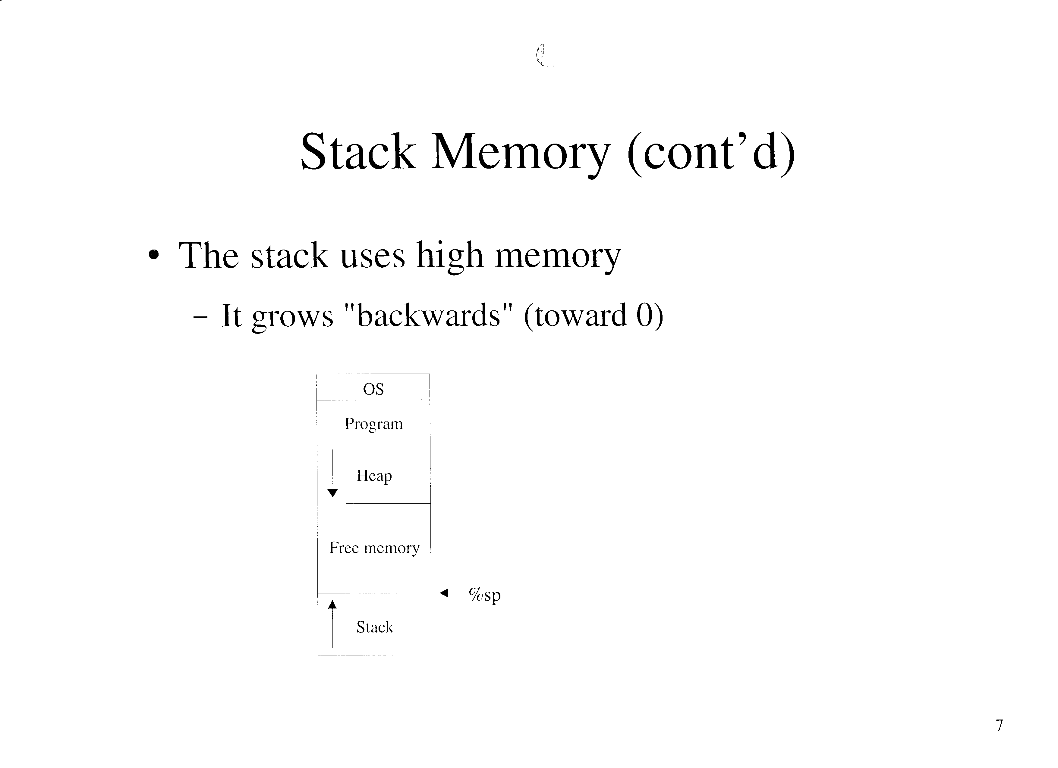

Slide 6
Stack Memory (cont’d)
Programs are loaded into low memory, just above space reserved for the OS
The heap is used for dynamically allocated memory for a program
The stack pointer register %sp (%o6) always points to the top of the stack
  Is decremented when the stack grows

Slide 7
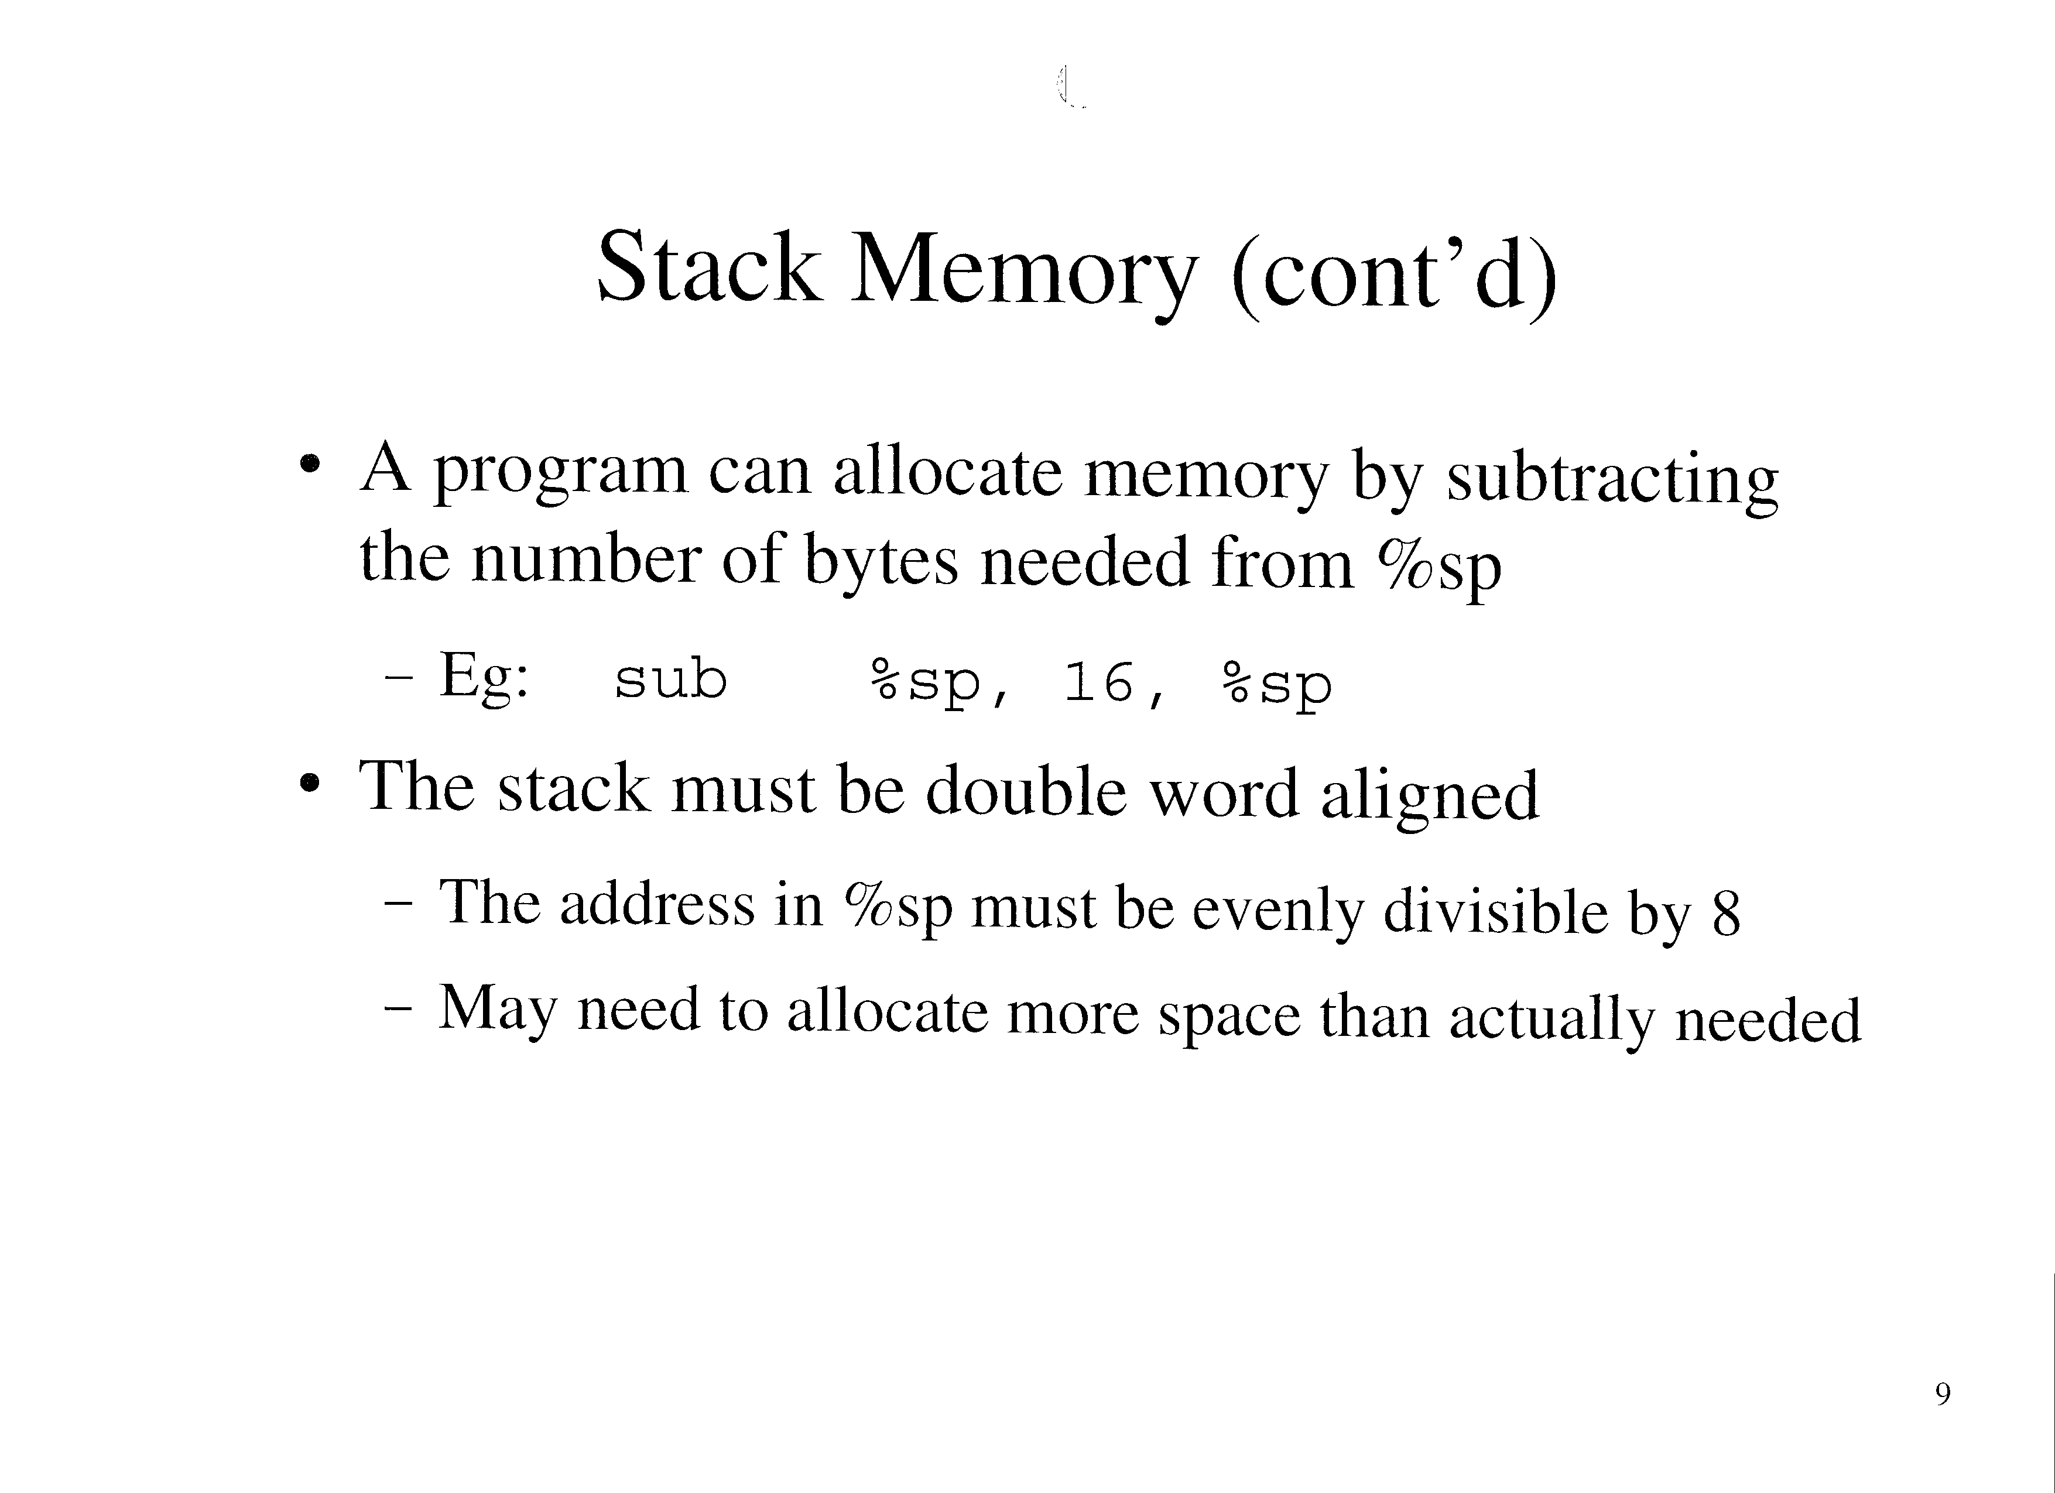

Slide 8
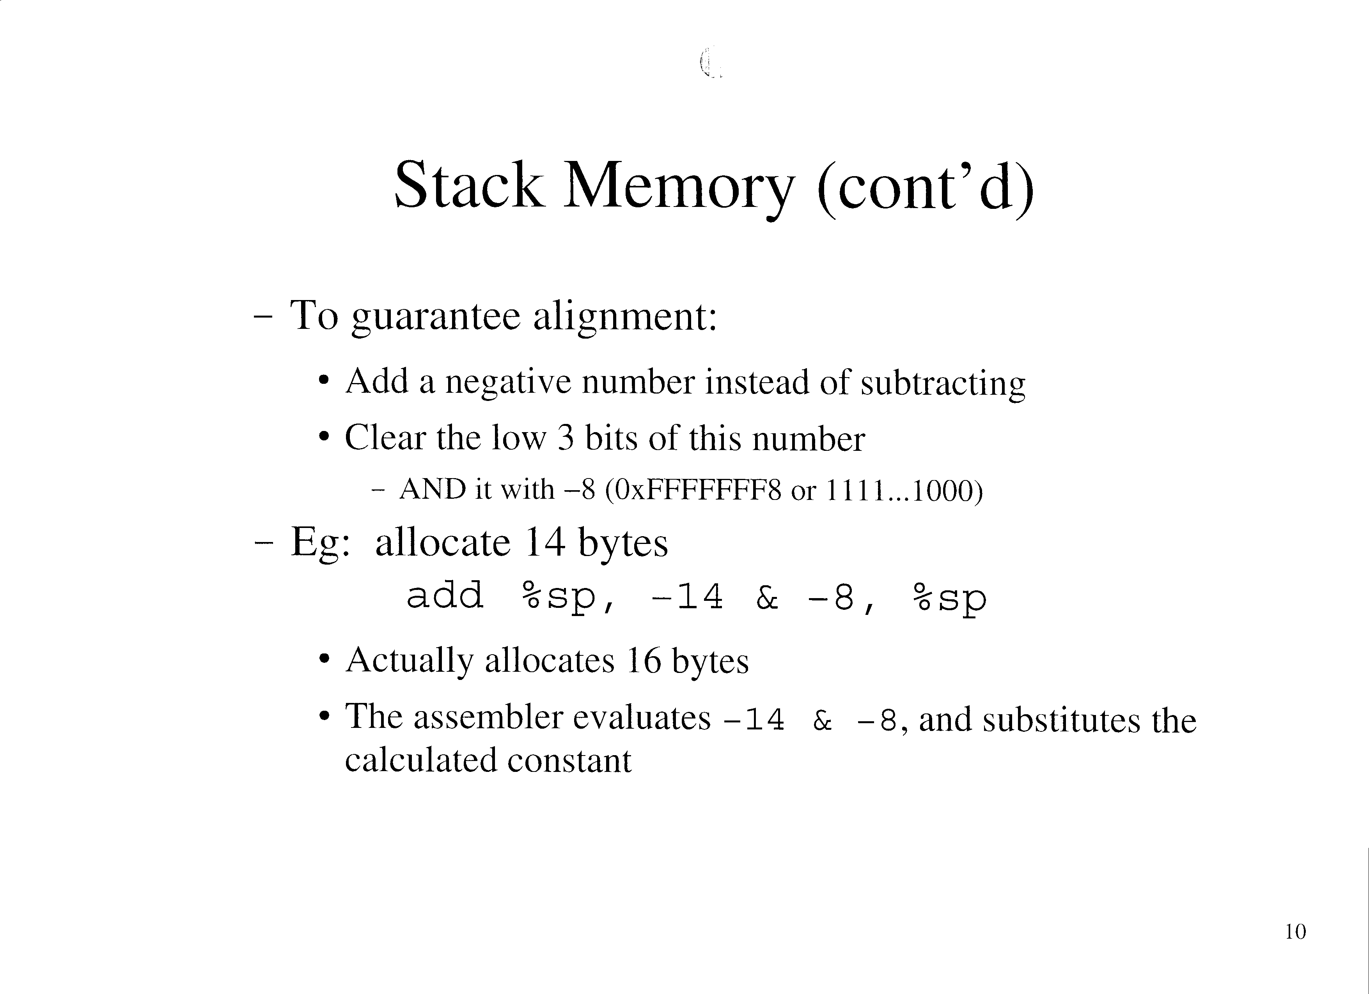

Slide 9
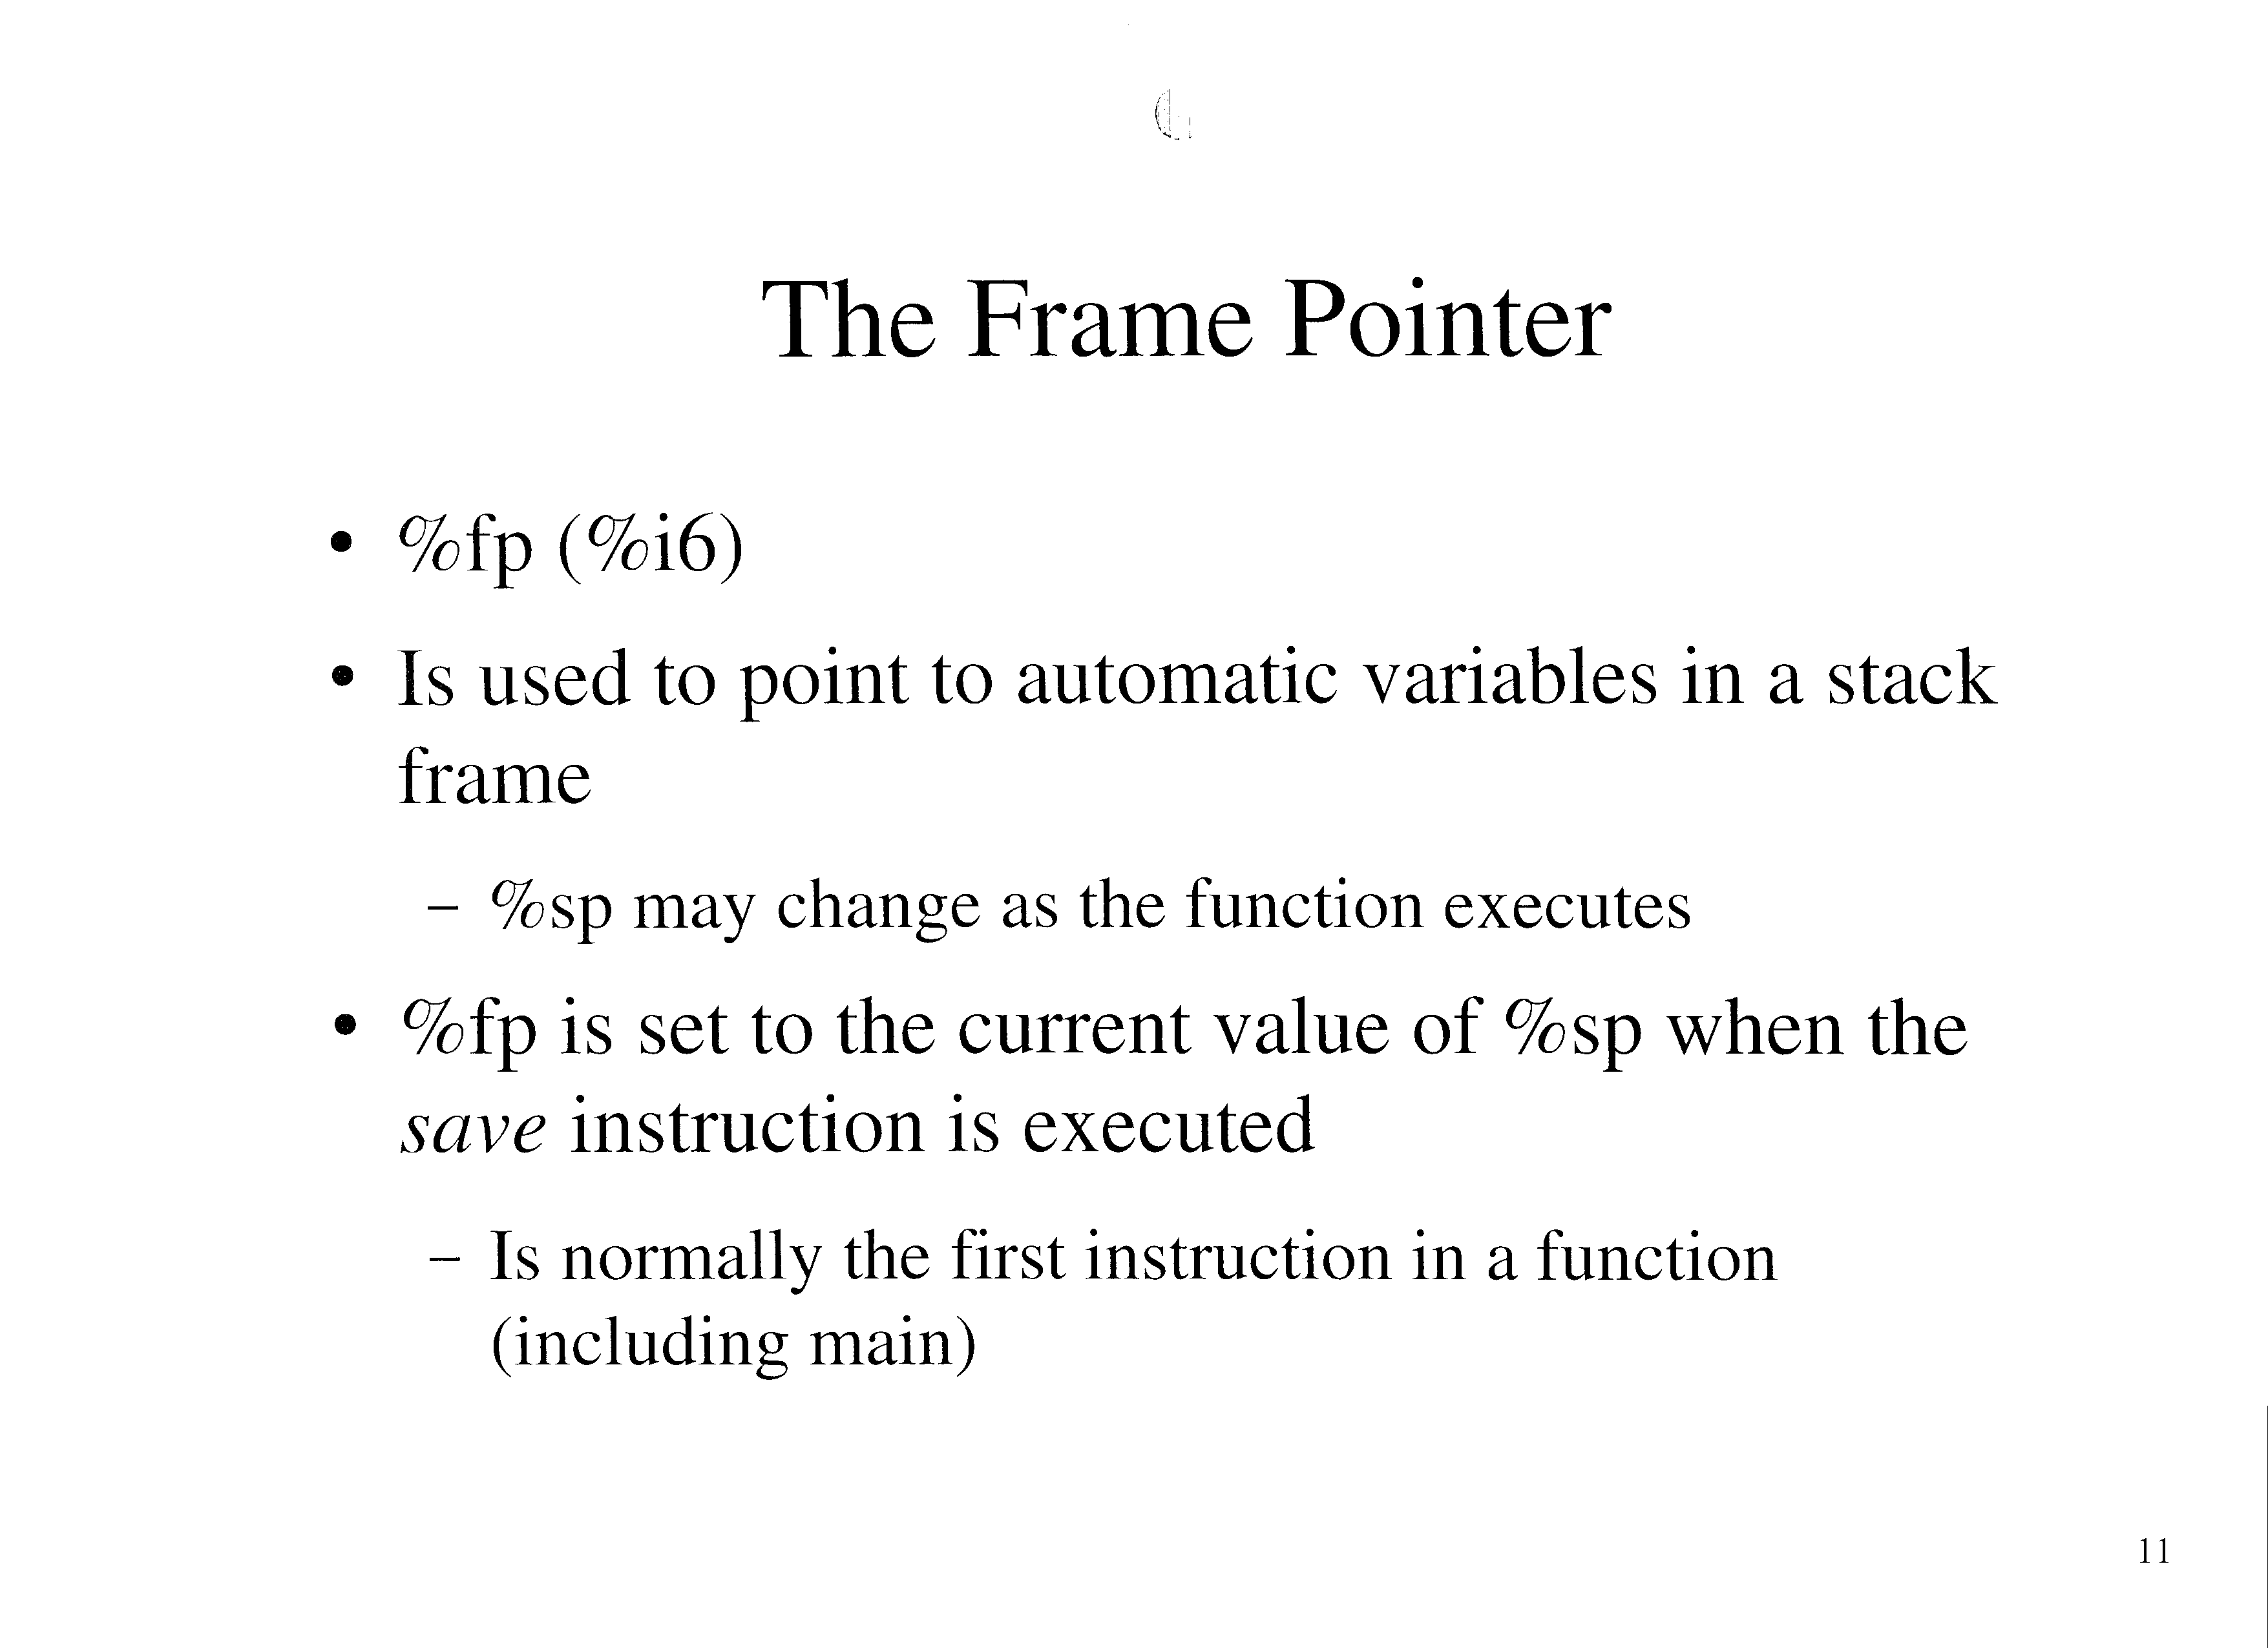

Slide 10
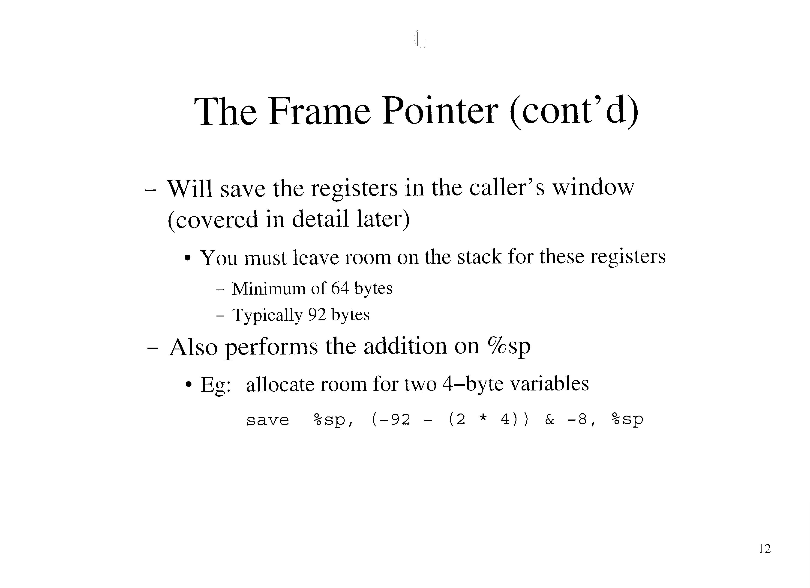

Slide 11
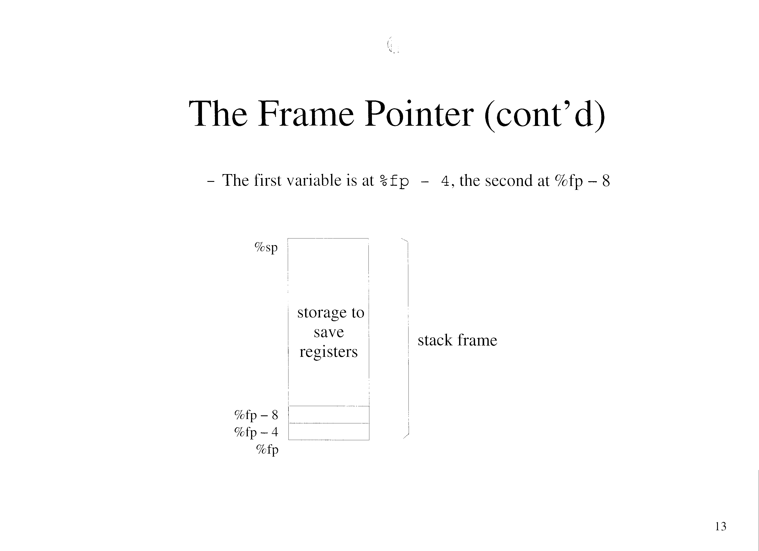

Slide 12
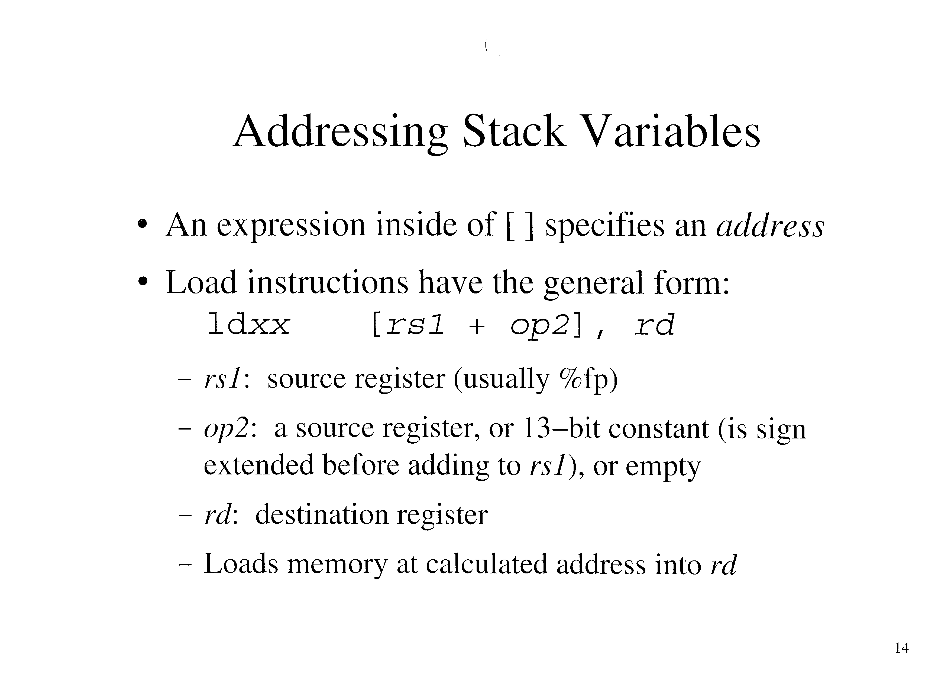

Slide 13
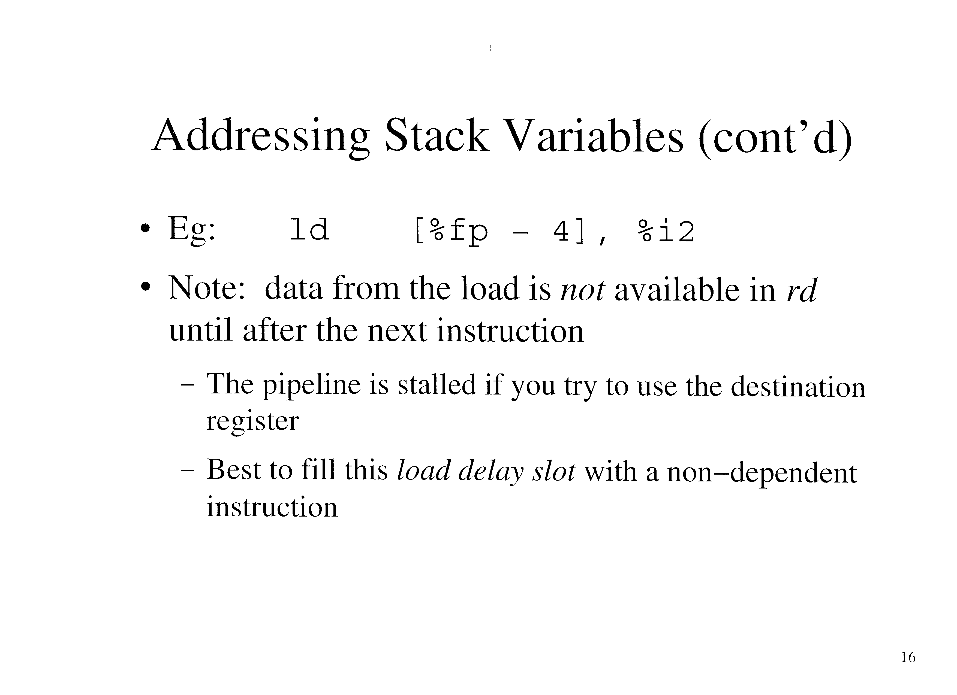

Slide 14
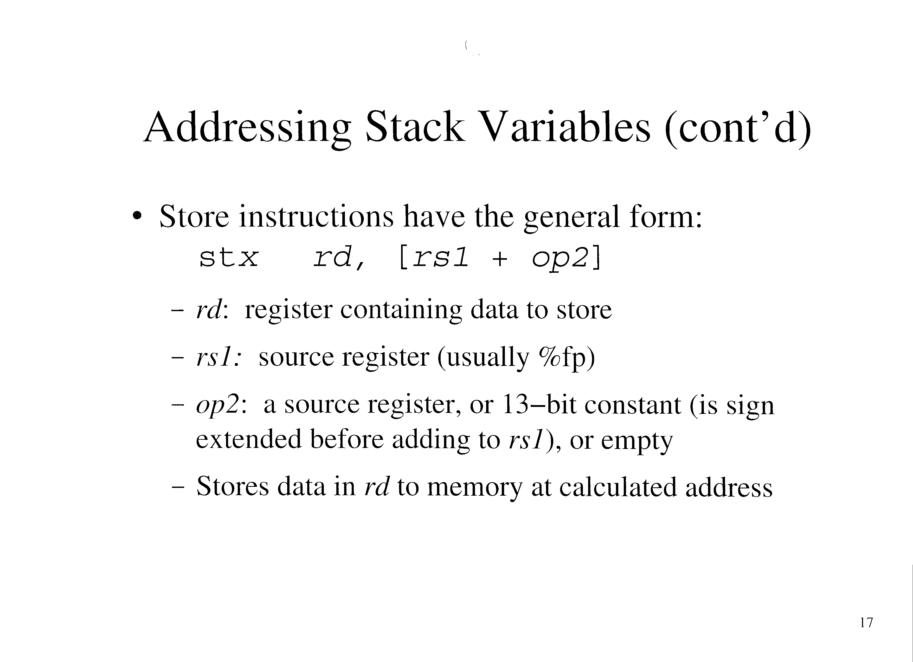

Slide 15
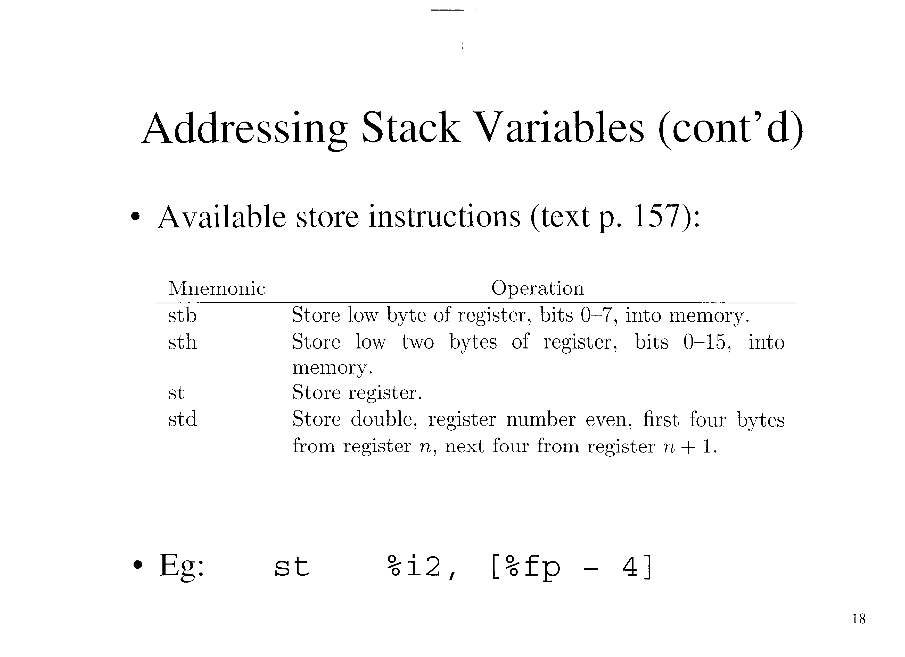

Slide 16
Stack Variable Offsets
Can use m4 to automatically assign offsets to local variables
  EG:
    define(local_var, `define(last_sym, 0)’)
    define(`var’,`define(`last_sym’,eval((last_sym - $2) & -$2))$1 = last_sym’)
    local_var
    var(x_s, 1)
    var(y_s, 2)
    var(z_s, 4)
    .global main
    main: save %sp, (-92 + last_sym) & -8, %sp
    ldsb [%fp + x_s], %l0
    ldsh [%fp + y_s], %l1
    ld [%fp + z_s], %l2

Slide 17
Stack Variable Offsets (cont’d)
The output of m4 is:
    x_s = -1
    z_s = -4
    z_s = -8
    .global main
    main: save %sp, (-92 + -8) & -8, %sp
    … ! The rest is the same

Slide 18
One Dimensional Arrays
Store consecutive array elements of the same type in a contiguous block of memory
  Block size = number of elements * element size
Address of element i:
  Base address + i * element size

Slide 19
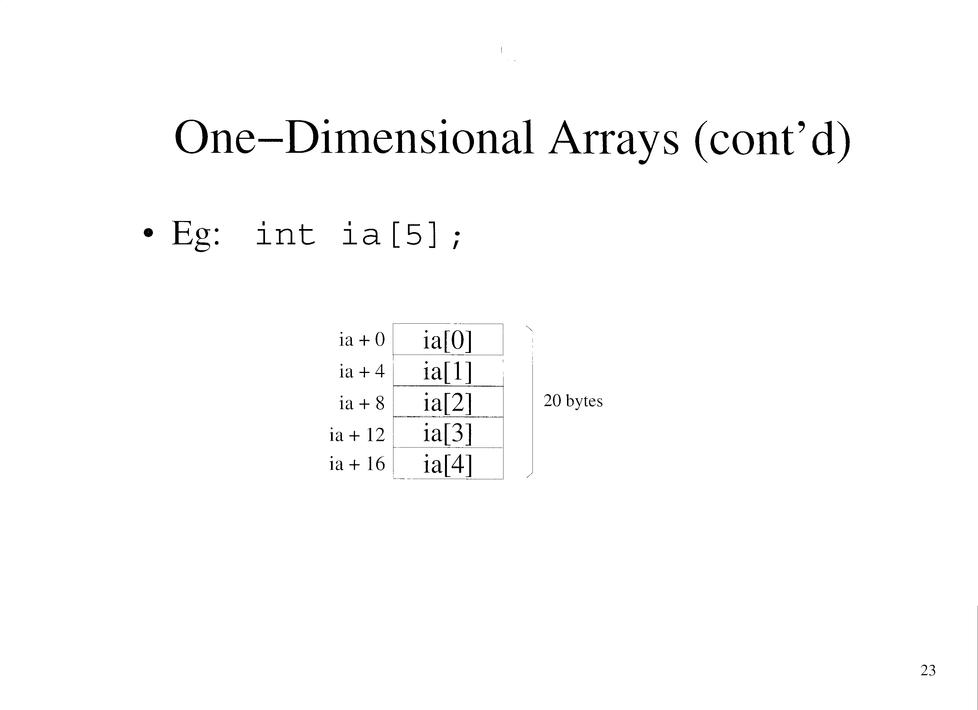

Slide 20
One Dimensional Arrays (cont’d)
Can use m4 to allocate array memory
  Must modify the macro to take an optional 3rd argument that specifies block size:
    define(`var’, `define(`last_sym’, eval((last_sym – ifelse($3,,$2,$3)) & -$2))$1 = last_sym’)
    local_var
    var(x_s, 1)
    var(y_s, 2)
    var(ia_s, 4, 4*5) ! The 4 is the element size, where ! the 5 is the number of elements

Slide 21
One Dimensional Arrays (cont’d)
The output of m4 is:
    x_s = -1
    y_s = -4
    ia_s = -24

Slide 22
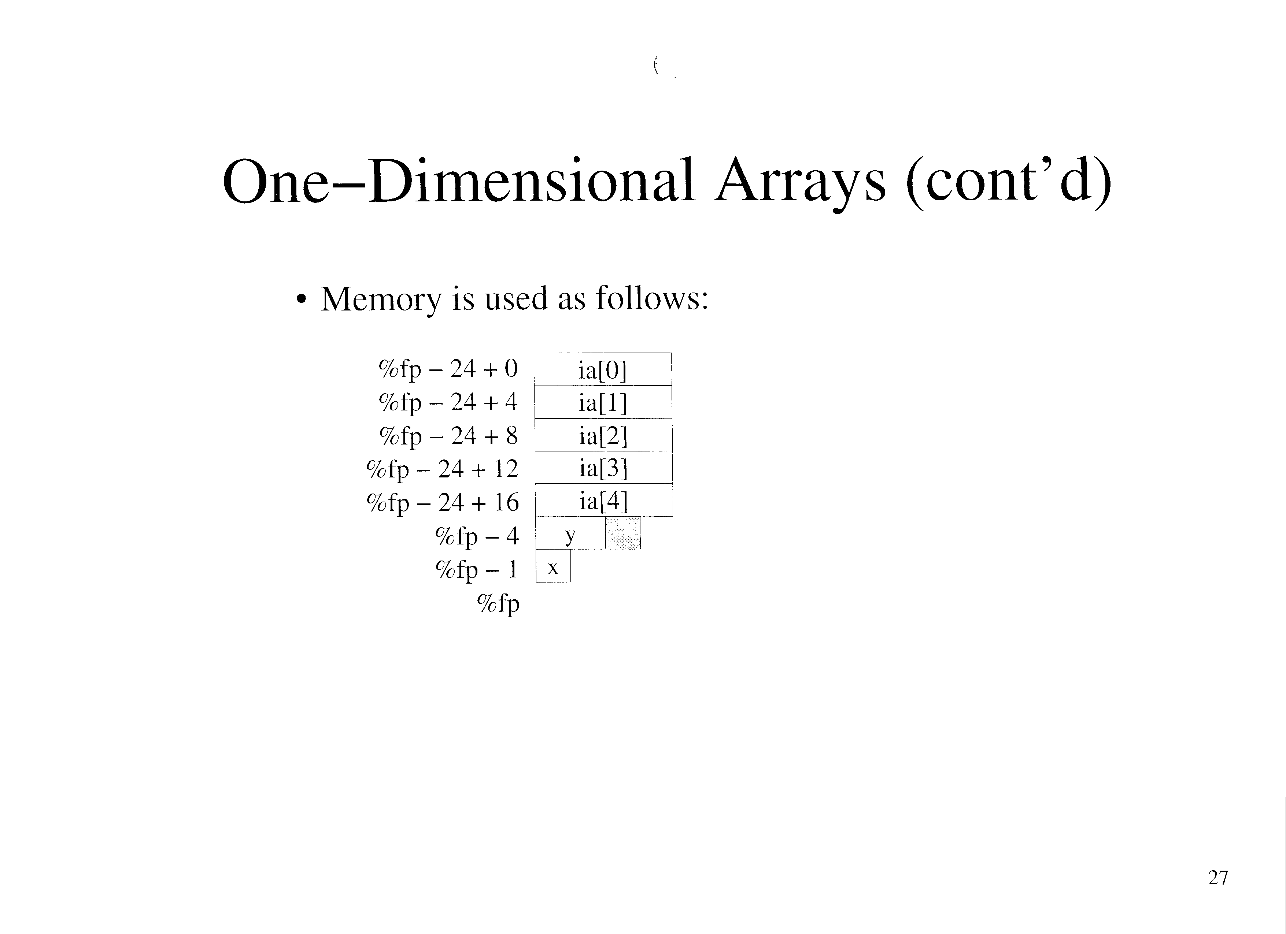

Slide 23
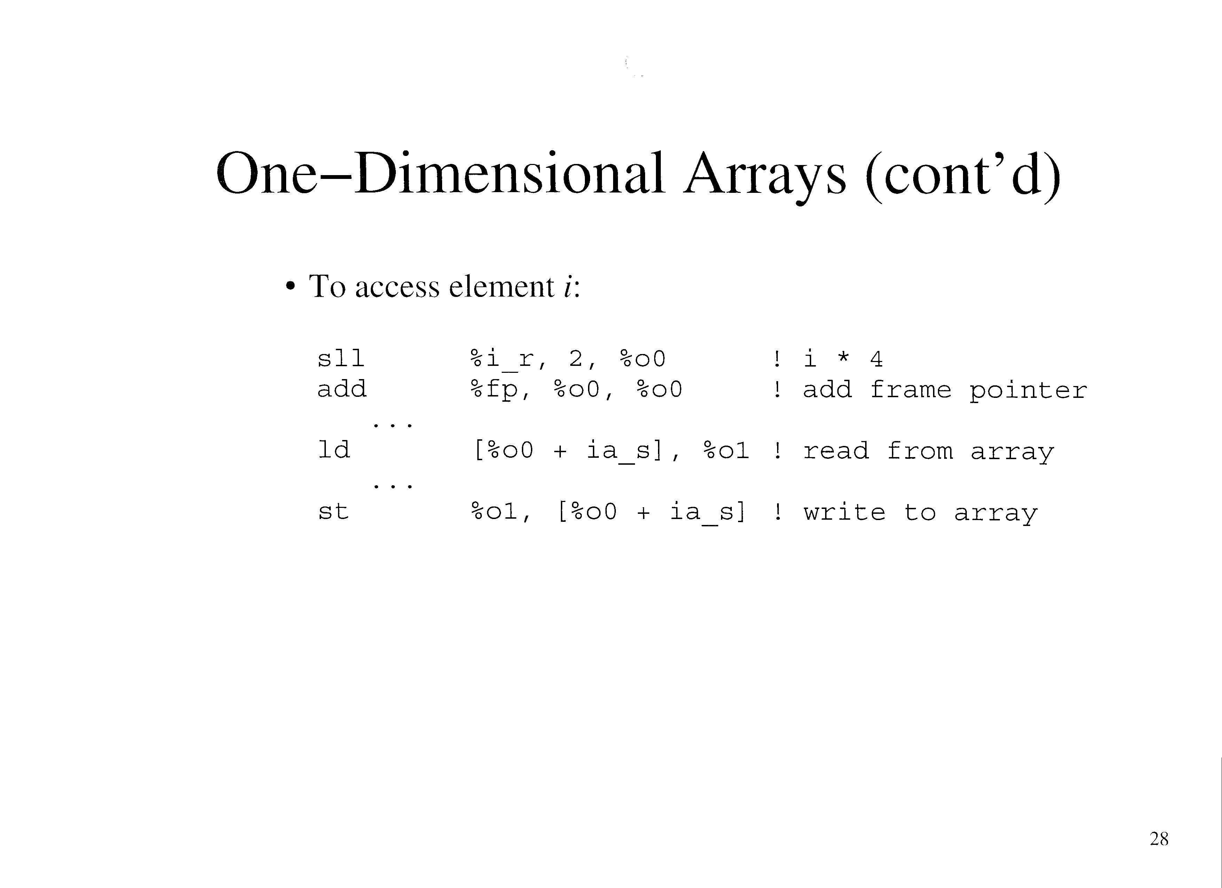

Slide 24
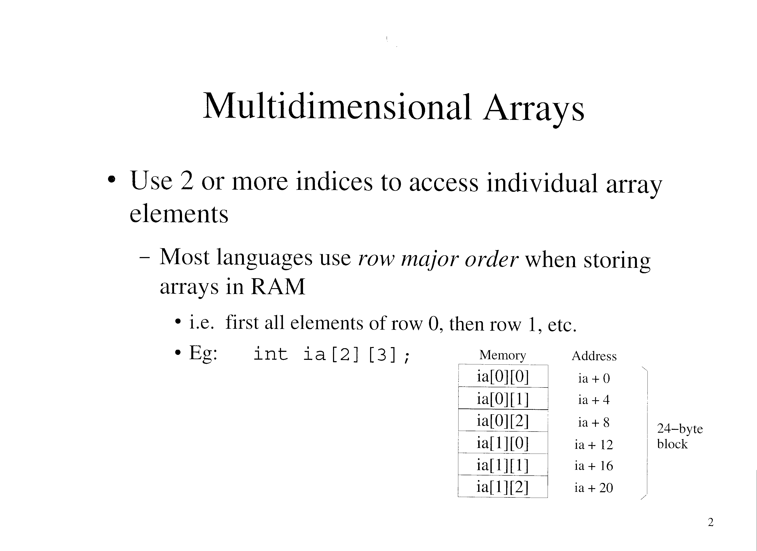

Slide 25
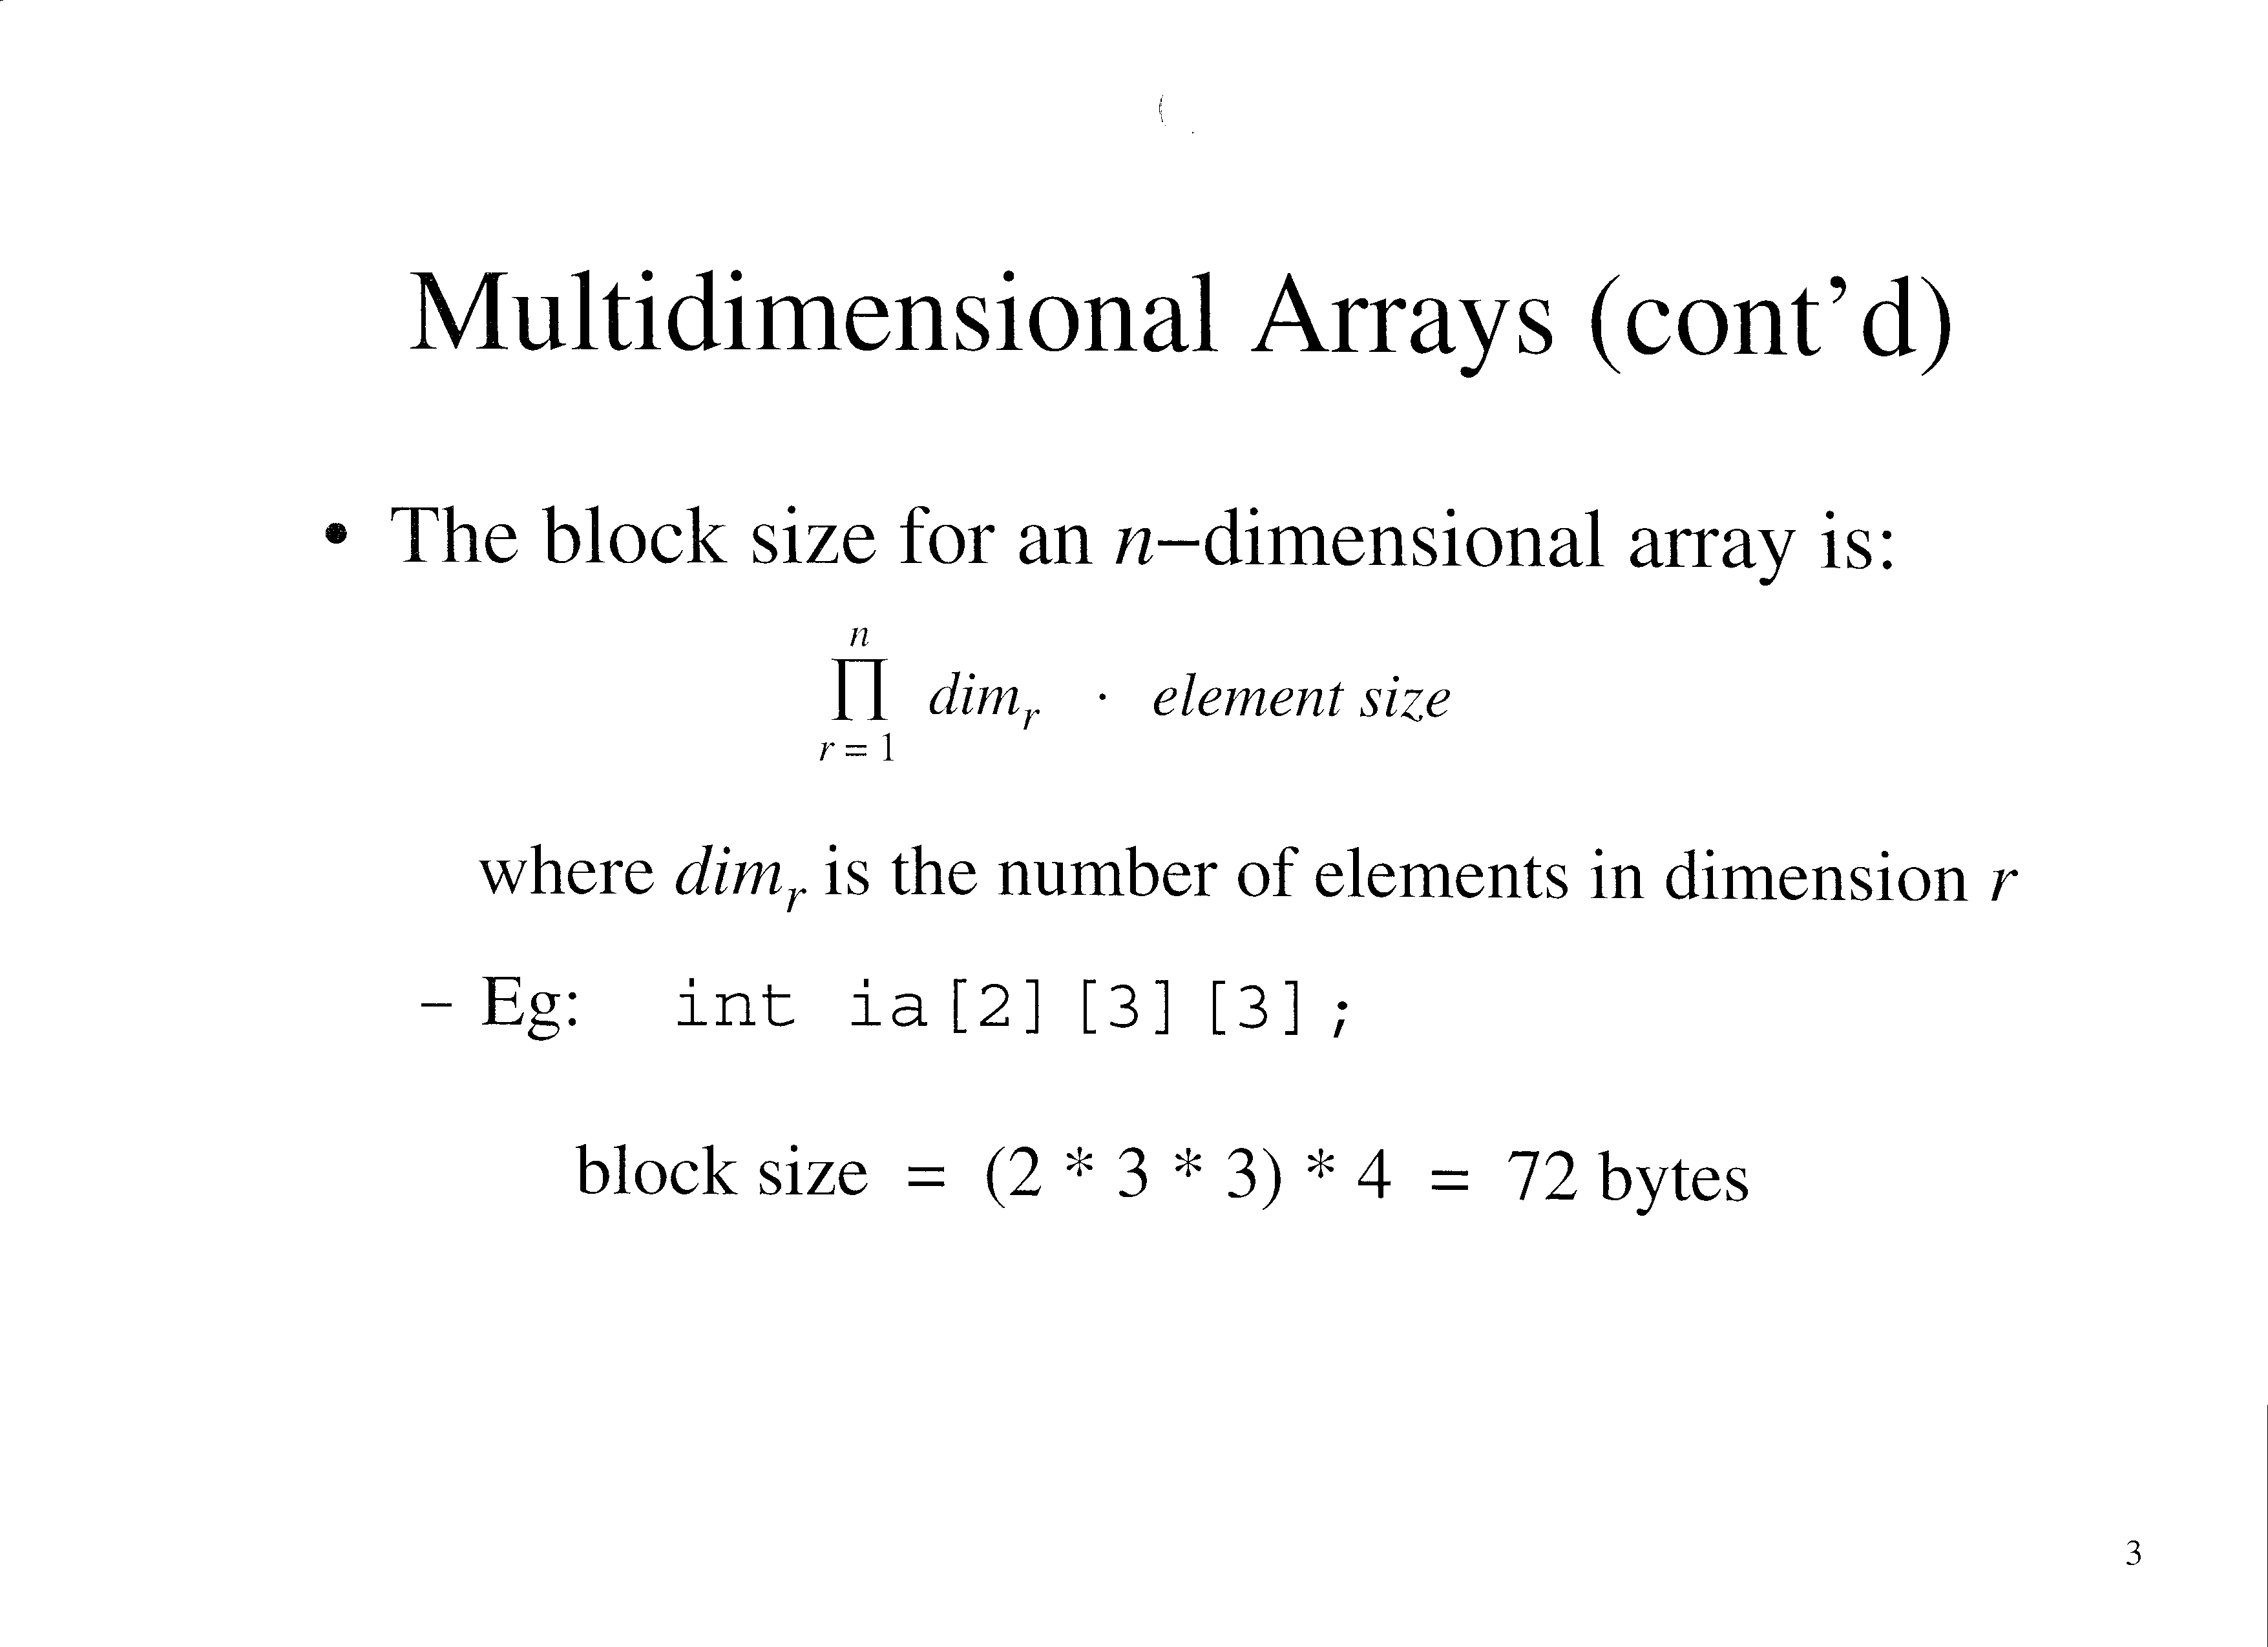

Slide 26
Multidimensional Arrays (cont’d)
The offset for a given element is:
  EG: A 3 dimensional array would be declared with:
    Type array[dim1][dim2][dim3];
    It’s offset for element array[index1][index2][index3] is:
      [[index1*dim2*dim3]+[index2*dim3]+index3]*element size
    If the array was declared as:
      int ia[2][3][4]
    It’s offset for ia[i][j][k] would be:
      [[i*3*4]+[j*4]+[k]]*4

Slide 27
Multidimensional Arrays (cont’d)
Can use the var macro to allocate memory
  Eg: int ia[2][3]
    define(d1, 2)
    define(d2, 3)
    local_var
    var(ia_s, 4, 4 * d1 * d2) ! Where 4 is the element size

Slide 28
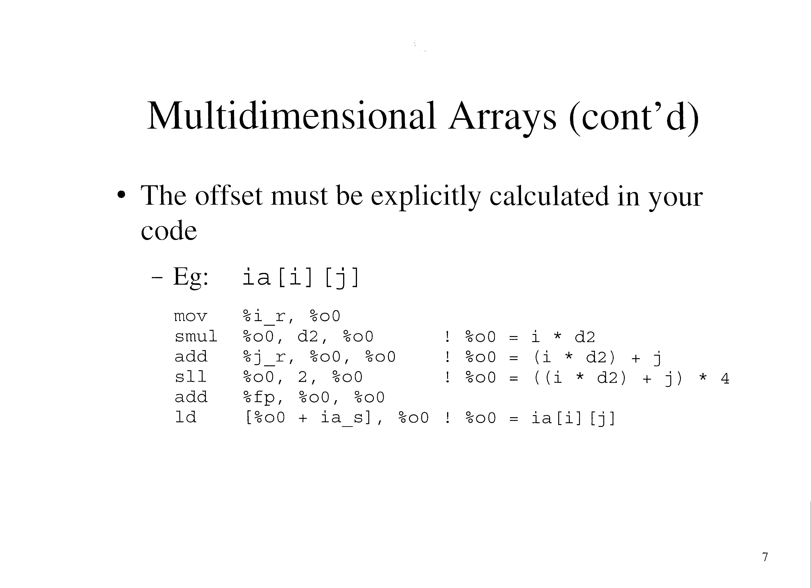

Slide 29
Multidimensional Arrays (cont’d)
Some languages allow lower bounds other than 0
  Pascal example:
    ia : ARRAY[-2..2, 1..3] of INTEGER
  The size of each dimension is given by:
    Upper(r) – lower(r) + 1
    Eg: for above decleration
      dim1 = 2 – (-2) + 1 = 5
      dim2 = 3 – 1 + 1 = 3

Slide 30
Multidimensional Arrays (cont’d)
Can use macros to define such arrays
  Eg:
    define(l_1, -2)
    define(u_1, 2)
    define(l_2, 1)
    define(u_2, 3)
    define(d1, eval(u_1 – l_1 + 1))
    define(d2, eval(u_2 – l_2 + 1))
    local_var
    var(ia, 4, 4*d1*d2)

Slide 31
Multidimensional Arrays (cont’d)
The offset is calculated as before, except the lower bounds is subtracted from the index
  Since the second term contains only constants, it can be pre-calculated
    Eg:
    local_var
    var(ia_s, 4, 4 * d1 * d2)
    b0 = ia_s – ((1_1 * d2) + l2) * 4

Slide 32
Multidimensional Arrays (cont’d)
The offset is calculated as before, except that the pre-calculated term is added
  Eg:
    ia[i][j]
    mov %i_r, %o0
    smul %o0, d2, %o0 ! %o0 = i * d2
    add %j_r, %o0, %o0 ! %o0 = (i * d2) + j
    sll %o0, 2, %o0 ! %o0 = ((i * d2) + j) * 4
    add %fp, %o0, %o0
    ld [%o0 + b0], %o0 ! %o0 = ia[i][j]

Slide 33
Multidimensional Arrays (cont’d)
Some languages do array bounds checking
  Indices must be in the range:
    Lower <= index <= upper
  Which can be rewritten:
    0 <= index – lower <= upper - lower
  Or as:
    0 <= index – lower < dim

Slide 34
Multidimensional Arrays (cont’d)
Must explicitly implement error checking logic
  Eg:
    subcc %i_r, l_1, %o0 ! i – l_1
    bl error ! Branch if < 0
    cmp %o0, d1
    bge error ! Branch if >= d1
    nop
    smul %o0, d2, %o0 ! %o0 = (I – l_1) * d2
    subcc %j_r, l_2, %o2 ! j – l_2
    bl error ! Branch if < 0
    mop
    cmp %o2, d2
    bge error ! Branch if >= d2
    nop
    add %o0, %o2, %o0 ! %o0 = ((i – l_1) * d2) + (j – l_2)
    sll %o2, 2, %o0 ! Multiply by the element size
    add %fp, %o0, %o0
    ld [%o0 + ia_s], %o0 ! %o0 = ia[i][j]
    error: …

Slide 35
Address Arithmetic
Multiplication can be done by shifting and adding
  Section 6.4 of text
May be used on systems where multiplication is slow
  Not necessary on SPARC V8 since it has an smul instruction

Slide 36
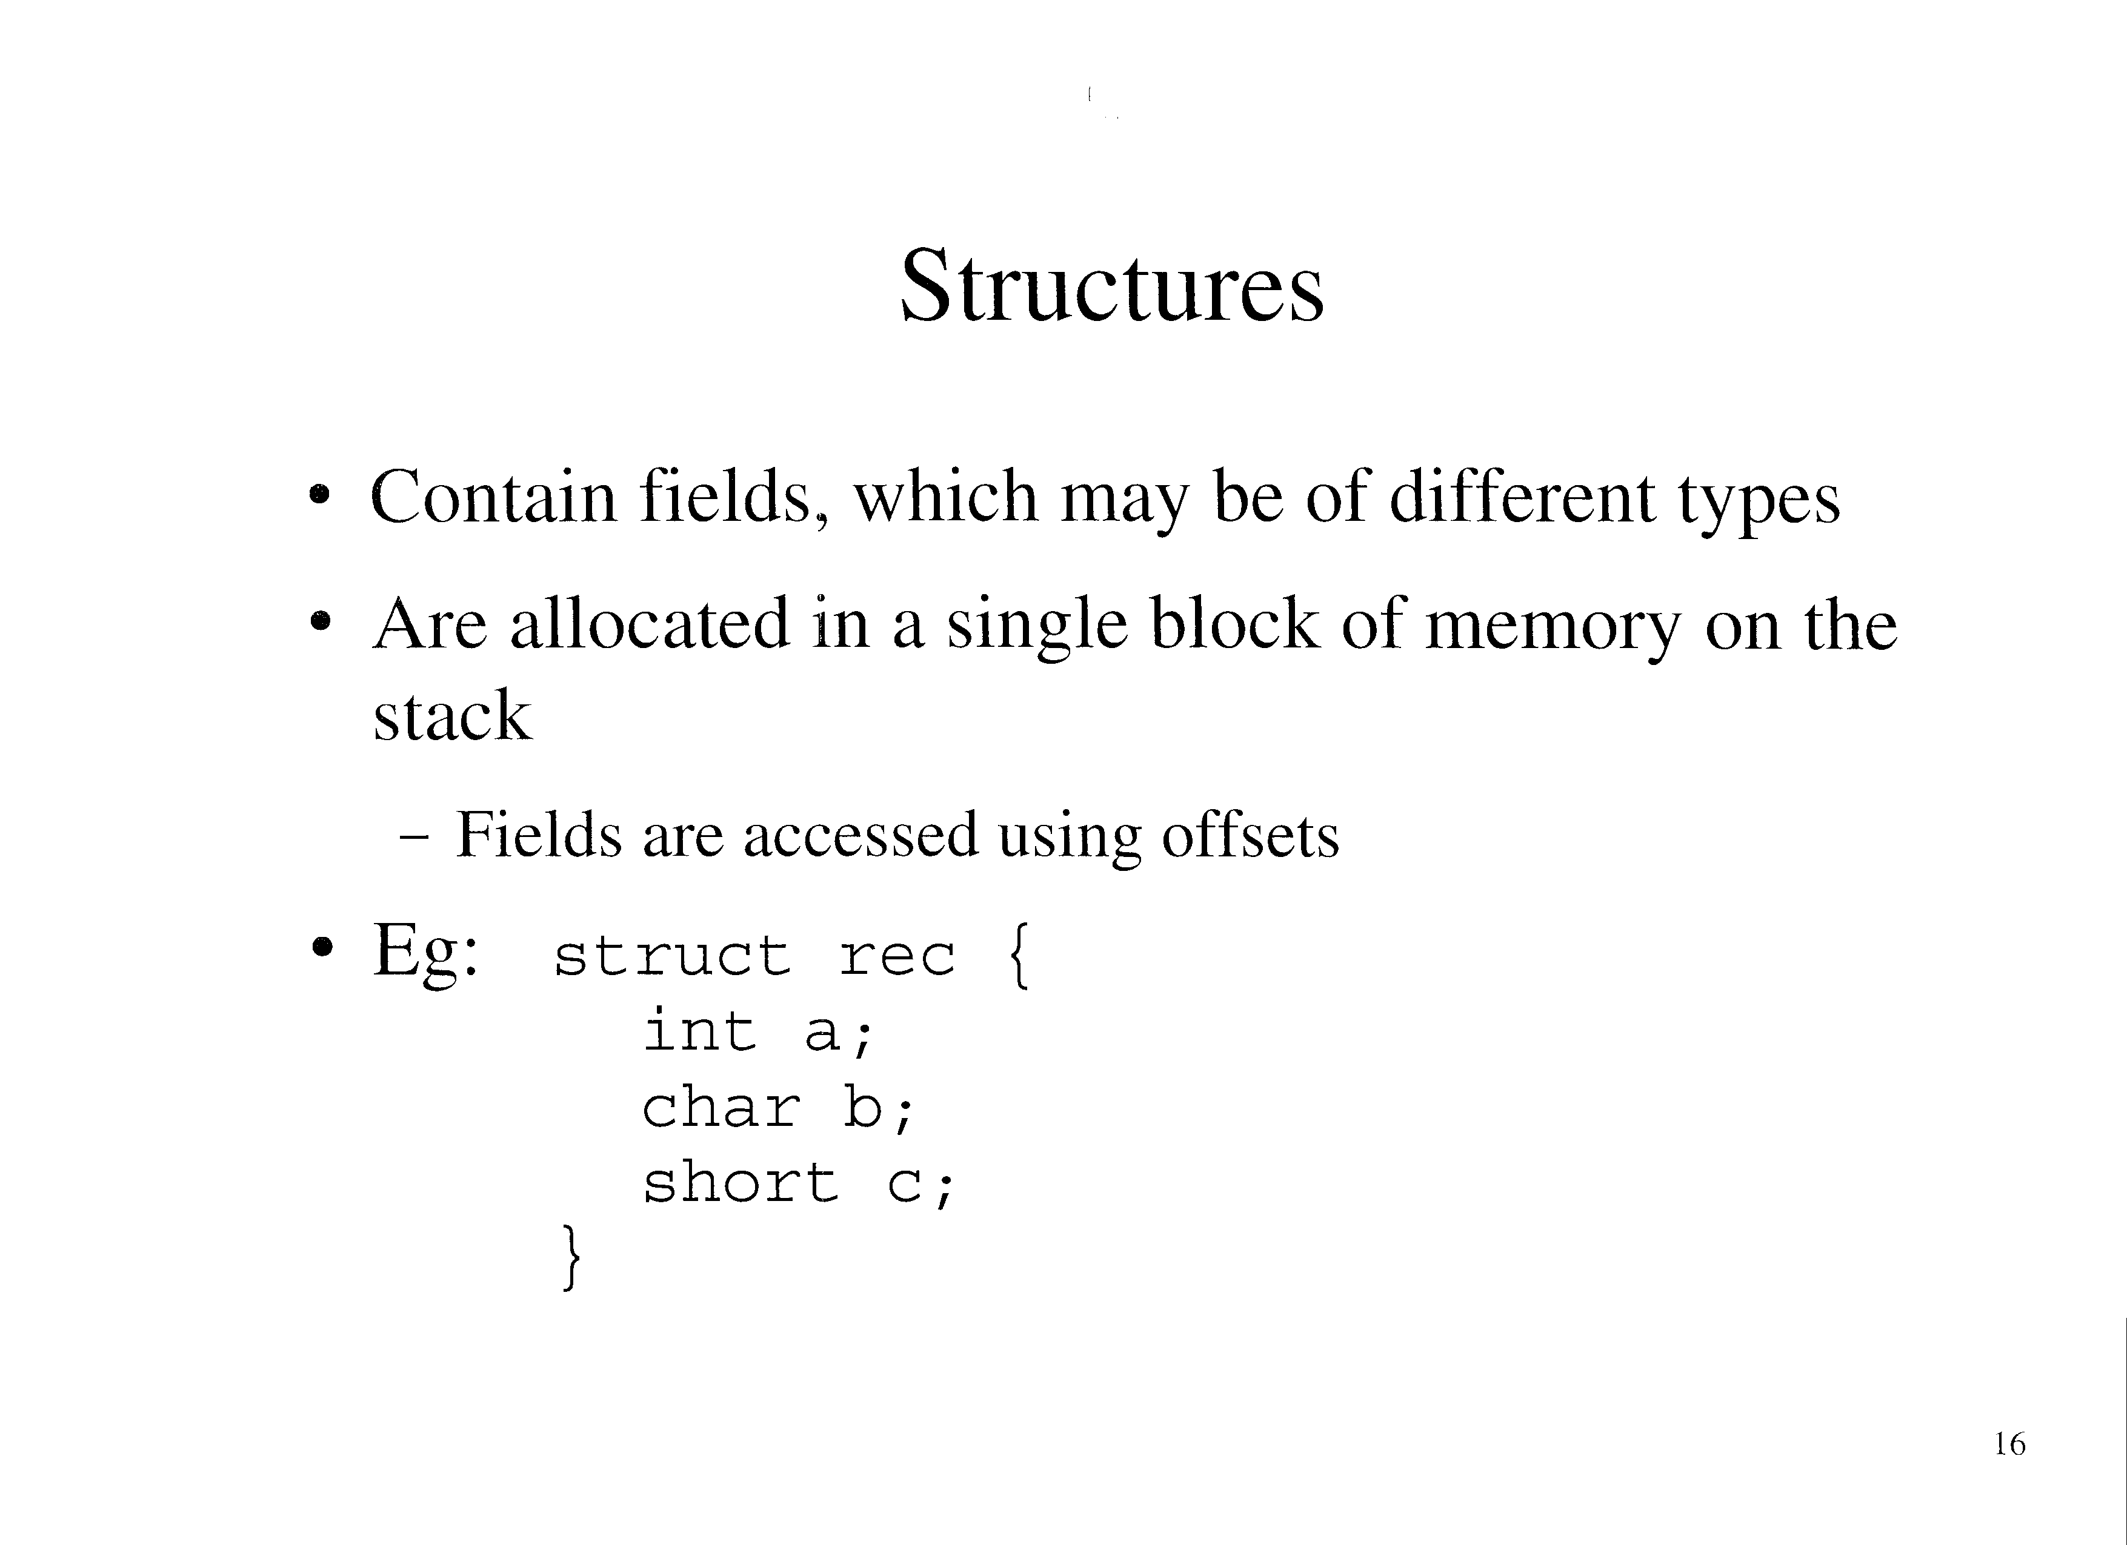

Slide 37
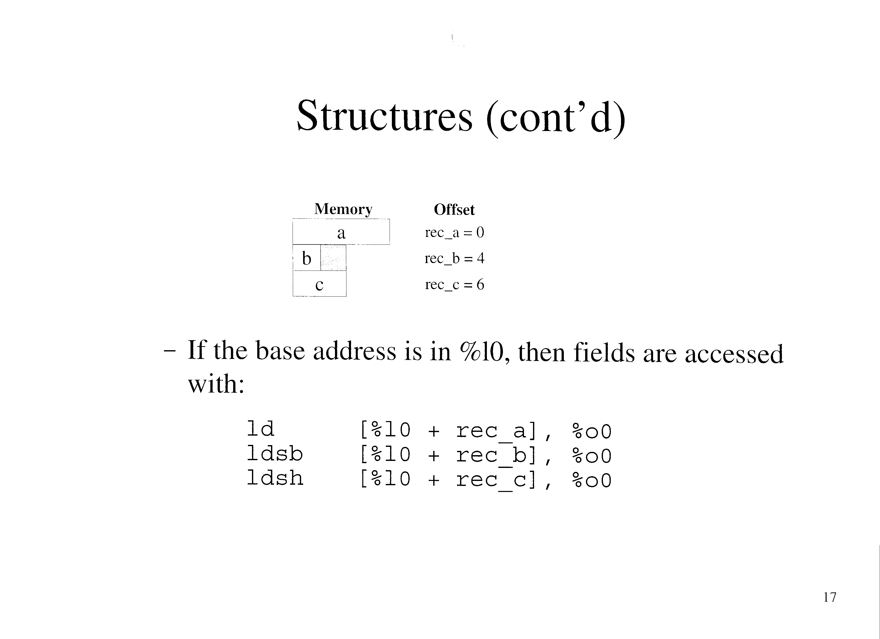

Slide 38
Structures (cont’d)
Macros can be used to define structs ande filed offsets (text p. 193, 194)
  Contain logic to guarantee correct alignment

Slide 39
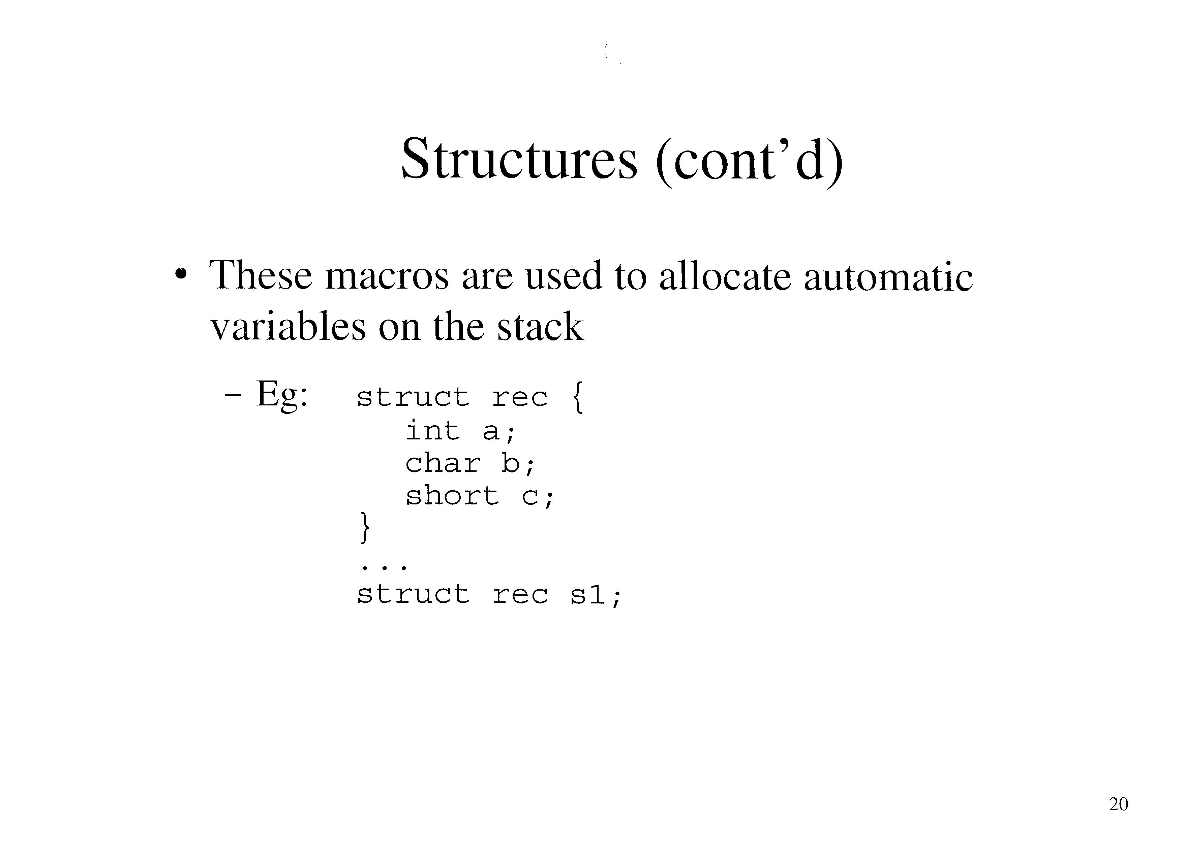

Slide 40
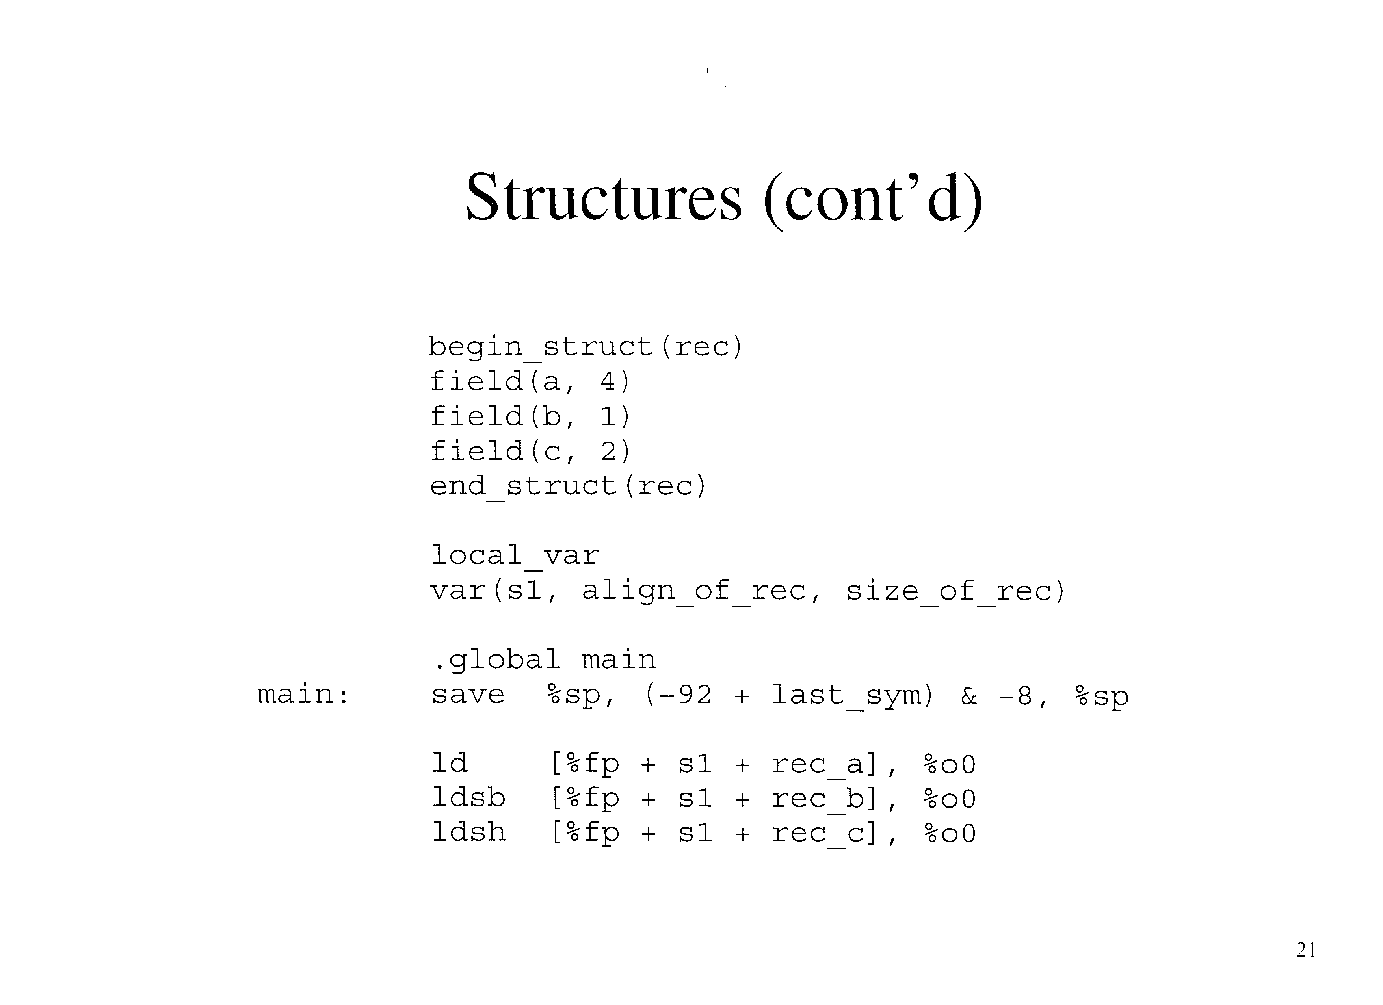

Slide 41
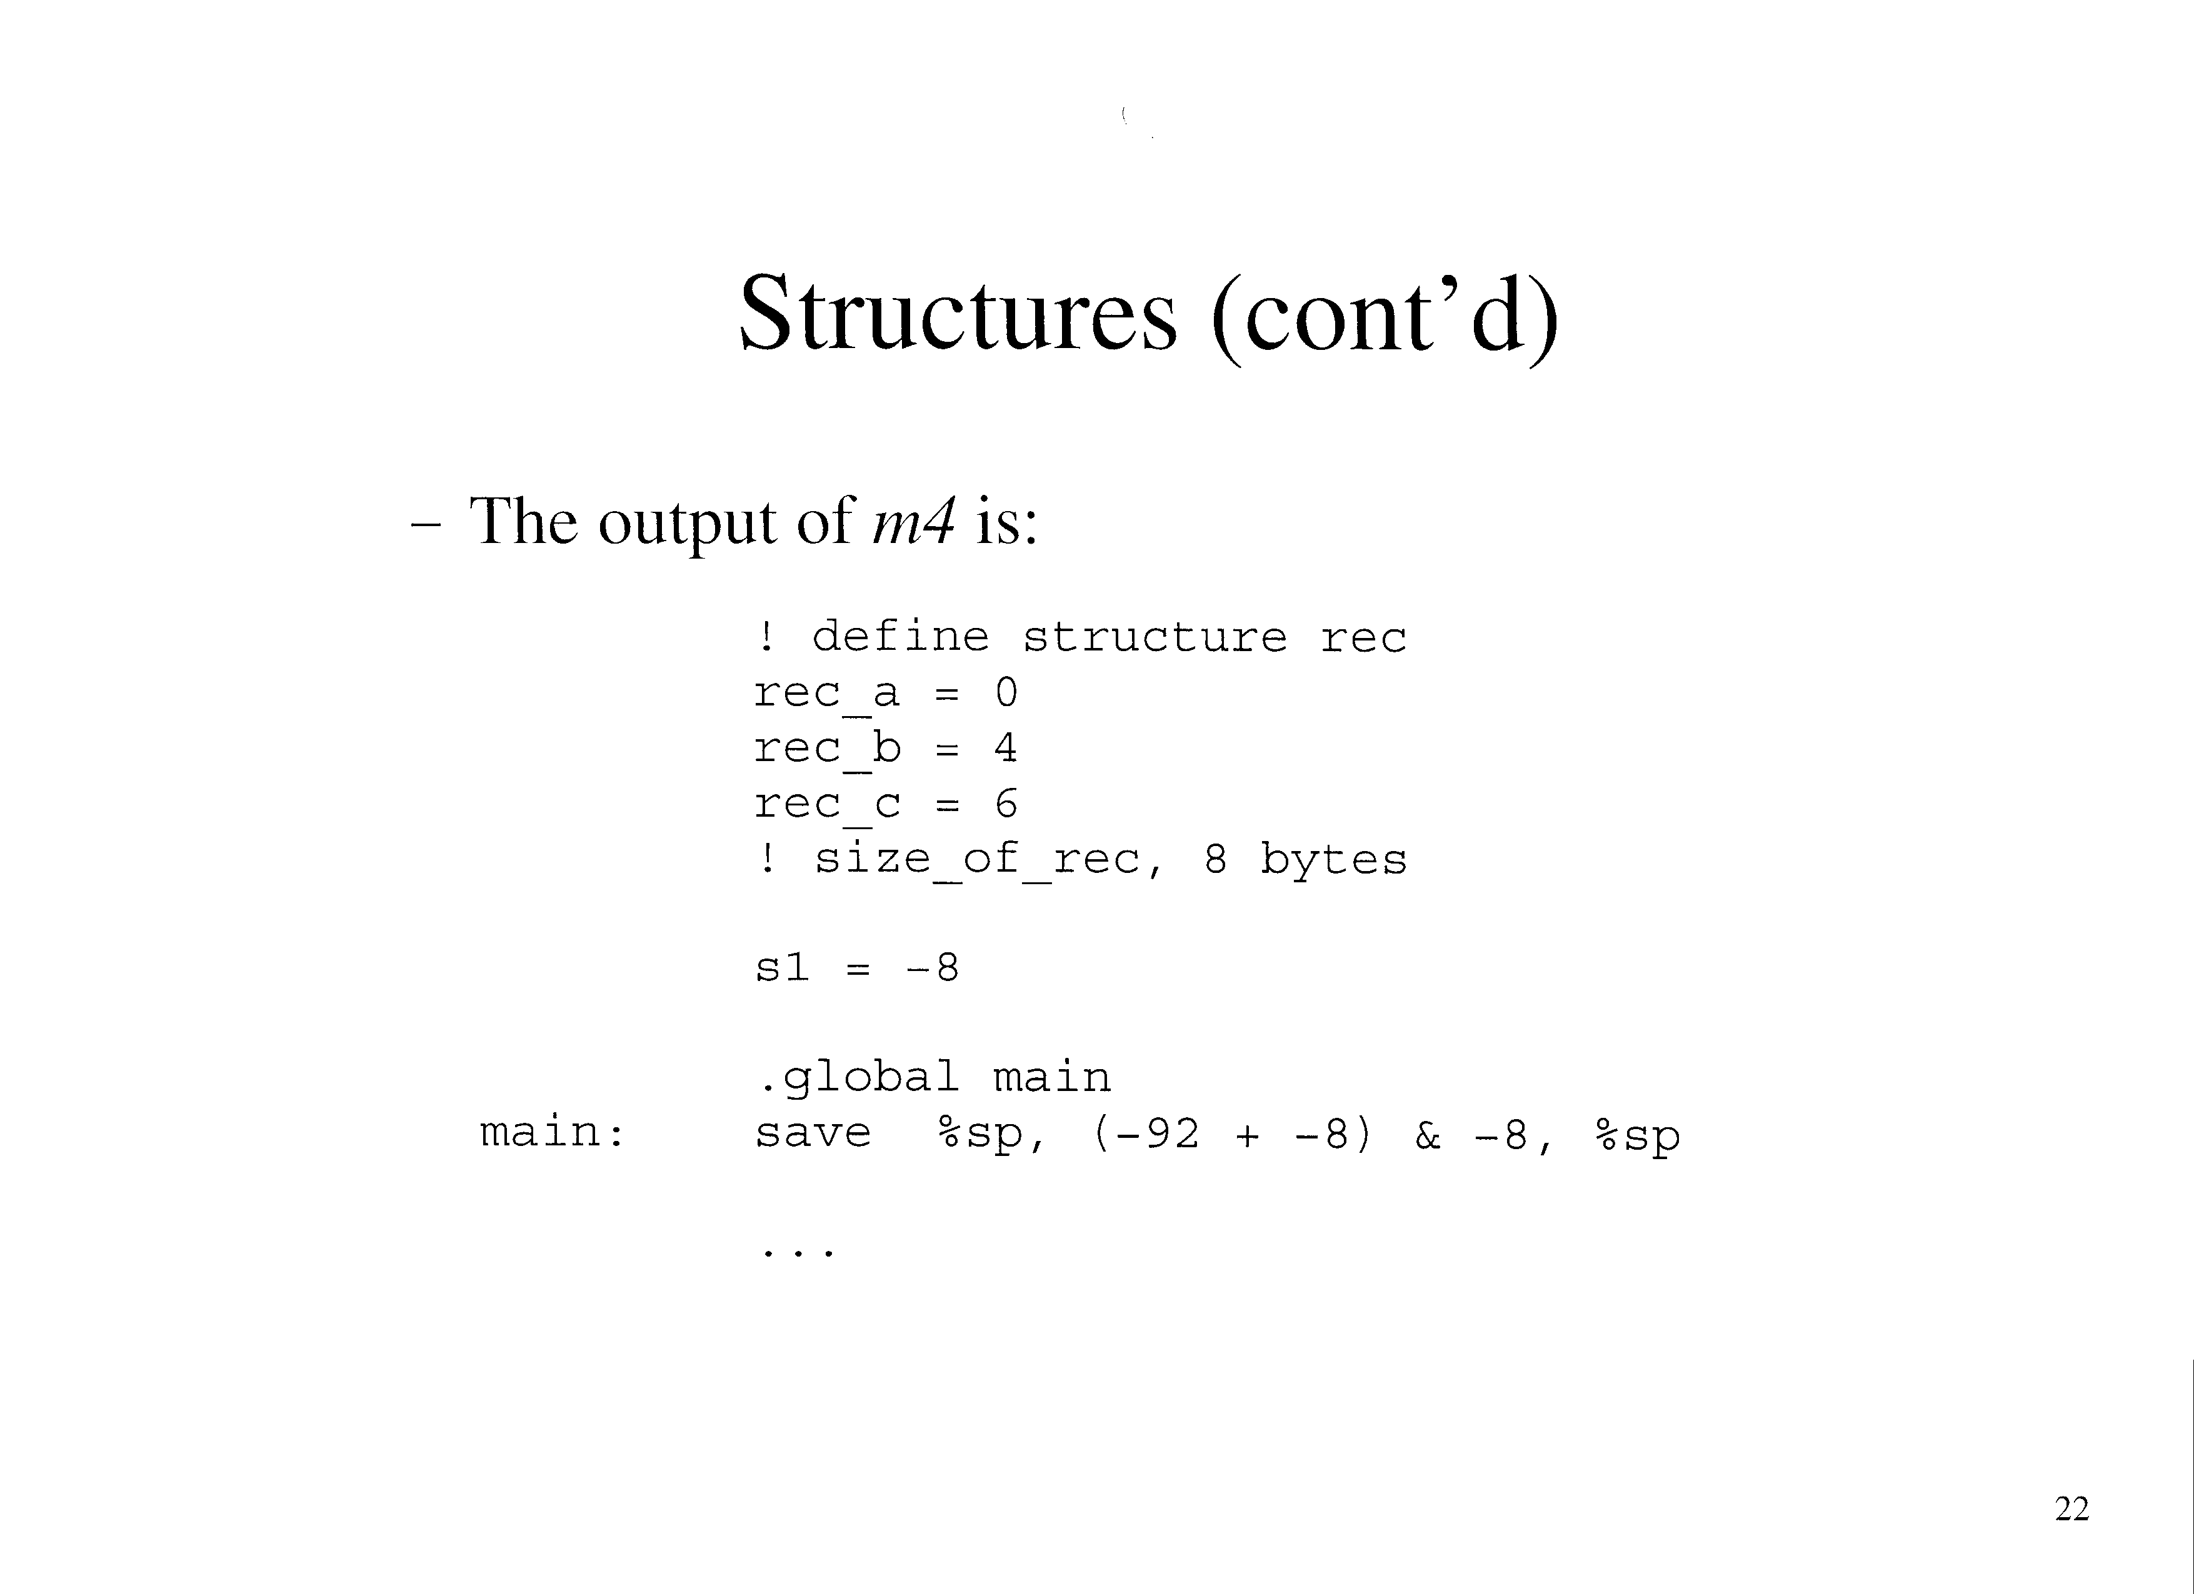

Slide 42
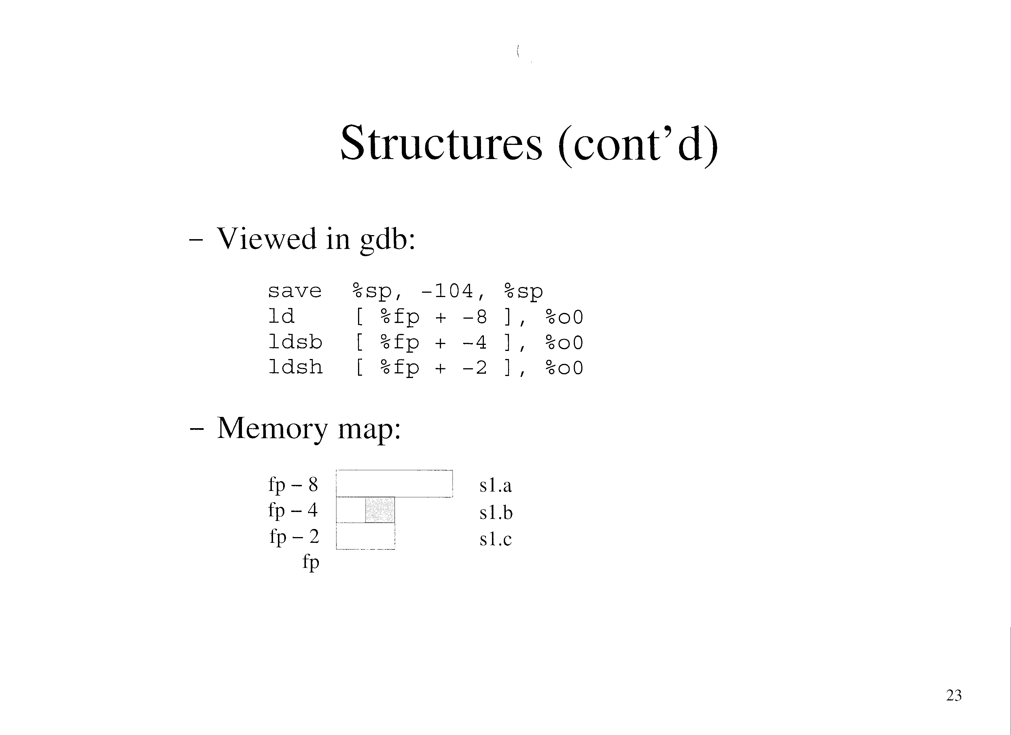

Slide 43
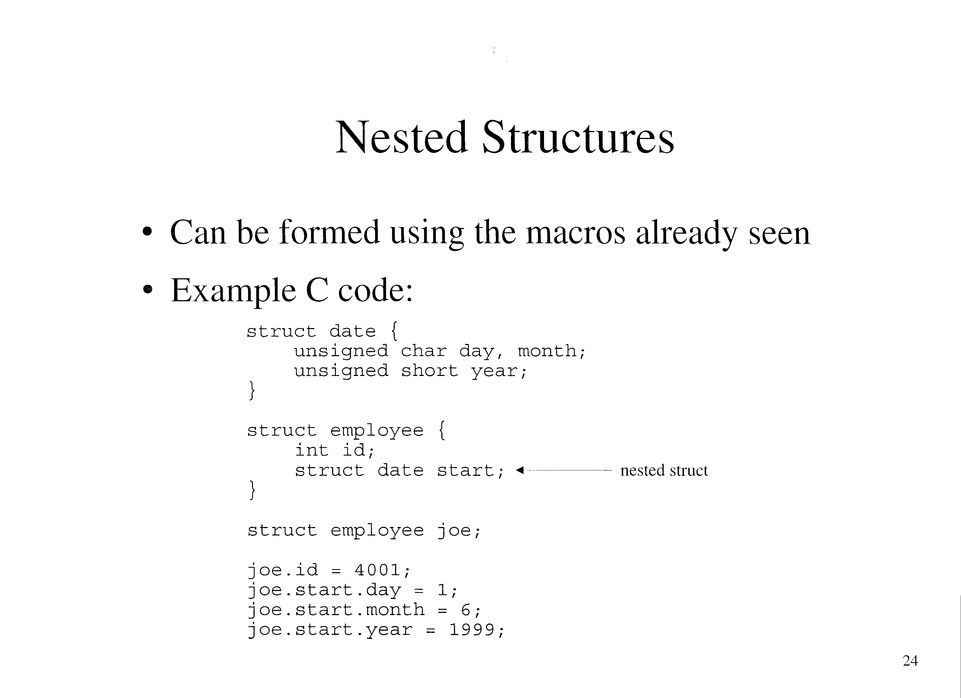

Slide 44
Nested Structures (cont’d)
Assembly Code:
    begin_struct(date)
    field(day, 1)
    field(month, 1)
    field(year, 2)
    end_struct(date)
    begin_struct(employee)
    field(id, 4)
    field(start, align_of_date, size_of_employee)
    end_struct(employee)
    local_var
    var(joe, align_of_employee, size_of_employee)

Slide 45
Nested Structures (cont’d)
.global main
main: save %sp, (-92 + last_sym) & -8, %sp
mov 4001, %o0
st %o0, [%fp + joe + employee_id]
mov 1, %o0
stb %o0, [%fp + joe + employee_start + date_day]
mov 6, %o0
stb %o0, [%fp + joe + employee_start + date_month]
mov 1999, %o0
sth %o0, [%fp + joe + employee_start + date_year]

Slide 46
