Slide 1
Machine Instructions
Introduction

Slide 2
Machine Instructions
Instructions are encoded into 32 bit words
  8-bits specify the instruction
5-bits each for the 2 source registers and 1 destination register
  2⁵ encodes 32 different registers
1 bit indicates if the instruction uses a 2nd source register or an immediate constant
  If a constant, then 13 bits are reserved
    8 remaining bits, plus the 5 normally used for the 2nd source register

Slide 3
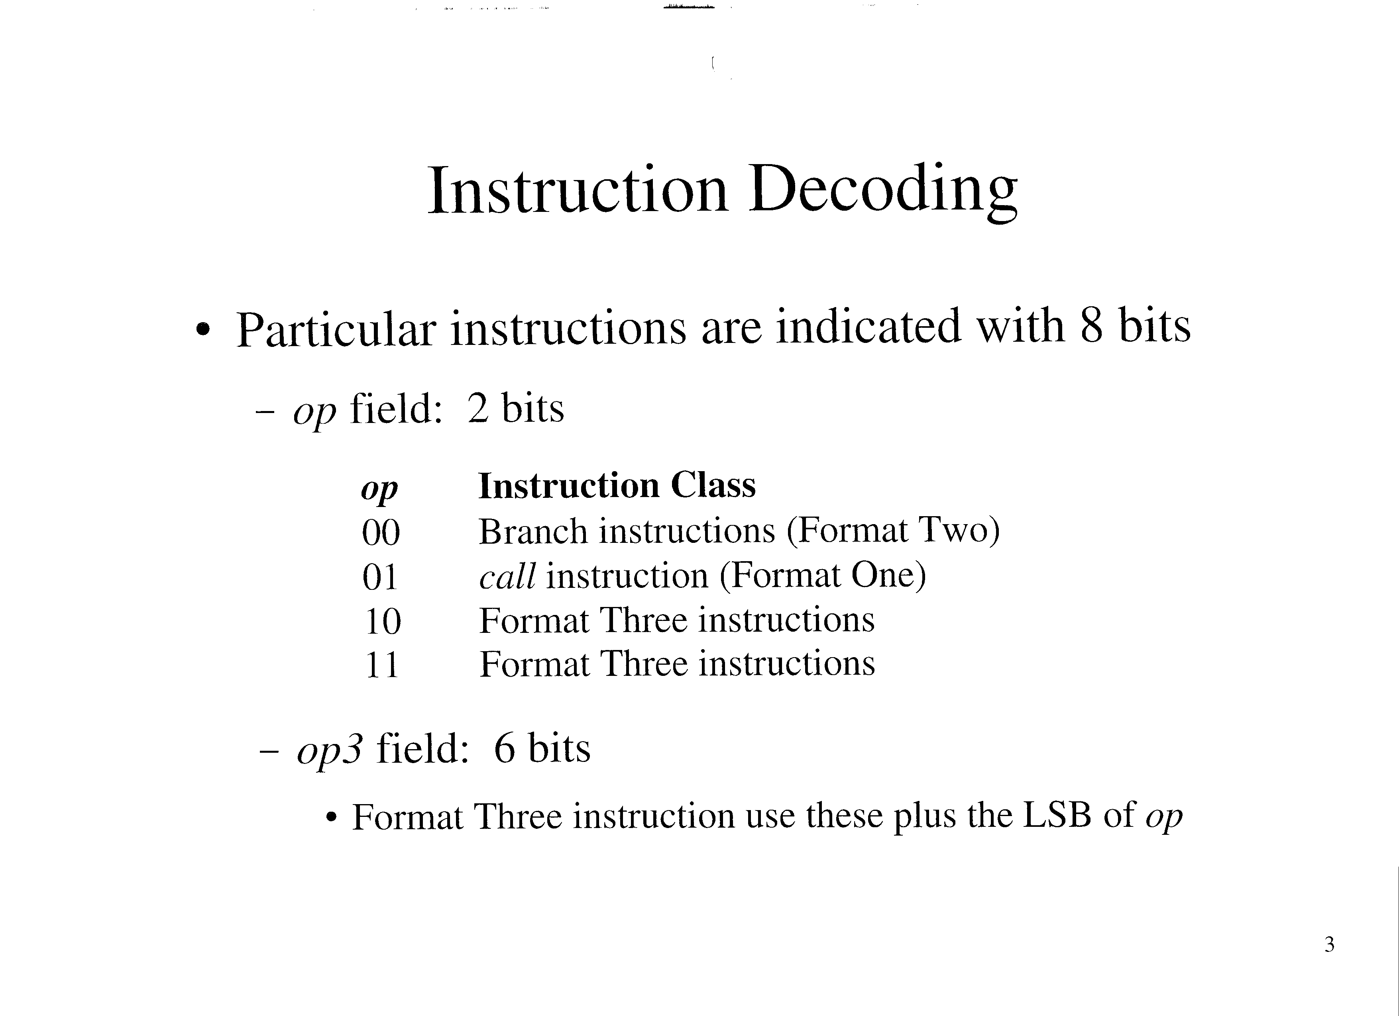

Slide 4
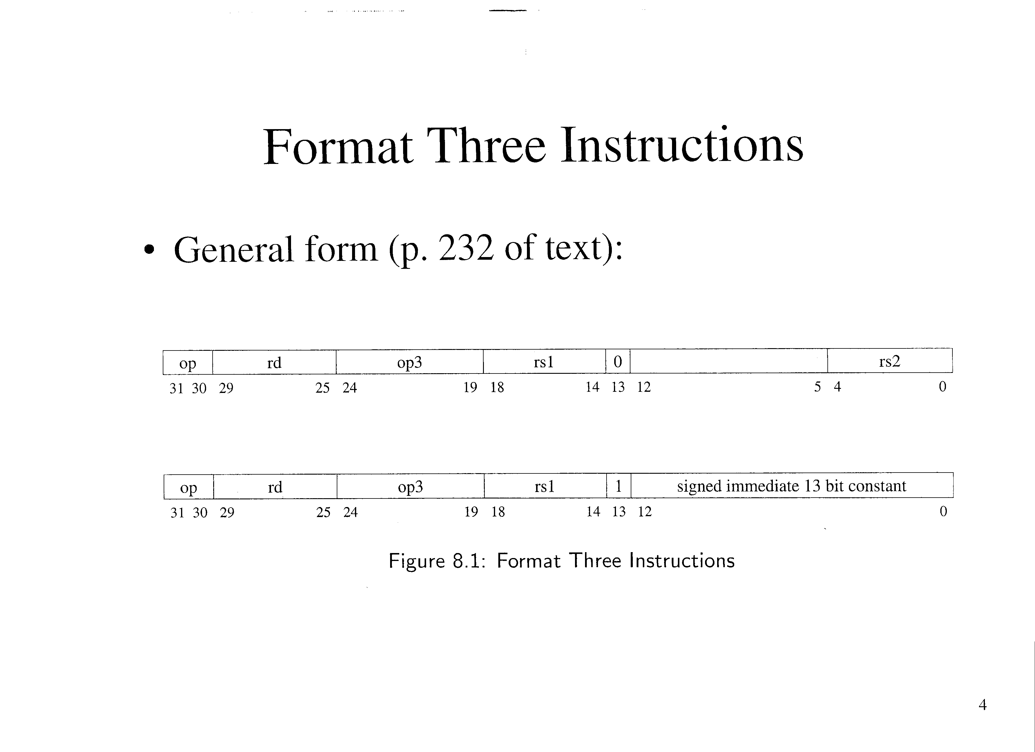

Slide 5
Format Three Instructions (cont’d)
7 bits encodes 2⁷ = 128 different instructions
Table (p. 235, 236 of text):
  Note:
    Unimpl: not implemented
    Many instructions are privileged instructions

Slide 6
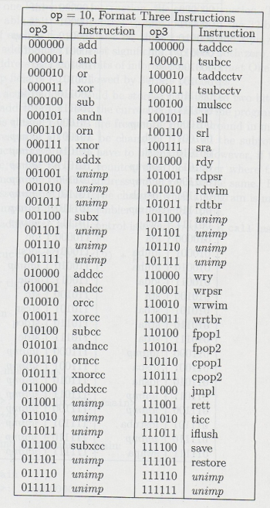
Format Three Instructions (cont’d)
See table on page 235 of text

Slide 7
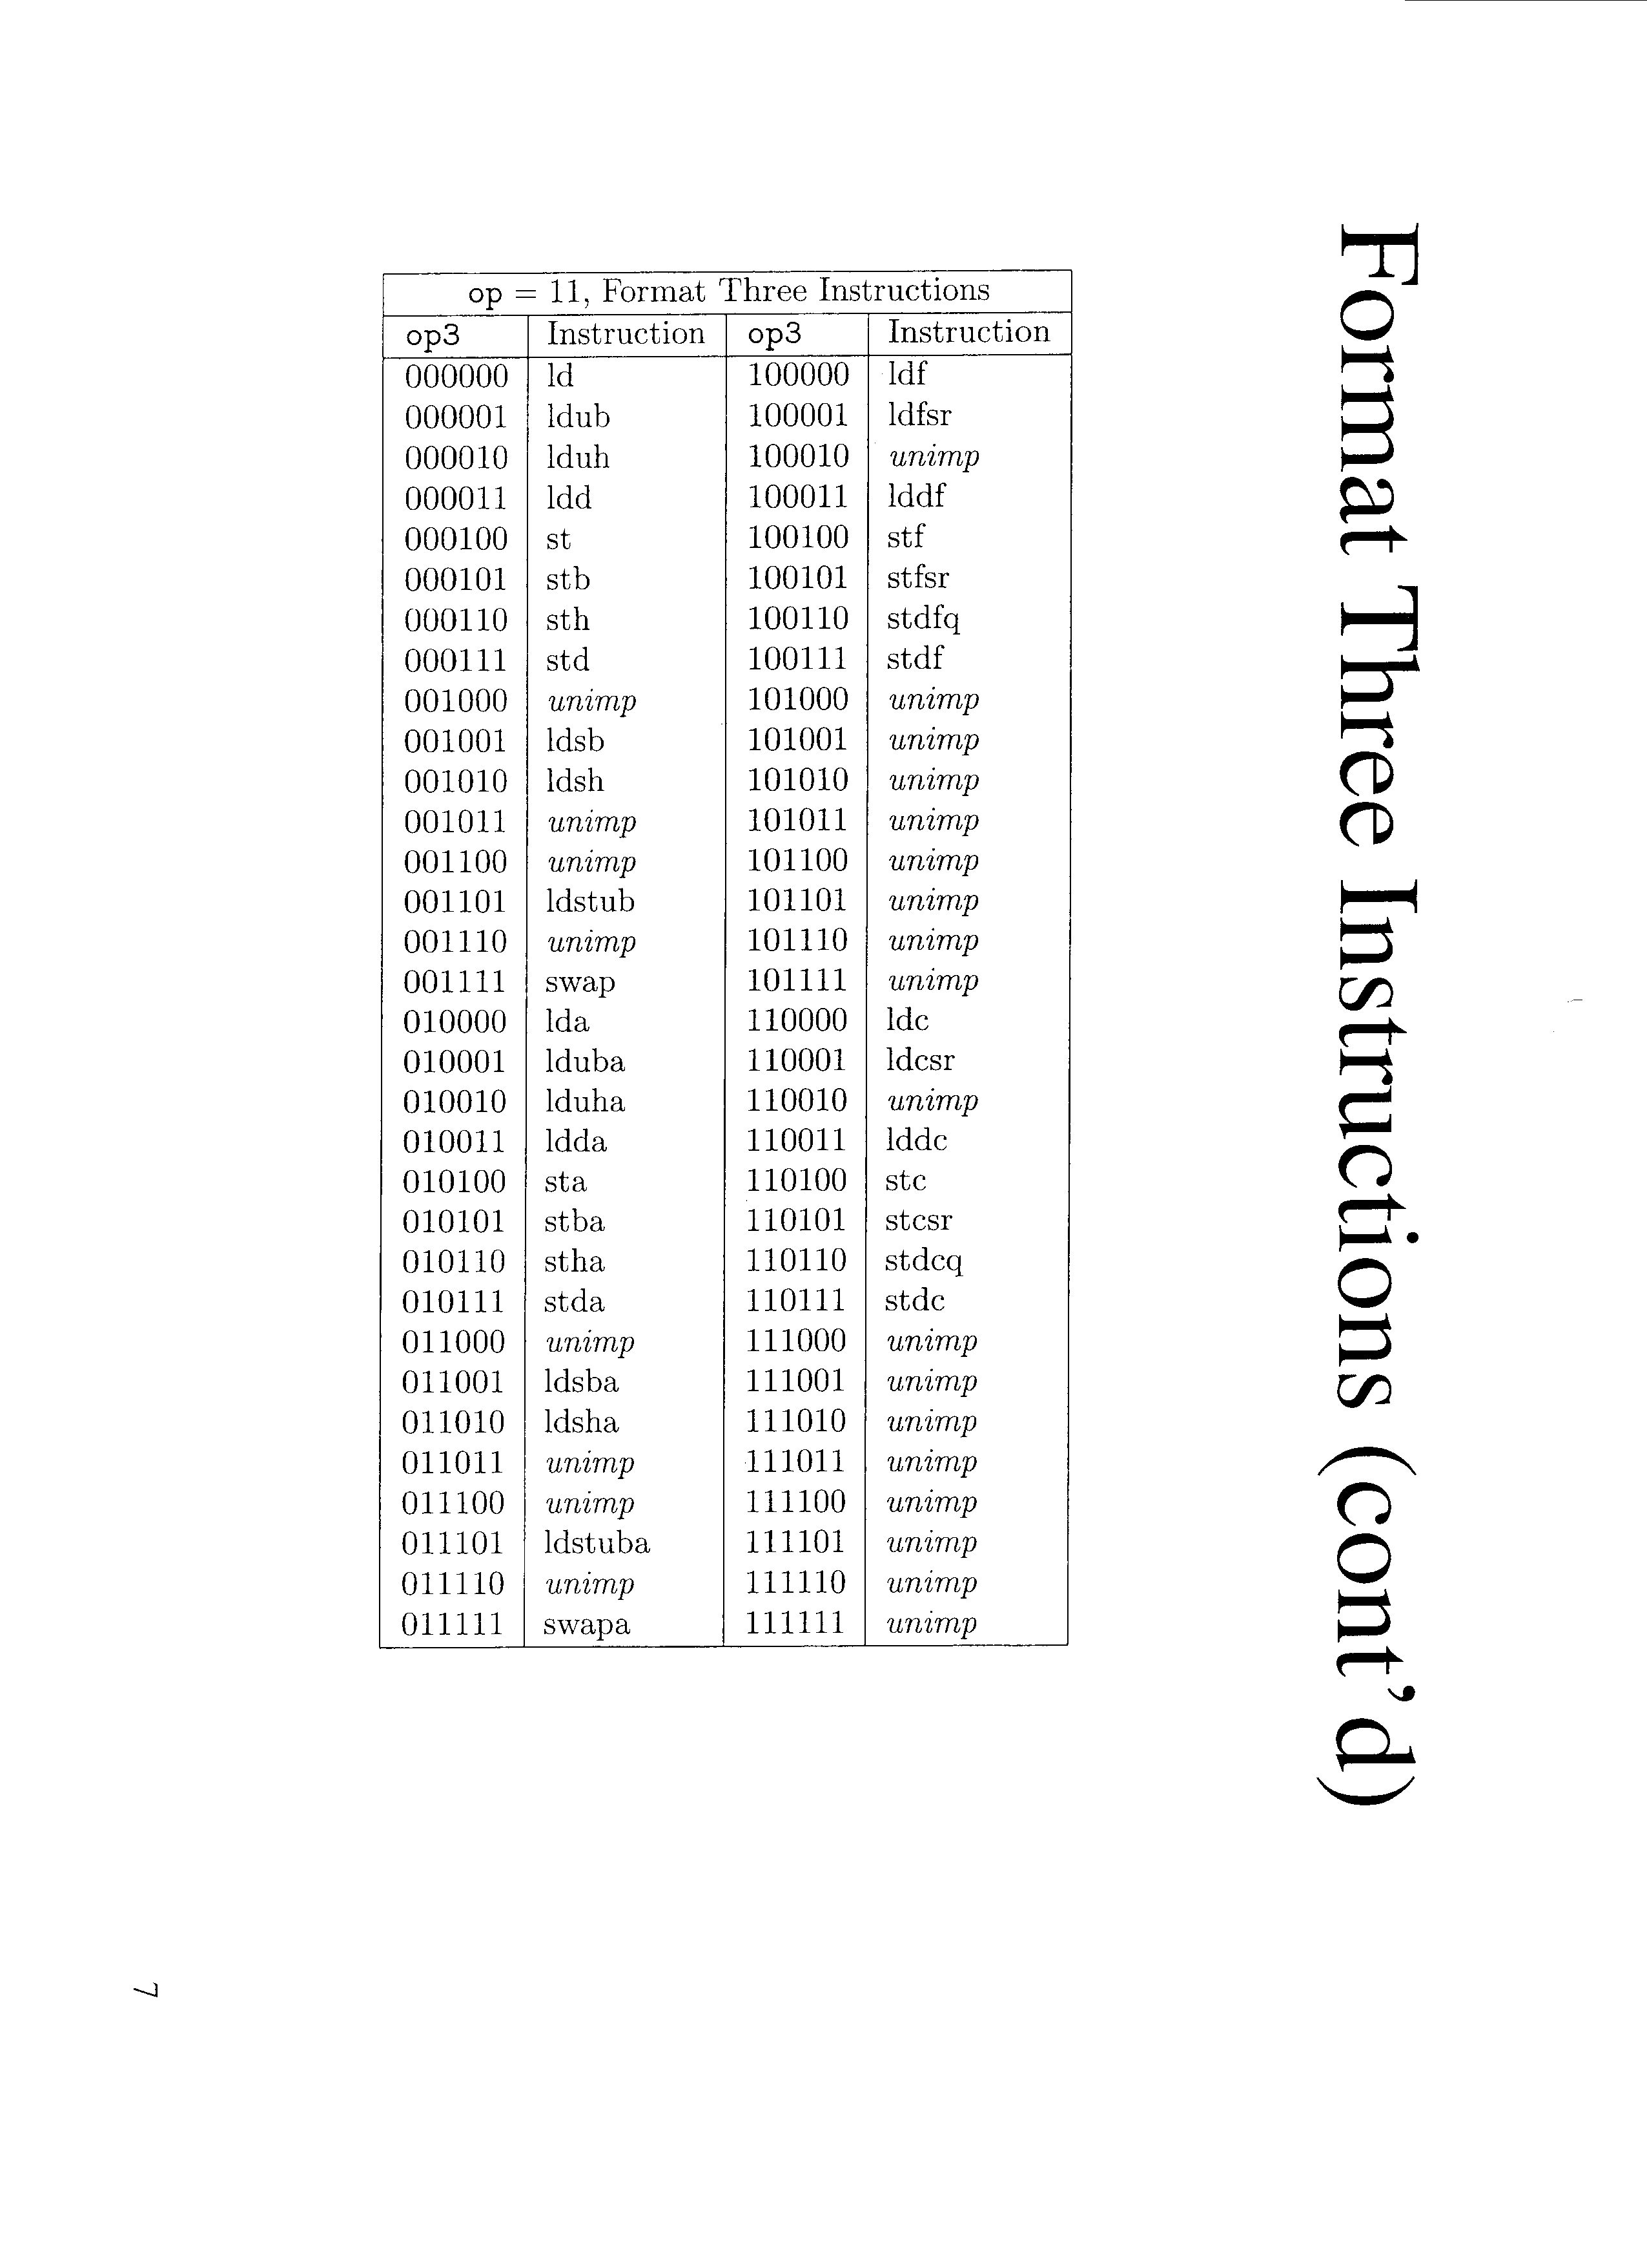

Slide 8
Format Three Instructions (cont’d)
Note that the first 8 instructions are encoded using 0 to 2 (bits 3 to 5 are 0)
  The “x” versions are the same, but bit 3 is set
  The “cc” versions have bit 4 set
  The “xcc” versions have bits 3 and 4 set
  Eg:
    add: 000000
    addx: 001000
    addcc: 010000
    adxcc: 011000

Slide 9
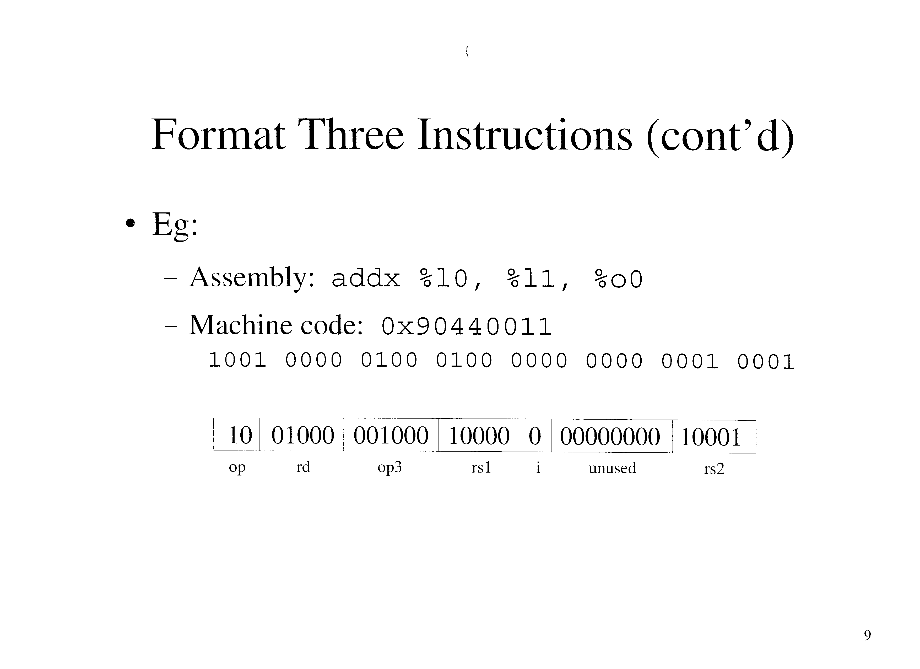

Slide 10
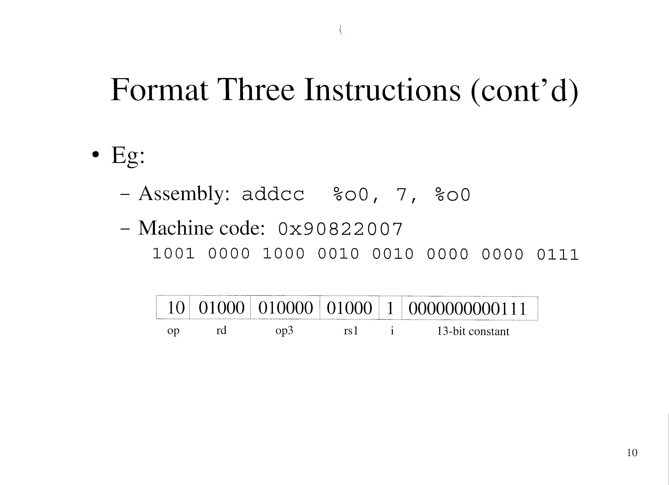

Slide 11
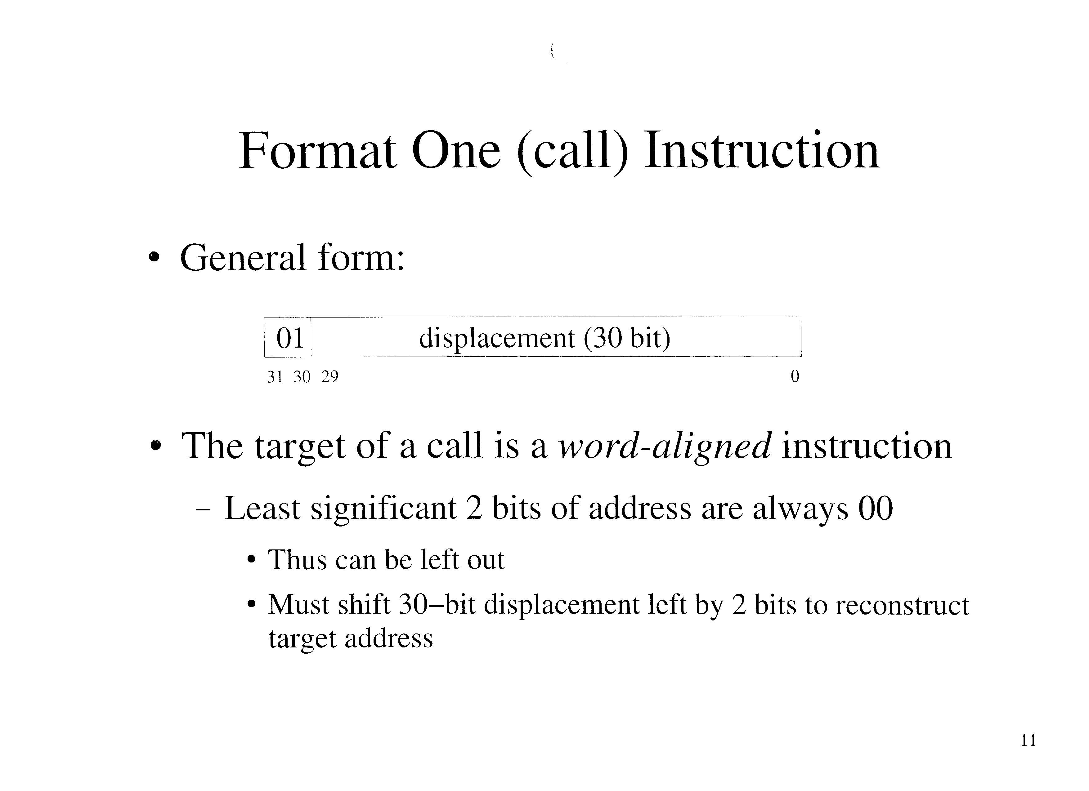

Slide 12
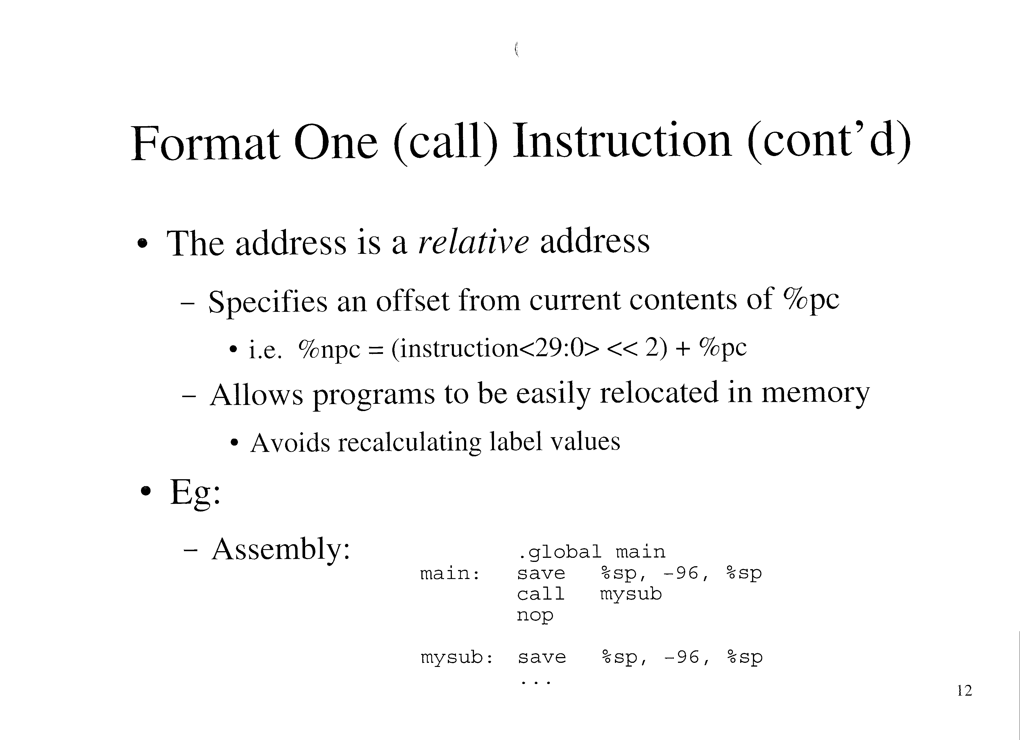

Slide 13
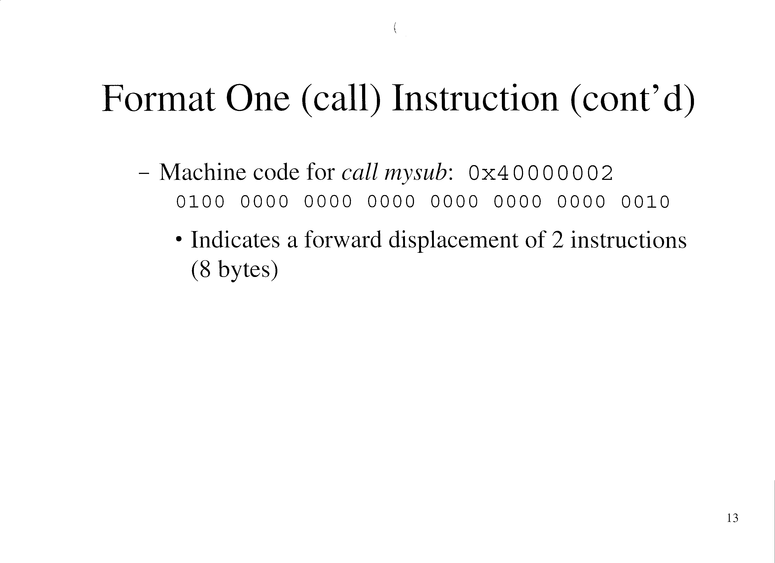

Slide 14
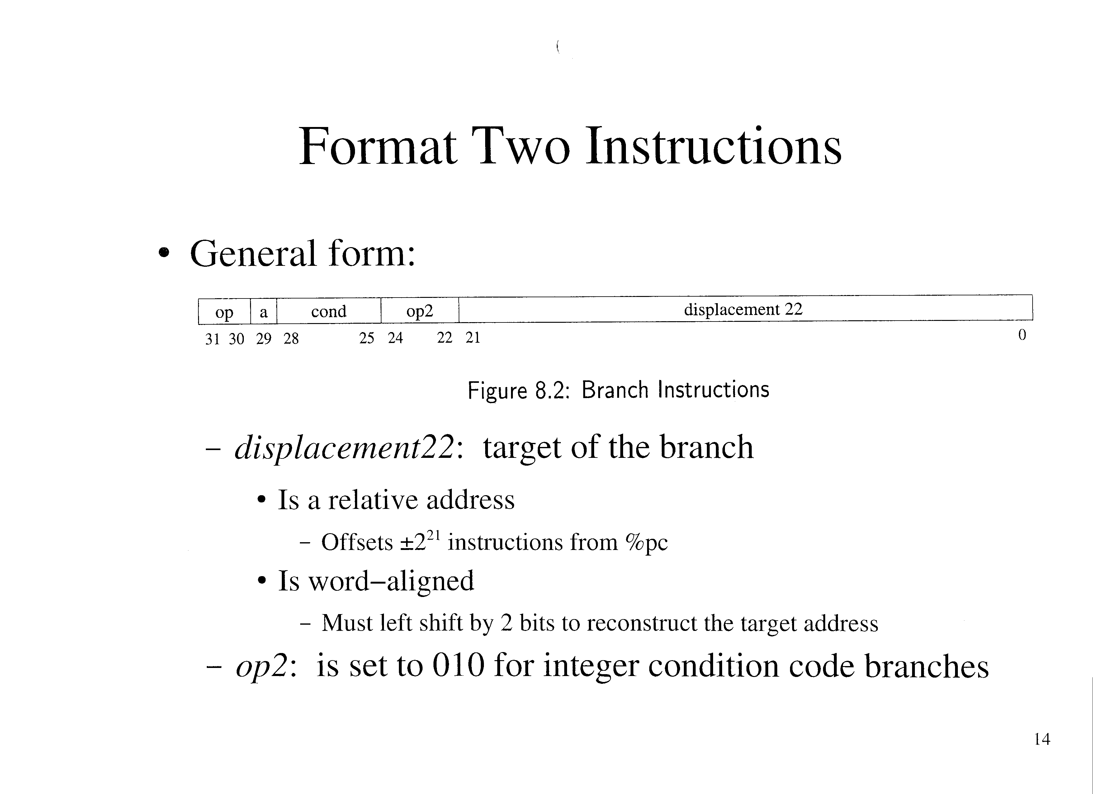

Slide 15
Format Two Instructions (cont’d)
a: if 1, the branch is annulled
cond: indicates the kind of branch
  Tables (p. 238, 239 of text)

Slide 16
Format Two Instructions (cont’d)
Check the tables on page 238, 239 of the text

Slide 17
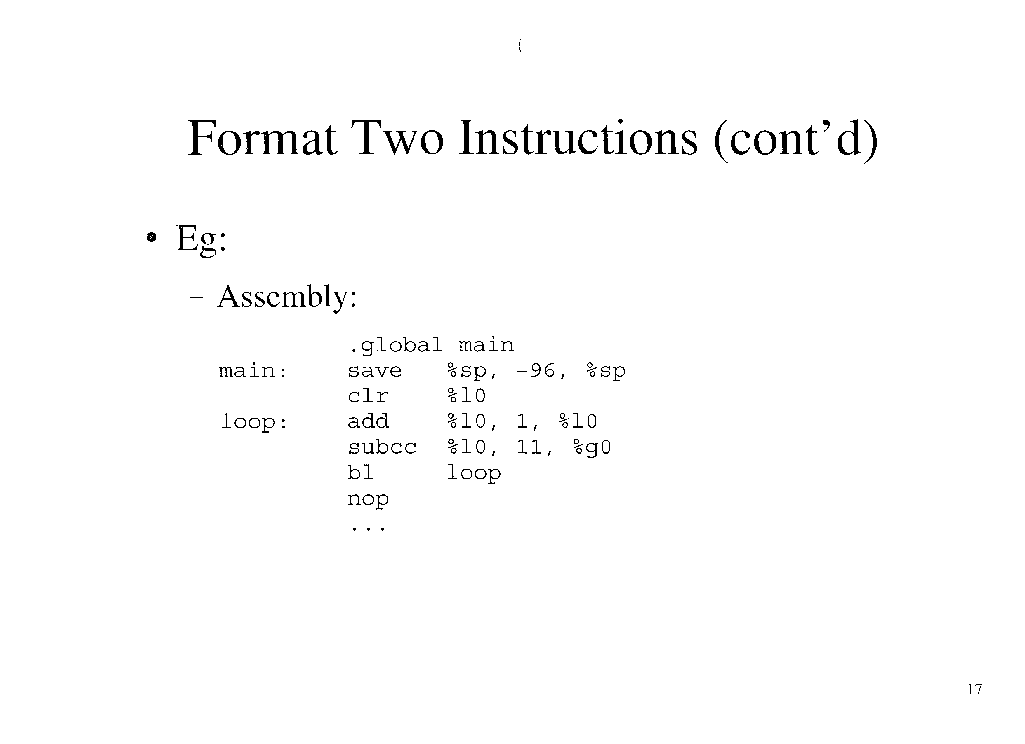

Slide 18
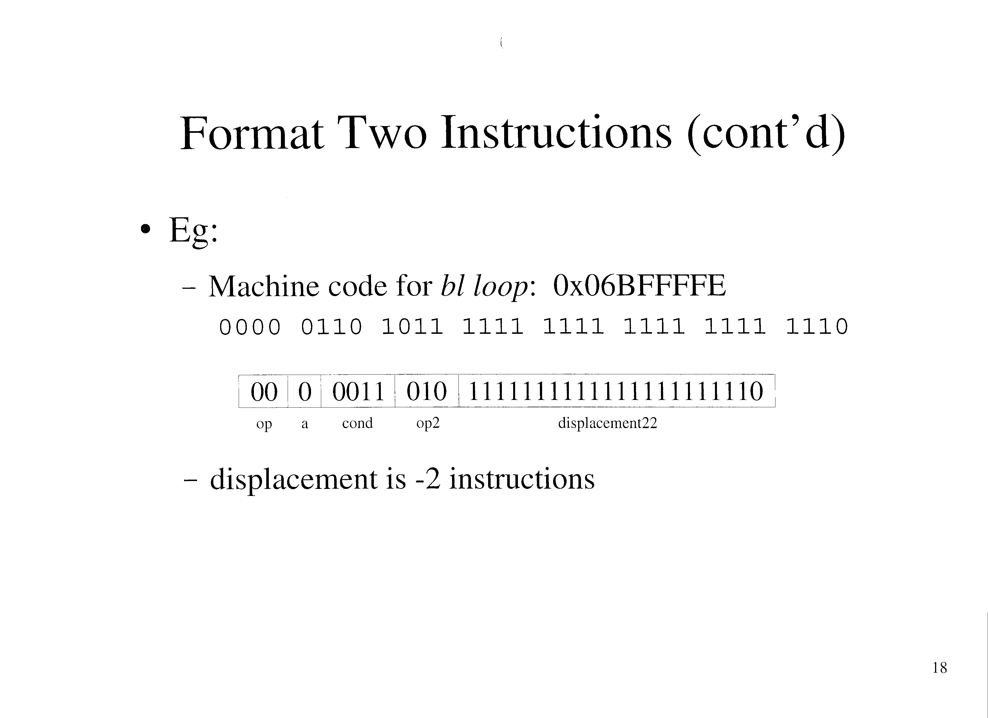

Slide 19
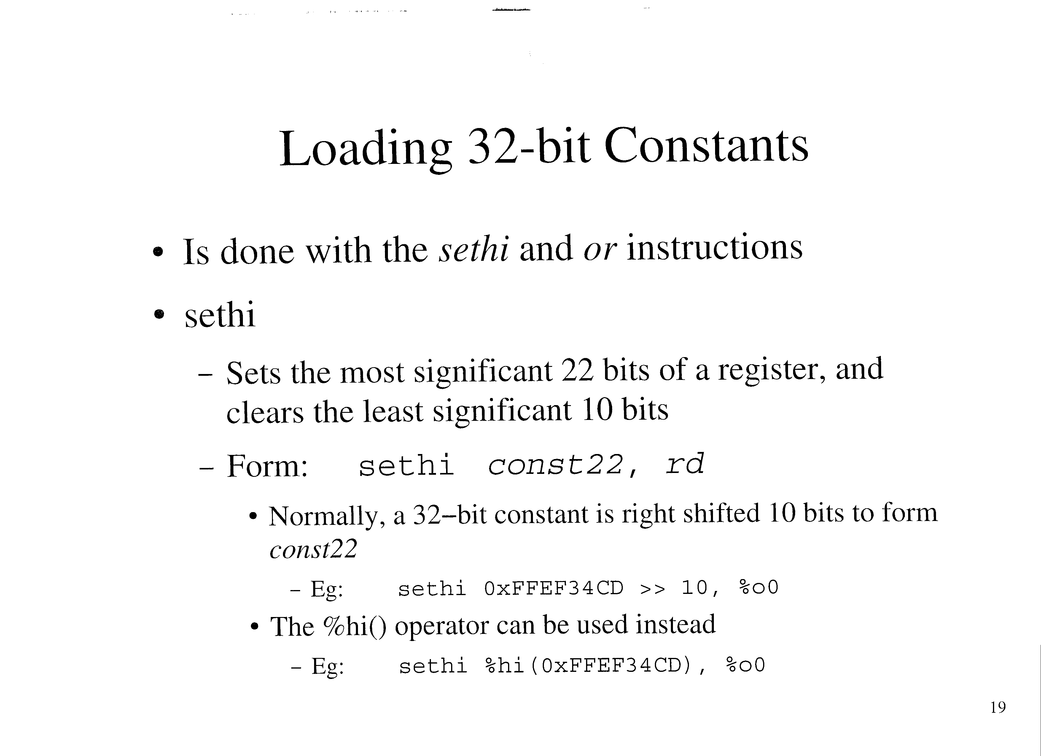

Slide 20
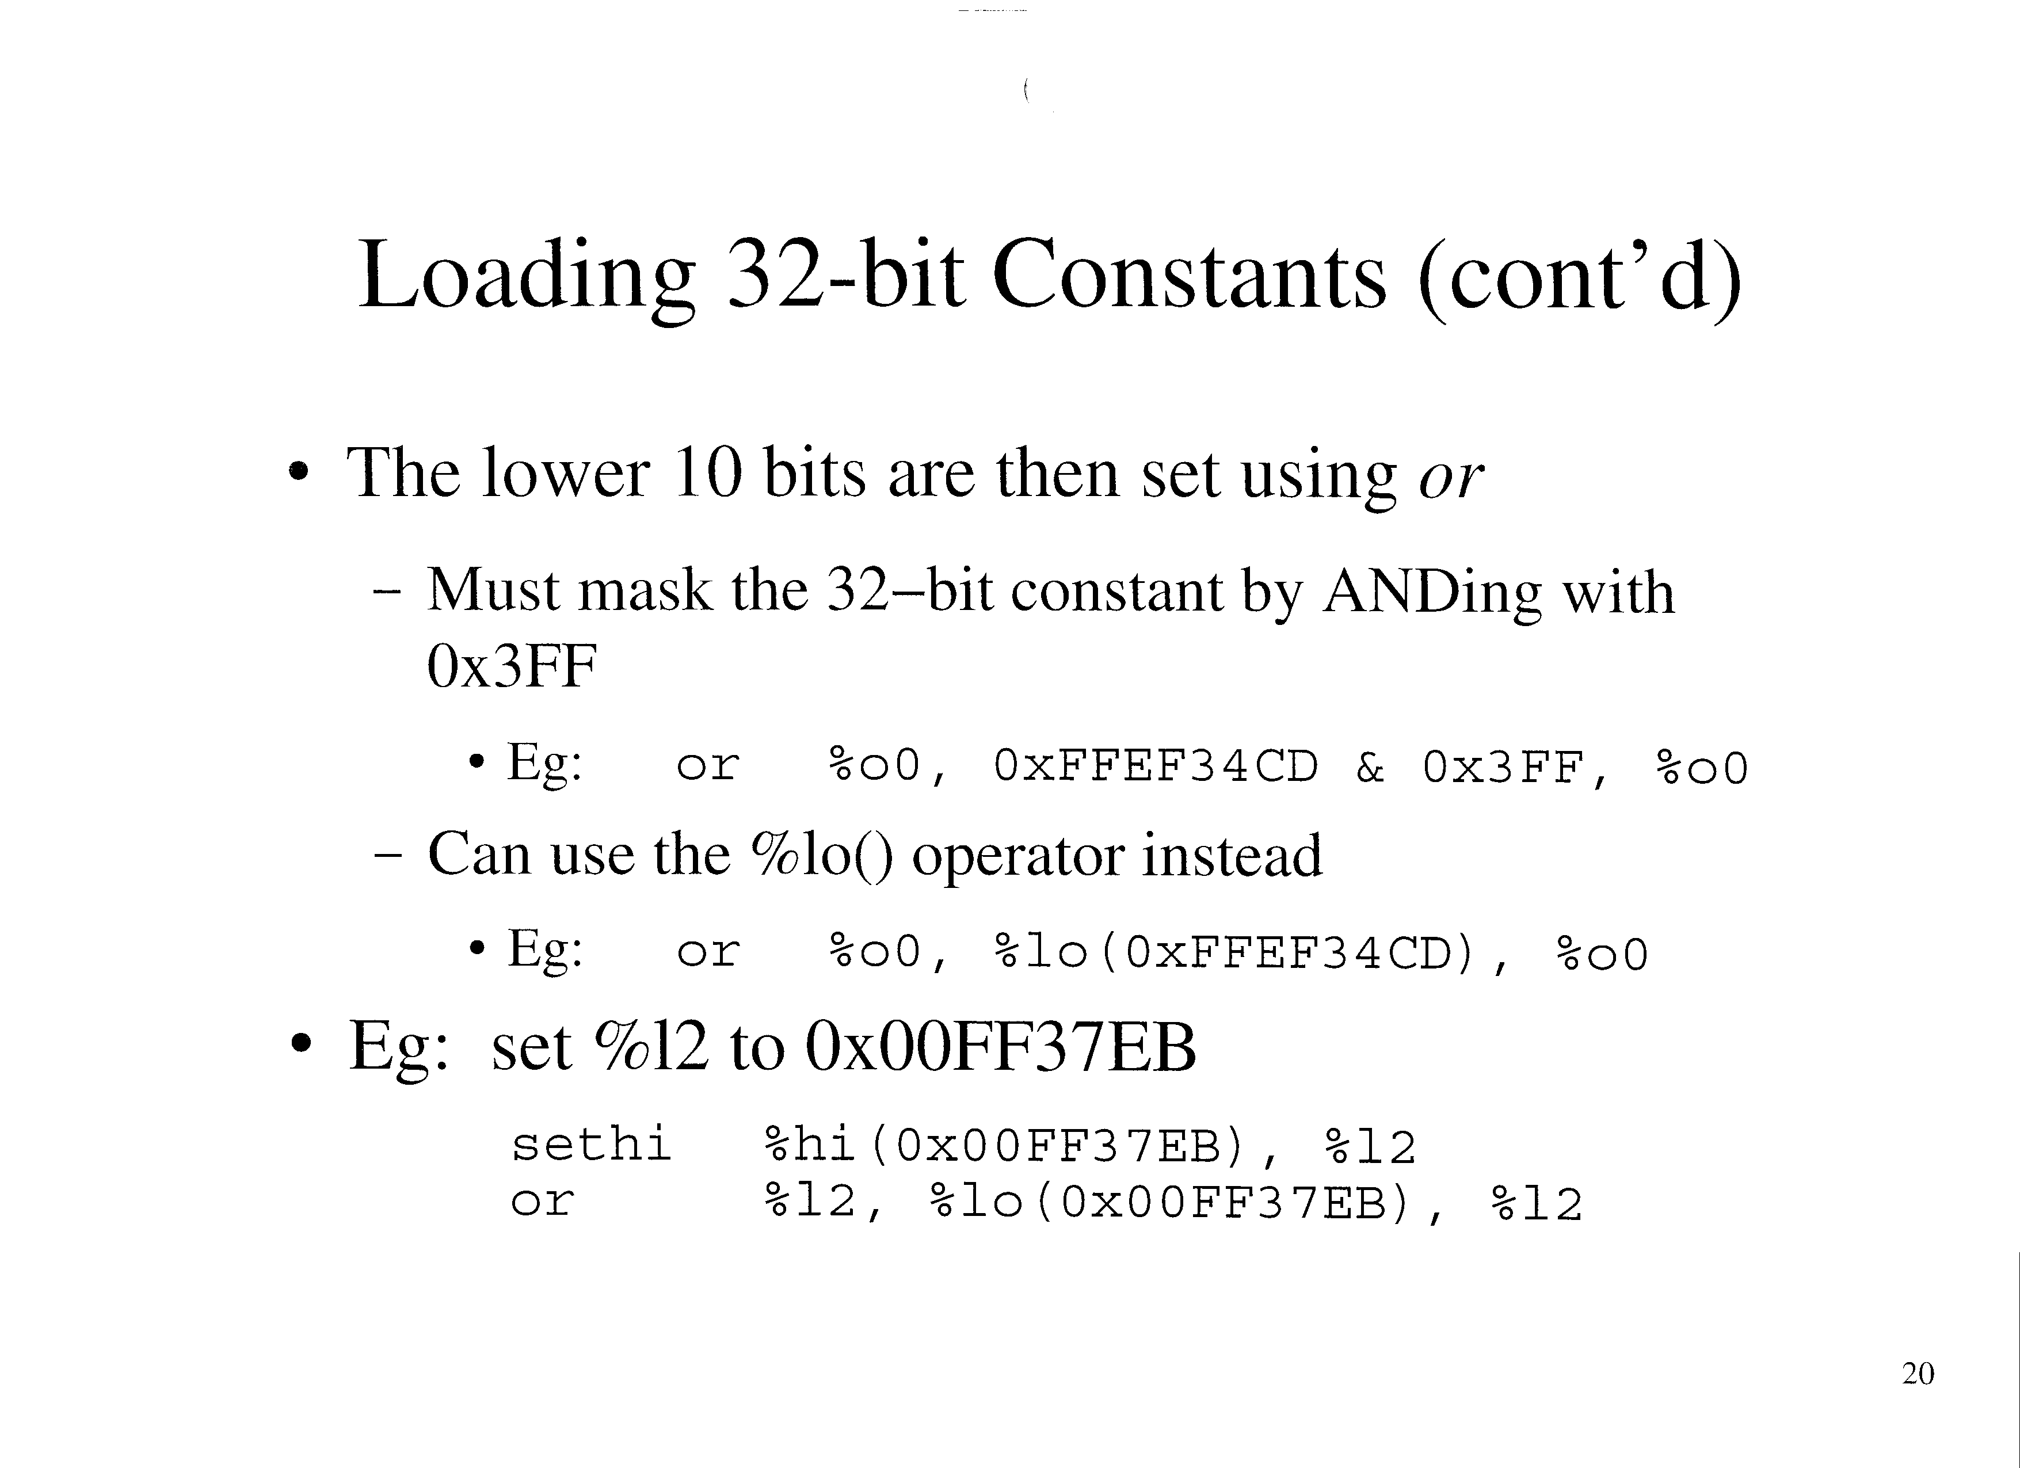

Slide 21
