Slide 1
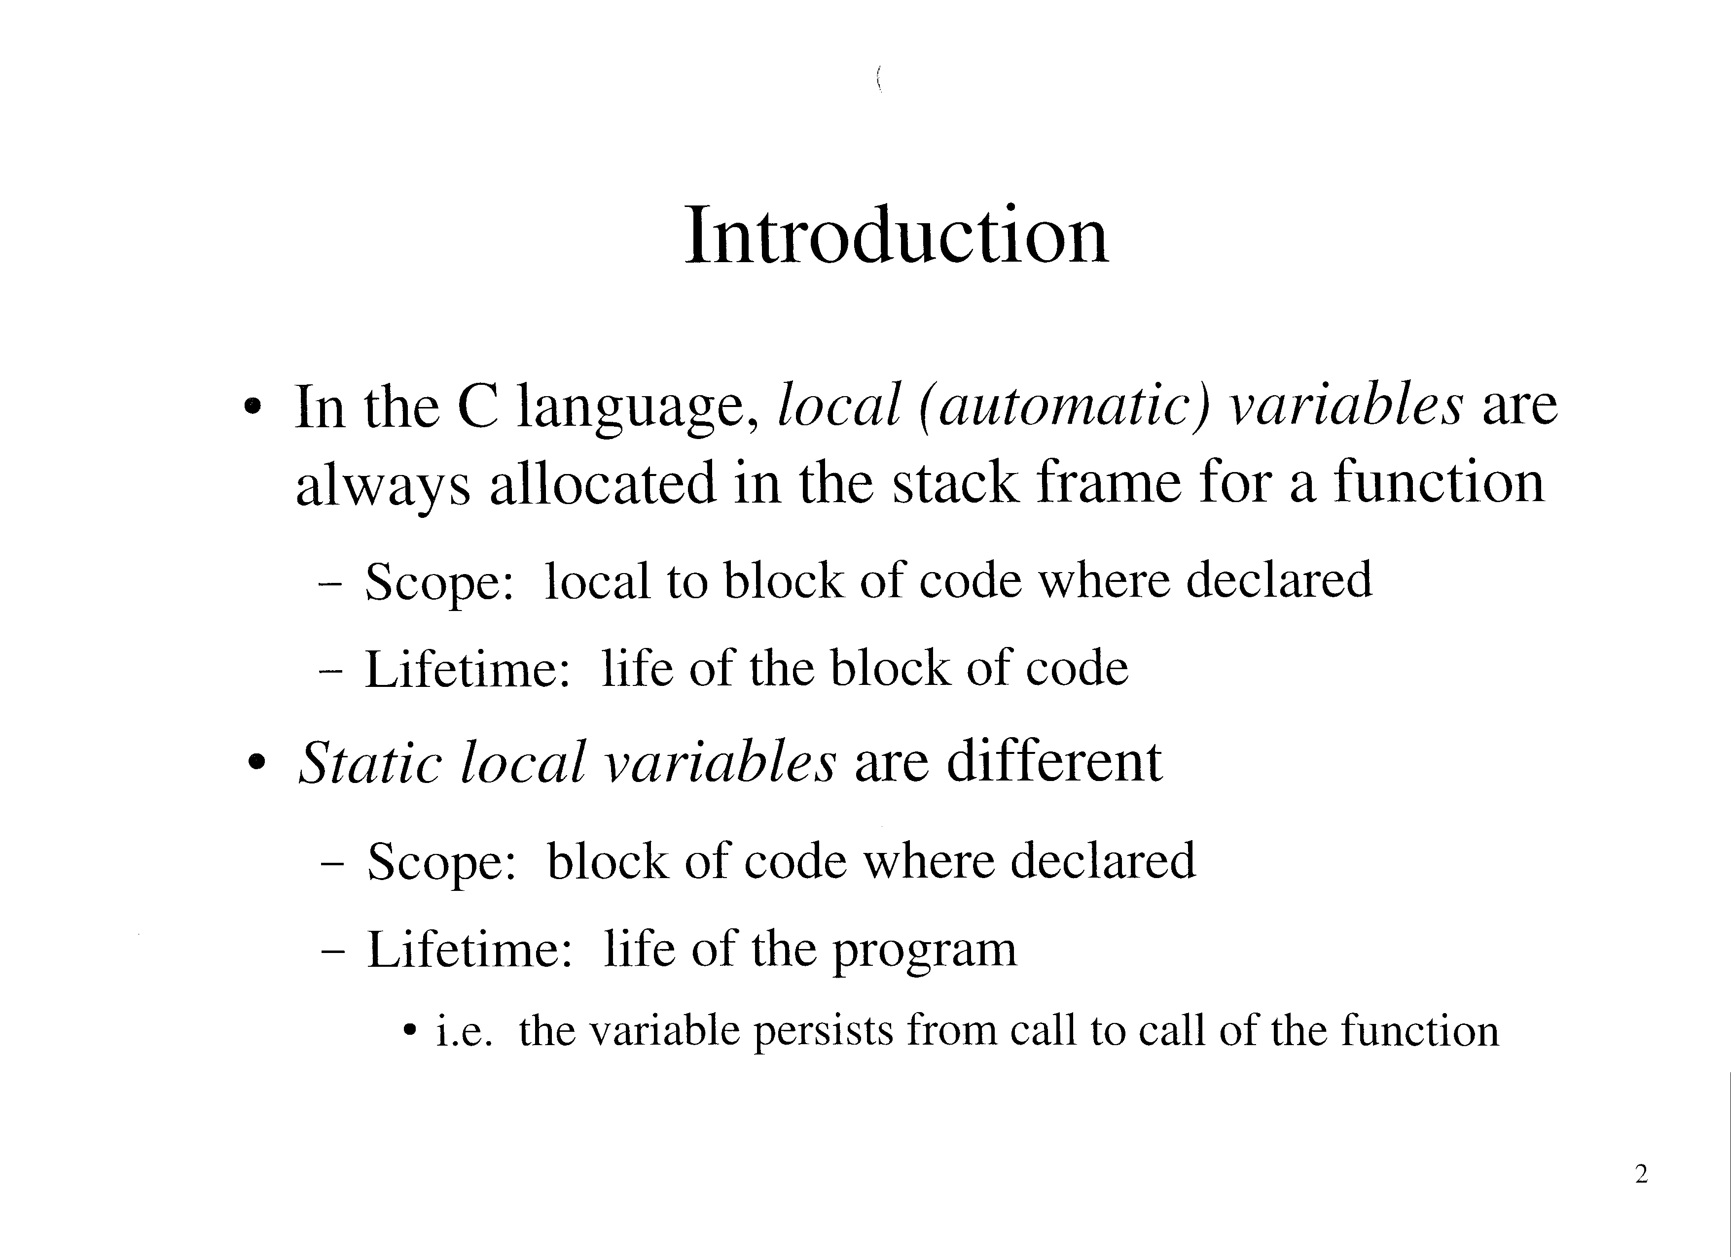

Slide 2
Introduction (cont’d)
Eg:
    int count()
    {
    static int value = 0;
    return ++value;
    }
Cannot be stored on the stack frame for the function
  Stack memory may be reused by other functions
Are stored in a separate segment of RAM
    int count()
    {
    static int value = 0;
    return ++value;
    }

Slide 3
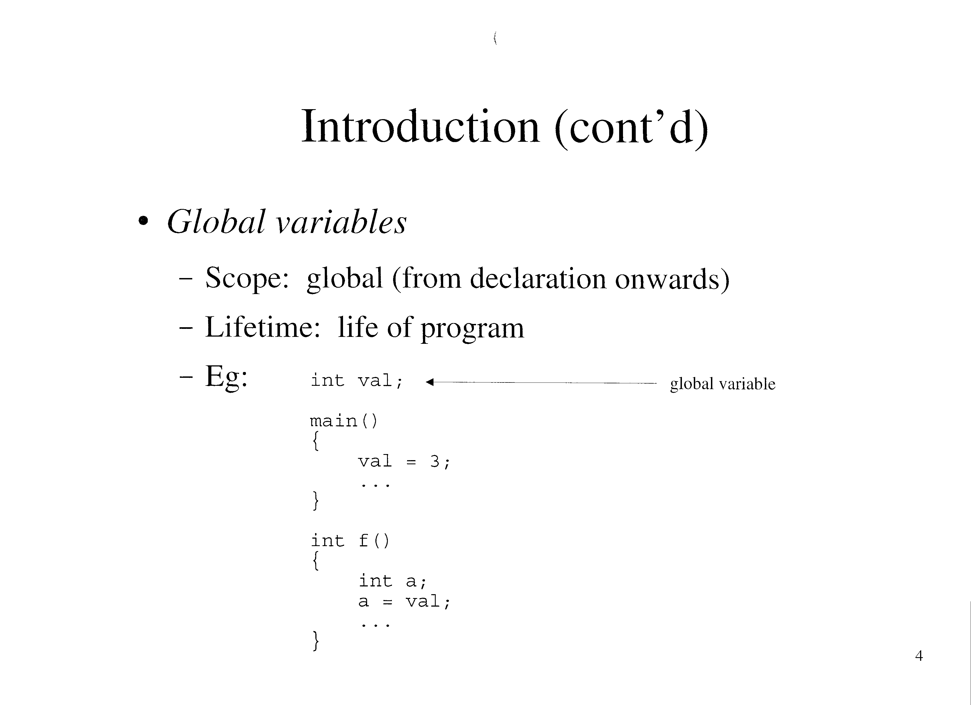

Slide 4
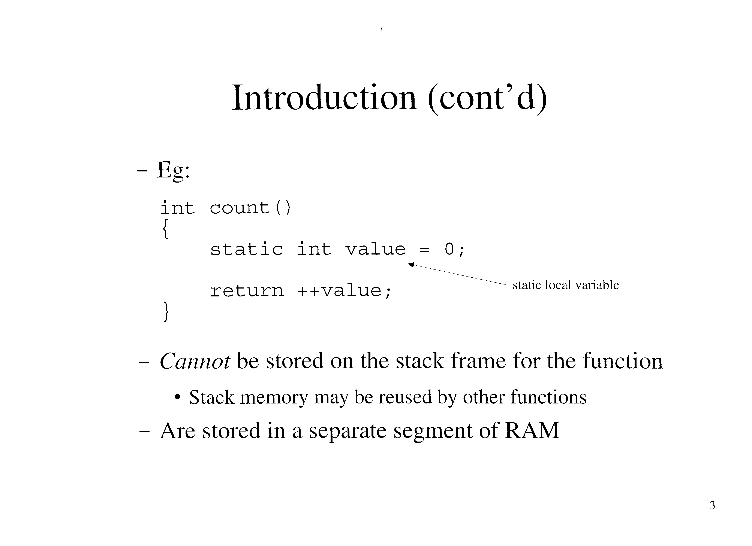

Slide 5
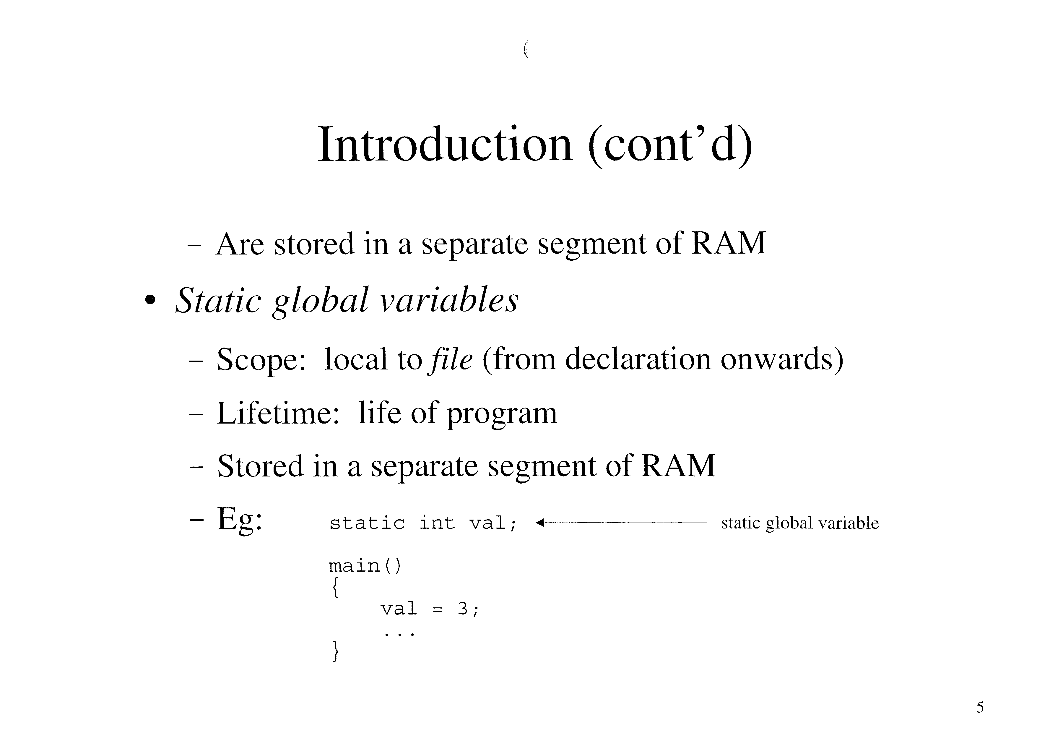

Slide 6
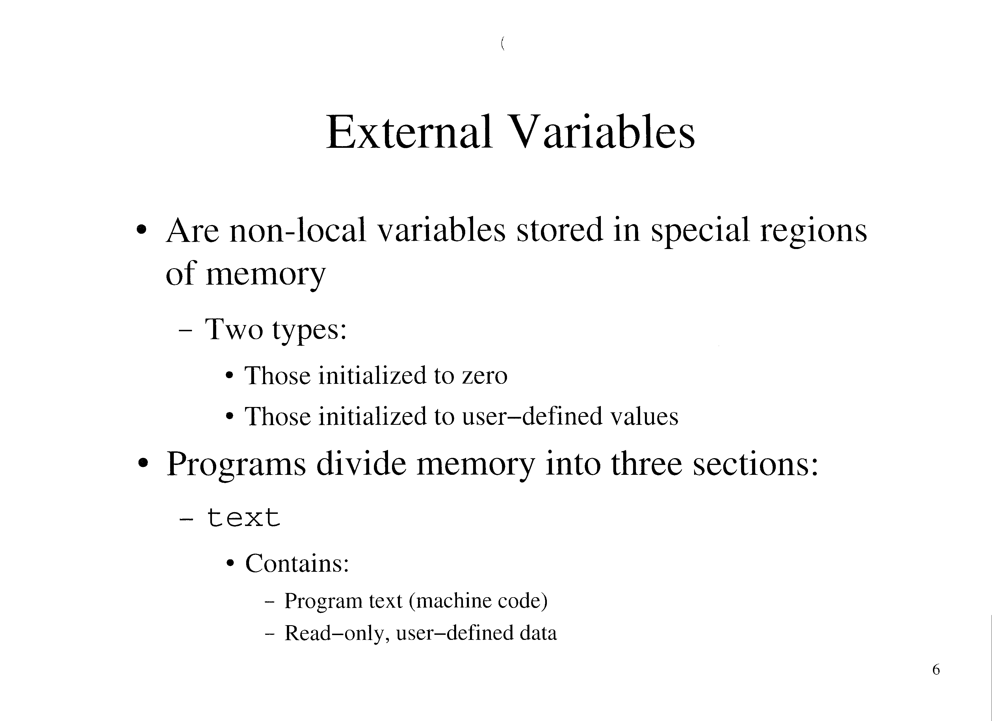

Slide 7
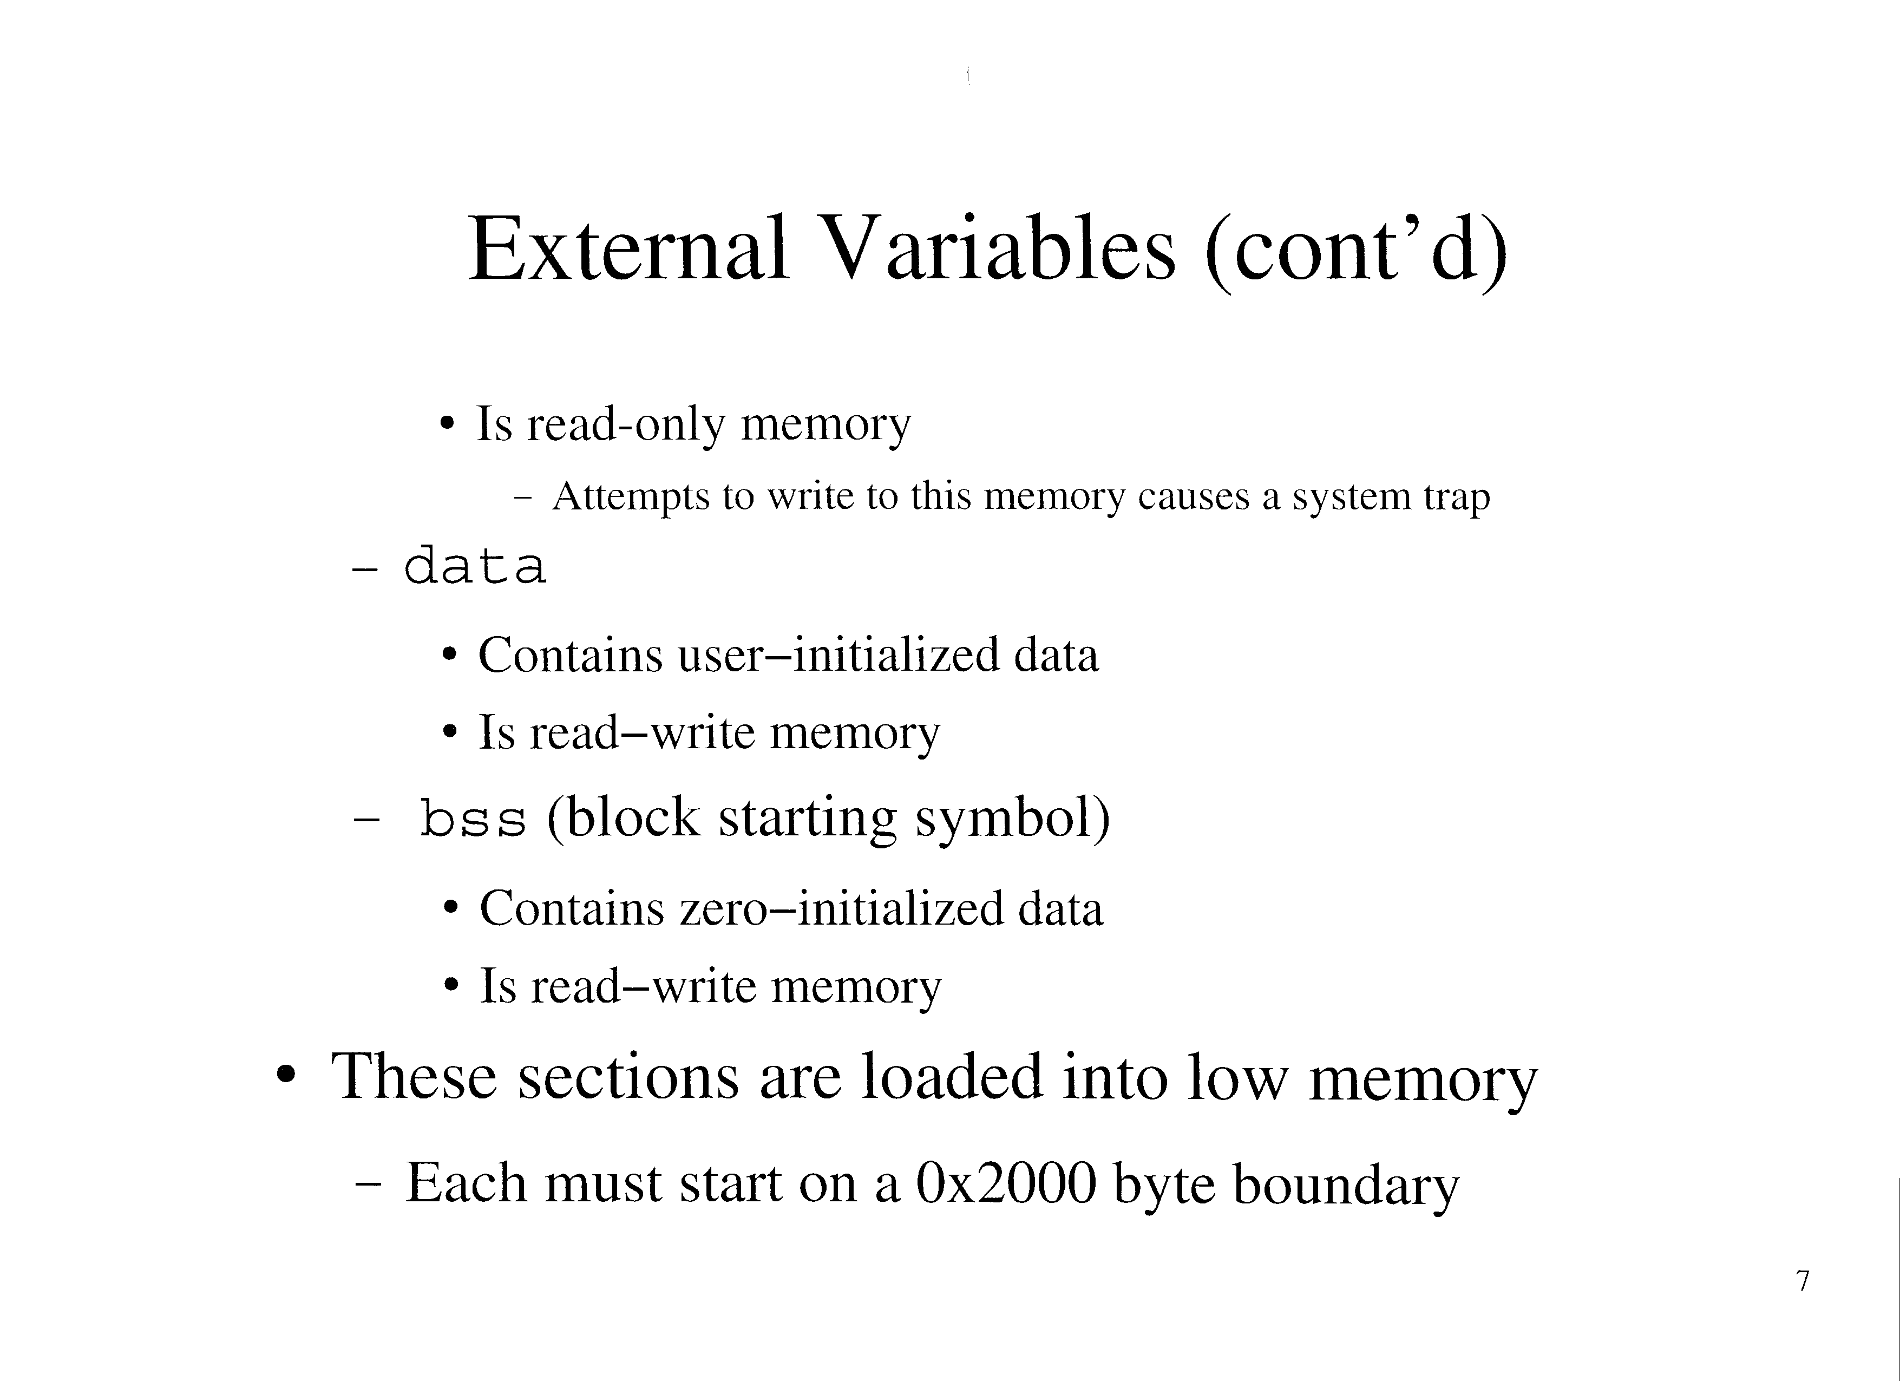

Slide 8
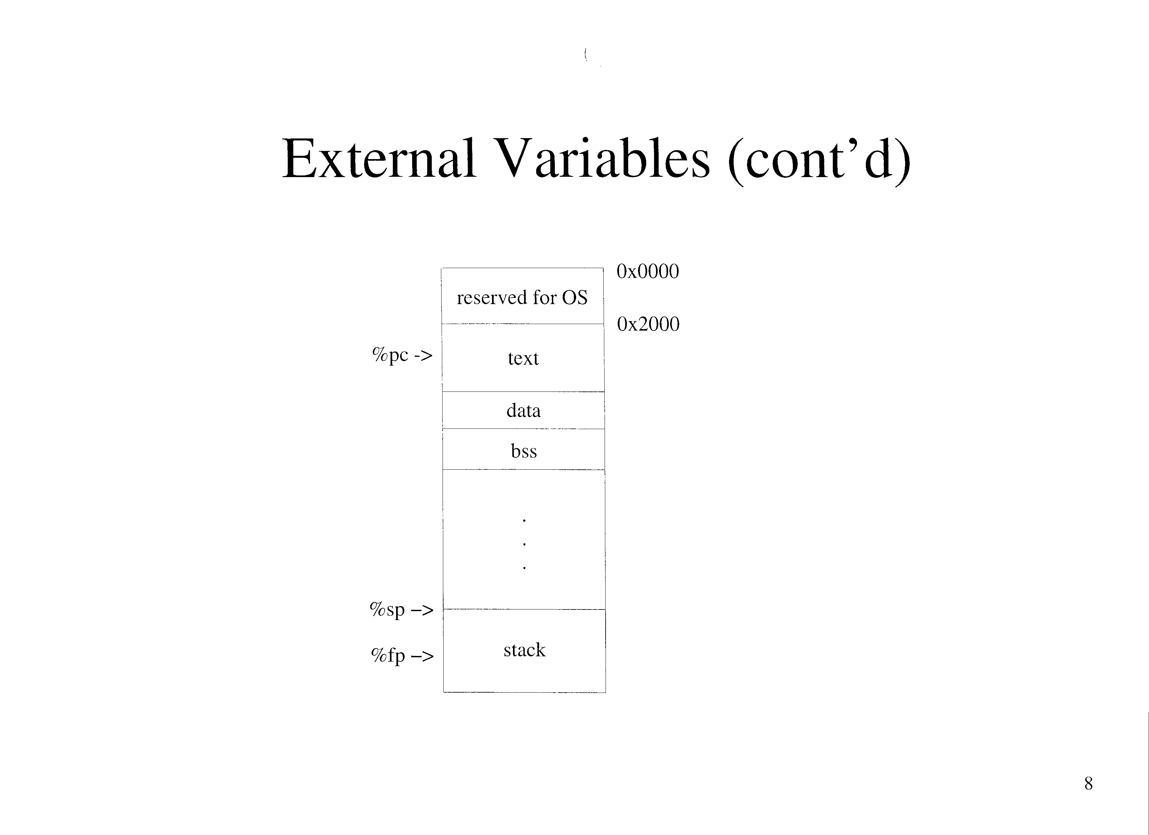

Slide 9
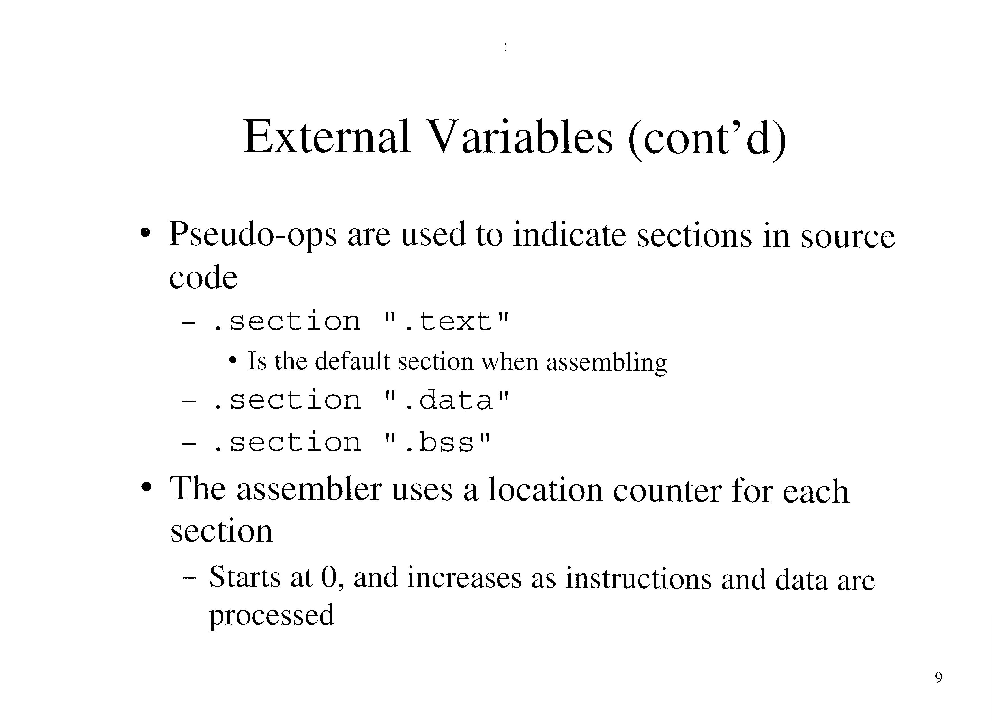

Slide 10
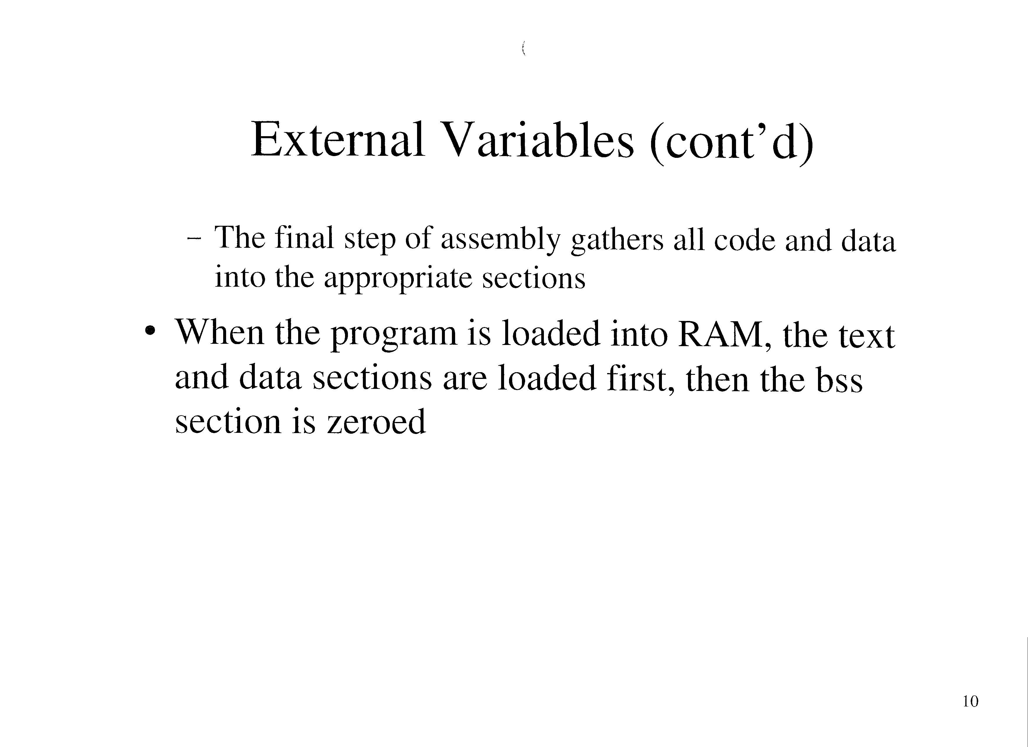

Slide 11
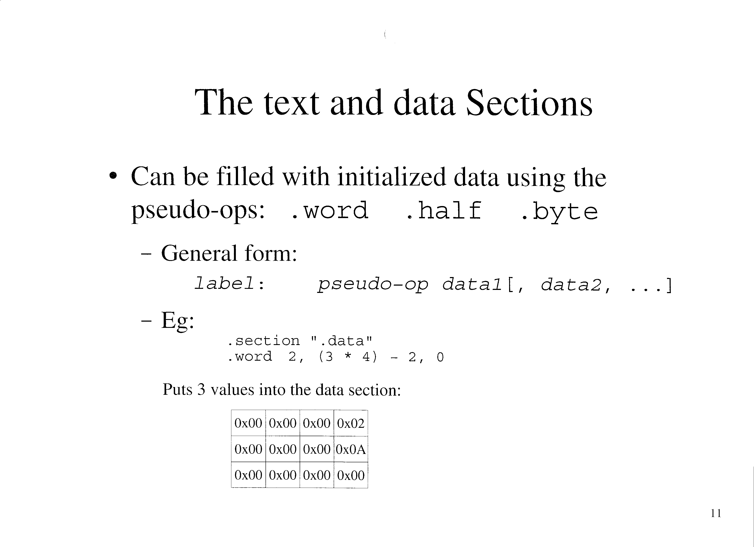

Slide 12
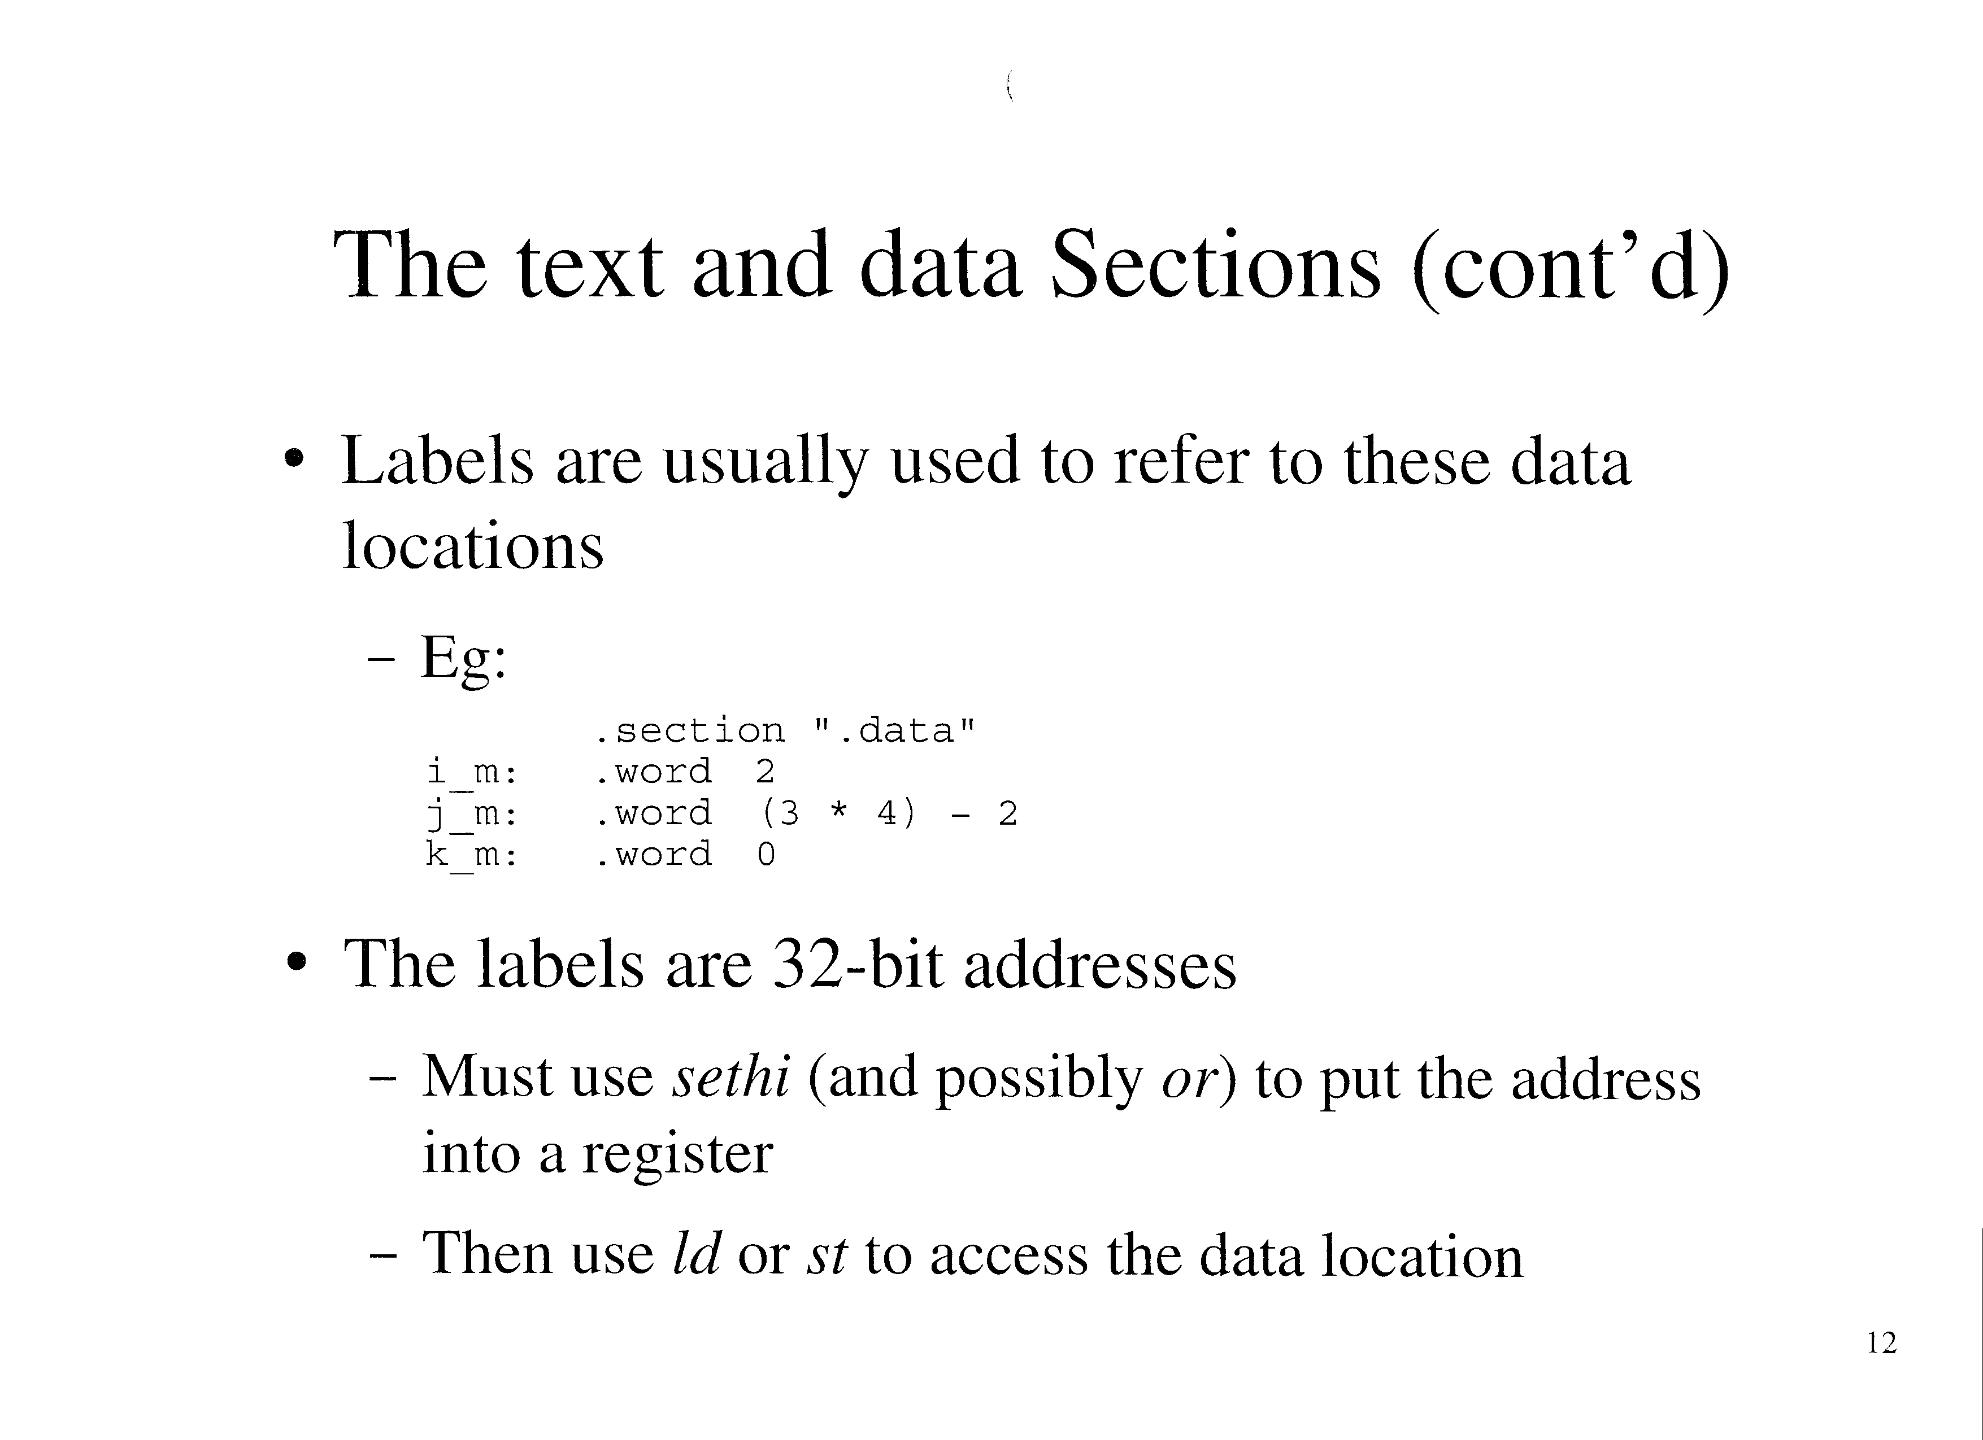

Slide 13
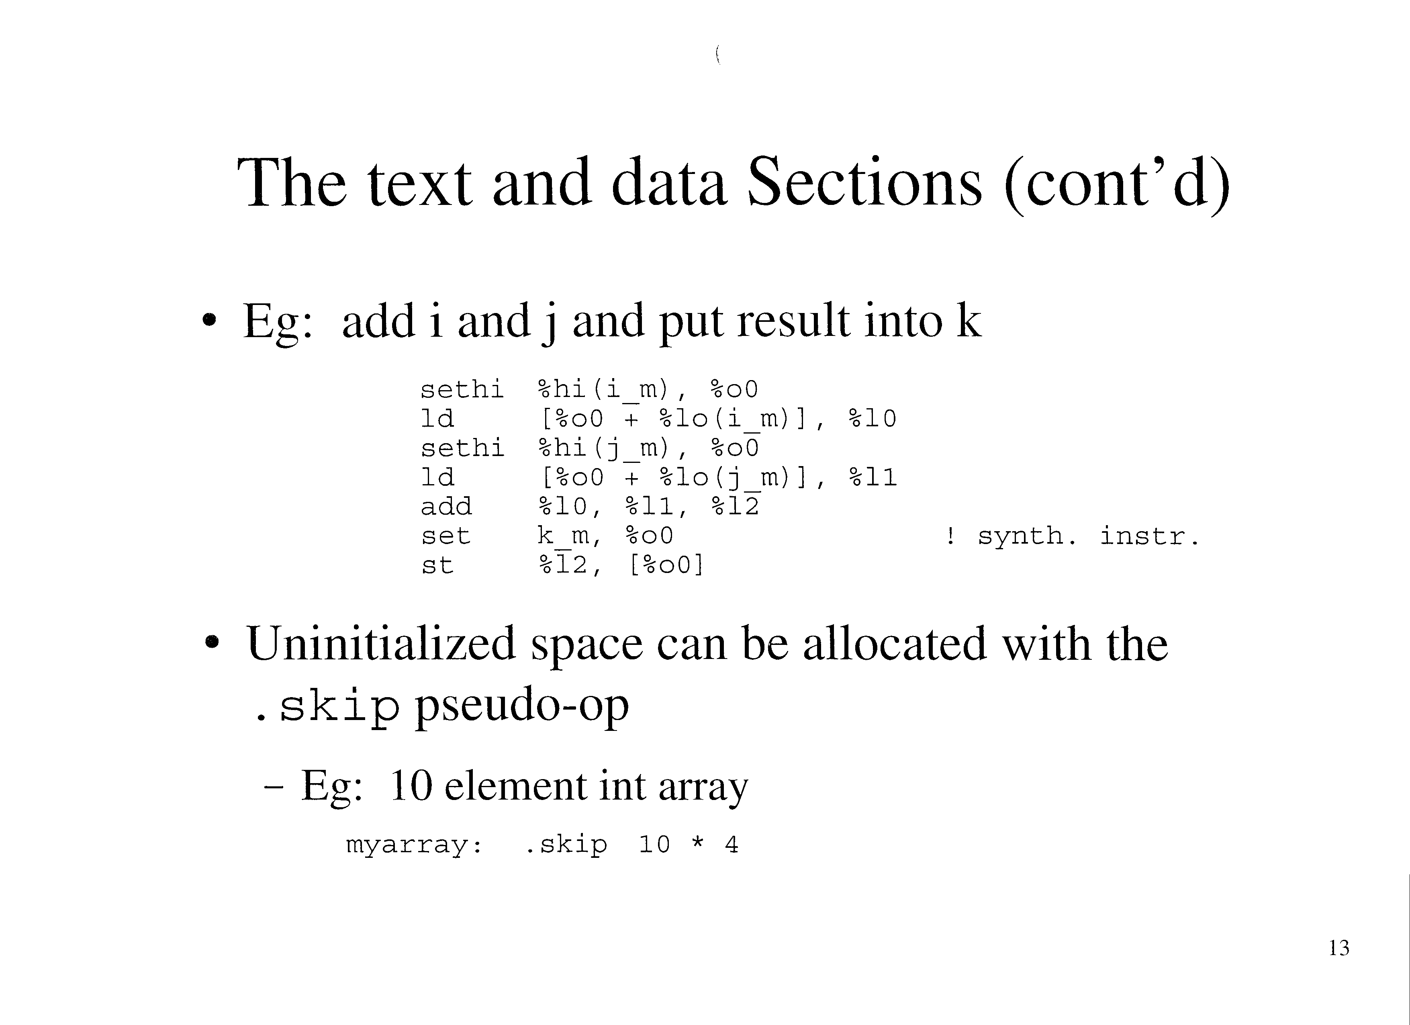

Slide 14
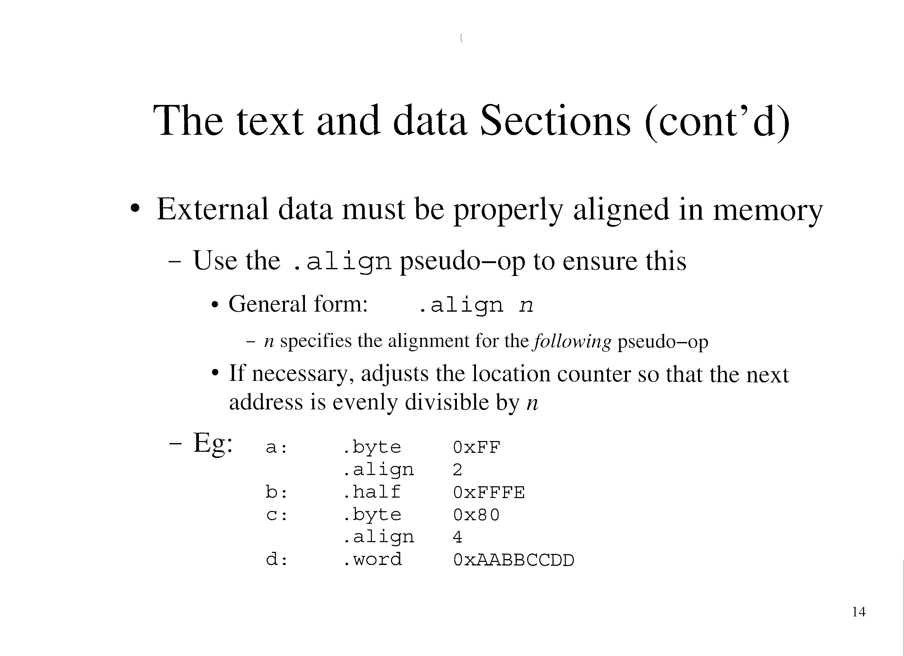

Slide 15
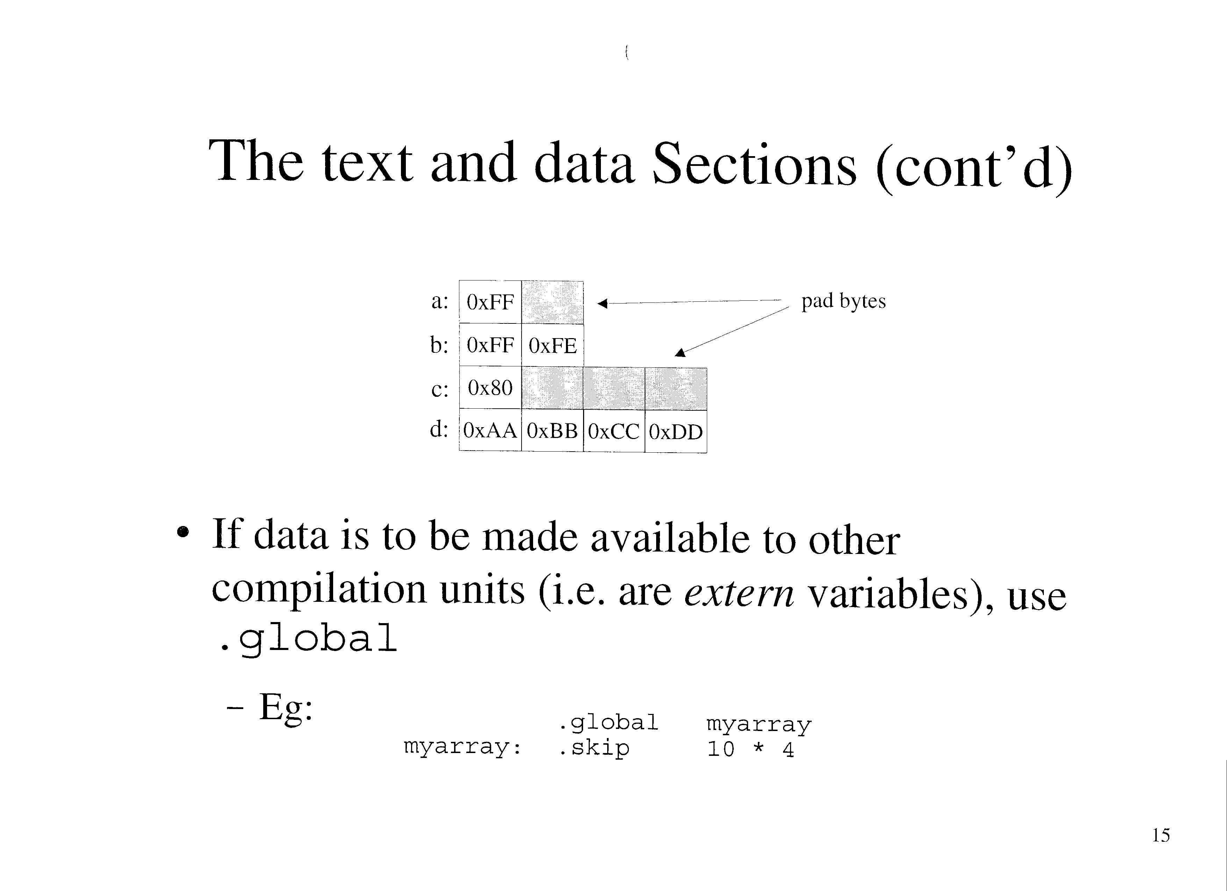

Slide 16
The text and data Sections (cont’d)
When putting read-only data into the text section, it is usually put between functions
  i.e. where it won’t be confused for instructions
Eg:
    .align 4
    func1: save %sp, -96, %sp
    …
    ret
    restore
    .align 2
    a: .half 0xFFFE
    .align 4
    func2: save %sp, -96, %sp
    …
    ret
    restore

Slide 17
ASCII
A string could be initialized in memory one byte at a time
  Eg: “cheers”
      .byte “c”,”h”,”e”,”e”,”r”,”s”
In C, strings are null terminated
  Could be done using two pseudo-ops:
    .ascii “cheers”
    .byte 0
  But more conveniently with .asciz
    .asciz “cheers”

Slide 18
ASCII (cont’d)
Read-only strings are common, especially for printf() format strings
  EG:
    void main()
    {
    printf(“Hello, World!\n”);
    }
  Assembly:
    fmt: .asciz “Hello, world!\n”
    .align 4
    .global main
    main: save %sp, -96, %sp
    sethi %hi(fmt), %o0
    or %o0, &lo(fmt), %o0
    nop
    …

Slide 19
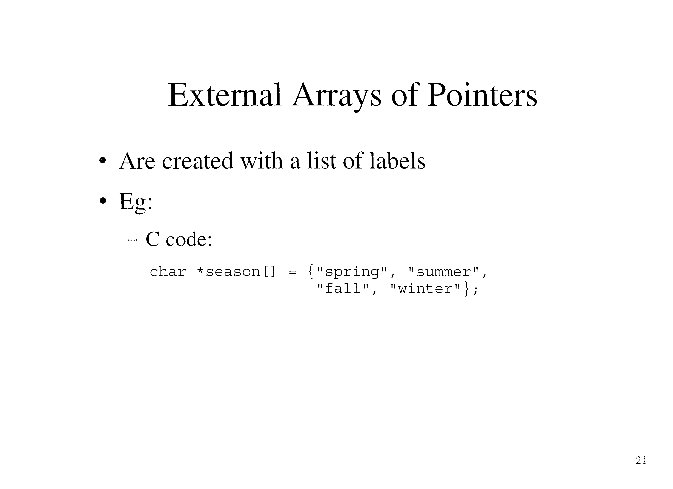

Slide 20
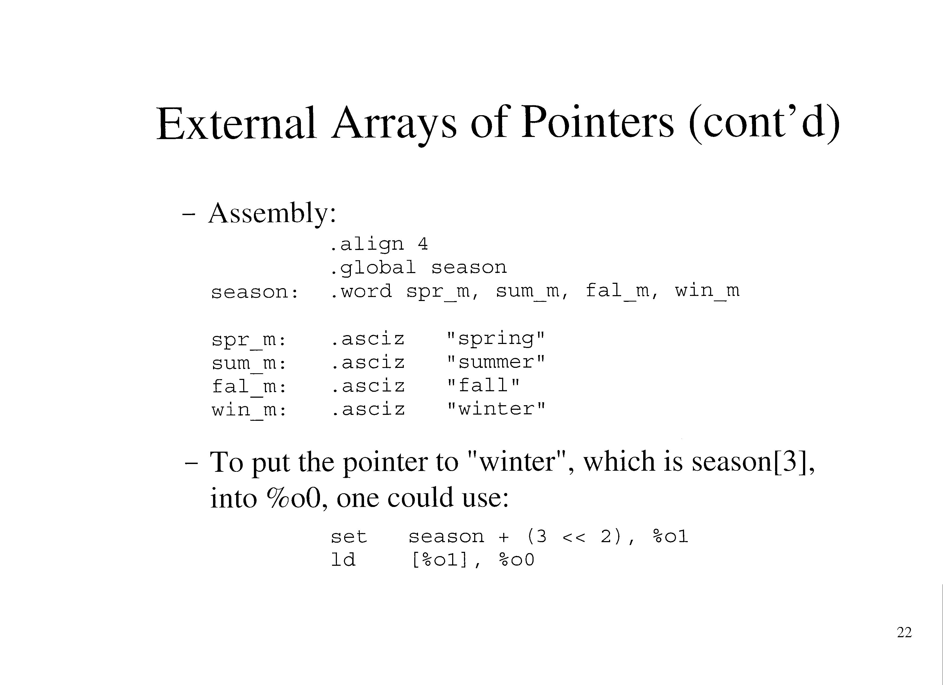

Slide 21
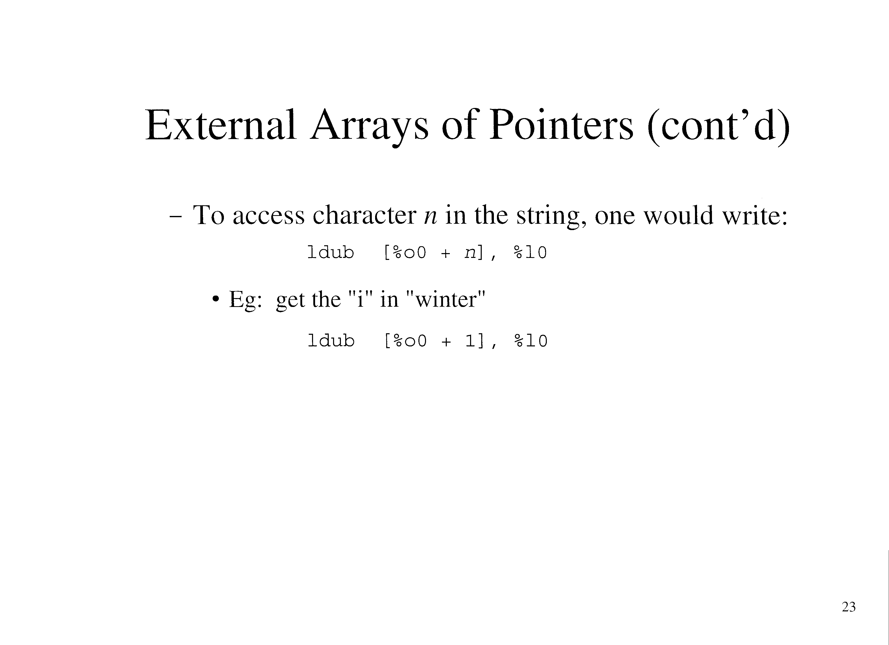

Slide 22
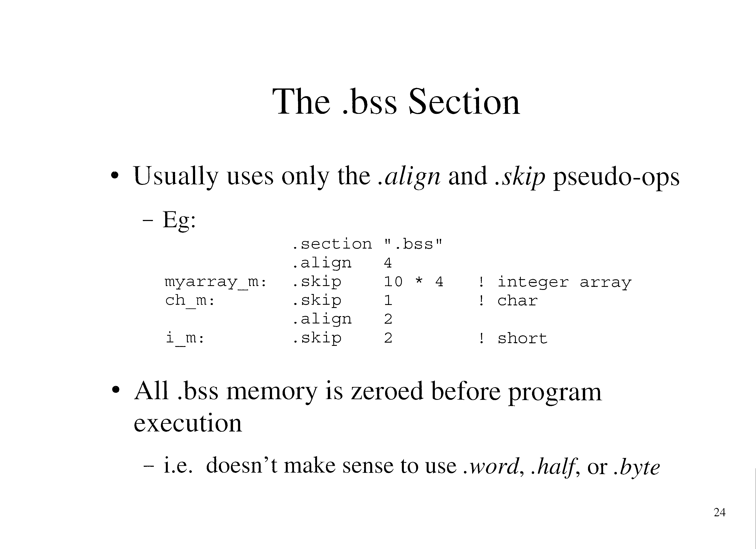

Slide 23
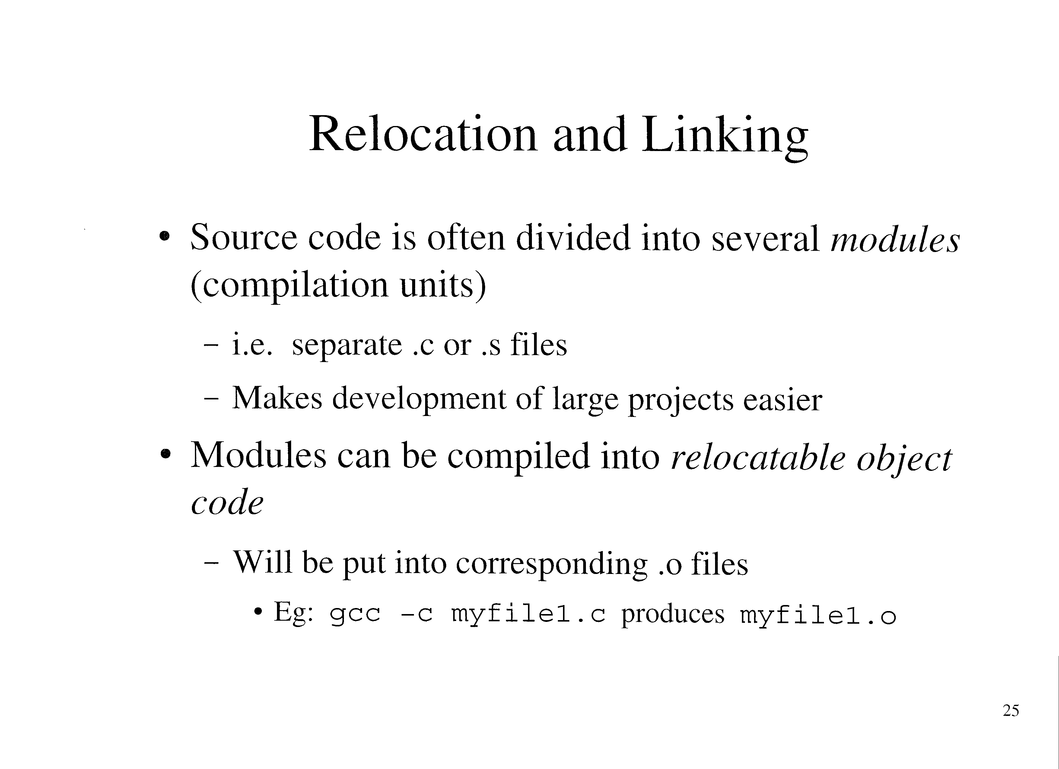

Slide 24
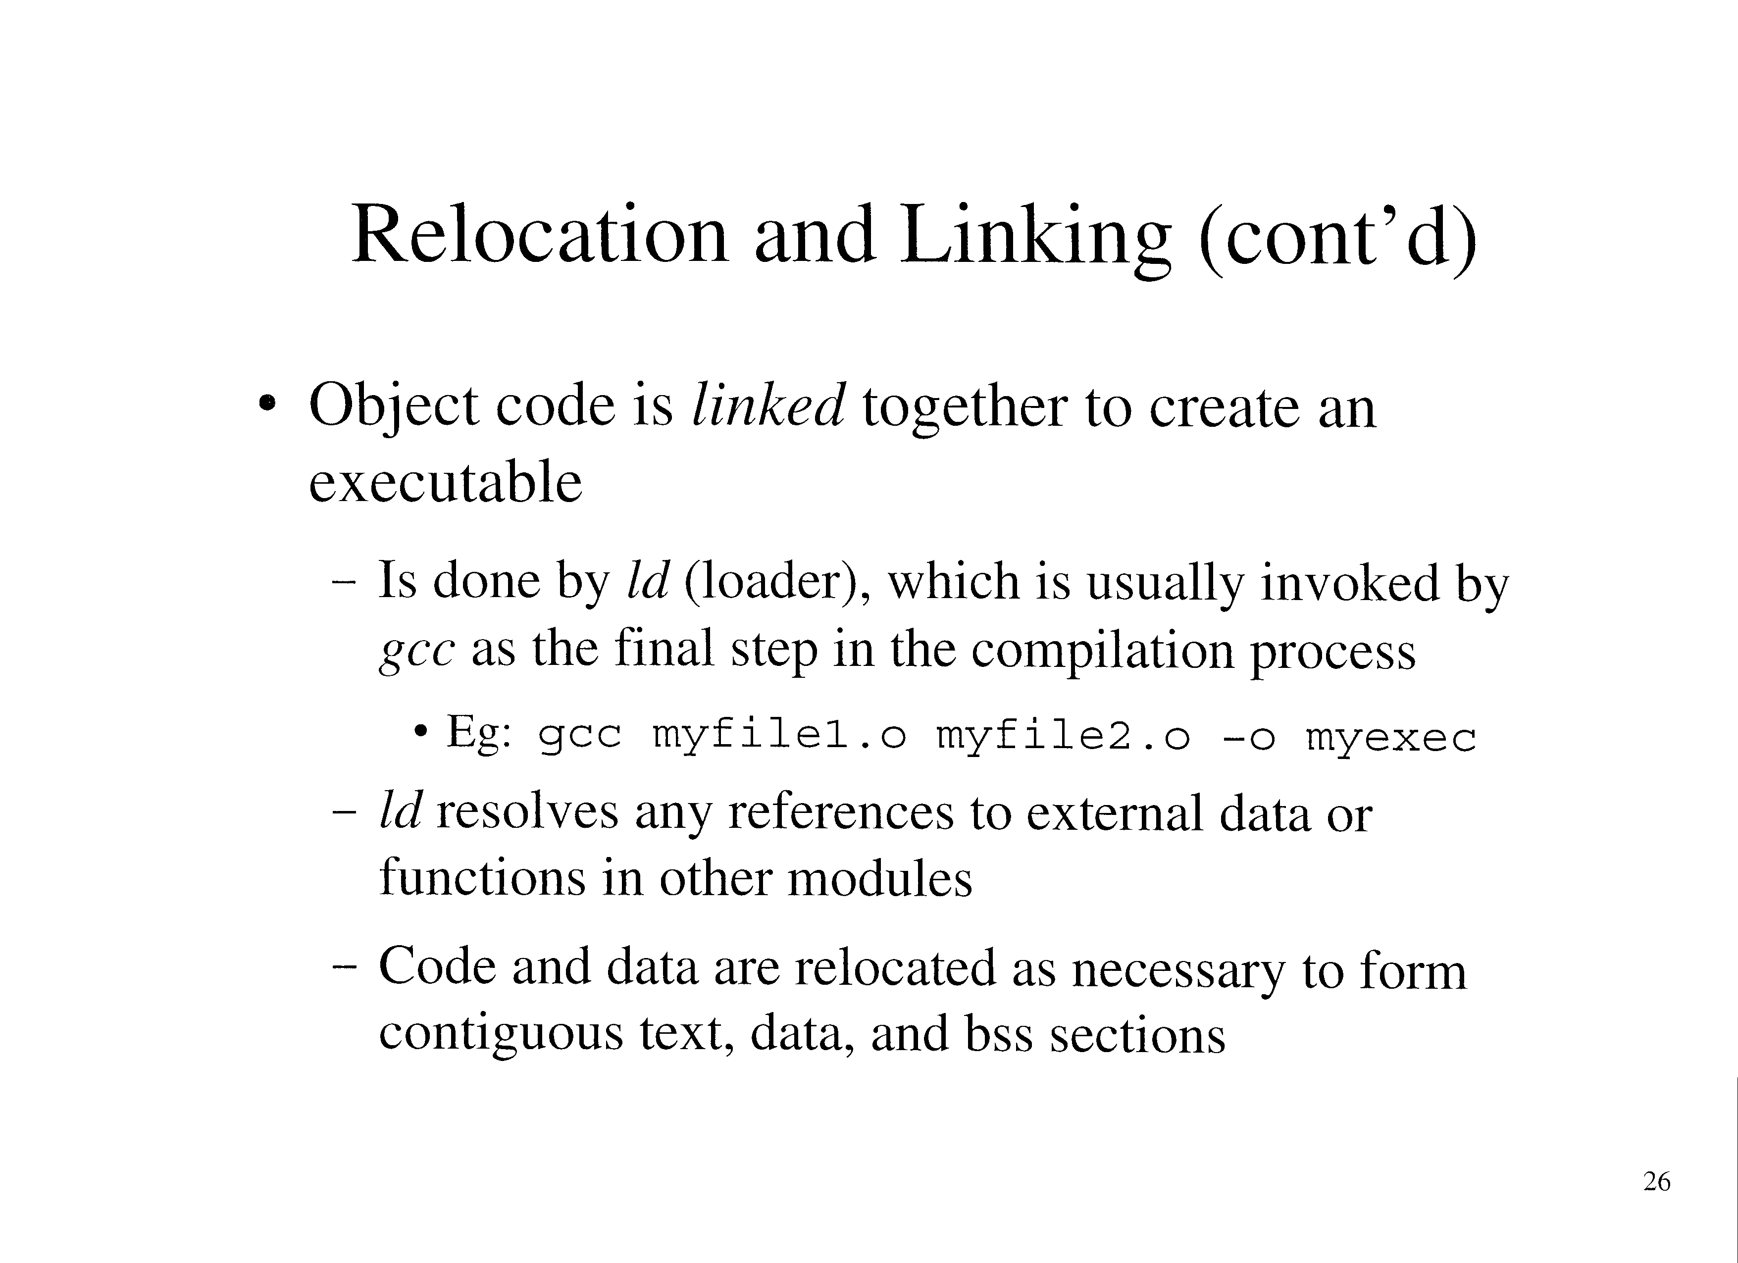

Slide 25
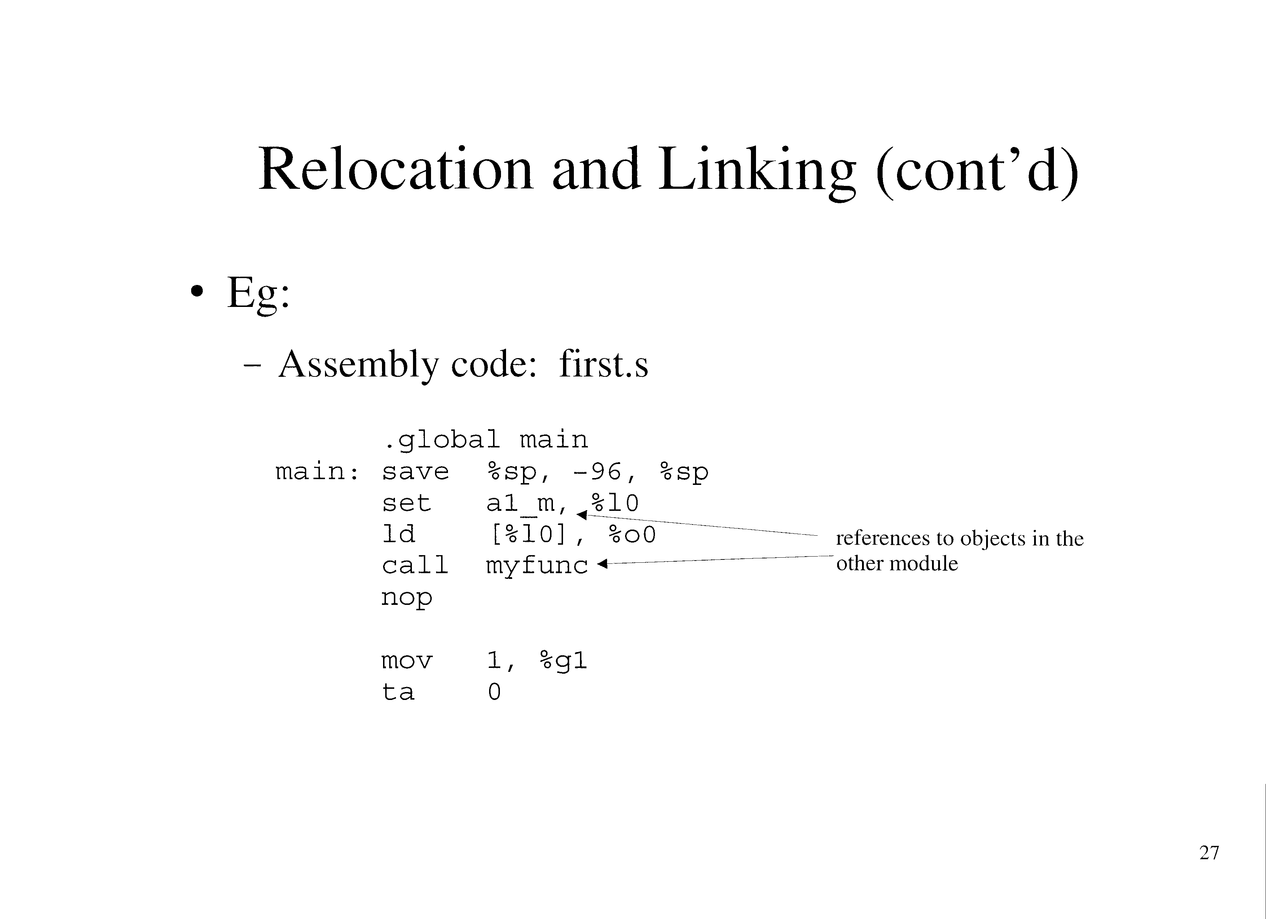

Slide 26
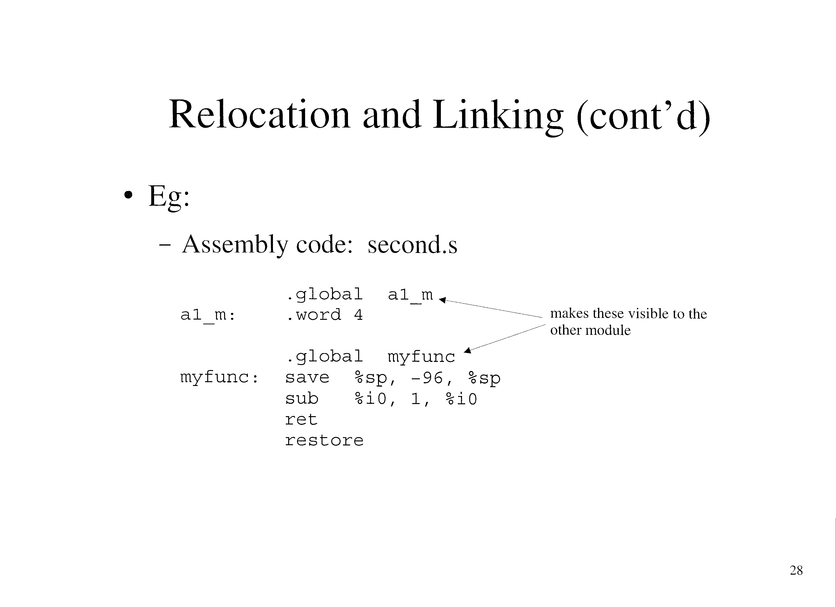

Slide 27
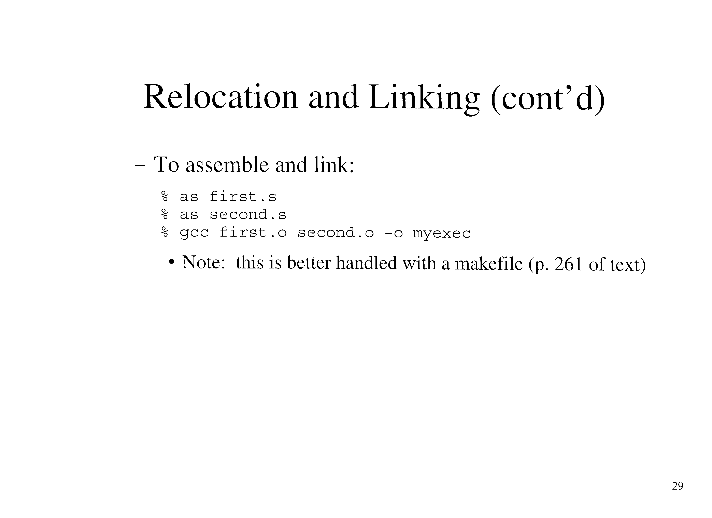

Slide 28
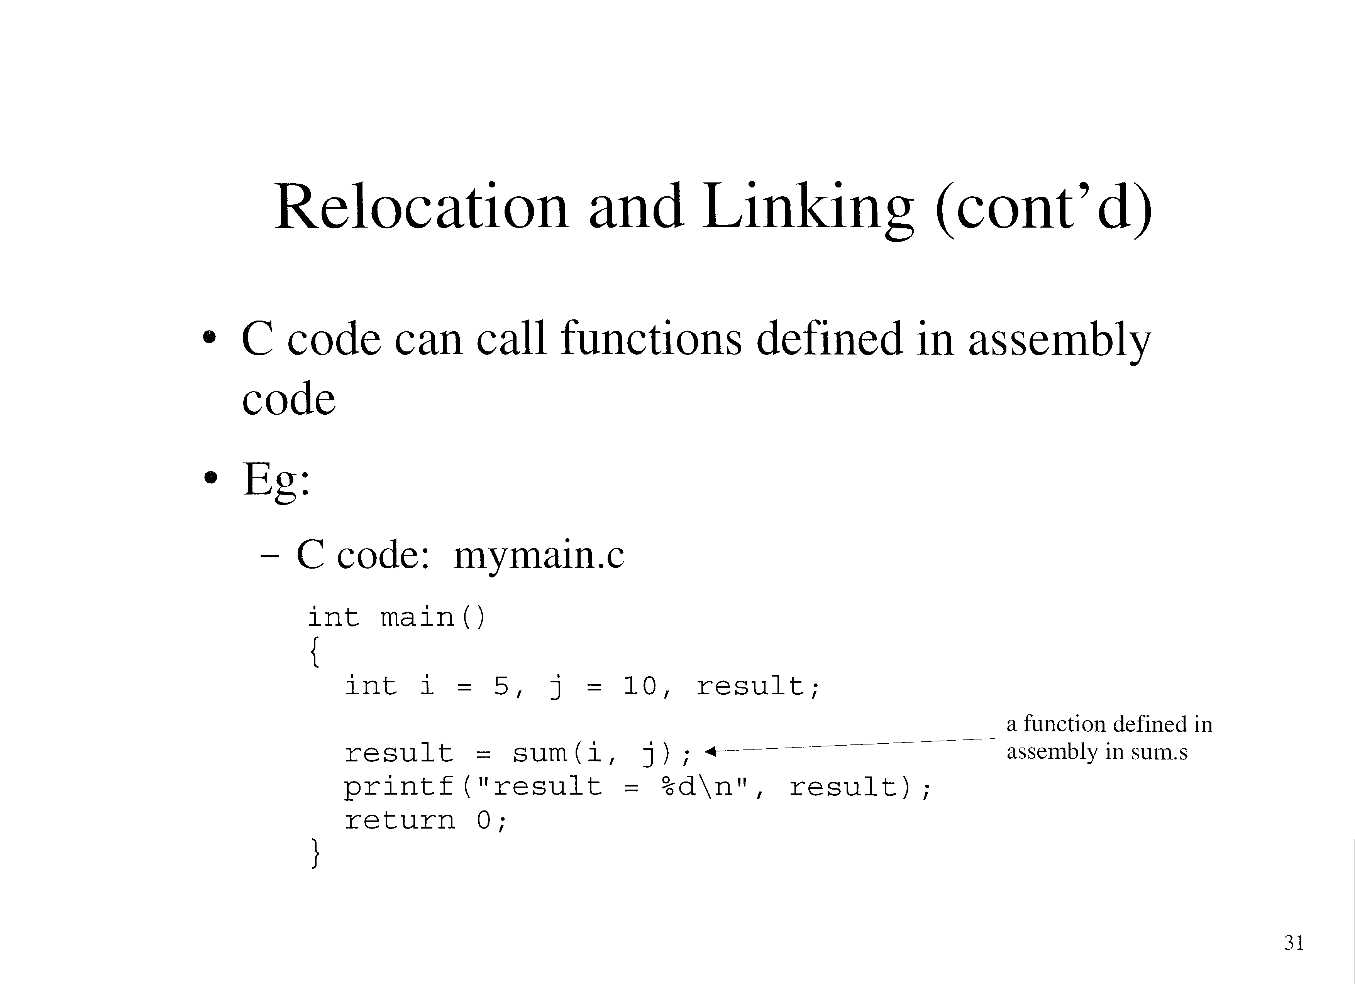

Slide 29
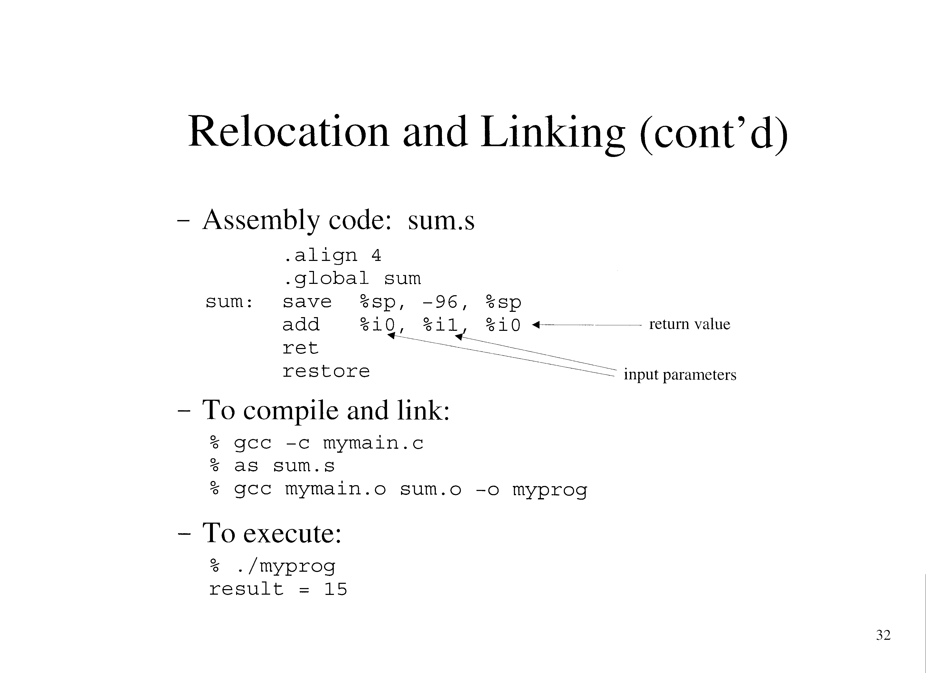

Slide 30
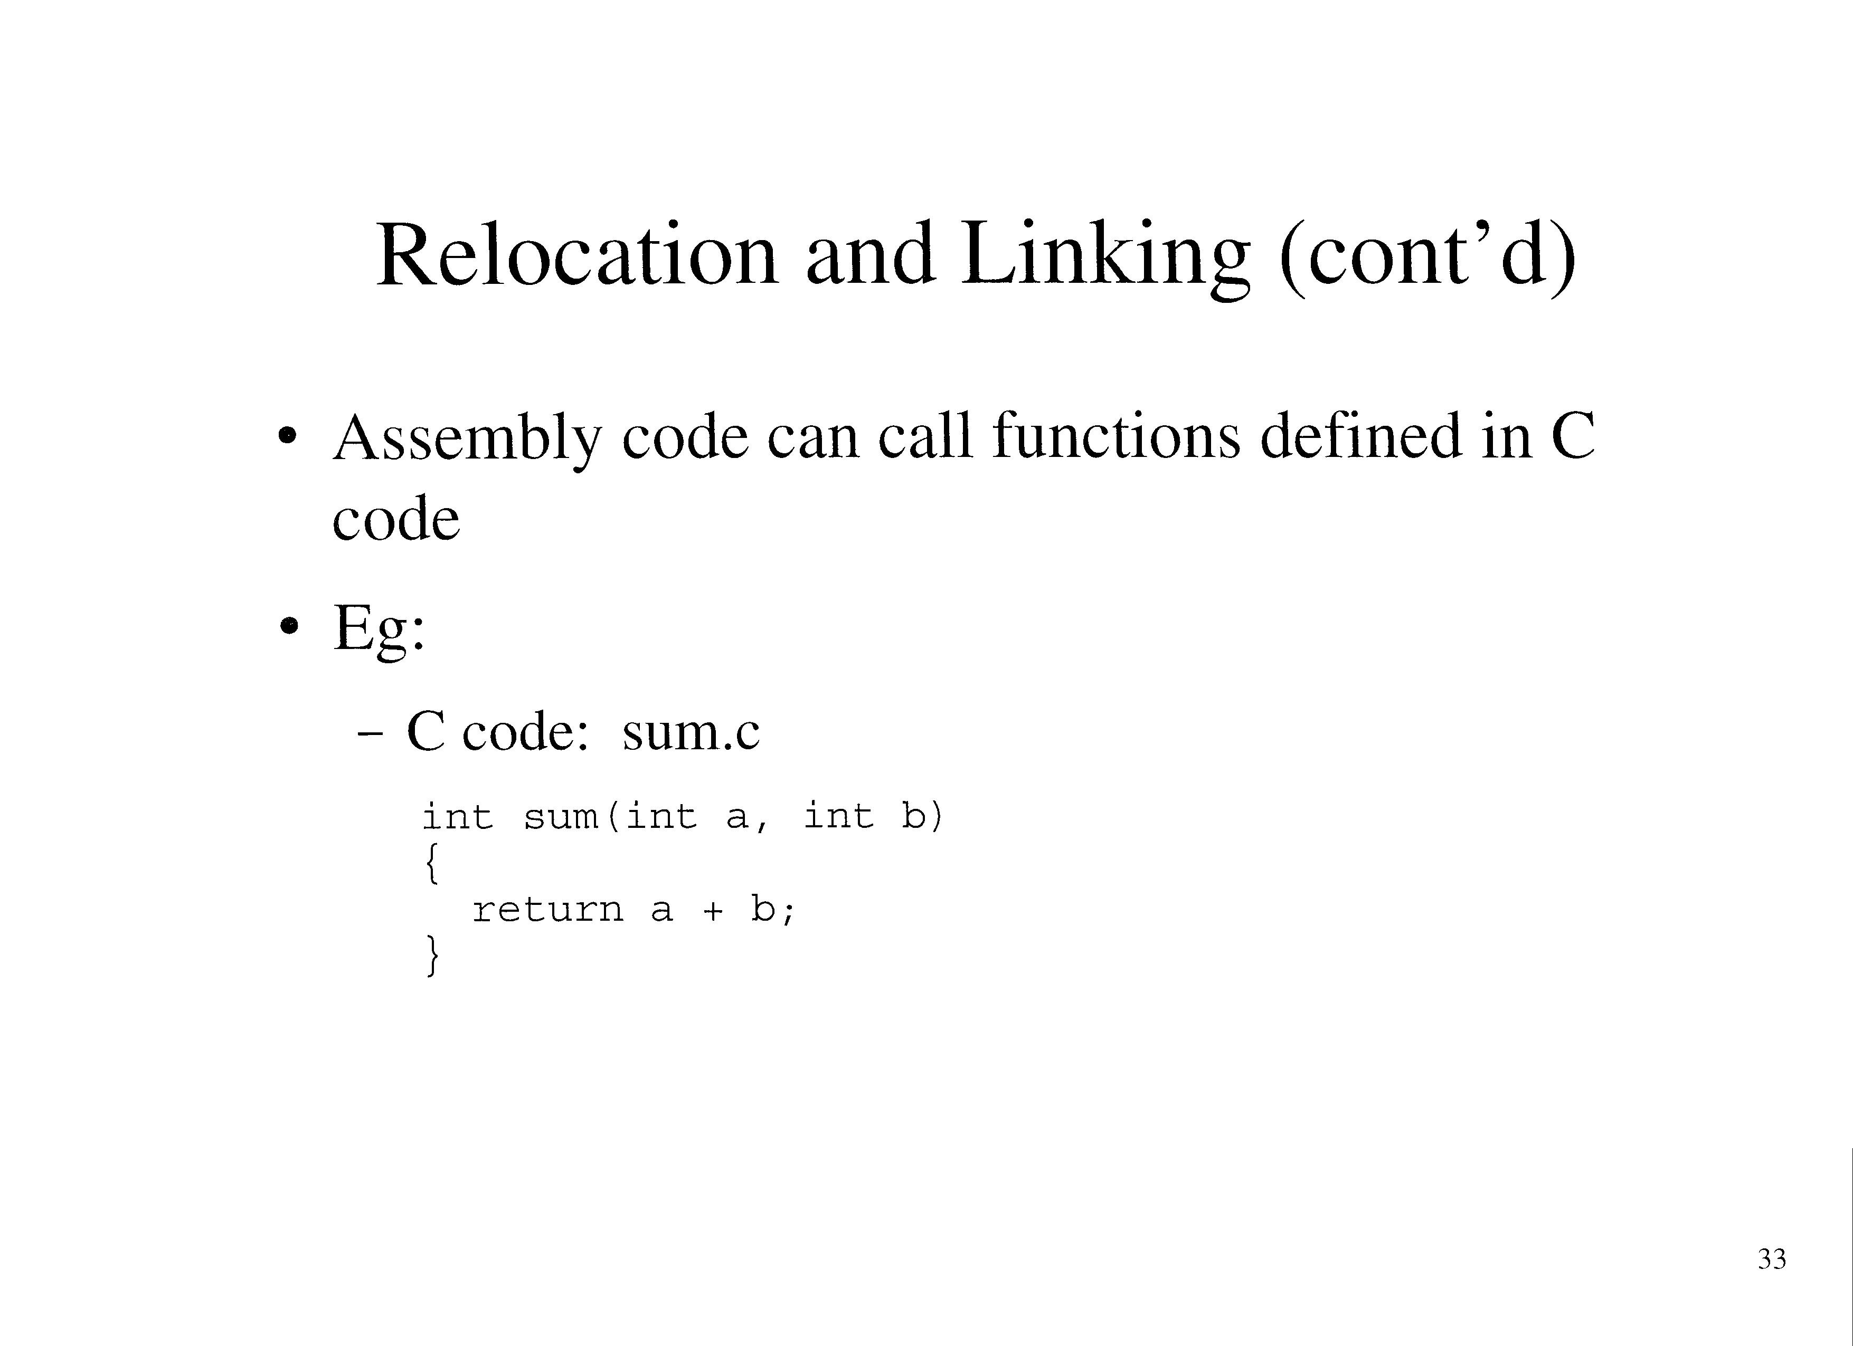

Slide 31
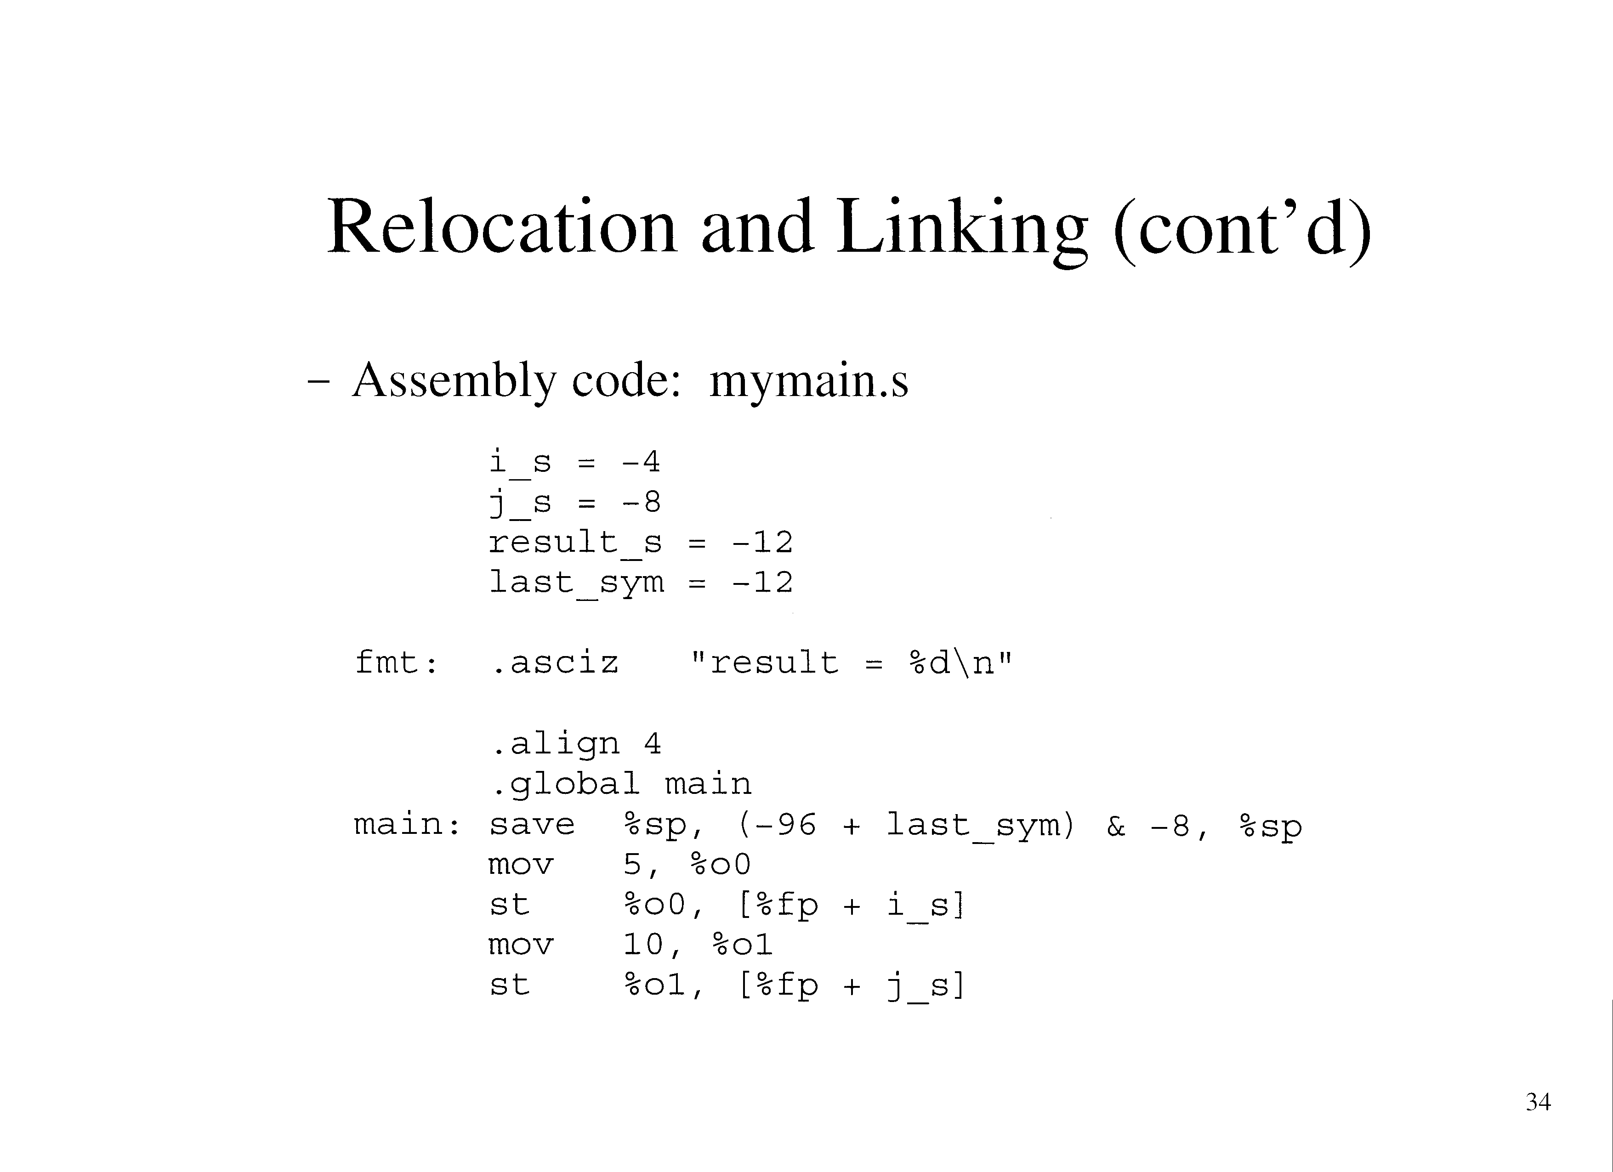

Slide 32
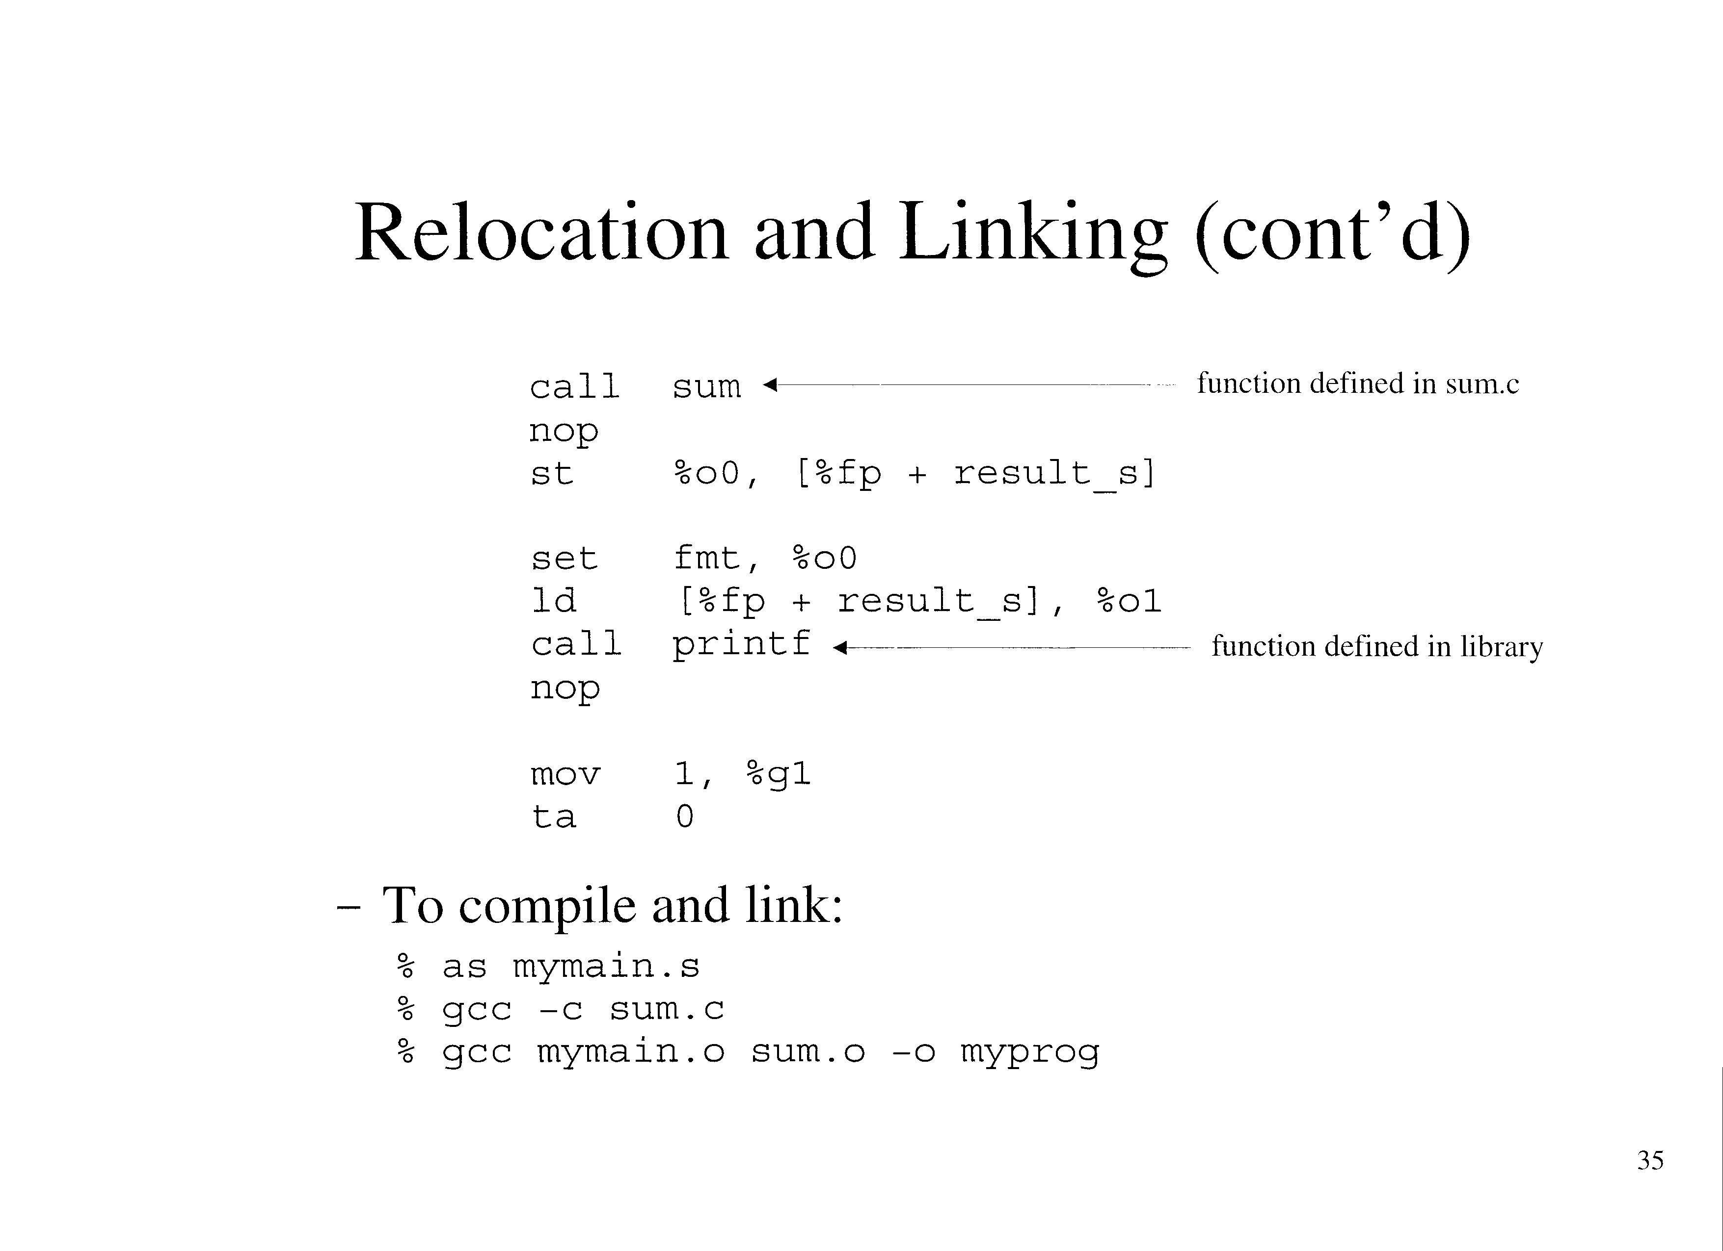

Slide 33
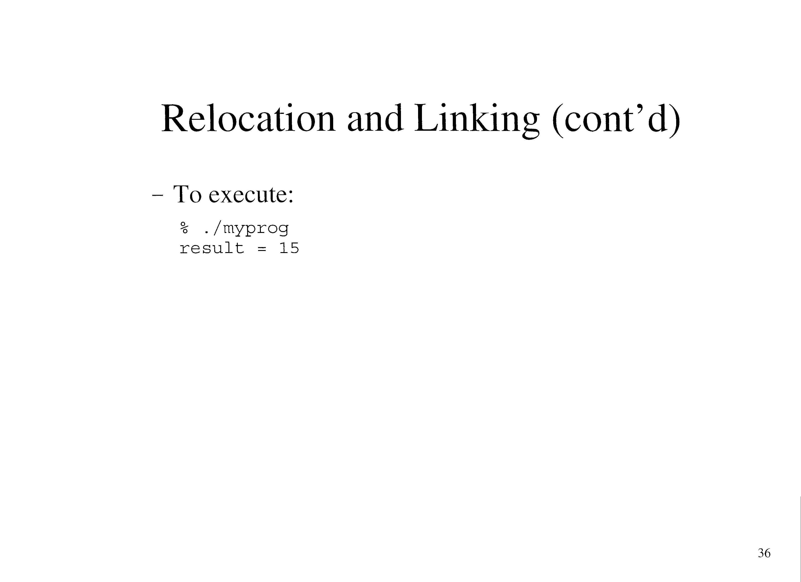

Slide 34
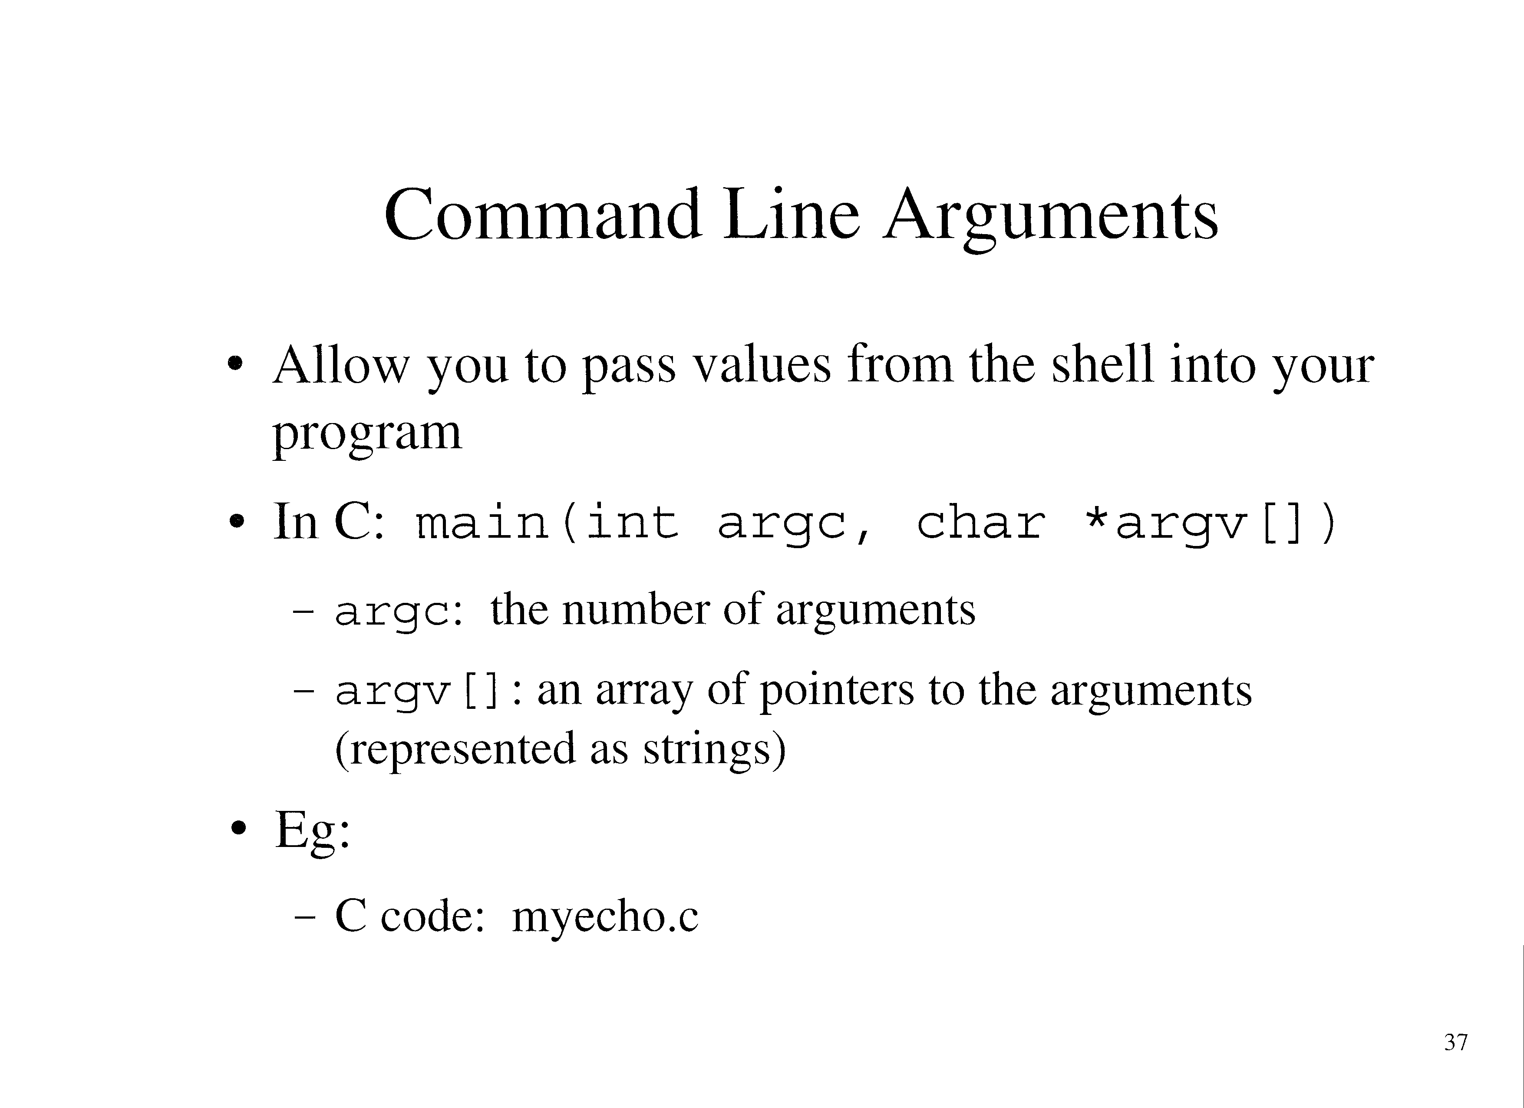

Slide 35
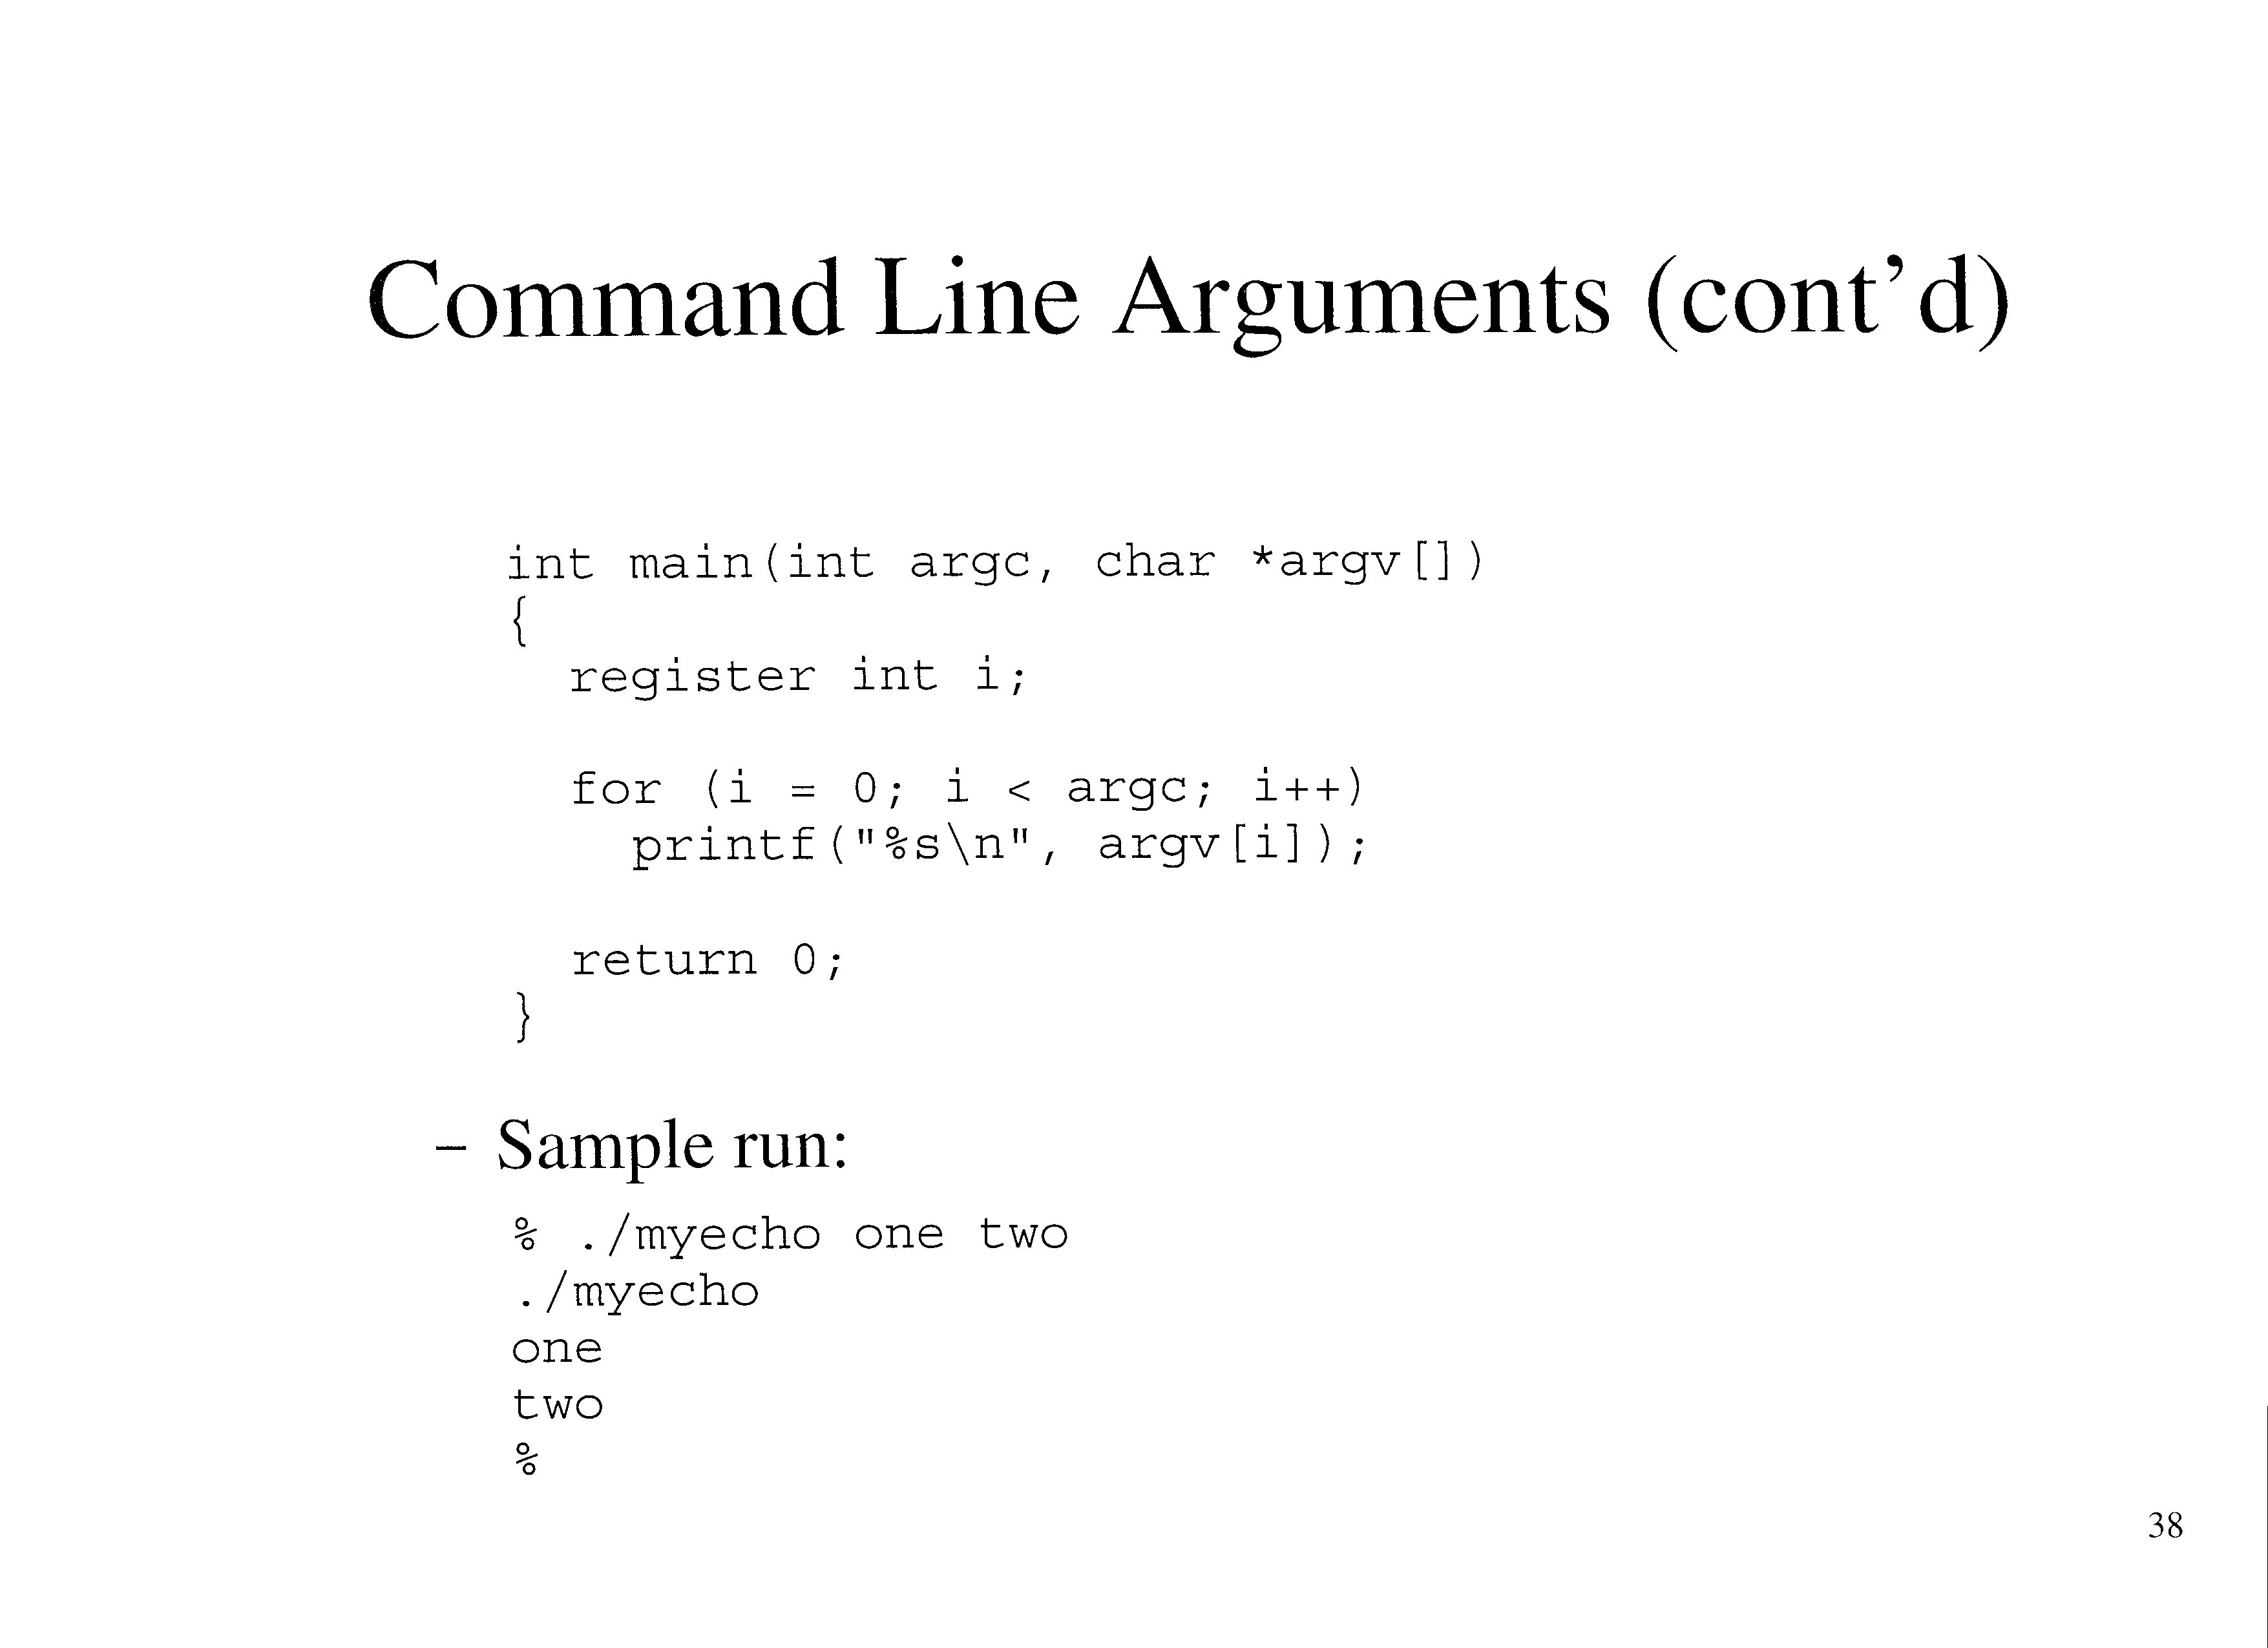

Slide 36
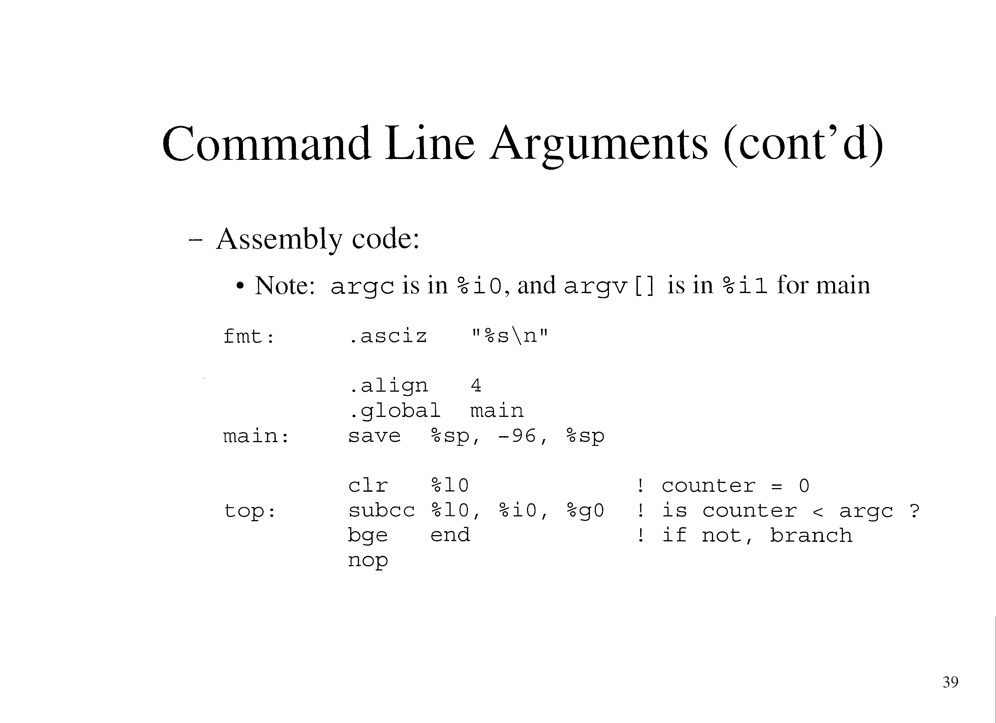

Slide 37
