Slide 1
Floating Point Numbers
Introduction

Slide 2
Introduction
Most modern architectures support floating-point representations for fractional quantities
  Usually implement the ANSI/IEEE standards
Most processors now include floating-point units (FPUs).
  Have instructions to do floating-point arithmetic
    Very quick
  If missing, FPU operation is emulated in software
    Very slow
A floating-point number may only approximate a real value

Slide 3
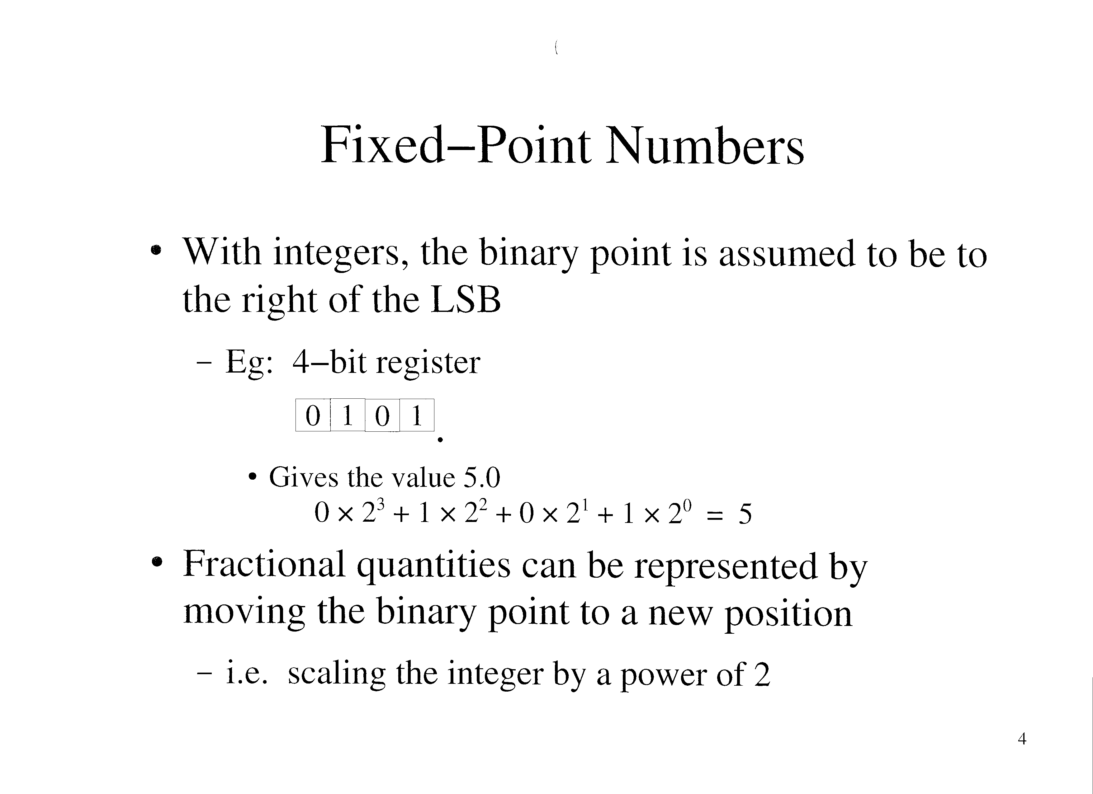

Slide 4
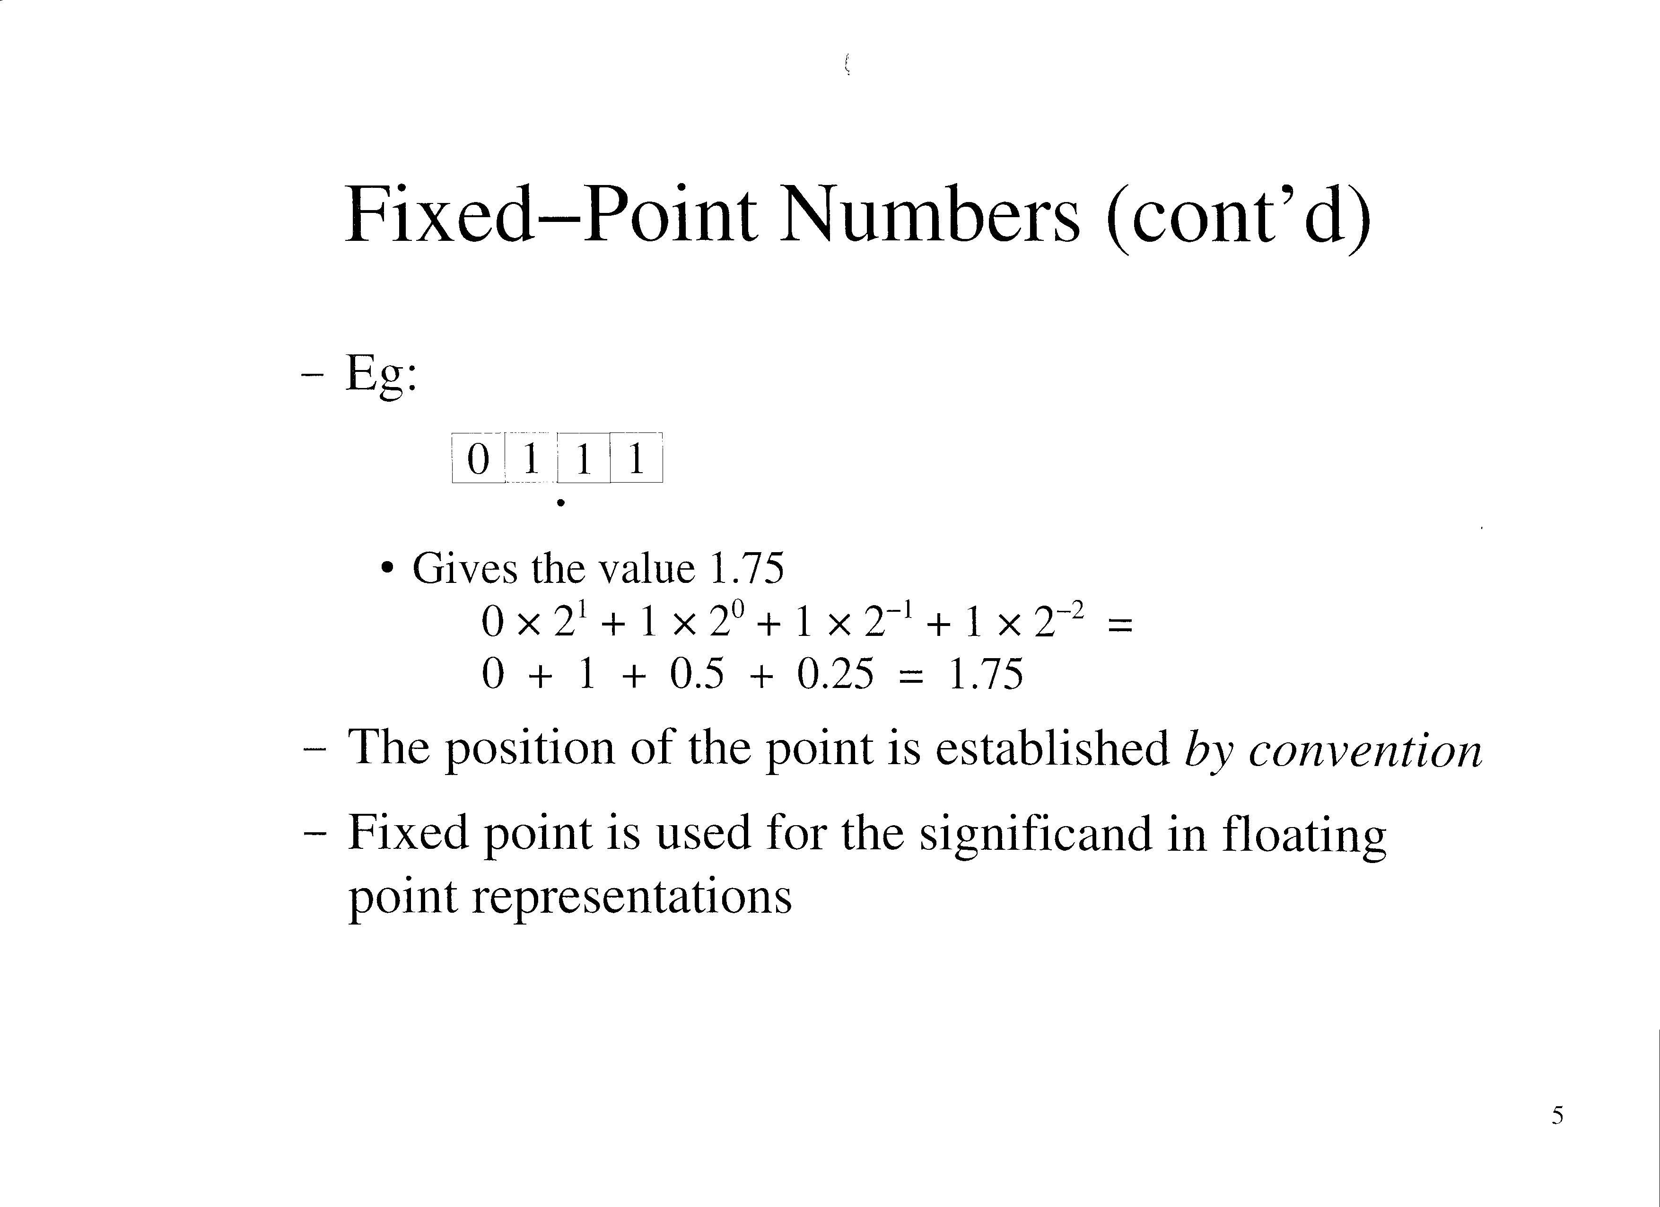

Slide 5
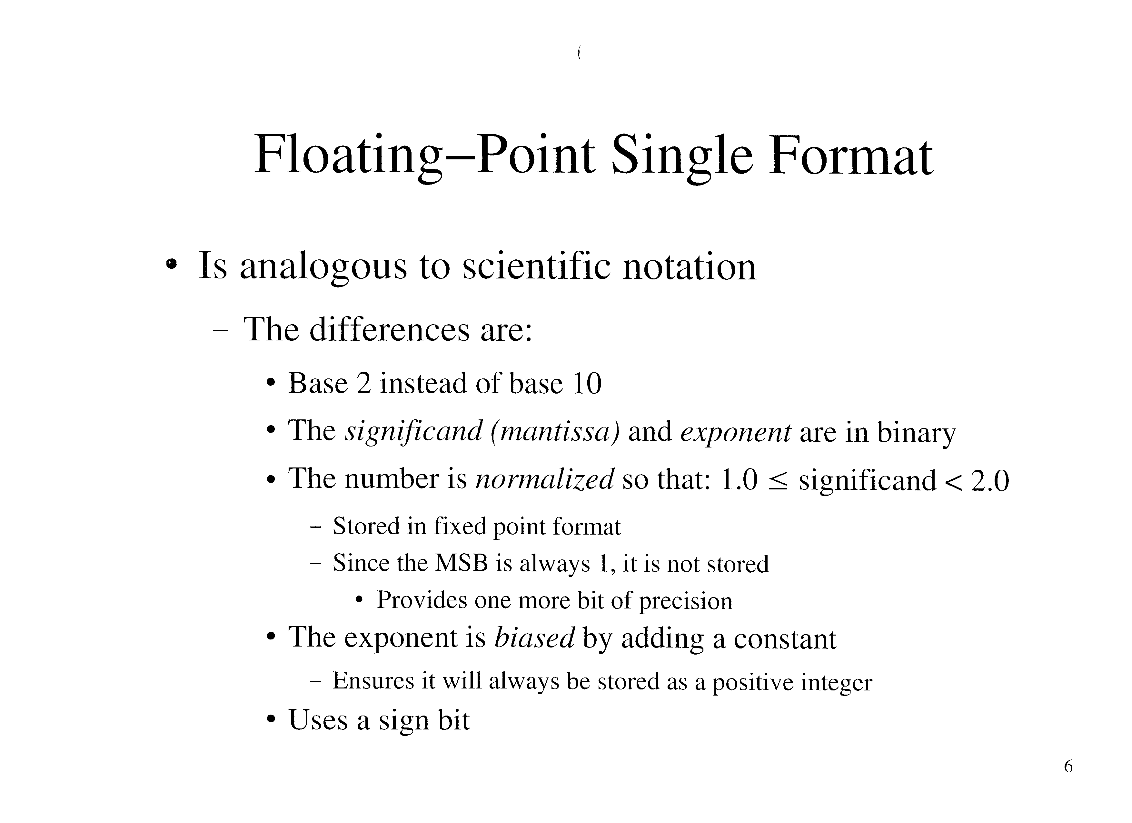

Slide 6
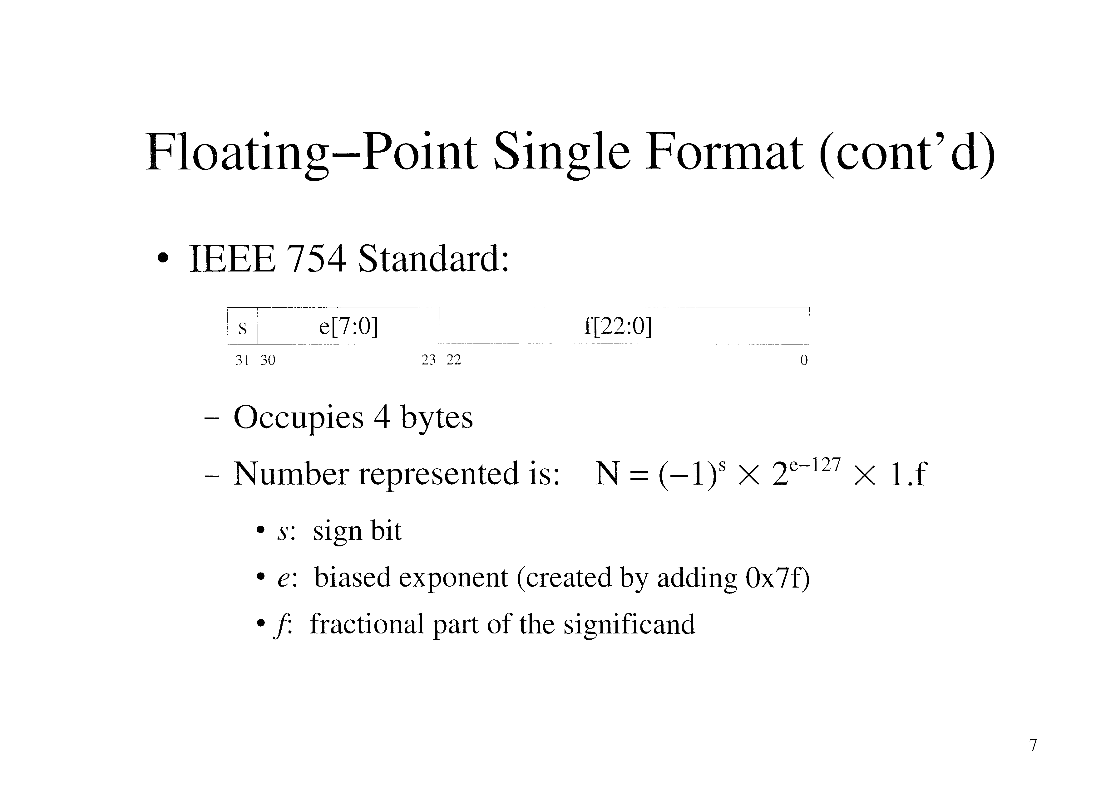

Slide 7
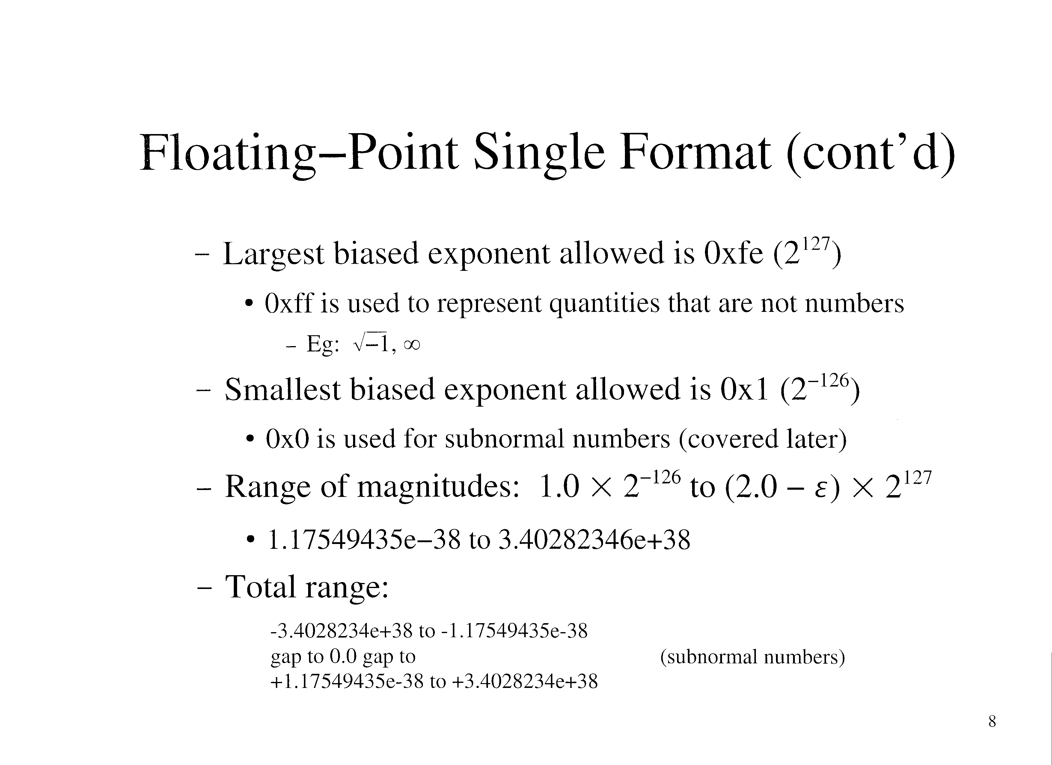

Slide 8
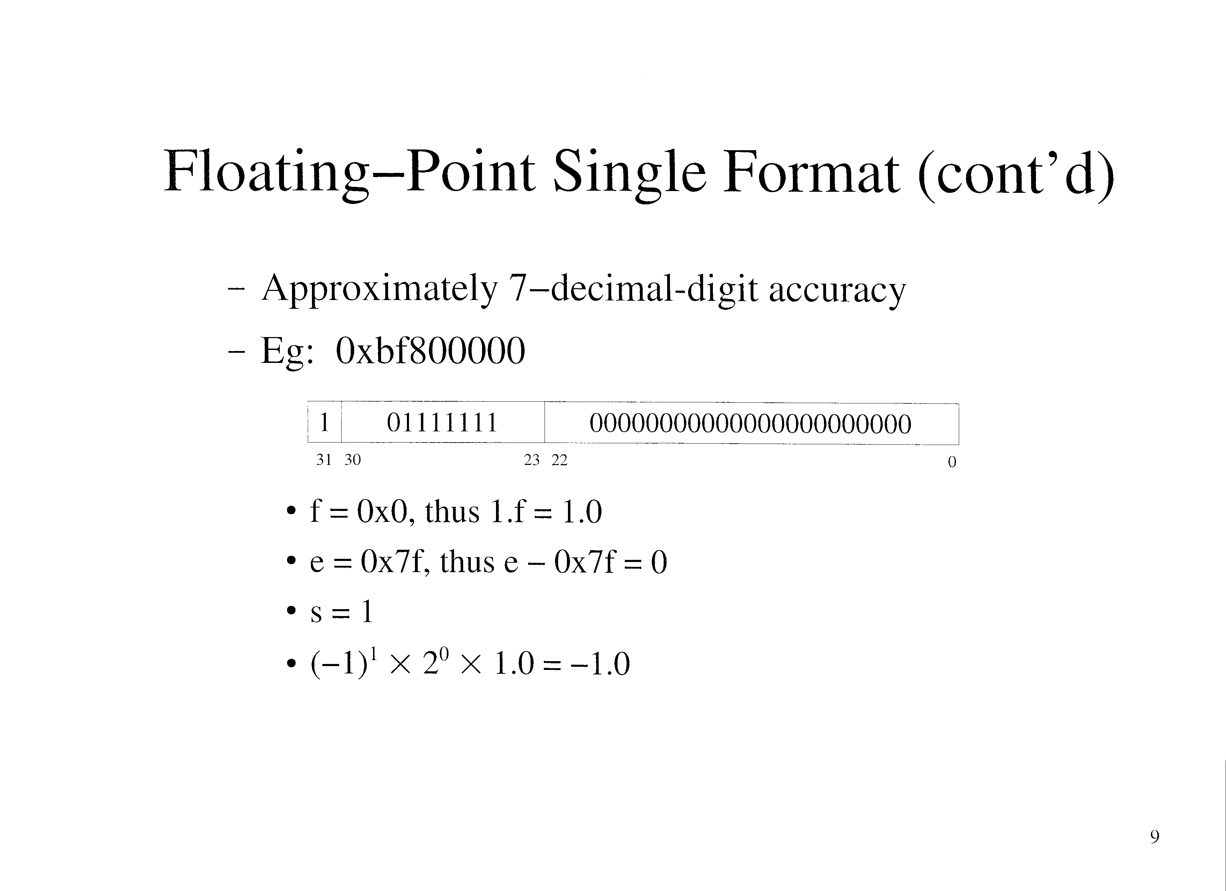

Slide 9
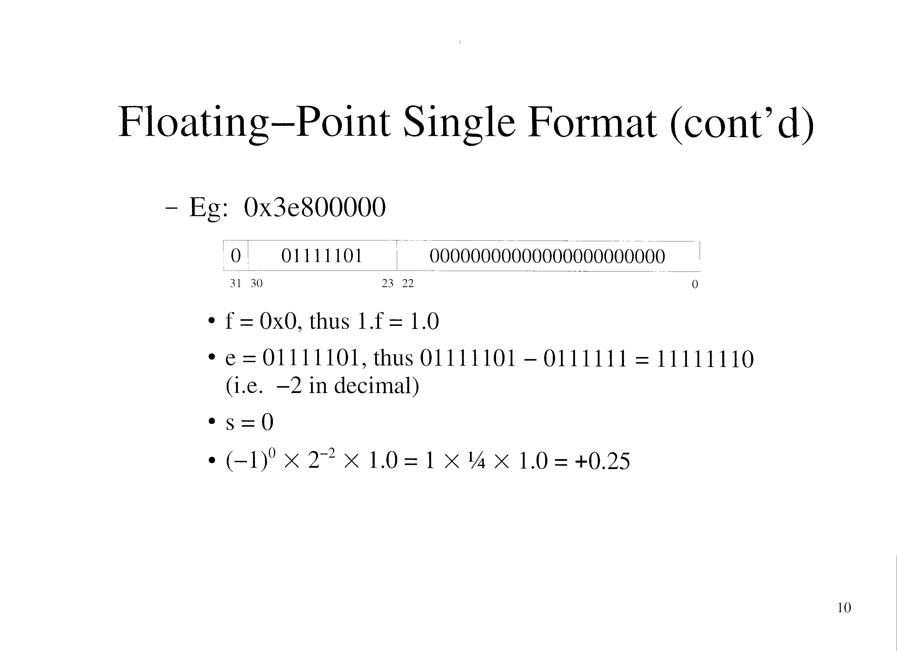

Slide 10
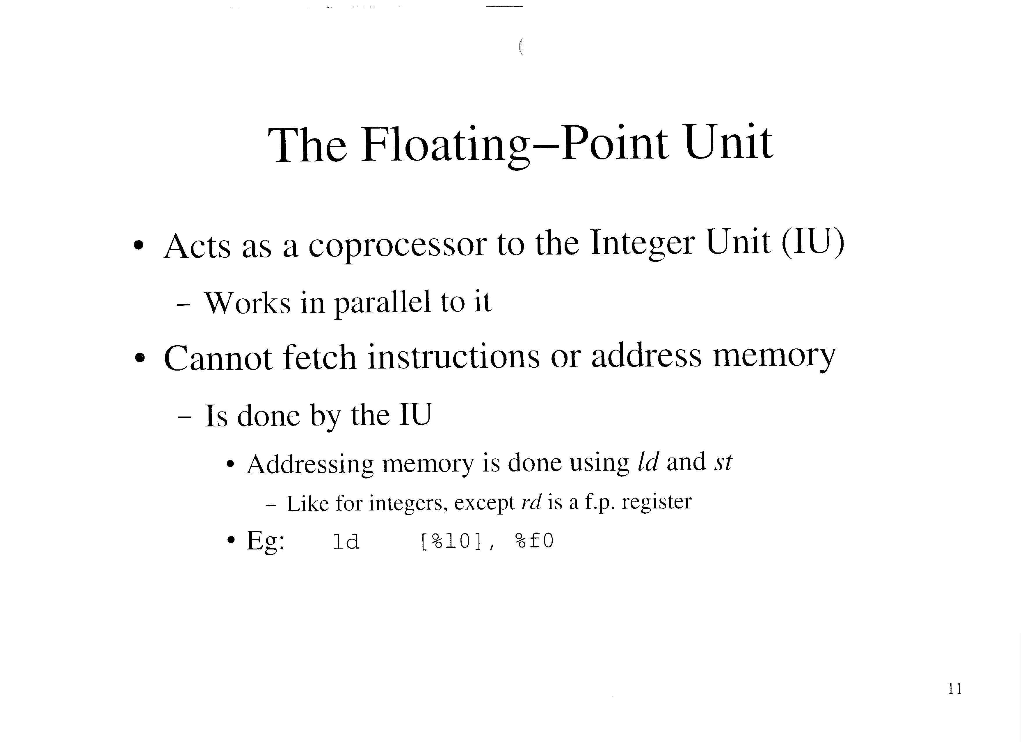

Slide 11
The Floating-Point Unit (cont’d)
Contains 32 32-bit registers
  %f0 to %f31
  Can hold f.p. data or integer data
  Are not part of a register file
    Thus register contents may have to be saved before calling a function

Slide 12
The Floating-Point Unit (cont’d)
Single format arithmetic instructions (text p. 292)
Compare instruction:
  fcmp fs1, fs2
  Sets condition codes in the floating-point state register (FSR):
    Mnemonic Relation
    E fs1 = fs2
    L fs1 < fs2
    G fs1 > fs2
    U unordered
    The U condition indicates that one or both numbers were NaNs (i.e. not a valid f.p. number)

Slide 13
The Floating-Point Unit (cont’d)
Branching instruction (text p. 293):
  Note: cannot follow right after fcmps (insert a nop)
Use the .single pseudo-op to allocate space for a 4-byte float in the text or data segments
  Use 0r to prefix a f.p. constant
  Can specify exponents using E notation
  Eg:
    .section “.data”
    f1_m: single 0r5.0
    f2_m: single 0r-7.3E5
    farray_m: single 0r2.5, 0r3.5, 0r4.5

Slide 14
The Floating-Point Unit (cont’d)
In gdb:
  You print the contents of a f.p. register using p/f
    Eg: p/f $f0
  You examine memory using x/wf
    Eg: x/wf <address of f1_m> shows 5
    x/wx shows the hex representation
      Eg: shows 0x40a00000

Slide 15
The Floating-Point Unit (cont’d)
Eg: Assembly code to divide 7.5 by 2.0
    .section “.data”
    .align 4
    x_m: .single 0r7.5
    y_m: .single 0r2.0
    z_m: .single 0r0.0
    .section “.text”
    .align 4
    .global main
    main: save %sp, -96, %sp
    set x_m, %l0 ! Get a pointer to x
    ld [%l0], %f0 ! Load x into %f0
    set y_m, %l1 ! Get a pointer to y
    ld [%l1], %f1 ! Load y into %f1
    fdivs %f0, %f1, %f2 ! x/y
    set z_m, %l2 ! Get a pointer to z
    st %f2, [%l2] ! Store result into z
    end: nop ! Breakpoint
    ret
    restore

Slide 16
Floating Point NaNs
A Nan (“Not a Number”) represents a quantity that cannot be represented conventionally
NaNs are represented in single format using a biased exponent of 0xff
Infinity
  Positive infinity
    0x7f800000 (Note: the text is wrong)
  Negative infinity
    0xff800000
  Can be compared with conventional numbers using fcmps
  May be used as a valid argument to some functions
    Eg: atan(infinity) returns pi/2
  Results from dividing a number by 0

Slide 17
Floating Point NaNs (cont’d)
Sqrt(-1)
  Is 0x7fffffff
Using a NaN as an operand to most instructions causes an exception (usually a system trap)

Slide 18
Extended Precision Formats
Floating-point double format
  IEEE 754 standard:
    s e[10:0] f[51:32]
    f[31:0]
  Uses 8 bytes
    Use pairs of “adjacent” registers on SPARC
      The first must be evenly-numbered (EG: %f2 and %3 are a set)
  Number represented is M = (-1)^{s} * 2^{e-1023} * 1.f
    s: sign bit
    e: biased exponent (created by adding 1023 or 0x3ff)
    f: fractional part of the significand

Slide 19
Extended Precision Formats (cont’d)
Range of magnitudes: ~2.2E-308 to ~1.8E+308
Approximately 17-decimal-digit accuracy
NaNs are represented using a biased exponent of 0x7ff
When loading or storing doubles, pairs of f.p. registers are used
  The first must an evenly-numbered register
  The second is assumed to be n+1
  Using the ldd or std instructions
  Eg: std %f0, [%o0]
    Stores 4 bytes from %f0, and 4 bytes from %f1

Slide 20
Extended Precision Formats (cont’d)
Arithmetic instructions are on page 301 of the text
There are no double versions of fmov, fnegs, and fabss
  Just use fmov, fnegs, or fabss on the high part, and an fmovs on the low part
    Eg: negate registers %f0-%f1, putting result in %f2-%f3
    fnegs %f0, %f2
    fmov %f1, %f3
Conversion instructions are on page 302 of the text

Slide 21
Extended Precision Formats (cont’d)
Use the .double pseudo-op to allocate space for an 8-byte float in data or text segments
  Uses the same format as .single
  Eg:
    .section “.data”
    .align 8
    x_m: .double 0r5.33E-18

Slide 22
Extended Precision Formats (cont’d)
In gdb:
  You cannot view pairs of registers as a double
    You must examine the registers separately in hex, and reconstruct the double (very awkward)
  You can examine memory using x/gf or x/gx
  Eg: x/gf <address of x_m> shows
    5.3300000000001e^(-18)

Slide 23
Extended Precision Formats (cont’d)
Eg: find the square root of 21.33
    .section “.data”
    .align 8
    x_m: .double 0r21.33
    y_m: .double 0r0.0
    .section “.text”
    .align 4
    .global main
    main: save %sp, -96, %sp
    set x_m, %l0 ! Get pointer to x
    ldd [%l0], %f0 ! Load x into %f0 & %f1
    fsqrtd %f0, %f2 ! Sqrt of x
    set y_m, %l1 ! Get a pointer to y
    std %f2, [%l1] ! Store result into y
    ret
    restore

Slide 24
Extended Precision Formats (cont’d)
Uses 16 bytes (text p. 309)
15-bit biased exponent, 112-bit significand
  Huge range, high precision
Quad floats must use 4 registers
  Specified with %fn, where n is evenly divisible by 4
  Eg: %f4 actually uses registers %f4, %f5, %f6, and %f7
Use instructions ending in q
  Eg: faddq
  Note: instructions may be emulated in software

Slide 25
Function Calls
Floats and doubles are passed to functions using output registers (%o0 - %o5)
  You cannot move data directly into an output register
    Must move it through a temporary variable in memory
  A single float will use one output register
  A double float will use pair of adjacent output registers
A single is returned in %f0
A double is returned in %f0 and %f1

Slide 26
Function Calls (cont’d)
Inside a function, you must move the data in input registers (%i0 - %i5) to f.p. registers
  Cannot be done directly
    Must be done through a temporary variable in memory
SPARC convention: a function is free to use any f.p. register
  Means that calling code should save any f.p. register it uses before the call, and reword it afterword

Slide 27
Function Calls (cont’d)
Eg: Assembly Code:
    .align 4
    .global subtract
    subtract:
    save %sp, (-92 – 8) & -8, %sp ! Make room for a temporary variable
    std %i0, [%fp – 8] ! Move i0/i1 into f2/f3
    ldd [%fp – 8], %f2
    std %i2, [%fp – 8] ! Move i2/i3 into f4/f5
    ldd [%fp – 8], %f4
    fsubd %f2, %f4, %f0 ! Arg1 – arg2
    ret
    restore

Slide 28
Function Calls (cont’d)
Can be called from C code:
    double subtract( double a, double b); // function prototype
    int main()
    {
    double c;
    c = subtract(5.5, 1.25);
    printf(“5.5 – 1.25 = %f\n”, c);
    return 0;
    }

Slide 29
Function Calls (cont’d)
Or from assembly code:
    .section “.data”
    fmt: .asciz “5.5 – 1.25 = %f\n”
    .align 8
    a_m: .double 0r5.5
    b_m: .double 0r1.25
    .section “.text”
    .align 4
    .global main
    main: save %sp, (-92 – 8) & -8, %sp ! Make room for a temp double
    set a_m, %l0 ! Arg1 (double in o0/o1)
    ldd [%l0], %o0

Slide 30
Function Calls (cont’d)
    set b_m, %l0 ! Arg2 (double in o2/o3
    ldd [%l0], %o2
    call subtract ! Result in f0/f1
    nop
    std %f0, [%fp – 8] ! Put f0/f1 onto stack
    set fmt, %o0 ! arg1
    ld [%fp – 8], %o1 ! High part of arg2
    ld [%fp – 4], %o2 ! Low part of arg2
    call printf
    nop
    ret
    restore

