Slide 1
Firewall Monitor Instructions
2026-07-03 FWM Client v02 and Viewer v02

Slide 2
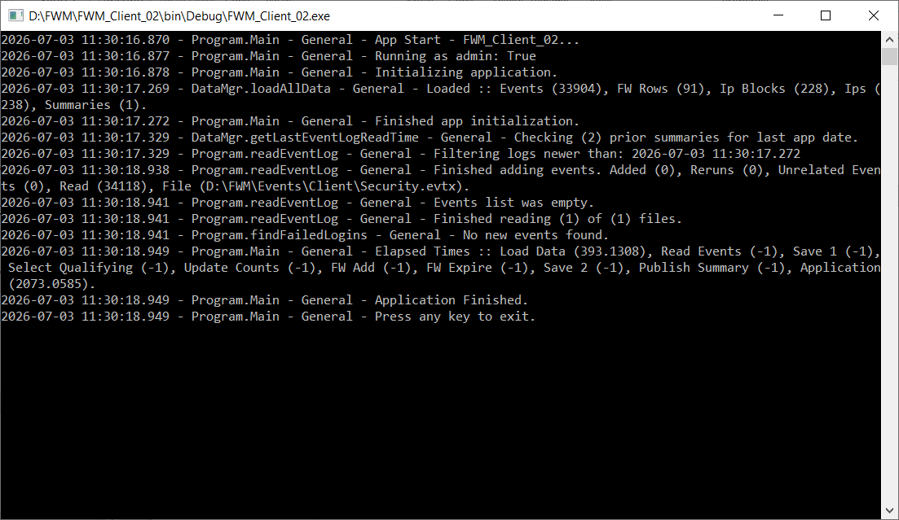
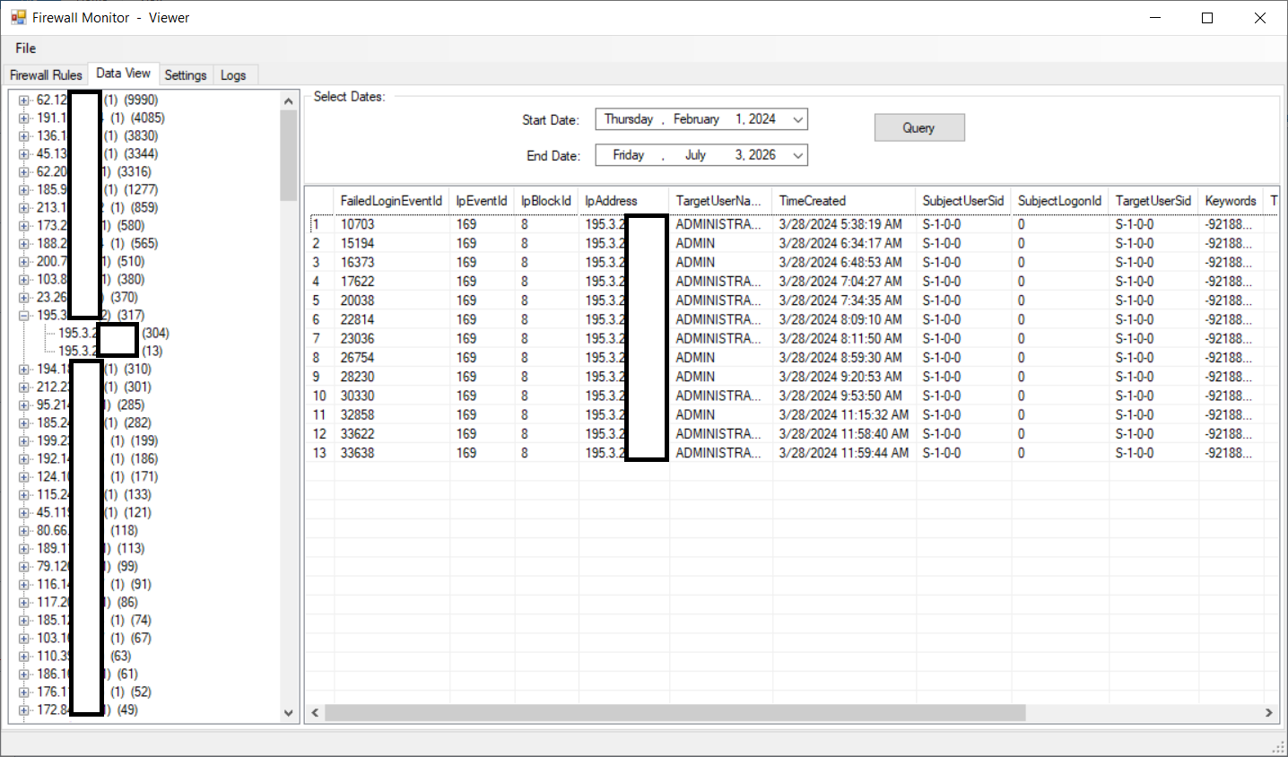
Getting Started
Firewall Monitor (FWM) comes in two components:
The console app, called the “client”, is meant to be run manually, or automated to run in the background.
The “viewer”, is a standard Windows app, that allows viewing and interacting with data and rules generated by the console.

Slide 3
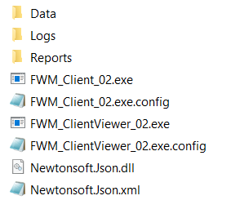
Installation
FWM is portable, meaning there is no actual install. As a consequence, the location of files becomes important during setup. The simplest thing to do, is to drop the preconfigured files and folders in a directory together, and not worry about it.
The essential layout of the base directory (when using a custom location) looks like this:
BaseDirectory
Data
Logs
Client
Viewer
Reports
Client
Viewer
The base directory, preconfigured at download:

Slide 4
How The App Works
The console wakes up when launched, reads in EventLogs (these can either be from the system folder, or offline copies being reviewed for historical purposes), and records any new failed login events since last run.
Then, the console reviews existing data, and decides whether any known IPs qualify for evasive action via the Windows Firewall. Firewall management is a separate process, and can be turned off / on.
For experimenting, running the console by hand is fine. For actively monitoring a system, the console is meant to be launched as a Scheduled Task. It is important for real monitoring, to ensure the console is launched often-enough to capture all events before the EventLog rolls over. Under moderate attack, this can be as-short-as a couple-hours.
The Viewer handles configuring the console (more on this later), allows user management of firewall rules created by the console, and filters the records generated, for viewing a date range by ip or ip block.

Slide 5
First Run
Run the Viewer app first. Because the viewer handles configuring settings for the console app, some of them important, open the viewer, select the Settings tab, and configure first.
On first launch, the viewer will create an appSettings.bin file in the Data folder, that both apps will use to communicate configuration settings.
After configuring within the viewer, close the viewer, and run the console app. The first time takes the longest, but should finish within a few minutes. By the time the console finishes running, the Data folder will be filled with files pertaining to records – specifically, failed logins.
Open the viewer again, open the Data View tab, and click the Query button. The default date range, is last 30-days until now.
On the left, you will see a list of IP blocks, with specific IPs nested below them. The list will be empty, if no failed logins were found in the EventLog record. Click a block, to see stats for its IPs, or click an IP, to see its individual events.
If you had “Manage Firewall” enabled during configuration, go back to the Firewall Rules tab, to see any rules that may have been created. These represent IPs that are now blocked until expiry.

Slide 6
Configuring
If you want to run out-of-the-box, with minimal configuration, drop the original download files together, open the viewer, and click on the Settings tab.
EventFolder – Ensure this matches the location of a Security.evtx you want to review. Include a trailing slash.
Manage Firewall – Set to False, until you are comfortable with counts and what you see. Base your thresholds appropriately.
If you want to store files separate from the exe folder, create a new folder with the same directory structure. See “Installation” section for details.
BaseDirectory – Point to the path of new folder, including a trailing slash.
If you want to manage the Firewall:
Manage Firewall – Set to True. When the console next-runs, it will begin blocking offending IPs.
Failures To Block After – Minimum number of login failures within time-range, to qualify for blocking.
Firewall Minutes To Review – Set how-long is relevant for taking action, in minutes.
Expire After Days – Sets how long a firewall rule should stay active. The console must run, to expire rules automatically.
For other settings, see in-app descriptions and tips on how-to-use.

Slide 7
Requirements
Both the console and viewer require Administrator privilege when running. The console app reads system files and administers firewall settings, the viewer allows changing firewall settings.
This means running the console app in automated fashion, requires “Run with highest privilege” to be enabled if using a Scheduled Task, and may also require the exe file to be set to always run as administrator in properties of the exe. Depending upon how the system is managed, it may also be required to permit the exe to run as administrator for all users (also in the properties of the exe). [ TODO – Document This ]

Slide 8
Unfinished Software Disclaimer
This software is an unfinished work-in-progress. There is no warranty expressed or implied, no fitness guaranteed, and no liability assumed. Use at-own-risk.
Some important features are missing. There is no aging of data, it simply collects forever. The safest and surest method of curing size, is to delete all datafiles (except for appSettings).
Data size has not been an issue over modest timespans, but exemplifies a larger long-term issue of growing histories.
Counts are limited, and at-least one visible date can be inaccurate (the Deactivated time shown on the Firewall Rules tab, shows a non-date when not set).
Software is not multithreaded yet. Expect to wait if a large process is launched. This still needs doing.
There is no paging of data, if an IP has 10,000 failed login events, viewing that IP will present all 10,000 records, may take several seconds to load, and may be sluggish to scroll. There are no current provisions, for breaking a large data selection down-into regularly-sized chunks.
There is no current option to export data collected. This should be a no brainer, along with exporting a query, but does not exist.

