Slide 1
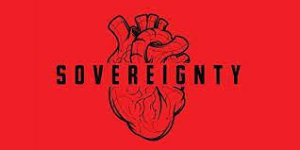
What is sovereignty?
Nature of sovereignty
Dimensions of sovereignty
4. Characteristics of sovereignty

Slide 2
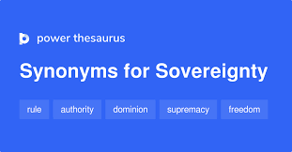

Slide 3
What is sovereignty
Sovereignty is the most important constituent element of a modern state. The concept of sovereignty has been called the very basis of modern political science. It is this concept which distinguishes a state from other institutions, and places a state over and every institution or association.
Sovereignty denotes the supreme power of the state over citizens and all other associations, institutions and organizations in a state.
It is a term about which there exist confusion and contradiction of thought. In fact, the concept has been changing with the transformation of social, economic and intellectual forces.
Sovereignty is a concept of modern political theory. The Greeks had no idea of this term. We may take note of the fact that Aristotle used the term ‘supreme power’ of the state in different senses. During the middle ages, the jurists, the theologians and other writers used terms like summa potestas (highest power of the state) or plenitudo potestas ( supreme authority of the state) in a sense different from what we mean now by the term sovereignty.

Slide 4
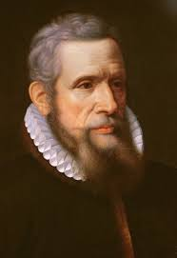
The 16th century French political scientist and philosopher, Jean Bodin (1530-96) was the father of the modern theory of sovereignty. Published in Paris in 1576, his book titled ‘De La Republique’, contained the first systematic presentation of his theory. Sovereignty as defined by Jean Bodin, ‘is the supreme power of the state over citizens and subjects, unrestrained by law’. As per Bodin, sovereignty was identified with royal absolutism. The earlier writers like Jean Bodin, Thomas Hobbes, John Locke, Jean Jacques Rousseau and modern political scientists like Jellinek, Duguit, Kelsen and Laski interpreted sovereignty in varying terms. We intend to cite three of them.

Slide 5
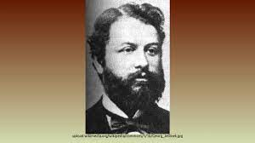
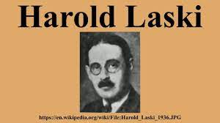
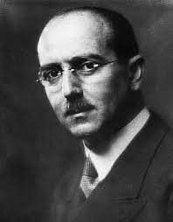
Jellinek, “Sovereignty is that characteristic of the state by virtue of which it cannot be legally bound except by its own will or limited by any other power than itself”.
Laski, “The sovereignty of the state issues orders to all men and all associations within its area; it receives order from one of them. It’s will is subject to no legal limitation of any kind. What is proposed is rightly by mere announcement of intention”.
Kelsen, “In its original and only specific meaning, sovereignty means supreme authority”.

Slide 6
2. Nature of Sovereignty
Two views explain the nature of sovereignty. They are (1) The traditional view and (2) the pluralist view.
(1) The traditional view: It holds that the state is an absolute and morally supreme organization endowed with coercive power for assuring the realization of the ideal of peace and security. Hence, the state can legitimately claim total obedience of man to its authority issuing in the forms of law. It may punish those who violate its commands being its will in the concrete form. The traditional view is also called ‘monism’ because it regards sovereignty as absolute, unlimited and indivisible.
(2) The pluralist view: Opposed to monism, the pluralists seek to justify the limited and divisible nature of sovereignty. They attack the doctrine of an absolute state. They contend that there are other essential associations on a parity with the state.

Slide 7
Man’s social nature as they maintain finds expression in numerous groupings, pursuing various ends – religious, social, economic, professional, political : no one of the groups is superior, morally or practically to the others.
Dimensions of sovereignty:
There are two dimensions of sovereignty. They are internal dimension and external dimension.
Internal dimension: In the internal sphere, the ideal of sovereignty means that the state has highest authority within the areas under its control or jurisdiction. All people and their associations are under the control of the state. The state has the power to make and enforce a law throughout its territory. State is the final power to command and enforce obedience. Sate is subject to no legal limitation.

Slide 8
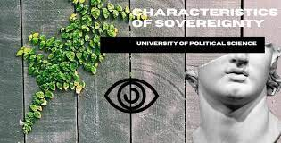
External dimension: In external sphere, the idea of sovereignty implies freedom of state from any alien subjugation. A dependent people cannot be called a state. However, it in pursuance of some international treaty or agreement, a state accepts limitations on its freedom of action, it does not amount to the loss or destruction of its sovereignty. For example, the association of a sovereign state with the Commonwealth of Nations or with the UN. In fact, the external aspect of sovereignty is an extension of its internal aspect in the international sphere.
The Characteristics of sovereignty: According to Professor Garner, the following are the characteristics of sovereignty:
1.Permanence
2. Exclusiveness
3. All comprehensiveness
4. Inalienability
5. Unity
6. Imprescriptibility
7. Indivisibility
8. Absoluteness
9. Originality

Slide 9
1. Permanence : Permanence is the chief characteristic of sovereignty. Sovereignty lasts as long as an independent state lasts. The death of the king, the overthrow of the government and the abdication of power does not lead to the destruction of sovereignty. “Sovereignty does not cease with the death or temporary dispossession of a particular bearer, or the reorganization of the state but shifts immediately to a new bearer, as the center of gravity shifts from one part of physical body to another when it undergoes external change”.
2. Exclusiveness: Exclusiveness means that there can not be two sovereigns in one independent state. If two sovereigns exist in a state, the unity of the state will be destroyed. There cannot exist another sovereign state within the existing sovereign state.

Slide 10
3. All comprehensiveness: The state is all comprehensive and the sovereign power is universally applicable. Every individual and every association of individuals is subject to the sovereignty of state. No association or groups of individuals, however rich or powerful it may be, can resist or disobey the sovereign authority. Sovereignty makes no exception and grants no exemption to anyone. It grants exemption only in case of foreign embassies and diplomatic representatives of foreign countries on a reciprocal basis. This does not in any restrict the sovereignty of the state in the legal sense. The state can abolish and withdraw the diplomatic privileges granted to the foreigners.

Slide 11
4.Inalienability : Inalienability is another characteristic of sovereignty. Sovereignty is inalienable. By inalienability we mean that the state cannot part with its sovereignty. Sovereignty is the life and soul of the state and it cannot be alienated without destroying the state itself.
5. Unity: Unity is the very spirit of sovereignty. The sovereign state is united just as we are united.
6. Imprescriptibility: By imprescriptibility we mean that if the sovereign state does not exercise its sovereignty for a certain period of time, it does not lead o the destruction of sovereignty. It lasts as long as the state lasts.

Slide 12
7. Indivisibility: Indivisibility is the life blood of sovereignty. Sovereignty cannot be divided. Calhoun, an American political scientist remarks, “Sovereignty is an entire thing; to divide it is to destroy it. It is the supreme power in a state and we might just well divide it to destroy it. It is the supreme power in a state ad we might just well speak of half square or half a triangle as half of sovereignty”. Gettel has also very aptly remarked in this regard. “If sovereignty is not absolute, no state exists. If sovereignty is divided, more than one state exists”.
8. Absoluteness: Sovereignty is absolute and unlimited. The sovereign is entitled to do whatever he likes. Sovereignty is subject to none.
9. Originality: By originality we mean that the sovereign wields power by virtue of his own right and not by virtue of anybody’s mercy.

Slide 13
