Slide 1























Overview
Latent TB infection/recovered
Routine healthcare
MDU screening
$$U$$
$$L$$
$$I$$
(Re-)Infection
$$I_{A}$$
$I_{A}$, $I_{S}$, $I_{E}$
$$T$$
$$L_{F}$$
Primary
Progression
Infection
Self clearance
Symptom
onset
$$L$$
stabilisation
$$L_{S}$$
Reactivation
$$I_{S}$$
Door-to-door screening
Progression
Self cure
$$R$$
Treatment
defaults
Initial
care-seeking
$I_{S}$, $I_{E}$
$$T$$
$$I$$
$$R_{D}$$
Relapse, high risk
$$I_{E}$$
Care-seeking
FN
Reinfection
completion
$$T$$
TP
Vulnerability-led screening
Relapse
$$R_{C}$$
low risk
Treatment
stabilisation
$$T$$
$I_{A}$, $I_{S}$, $I_{E}$
$$T$$
$$R$$
$$R_{S}$$
stabilised risk
Repeat
care-seeking

Slide 2
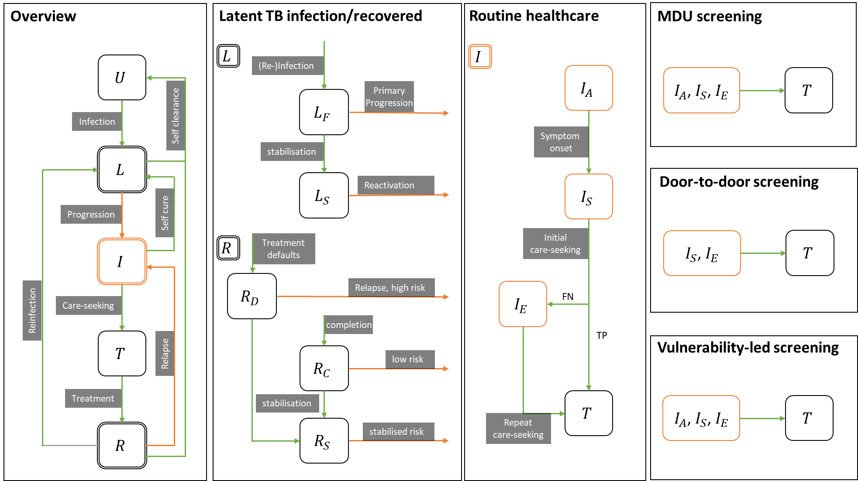

Slide 3
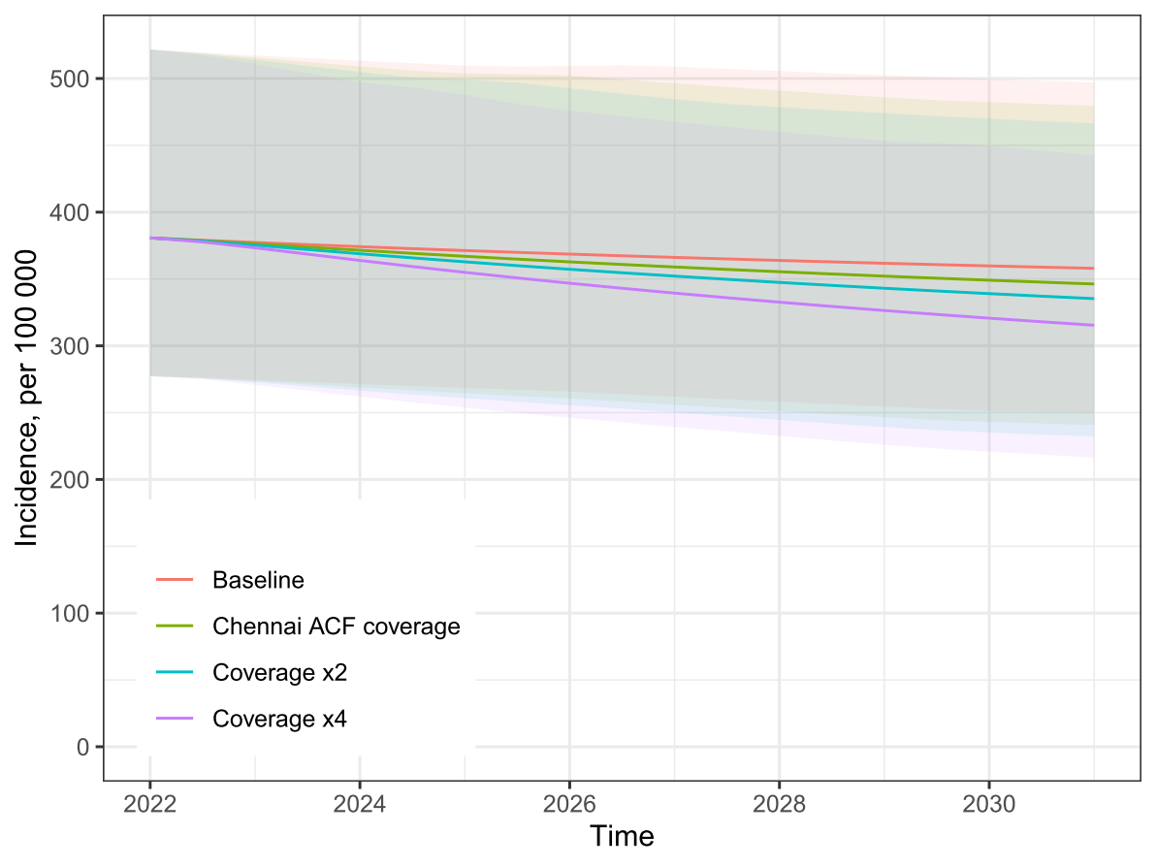
Figure 2

Slide 4
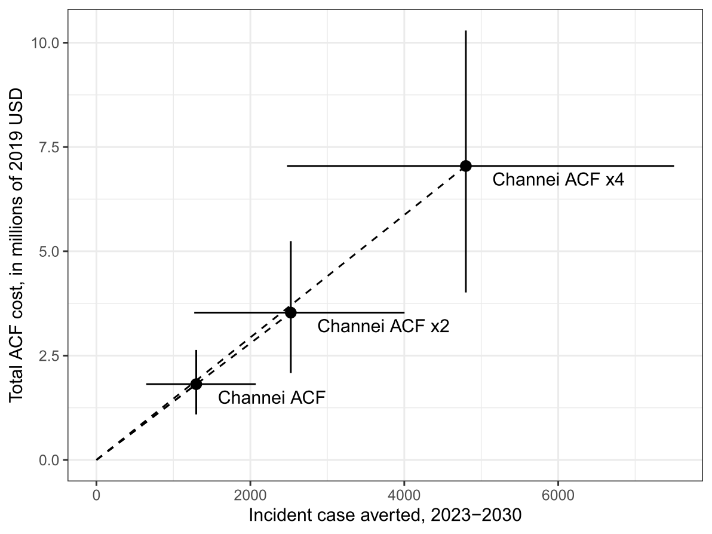
Figure 3

Slide 5
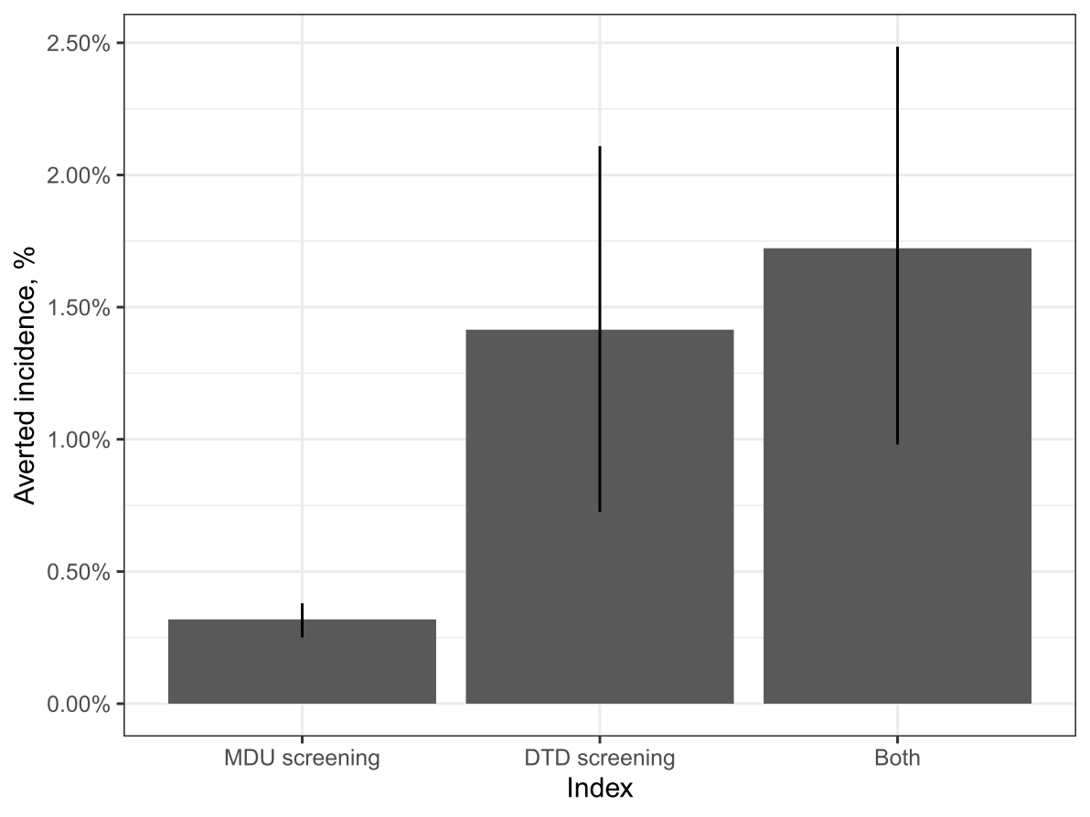
Figure 4

Slide 6
Figure 5

Slide 7
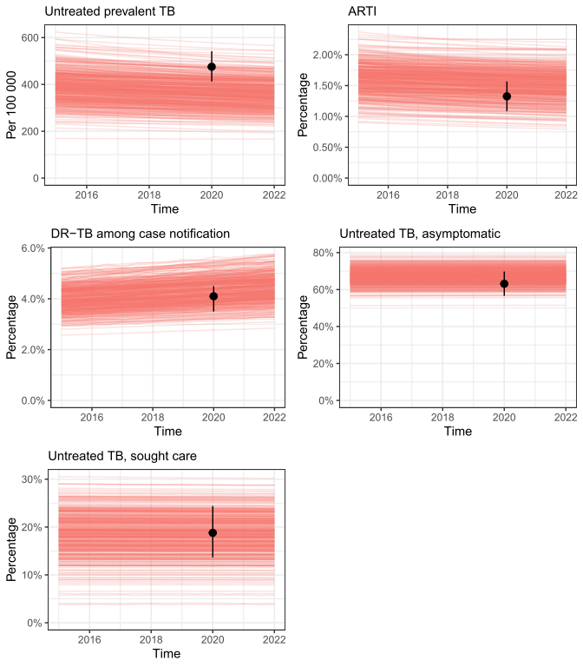
Figure S1

Slide 8
