Slide 1












Model structure
Overview
Routine healthcare
Latent TB infection
$$I$$
$$U$$
$$L$$
$$I_{A}$$
(Re-)Infection
$$L_{F}$$
Primary
Progression
Infection
Self clearance
Symptom
onset
$$L$$
stabilisation
$$I_{S}$$
$$L_{S}$$
Reactivation
Progression
Self cure
Initial
care-seeking
$$I$$
$$I_{E}$$
FN
Reinfection
Care-seeking
$$T$$
FN
TP
Relapse
TP
Treatment
$$T$$
$$R$$
Repeat
care-seeking

Slide 2
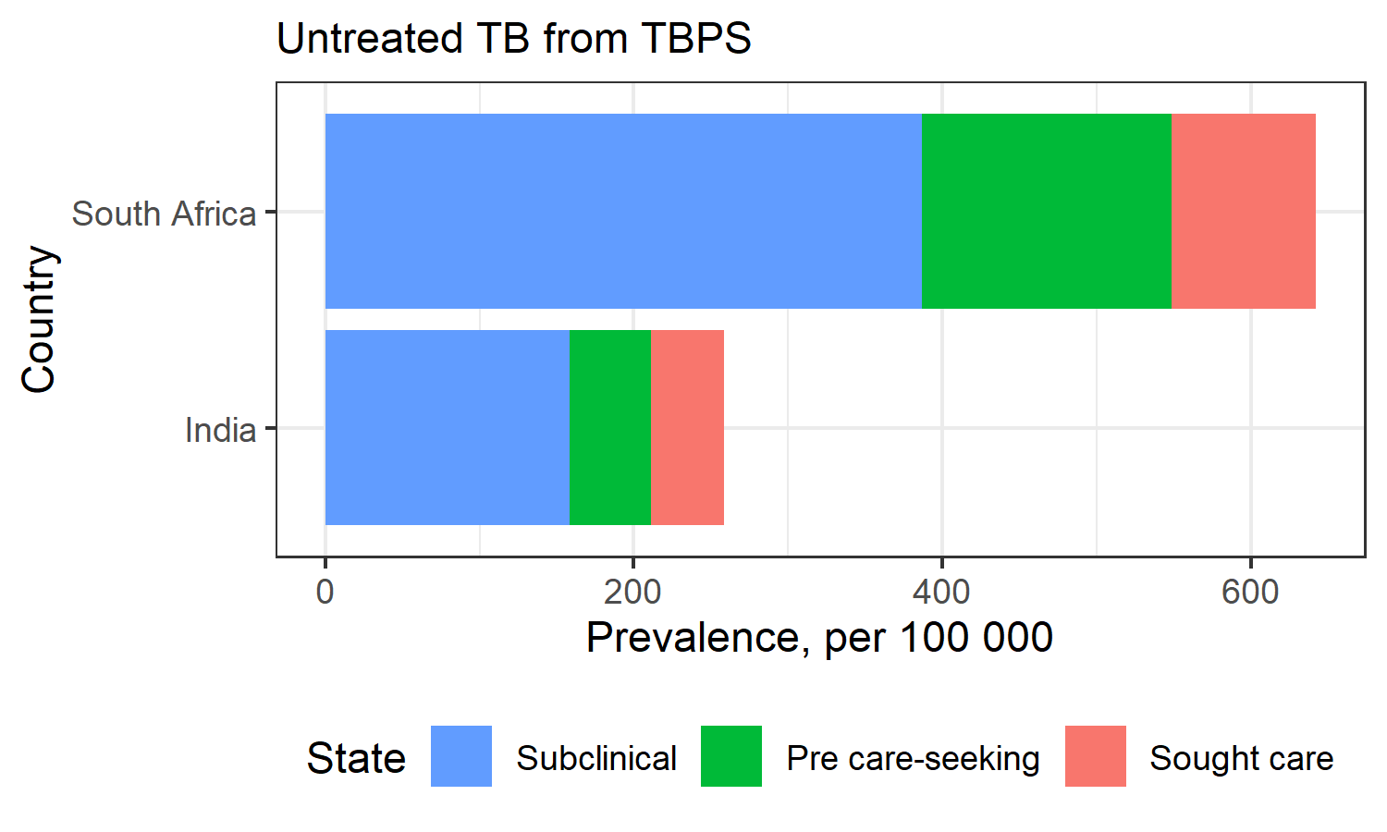
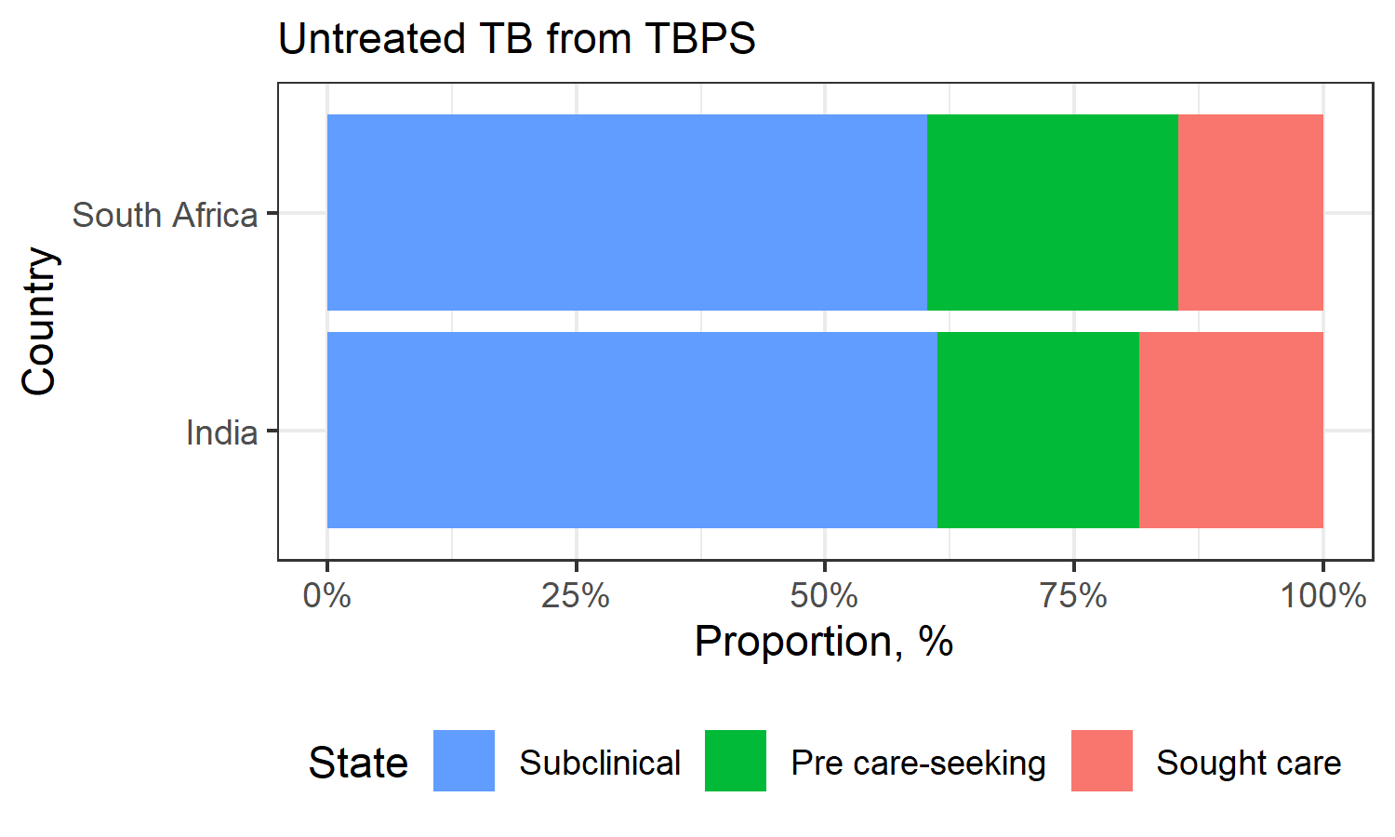
Data

Slide 3
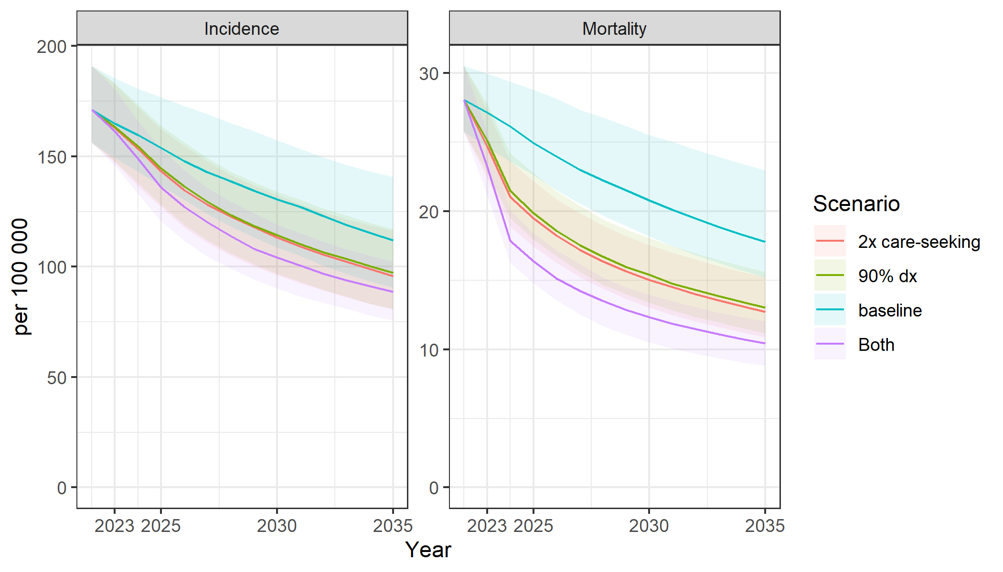
India
Immediate change at the start of 2023

Slide 4
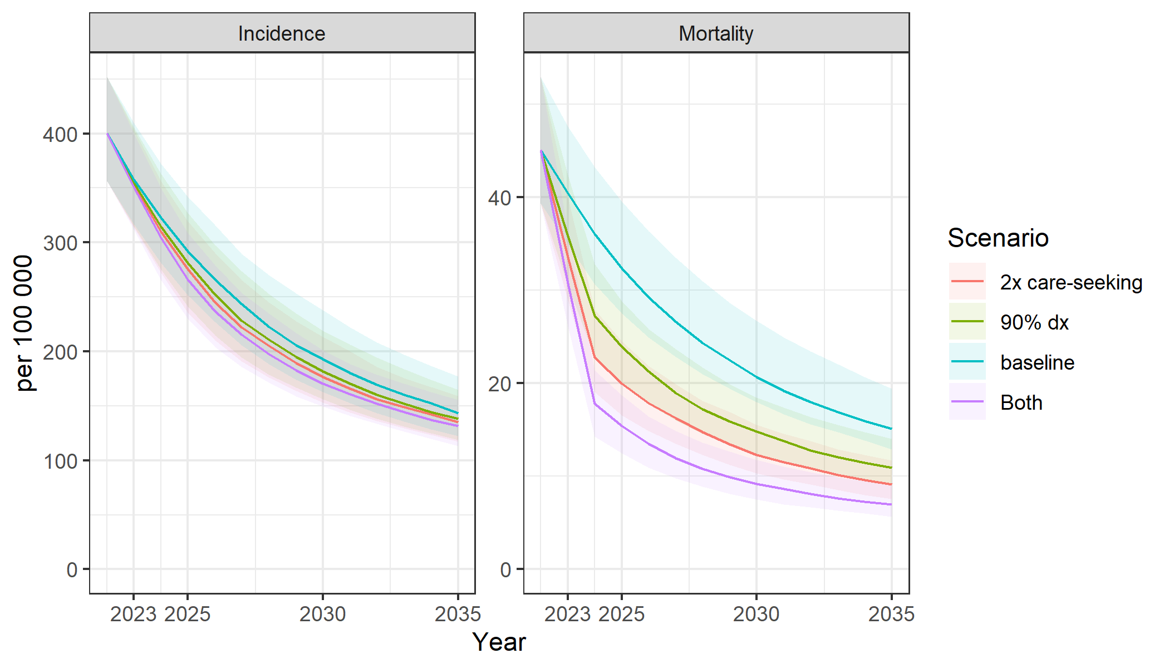
South Africa
Immediate change at the start of 2023

Slide 5
South Africa
Immediate change at the start of 2023

Slide 6
Data
Calibration targets
WHO TB notification
Cases
Deaths after treatment initiated
WHO burden estimates
Incidence/Mortality
National TBPS
IND 2020, ZAF 2019
Untreated by sub-clinical/ pre-care seeking / sought care
Inputs
WPP
Population size
Crude death rates
2010-2036

Slide 7

Underlying dynamics
Population growth
$β=\left\{\begin{aligned}β_{0}, t<2010 \\ &β_{0}(1 −e^{−k(t −2010)}), t≥2010\end{aligned}\right.$ , where $\left\{\begin{aligned}β_{0}∼U(1, 30) \\ k\sim U(0, 0.2)\end{aligned}\right.$

Slide 8
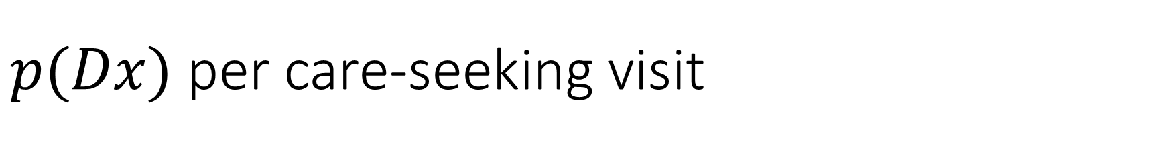
$p(Dx)$ per care-seeking visit
India
Data synthesis from existing studies and
Extracting where to seek care from the TBPS
Drug-sale data + TBPS to support the public/private mixing
45% for initial care-seeking
70% for revisiting
South Africa
Adjust values to match 22-25 days system delays
Looing for more evidence

Slide 9
Calibration methods
Current
ABC (vanilla)
ESS: 300
Final
Adaptive ABC-SMC
ESS: 1000 ~ 3000

Slide 10
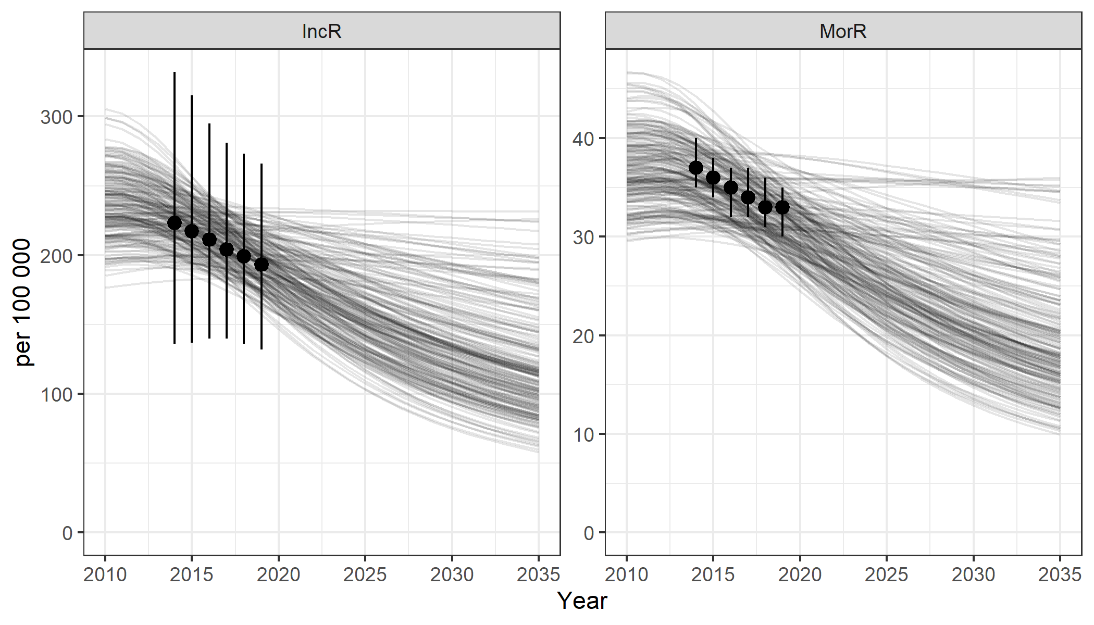
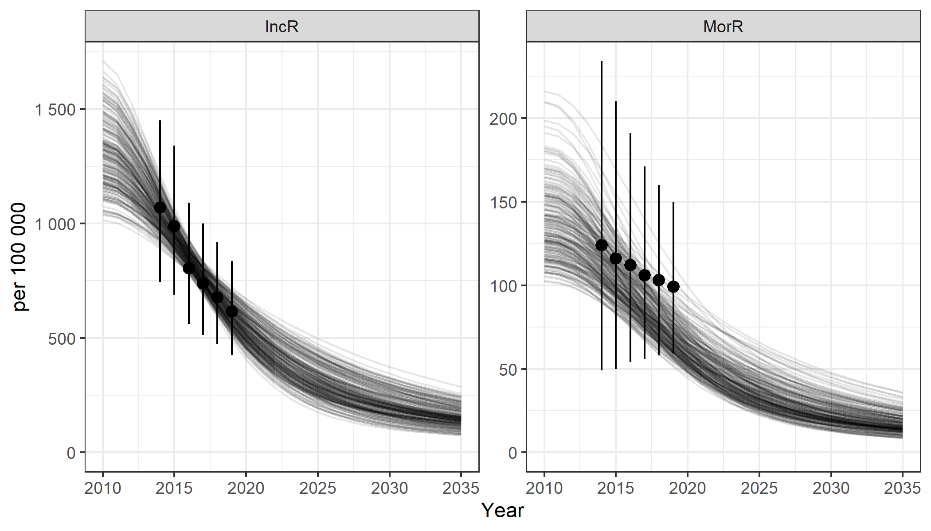
Current fits
India
South Africa

Slide 11
Go complex
India
Public / private
Covid
Care-seeking rate
South Africa
Non-HIV / HIV / HIV-ART
Empirical p(Dx)
Covid

