Slide 1

Big data – LAB 2
Predicting prices using only candlestick data

Slide 2

Chosen input
Momentum: price inertia
Intraday Momentum Index: overbought/oversold signal
Volatility: standard deviation of prices
4 Past High (we chose to give up memory to stay narrow)
4 Past Low (we chose to give up memory to stay narrow)
4 Past Open (we chose to give up memory to stay narrow)
4 Past Close (we chose to give up memory to stay narrow)
While not using them for prediction, we also compute: - the Relative Strength Index;
- Upside Downside Ratio;
- Money Flow Index;

Slide 3
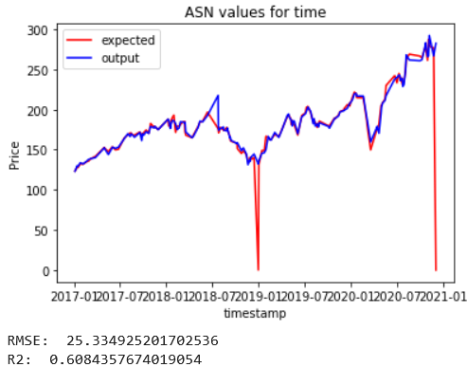
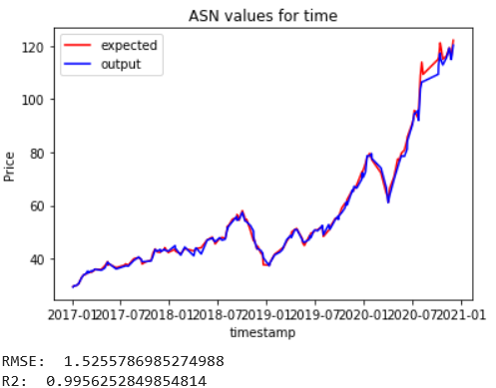
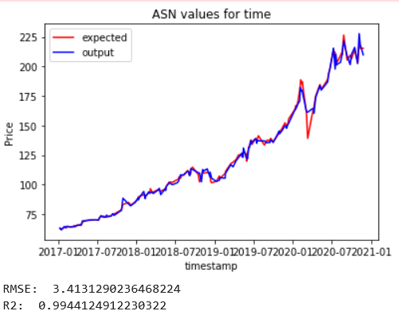
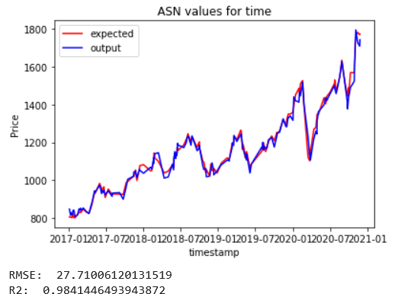
model

Slide 4

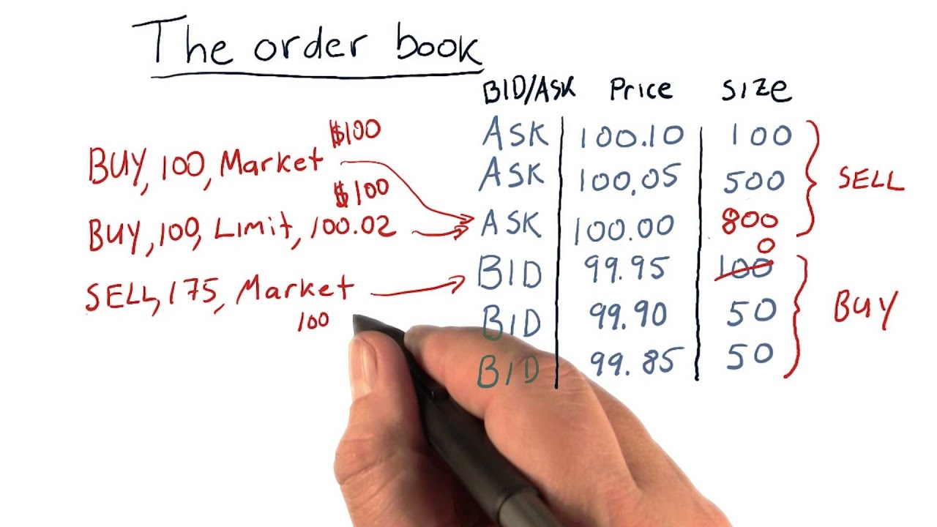
POSSIBLE IMPROVEMENT: ADD ORDER BOOK DATA

Slide 5

Thank you
MERAT Adrien
MOLLARD Emmanuel
OUESLATI Mehdi

