Slide 1
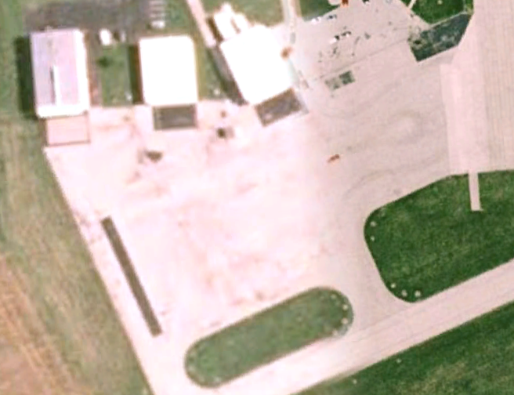
Whiteside County Airport
Red line indicates west border of course area.

