Slide 1
Titrations-kurve von Glycin (und mehr)
Nathalie Sonnleitner, Tim Peko

Slide 2
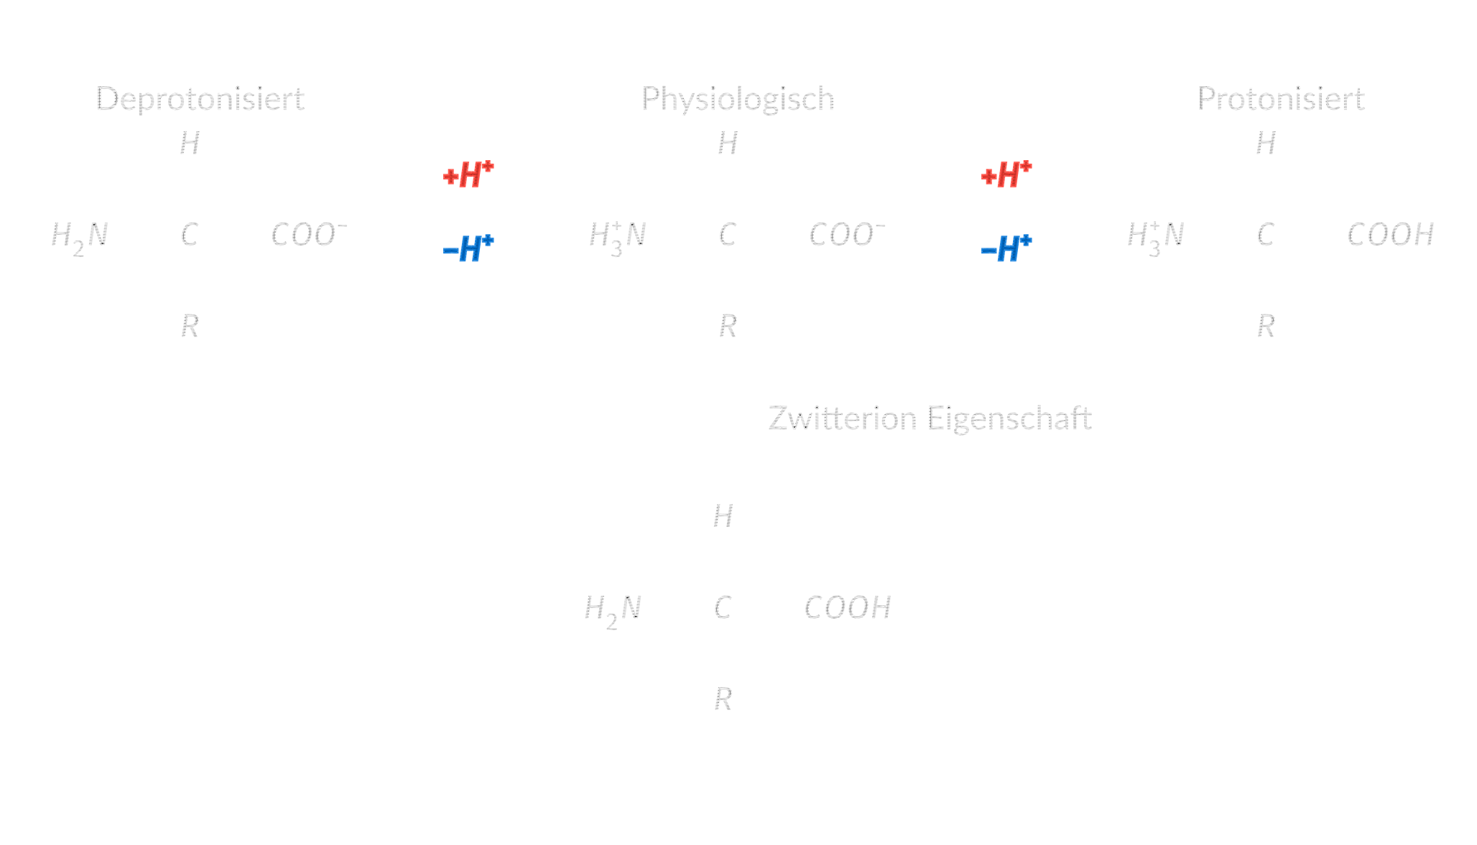
pH-Abhängigkeit
Basische Lösung
Saure Lösung

Slide 3
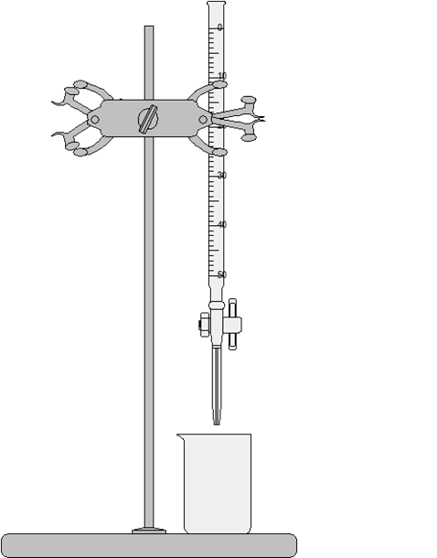
Titration
01
Bürette
Beinhaltet Maßlösung
Halterung
02
03
Maßlösung
Befestigt Bürette über Probelösung
Langsam der Probelösung zugegeben
Magnetrührer
04
05
Probelösung
Eingestellt auf initialen pH-Wert
Sorgt für gleichmäßige Verteilung

Slide 4
Forschungsziele
pH-Wert vs. zugegebenem NaOH-Volumen
01
Titrationskurve
Glycin
Punkte mit größter Pufferwirkung
Lysin Glutaminsäure
Histidin
02
pK_{s}-Werte
Nach außen hin neutral
03
IEP = pl

Slide 5
Materialien
pH-Meter
Becherglas
01
02
Kalibrierung!
Bürette
Magnetrüher
03
04
Glycin-Lsg.
NaOH-Lsg.
05
06
0,1 M
Maßlösung 0,01 M
HCl-Lsg.
???
07
08
verdünnt
Glycin-Lsg. bereits fertig? Maßlösung zu verdünnt?

Slide 6
Experiment Ablauf
Vorbereitung
Messung
Glycin-Lösung auf
pH 2? einstellen
→ voll protoniert
pH-Elektrode eintauchen
01
02
03
04
Titration
WRITE THAT DOWN!
Zugabe von NaOH
Messergebnisse niederschreiben

Slide 7
Plan für Heute
Aufbau & Verdünnung
Reinigung
Sauber auspülen Fachgerecht entsorgen
Kalibrieren, Herstellen der Lösungen, ...
01
02
03
04
Durchführung
Profit?
Titration von Glycin
(genug Zeit ⇒ weitere AA)
Wir freuen uns über die Rohdaten

Slide 8
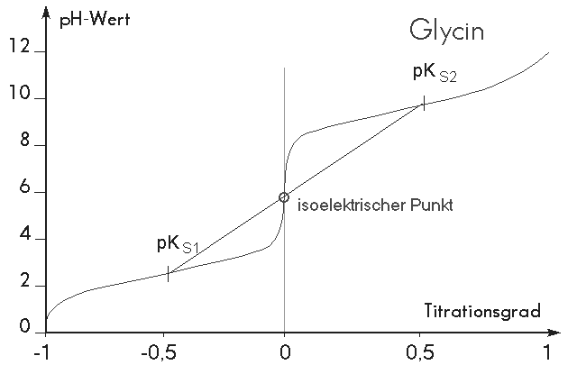

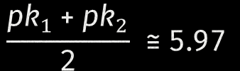
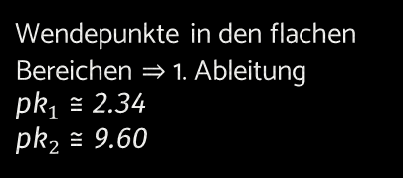
Erwartete Ergebnisse Glycin
pK₁ & pK₂
Wendepunkte in den flachen Bereichen ⇒ 1. Ableitung
${pk}_{1}≅$ 2.34
${pk}_{2}≅$ 9.60
Isoelektrischer Punkt
$$\frac{pk_{11}+{{pk}_{2}}_{2}}{2} ≅5.97$$
© Prof. Dr. J. Gasteiger, Dr. A. Schunk, CCC Univ. Erlangen, Thu Oct 12 17:05:26 2000 GMT

Slide 9

Erwartete Ergebnisse
Histidin
✓
Pufferfunktion
Lysin
✓
Kurve mit 3 Stufen
pK_{R}-Wert nahe am neutralen Bereich
Glutaminsäure
✓
+1 Aminogruppe
+1 Carboxylgruppe
2
Kurve mit 3 Stufen pK_{R} und pK₂ nahe beinander
Kurve mit 3 Stufen pK_{R} und pK₁ nahe beinander
1
3

Slide 10
Danke fias zuahoachn

Slide 11
About Chemistry Lesson Infographics
This template contains an assortment of complementary infographic resources for the Chemistry Lesson presentation.
These infographics are adapted to the style of the aforementioned presentation, so you can insert them easily and have them completely integrated at once. You just need to do the following:
Select the element that you want to copy
Right-click and choose “Copy”
Go to the slide where you want the element to appear
Right-click and choose “Paste”

Slide 12
Chemistry Lesson Infographics
Mars
Mercury
Despite being red, Mars is a very cold place
Mercury is the closest planet to the Sun
Venus
Jupiter
Venus has a beautiful name, but is hot
Jupiter is the biggest planet of them all
Earth
Saturn
Earth is the planet where we all live on
Saturn is the ringed one. It’s a gas giant

Slide 13
Chemistry Lesson Infographics
Mars
01
02
Mercury
Despite being red, Mars is a very cold place
Mercury is the closest planet to the Sun
07
Neptune
03
Venus
04
Jupiter
Neptune is the farthest planet from the Sun
Venus has a beautiful name, but is hot
Jupiter is the biggest planet of them all
Earth
05
06
Saturn
Earth is the planet where we all live on
Saturn is the ringed one. It’s a gas giant

Slide 14
Chemistry Lesson Infographics
04
Jupiter
03
Jupiter is the biggest planet of them all
Neptune
02
Neptune is the farthest planet from the Sun
Mercury
01
Mercury is the closest planet to the Sun
Mars
Despite being red, Mars is a very cold place

Slide 15
Chemistry Lesson Infographics
05
Jupiter
06
Jupiter is the biggest planet of them all
Neptune
07
Neptune is the farthest planet from the Sun
Mercury
Mercury is the closest planet to the Sun
08
Mars
Despite being red, Mars is a very cold place

Slide 16
Chemistry Lesson Infographics
A
B
Mars
Mercury
Despite being red, Mars is actually a cold place. It's full of iron oxide dust
It is the closest planet to the Sun and the smallest one in the Solar System
C
D
Venus
Jupiter
Venus has a beautiful name and is the second planet from the Sun
Jupiter is a gas giant and the biggest planet in the entire Solar System

Slide 17
Chemistry Lesson Infographics
Mars
Earth
Despite being red, Mars is cold
Mercury
Earth is the planet that harbors life
Neptune
It is the farthest one from the Sun
Jupiter
Venus
It is the biggest planet of them all
Saturn
Venus has a really nice name

Slide 18
Chemistry Lesson Infographics
Mars
Mercury
Despite being red, it is a cold place
It is the closest planet to the Sun
01
02
03
04
Neptune
Jupiter
It is the farthest one from the Sun
Jupiter is the biggest planet

Slide 19
Chemistry Lesson Infographics
Neptune
Pluto
Ceres
Neptune is the farthest planet from the Sun
It is now considered a dwarf planet
Ceres is located in the main asteroid belt
Saturn
Mercury
Saturn is a gas giant with several rings
Mercury is the closest planet to the Sun
Mars
Jupiter
Earth
Despite being red, Mars is a very cold place
Jupiter is the biggest planet of them all
Earth is the planet that harbors some life

Slide 20
Chemistry Lesson Infographics
Neptune
Mars
Mercury
Neptune is the farthest planet from the Sun
Despite being red, Mars is a very cold place
Mercury is the closest planet to the Sun
Saturn
Earth
Saturn is a gas giant with several rings
Earth is the planet that harbors some life
Jupiter
Sun
Jupiter is the biggest planet of them all
It’s at the center of the Solar System

Slide 21
Chemistry Lesson Infographics
Despite being red, Mars is actually a cold place. It's full of iron oxide dust
01
Mars
Earth
Venus has a beautiful name and is the second planet from the Sun
Earth is the only planet that harbors life and the one where we all live on
02
Venus
Jupiter is a gas giant and the biggest planet in the entire Solar System
03
Jupiter

Slide 22
Chemistry Lesson Infographics
A
B
Saturn
Jupiter
Saturn is a gas giant and has several rings. It's composed mostly of hydrogen and helium. It was named after a Roman god
Jupiter is a big gas giant and the biggest planet in the Solar System. It is the fourth-brightest object in the entire night sky

Slide 23
Chemistry Lesson Infographics
Neptune
Mercury
01
02
Neptune is the farthest planet from the Sun
Mercury is the closest planet to the Sun
Saturn
Earth
03
04
Saturn is a gas giant with several rings
Earth is the planet that harbors some life
Jupiter
Pluto
05
06
Jupiter is the biggest planet of them all
It is now considered a dwarf planet
Venus
Mars
07
08
Venus has a very nice name, but is hot
Despite being red, Mars is a very cold place

Slide 24
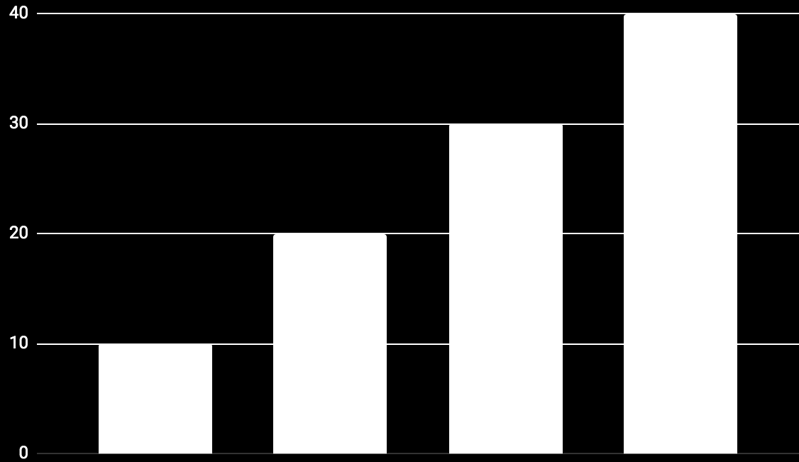
Chemistry Lesson Infographics
Mercury
10%
Mercury is the closest planet to the Sun
Earth
20%
Earth is the planet that harbors some life
Pluto
30%
It is now considered a dwarf planet
Mars
40%
To modify this graph, click on it, follow the link, change the data and paste the new graph here
Despite being red, Mars is a very cold place

Slide 25
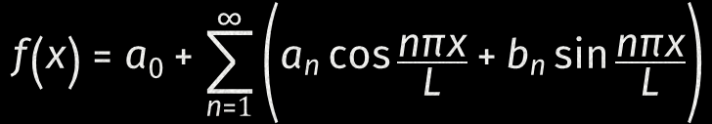
Chemistry Lesson Infographics
$$f\left(x\right)=a_{0}+\sum_{n=1}^{∞}{\left(a_{n}\cos{\frac{nπx}{L}}+b_{n}\sin{\frac{nπx}{L}}\right)}$$
Saturn
Saturn is a gas giant composed mostly of hydrogen and helium
Jupiter
Jupiter is a gas giant and the biggest planet in the entire Solar System
Mars
Venus

Slide 26
Chemistry Lesson Infographics
Mo | Tu | We | Th | Fr | Sa | Su
 |  | 1 | 2 | 3 | 4 | 5
6 | 7 | 8 | 9 | 10 | 11 | 12
13 | 14 | 15 | 16 | 17 | 18 | 19
20 | 21 | 22 | 23 | 24 | 25 | 26
27 | 28 | 29 | 30 | 31
09:00
10:00
11:00
12:00
14:00
15:00
Despite being red, Mars is actually a cold place full of iron oxide dust
Saturn has several rings

Slide 27
Chemistry Lesson Infographics
Saturn
Saturn is a gas giant and has several rings. It was named after the Roman god of wealth
55%
45%
Mercury
Pluto
Mercury is the closest planet to the Sun
It is now considered a dwarf planet

Slide 28
Chemistry Lesson Infographics
Start
Earth
Mercury
Venus
Jupiter
Saturn
Neptune
Venus has a very nice name, but is hot
Jupiter is the biggest planet of them all
Saturn is a gas giant with several rings
Neptune is the farthest planet from the Sun
Venus
Mars
Mercury
Despite being red, Mars is a cold place
Mercury is the closest planet to the Sun

Slide 29
Chemistry Lesson Infographics
Mercury
Pluto
It’s the closest planet to the Sun
It is now considered a dwarf planet
55%
45%

Slide 30

Chemistry Lesson Infographics
45%
Neptune
Neptune is the farthest planet from the Sun
55%
Saturn
Yes, Saturn is a gas giant with several rings
To modify this graph, click on it, follow the link, change the data and paste the new graph here

Slide 31
Chemistry Lesson Infographics
 | Monday | Tuesday | Wednesday | Thursday | Friday
Lesson 1 | Venus has a very nice name |  |  |  | Pluto is a small dwarf planet
Lesson 2 |  | Jupiter is the biggest planet
Lesson 3 |  |  | Despite being red, it is cold
Lesson 4 |  | Saturn is a giant with rings |  | Mercury is the smallest planet
Lesson 5 | Earth is the planet with life |  |  |  | Neptune is the farthest planet

Slide 32
Chemistry Lesson Infographics
List item 1
List item 2
List item 3
List item 4
List item 5
List item 6
Mars
Despite being red, Mars is actually a cold place full of iron oxide dust
Saturn
Saturn is a gas giant and has several rings. It's composed mostly of hydrogen and helium. It was named after the Roman god of wealth and agriculture
List item 1
List item 2
List item 3
List item 4
List item 5
List item 6
Venus
Venus has a nice name and is the second planet from the Sun

Slide 33
Erwartete Ergebnisse
Histidin
Neptune
✓
Lysin
✓
Glutaminsäure
Neptune is the farthest planet from the Sun
✓
Saturn
Venus
2
Kurve mit 3 Stufen
Kurve mit 3 Stufen
1
3

Slide 34
Chemistry Lesson Infographics
Mars
Neptune
Despite being red, it is a cold place
It is the farthest one from the Sun
01
02
03
04
Mercury
Jupiter
It is the closest planet to the Sun
Jupiter is the biggest planet

Slide 35
Chemistry Lesson Infographics
Mercury
Mercury is the closest planet to the Sun
Neptune
Neptune is the farthest planet from the Sun
Saturn
Mars
Saturn is a big gas giant with several rings
Despite being red, Mars is a very cold place

Slide 36
Chemistry Lesson Infographics
A
B
Mars
Jupiter
Despite being red, Mars is a very cold place
Jupiter is the biggest planet of them all
C
D
Venus
Earth
Venus has a really nice name, but is hot
Earth is the planet that harbors some life

Slide 37
Chemistry Lesson Infographics
 | Exercise 1 | Exercise 2 | Exercise 3 | Exercise 4
Mercury | ✓ | ✗ | ✗ | ✗
Neptune | ✗ | ✓ | ✗ | ✓
Venus | ✓ | ✗ | ✓ | ✗
Mars | ✓ | ✓ | ✗ | ✓

Slide 38
Chemistry Lesson Infographics
02
01
Mercury
Mercury is the closest planet to the Sun
Neptune
Neptune is the farthest planet from the Sun
30%
70%

Slide 39

Chemistry Lesson Infographics
A
B
Neptune
Saturn
Neptune is the farthest planet from the Sun
Saturn is a gas giant and has several rings
To modify this graph, click on it, follow the link, change the data and paste the new graph here

Slide 40
Chemistry Lesson Infographics
Mars
Mercury
Despite being red, Mars is a very cold place
Mercury is the closest planet to the Sun
Venus
Jupiter
Venus has a beautiful name, but is hot
Jupiter is the biggest planet of them all
Earth
Saturn
Earth is the planet where we all live on
Saturn is the ringed one. It’s a gas giant

Slide 41
Chemistry Lesson Infographics
Saturn
Earth
Neptune
Pluto
Ceres
Neptune is the farthest planet from the Sun
It is now considered a dwarf planet
Ceres is located in the main asteroid belt
Mars
Jupiter
Earth
Despite being red, Mars is a very cold place
Jupiter is the biggest planet of them all
Earth is the planet that harbors some life

Slide 42
Instructions for use (free users)
In order to use this template, you must credit Slidesgo by keeping the Thanks slide.
You are allowed to:
Modify this template.
Use it for both personal and commercial purposes.
You are not allowed to:
Sublicense, sell or rent any of Slidesgo Content (or a modified version of Slidesgo Content).
Distribute this Slidesgo Template (or a modified version of this Slidesgo Template) or include it in a database or in any other product or service that offers downloadable images, icons or presentations that may be subject to distribution or resale.
Use any of the elements that are part of this Slidesgo Template in an isolated and separated way from this Template.
Delete the “Thanks” or “Credits” slide.
Register any of the elements that are part of this template as a trademark or logo, or register it as a work in an intellectual property registry or similar.
For more information about editing slides, please read our FAQs or visit Slidesgo School:
https://slidesgo.com/faqs and https://slidesgo.com/slidesgo-school

Slide 43
Instructions for use (premium users)
In order to use this template, you must be a Premium user on Slidesgo.
You are allowed to:
Modify this template.
Use it for both personal and commercial purposes.
Hide or delete the “Thanks” slide and the mention to Slidesgo in the credits.
Share this template in an editable format with people who are not part of your team.
You are not allowed to:
Sublicense, sell or rent this Slidesgo Template (or a modified version of this Slidesgo Template).
Distribute this Slidesgo Template (or a modified version of this Slidesgo Template) or include it in a database or in any other product or service that offers downloadable images, icons or presentations that may be subject to distribution or resale.
Use any of the elements that are part of this Slidesgo Template in an isolated and separated way from this Template.
Register any of the elements that are part of this template as a trademark or logo, or register it as a work in an intellectual property registry or similar.
For more information about editing slides, please read our FAQs or visit Slidesgo School:
https://slidesgo.com/faqs and https://slidesgo.com/slidesgo-school

Slide 44
Infographics
You can add and edit some infographics to your presentation to present your data in a visual way.
Choose your favourite infographic and insert it in your presentation using Ctrl C + Ctrl V or Cmd C + Cmd V in Mac.
Select one of the parts and ungroup it by right-clicking and choosing “Ungroup”.
Change the color by clicking on the paint bucket.
Then resize the element by clicking and dragging one of the square-shaped points of its bounding box (the cursor should look like a double-headed arrow). Remember to hold Shift while dragging to keep the proportions.
Group the elements again by selecting them, right-clicking and choosing “Group”.
Repeat the steps above with the other parts and when you’re done editing, copy the end result and paste it into your presentation.
Remember to choose the “Keep source formatting” option so that it keeps the design. For more info, please visit Slidesgo School.

