Slide 1

Generative Learning of Continuous Data by Tensor Networks March Meeting 2023
Alex Meiburg UCSB
Jing Chen, Jacob Miller, Alejandro Perdomo-Ortiz Zapata Computing

Slide 2
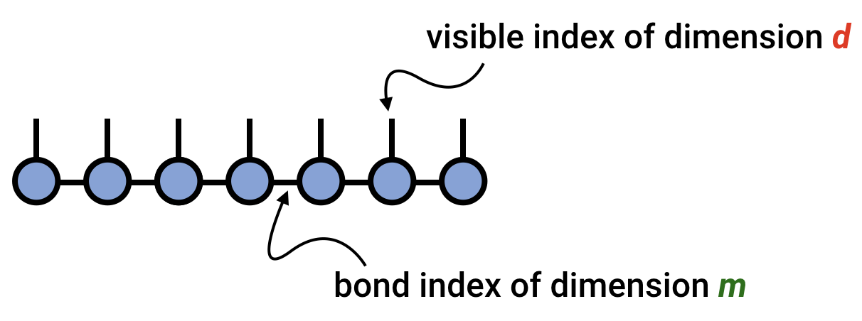
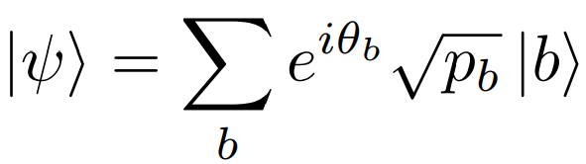
Matrix Product States: Density Modelling
By now you’ve been hearing for a while about density modelling (generative modelling) with tensor networks…
d is number of ‘states’ or ‘values’ at the site
For binary strings, d=2
Approximates some quantum state:

Slide 3
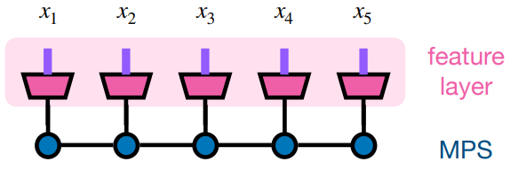

Bits → Real-valued distributions
Map index d into Hilbert space over the reals
New tensor is an isometry in

Slide 4
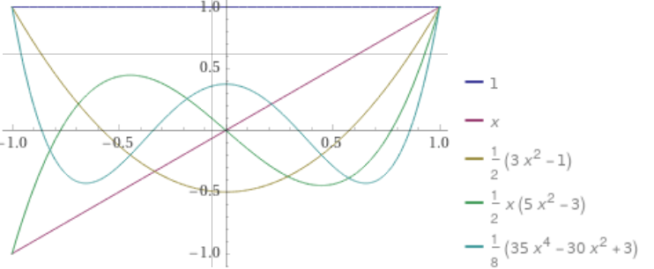
Bits → Real-valued distributions
Isometry: d orthogonal basis functions
For example: polynomials on the interval [-1, 1]

Slide 5
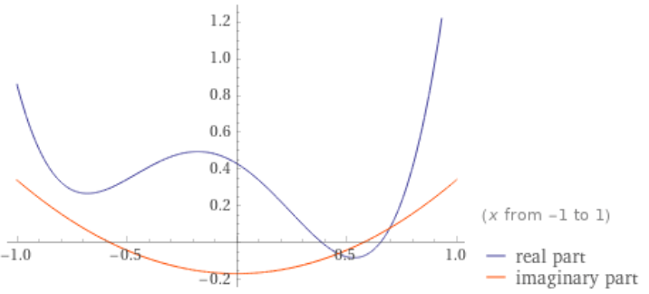
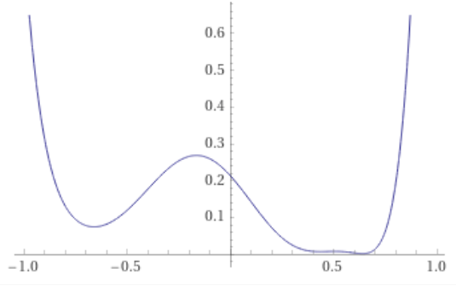
Representing real densities
Linearly combine
with complex coefficients
Yields normalized density over [-1,1] (Born rule)

Slide 6
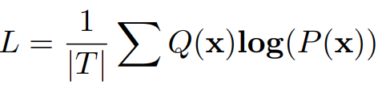
Training the MPS
Continuous values of a datum are fixed: push through the isometry (embed them) to d-dim quantum states. Then normal MPS training
Train to minimize negative log-likelihood (average entropy of generated samples)
All probabilities are densities, so loss can be negative
e.g. uniform on [0, ½] has negative one bit of differential entropy

Slide 7
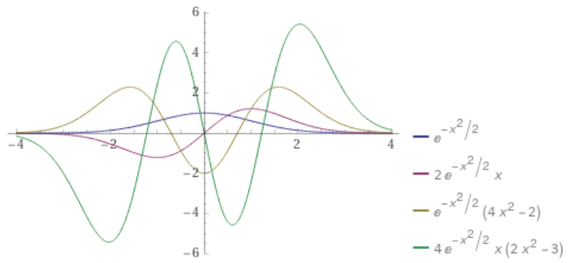
Several options for basis functions (“features”)
Polynomials on fixed interval (shown before)
Hermite functions: Gaussian × polynomial, over all of R
Fourier series on a fixed interval
Anything (1) easily integrable, (2) orthogonal, and ideally (3) complete

Slide 8
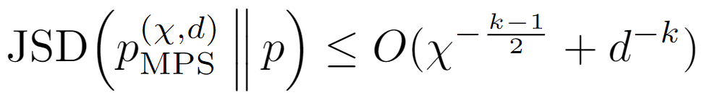
Several options for basis functions (“features”)
Anything (1) easily integrable, (2) orthogonal, and ideally (3) complete
This suffices to show a universal approximation ability, for C^{k} functions:
with site dimension d and bond dimension χ.

Slide 9
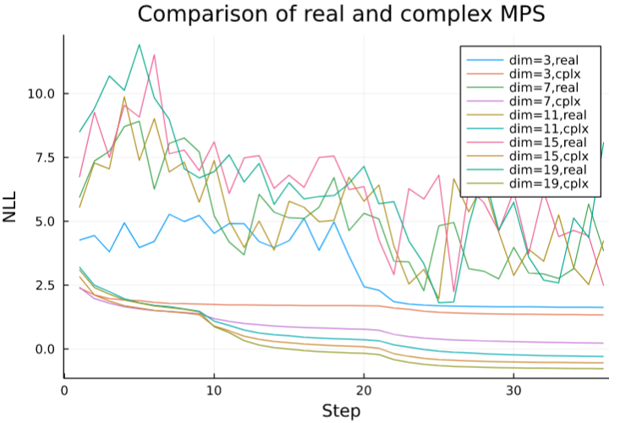
Real vs. Complex MPS
Real MPS: Memory compact, faster to compute with, in theory we don’t need complex phases
Complex MPS: Higher model capacity (per bond dimension), alters loss landscape
Complex seems the better
way to go!

Slide 10
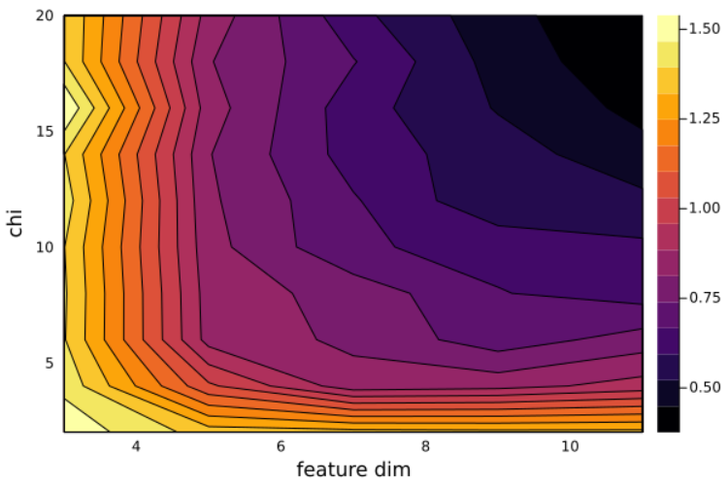
Test Problems – Skewed Cube
Rotate a N-cube by some angles. Gives a convex distribution with some correlations between variables. Here, N=5.

Slide 11
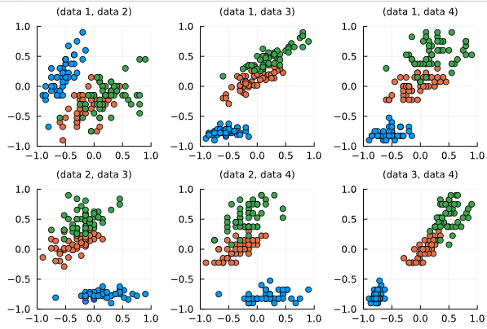
Test Problems – Iris Dataset
Classic small ML dataset
4 continuous values, 1 class label (k=3)
Pairwise plot of features:

Slide 12
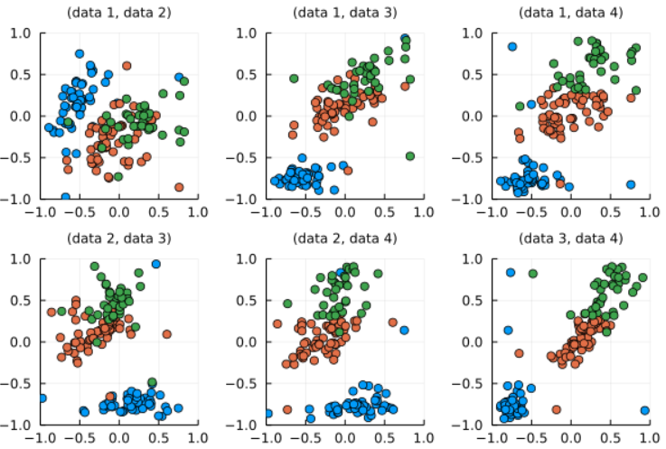
Test Problems – Iris Dataset
We can support this mixture of continuous + discrete. Different local dimensions in the MPS. 5-site MPS
Pairwise plot of features:

Slide 13
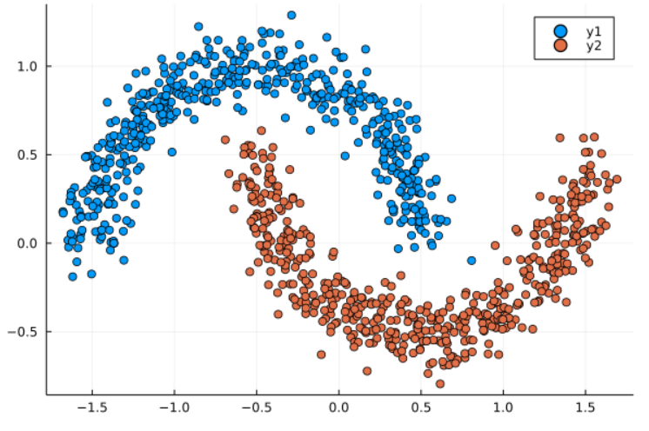
Test Problems - Moons
Popular synthetic data for clustering problems
Two continuous values, and one discrete class. 3-site MPS: two mapped values of dimension 10, one qubit (for class label).
True distribution:

Slide 14
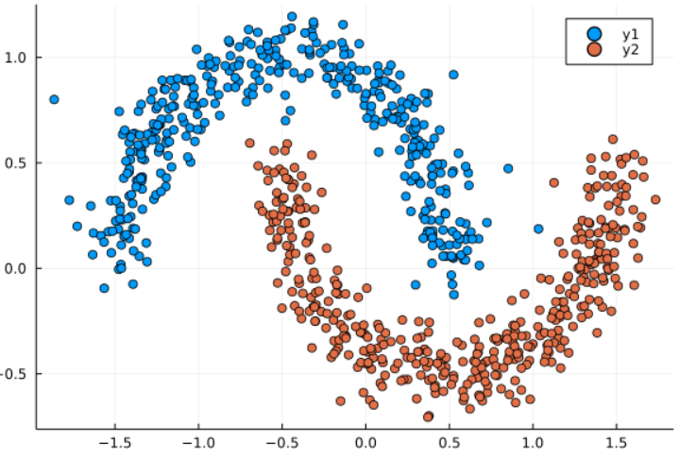
Test Problems - Moons
Our MPS produces:

Slide 15
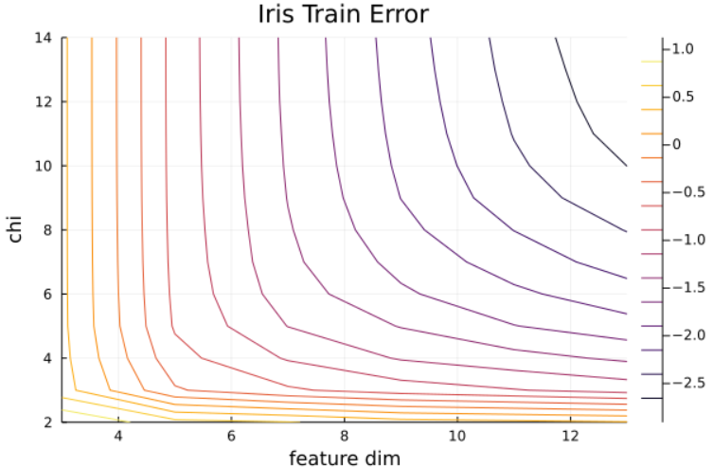
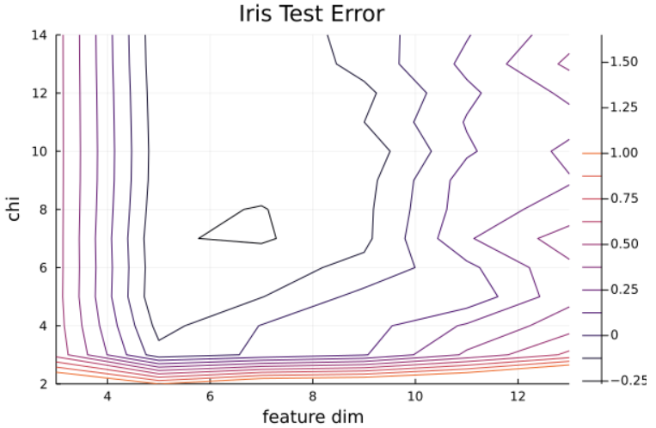
Test Problems – Iris Dataset
Generalization capability – 5-fold cross-validation

Slide 16
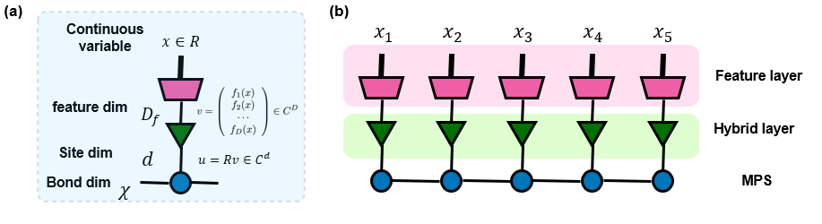
Dynamic Basis
Getting a decent precision on the wave function requires a significant feature dimension
An error of e requires d≈1/e feature functions
Training requires SVD on matrices d·χ by d·χ, or O(f³) time … not very favorable
Idea: map from a lower dimension d up to D with a unitary. MPS only has dimension d.

Slide 17
How to Train a Basis?
Training NLL means we want to maximize sum[log(prob)] at any given sites s
Take a data point (one sample in the dataset) and condition the MPS on all the other sites besides s. We get a state Ψ at site s, and want to maximize overlap with the true state Φ of that data point, as embedded with the feature function
Choose U to maximize:
Sum log( |<Φ|U|Ψ>|^2 )

Slide 18
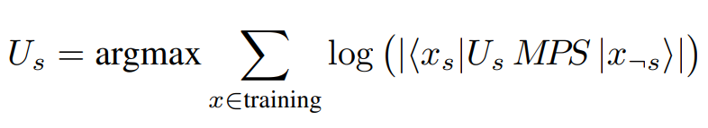
How to Train a Basis?
Related to some well-studied problems in aligning vectors
Training loop: correct for phases and nonlinear log term, align the vectors using SVD, and repeat.
Can be thought of as linearizing the NLL and then training a TNS
Converges in a few iterations
Alternate between optimizing basis-alignment (the green compression layer, 1-site marginals) and the MPS optimization (inter-site correlations)

Slide 19
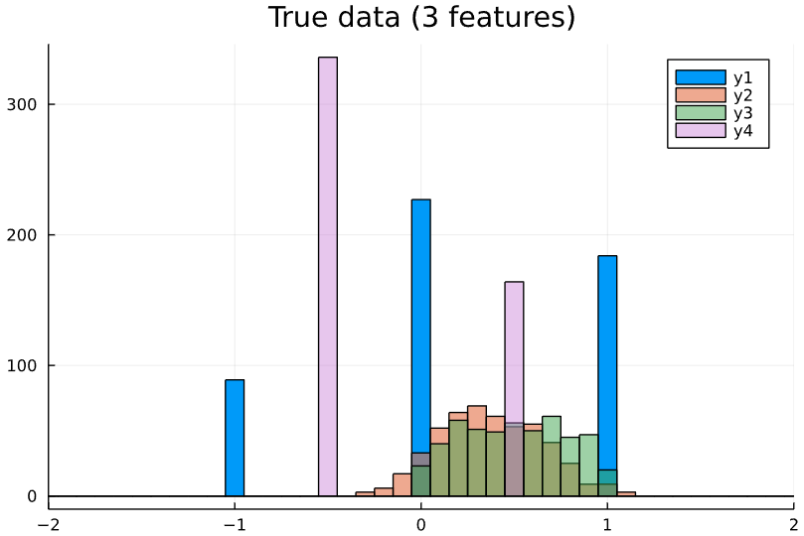
Test Data
Small synthetic dataset
Four features
Two features are bi- or tri-modal. Can we learn them with just d=3?
For this model, each feature requires its own embedding. They can be shared

Slide 20
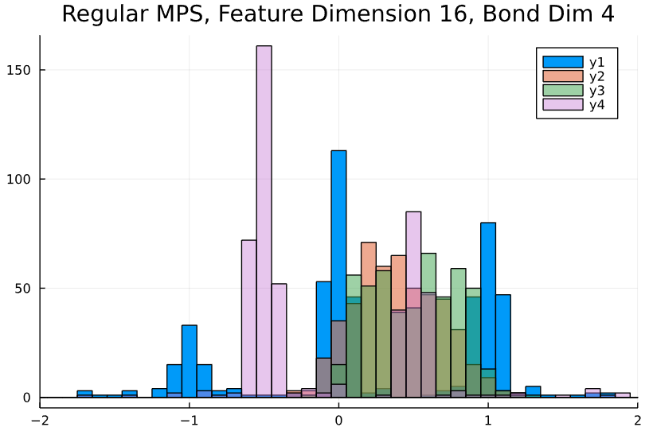
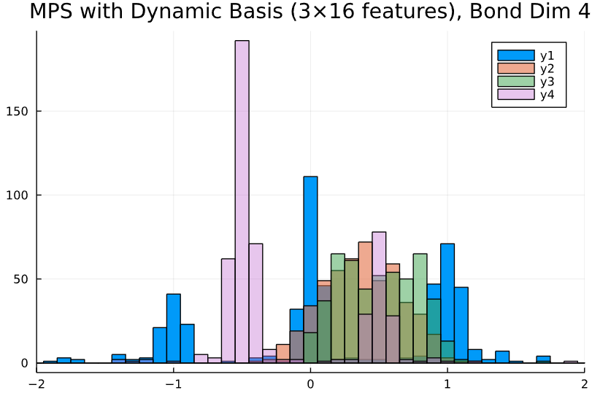
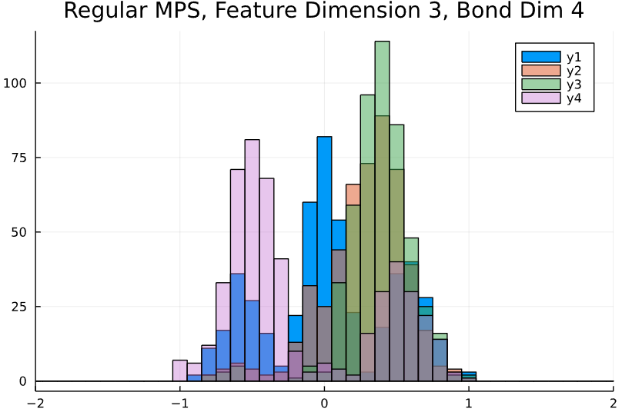
Test Data
With a dynamic basis, mapping c=3 to f=16, the MPS can learn it pretty well again!
Loss Values:
f=3: +2.04
f=16: -2.17
c=3, f=16: -2.06

Slide 21
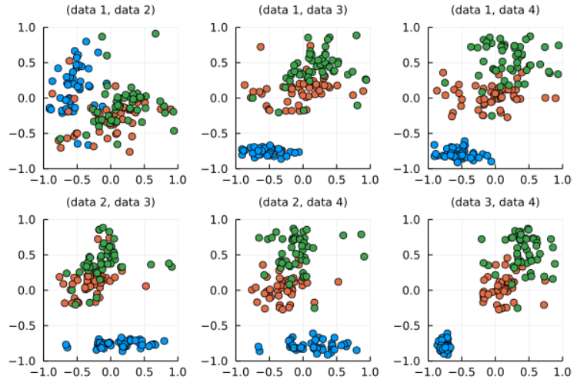
Dynamic Basis - Iris
With d=4 and a dynamic basis, can match the performance of d=8

Slide 22
Conclusions
Models do learn to generalize
Can be effectively and efficiently compressed with a dynamic basis
Flexible choices of bond dimension, feature type, TNS topology
Compatible with mixed discrete data, HETEROGENEOUS DATA TYPES AND SUPPORTS
Can work with any existing MPS training strategy (DMRG, SGD..)

Slide 23
Thank you!
… for staying until the end of the session. ☺
Paper will be on arXiv soon!
Collaborators:
Jing Chen, Jacob Miller, Alejandro Perdomo-Ortiz

