Slide 1
Subs management:
Capture
Transactions
Reporting:
Strengths
Weaknesses
AVUSA Subscription system
Campaign
management:
Categorisation
Promotions
Fulfilment:
Delivery run
Delivery trail
Finance:
Bank statements
Who owes us?

Slide 2
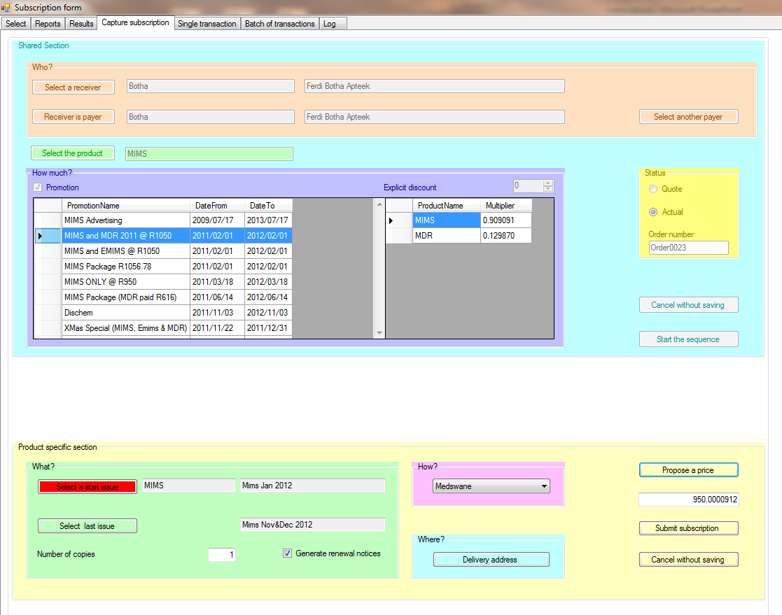
Capture a promotion as a package of 2 products

Slide 3
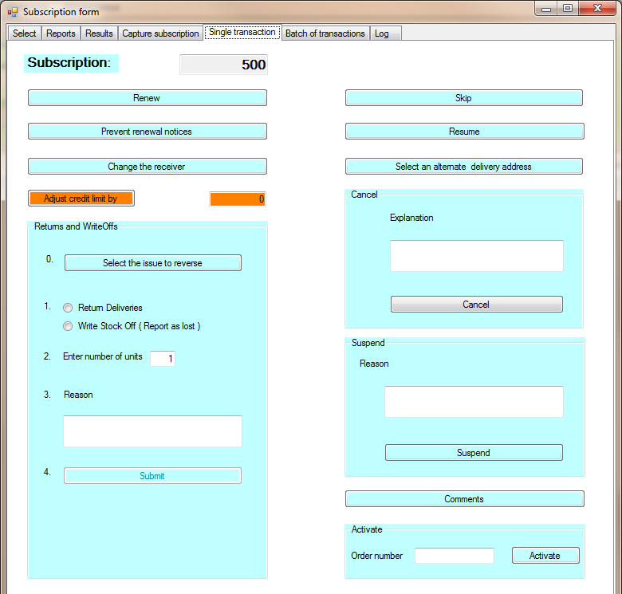
Various transactions you can be performed against a subscription

Slide 4
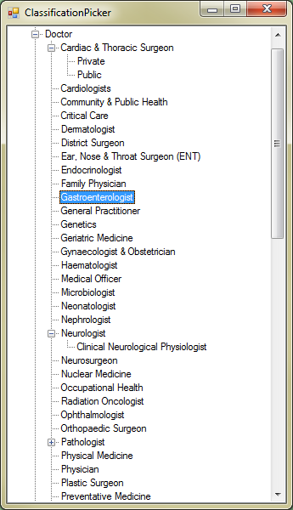
You can profile your customers in many ways in hierarchies of any depth

Slide 5
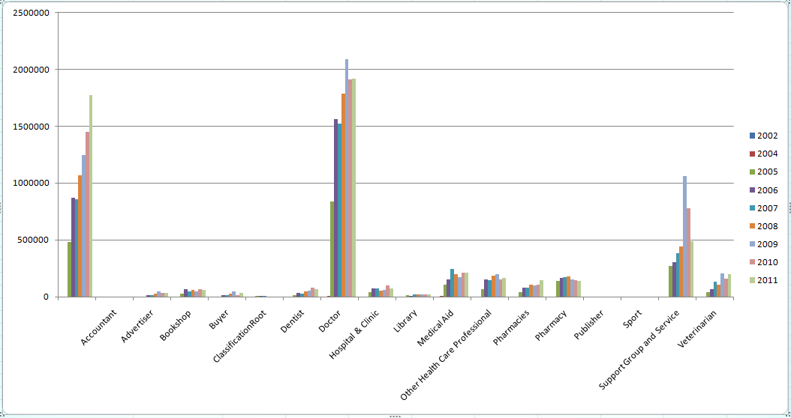
Based on the profiling, you can see where your support lies

Slide 6
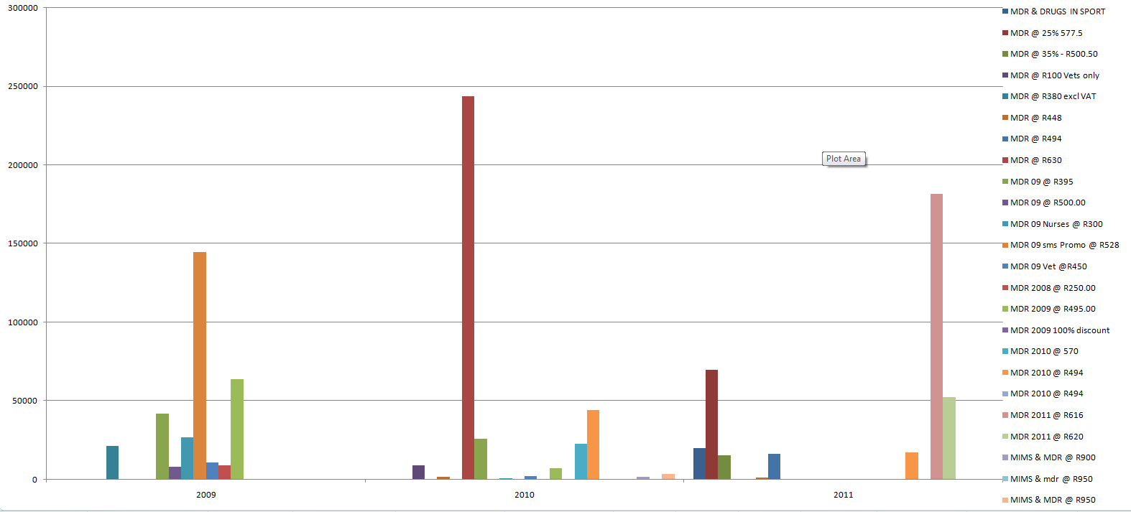
You can compare the efficacy of various promotions

Slide 7
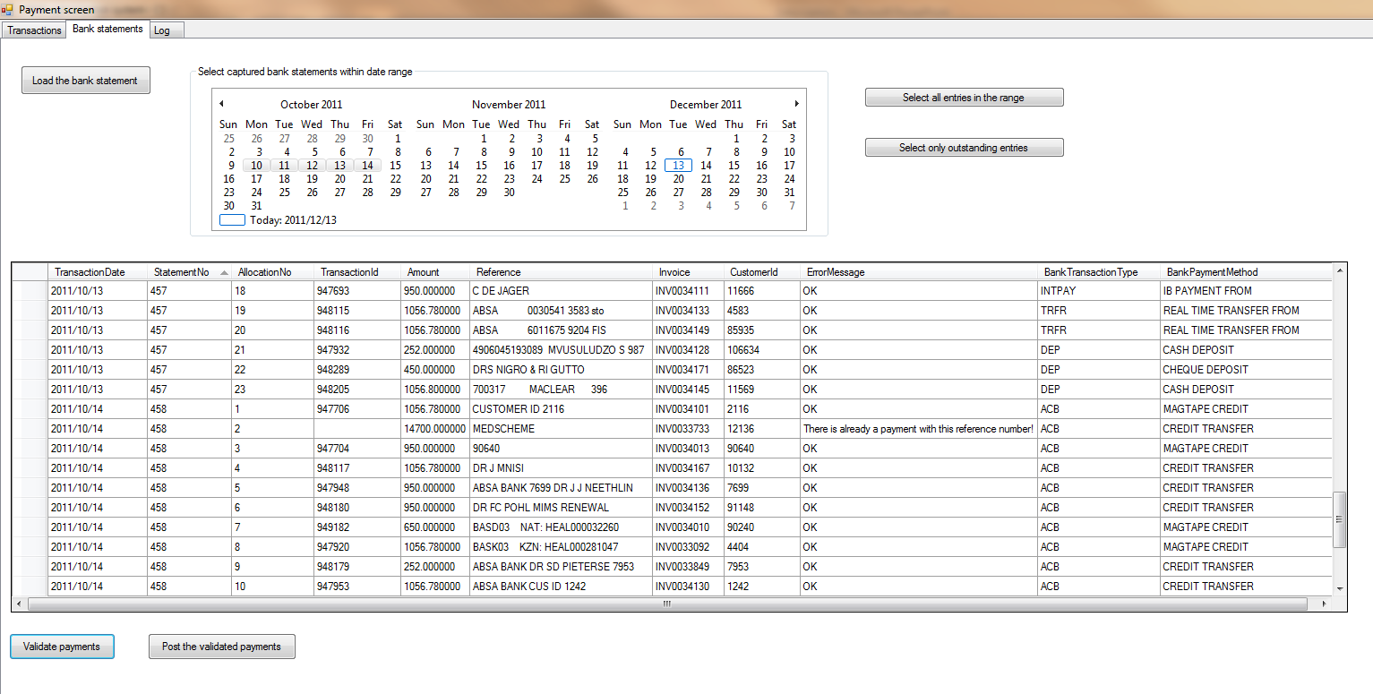
You can reconcile payments by importing the bank statements

Slide 8
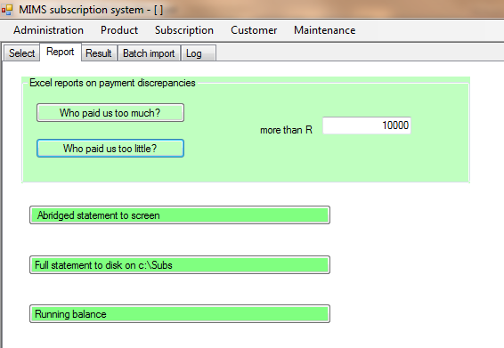
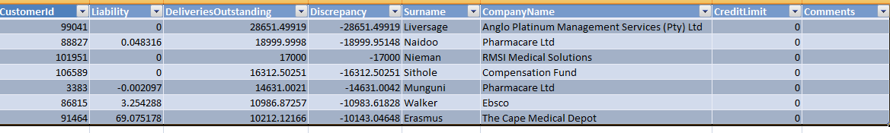
You can draw reports to see who owes what to whom

Slide 9
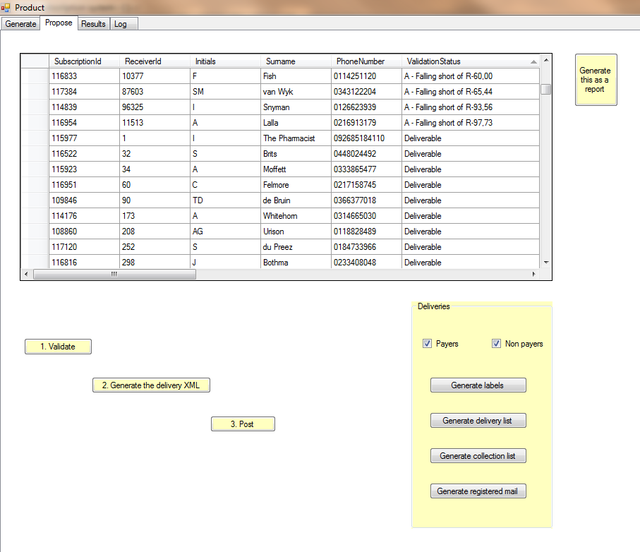
You can propose deliveries and then validate them

Slide 10
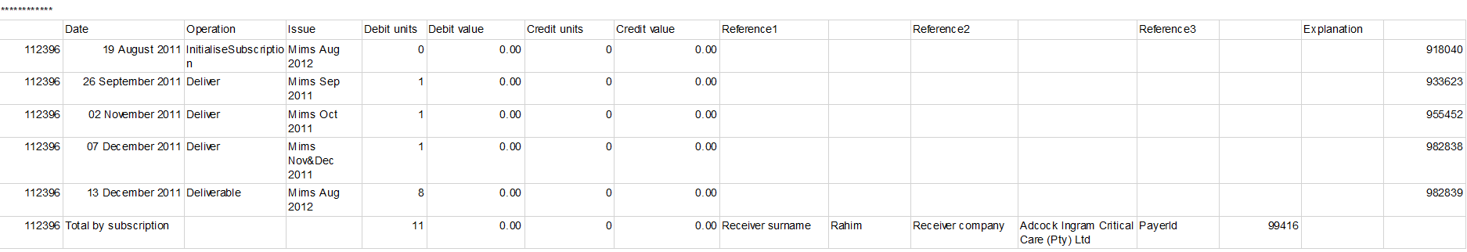
What happened with this subscription?

Slide 11
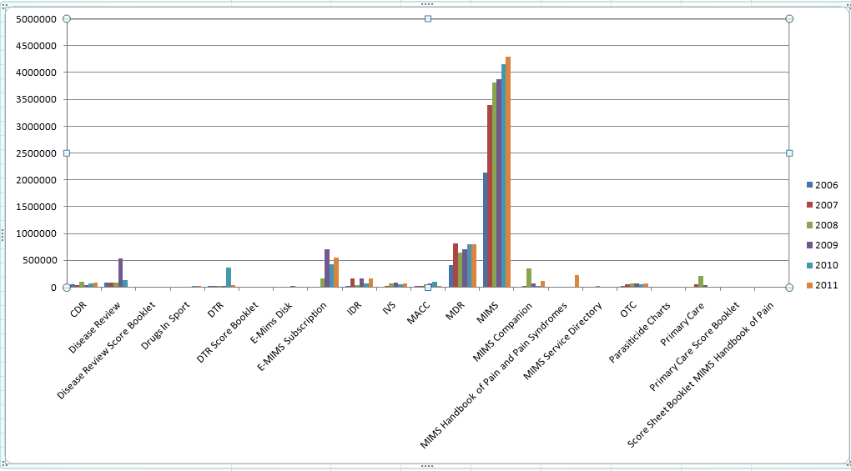
Which products make the most money?

Slide 12
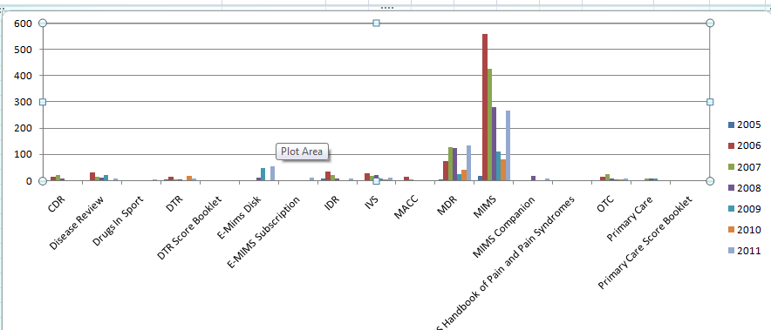
Why are there so many returns this year?

