Slide 1
Baxter & Alexa Project
By Adrian Beehner

Slide 2





What is the Project?
Interface between Alexa and ROS Node (that begins the Baxter making coffee program)
Be able to ask “Alexa, ask Baxter the Robot to make me a cup of coffee” and Baxter makes you a cup of coffee

Slide 3
Project Scope
Four Main Parts:
Alexa Skill – Capabilities provided by Alexa for personalized Alexa experience
PubNub – MQTT Broker between ROS Node and AWS Lambda Function
AWS Lambda Function – Broker information from PubNub to Alexa Skill, as well as Publish coffee request info to PubNub
ROS Node – MQTT Publish Baxter info to PubNub and Subscribe to PubNub channel containing coffee request, and interface to begin “coffee_time” program

Slide 4
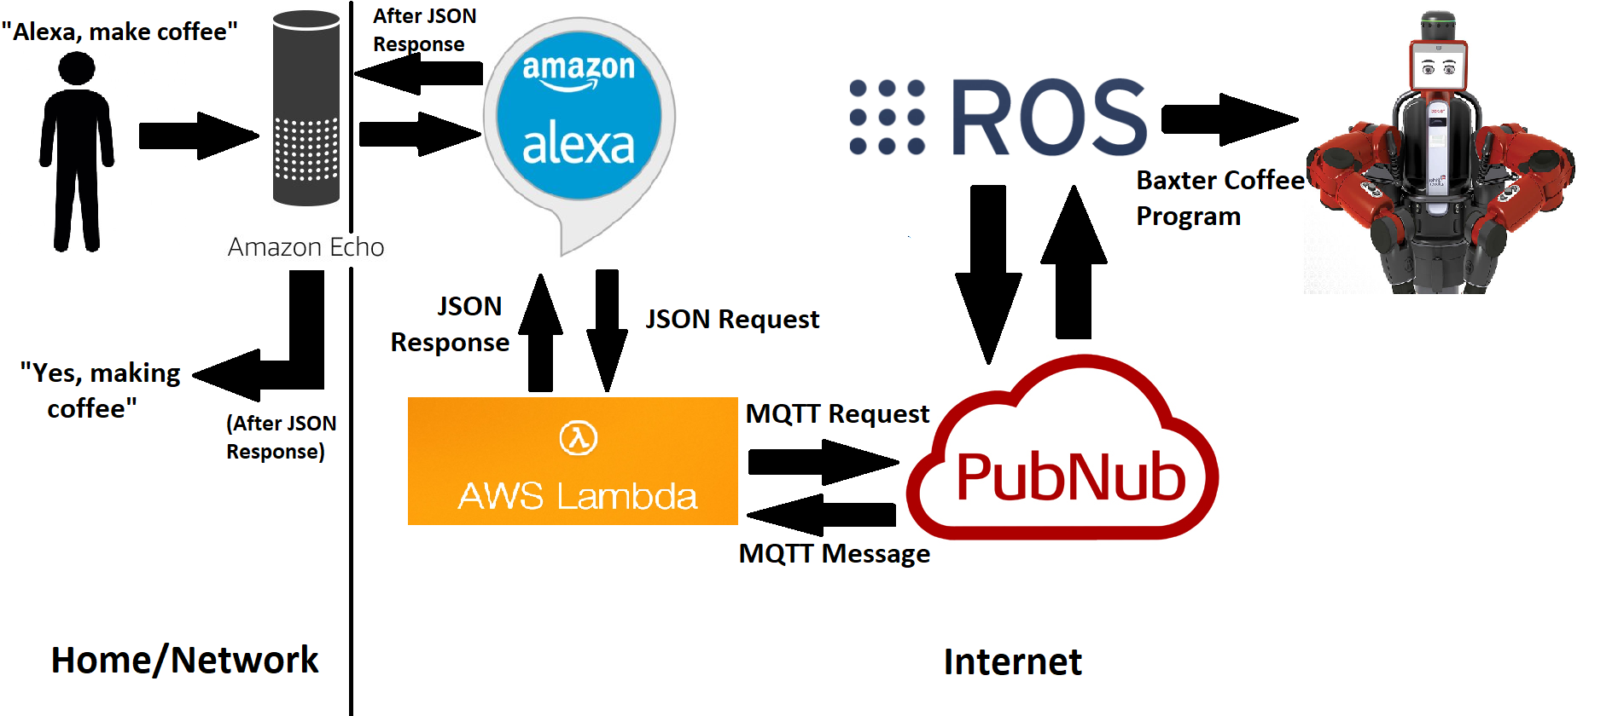
Project Scope (Cont.)

Slide 5
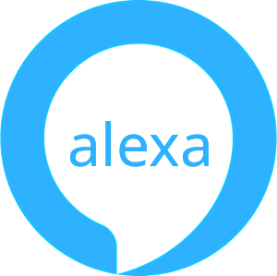
The Alexa Skill
Create skill that will interface from Amazon Echo to ROS Node (that can communicate with Baxter)
The skill handles the voice-related aspect of this project
Ex: “Alexa, “Alexa, ask Baxter the Robot to…”
The voice input from the echo is translated into text by the skill (expecting certain phrases termed “utterances”)
This “text” is then sent as a JSON response to a specific application/server, which is the AWS lambda function for this project

Slide 6
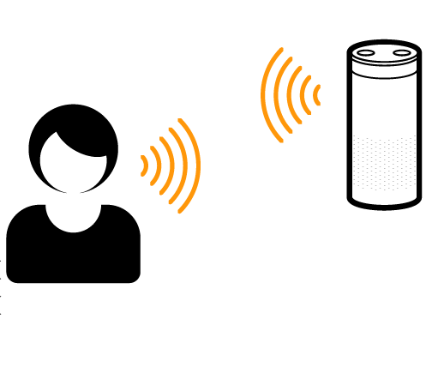
The Alexa Skill (cont.)
Alexa Skill was created using “Alexa Skills Kit” (ASK), which is a collection of tools for easily making skills
Bi-Directional Link – Sends recorded voice for translation, and returning text is also rendered through Alexa skill

Slide 7
The Alexa Skill – Intents and Utterances
When Creating Alexa Skill, must define voice interface where user will interact with the skill, using Intents and Utterances
Intents - An intent represents an action that fulfills a user’s spoken request
Intents are entered using JSON
Utterances - A set of likely spoken phrases mapped to the intents.
Name of Intent on Left, followed by phrase user might say

Slide 8
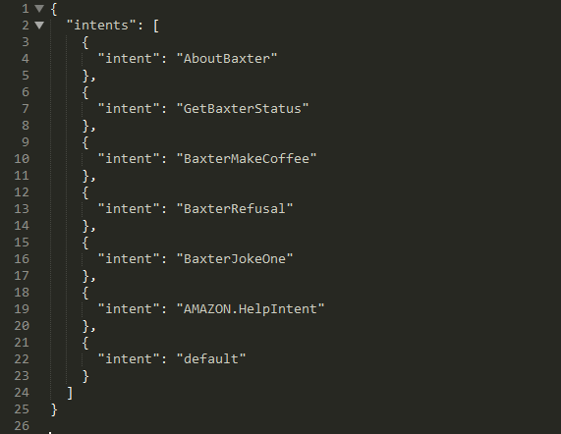
Alexa Skill - Intents

Slide 9
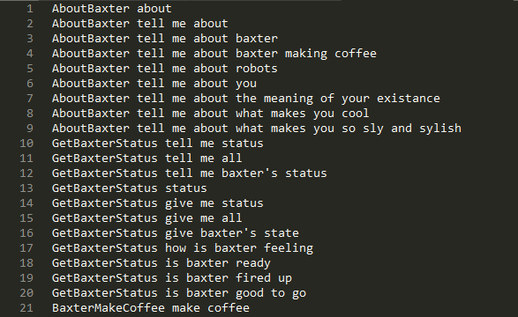
Alexa Skill - Utterances

Slide 10
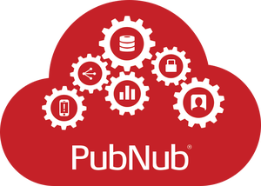
PubNub - What is it?
Acts as a MQTT Broker (MQTT is an ISO standard publish-subscribe-based messaging protocol) for ROS Node and AWS Lambda Function
Is a Global Data Stream Network (DSN) and realtime infrastructure-as-a-service (laaS) company based in San Francisco, California
Main Catch of PubNub is its realtime MQTT publish/subscribe messaging API built on their DSN (14 Data Centers worldwide)

Slide 11

PubNub - Importance
Publish/Subscribe paradigm, as subscribers to a particular “channel” will receive any and all message that are published to it
# of Subscribers doesn’t matter, published message delivered in < ¼ second
Stores a short (1 Day for project) history of messages
The Last message published will be grabbed for this project
Thus Lambda and ROS Node can communicate

Slide 12
PubNub – Project Details
Created an “App” with name “Baxter_Alexa”, which provided a Keyset (These Keys are required to publish and subscribe to this app)
“Publish Key” and “Subscribe Key”
Created 2 Channels for the app, as bi-directional communication is required, Channels “Baxter_Status” and “Alexa_Data”
Lambda knows status of Baxter, and ROS node knows of coffee request
In Publish/Subscribe, can specify channel (or use “default”)
Baxter Status Updated every 10 Minutes (via ROS Node)

Slide 13
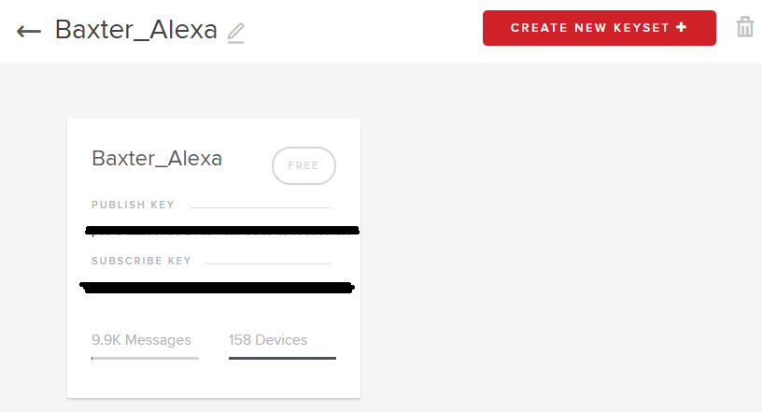
PubNub – Baxter_Alexa App

Slide 14
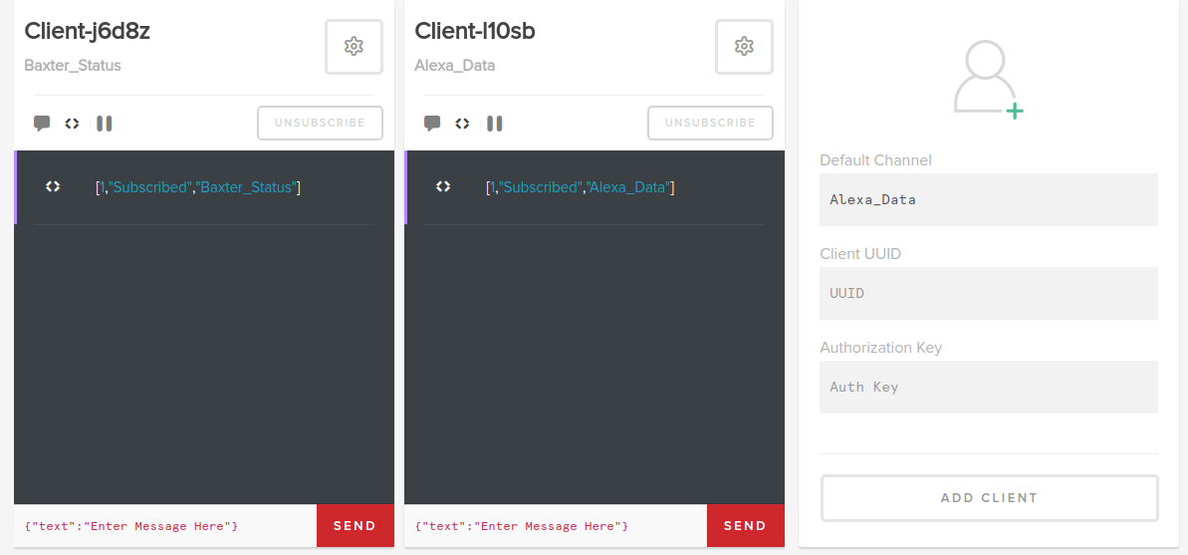
PubNub – The Two Channels

Slide 15
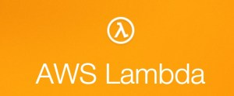
AWS Lambda Function - What is it?
AWS lambda is an Event-Driven, serverless, computing platform provided by Amazon (part of Amazon Web Services).
No server = no firewall = no messy problems = nice and simple
An AWS Lambda Function Runs code in response to “events” and automatically manages the compute resources required by that same code

Slide 16

AWS Lambda Function - Importance
Alexa Skill translates speech to text, and determines intent, it then sends that JSON response to some application/server
AWS Lambda Function is our application that interprets the JSON response, and actually “decides” what to do about the request you asked Alexa
Since AWS Lambda is event-Driven, it wakes up performs it task then exits, thus it has no “State” (PubNub has our state info)
Only awakes on request from Alexa for project

Slide 17
AWS Lambda Function – In Project
For one intent, “make coffee”, the lambda function needs to:
publish a message (request to make coffee) to the “Alexa_Data” channel
gather data (via MQTT history request) from PubNub from the “Baxter_Status” channel (via “Promises” – more on that later)
send JSON text response back to Alexa Skill (where then Alexa will speak result)
Node.js 6.10 is runtime environment for Lambda Function
Node.js® is a JavaScript runtime built on Chrome's V8 JavaScript engine. Node.js uses an event-driven, non-blocking I/O model that makes it lightweight and efficient
Thus JavaScript is the language used for the Lambda Function

Slide 18

AWS Lambda Function – About Promises
As I mentioned previously, the Make Coffee Intent did not subscribe to “Alexa_Data” channel
This is because Lambda function can’t be running all the time. Event-Driven request from Alexa wakes it up
Instead use “Promises” – a result of an asynchronous operation
Pending, fulfilled, or rejected “states” (once fulfilled or rejected, cannot be changed)
Thus “Promise.all” function call waits for the history of PubNub from statement “pubnub.history”, then builds response to Alex Skill afterword (Code Next Slide)

Slide 19
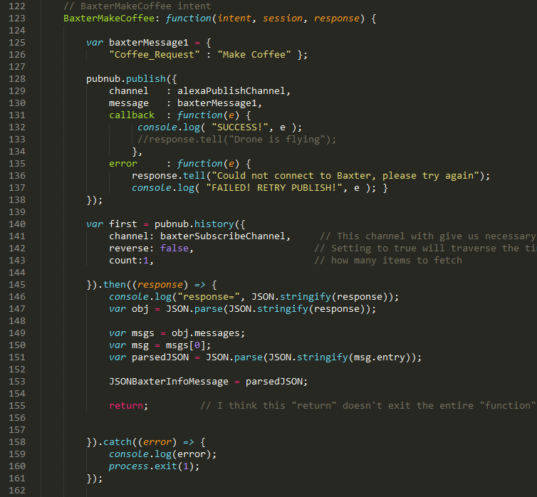
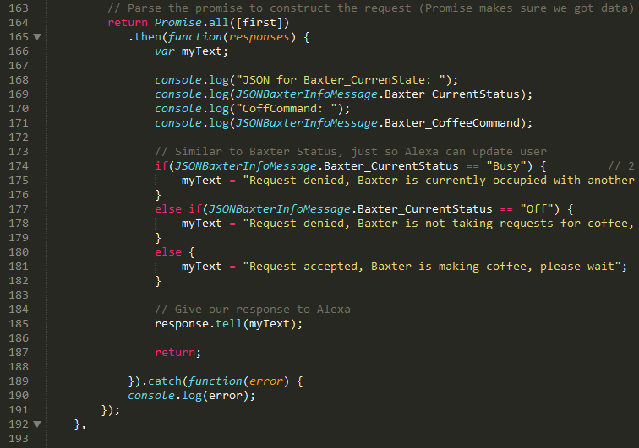
AWS Lambda Function – Make Coffee Intent

Slide 20

ROS Node - What is it?
ROS – (Robot Operating System) is a robotics middleware collection of software frameworks for robot software development
A ROS Node really isn't much more than an executable file within a ROS package
ROS nodes use a ROS client library to communicate with other nodes

Slide 21
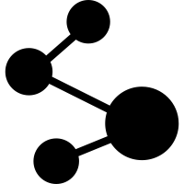
ROS Node - Importance
Allows communication with Baxter via ROS Nodes
Allows communication with other ROS Nodes
Can perform “normal” functions that are not ROS related (like publishing/subscribing to PubNub)
Fault tolerance (crashes isolated to indiv. Nodes)
Code Complexity reduced vs monolithic systems

Slide 22
ROS Node – In Project
ROS Node acts a “Listener” to Alexa, waiting for Alexa Coffee Request
ROS Node thus Subscribes to the “Alexa_Data” Channel
Anytime, a new message is published, Node will get the new message
ROS Node Publishes to “Baxter_Status” Channel
Provides “Status” of Baxter, this message is published every 10 minutes, or when Node is executed, requested to make coffee, or node is exited/turned off
Once a message to make coffee is received, make new thread to run “Coffee_Time” ROS Node (where Baxter makes coffee)
Update Baxter_Status During Execution as “Busy”, and “Ready” when finished

Slide 23
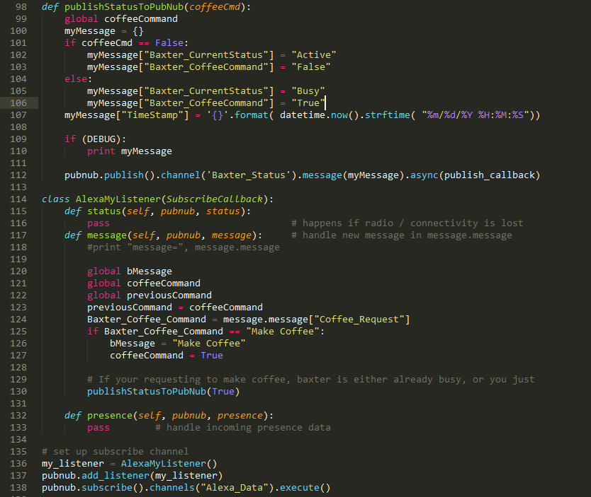
ROS Node – Publish/Subscribe to PubNub

Slide 24
Putting It All Together – Project Steps
Give Amazon Echo a Command
Interpret Voice Command (Voice to Text) via Alexa Skill
Lambda Function Determines What to Do with That Command
ROS Node Listens for Alexa Request
Lambda Function publishes request to make coffee, and grabs data from PubNub about Baxter_Status to send to Alexa Skill
ROS Node receives published message “make coffee”, begins ROS Node “Coffee_Time” and updates Baxter_Staus as “Busy”
Alexa Skill sends JSON response from Lambda to Echo (text to voice)
Baxter Finishes “Coffee_Time”, ROS Node updates Baxter_Staus as “Active”

Slide 25
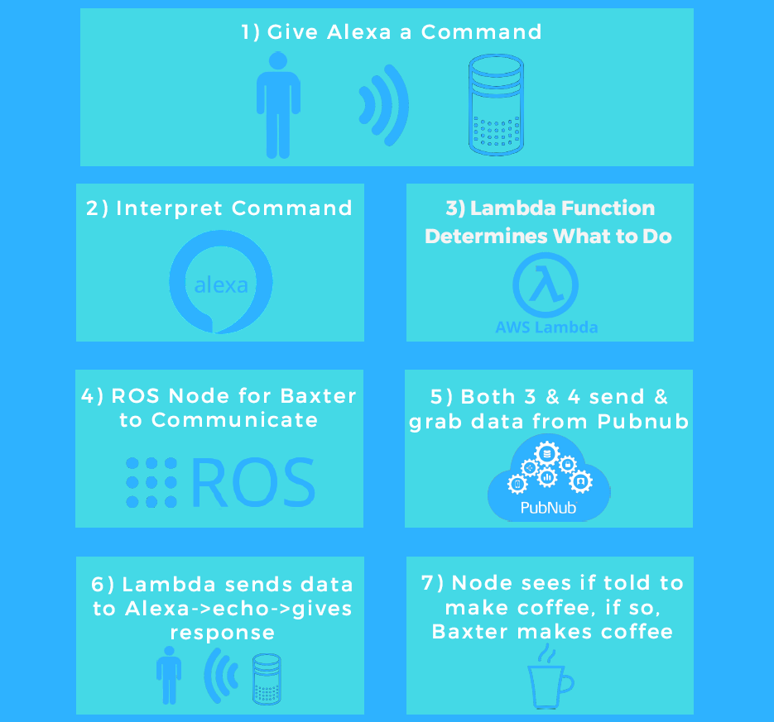
Project Steps - Visual

Slide 26

Thanks for Listening!

