Slide 1
The Energy Services Provider Interface (ESPI) for Green Button: The nature and format of standardized Energy Usage Information (EUI)
David Wollman, NIST
Marty Burns, Hypertek for EnerNex

Slide 2
Agenda
What/why EUI
Sources and Complexity of EUI
Comparison of XML to CSV formats
World Wide Web Consortium (W3C) technologies for EUI
Demonstration of flat XML-based file format and related file resources and opening EUI in web browser
The three-legged stool to lower barriers to interoperability

Slide 3
PAP 10 Charter Abstract
Customers will benefit from standardized energy usage information that enables them to make better decisions and take other actions consistent with the goals of Sections 1301 and 1305 of EISA. An understanding of energy usage informs better decisions about energy use and conservation, and is the basis for performance feedback on the operation of customer owned energy management systems and understanding device energy usage and management.

Slide 4

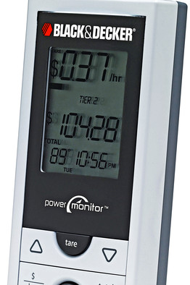
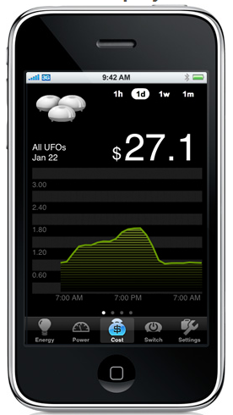
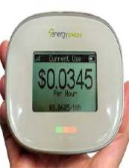


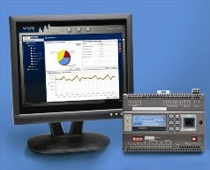
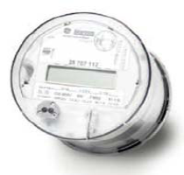
Usage Profile
Overall Usage
Economic

Slide 5
Evolution of Interoperability Through SGIP
EUI
IEC61968-9 (CIM)
UCAIug OpenADE
ZigBee SEP 2.0
EIS Alliance Use Cases
3rd Pty Access
NAESB REQ18/WEQ19 PAP10
OpenADE Use Cases and Requirements
NAESB REQ22
Inter op
NAESB REQ21
SGTCC , UCAIug ITCA, Cerification
CSWG Cyber Security, REQ22
OpenESPI Open Source
Products And Services

Slide 6
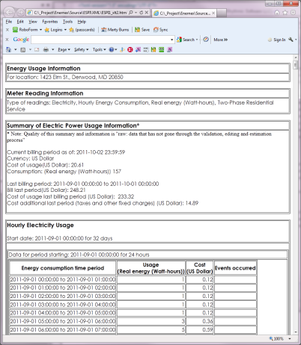
Diversity of information in EUI
Dimensions
Quality: Raw, validated, estimated, …
Source: Meter near real-time, utility back end, third party
Economics: Consumers need to know the cost of their consumed power (but we did not construct a pricing model)
Identification: by customer, device, location
Measurements of power, energy, gas, water, …
Kinds of Data
Readings
Interval data
Summary Information
Power Quality Metrics

Slide 7
Composition of Energy Usage Information
Best practices include modeling information in UML; generating documentation and Schemas directly from the UML for life cycle model and data management
UsagePoint
ServiceCategory
MeterReading
IntervalBlock
ElectricPowerSummary
IntervalReading
ReadingType
ElectricPowerQualitySummary
ReadingQuality
Note: This information is multidimensional. Many different reading types, summaries, and readings possible. i.e. not “flat”

Slide 8
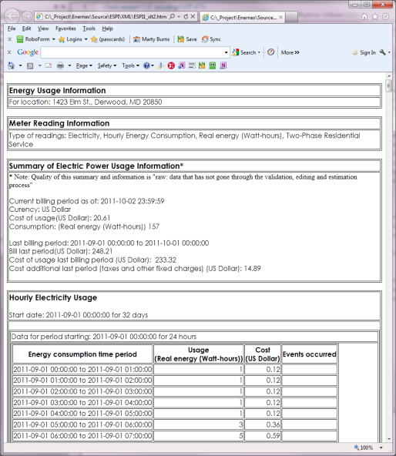
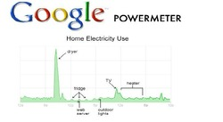
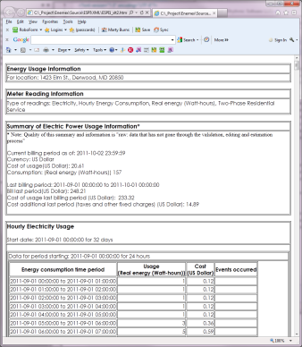


Alternate paths to EUI – single format
Sources of EUI
Single Data Format: all at once
Uses of EUI
Power Utility
Via: ESPI, HAN, Web Portal
Single Data Format: as sequence
Acknowledgements to graphics owners

Slide 9
Key attributes of file formats
XML
CSV
Pros:
Flexible hierarchical data structures
Can contain style description for user friendly presentation when opened in web browser
can be transformed into CSV
suitable for communications and database technologies
many other technologies built on XML: SOAP, atom etc, etc.
can be viewed as “flat file” – it is text
can be read by programs like excel
Cons:
Viewed in text editor is hard to read
Hard to explain raw form
Pros:
Human readable
“Easy” to open/view in Excel
Can be imported into database
Cons:
Open in Excel requires the consumer to have Excel and be able to use it
No internal tools for HTML production or user formatting
No hierarchical data structuring
No other technologies based on CSV
Can’t easily modify to add inserted new fields with backwards compatibility

Slide 10

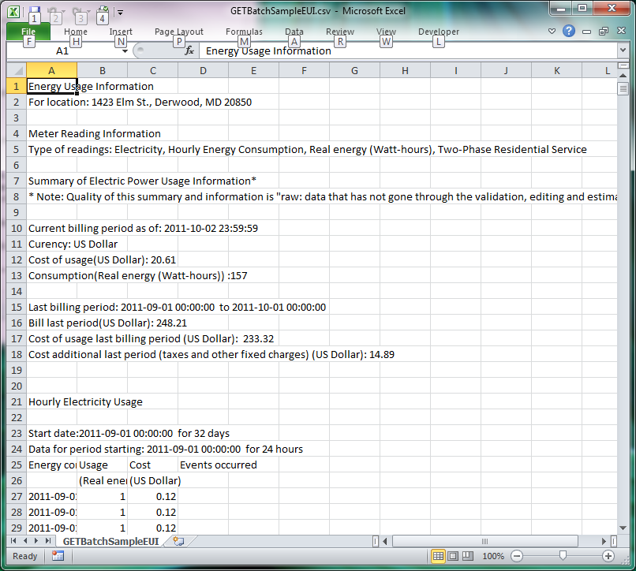
EUI XML vs. CSV
XML Rendered in Web Browser
CSV Rendered in Excel

Slide 11
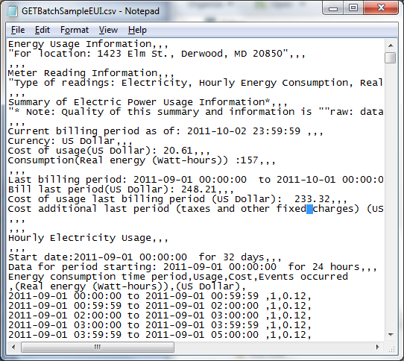
EUI XML vs. CSV
XML Rendered in Web Browser
CSV Rendered in notepad

Slide 12
Web Technologies for definition and presentation of EUI file format
X
XML Schema (XSD)
XML
XSLT
Describes the rules of file format
Contains customer EUI data in standard file format and references to XSD and XSLT
Defines how to transform for humans
Standard EUI file Format

Slide 13
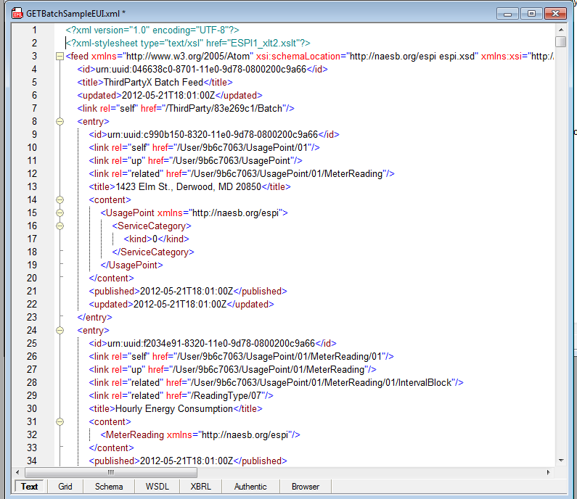
From XML to HTML via XSLT Transform
XML: Structured data in flat file
HTML: User Friendly Rendition

Slide 14
Demonstration
The XML File – The standard EUI file format
The XML Schema – The rules of the file format
The XSLT – Transforms the EUI file to web browser readable form
The HTML – what was viewed in Internet Explorer® and Fire Fox®

Slide 15
Ingredients for Successful Industry Level Interoperable and Managed Systems Development
Three Legged Stool: For Interoperable Products
UCAIug OpenADE Conformance
NAESB REQ18 EUI, REQ21 ESPI
INTEROPERABILITY ARCHITECTURE
1) Open Mature standards (SSO): Protocols, test schemas, object models
2) Involved User Group: Interoperability Agreements, Labeling, Testing, Issues Resolution
STANDARDS
REFERENCE DESIGNS
USERS GROUPS
EnergyOS OpenESPI
3) Reference/Sample implementations and Designs: Focused Development Projects, Developer Tools, Standards Implementations and test implementations, Open Source

Slide 16
Links
SGIP PAP10
http://collaborate.nist.gov/twiki-sggrid/bin/view/SmartGrid/PAP10EnergyUsagetoEMS
NAESB REQ21 ESPI, REQ18/WEQ19 PAP10 EUI
http://www.naesb.org/espi_task_force.asp
http://www.naesb.org/smart_grid_PAP10.asp
EnergyOS
Web Site: http://www.openespi.org
Repository: https://github.com/energyos/OpenESPI
Mail List: energyos_espi@googlegroups.com
UCAIug OpenADE:
http://osgug.ucaiug.org/sgsystems/OpenADE/default.aspx
INTEROPERABILITY ARCHITECTURE
STANDARDS
REFERENCE DESIGNS
USERS GROUPS

