Slide 1
Antitrust Admonition
Kathy Scott
July 24, 2015

Slide 2
Introductions
Kathy Scott
July 24, 2015

Slide 3
Improving Third Party Access to SMT Workshop Goals and Steps
Goal – Improve Third Party access to Advanced Metering energy data and HAN devices
How -
Conduct a series of workshops to discuss potential improvements and a conceptual plan to accomplish those improvements
Level set governance, rules, boundaries and criteria that short term, mid term and long term enhancements must follow – Completed in Workshop 1 Day 1
Level set the potential processes to be utilized to promote and possibly implement short term and mid term improvements – Completed in Workshop 1 Day 2 (the long term improvement process is not yet known)
Define potential short term and mid term enhancements to the existing solution
Define a conceptual long term strategy for potential future improvements
Create a plan outlining the possible short, mid and long term improvements

Slide 4
Improving Third Party Access to SMT Workshop Rules of Engagement
Ask questions during the speakers presentations and participate interactively during the workshop
There are no bad questions
Use the microphones provided in the room
Mute cell phones
Take unrelated discussions outside of the room
Limit side bar discussions
Restrooms are located around the corner just past the elevators
Be creative there

Slide 5
Agenda Day 2
1. Antitrust Admonition | Kathy Scott | 9:00AM
2. Introductions | Kathy Scott
3. Identify and overview the Texas competitive market, SMT, and third party access materials | Andrea O’Flaherty / Donny Helm
4. Analyze SMT’s third party access strategy, design, and development | Donny Helm / Andrea OFlaherty
5. Review existing SMT third party access capabilities and features | Andrea O’Flaherty / Donny Helm
6. Define new third party access goals and plans | Doug Lewin
------------------------------ Lunch Break---------------------------------
7. Develop a strategy for identifying potential third party access improvements to support goals and plans | Michael Murray
8. Discussion on access to the outflow/generation channel of the advanced meter data | Larry Howe
9. Discussion on making more utility consumers aware and signed up for SMT | Larry Howe
10. Document action items and next steps | JohnSchatz /Esther Kent
11. Adjourn |  | 3:30PM

Slide 6
Identify and Overview the Texas Competitive Market, SMT and Third Party Access Materials
Andrea OFlaherty and Donny Helm
July 24, 2015

Slide 7
Texas Market, SMT and
Third Party Access Materials
Overview of SMT:
http://www.ercot.com/committees/board/tac/rms/amwg/ under key documents
Understanding of SMT:
http://www.ercot.com/committees/board/tac/rms/amwg/ under key documents
SMT Third Party Access:
http://www.ercot.com/committees/board/tac/rms/amwg/ under key documents
Customer User Guide:
Available to SMT Registered Customers when Logged into SMT
REP (ROR) User Guide:
Available to SMT Registered REPS when Logged into SMT

Slide 8
Texas Market, SMT and
Third Party Access Materials
Third Party User Guide:
Available to SMT Registered Third Parties when Logged into SMT
Third Party Training Materials:
http://www.ercot.com/committees/board/tac/rms/amwg/ under key documents
Third Party Navigation Tool Prototype
http://www.ercot.com/committees/board/tac/rms/amwg/ under key documents
Third Party Starter Kit:
Available upon successful SMT portal account registration
*All of these documents can be requested through the SMT help desk. The Third Party Starter Kit does require validation of an SMT registered account.

Slide 9
Analyze SMT’s Third Party Access Strategy, Design, and Development
Donny Helm and Andrea OFlaherty
July 24, 2015
9

Slide 10

SMT Third Party Access Was Designed Within This Physical Texas Model
Advanced Metering System (AMS) – The Players
Retail Electric Providers
Third-Parties (+170)
Daily 15 Minute Settlement Transactions and Market Transactions
TDSP IT System (7)
ERCOT
( Monthly Meter Readings and Daily 15 Minute VEE Data )
Optional Path
for Retail
Electric
Provider
HAN Services
Market Transactions
Meter / HAN Services (thru Oncor system) and Daily 15 Minute VEE Meter Data
Meter / HAN Services
( Daily and 15 Minute Meter Data)
Historic Daily 15 Minute VEE Meter Data and limited Meter / HAN Services
SMART METER TEXAS
Host (IBM)
Consumers (X 3 million)
Daily and 15 Minute Meter Data
Perform HAN Transactions
10

Slide 11
SMT Third Party Access Was Developed to Within These PUC-Approved Provisions
Key Provisions Approved:
SmartMeterTexas (SMT) is the conduit for customer information
Customer must opt-in rather than opt-out
Customer can grant or revoke access to a third party of their choice at any time
Customer must accept or reject the Access Agreement through electronic authorization prior to information being provided to Third-Party
Agreement lengths vary in duration and customer can choose length
Process is driven by security & customer data privacy with verification through SMT
Disclosures are provided to the customer that they control and manage their agreements with third parties, that third parties are not regulated by a state agency and that customers should read and understand third party privacy policies before accepting an agreement

Slide 12
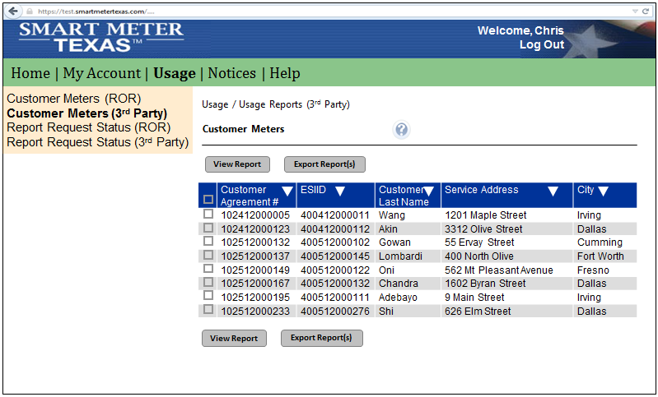
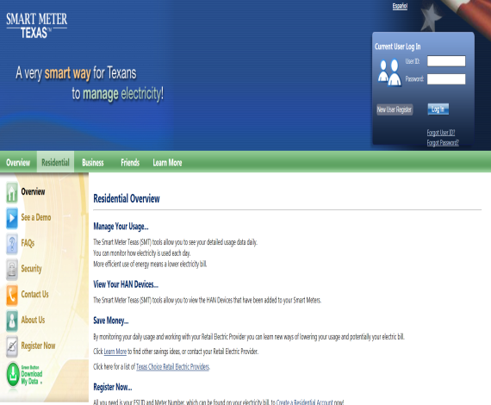
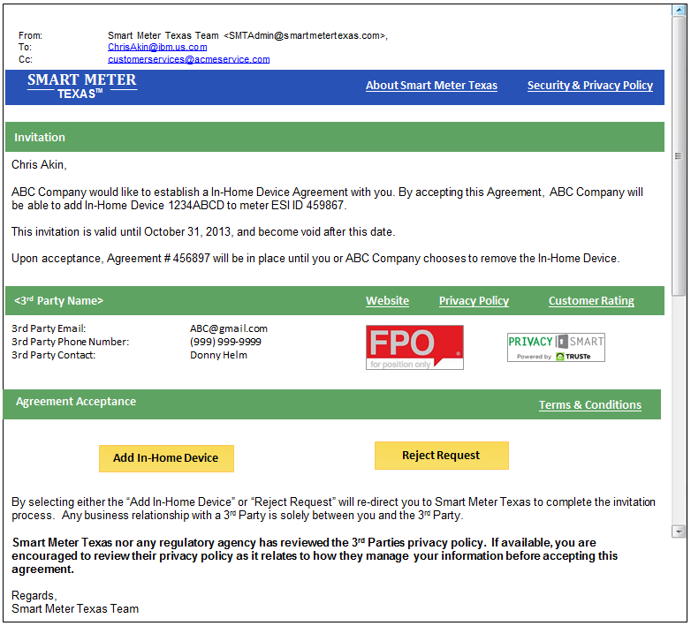
Third Party Access Strategy
Customer
“Accept / Reject
Agreements”
Third-Party
“Create / Manage
Agreements”
SMT
“Process
Agreements / Information”
12

Slide 13
Overview of SMT Third-Party Functional Rules
Third-Party Registration and Account Management
Third-Party is required to have an SMT account.
REP SMT accounts will have the same functionality as an Independent Third-Party.
Independent Third-Party account model will follow the same processes and business rules as REP accounts (e.g.: Admin/User model).
Third-Party may provide SMT their company logo, URLs to their website and privacy policy, and confirm that they have met the requirements for a Privacy Seal during new account registration.
Customer Agreement Invitations for Third Party Access
Third-Party may invite Customers that do or do not have an SMT Account to an Agreement.
Customer is required to have an SMT account to accept the Agreement Invitation.
Third-Party Access To Customer Energy Data
Customer must accept the Energy Data Agreement to allow SMT to begin provide information to Third-Party.
Third-Party can acquire up to 12 months of Customer Historical Data per Agreement.
Third-Party can acquire future Customer Historical Data per same Agreement until agreement is expired.
The Energy Data Agreement may have a terms of up to 1 year only.
Customer can terminate the Energy Data Agreement at any time.

Slide 14
Overview of SMT Third-Party Functional Rules
Third-Party Ability to Provision / De-Provision Customer In-Home Device (HAN)
An In-Home DEVICE Agreement authorizes a Third-Party to provision and de-provision an In-Home Device with the Customer’s Smart Meter.
An In-Home DEVICE Agreement does not enable a Third-Party to send In-Home Device messages to Customer’s In-Home Device.
Customer must accept an agreement invitation to allow the Third-Party In-Home Device to be provisioned with the Customer’s meter.
Provision / De-Provision process must follow Smart Energy Profile (SEP) 1.0 standard.
The Third-Party ability to provision / de-provision In-Home Devices will remain in effect until the In-Home Device is de-provisioned from the meter, or either the Customer or the Third-Party terminates the Agreement.
Third-Party Ability to Provide Customer with In-Home Device Messaging Services
An In-Home Device SERVICES Agreement authorizes a Third-Party to communicate with a Customer’s In-Home Device using SEP 1.0 messages. An agreement can specify any combination of simple text, pricing and/or load control message types.
An In-Home Device SERVICES Agreement does not enable a Third-Party to provision or de-provision a Customer’s In-Home Device.
Customer must accept agreement invitation before the Third-Party is able to send In-Home Device messages (e.g. Load Control, Pricing, Text).
In-Home Device messages must follow Smart Energy Profile (SEP) 1.0 standard.
The Third-Party In-Home Device Messaging Services will remain in effect until the Customer or the Third-Party terminates the Agreement.

Slide 15
Review Existing SMT Third Party Access Capabilities and Features
Andrea O’Flaherty and Donny Helm
July 24, 2015
15

Slide 16
SMT Third Party Integration
Register and Create a Third Party Account on SMT
Receive an SMT Third Party Starter Kit from SMT Support
Open Help Desk Ticket to Set Up a Conference with SMT Support to Review the SMT Third Party Starter Kit with Discuss Next Steps and Ask Question
Prepare for FTPS Integration per SMT Starter Kit Instructions
Open a Help Desk Ticket to Work with SMT Support to Integrate with SMT FTPS
Prepare for API Integration per SMT Starter Kit Instructions
Open a Help Desk Ticket to Work with SMT Support to Integrate with SMT API

Slide 17
SMT Third Party Capabilities and Features
SMT Third-Party Navigation Prototype
This tool can be found at
http://www.ercot.com/committees/board/tac/rms/amwg/ under key documents

Slide 18
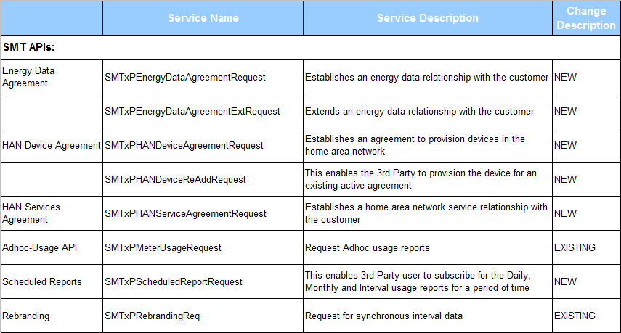
SMT Third Party Capabilities and Features

Slide 19
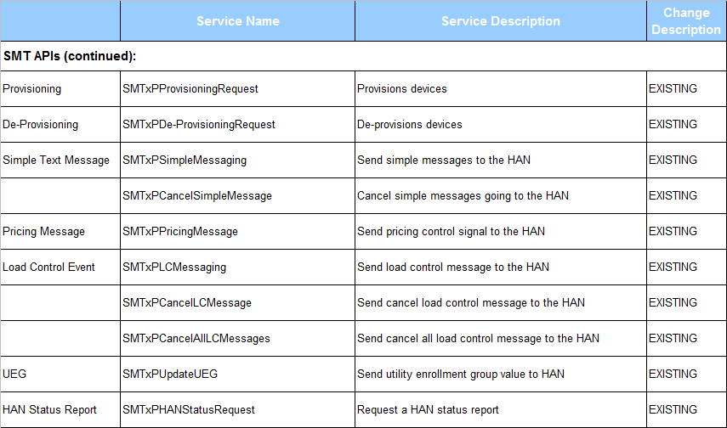
SMT Third Party Capabilities and Features

Slide 20
SMT 3rd Party Data Access Goals
Doug Lewin, SPEER
July 24, 2015

Slide 21
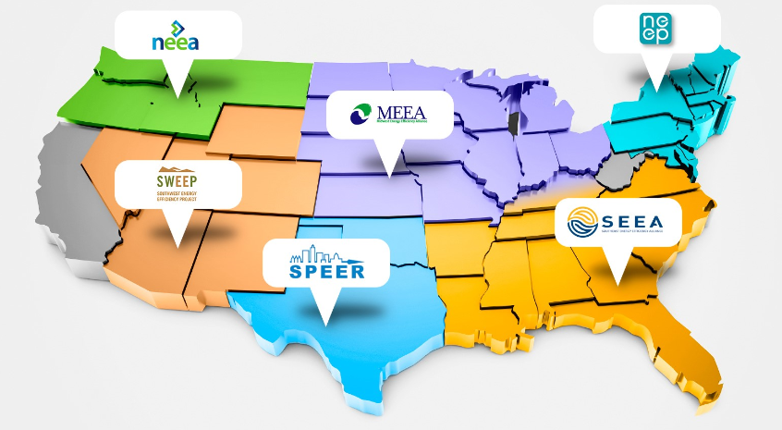
What is SPEER?
Member-based, 501(c)3 non-profit organization
Mission to accelerate adoption of energy efficient products, services, and technologies.
One of six Regional Energy Efficiency Organizations (REEOs)
Founded in 2011
47 members
Our goal: drive EE
through use of data

Slide 22
Objectives from the Agenda
Define new third party access goals and plans
Develop a strategy for identifying potential third party access improvements to support goals and plans

Slide 23
Overview
Goal: Make data access and sharing easier for customers and third parties trying to serve them.
BIGGER GOAL: “Smart Meter Texas was created to help families save money.”
To achieve the goal, need more participation, greater convenience.

Slide 24
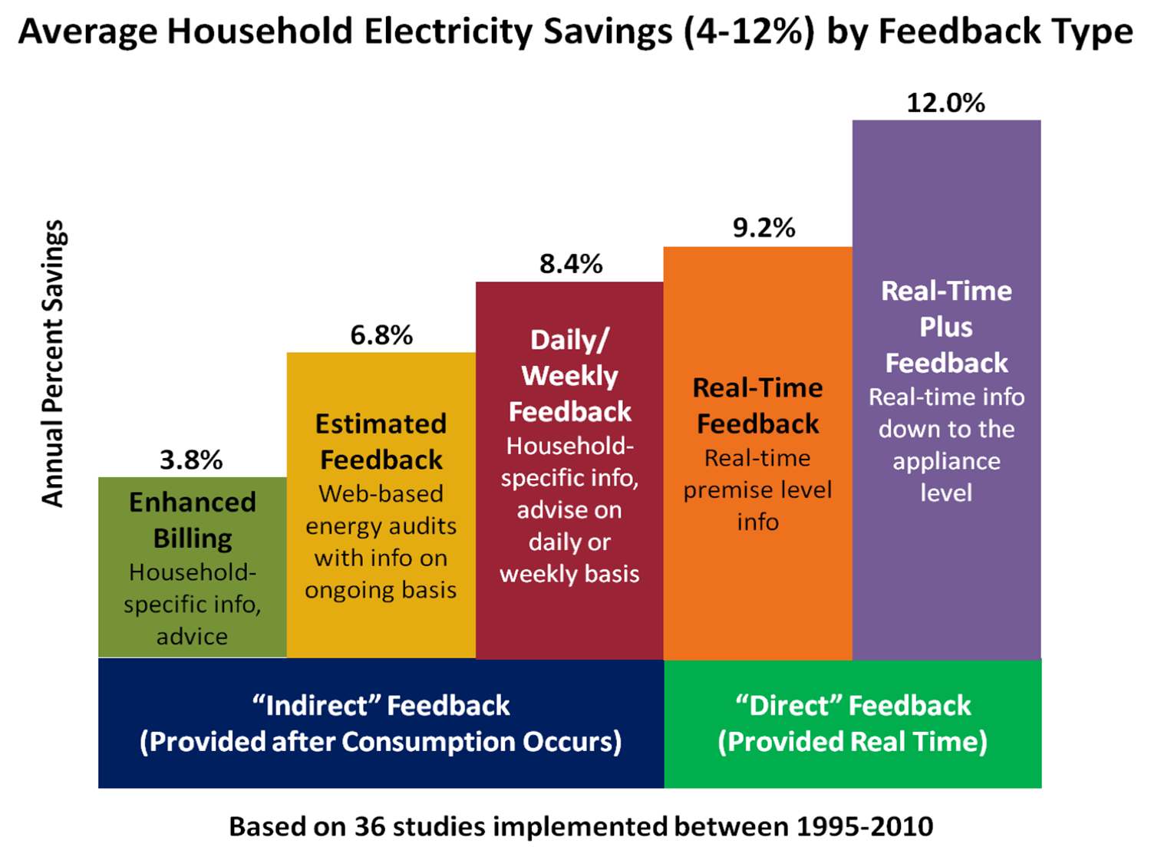
Why is data access important?
Source: ACEEE

Slide 25
Make It Easier
Most third parties report sign up process is biggest barrier to usage.
Several reported giving up on SMT because customers would not create an account, and if they did, would not login second time.
Even if they did register and then login second time, must do it again to extend.
Others reported giving up because process of using SMT API was too difficult, customer support inadequate.
Many reported issues with functionality and reliability of site.

Slide 26
Current State
To share data with a third party, a customer must:
Create an account.
Requires:
ESIID
Meter Number
Username and Password
Login a second time
Receive an email from the third party within the SMT site, accept the invitation to share data.
Customer must renew the agreement each year by logging in, receiving the email again, accepting again.

Slide 27






Current 3rd Party SMT Customer Registration Process
3rd Party SMT
Invitation
Generation
SMT 3rd Party Invitation
Email To Customer
3rd Party
Service Provider
Customer Initiation of
3rd Party Energy Service
Click
Yes
Potential
New Acquisition
Barriers
New SMT
Customer
Request New
SMT Account
Customer
Acceptance
Click
Yes
SMT Account
Registration
Confirmation Email
3rd Party Service Provider
Customer

Slide 28
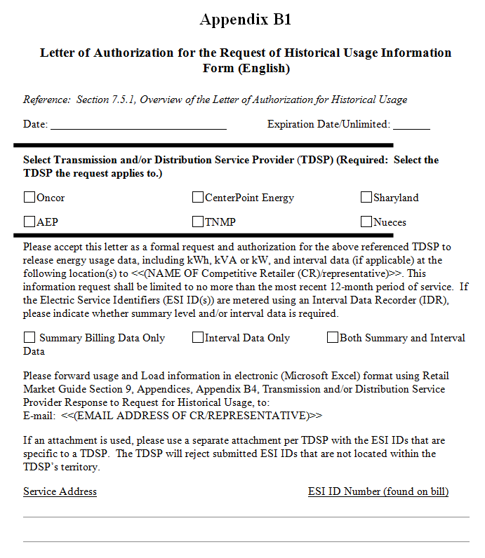
Contrast with LOA Process
LOA requires only ESIID and service address.
It’s easy to use and widely used.
If you’re using paper to share data, you should be able to grant SMT data access.
If you’re going online to share data, shouldn’t be more onerous than paper process.

Slide 29
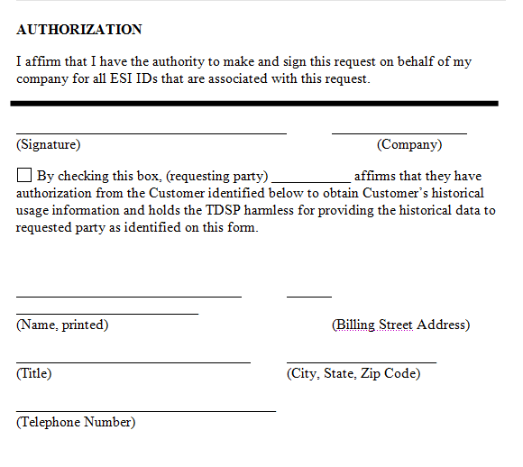
LOA, page 2

Slide 30
Current Issues
From the customer’s perspective, current SMT process requires disjointed engagements/follow-ups for 3rd party and SMT registration.
A UX barrier to new customer acquisition
Likely major reason for <1% customers using SMT
Difficult for 3rd party to track and resolve a customer SMT registration issue.
Customer provided a wrong/erroneous information
Some customers don’t know they already have SMT account but apply for the new SMT account.
Customer is not responding to SMT acceptance/confirmation emails.
III. Must have new agreement each year.

Slide 31


Proposed 3rd Party SMT Customer Registration Process
Third party has pre-registered with SMT. Third party submits authentication information to SMT
Customer provides authorization
and authentication to third party to help them manage data, save money, examine new rates, etc.
1
2
Customer
3rd Party
Service Provider
Third party provides services to customer. Customer may revoke access at any time by written request, or by creating an SMT account and revoking it.
SMT adds customer to third party’s energy data agreement list, allowing them access.
4
3

Slide 32
Alternative: Proposed 3rd Party New SMT Customer Registration Process
I. Customer registers 3rd party service with 3rd Party
LOA like delegation to 3rd party - revocable and exclusively limited to SMT registration process and SMT 3rd party data access permission
SMT registration related customer information
Name
Home address
ESIID
Meter number
Potential user IDs for SMT
Security question & answer for SMT
3rd party handles current SMT registration interactions on behalf of the new customer until completion
3rd party responds to customer’s SMT correspondences
Store and forward copies of all SMT registration correspondences to customers
Continuous interactions with customers to track registration progress and resolve any arising issue

Slide 33
Alternative: 3rd Party Registers Customer on SMT
3rd Party
Service Provider
Registration
New SMT account
3rd party invitation initiation
SMT Confirmation
New SMT account
3rd party invitation confirmation
3rd Party Energy Service
Customer Registration
Customer LOA for 3rd party service and SMT registration
Customer Info
SMT Registration
Status Tracking
& Updates
Customer Acceptance
New SMT account
3rd party invitation acceptance
Customer

Slide 34
Benefits
Easier for customers and third parties.
A convenient single customer interface channel , generally better UX for customers.
3rd parties reach broader new customer base for SMT portal usage.
More customers using energy data to save money, which is the stated goal of SMT.

Slide 35
Goals: Make it Easier
Allow federated access through third party websites.
Expand LOA process to include SMT data.
Make longer term agreements possible and renewals easier.

Slide 36
Attributes of Successful Data Access Systems: Lessons learned from California and Illinois
Michael Murray Chief Technology Strategist
July 24, 2015

Slide 37

Who is Mission:data?
32 companies
Data-driven energy management services
Residential and commercial/industrial
“Backhaul” data and Home Area Network
$1.0 billion/yr in North America

Slide 38
California: data access context
Green Button “Download My Data” since 2012
HAN pairing available but little used (<0.02%)
Green Button “Connect My Data” aka ESPI
2011 privacy decision invited applications for backhauled data access to customer-authorized third parties (3Ps)
Tariff “advice letters” filed March ’14 ($28.0M)
Implementation is live for PG&E, SDG&E
So. Cal Edison still closed (for unknown reasons)

Slide 39

California: Challenges and Potential Solutions
Issue with backhaul data | Suggested improvement
Not all customers have a utility website account | Allow telephone authorization and 3P-driven process (like LOA)
Up to 24-hour delay between GBC authorization and data transmission | Invest in I.T. to transmit in seconds, not hours
No API exists for HAN pairing | Ex: solar inverters, HEMS
Resi billing interval ≠ ISO interval | Provide reprogramming at no cost to DER provider
Poor tech support & response times | Mandate SLA; be specific in rules
24-hr delayed data was not revenue quality | Update using “QualityOfReading” flag in Green Button
3P services “buried” in utility website | Allow “handoff” beginning with 3P website for optimal UX
…If authorization has friction, scraping will grow!

Slide 40
Illinois: data access context
Energy Infrastructure Modernization Act led to AMI; roll-out underway
“Open Data Access Framework” is active proceeding petitioned by CUB/EDF (#14-0507)
Follows resolution of data access for retail energy suppliers (RES) for non-billing purposes (#14-0701)
“Principles” of ODAF include:
Convenient customer access to energy and cost data
Data format & transmission must be standards-based
Third parties receive 24-months historical data upon authorization
Backhaul access and Home Area Network
Free of charge
Comprehensive requirements enumerated up front will probably lead to a better system than California’s

Slide 41
Attributes of Data Access Systems
Attribute | Considerations & best practices
3P-led authorization | Should such a method exist? Must define minimum info for customer authentication with reasonable certainty.
Authorization language | Should be standardized. Avoid putting utility in position of policing. Disclosure should satisfy AG.
Historical data upon authorization | 24+ months historical data is best practice due to EE M&V needs.
Authorization term | Let the customer specify term, including “authorized until rescinded.” Consider a default term to balance risk of fraudulent consents. Consider annual notices for longer terms.
Latency | HAN: instant Backhaul: historic data instant, daily thereafter

Slide 42
Attributes … cont’d
Attribute | Considerations & best practices
Independent certification | ESPI (NAESB REQ.21) now has independent certification done by the Green Button Alliance. Certification should be mandated.
3P eligibility | California is a good model: (i) contact information, (ii) successful technical interoperability, (iii) acknowledge receipt of tariff rules, (iv) not be banned by the Commission
Jurisdiction over disputes | Clarify Commission boundaries over 3Ps; utility enforcement role (ideally none); recourse avenues for victims of abuse
Utility liability if 3P breach | Clarify liability of the utility (TDSP in TX) following 3P breach (ideally none)
Termination matters | What is the process? If a 3P led the authorization process, how is authorization rescinded?

Slide 43

Thank You
Michael Murray
Chief Technology Strategist
michael@missiondata.org
510-910-2281

Slide 44
Appendices

Slide 45
Solving “Revenue quality”
UsageSummary of ESPI
<content>
<espi:UsageSummary> ...
<espi:currentBillingPeriodOverAllConsumption>
<espi:powerOfTenMultiplier>0</espi:powerOfTenMultiplier>
<espi:timeStamp>1395374400</espi:timeStamp>
<espi:uom>72</espi:uom>
<espi:value>447993</espi:value>
</espi:currentBillingPeriodOverAllConsumption>
<espi:qualityOfReading>17</espi:qualityOfReading>
<espi:statusTimeStamp>1395374400</espi:statusTimeStamp>
</espi:UsageSummary>
</content>

Slide 46
Improving UX: Example from PG&E

Slide 47
Access to Outflow / Generation Channel
Larry Howe (TXSES)
July 24, 2015

Slide 48
Overview
Rooftop solar/DG consumers drive the market for increased “energy awareness” and therefore increased opportunities for 3PP
A very high percentage of rooftop solar consumers have SMT accounts
DG Monthly Validation
Time interval chart comparisons
What’s possible from 3rd party providers (3PP)
Near Real Time monitoring

Slide 49
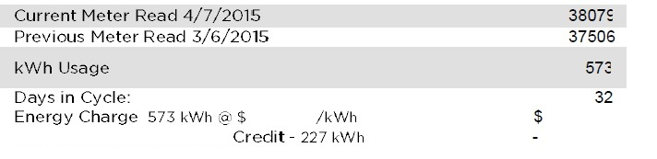
DG Monthly Validation
Consumer needs access to inflow and outflow register values monthly to validate bill (from REP)
In example below, meter reads provided for inflow, but not outflow, which for this example were 1916 (current), 1689 (previous)
Currently SMT provides outflow interval data (csv export only) requiring consumer to “reconstruct” monthly outflow register value – this needs to improve!

Slide 50
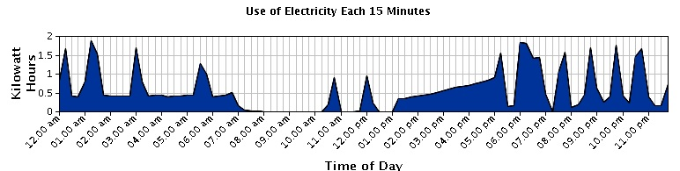
Time interval chart comparisons
15 min chart currently available from SMT
15 min bar chart
with outflow included
Need outflow data included
(example shown below)
Alternative 1 hr interval with outflow included

Slide 51
Usage trends - weekly charts (in the future from 3PP?)
Total Used
41.2 kWh
=
Gen +11.0
In +32.6
Out –2.4
34.6 kWh
=
+5.5
+29.3
–0.2
60.2 kWh
=
+23.7
+41.0
–4.5
74.8 kWh
=
+26.4
+54.7
–6.3
73.8 kWh
=
+26.5
+53.3
–6.0
77.5 kWh
=
+25.6
+58.1
–6.2
74.2 kWh
=
+21.4
+57.8
–5.0

Slide 52
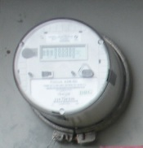
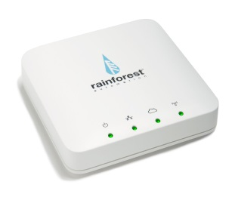
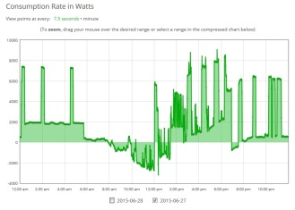
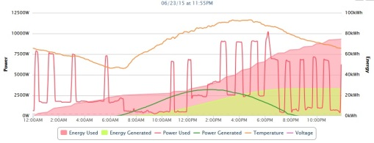

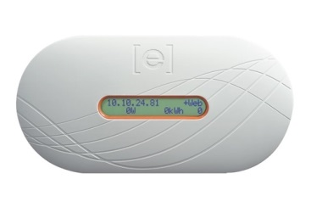
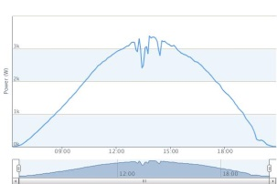
“My” Energy Monitoring Example Combining Inflow, Outflow, and Generation
Onsite elements/devices
Internet/Cloud Applications
Rainforest Eagle Ethernet Zigbee Gateway
Advanced
Meter
Wattvision
PVOutput
Enphase Envoy
Enlighten
PV Array

Slide 53
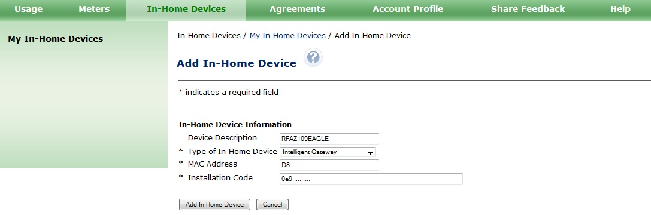
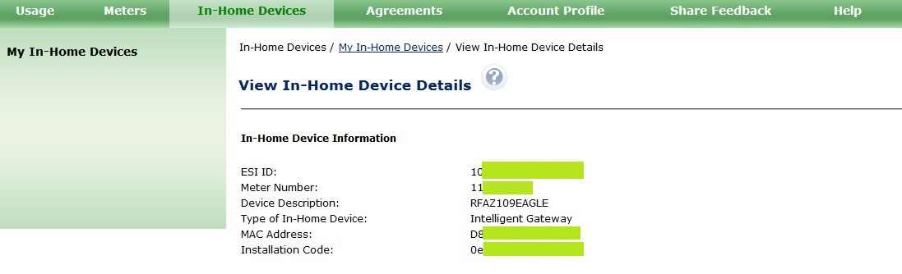
SMT setup for In-Home Gateway

Slide 54
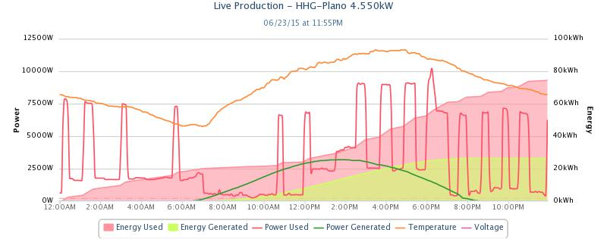
Near real time example (PVoutput)
Notes:
Total power used at home (shown in red line) = inflow from grid + generation – outflow to grid
Level 1 EV charging from about 12am to 7am
Largest peaks are A/C
Pool pump runs from about 12pm to 7pm, with pool sweep from about 1-2pm

Slide 55
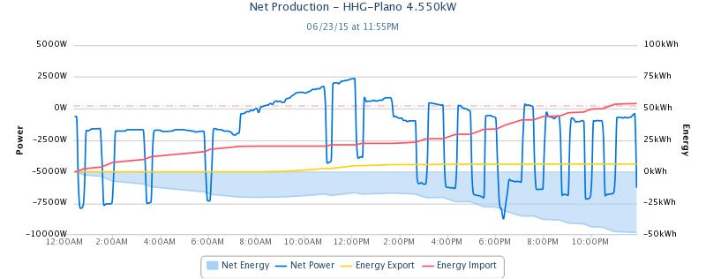
Near real time example (PVoutput)
Notes:
Showing net power (to/from grid) = inflow from grid (as negative) – outflow to grid (as positive)

Slide 56
Increase Consumer Awareness of SMT
Larry Howe (TXSES)
July 24, 2015

Slide 57
Increase Consumer Awareness of SMT– more market opportunities for 3PP
Organization Outreach to members
Business Outreach to customers
Retail Electric Service Providers and TDSP customer touch points
Agency Outreach

Slide 58
Organization & Business Outreach Opportunities
Organization Outreach to members
SPEER,
TXSES,
Sierra Club,
Environment Texas,
others
Business Outreach to customers
Solar installers,
A/C contractors,
Energy Auditor/Mgmt businesses,
other residential energy related businesses

Slide 59
Electric Utilities Outreach ideas
Retail Electric Service Providers
Note about SMT (URL) included with every electric bill
Periodic SMT Bill insert
Target all users that have paperless billing – automatically sign up users to SMT when the sign up for paperless billing
With opt-out option
Organize competition between REPs to see which REP can increase SMT usage (% of customers)
At customer signup with REP for electric service, automatically sign customer up for SMT if not already signed up
With opt-out option
TDSP customer touch points?
Organize competition to see which TDSP can increase SMT usage (% of customers)

Slide 60
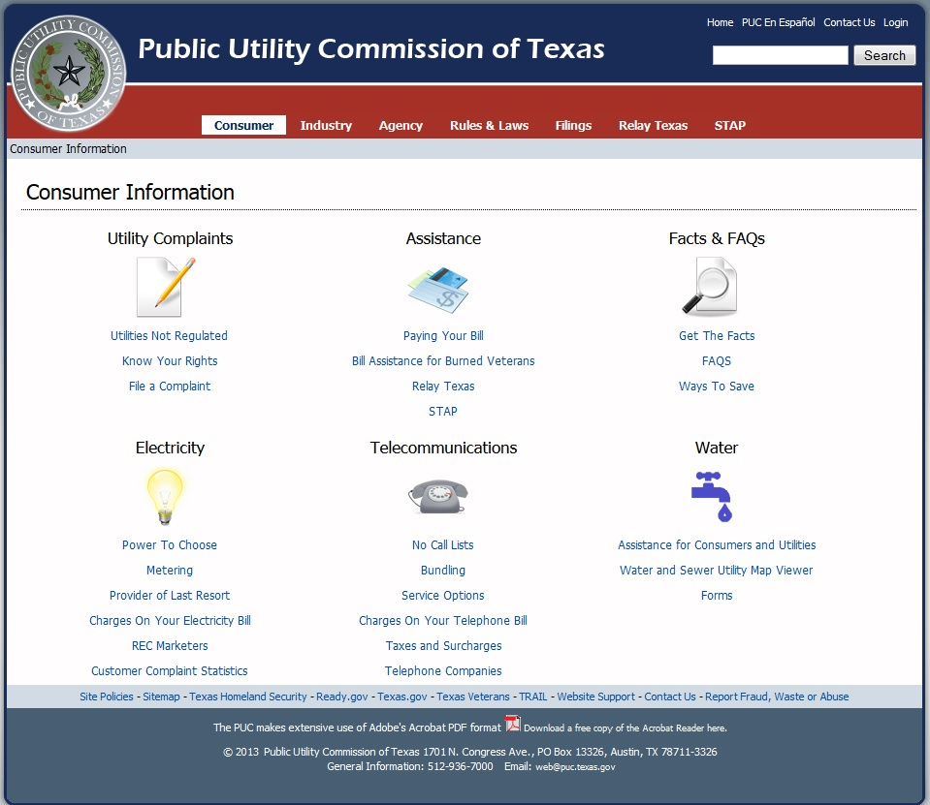
Agency Outreach
Add SMT here
SMT website improvements
ADD explanation page – why use SMT

Slide 61
Action Items and Next Steps
John Schatz and Esther Kent
July 24, 2015

