Slide 1
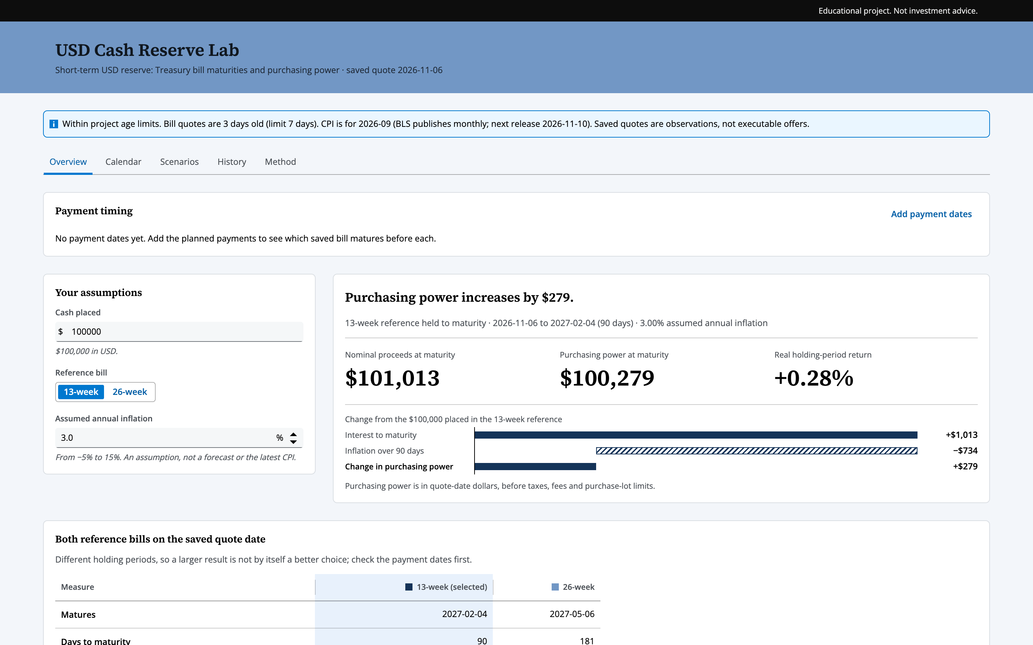
USD Cash Reserve Lab
Backup slides
When is the cash there for each payment, and what does inflation do to it meanwhile?
Group 9 · BMS5312 Fintech Management
Live dashboard demo, 5 minutes
Notes:
Backup slides. The talk itself is the live dashboard.

Slide 2
Who is the user, and what is the page for?
Speaker 1 · The user and the question
The user
A benchmark for the reserve
A family-office client and their advisor
A US-dollar reserve for payments in the next few months: tax, tuition, a household budget
Today: spreadsheets and
separate data websites
Timing: will the cash be there on time? The calendar checks all seven saved bill maturities.
Value: what happens to purchasing power in the safest short-term bills? Two reference bills, 3-month and 6-month, the maturities the Federal Reserve publishes in H.15.
Which bill to buy, and anything beyond the reserve, stays with the advisor.
Notes:
Our user is a family-office client and their advisor. The family keeps a US-dollar reserve for payments in the next few months: a tax instalment, tuition, a household budget. Every number comes from official sources, and the banner shows how old each one is. The page is a benchmark for that reserve. First, will the cash be there on time? The calendar checks all seven saved Treasury bill maturities. Second, what happens to its purchasing power in the safest short-term bills? Here we use two reference bills, the 3-month and the 6-month, so we all work from the same numbers. Which bill to buy, and anything beyond the reserve, stays with the advisor.

Slide 3
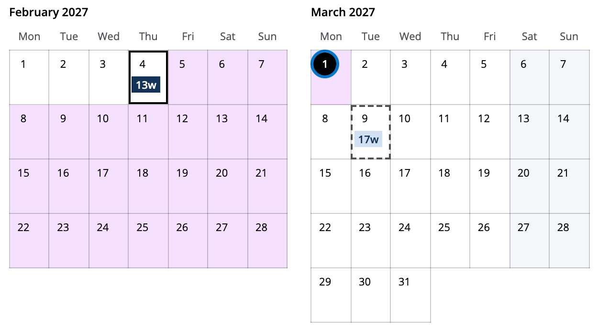
When is the cash there for each payment?
Speaker 2 · Live dashboard
Tuition, Monday 1 March 2027
Fixed USD payment
13w
Matures on or before: 13-week bill, 2027-02-04
Cash waits 25 days, no return assumed
17w
Next maturity: 17-week bill, 2027-03-09, 8 days late
So it would have to be sold before maturity at an unknown price
Calendar fit by payment
Payment | Date | Matures on or before | Cash waits | Next maturity after
Property tax instalment | 2027-01-15 | 8-week · 2027-01-05 | 10 days | 13-week · 2027-02-04, 20 days after
Tuition | 2027-03-01 | 13-week · 2027-02-04 | 25 days | 17-week · 2027-03-09, 8 days after
Spring household budget | 2027-04-15 | 17-week · 2027-03-09 | 37 days | 26-week · 2027-05-06, 21 days after
Notes:
Let me load three example payments and pick tuition, on the first of March 2027. The latest bill that matures before it is the 13-week, on the fourth of February. So the cash waits 25 days, shown in purple. The next bill, the 17-week, matures on the ninth of March: 8 days too late, so it would have to be sold early at an unknown price.

Slide 4
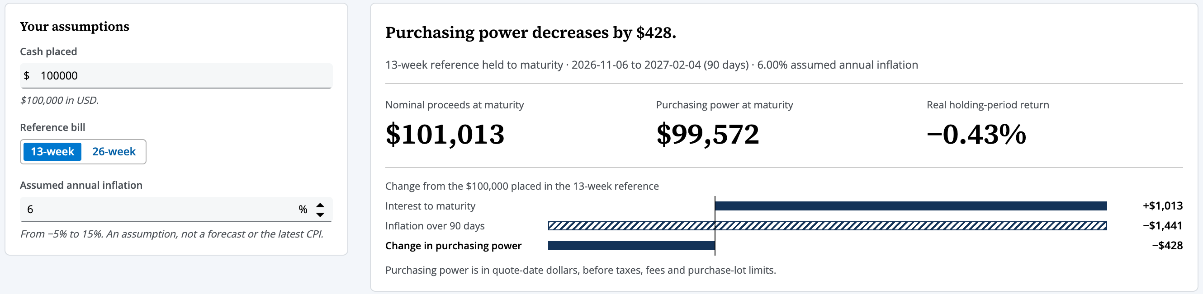
What does inflation do to the cash?
Speaker 2 · Live dashboard
$100,000 in the 13-week bill · 2026-11-06 to 2027-02-04 (90 days) · bank discount quote 4.01%
 | Inflation 3% | Inflation 6%
Nominal proceeds at maturity | $101,013 | $101,013
Purchasing power at maturity | $100,279 | $99,572
Real holding-period return | +0.28% | −0.43%
Change in purchasing power | +$279 | −$428
Inflation changes what the money buys, not the dollars that arrive.
Break-even inflation:
13-week 4.17%, 26-week 4.31%.
A threshold, not a forecast.
Live page, inflation set to 6%
Notes:
On the Overview, every bar is a saved bill and every line a payment. The navy and blue bars are the two reference bills we value below. At 3 percent inflation, 100,000 dollars in the 13-week bill pays 101,013 and keeps purchasing power of 100,279. Now 6 percent. The dollars stay the same, but the purchasing power falls to 99,572. Inflation changes what the money buys, not the dollars that arrive.

Slide 5
How do we know the numbers are right?
Speaker 3 · Data and method
Price per $100
Nominal proceeds
Inflation factor
Purchasing power
P = 100 (1 − d·n/360)
N = B·100/P
F = (1 + a)^{n/365}
R = N/F
Independent Excel check
6 / 6
By a member who did not build the page · quote 2026-11-06 · inputs copied from the official websites
checks passed
Check | Excel | Page | Result
Price per $100 | 98.9975 | — | input to the next rows
Nominal proceeds | 101,012.65 | $101,013 | PASS
Purchasing power at 3% | 100,279.10 | $100,279 | PASS
Real holding-period return | 0.279% | +0.28% | PASS
Break-even, 13-week | 4.1708% | 4.17% | PASS
Break-even, 26-week | 4.3114% | 4.31% | PASS
CPI year on year, Sep 2026 | 3.7377% | 3.74% | PASS
Limitations
Saved quotes are observations, not executable prices.
Settlement, taxes and fees are not modelled.
Inflation is an assumption, not a forecast.
Notes:
The Method tab shows every formula. The inputs are the Treasury's daily bill rates and the BLS consumer price index. A member who did not build the page copied the 6 November quote into Excel and recalculated: 101,012.65 dollars at maturity and purchasing power of 100,279.10, against 101,013 and 100,279 on the page. All six checks passed. The boundary holds too: at the break-even rate of 4.17 percent, purchasing power is exactly 100,000 dollars. Our main limitation: these are saved quotes, not prices you can trade at. Taxes, fees and settlement are not modelled, and inflation is an assumption, not a forecast.

Slide 6
How does an AI assistant update the data, and who decides?
Speaker 4 · AI maintenance
AI assistant
Person
1
2
3
4
5
6
Fresh AI chat reads SKILL.md
Downloads into candidate/
Rebuilds and pre-reviews
Before/after table with source links
Person compares and accepts
Release; old version kept; checks rerun
Normal update, 2026-11-09
Failure test
 | Before | After
Treasury quote date | 2026-10-26 | 2026-11-06
13-week bank discount | 4.05% | 4.01%
26-week bank discount | 4.21% | 4.12%
CPI month | 2026-09 | 2026-09 (no new release)
Rates set to basis points
→ STOP: Incompatible input unit
Nothing written; data.js unchanged.
The AI does the checks; the source comparison and the decision stay with a person.
Notes:
An AI assistant keeps this data fresh, following a written skill file. We tested it in a fresh Codex conversation with none of our development chats. It downloaded the newest Treasury and BLS files into a separate candidate folder, rebuilt every number and showed a before-and-after table with source links. The quote date moved from 26 October to 6 November; the 13-week rate from 4.05 to 4.01 percent. Our data maintainer checked the Treasury page and replied accept. Only then were the files replaced. In a second test we set a wrong unit, basis points instead of percent. The assistant stopped with 'Incompatible input unit' and changed nothing. Our lesson: the AI does the checks, but the source comparison and the decision stay with a person.

Slide 7
Can someone else run it after the course?
Speaker 5 · Handover
Handover
Risks
The ZIP alone works
Double-click index.html
One command rebuilds data.js byte for byte
One command downloads and checks an update
Nothing is released until a person accepts
The previous version is one command away
No scheduler, so quotes go stale after 7 days and the page says “Review required”
BLS release dates must be added each December
October 2025 CPI was never published
Feedback and the change we made
Next improvement
AI-assisted review by a teammate: the timing chart shows seven maturities, but the value uses two reference bills. The chart caption now names the two reference bills valued below.
Let the value follow whichever bill fits each payment,
not only the two reference bills.
Notes:
Can someone else run it? Yes. The ZIP alone is enough: one command rebuilds the saved data byte for byte, and one downloads and checks an update. Nothing is released until a person accepts it. The main risk: there is no scheduler, so if nobody refreshes for a week, the banner says 'Review required'. A teammate's AI-assisted review found that the chart shows seven bills while the value uses two, so the chart now names the two reference bills. Our next step: let the value follow whichever bill fits each payment, not only the two reference bills. Thank you.

