Slide 1
CDS 535 · DATA MINING · DATAWARTS
Mushroom & Ionosphere
A Data Mining Analysis
Team Members
A1 He Haodong | A2 Bei Xuecheng | A3 Gu Ruiqi
B1 Gong Tinglu | B2 He Mingen | B3 Hu Shuaishuai
Datasets: UCI Mushroom & Ionosphere (ID 52) · November 2026

Slide 2
CONTENTS
Contents
01
Mushroom Dataset
· Dataset, preprocessing & ZeroR baseline
· J48, Logistic Regression, KNN & model comparison
· Apriori association rules
02
Ionosphere Dataset
· Dataset, preprocessing & J48 analysis
· Random Forest, Logistic Regression & RBF-SVM
· Model comparison, evaluation protocols & KMeans
03
Comparison & Conclusions
CDS 535 · Data Mining · Group Project

Slide 3
PART 01 · MUSHROOM
Mushroom Dataset
01
Presentation Flow
Data → Preprocessing → Classification → Association Rules
CDS 535 · Data Mining · Group Project

Slide 4
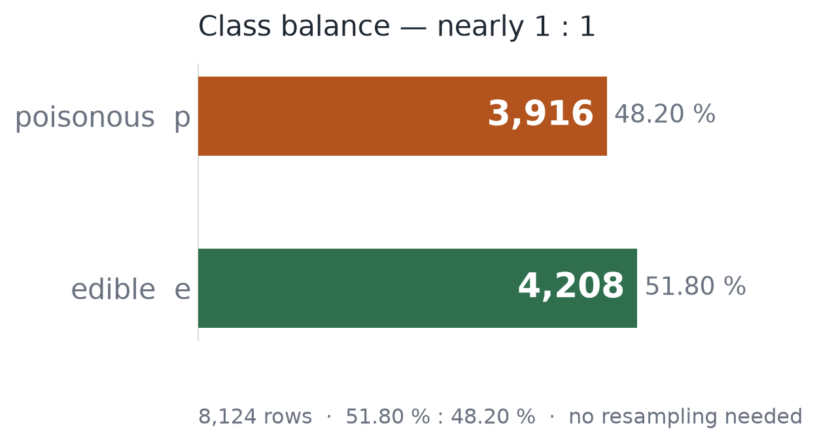
A1 · HE HAODONG
01 · DATA & DATASET TRAITS
All nominal, nearly balanced, one column with gaps
These three facts drove every preprocessing and model decision downstream
8,124
22
rows
predictors, all nominal
2,480
51.8 : 48.2
missing, all in stalk-root
edible : poisonous
All nominal, multi-valued
odor alone has 9 values — J48 splits multi-way on gain ratio, so the tree stays shallow
One gap, one dead column
stalk-root is missing 30.5 %; veil-type holds a single value, so it carries no information
Classes close to 1 : 1
no resampling needed, so F1 and accuracy cannot mask each other

Slide 5
A1 · HE HAODONG
02 · PREPROCESSING
Four cleaning steps
Impute → drop the dead column → rank only; the real reduction happens inside the training folds
STEP 1
STEP 2
STEP 3
STEP 4 · OPTIONAL
Impute
Drop useless
Rank, don’t delete
NominalToBinary
ReplaceMissingValues fills the 2,480 missing in stalk-root with the column mode b: 2,480 → 0.
RemoveUseless -M 99 deletes the single-valued veil-type: 22 → 21 predictors.
InfoGain + Ranker only ranks: odor 1st, spore-print-color 2nd. All 21 attributes survive.
Only for models that need numbers (SMO, Logistic): 21 attributes expand to 115 dimensions.
Must run before dropping columns, or “?” counts as a value
One value means zero variance: it can never split
Real reduction sits in FilteredClassifier, re-selected per fold
J48 / RF / NB handle nominal natively, so skip it

Slide 6
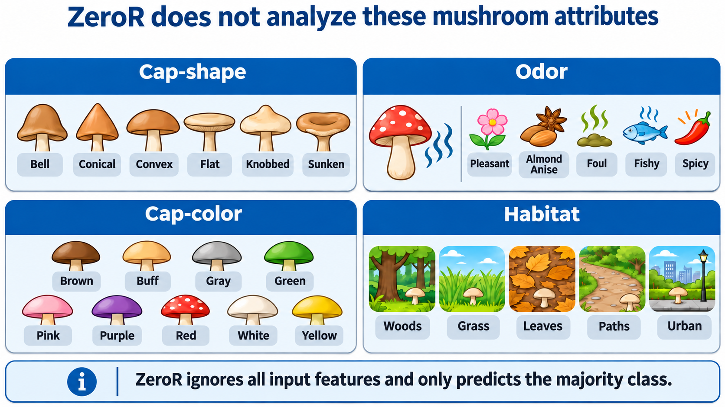
A3 · GU RUIQI

Slide 7
A3 · GU RUIQI
ZeroR | A Majority-Class Baseline
Rule
ZeroR confusion matrix
Always predict the majority class: edible (e).
Actual \ Predicted
Edible (e)
Poisonous (p)
Edible (e)
4,208
0
Purpose
Poisonous (p)
3,916
0
Checks whether other models learn useful patterns beyond a simple majority-class guess.
Positive class = poisonous (p)
51.80%
0.000
0.000
0.000
0.500
Accuracy
Precision
Recall
F1-score
ROC-AUC
Why is Accuracy 51.8% but F1 = 0? ZeroR correctly labels all edible mushrooms, but misses every poisonous mushroom.

Slide 8
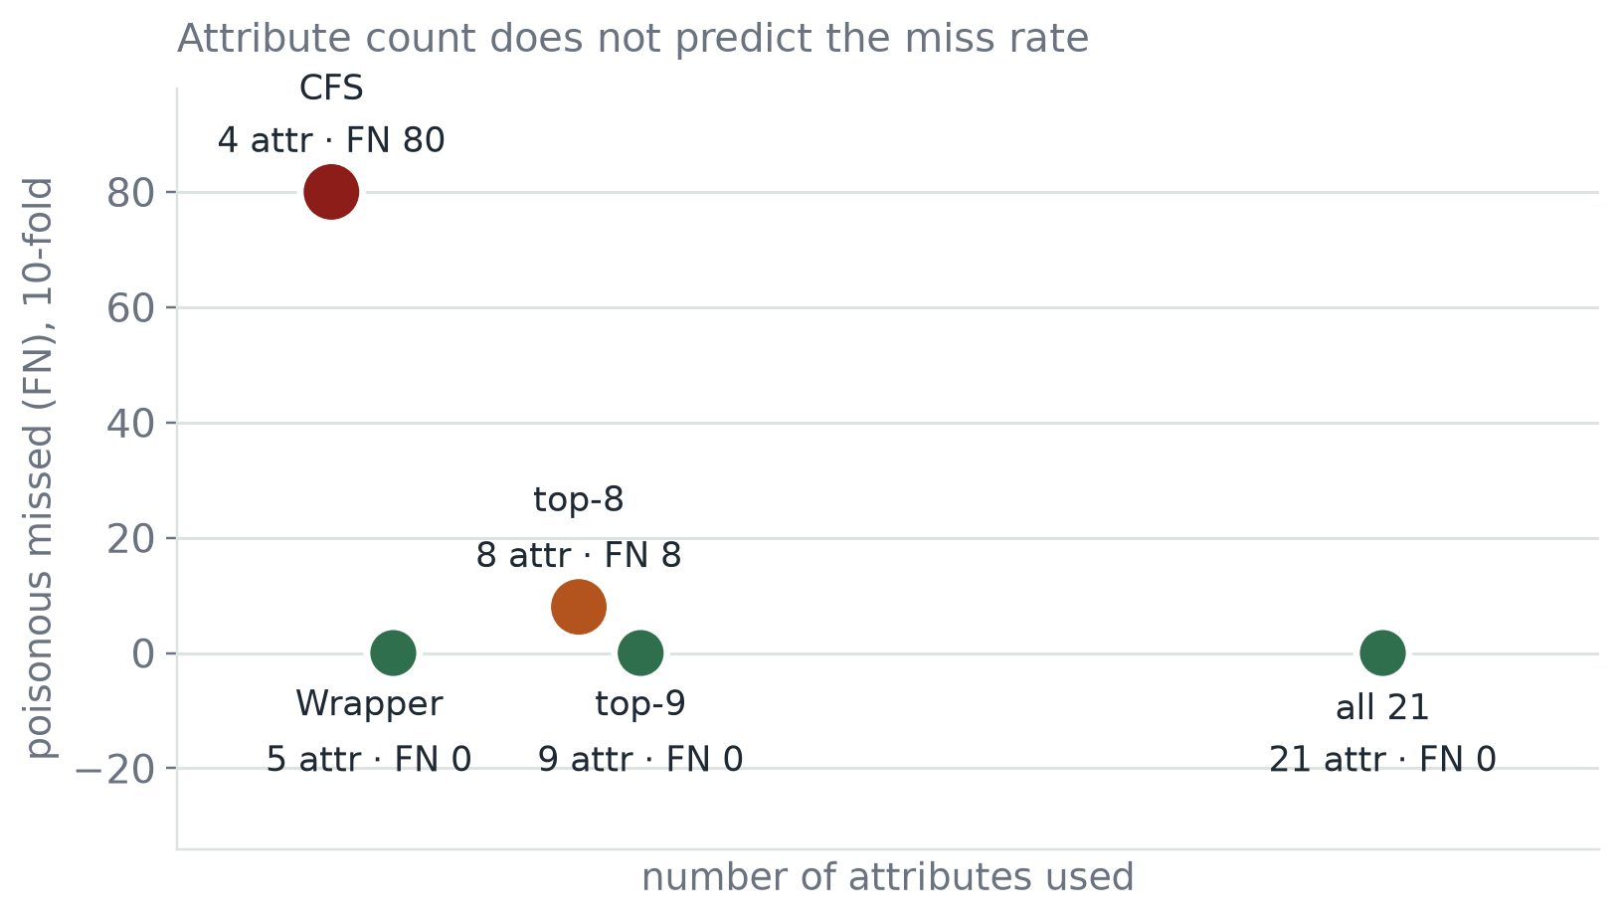
A1 · HE HAODONG
03 · MODEL · FIVE J48 VARIANTS
Five schemes, only the filter changes
The left column is the attribute count (21 / 8 / 9 / 4 / 5); deliberately laid out as a reduction gradient
21
Full set · baseline
What no reduction buys; anything lost later is the price
8
top-8 · InfoGain, univariate
One rank short on purpose: it differs from top-9 by a single attribute
9
top-9 · one more, gill-size
This single cut is the most telling design in the whole experiment
4
CFS · multivariate filter
Explicitly penalises redundancy: is a smaller subset more reliable?
Wrapper · J48 scores itself
Attribute count on x, poison missed on y: the points follow no line — count is not the driver.
5
Real criterion instead of a proxy: are five enough?
Three axes kept apart: criterion · redundancy · cost

Slide 9
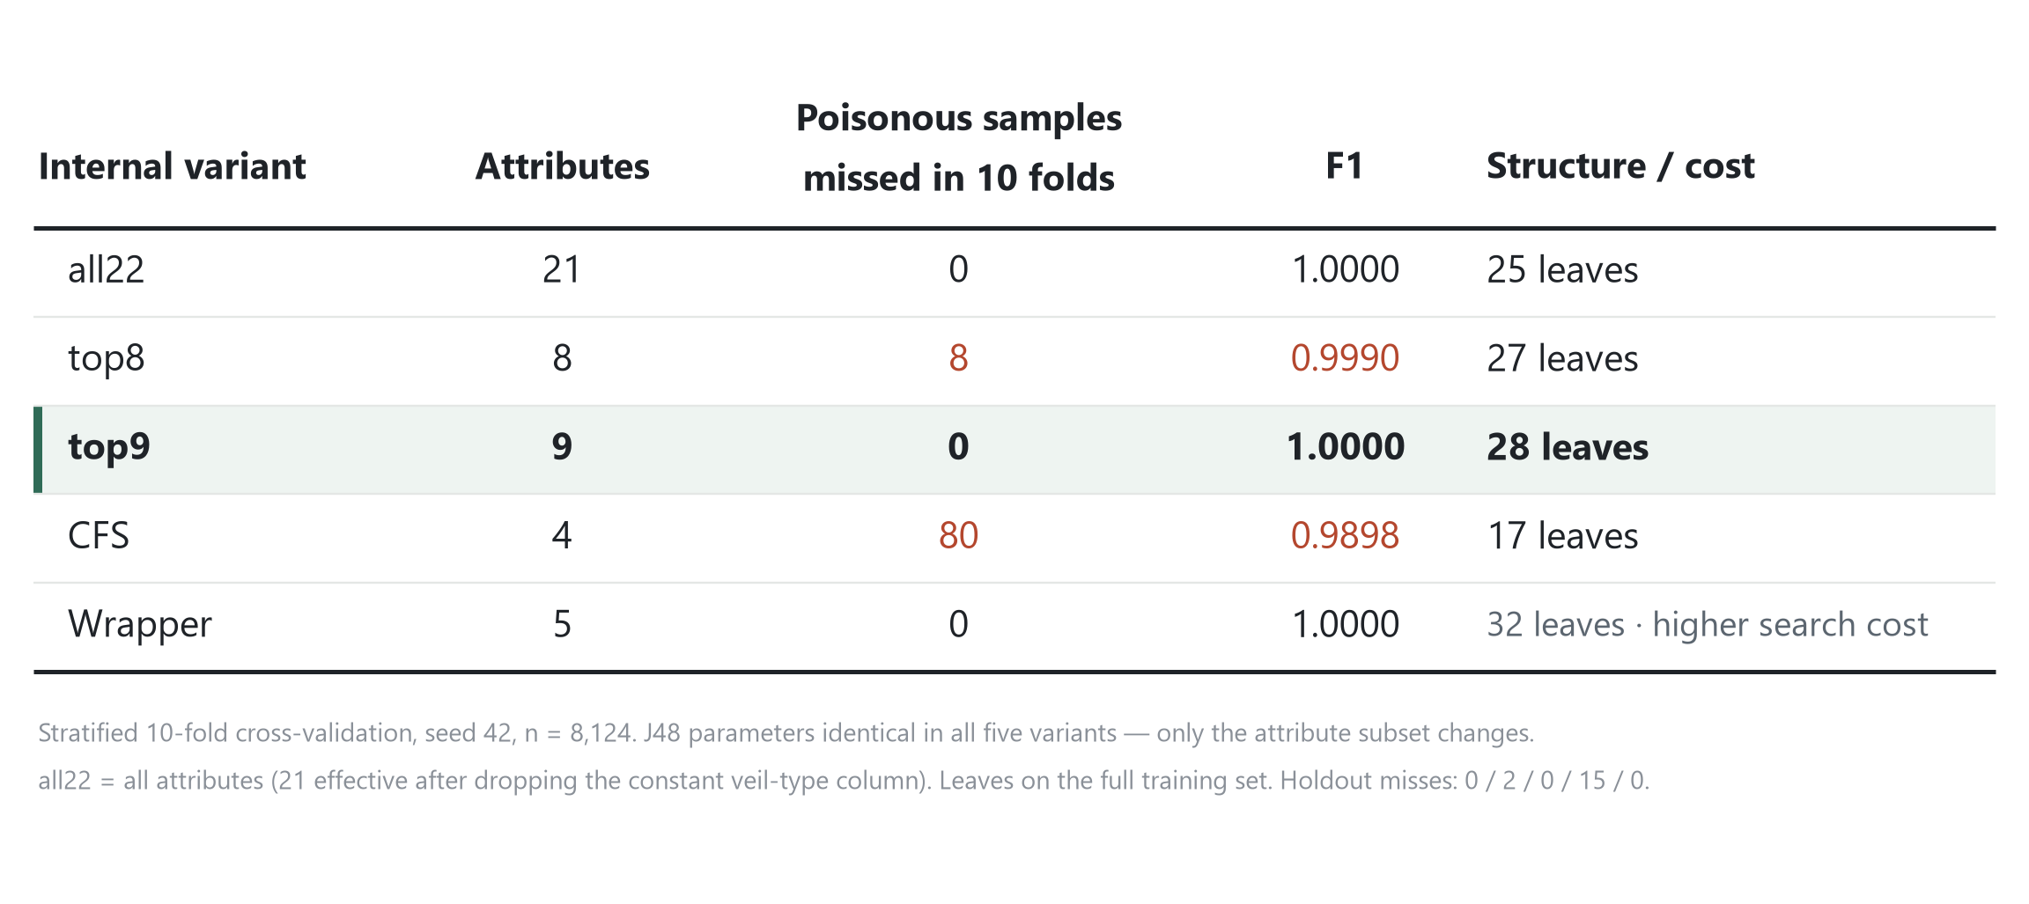
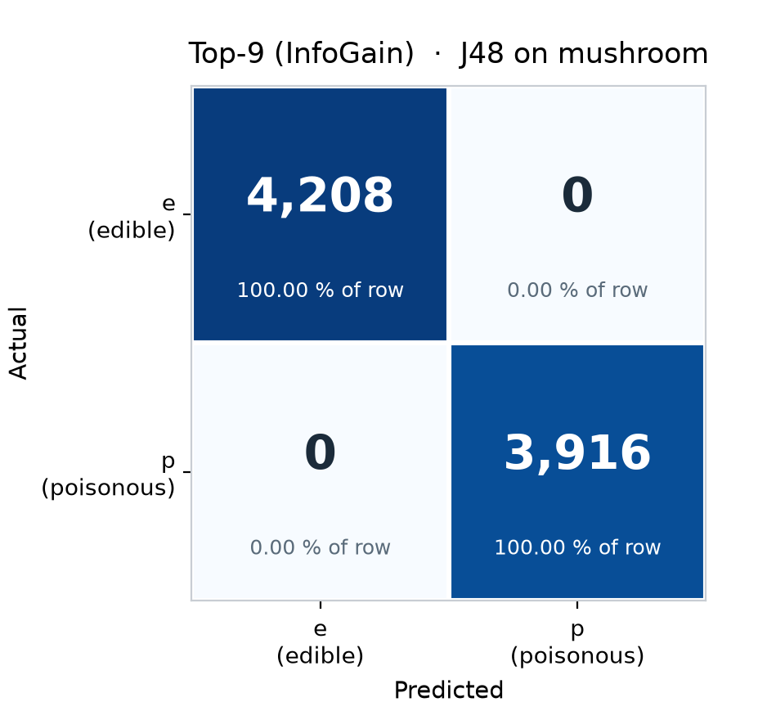
A1 · HE HAODONG
04 · COMPARISON · RESULTS
The five schemes split on one column only
Stratified 10-fold CV, seed 42, poisonous as the positive class; the reverse error is 0 in all five
Confusion matrix for top-9: top-right 0, bottom-left 0. All three perfect schemes look identical.
Holdout check: 0 / 2 / 0 / 15 / 0 — same ranking as the 10-fold

Slide 10
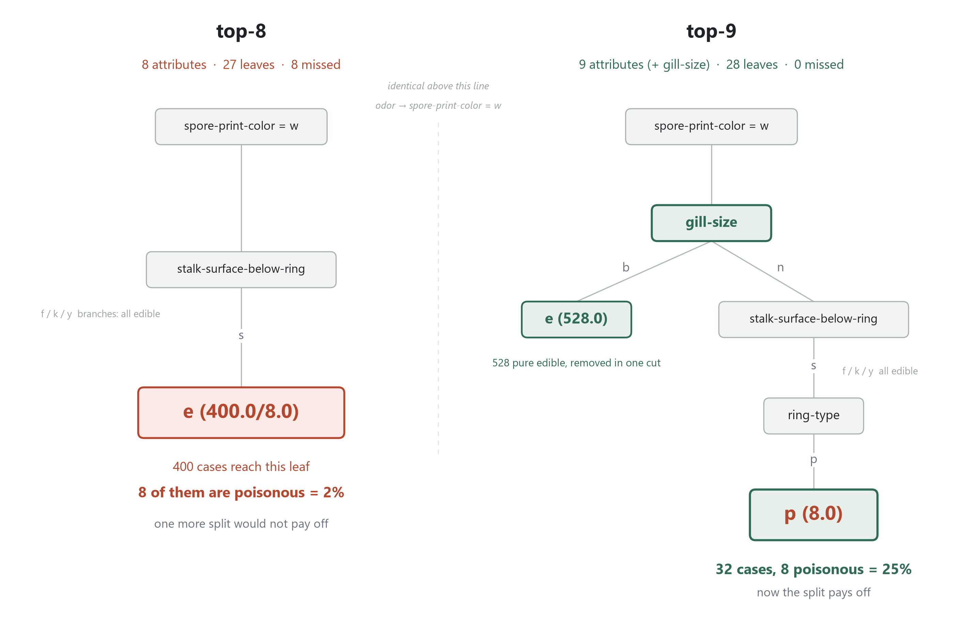
A1 · HE HAODONG
05 · COMPARISON · WHY
One extra attribute recovers 8; five complementary beat eight related
What decides the outcome is not how many attributes you keep, but whether they complement each other
① top-8 → top-9: exactly one attribute, gill-size
② Wrapper hits 100 % with 5; top-8 gets 99.90 % with 8
③ None of the five overfits

Slide 11
A1 · HE HAODONG
06 · CONCLUSION
Recommend top-9
Three takeaways from the J48 internal selection
01
Pick top-9: 9 attributes, 100 %, same cost class as the full set
build 0.25 s vs 0.18 s; 28 leaves vs 25 — interpretation barely gets harder
02
Do not pick CFS: 4 attributes for 80 missed poison mushrooms
fewest attributes and the smallest tree (17 leaves), but p recall falls to 0.9796
03
The bottleneck is features, not the model
J48 is untouched across all five; 99.02 → 100 comes from the attribute subset alone

Slide 12
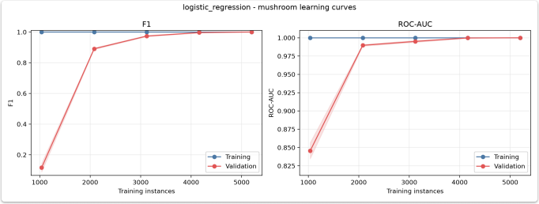
A3 · GU RUIQI
Logistic Regression | Learning Curves
Training stays near 1.0; validation improves as more training instances are used.
F1
ROC-AUC
Validation F1 rises from about 0.12 to 1.00.
Validation ROC-AUC rises from about 0.845 to 1.00.
Notes:
logistic regression:weight input features and uses a sigmoid function to output class probabilties,providing a stable linear reference.
we can see validation F1 and ROC-AUC reach 1.0 as sample size increases,and the training-validation gap disappears,YE,when sample size in 2000,indicting that linear cmbinations are sufficient for this dataset.

Slide 13
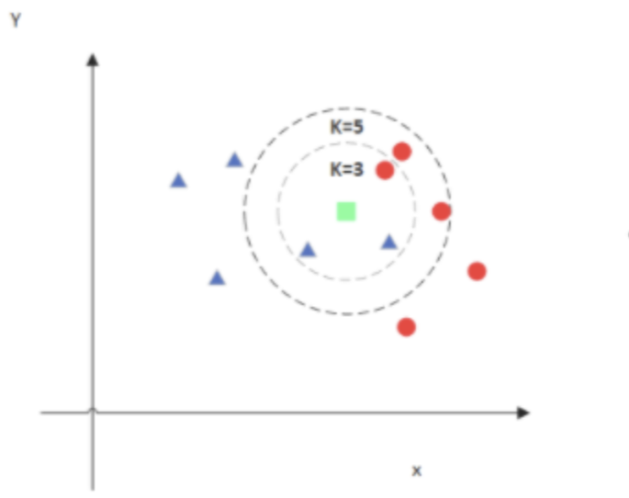
A2 · BEI XUECHENG
02 · KNN CLASSIFICATION
KNN: Classification Based on Local Similarity
How it works
KNN measures the Euclidean distance between a new sample and the training samples, then assigns the class voted for by its nearest k neighbors.
Why it fits Mushroom
All input attributes are nominal. After one-hot encoding, Euclidean distance reflects how differently two samples are described by these attributes.
CDS 535 · Data Mining · Group Project

Slide 14
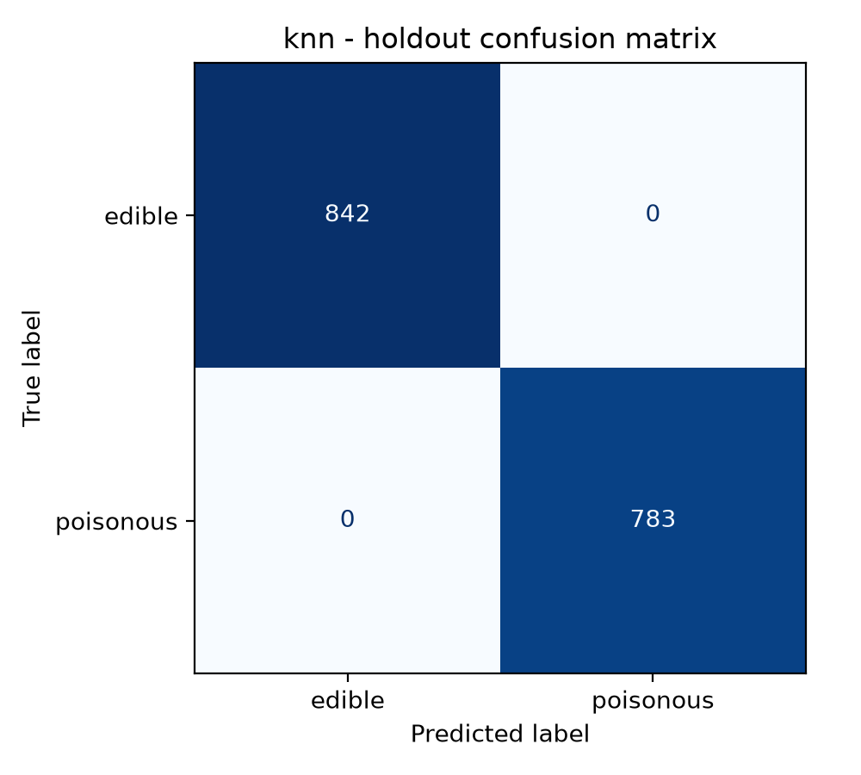
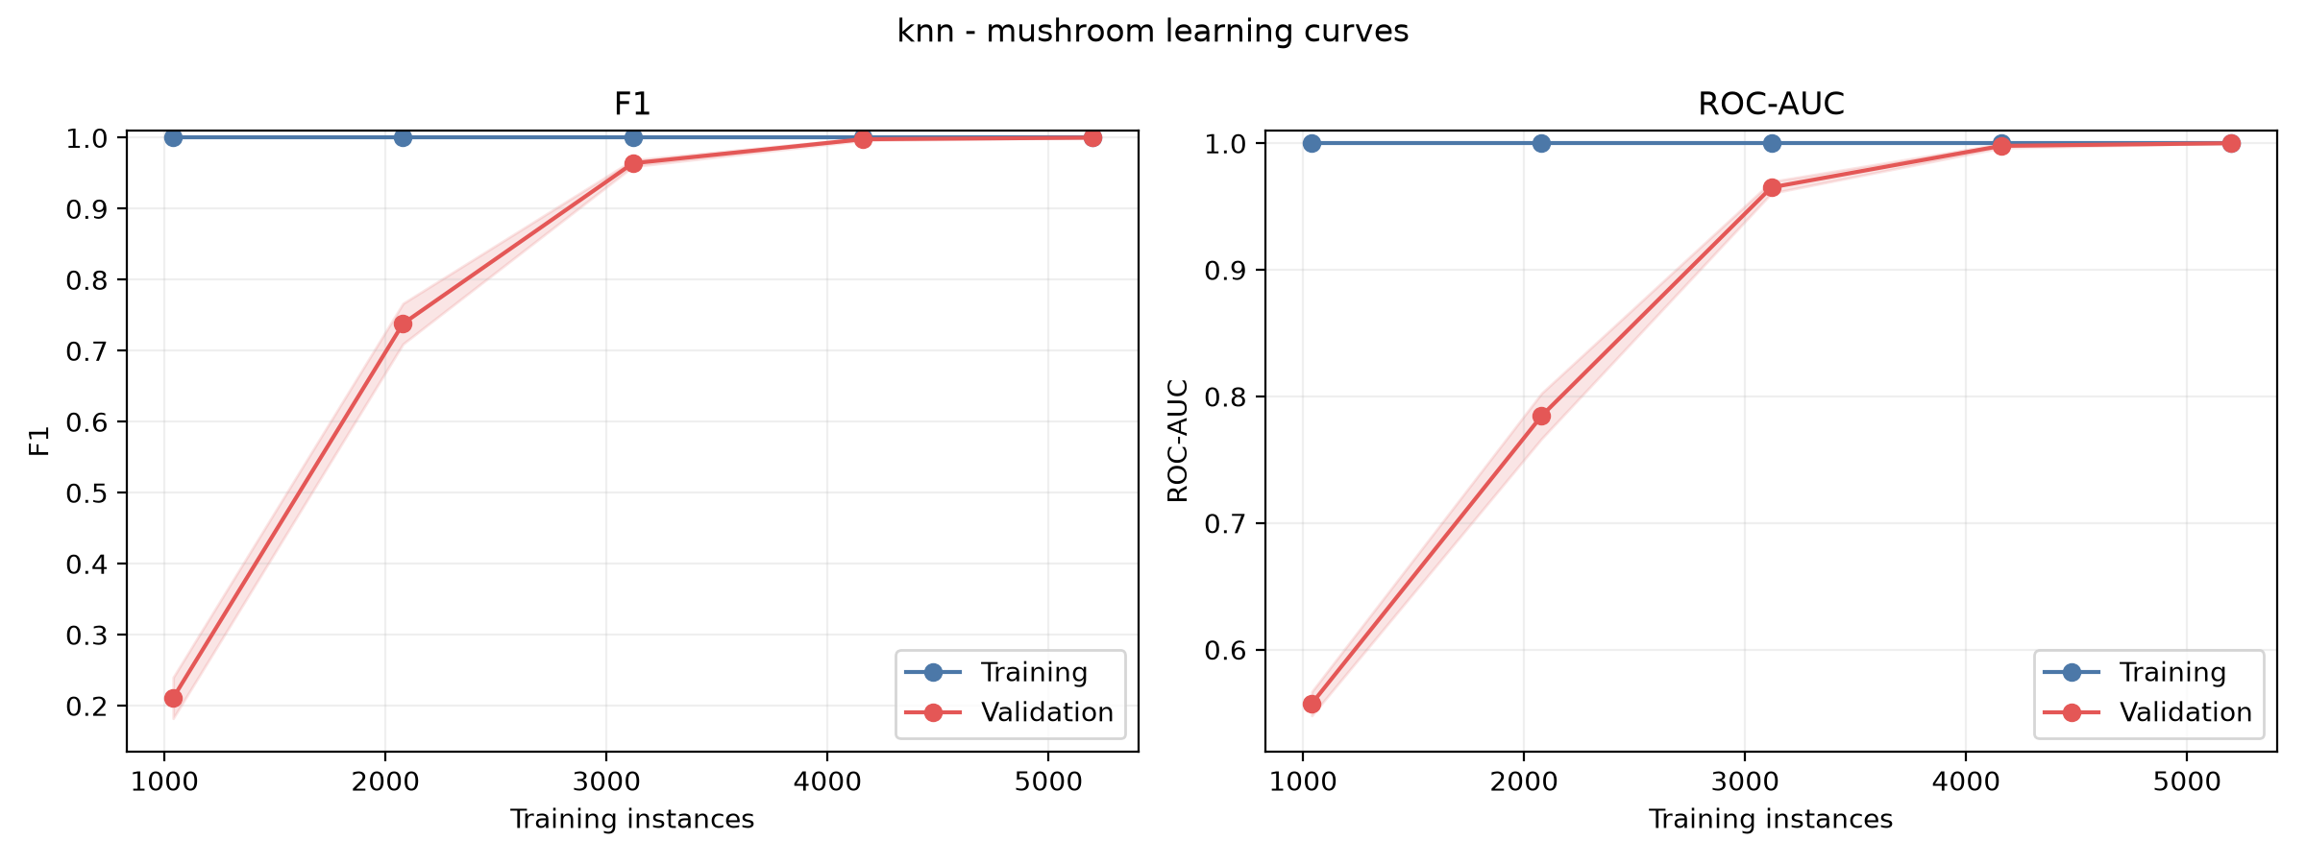
A2 · BEI XUECHENG
02 · KNN — RESULTS
KNN: Parameter Selection & Perfect Scores
Parameter selection: We searched k=1–20 and compared uniform and distance voting within the training folds, using poisonous-class F1 for selection.
KEY RESULT
F1 = 1.0000 ROC-AUC = 1.0000
Final setting: All values from k=1 to k=9 achieved perfect scores. We recorded k=1, weights=uniform according to the tie order.
Both 10-fold F1 and ROC-AUC reached 1.0000, showing very strong local class consistency in this dataset.

Slide 15
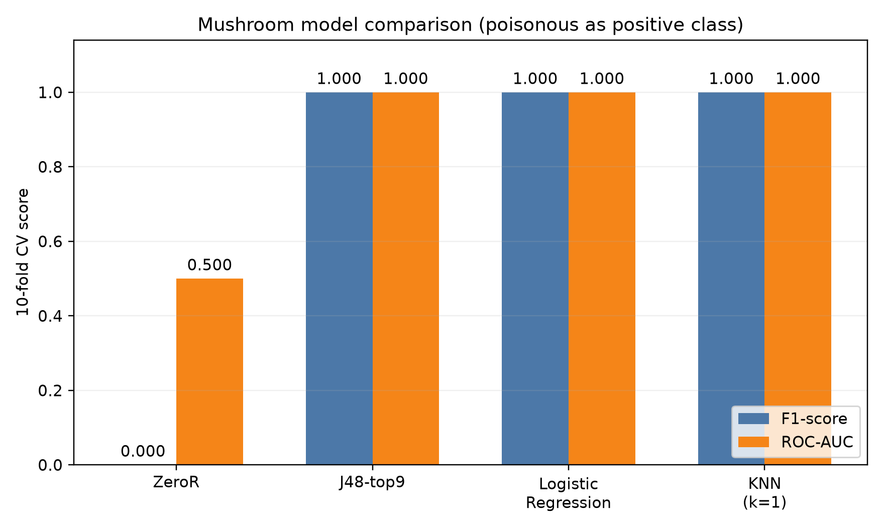
A2 · BEI XUECHENG
02 · MODEL COMPARISON
Model Comparison
Selection order
1
F1
2
ROC-AUC
3
Model Complexity
CDS 535 · Data Mining · Group Project

Slide 16
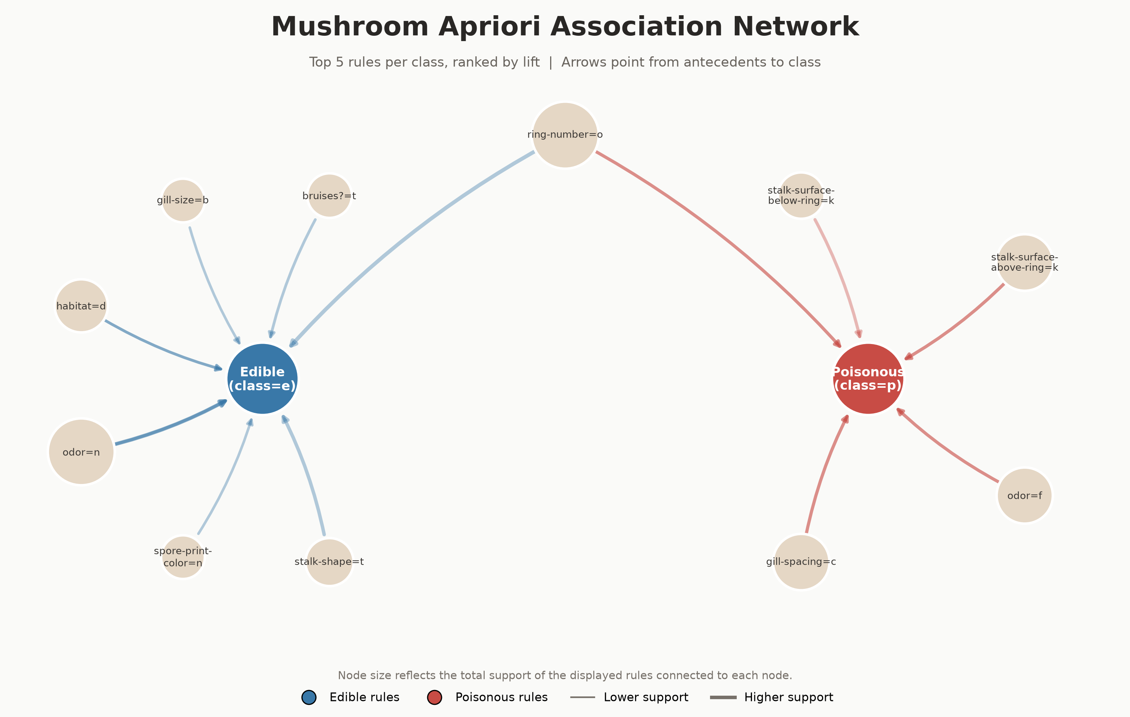
A2 · BEI XUECHENG
02 · APRIORI ASSOCIATION RULES
Apriori: Finding Strong Associations
How it works
Apriori first identifies attribute combinations that occur frequently, then generates association rules from them. We use Support, Confidence, and Lift to evaluate how common, reliable, and informative each rule is.
Why it fits Mushroom
All attributes are nominal, so each attribute value can be naturally treated as an item, such as odor=f. This makes Apriori suitable for discovering interpretable co-occurrence patterns without distance calculations or numerical assumptions.
CDS 535 · Data Mining · Group Project

Slide 17
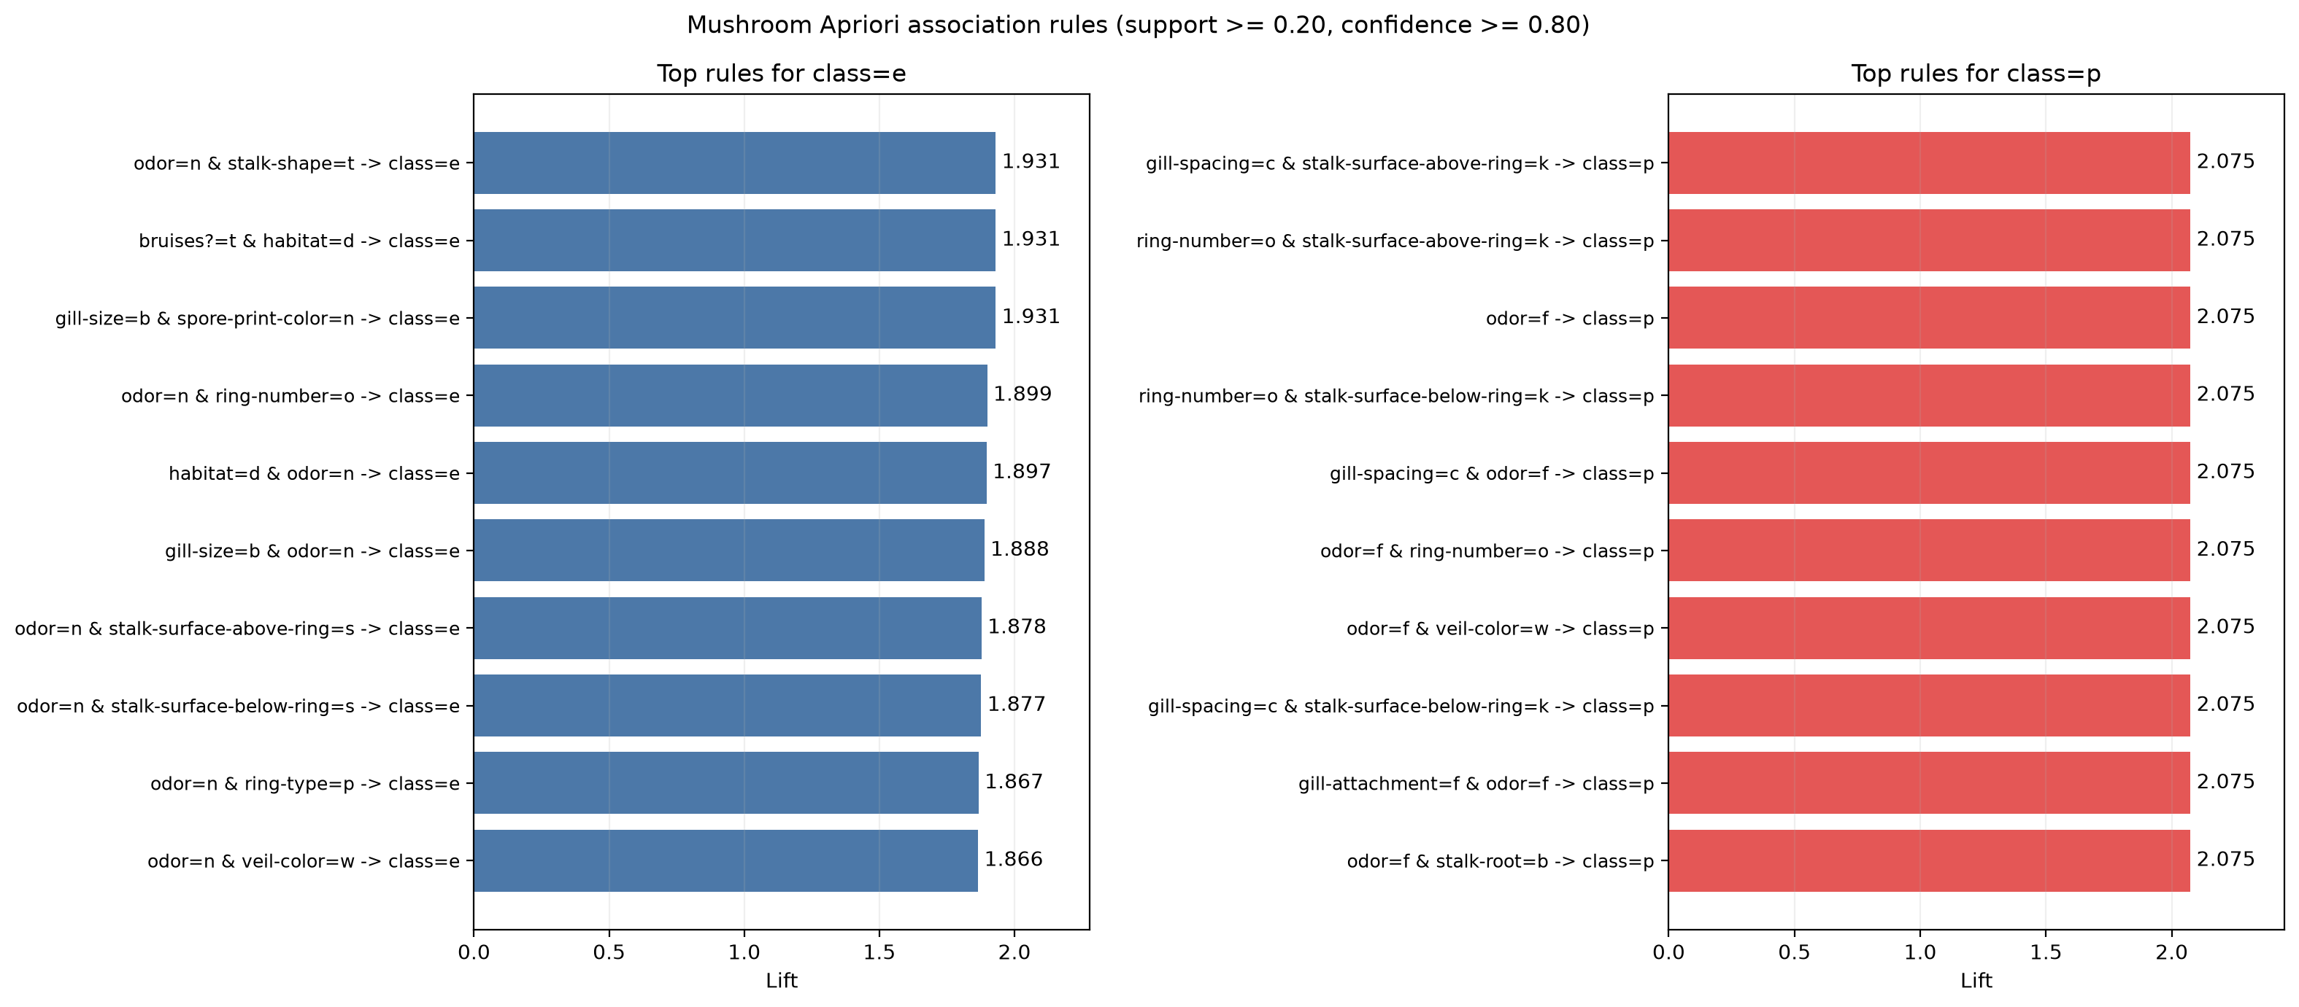
A2 · BEI XUECHENG
02 · APRIORI — RULES
Apriori: Settings, Representative Rules & Interpretation
1,568
frequent itemsets
104
rules ending in class=e or class=p
Settings: Support ≥ 0.20 ｜ Confidence ≥ 0.80 ｜ maximum itemset length = 3
odor=f → class=p
odor=n → class=e
Support = 0.2659 ｜ Confidence = 1.0000 ｜ Lift = 2.0746
Support = 0.4195 ｜ Confidence = 0.9660 ｜ Lift = 1.8649
Interpretation: Odor and several other attributes show strong associations with the class labels.

Slide 18
PART 02 · IONOSPHERE
Ionosphere Dataset
02
Presentation Flow
Data → Preprocessing → Classification → Clustering
CDS 535 · Data Mining · Group Project

Slide 19
B1 · GONG TINGLU
Presentation Roadmap
Data at a Glance
Preprocessing
Ionosphere Dataset
351 × 34 radar returns; class ratio 64 : 36
Three filters + ablation study
Preprocessing must match the model type
Preprocessing
Four-Model Comparison
Information gain attribute ranking
a05 ranks first — and later becomes the tree root
Four models compared side by side
RBF-SVM wins: F1 0.956
J48
J48
Depth Tuning + Test Results
F1 0.9011; only 9 errors among 71 samples
J48 vs Random Forest
The trade-off between interpretability and performance
Notes:
Here is the roadmap for my section: a 30-second data review, then preprocessing — three filters, information-gain ranking, and an ablation study; next, a side-by-side comparison of four models; finally, a closer look at our J48 decision tree, including depth tuning, test results, and comparison with Random Forest.

Slide 20
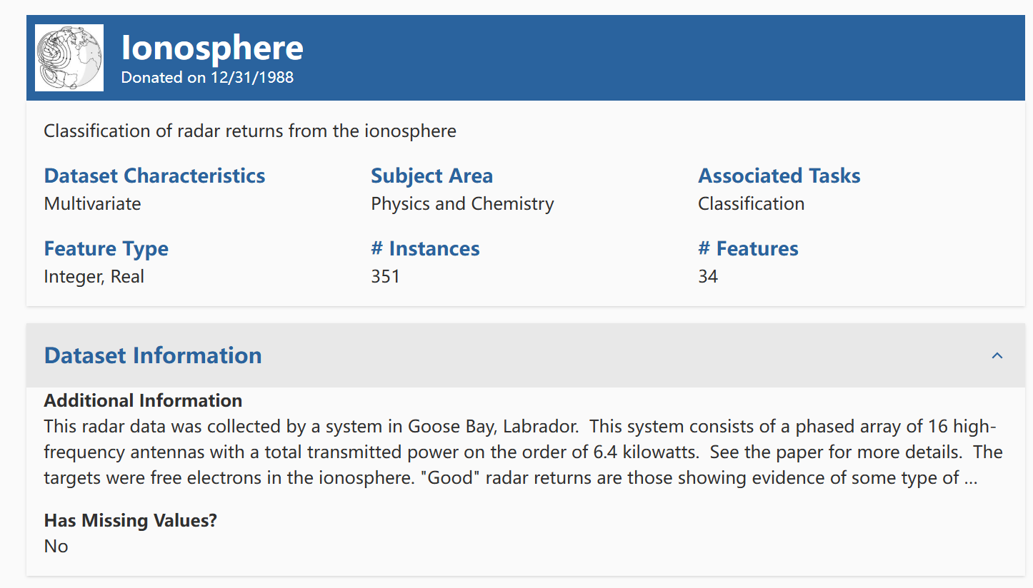
B1 · GONG TINGLU
Dataset Introduction · Ionosphere (UCI #52)
01 Dataset Introduction
Source & Task
UCI DATASET
Official Dataset Description
Goose Bay phased-array radar: 16 high-frequency antennas, approximately 6.4 kW total power, targeting free electrons in the ionosphere; 17 pulses × 2 complex attributes = 34 numeric attributes. g = good returns showing ionospheric structure; b = bad returns where signals pass through.
Cleaning Highlights
351 samples
No missing values
Attribute2 is all zero → removed; attributes reduced from 34 to 33
Attribute1 has only 2 values; retained after plots confirmed discriminative power
Label encoding: g → 1, b → 0
Class ratio approximately 64 : 36; mildly imbalanced
CDS 535 · Data Mining · Group Project
Notes:
First, the dataset. Ionosphere radar data was collected by a phased-array system in Goose Bay, Canada, with 16 high-frequency antennas and approximately 6.4 kW total transmitted power, targeting free electrons in the ionosphere. After autocorrelation processing, 17 pulse numbers each correspond to 2 complex attributes, giving 34 numeric attributes per record.
The task is binary classification: g denotes good returns showing ionospheric structure, while b denotes bad returns where signals pass directly through the ionosphere. The dataset contains 351 samples.
For cleaning: there are no missing values; Attribute2 is an all-zero constant column and is removed, leaving 33 attributes; Attribute1 has only two special values and is retained after plots confirm discriminative power; labels g and b are encoded as 1 and 0. The upper-right plot shows the class distribution, 225 versus 126, or about 64:36 with mild imbalance; the lower-right heat map shows correlations among attributes, motivating the later feature selection and PCA.

Slide 21
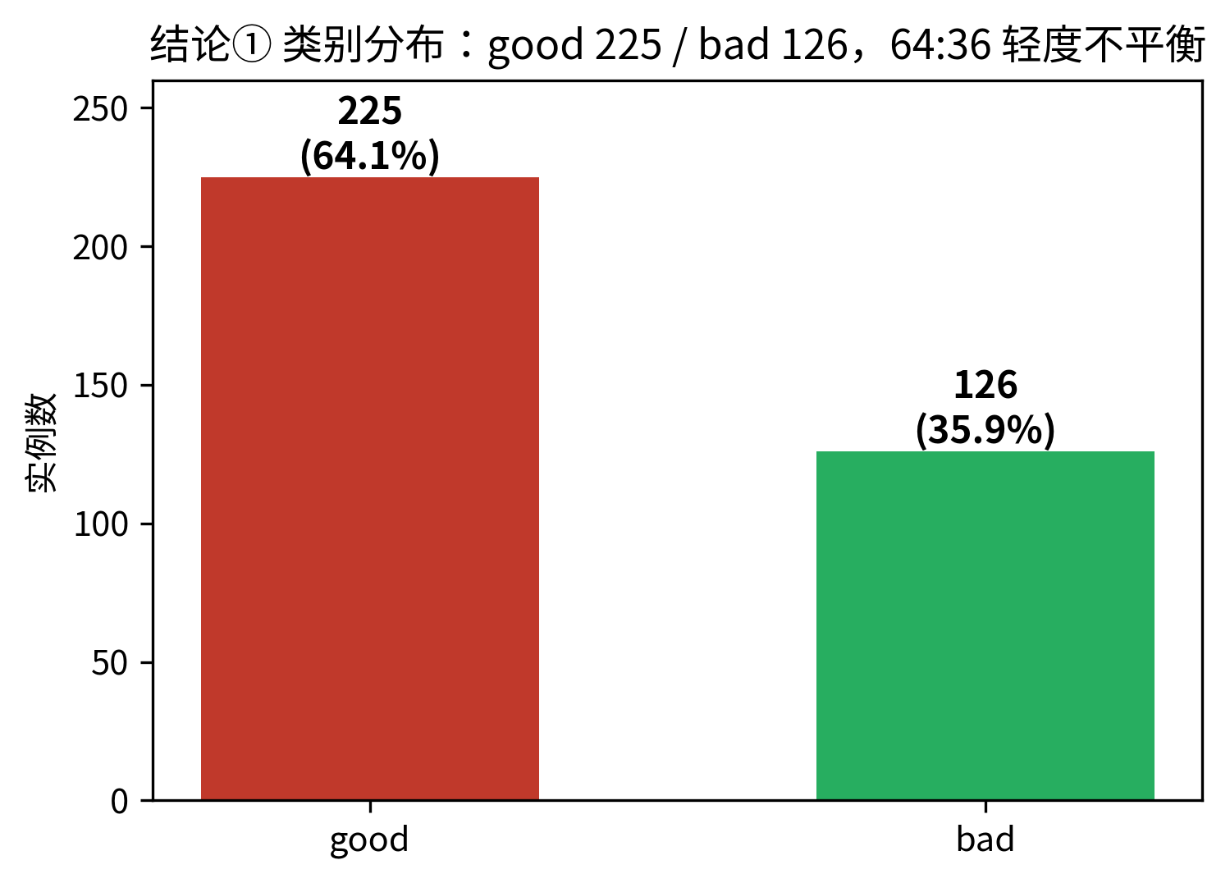
B1 · GONG TINGLU
Dataset Introduction
351 × 34
17 × 2
Radar Returns × Numeric Attributes
Pulse signals, complex pairs
UCI #52
64 : 36
Sigillito · JHU APL · 1988
good 225 vs bad 126; mildly imbalanced
Task: binary classification of radar returns.
good = returns showing ionospheric structure
bad = signals passing directly through
good is the positive class.
Class distribution: good 225 (64.1%) vs bad 126 (35.9%)
Notes:
A quick data review. Ionosphere comes from the UCI repository as dataset 52 and was donated by Sigillito's team at the Johns Hopkins Applied Physics Laboratory. It contains 351 radar returns and 34 numeric attributes from complex pairs of 17 pulse signals. The task is binary classification: good denotes returns showing ionospheric structure, while bad denotes signals passing directly through. The classes contain 225 and 126 samples, respectively — about 64:36, mildly imbalanced — and good is the positive class.

Slide 22
B1 · GONG TINGLU
Preprocessing — Three Filters
RemoveUseless
Missing-Value Check
Standardize
Attribute a02 is constantly zero and carries no information, so it is removed.
Verify before acting: 0 missing values found; no imputation needed.
All attributes scaled to zero mean and unit variance — for distance-based models such as SVM.
34 → 33 attributes
A verified no-op
z-score · All 33 attributes
All filters are fitted inside the cross-validation pipeline, using training folds only — preventing information leakage.
Notes:
Preprocessing uses three filters. First, RemoveUseless: attribute a02 is constantly zero and is removed, leaving 33 input attributes. Second, missing values: verification confirms there are none, so no imputation is needed. Third, Standardize: all attributes are scaled to zero mean and unit variance, which is necessary for distance-based models such as SVM. All filters are fitted inside the cross-validation pipeline using training folds only, avoiding information leakage.

Slide 23
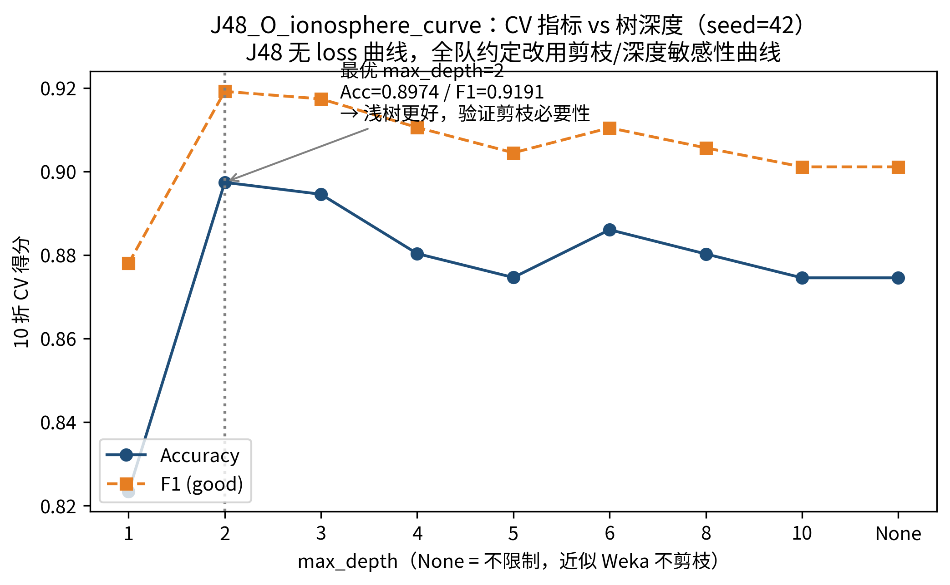
B1 · GONG TINGLU
J48
Why J48
· Every path is a readable rule: thresholds, sample counts, and class composition at a glance
· Immune to monotonic scaling; no standardization required
· A strong baseline for small numeric datasets (351 rows)
Validation scores by tree depth (10-fold cross-validation)
Root = a05 — the top information-gain attribute: two independent lines of evidence agree.
Notes:
Now for J48. We selected it for three reasons: every path is a readable rule with thresholds, sample counts, and class composition; it is immune to monotonic scaling and needs no standardization; and it is a strong baseline for small numeric datasets. The depth-sensitivity curve shows that depth 2 is already optimal — accuracy 0.8974 and F1 0.9191 — while deeper trees fall back toward the unpruned baseline, showing that pruning is necessary. Another detail: the tree root is a05, exactly the top information-gain attribute, so the two independent lines of evidence agree.

Slide 24
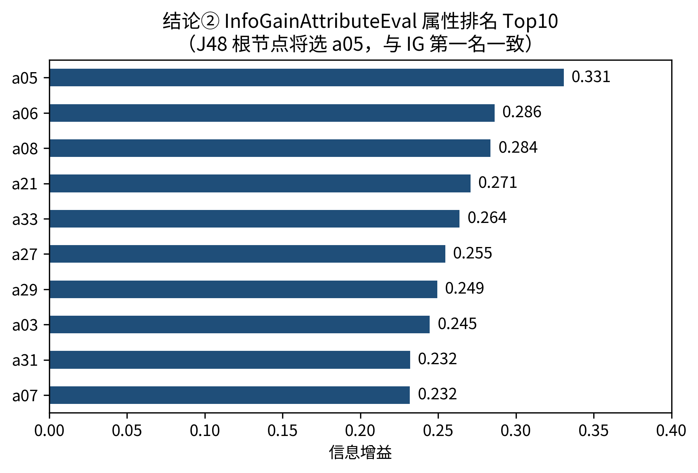
B1 · GONG TINGLU
J48 Information Gain Attribute Ranking
Information Gain Top 5
a05 — 0.331
a06 — 0.286 · a08 — 0.284
a21 — 0.271 · a33 — 0.264
a05 ranks first —
It later becomes the root of the J48 tree: two independent lines of evidence reinforce each other.
Top 10 Attributes by Information Gain (InfoGain + Ranker)
Notes:
Before modeling, we ranked all attributes by information gain. The top five are a05, a06, a08, a21, and a33, with a05 clearly leading at 0.331. Remember a05 — it will reappear as the root of the J48 tree, providing two independent lines of evidence through the filter ranking and the tree structure.

Slide 25
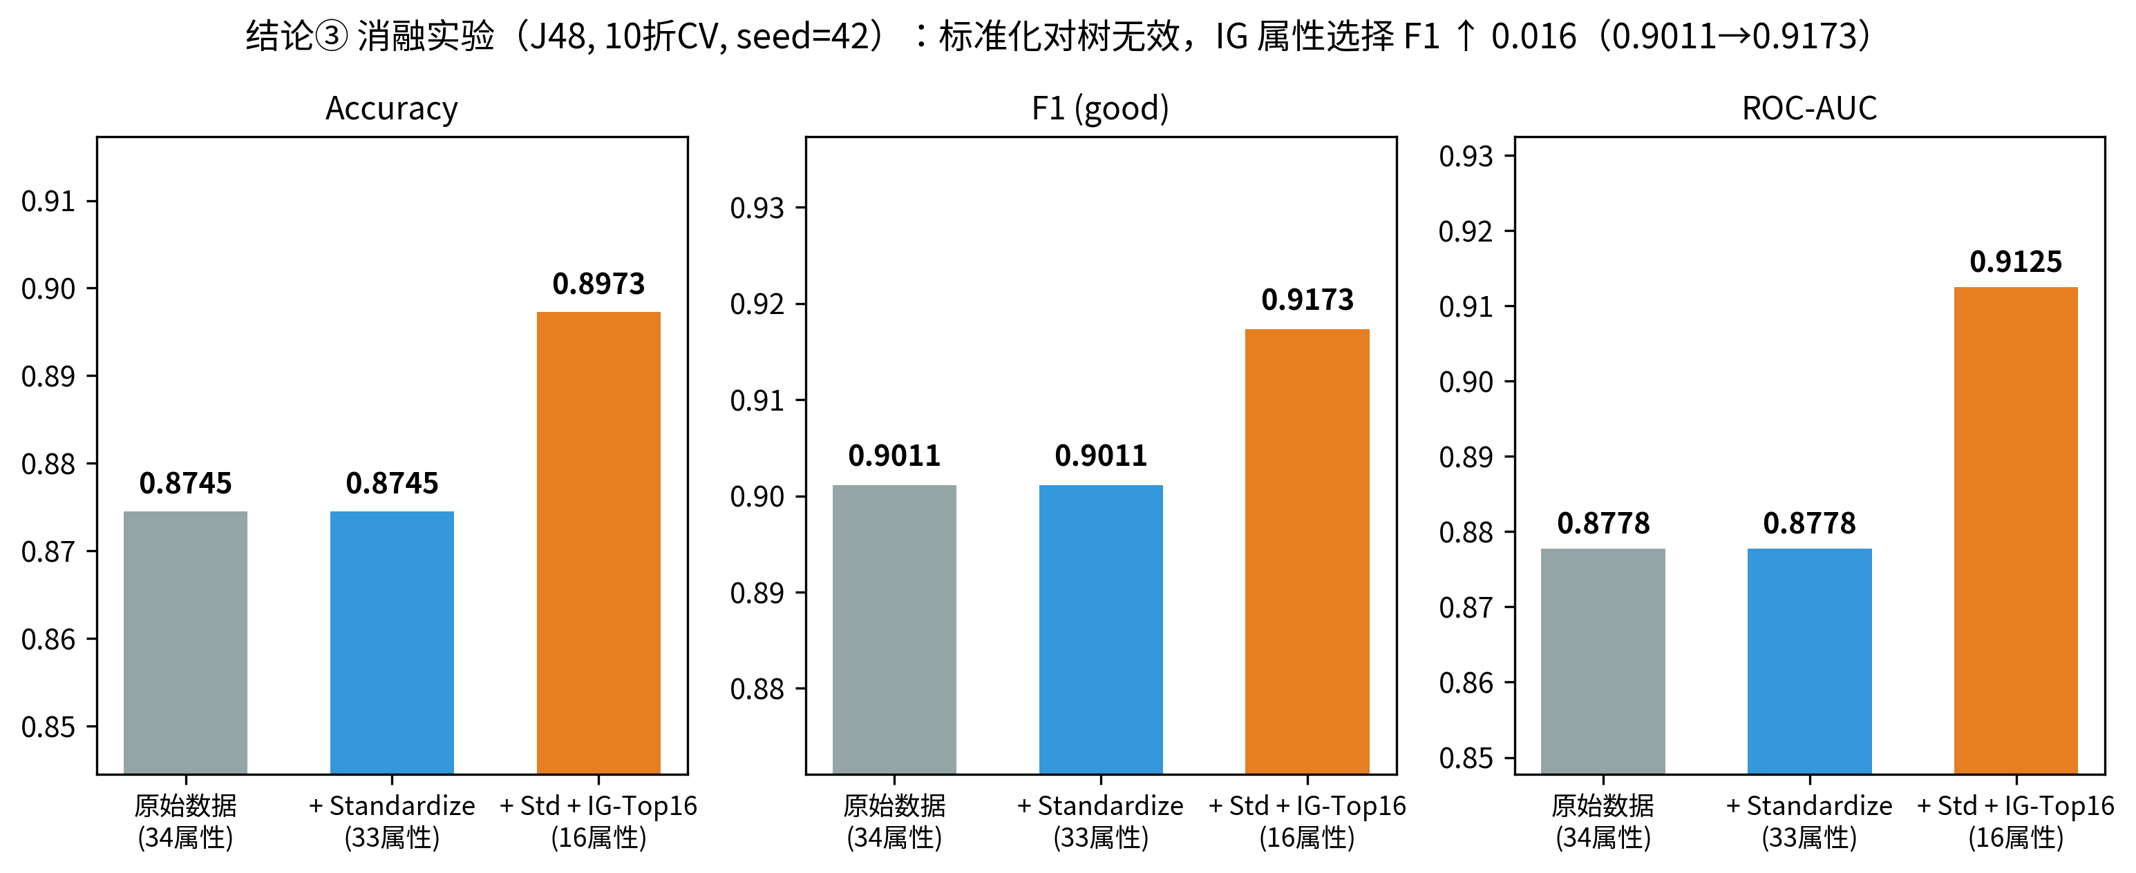
B1 · GONG TINGLU
J48 Ablation Study — Do the Filters Help?
Standardization → No Change
F1 stays at 0.9011 — trees split on thresholds, and scaling does not change within-attribute ordering.
InfoGain Top-16 → Better
F1 0.9011 → 0.9173 · AUC 0.8778 → 0.9125
Attribute selection is effective for small, high-dimensional datasets.
Conclusion:
Preprocessing must match the model type.
J48 under three preprocessing settings (10-fold CV, seed = 42)
Notes:
Do these preprocessing choices actually help? We conducted an ablation study. For J48, standardization leaves results completely unchanged — F1 stays at 0.9011 because trees split on thresholds and scaling does not change within-attribute ordering. Retaining the top 16 information-gain attributes raises F1 to 0.9173 and AUC to 0.9125. Thus attribute selection works on small, high-dimensional data, while scaling does not. The conclusion is simple: preprocessing must match the model type.

Slide 26
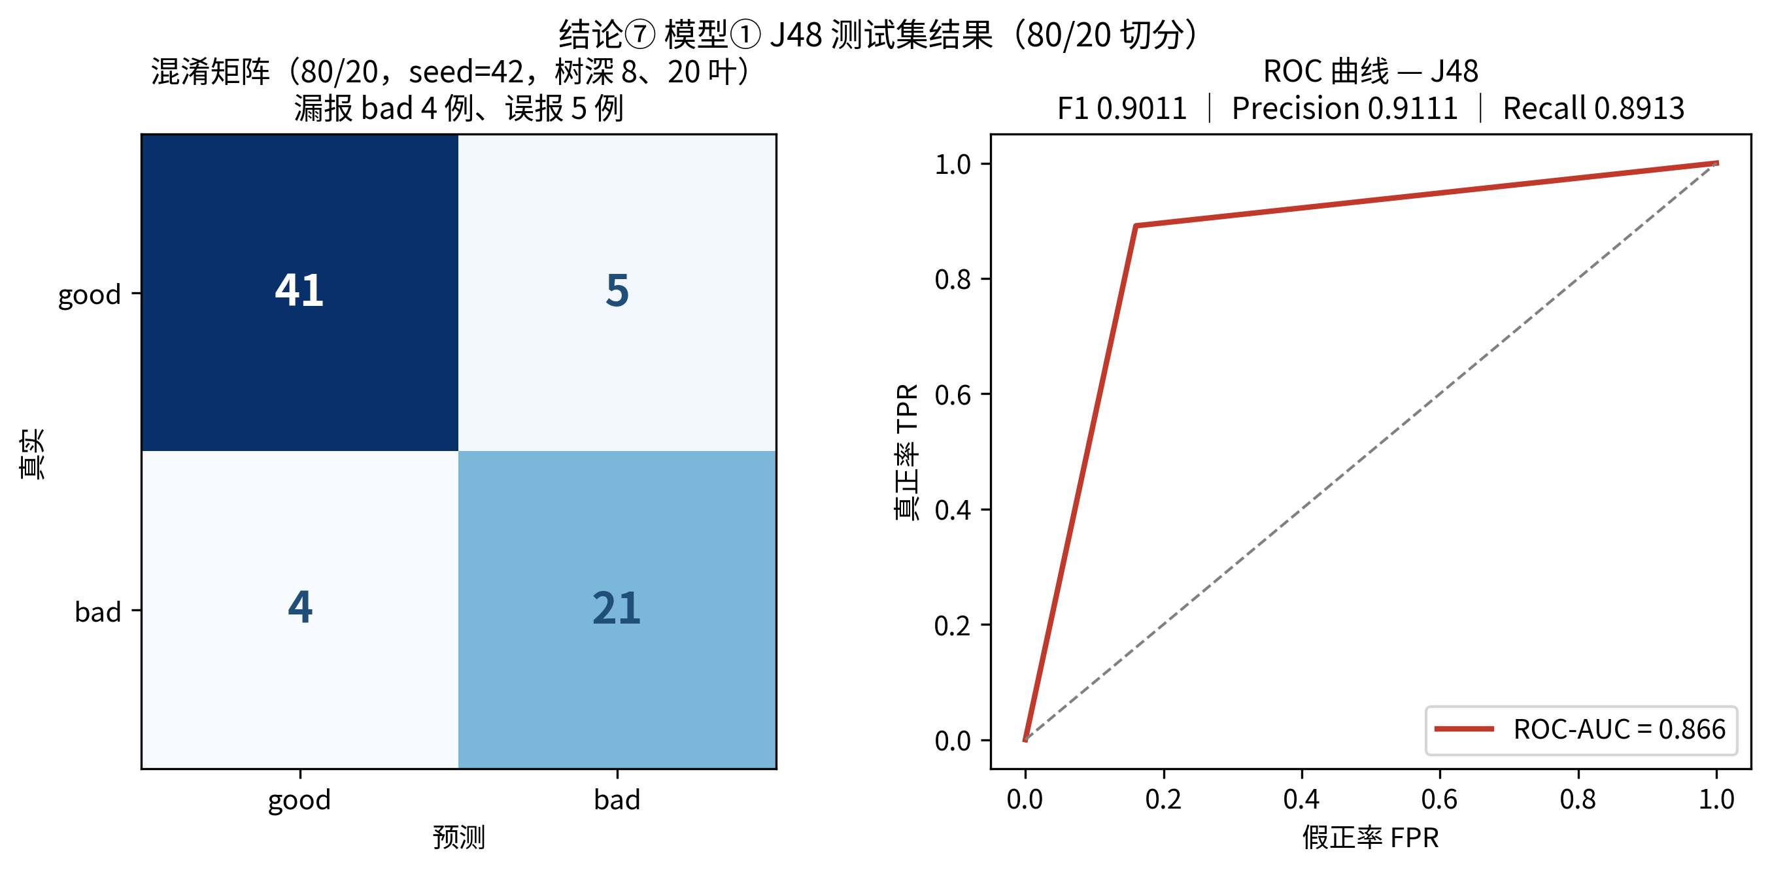
B1 · GONG TINGLU
J48 Test Results (80/20, seed = 42)
0.9011
0.9111
0.8913
0.866
8 / 20
F1（good）
Precision
Recall
ROC-AUC
Tree Depth / Leaves
Confusion matrix (41 + 21 correct, 9 errors) and ROC curve (held-out test set)
Notes:
On the 80/20 held-out test set, the pruned tree — depth 8 with 20 leaves — achieves F1 0.9011, precision 0.9111, recall 0.8913, and AUC 0.866. The confusion matrix shows only 9 errors among 71 test samples: 5 false positives and 4 false negatives. The 10-fold cross-validation scores are consistent with these results, indicating good generalization.

Slide 27
B2 · HE MINGEN
B2 · HE MINGEN
Random Forest
01 · RANDOM FOREST · WHY & HOW
WHY THIS MODEL · IN ONE SENTENCE
Because the class boundary on Ionosphere is curved, and only a forest can bend a boundary around 33 inputs.
HOW IT WAS TRAINED · FOUR SETTINGS AND ONE VALIDATION SPLIT
100
6
100 %
None
10-fold
trees, each on its own bootstrap sample
inputs considered at every split
bootstrap rows, with replacement
depth cap — trees grow until pure
stratified CV, seed 42, fixed once
Each tree sees only six of the thirty-three inputs at a split, so no single dimension can dominate the vote. A hundred trees then vote and the majority wins. Nothing was scaled, and the F1 on the next page is an out-of-fold average over those ten folds — not a training score.
Ten folds, one seed, a hundred trees — the next page shows where the training stopped improving.

Slide 28
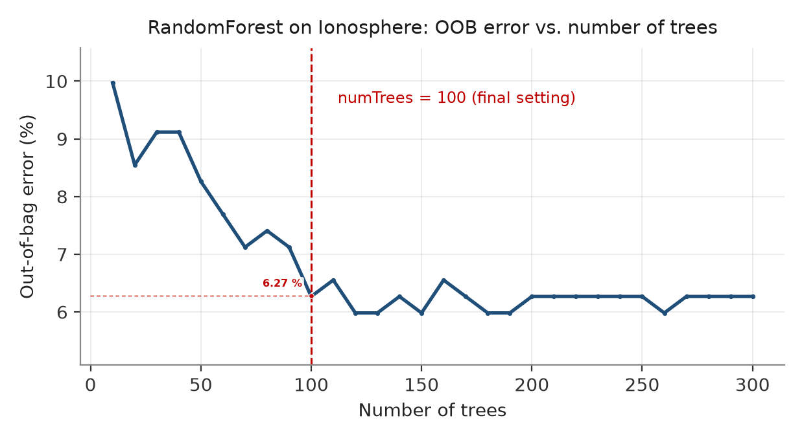
B2 · HE MINGEN
B2 · HE MINGEN
Random Forest — what the training produced
02 · RANDOM FOREST · RESULT
OUT-OF-BAG ERROR VS NUMBER OF TREES
0.9497
F1 on g
ROC-AUC 0.9785
WHERE THE 23 ERRORS GO · 351 CASES
Fifteen of the twenty-three are false alarms — the cheaper kind. Only 8 of the 225 g returns are missed, 3.6 %.
OOB error falls from 10.0 % at ten trees to 6.27 % at a hundred, then stays flat. That 6.27 % sits beside 6.55 % from cross-validation — a fit, not a memorised training set.
The forest was ready at a hundred trees, and what it learned holds up off the training set.

Slide 29
B2 · HE MINGEN
B2 · HE MINGEN
Logistic
03 · LOGISTIC · WHY & HOW
WHY THIS MODEL · IN ONE SENTENCE
Because on 351 rows a thirty-five-parameter line is a stable fit, and every coefficient can still be read out loud.
HOW IT WAS TRAINED · FOUR SETTINGS AND ONE VALIDATION SPLIT
35
1e-8
L-BFGS
None
10-fold
coefficients in total — small enough to print
L2 penalty — near zero, so the fit is undamped
solver, run until the gradient stops
scaling — inputs already sit in [−1, 1]
stratified CV, seed 42, fixed once
One weighted sum per case, pushed through a sigmoid and cut at 0.5. With L2 at 1e-8 nothing is shrunk, so the result is the plain maximum-likelihood line. The solver stops when the gradient settles — and every score is an out-of-fold average over the same ten folds.
Nothing was tuned to make it work — the next page shows the loss it settled at.

Slide 30
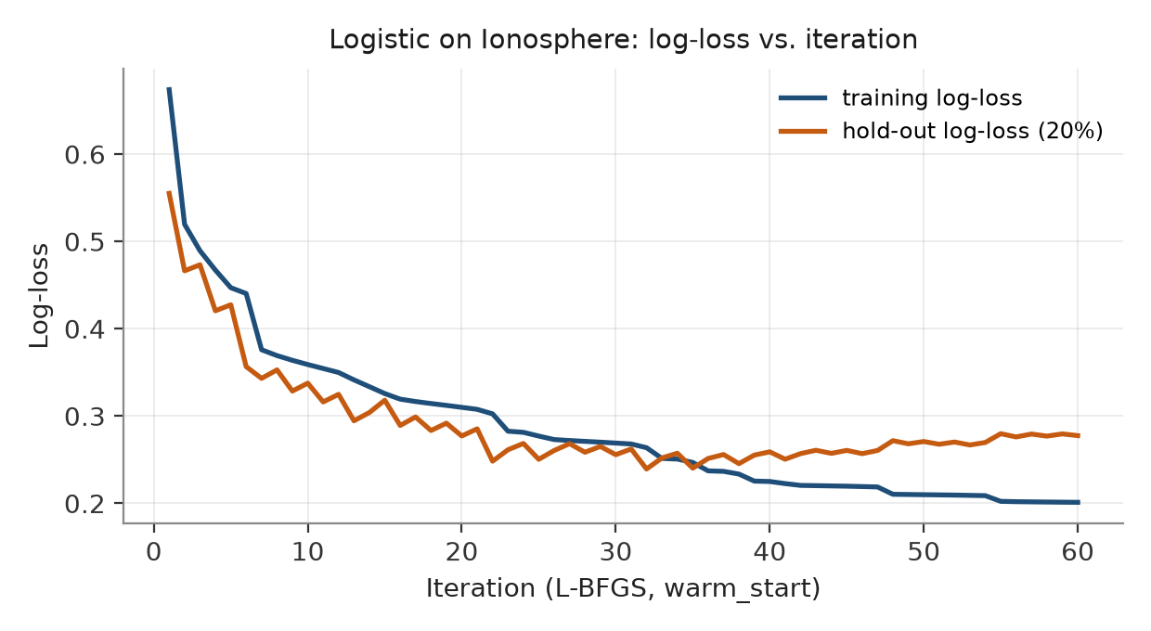
B2 · HE MINGEN
B2 · HE MINGEN
Logistic — what the training produced
04 · LOGISTIC · RESULT
LOG-LOSS VS ITERATION · TRAIN AND HOLD-OUT
0.8996
F1 on g
ROC-AUC 0.8489
WHERE THE 46 ERRORS GO · 351 CASES
Twenty-seven of the forty-six are missed g returns — 12 % of the g cases. The remaining nineteen are b cases read as g.
Training log-loss flattens at 0.20 while the hold-out curve stalls at 0.26, roughly thirty rounds in. The optimiser ran to convergence; the ceiling is the model, not the search.
Same data, same split, same seed — only the shape of the boundary differed, and that is what Ionosphere rewards.

Slide 31
B3 · HU SHUAISHUAI
Result · Preprocessing Schemes × Algorithms (Accuracy)
02 Results & Analysis
Model | nobalance | noselect | over | smote
Decision Tree | 0.914 | 0.877 | 0.909 | 0.912
Random Forest | 0.931 | 0.932 | 0.937 | 0.923
Logistic Regression | 0.863 | 0.883 | 0.843 | 0.849
SVM | 0.940 | 0.940 | 0.937 | 0.943
Decision Tree:In no select but have balance situation, Decision tree reach the highest goal.So it is not sensitive to imbalance
Random Forrest:The various between different pipeline is not very big, so it’s generalize ability is good
Losgistic Regression: In no select and no balance situation, Logistic reach the best goal. So it’s not so sensitive to noise since it can control the weigh of noise
SVM: SVM using kernal so it can fit the unliner curve.It’ also have a good generalize ability like random forrest.
nobalance: no balancing, with feature selection noselect: no balancing, no feature selection
over: class balancing, with feature selection smote: class balancing, with feature selection
Compare
Balance or not:mild imbalance of about 64:36 , so resampling alone offers limited gains;
Smote or over:SMOTE is an interpolation algorithm; its samples may not be real, but they can supplement the data.
CDS 535 · Data Mining · Group Project
Notes:
As we can see in the picture , the rank of different pipeline for different model are pretty clear.
(1)
Beside model Let us do some compare about the pipeline
(2)

Slide 32
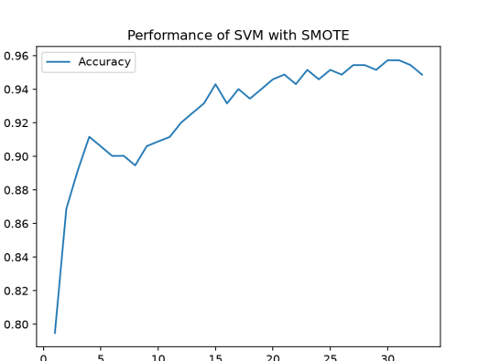
B3 · HU SHUAISHUAI
Result · SelectKBest Feature-Count Scan
02 Results & Analysis
Setup: Standardize → SelectKBest → SMOTE → SVM; stratified 10-fold CV; all fitting inside the pipeline
k = 15
Acc 0.943｜F1 0.956｜F1_std 0.031
k = 30 Is Optimal
Acc 0.957 | F1 0.967 | F1_std 0.015 — more stable
Conclusion
To balance the speed and accuracy we choose K=15
CDS 535 · Data Mining · Group Project
Notes:
We conduct two experiment one is gird search K for PCA and Select best.
PCA and Select best. SelectKBest uses ANOVA values and PCA uses eigenvalues of the covariance matrix
And in select best . To balance the speed and accuracy we choose K=15

Slide 33
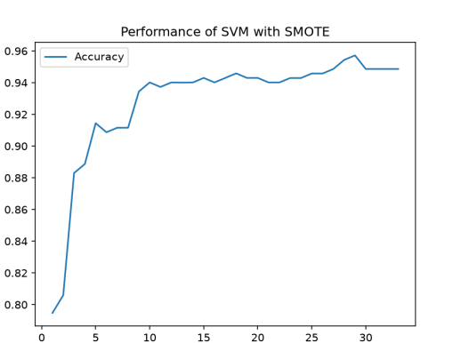
B3 · HU SHUAISHUAI
Result · PCA Component Scan & Comparison with SelectKBest
Setup: Standardize → PCA → SMOTE → SVM; stratified 10-fold CV; all fitting inside the pipeline
We conduct two experiment is gird search K for PCA and Select best. SelectKBest uses ANOVA values and PCA uses eigenvalues of the covariance matrix
And what we can get is that not higher K get greater Performance.
PCA vs SelectKBest (Best Accuracy)
PCA（k=29）：0.9577
SelectKBest（k=30/31）：0.9572
CDS 535 · Data Mining · Group Project
Notes:
(1)

Slide 34
B1 · GONG TINGLU
B1 · GONG TINGLU
Five-Model Comparison — RBF-SVM Still Wins
02 · RESULTS & ANALYSIS
Ionosphere · 351 cases · 33 inputs · 10-fold stratified CV · positive class = good (g)
Ionosphere model comparison (good as positive class)
FINAL SELECTION
0.956
F1 · RBF-SVM
AUC 0.980 · Acc 0.943
Recall 0.982 — fewest missed good returns.
ZEROR · THE FLOOR
0.781
F1 · ZeroR
AUC 0.500
Always answer “good”: precision 0.641, recall 1.0.
WHY THE MARGIN STILL WINS
Kernel boundaries suit 351 rows of continuous signal. The straight logistic cut stops at 0.914; the forest reaches 0.952; the margin adds the last four points.
10-fold CV mean. ZeroR ignores every input — it is the floor the other four have to clear.
The order never changes — ZeroR 0.781 < Logistic 0.914 < Tree 0.933 < Forest 0.952 < SVM 0.956. Only the size of the gap does.

Slide 35
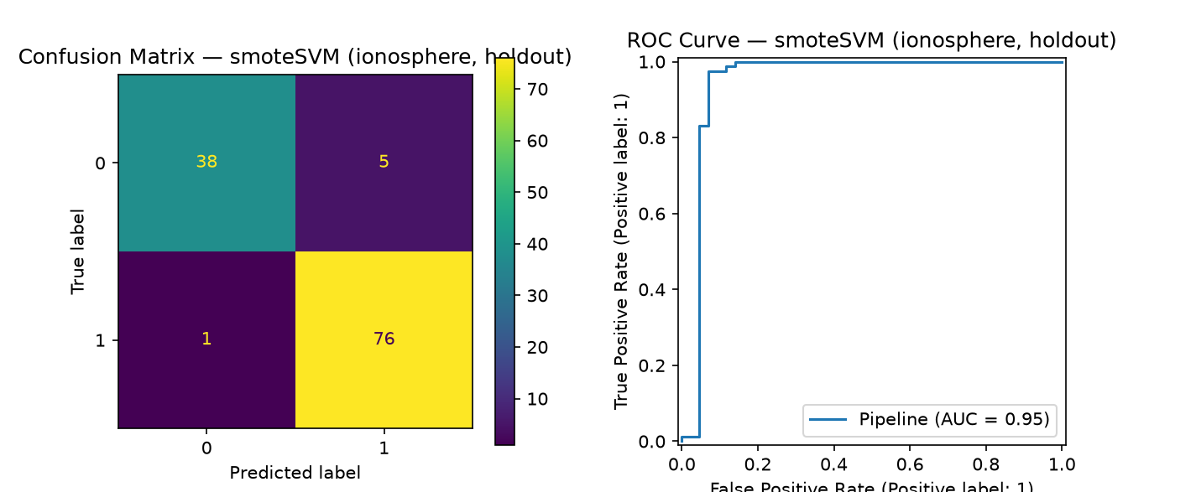
B3 · HU SHUAISHUAI
Result · Comparison of Two Evaluation Protocols
02 Results & Analysis
Protocol A | Stratified 10-Fold Cross-Validation (Primary)
Each fold takes a turn as validation; mean and standard deviation quantify variation and support robust conclusions
Protocol B | Single Stratified Hold-Out Split (Control)
Simple and intuitive, but results depend on one train/test composition; some model metrics vary noticeably
We conduct two train_test_split protocol. One is K-fold cross validation and one is simple split only one time.The result are similar but as we change the random state the simple split become unstable.
SMOTE + SVM on hold-out set: confusion matrix and ROC (AUC = 0.95)
CDS 535 · Data Mining · Group Project

Slide 36
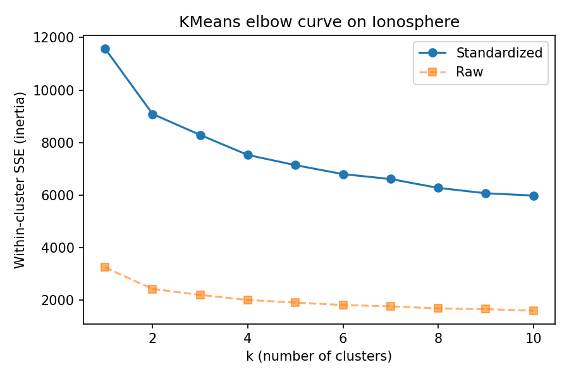
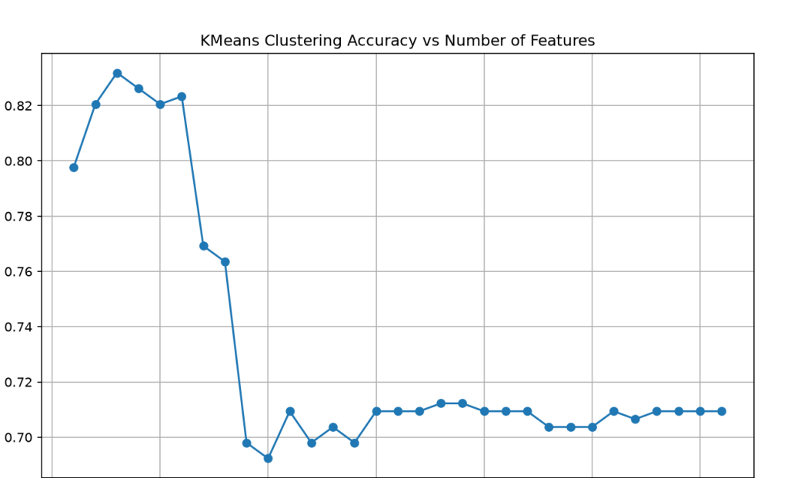
B3 · HU SHUAISHUAI
Result · KMeans Unsupervised Clustering
02 Results & Analysis
Elbow curve: k = 2 is a reasonable choice (though not sharp)
Cluster–label agreement (purity) across feature counts
1. Limit the k in 2 but using different number of feature.And even without target ,the highest score still can reach nearly 83%
2.Let free the k. We can see the elbow shows when K=2
So we can confirm the information lies in the feature wether there is target.
CDS 535 · Data Mining · Group Project
Notes:
We also try to train in a unsupervised way.We use K-means clustering to conduct two survey
(1)

Slide 37
GROUP
PART 03 · COMPARISON
Mushroom × Ionosphere Shared-Model Comparison
Shared model
Mushroom
Ionosphere
J48 / Decision Tree · F1 / ROC-AUC
1.000 / 1.000
0.933 / 0.907
Logistic Regression · F1 / ROC-AUC
1.000 / 1.000
0.914 / 0.897
Why J48 changes
Strong nominal rules split easily
Single tree is less stable on small numeric data
Why Logistic Regression changes
Linear weighting is sufficient
The boundary is more complex and nonlinear
Final selection
Logistic Regression · F1 = 1.000
RBF-SVM · F1 = 0.956 · ROC-AUC = 0.980
Is extra complexity worthwhile?
No additional gain; choose the simpler model after perfect ties
Yes; the nonlinear kernel matches the numeric boundary
Shared conclusion: model advantage depends on whether its inductive bias matches the data structure—not on complexity alone. Both datasets use stratified 10-fold CV and seed = 42.
CDS 535 · Data Mining · Group Project

Slide 38
GROUP
PART 03 · TAKEAWAYS
Summary
01
Preprocessing Sets the Ceiling
For Mushroom, top-9 features suffice for perfect classification; for Ionosphere, feature selection and class balancing significantly change the performance of models such as SVM.
02
Match Models to Data Characteristics
KNN, association rules, and decision trees suit nominal data; RBF-SVM and Random Forest are more robust on small, high-dimensional continuous data.
03
Evaluation Protocols Must Be Consistent and Robust
Both groups use stratified 10-fold CV (seed = 42); Ionosphere is also verified with an 80/20 split, yielding consistent conclusions under both protocols.
04
Interpretability Also Matters
J48 information-gain ranking, Apriori's 104 strong association rules, and the agreement between the KMeans elbow at k = 2 and the true classes all provide supporting evidence.
CDS 535 · Data Mining · Group Project

Slide 39
Thank You · Q & A
CDS 535 · Data Mining · Group Project
A1 He Haodong | A2 Bei Xuecheng | A3 Gu Ruiqi | B1 Gong Tinglu | B2 He Mingen | B3 Hu Shuaishuai

