Slide 1
CDS 535 · DATA MINING · GROUP PROJECT
Mushroom & Ionosphere
A Data Mining Analysis
MUSHROOM
8,124 × 22
All nominal attributes · Nearly balanced classes
Team Members
IONOSPHERE
A1 He Haodong | A2 Bei Xuecheng | A3 Gu Ruiqi
B1 Gong Tinglu | B2 He Mingen | B3 Hu Shuaishuai
351 × 34
Continuous numeric attributes · 64 : 36
Datasets: UCI Mushroom & Ionosphere (ID 52) · November 2026

Slide 2
CONTENTS
Contents
01
Mushroom Dataset
· Dataset introduction & preprocessing — A1 He Haodong
· KNN classification & Apriori association rules — A2 Bei Xuecheng
· ZeroR baseline & logistic regression — A3 Gu Ruiqi
02
Ionosphere Dataset
· Dataset · Preprocessing · Four-model comparison · J48 — B1 Gong Tinglu
· Random Forest vs Logistic Regression — B2 He Mingen
· Feature scan · PCA · Evaluation protocols · KMeans — B3 Hu Shuaishuai
03
Comparison & Conclusions
CDS 535 · Data Mining · Group Project

Slide 3
PART 01 · MUSHROOM
Mushroom Dataset
01
Presenters
A1
He Haodong
A2
Bei Xuecheng
Mushroom
A3
Gu Ruiqi
CDS 535 · Data Mining · Group Project

Slide 4
SPEAKER
A1 · He Haodong
Scope of Work
A1
Mushroom dataset introduction & preprocessing plan
Presentation Outline
· Data profile: 8,124 × 22, all nominal; nearly balanced classes; 30.5% missing in stalk-root
· Three-step cleaning: impute missing values → remove useless columns → rank attributes
· Five feature schemes compared (21 / 8 / 9 / 4 / 5 attributes)
· Conclusion: top-9 features recommended; features, not models, are the bottleneck
Mushroom
CDS 535 · Data Mining · Group Project

Slide 5
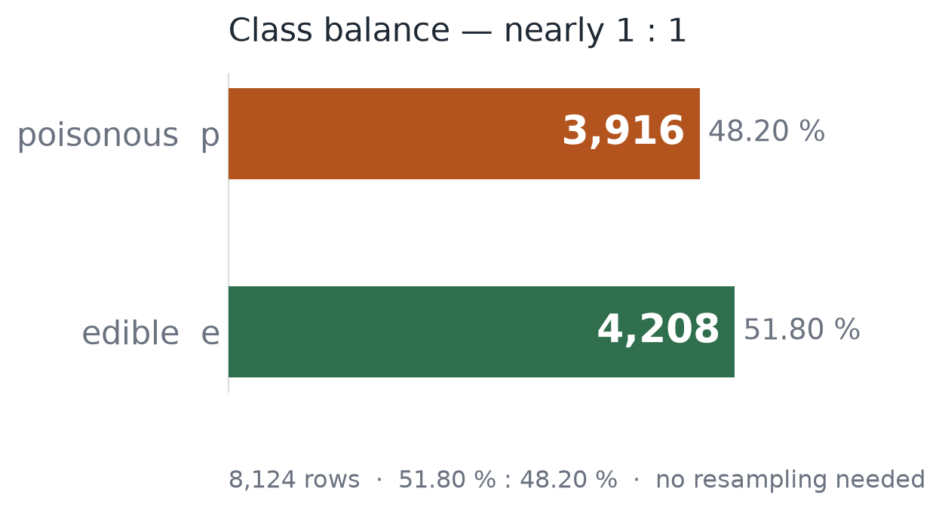
01 · DATA & DATASET TRAITS
CDS535 · DATAWARTS
All nominal, nearly balanced, one column with gaps
These three facts drove every preprocessing and model decision downstream
8,124
22
rows
predictors, all nominal
2,480
51.8 : 48.2
missing, all in stalk-root
edible : poisonous
All nominal, multi-valued
odor alone has 9 values — J48 splits multi-way on gain ratio, so the tree stays shallow
One gap, one dead column
Report §3.1.1. Missing values sit in a single column, so imputation is a controlled risk.
stalk-root is missing 30.5 %; veil-type holds a single value, so it carries no information
Classes close to 1 : 1
The signal is dense: five attributes already reach 100 %.
no resampling needed, so F1 and accuracy cannot mask each other

Slide 6
02 · PREPROCESSING
CDS535 · DATAWARTS
Three cleaning steps: the gain is not in the score
Impute → drop the dead column → rank only; the real reduction happens inside the training folds
STEP 1
STEP 2
STEP 3
STEP 4 · OPTIONAL
Impute
Drop useless
Rank, don’t delete
NominalToBinary
ReplaceMissingValues fills the 2,480 missing in stalk-root with the column mode b: 2,480 → 0.
RemoveUseless -M 99 deletes the single-valued veil-type: 22 → 21 predictors.
InfoGain + Ranker only ranks: odor 1st, spore-print-color 2nd. All 21 attributes survive.
Only for models that need numbers (SMO, Logistic): 21 attributes expand to 115 dimensions.
Must run before dropping columns, or “?” counts as a value
One value means zero variance: it can never split
Real reduction sits in FilteredClassifier, re-selected per fold
J48 / RF / NB handle nominal natively, so skip it

Slide 7
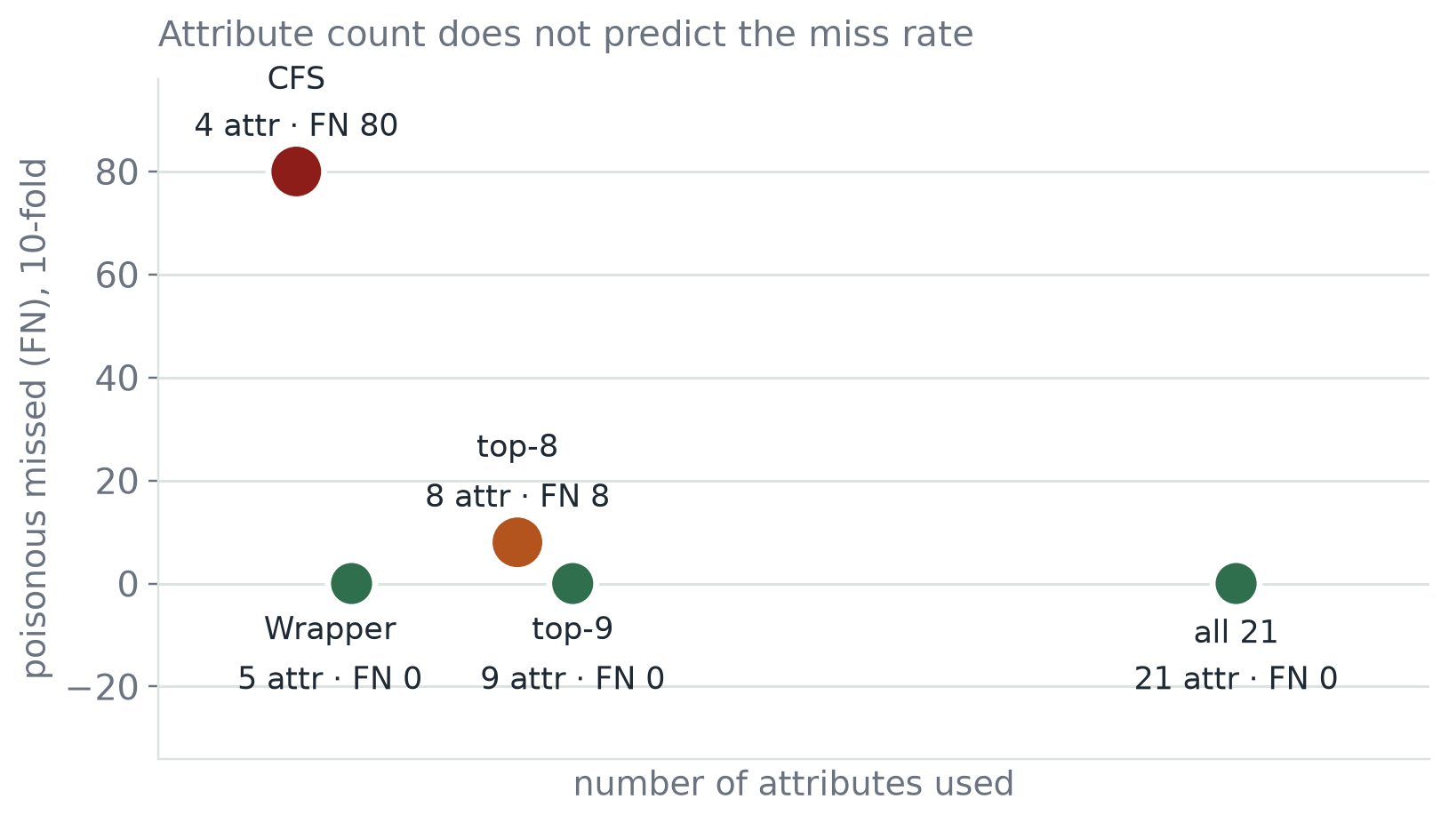
03 · MODEL · FIVE J48 VARIANTS
CDS535 · DATAWARTS
Five schemes, only the filter changes
The left column is the attribute count (21 / 8 / 9 / 4 / 5); deliberately laid out as a reduction gradient
21
Full set · baseline
What no reduction buys; anything lost later is the price
8
top-8 · InfoGain, univariate
One rank short on purpose: it differs from top-9 by a single attribute
9
top-9 · one more, gill-size
This single cut is the most telling design in the whole experiment
4
CFS · multivariate filter
Explicitly penalises redundancy: is a smaller subset more reliable?
Wrapper · J48 scores itself
Attribute count on x, poison missed on y: the points follow no line — count is not the driver.
5
Real criterion instead of a proxy: are five enough?
Three axes kept apart: criterion · redundancy · cost

Slide 8
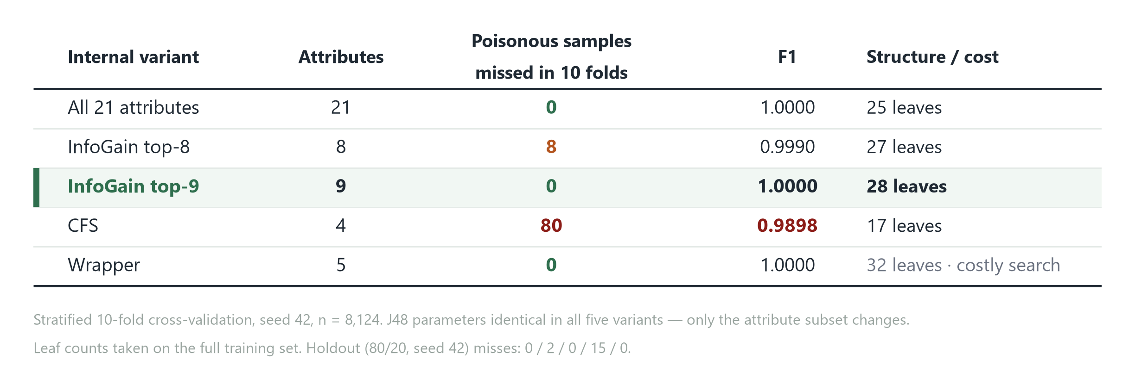
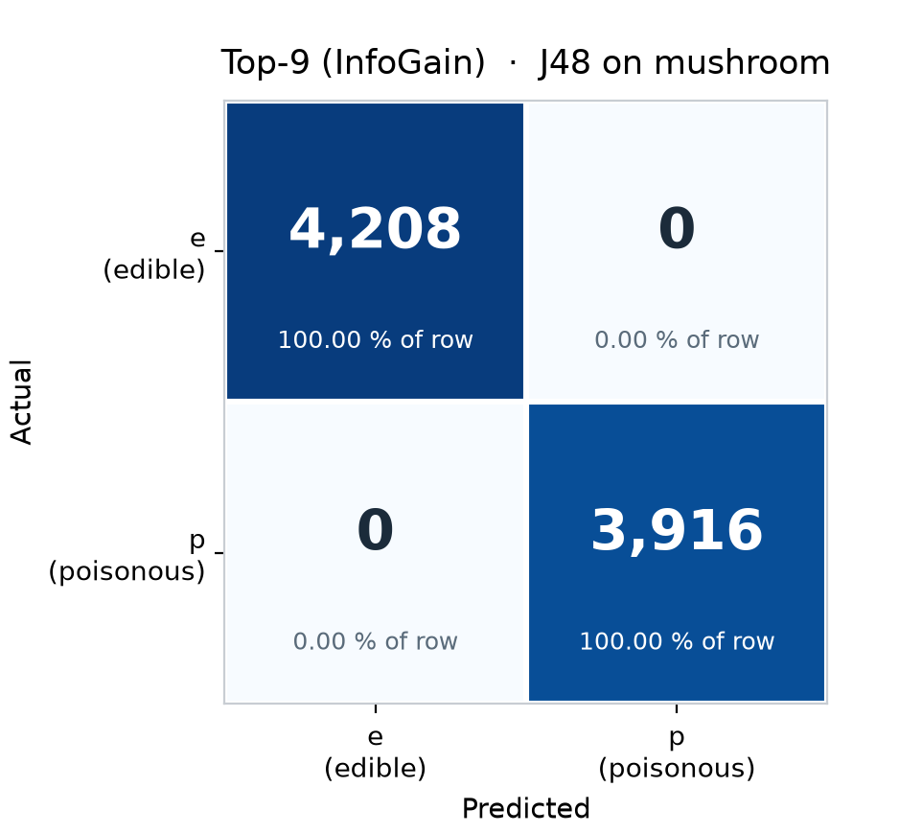
04 · COMPARISON · RESULTS
CDS535 · DATAWARTS
The five schemes split on one column only
Stratified 10-fold CV, seed 42, poisonous as the positive class; the reverse error is 0 in all five
Confusion matrix for top-9: top-right 0, bottom-left 0. All three perfect schemes look identical.
Three schemes tie at the top; the only real gap is CFS at 80 — 2 poison mushrooms in 100 slip through, the one scheme with real risk.
Holdout check: 0 / 2 / 0 / 15 / 0 — same ranking as the 10-fold

Slide 9
05 · CONCLUSION & HANDOFF
CDS535 · DATAWARTS
Recommend top-9: the bottleneck is features, not the model
Three takeaways for my part, and the interface I hand over
01
Pick top-9: 9 attributes, 100 %, same cost class as the full set
build 0.25 s vs 0.18 s; 28 leaves vs 25 — interpretation barely gets harder
02
Do not pick CFS: 4 attributes for 80 missed poison mushrooms
fewest attributes and the smallest tree (17 leaves), but p recall falls to 0.9796
03
The bottleneck is features, not the model
J48 is untouched across all five; 99.02 → 100 comes from the attribute subset alone
HANDOFF
Over to A2 for logistic regression, KNN and Apriori — the attribute subset is fixed at top-9, so the same data and seed can be reused directly.

Slide 10
SPEAKER
A2 · Bei Xuecheng
Scope of Work
A2
KNN classification & Apriori association rules
Presentation Outline
· KNN: classification by local similarity; k = 9 performs best
· Apriori: support ≥ 0.20, confidence ≥ 0.80; 1,568 frequent itemsets → 104 strong rules
· Model comparison: J48-top9 / Logistic Regression / KNN all achieve F1 = 1.000
Mushroom
CDS 535 · Data Mining · Group Project

Slide 11
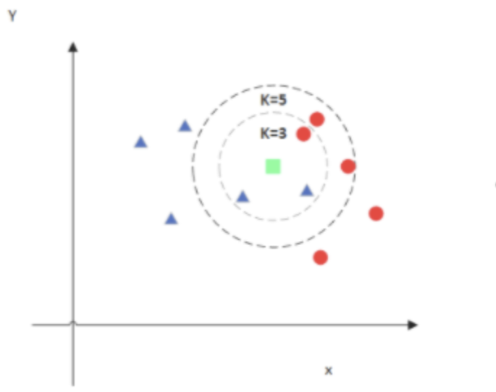
02 · KNN CLASSIFICATION
A2 · MUSHROOM
KNN: Classification Based on Local Similarity
How it works
KNN measures the Euclidean distance between a new sample and the training samples, then assigns the class voted for by its nearest k neighbors.
Why it fits Mushroom
All input attributes are nominal. After one-hot encoding, Euclidean distance reflects how differently two samples are described by these attributes.
CDS 535 · Data Mining · Group Project

Slide 12
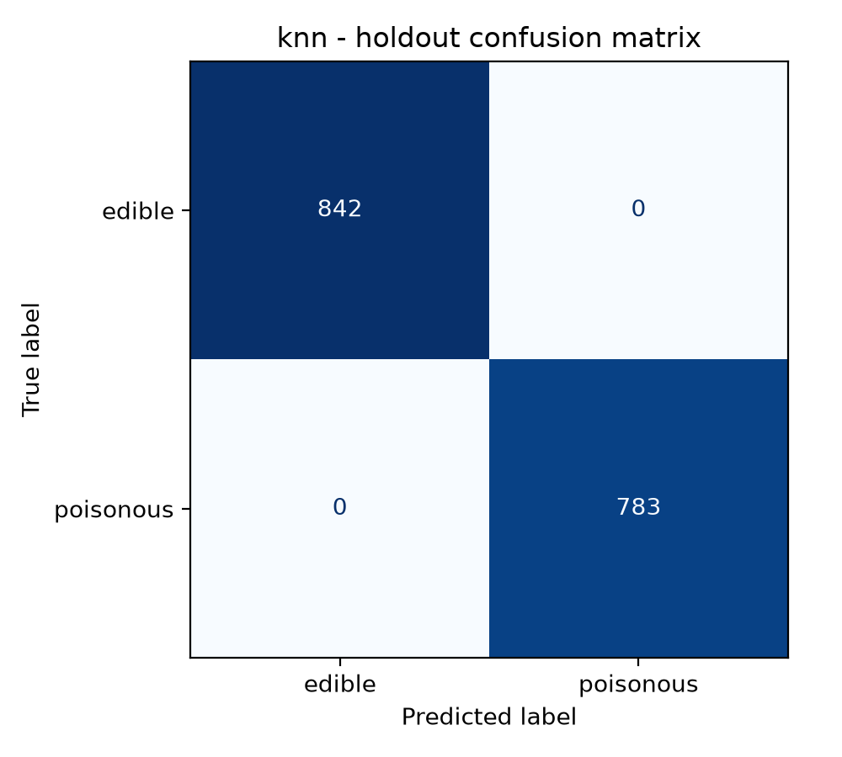
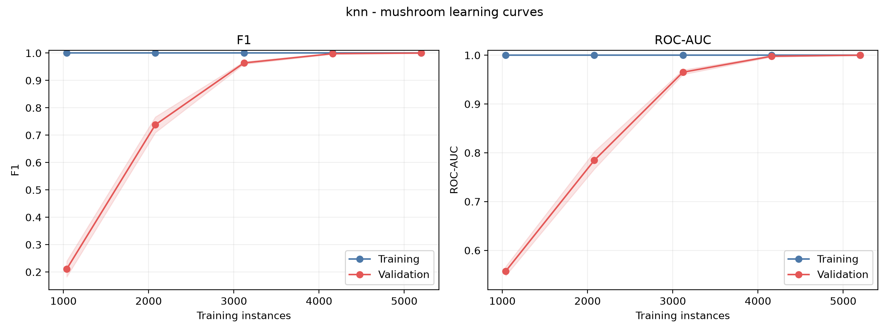
02 · KNN — RESULTS
A2 · MUSHROOM
KNN: Parameter Selection & Perfect Scores
Parameter selection: We searched k=1–20 and compared uniform and distance voting within the training folds, using poisonous-class F1 for selection.
KEY RESULT
F1 = ROC-AUC = 1.0000
Final setting: All values from k=1 to k=9 achieved perfect scores. We recorded k=1, weights=uniform according to the tie order.
Both 10-fold F1 and ROC-AUC reached 1.0000, showing very strong local class consistency in this dataset.

Slide 13
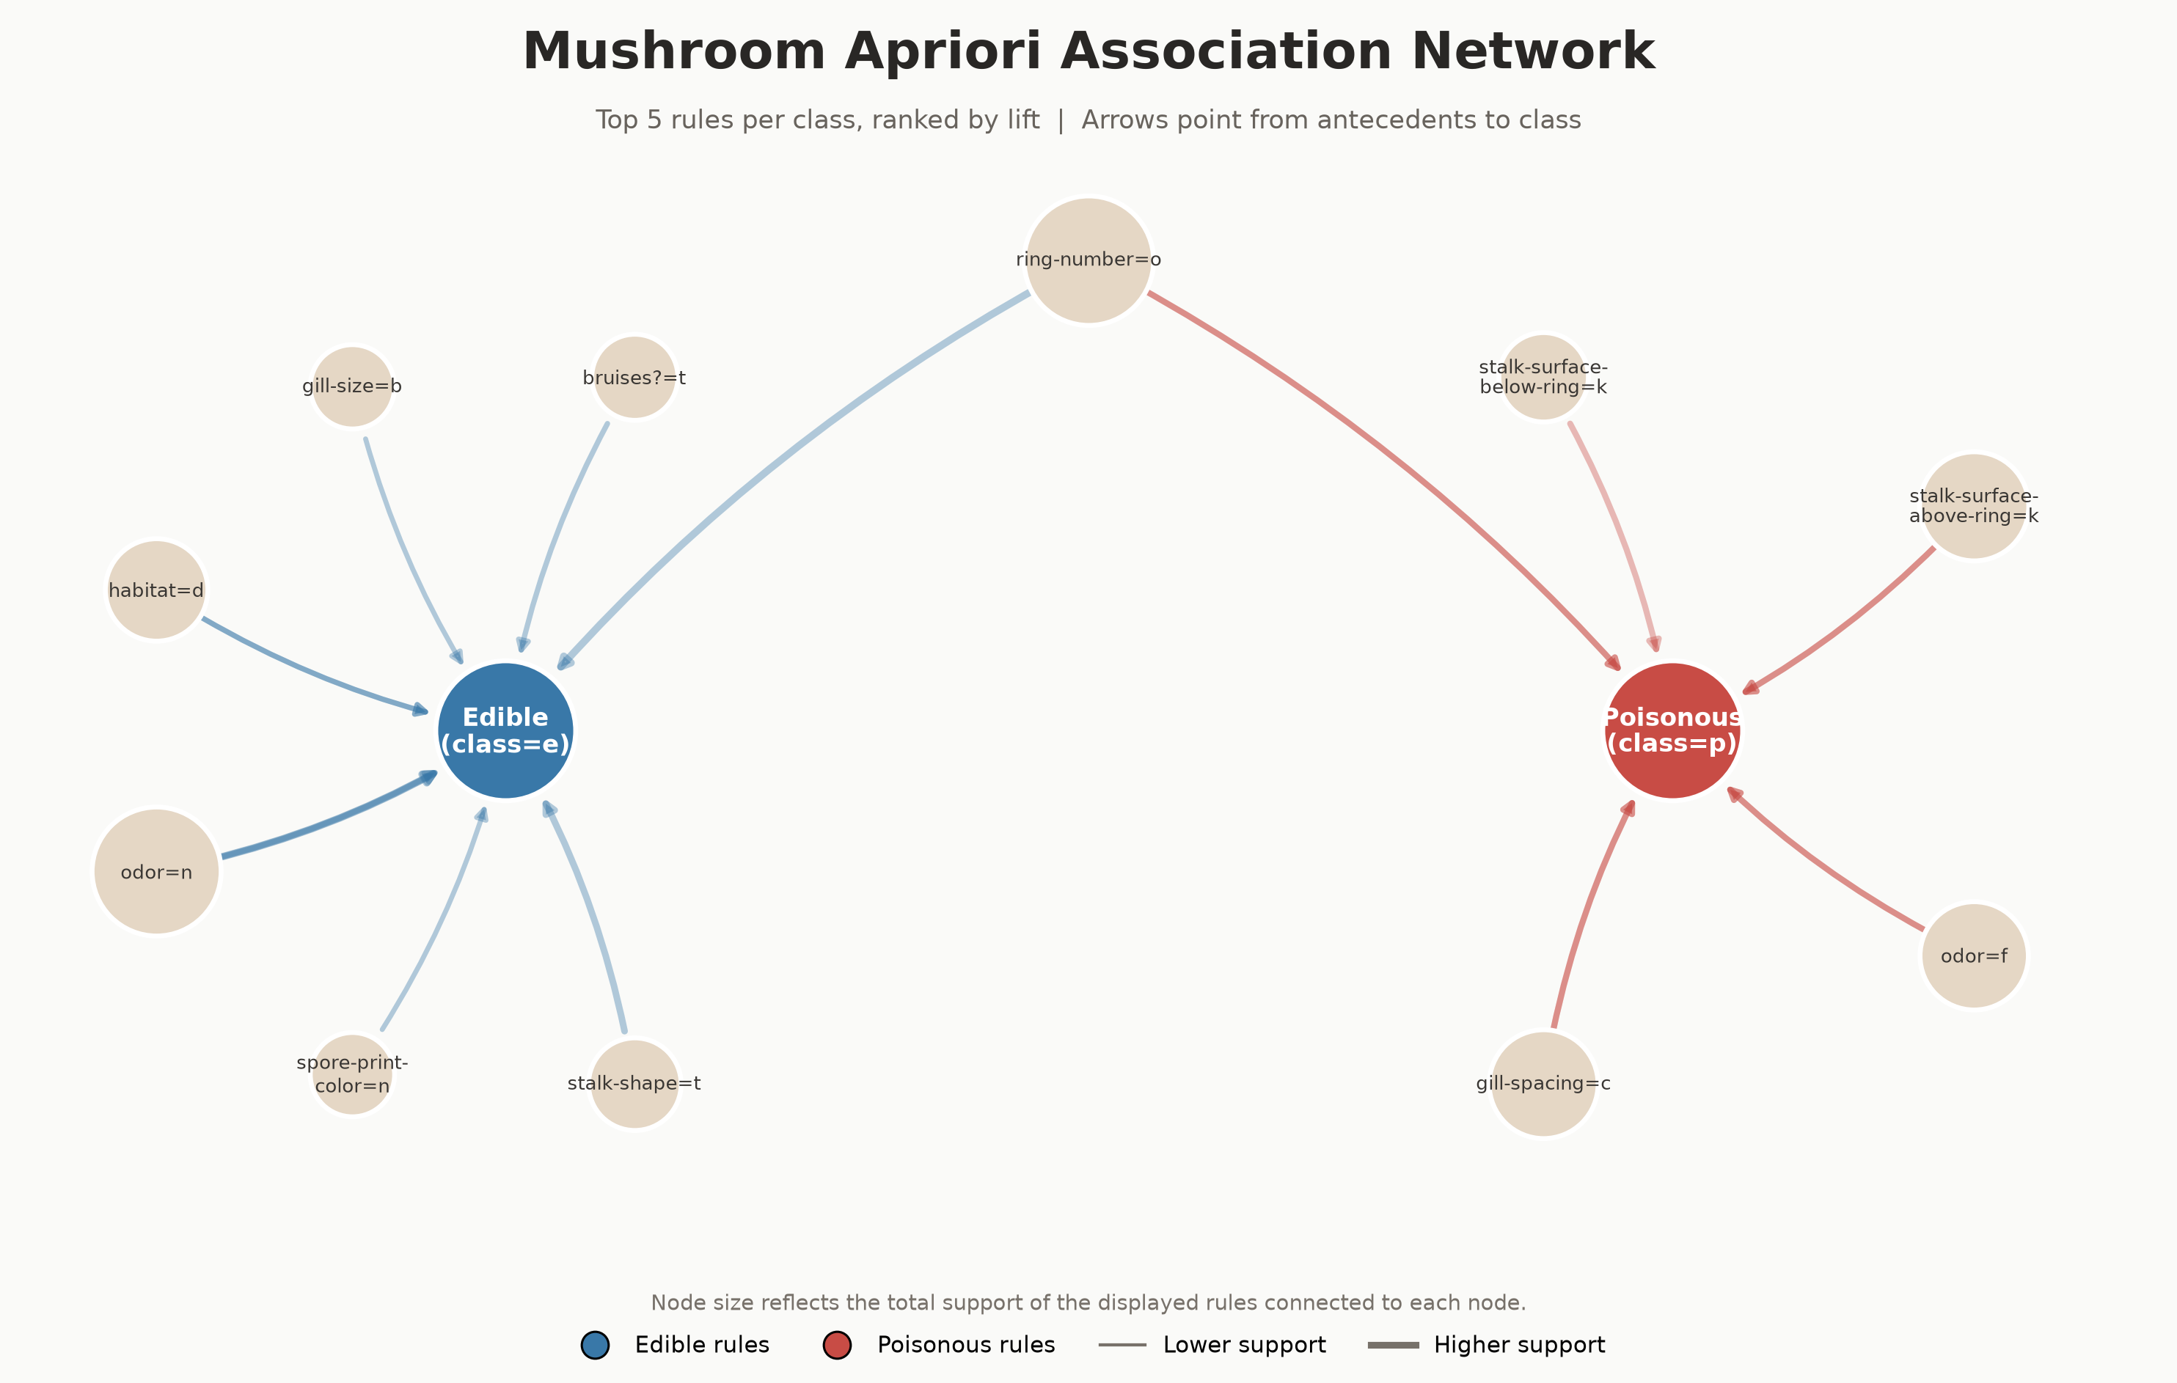
02 · APRIORI ASSOCIATION RULES
A2 · MUSHROOM
Apriori: Finding Strong Associations
How it works
Apriori first identifies attribute combinations that occur frequently, then generates association rules from them. We use Support, Confidence, and Lift to evaluate how common, reliable, and informative each rule is.
Why it fits Mushroom
All attributes are nominal, so each attribute value can be naturally treated as an item, such as odor=f. This makes Apriori suitable for discovering interpretable co-occurrence patterns without distance calculations or numerical assumptions.
CDS 535 · Data Mining · Group Project

Slide 14
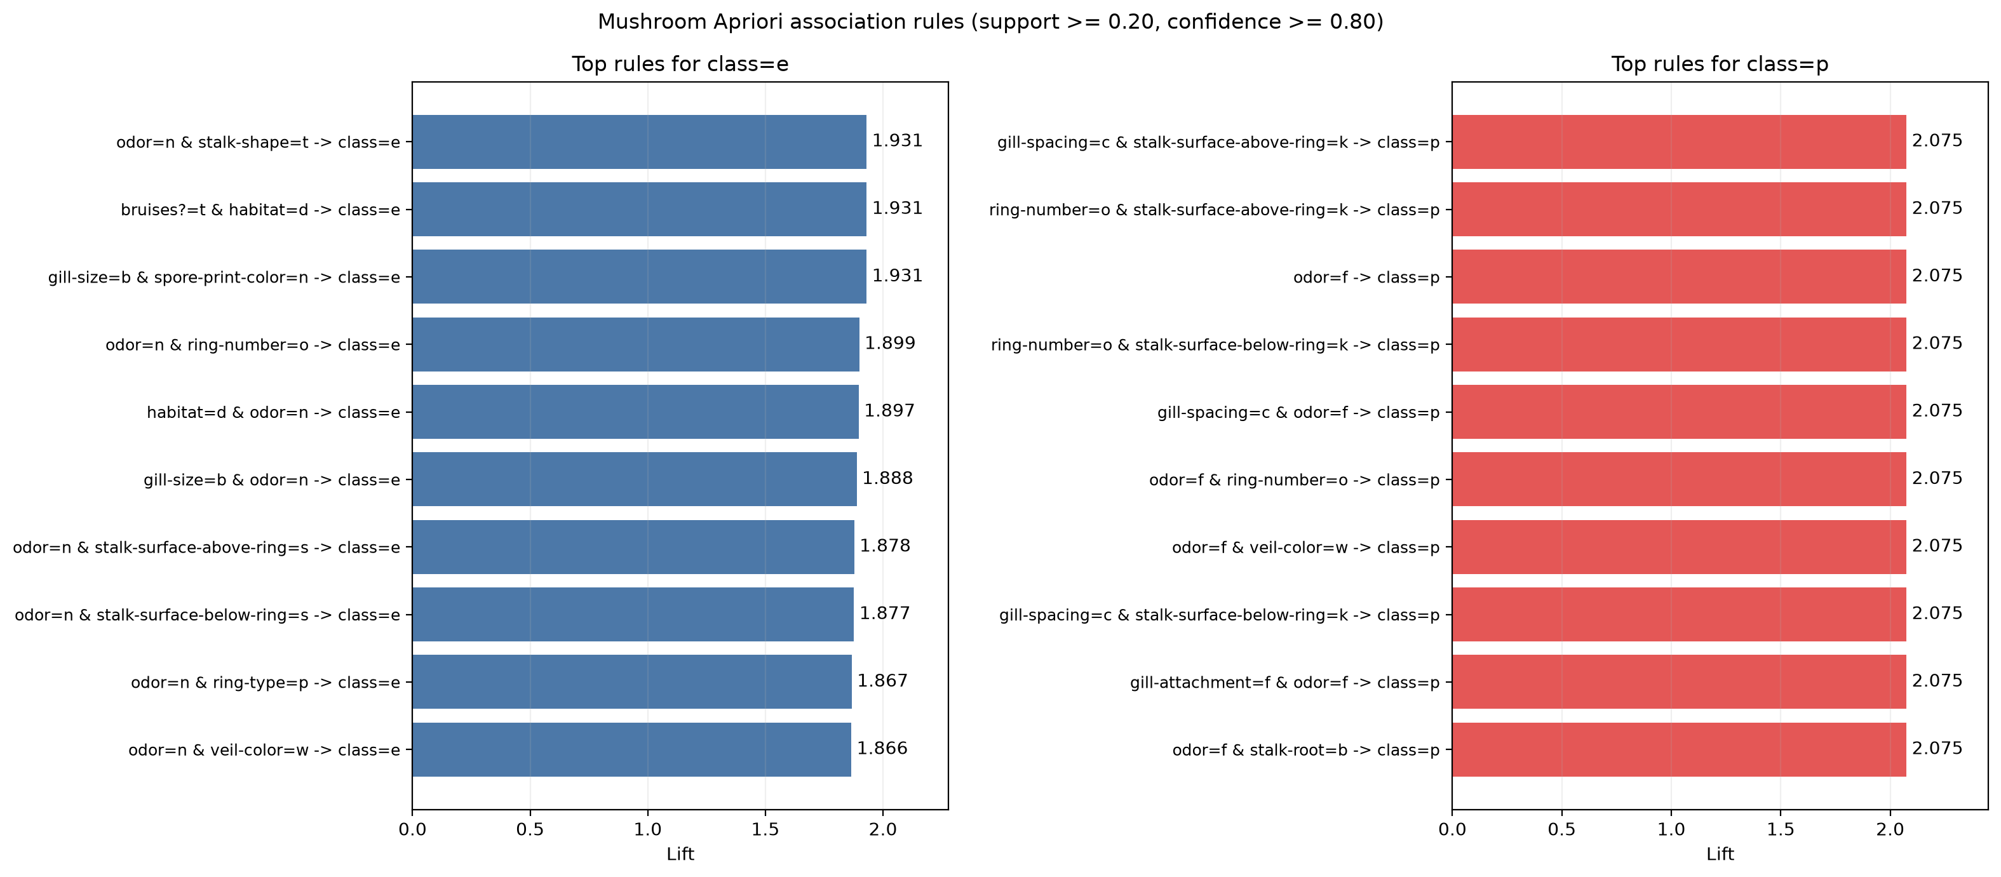
02 · APRIORI — RULES
A2 · MUSHROOM
Apriori: Settings, Representative Rules & Interpretation
1,568
frequent itemsets
104
rules ending in class=e or class=p
Settings: Support ≥ 0.20 ｜ Confidence ≥ 0.80 ｜ maximum itemset length = 3
odor=f → class=p
odor=n → class=e
Support = 0.2659 ｜ Confidence = 1.0000 ｜ Lift = 2.0746
Support = 0.4195 ｜ Confidence = 0.9660 ｜ Lift = 1.8649
Interpretation: Odor and several other attributes show strong associations with the class labels.

Slide 15
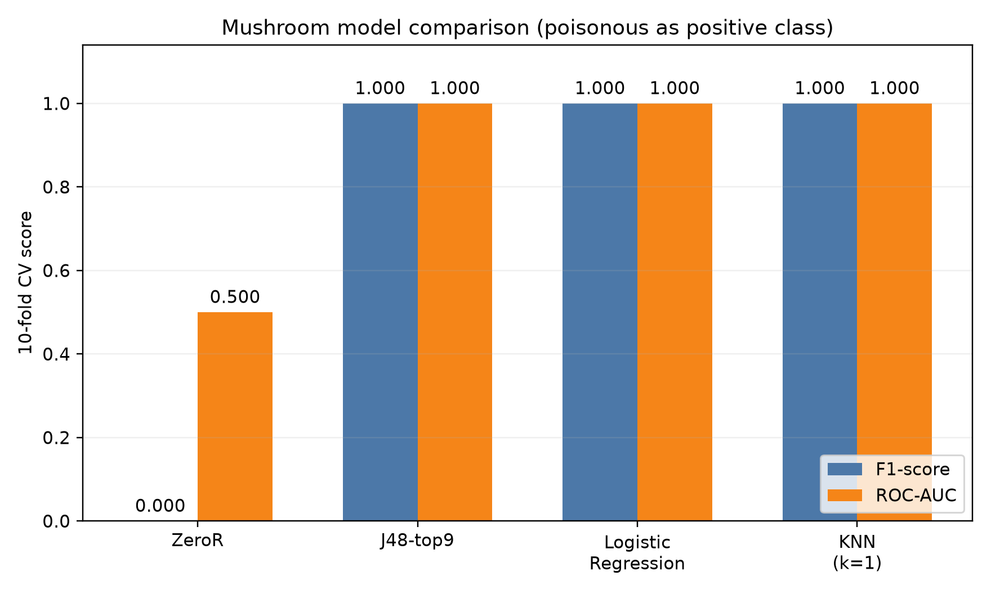
02 · MODEL COMPARISON
A2 · MUSHROOM
Model Comparison
Selection order
1
F1
2
ROC-AUC
3
Model Complexity
CDS 535 · Data Mining · Group Project

Slide 16
SPEAKER
A3 · Gu Ruiqi
Scope of Work
A3
ZeroR baseline & logistic regression
Presentation Outline
· ZeroR: majority-class baseline; ignores all input attributes
· Logistic regression: learning curves and convergence behavior
Mushroom
CDS 535 · Data Mining · Group Project

Slide 17
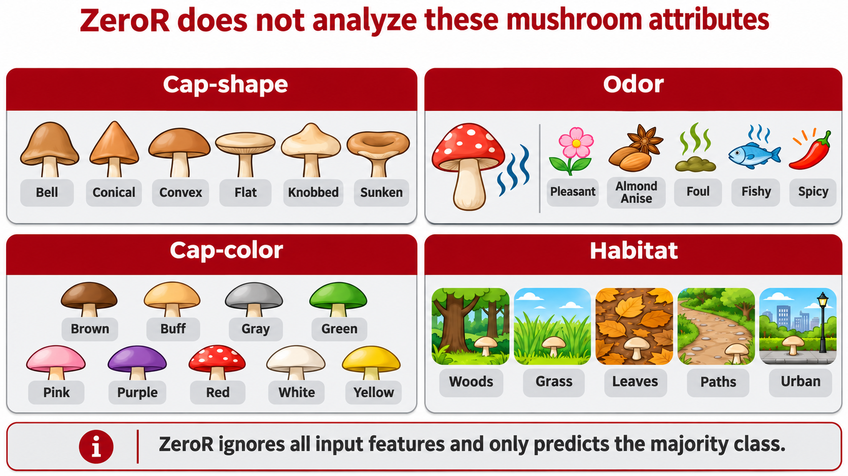

Slide 18
ZeroR | A Majority-Class Baseline
Rule
ZeroR confusion matrix
Always predict the majority class: edible (e).
Actual \ Predicted
Edible (e)
Poisonous (p)
Edible (e)
4,208
0
Purpose
Poisonous (p)
3,916
0
Checks whether other models learn useful patterns beyond a simple majority-class guess.
Positive class = poisonous (p)
51.80%
0.000
0.000
0.000
0.500
Accuracy
Precision
Recall
F1-score
ROC-AUC
Why is Accuracy 51.8% but F1 = 0? ZeroR correctly labels all edible mushrooms, but misses every poisonous mushroom.
2/5

Slide 19
Logistic Regression | Learning Curves
Training stays near 1.0; validation improves as more training instances are used.
F1 Learning Curve
ROC-AUC Learning Curve
1.0
● Training
1.0
● Training
● Validation
● Validation
0.0
0.8
1k
2k
3k
4k
5k
1k
2k
3k
4k
5k
Training instances
Training instances
F1
ROC-AUC
Validation F1 rises from about 0.12 to 1.00.
Validation ROC-AUC rises from about 0.845 to 1.00.
4/5

Slide 20
PART 02 · IONOSPHERE
Ionosphere Dataset
02
Presenters
B1
Gong Tinglu
B2
He Mingen
B3
Hu Shuaishuai
Ionosphere
CDS 535 · Data Mining · Group Project

Slide 21
SPEAKER
B1 · Gong Tinglu
Scope of Work
B1
Dataset · Preprocessing · Four-model comparison · J48
Presentation Outline
· Dataset: 351 × 34 continuous attributes; class ratio 64 : 36
· Three preprocessing filters + four-model comparison; RBF-SVM wins at 0.914
· J48 in depth: information gain ranking · ablation · depth sensitivity · test F1 0.9011
· J48 vs Random Forest: the trade-off between interpretability and performance
Ionosphere
CDS 535 · Data Mining · Group Project

Slide 22
Presentation Roadmap
Data at a Glance
Preprocessing
Ionosphere Dataset
351 × 34 radar returns; class ratio 64 : 36
Three filters + ablation study
Preprocessing must match the model type
Preprocessing
Four-Model Comparison
Information gain attribute ranking
a05 ranks first — and later becomes the tree root
Four models compared side by side
RBF-SVM wins: F1 0.956
J48
J48
Depth Tuning + Test Results
F1 0.9011; only 9 errors among 71 samples
J48 vs Random Forest
The trade-off between interpretability and performance
2
Notes:
Here is the roadmap for my section: a 30-second data review, then preprocessing — three filters, information-gain ranking, and an ablation study; next, a side-by-side comparison of four models; finally, a closer look at our J48 decision tree, including depth tuning, test results, and comparison with Random Forest.

Slide 23
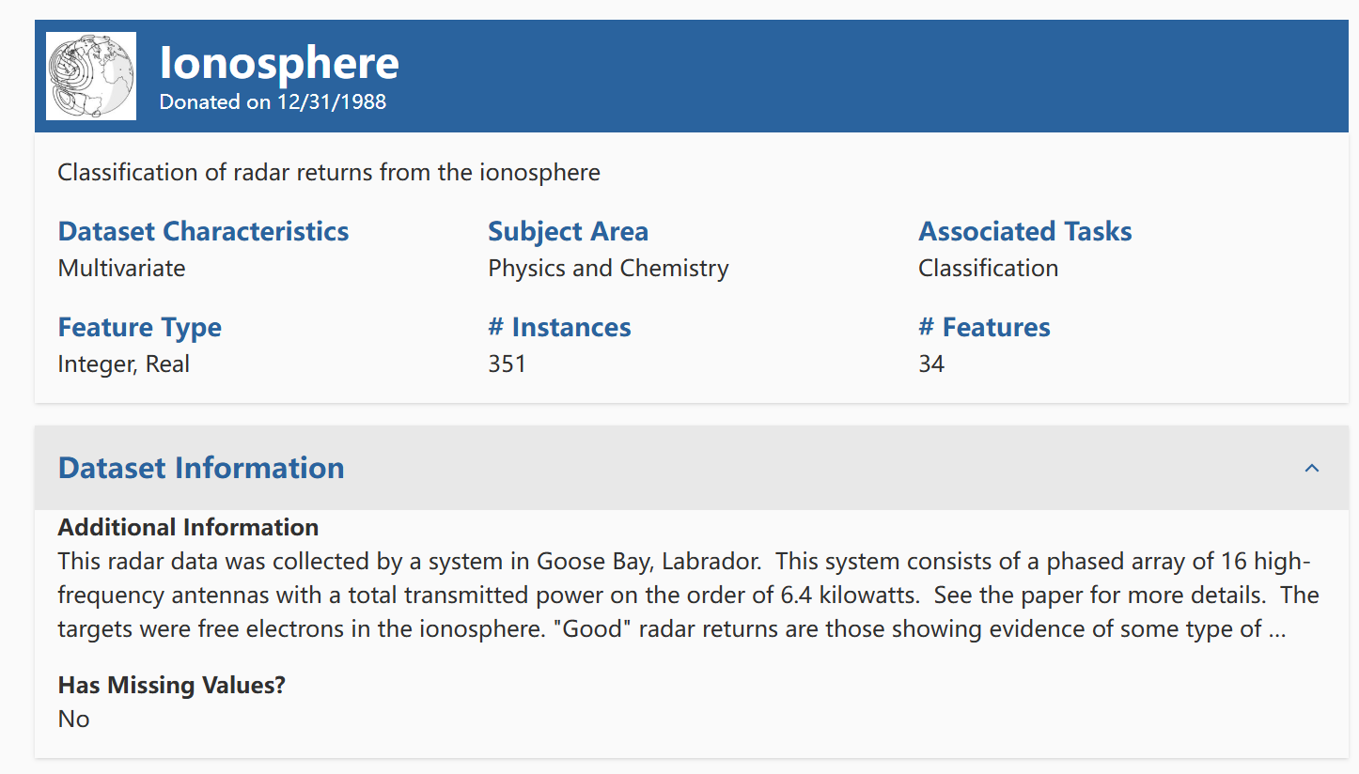
Dataset Introduction · Ionosphere (UCI #52)
01 Dataset Introduction
Source & Task
UCI DATASET
Official Dataset Description
Goose Bay phased-array radar: 16 high-frequency antennas, approximately 6.4 kW total power, targeting free electrons in the ionosphere; 17 pulses × 2 complex attributes = 34 numeric attributes. g = good returns showing ionospheric structure; b = bad returns where signals pass through.
Cleaning Highlights
351 samples
No missing values
Attribute2 is all zero → removed; attributes reduced from 34 to 33
Attribute1 has only 2 values; retained after plots confirmed discriminative power
Label encoding: g → 1, b → 0
Class ratio approximately 64 : 36; mildly imbalanced
CDS 535 · Data Mining · Group Project
3 / 10
Notes:
First, the dataset. Ionosphere radar data was collected by a phased-array system in Goose Bay, Canada, with 16 high-frequency antennas and approximately 6.4 kW total transmitted power, targeting free electrons in the ionosphere. After autocorrelation processing, 17 pulse numbers each correspond to 2 complex attributes, giving 34 numeric attributes per record.
The task is binary classification: g denotes good returns showing ionospheric structure, while b denotes bad returns where signals pass directly through the ionosphere. The dataset contains 351 samples.
For cleaning: there are no missing values; Attribute2 is an all-zero constant column and is removed, leaving 33 attributes; Attribute1 has only two special values and is retained after plots confirm discriminative power; labels g and b are encoded as 1 and 0. The upper-right plot shows the class distribution, 225 versus 126, or about 64:36 with mild imbalance; the lower-right heat map shows correlations among attributes, motivating the later feature selection and PCA.

Slide 24
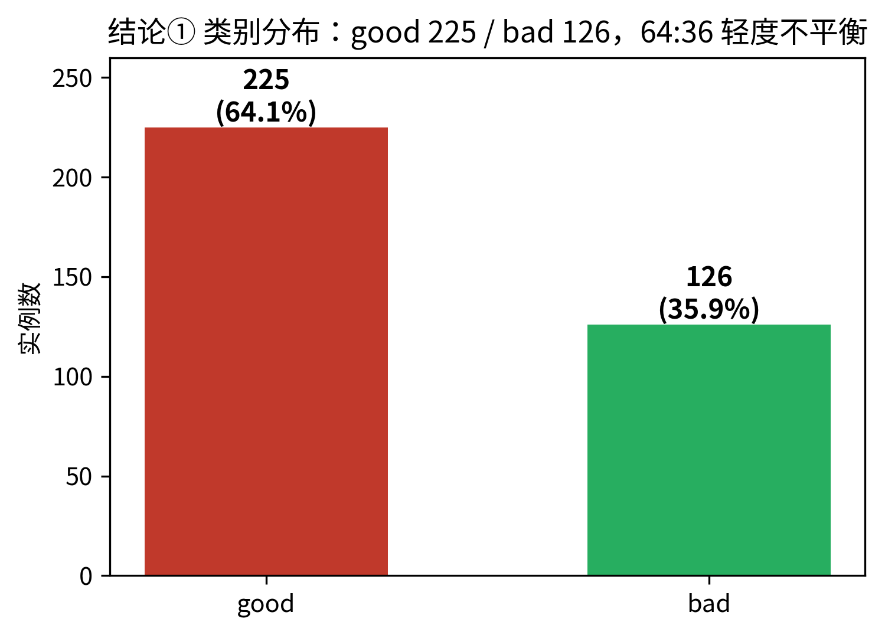
Dataset Introduction
351 × 34
17 × 2
Radar Returns × Numeric Attributes
Pulse signals, complex pairs
UCI #52
64 : 36
Sigillito · JHU APL · 1988
good 225 vs bad 126; mildly imbalanced
Task: binary classification of radar returns.
good = returns showing ionospheric structure
bad = signals passing directly through
good is the positive class.
Class distribution: good 225 (64.1%) vs bad 126 (35.9%)
3
Notes:
A quick data review. Ionosphere comes from the UCI repository as dataset 52 and was donated by Sigillito's team at the Johns Hopkins Applied Physics Laboratory. It contains 351 radar returns and 34 numeric attributes from complex pairs of 17 pulse signals. The task is binary classification: good denotes returns showing ionospheric structure, while bad denotes signals passing directly through. The classes contain 225 and 126 samples, respectively — about 64:36, mildly imbalanced — and good is the positive class.

Slide 25
Preprocessing — Three Filters
RemoveUseless
Missing-Value Check
Standardize
Attribute a02 is constantly zero and carries no information, so it is removed.
Verify before acting: 0 missing values found; no imputation needed.
All attributes scaled to zero mean and unit variance — for distance-based models such as SVM.
34 → 33 attributes
A verified no-op
z-score · All 33 attributes
All filters are fitted inside the cross-validation pipeline, using training folds only — preventing information leakage.
4
Notes:
Preprocessing uses three filters. First, RemoveUseless: attribute a02 is constantly zero and is removed, leaving 33 input attributes. Second, missing values: verification confirms there are none, so no imputation is needed. Third, Standardize: all attributes are scaled to zero mean and unit variance, which is necessary for distance-based models such as SVM. All filters are fitted inside the cross-validation pipeline using training folds only, avoiding information leakage.

Slide 26
Four-Model Comparison — RBF-SVM Wins
RBF-SVM — Final Selection
F1 0.956 · Acc 0.943 · AUC 0.980
Recall 0.982 — fewest missed good samples
0.956
0.952
0.933
Why SVM Wins
Kernel boundaries + maximum margin suit small numeric datasets; logistic regression's linear boundary cannot capture nonlinear patterns.
0.914
Note: these are cross-validation means, not evidence of statistical significance.
F1 for good class (cross-validation mean)
7
Notes:
Next is the four-model comparison. Decision Tree achieves F1 0.933; Random Forest improves to 0.952 through ensembling; Logistic Regression reaches only 0.914 because a linear boundary cannot capture nonlinear patterns in the radar data; RBF-SVM ranks first with F1 0.956, accuracy 0.943, the highest AUC of 0.980, and the highest recall of 0.982, meaning the fewest missed good samples. SVM wins because kernel boundaries and maximum margin are particularly suitable for small numeric datasets. Using F1 as the primary metric and AUC as secondary, RBF-SVM is selected for Ionosphere without a tie-break. Note that these are cross-validation means and do not establish statistical significance.

Slide 27
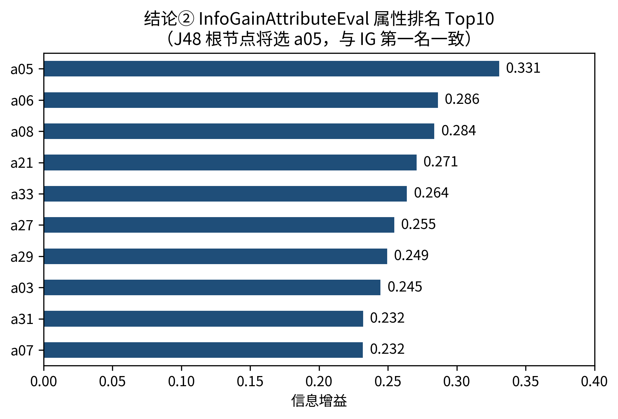
J48 Information Gain Attribute Ranking
Information Gain Top 5
a05 — 0.331
a06 — 0.286 · a08 — 0.284
a21 — 0.271 · a33 — 0.264
a05 ranks first —
It later becomes the root of the J48 tree: two independent lines of evidence reinforce each other.
Top 10 Attributes by Information Gain (InfoGain + Ranker)
5
Notes:
Before modeling, we ranked all attributes by information gain. The top five are a05, a06, a08, a21, and a33, with a05 clearly leading at 0.331. Remember a05 — it will reappear as the root of the J48 tree, providing two independent lines of evidence through the filter ranking and the tree structure.

Slide 28
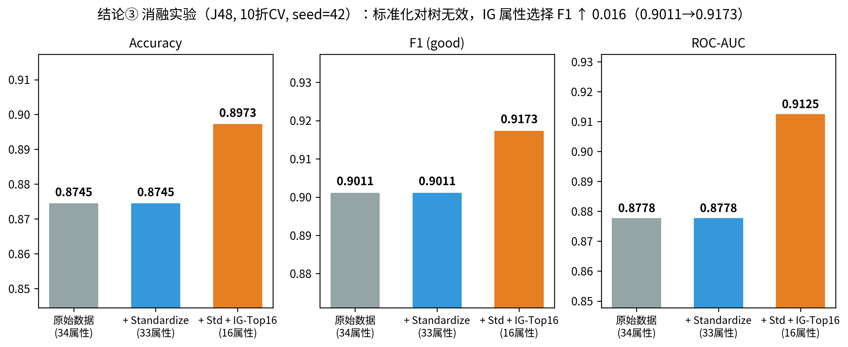
J48 Ablation Study — Do the Filters Help?
Standardization → No Change
F1 stays at 0.9011 — trees split on thresholds, and scaling does not change within-attribute ordering.
InfoGain Top-16 → Better
F1 0.9011 → 0.9173 · AUC 0.8778 → 0.9125
Attribute selection is effective for small, high-dimensional datasets.
Conclusion:
Preprocessing must match the model type.
J48 under three preprocessing settings (10-fold CV, seed = 42)
6
Notes:
Do these preprocessing choices actually help? We conducted an ablation study. For J48, standardization leaves results completely unchanged — F1 stays at 0.9011 because trees split on thresholds and scaling does not change within-attribute ordering. Retaining the top 16 information-gain attributes raises F1 to 0.9173 and AUC to 0.9125. Thus attribute selection works on small, high-dimensional data, while scaling does not. The conclusion is simple: preprocessing must match the model type.

Slide 29
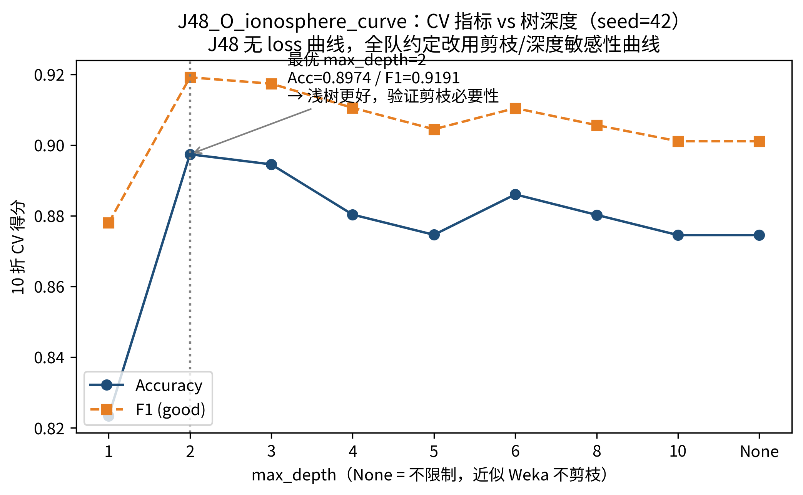
J48 — Depth Sensitivity
Why J48
· Every path is a readable rule: thresholds, sample counts, and class composition at a glance
· Immune to monotonic scaling; no standardization required
· A strong baseline for small numeric datasets (351 rows)
Depth sensitivity: depth = 2 is optimal
Acc 0.8974 · F1 0.9191 — deeper trees fall back toward the unpruned baseline (0.8745)
Validation scores by tree depth (10-fold cross-validation)
Root = a05 — the top information-gain attribute: two independent lines of evidence agree.
8
Notes:
Now for J48. We selected it for three reasons: every path is a readable rule with thresholds, sample counts, and class composition; it is immune to monotonic scaling and needs no standardization; and it is a strong baseline for small numeric datasets. The depth-sensitivity curve shows that depth 2 is already optimal — accuracy 0.8974 and F1 0.9191 — while deeper trees fall back toward the unpruned baseline, showing that pruning is necessary. Another detail: the tree root is a05, exactly the top information-gain attribute, so the two independent lines of evidence agree.

Slide 30
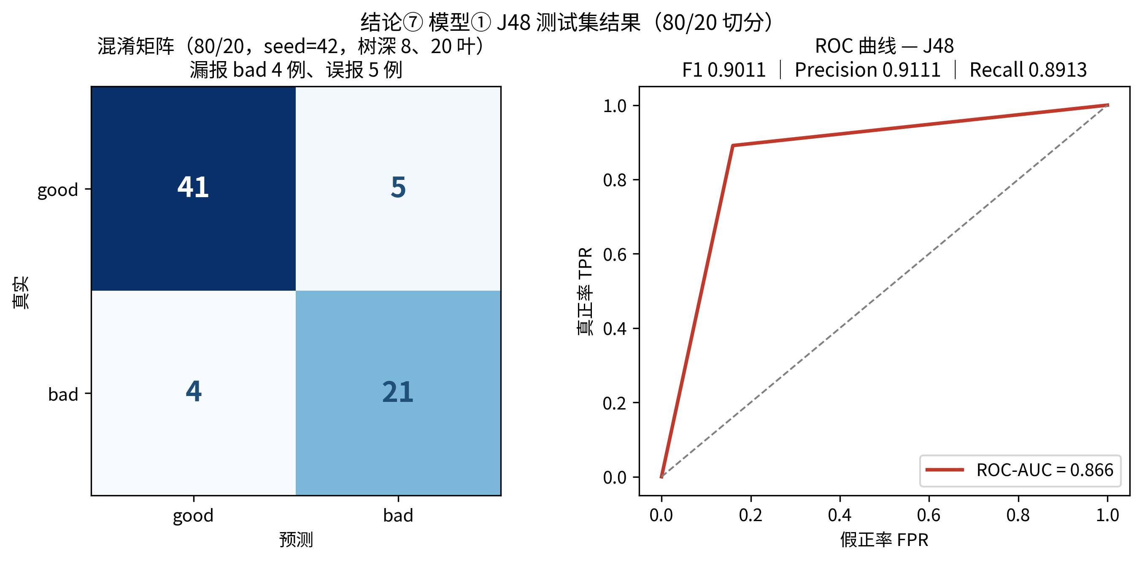
J48 Test Results (80/20, seed = 42)
0.9011
0.9111
0.8913
0.866
8 / 20
F1（good）
Precision
Recall
ROC-AUC
Tree Depth / Leaves
Confusion matrix (41 + 21 correct, 9 errors) and ROC curve (held-out test set)
9
Notes:
On the 80/20 held-out test set, the pruned tree — depth 8 with 20 leaves — achieves F1 0.9011, precision 0.9111, recall 0.8913, and AUC 0.866. The confusion matrix shows only 9 errors among 71 test samples: 5 false positives and 4 false negatives. The 10-fold cross-validation scores are consistent with these results, indicating good generalization.

Slide 31
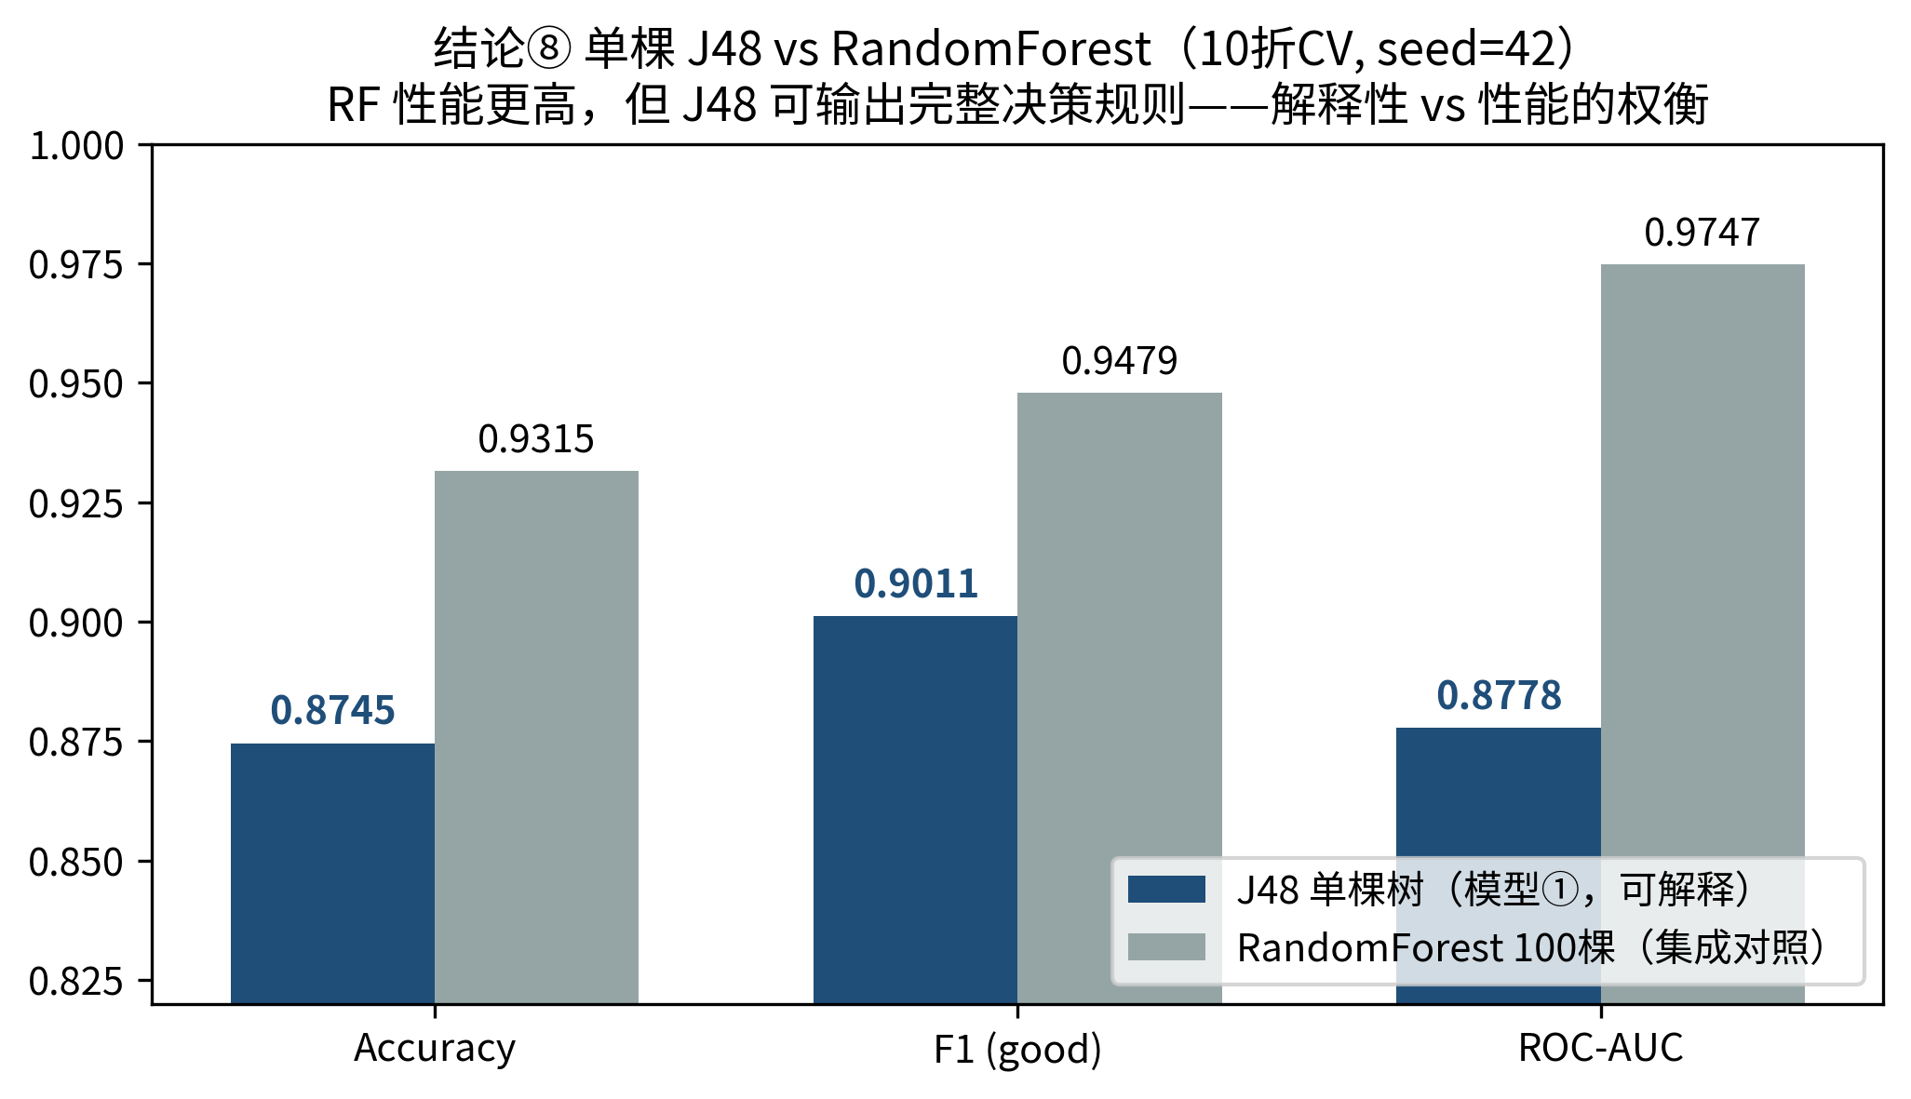
Result ⑧ J48 vs Random Forest
Random Forest Higher Overall
Acc 0.9315 · F1 0.9479 · AUC 0.9747
J48 Fully Readable
One tree = a complete rule set; a forest is a black box
Original report figure: three metrics for both models (10-fold CV, seed = 42)
Line comparison: Random Forest exceeds J48 on all three metrics
J48 = interpretable model; Random Forest = performance benchmark — the interpretability–performance trade-off
10
Notes:
Finally, we compare a single J48 tree with 100 Random Forest trees under the same 10-fold cross-validation. The forest is higher on every metric — accuracy 0.9315, F1 0.9479, and AUC 0.9747. But the forest is a black box, whereas J48 outputs a complete, readable set of decision rules. Our positioning is therefore: J48 is the interpretable model and Random Forest is the performance benchmark — the trade-off between interpretability and performance.

Slide 32
Summary
01
Preprocessing must match the model. Standardization does not affect trees; InfoGain Top-16 selection improves F1 by +0.016.
02
J48 offers readable rules and robust performance (F1 0.9011) — root attribute a05 is independently supported by the information-gain ranking.
03
RBF-SVM is best among four models (F1 0.956 · AUC 0.980); J48 provides interpretability, while Random Forest serves as a performance benchmark.
That concludes my section — over to the next presenter. Thank you.
11
Notes:
To summarize: first, preprocessing must match the model — standardization does not affect trees, while information-gain selection improves F1 by about 0.016. Second, J48 provides readable rules and robust performance, and root attribute a05 is independently supported by information gain. Third, RBF-SVM is best among the four models, while J48 provides interpretability. That concludes my section; over to the next presenter. Thank you.

Slide 33
SPEAKER
B2 · He Mingen
Scope of Work
B2
Random Forest vs Logistic Regression
Presentation Outline
· Training and convergence diagnostics: OOB 6.27% ≈ CV error; no overfitting
· Source of difference: ranking ability rather than threshold selection
· Conclusion: Random Forest achieves ROC-AUC 0.9497 and outperforms logistic regression overall
Ionosphere
CDS 535 · Data Mining · Group Project

Slide 34
RandomForest vs Logistic on Ionosphere
Model card · 10-fold stratified CV, seed 42 · positive class = g
01 · WHY & HOW
351 samples
33 numeric inputs
values in [−1, 1]
64 : 36 imbalance
RandomForest
Logistic
100 trees vote on random feature subsets.
One weighted sum through a sigmoid — 35 parameters.
trees 100 · features/split 6 · depth unlimited · bag 100%
L2 1e-8 ≈ none · L-BFGS to convergence · no scaling
Fits because the boundary is curved, and sampling dilutes the weak dimensions among 33.
Fits because inputs are already on one scale, so coefficients stay stable on 351 rows.
a02 (all zeros) dropped: 34 inputs → 33. One model covers the curve, the other anchors the straight line.
Model Card · B2 HE Mingen
01 / 04

Slide 35
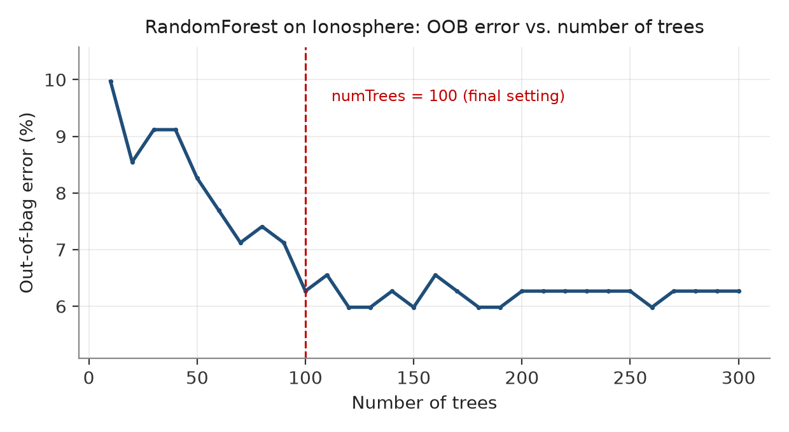
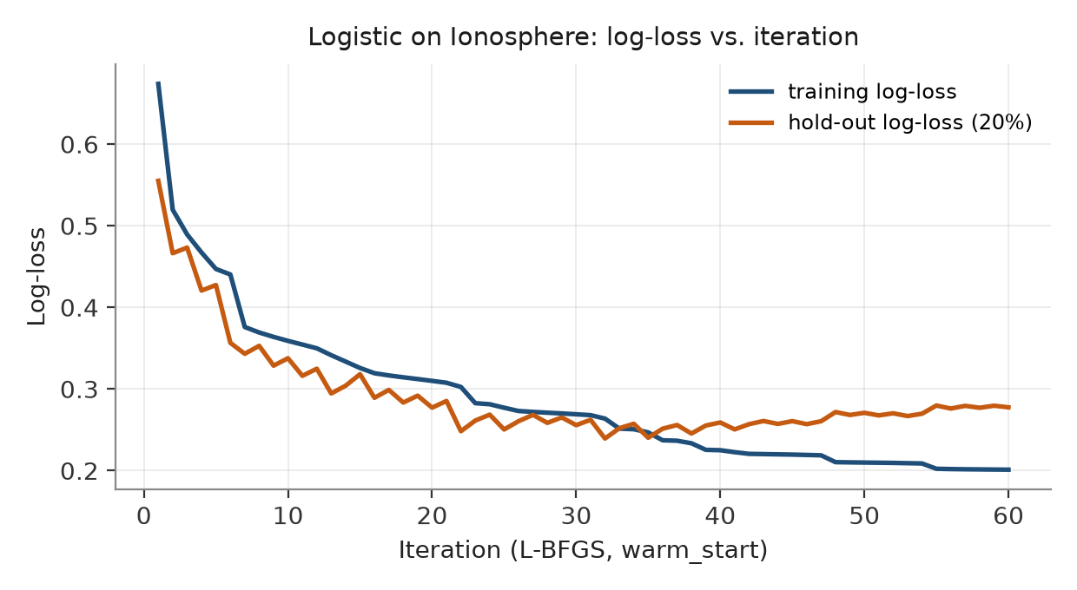
Both models finished training
02 · CURVES
OOB error: 10.0% → 6.27% by 100 trees, then flat.
Log-loss: training flattens at 0.20, hold-out stalls at 0.26.
OOB 6.27% ≈ CV error 6.55% — no overfitting; extra trees only cost time.
Converged by ~30 rounds — 35 parameters is the ceiling, not the optimiser.
Neither model is under-trained — whatever separates them is the model itself.
Model Card · B2 HE Mingen
02 / 04

Slide 36
Where the difference comes from
03 · RESULT
F1 AND ROC-AUC · 10-FOLD CV · POSITIVE = g
WHERE THE ERRORS GO · 351 CASES
RandomForest: 23 errors, mostly false alarms. Logistic: 46 errors, and 27 of them are missed g returns.
Both bars favour RandomForest — no tie-break rule had to be invoked.
A straight border pushes the grey zone to b — that is a missed-g problem, not a threshold problem.
Model Card · B2 HE Mingen
03 / 04

Slide 37
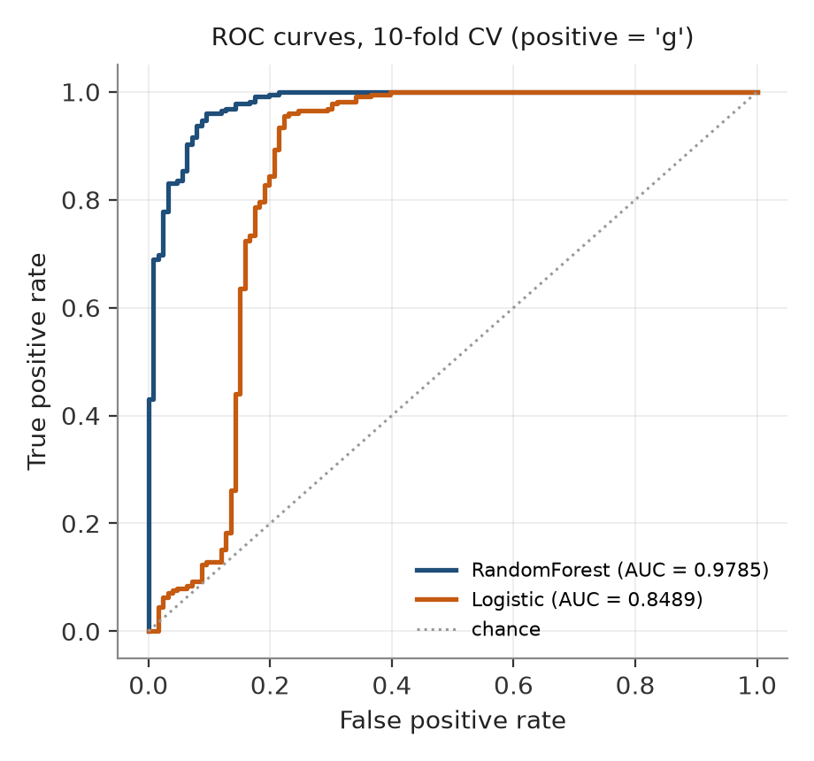
Verdict: the gap is ranking, not threshold
04 · TAKEAWAY
SELECTED MODEL
0.9497
F1
AUC 0.9785
+1.3 pp over the J48 baseline · +5.0 pp over Logistic
Logistic did not lose to training: its loss curve had already flattened at 35 parameters. It lost to a boundary it cannot bend.
Rule applied: F1 → ROC-AUC → simpler model. RandomForest takes the first two.
Logistic sags exactly where false alarms matter most — FPR below 0.2.
Model Card · B2 HE Mingen
04 / 04

Slide 38
SPEAKER
B3 · Hu Shuaishuai
Scope of Work
B3
Preprocessing schemes · Feature scan · PCA · Evaluation protocols · KMeans
Presentation Outline
· Preprocessing schemes × algorithms: SVM + SMOTE achieves the best accuracy of 0.943
· SelectKBest feature-count scan: k = 30 is optimal
· PCA component scan and comparison with SelectKBest
· Two evaluation protocols + KMeans clustering
Ionosphere
CDS 535 · Data Mining · Group Project

Slide 39
Result 2 · Preprocessing Schemes × Algorithms (Accuracy)
02 Results & Analysis
Model | nobalance | noselect | over | smote
Decision Tree | 0.914 | 0.877 | 0.909 | 0.912
Random Forest | 0.931 | 0.932 | 0.937 | 0.923
Logistic Regression | 0.863 | 0.883 | 0.843 | 0.849
SVM | 0.940 | 0.940 | 0.937 | 0.943
Decision Tree: feature selection reduces candidate splits and complexity → best
Random Forest: oversampling is best, but differences are small; insensitive to preprocessing
Logistic Regression: baseline is best; high Recall and low Precision favor positive predictions
SVM: SelectKBest + SMOTE is best; differences between schemes are small
nobalance: no balancing, with feature selection noselect: no balancing, no feature selection
over: class balancing, with feature selection smote: class balancing, with feature selection
Two Observations on Class Resampling and Feature Selection
1 With mild imbalance of about 64:36, the original distribution already provides sufficient training information, so resampling alone offers limited gains;
2 SMOTE is an interpolation algorithm; its samples may not be real, but they can supplement the data.
3 Retaining a fixed 15 features helps only the decision tree and often discards useful details; however, a suitable k can still filter noise — as confirmed by the k scan below.
CDS 535 · Data Mining · Group Project
4 / 10
Notes:
The first group of results concerns the effect of preprocessing on each model. The table reports accuracy for 4 models × 4 pipelines: nobalance with feature selection only, the noselect baseline with standardization only, over with random oversampling, and smote with SMOTE.
Decision Tree performs best with feature selection only, because fewer candidate split features reduce complexity. Random Forest performs best with random oversampling, but differences among the four schemes are small, so it is insensitive to preprocessing. Logistic Regression performs best with no additional processing — feature selection or resampling changes the input structure of the linear model and hurts performance. Its high Recall and low Precision indicate a tendency to predict more positives. SVM performs best with SelectKBest plus SMOTE, although differences among schemes are again small.
Regarding resampling: only random oversampling for Random Forest slightly outperforms SMOTE. Our interpretation is that, for small samples, whether added samples help depends on whether they capture real structure rather than merely balance class counts. Overall, with mild 64:36 imbalance, resampling alone offers limited gains.

Slide 40
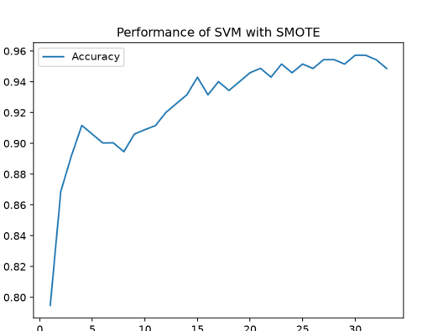
Result 3 · SelectKBest Feature-Count Scan
02 Results & Analysis
Setup: Standardize → SelectKBest → SMOTE → SVM; stratified 10-fold CV; all fitting inside the pipeline
k = 15
Acc 0.943｜F1 0.956｜F1_std 0.031
k = 30 Is Optimal
Acc 0.957 | F1 0.967 | F1_std 0.015 — more stable
Conclusion
Too few features omit signals; too many reintroduce redundancy and noise.
CDS 535 · Data Mining · Group Project
5 / 10
Notes:
The second experiment scans the number of features. With SMOTE plus RBF-SVM fixed, SelectKBest k is scanned from 1 to 33 under stratified 10-fold cross-validation, with all preprocessing inside the pipeline to avoid information leakage.
The curve rises rapidly when k is small. At k = 15, accuracy is 0.943 and F1 is 0.956. At k = 30, this group reaches its best results — accuracy 0.957 and F1 0.967 — while the fold-level standard deviation of F1 falls from 0.031 to 0.015, improving both accuracy and stability. Adding all 33 features causes a slight decline.
The explanation is that SelectKBest uses class labels within training folds to retain discriminative information directly. Too few features omit signals, while too many introduce redundancy and noise. Considering performance and stability, k around 30 is a strong choice in this scan, but the conclusion applies only to the current cross-validation split and parameter range.

Slide 41
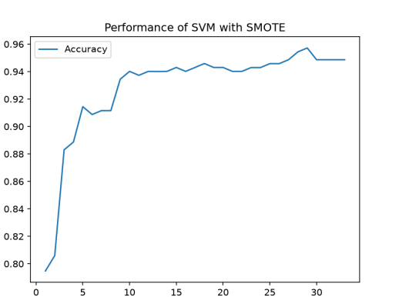
Result 4 · PCA Component Scan & Comparison with SelectKBest
02 Results & Analysis
Setup: Standardize → PCA → SMOTE → SVM; stratified 10-fold CV; all fitting inside the pipeline
Adding more components yields diminishing gains and small fluctuations
More components do not guarantee better performance
PCA vs SelectKBest (Best Accuracy)
PCA（k=29）：0.9577
SelectKBest（k=30/31）：0.9572
SelectKBest uses ANOVA values
PCA uses eigenvalues of the covariance matrix
CDS 535 · Data Mining · Group Project
6 / 10
Notes:
The third experiment replaces SelectKBest with PCA and likewise scans component count k from 1 to 33. At k = 1, accuracy is only about 0.795, showing substantial information loss; at k = 10, it recovers to about 0.940; at k = 15, it is about 0.943. Adding more components yields diminishing gains and small fluctuations.
The key distinction is that PCA extracts directions by variance rather than class labels, so more components do not guarantee continuously improving classification performance.
Comparing the two dimensionality-reduction methods directly: PCA reaches its best accuracy of 0.9577 at k = 29, while SelectKBest reaches 0.9572 at k = 30 or 31. The difference is only about 0.0005, insufficient to conclude that PCA is better. From an engineering perspective, SelectKBest retains original features and is easier to interpret; PCA can compress correlated information, but component meanings are less clear than those of the original features.

Slide 42
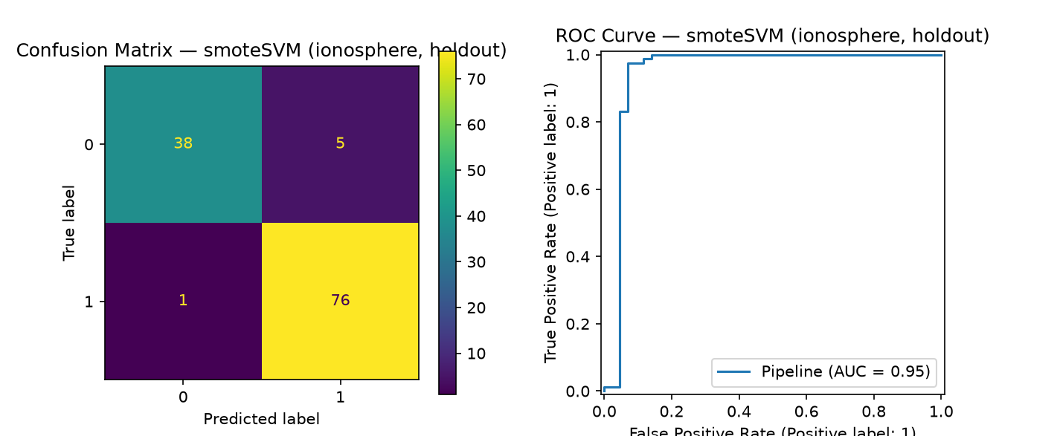
Result 7 · Comparison of Two Evaluation Protocols
02 Results & Analysis
Protocol A | Stratified 10-Fold Cross-Validation (Primary)
Each fold takes a turn as validation; mean and standard deviation quantify variation and support robust conclusions
Protocol B | Single Stratified Hold-Out Split (Control)
Simple and intuitive, but results depend on one train/test composition; some model metrics vary noticeably
Both Protocols Produce Nearly Identical Rankings
Model comparisons use 10-fold CV mean ± standard deviation; hold-out results serve only as a control.
SMOTE + SVM on hold-out set: confusion matrix and ROC (AUC = 0.95)
CDS 535 · Data Mining · Group Project
7 / 10
Notes:
The fourth experiment tests the robustness of the evaluation protocol. We use a single stratified hold-out split as a control protocol and rerun all models.
The overall rankings are nearly identical under both protocols, with SVM and Random Forest still leading. On the right are the confusion matrix and ROC curve for SMOTE plus SVM on the hold-out set; AUC reaches 0.95, with only 6 errors among 120 hold-out samples.
However, a single split is more sensitive to the composition of the training and test sets, and some model metrics vary noticeably. Therefore, single hold-out evaluation serves only as a control, while model comparisons still rely primarily on the mean and standard deviation from 10-fold cross-validation.

Slide 43
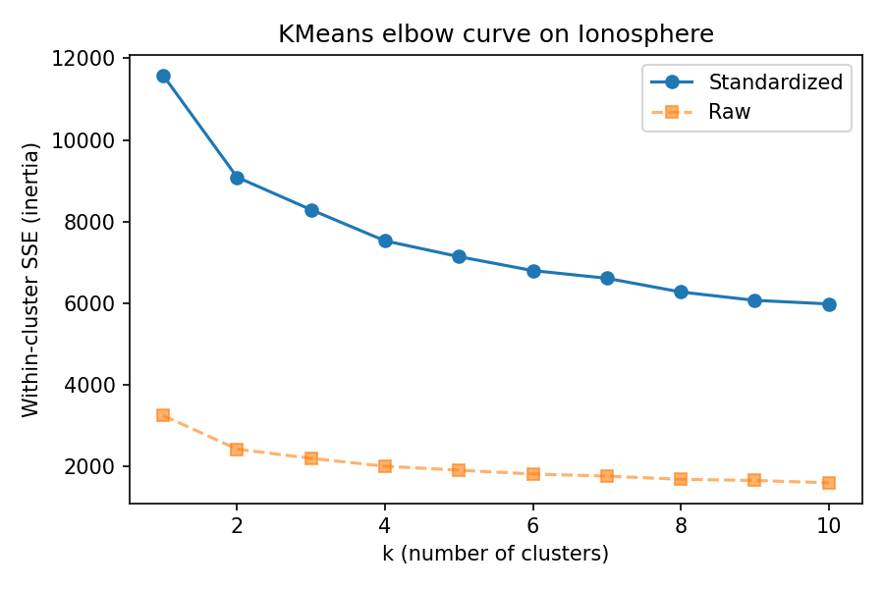
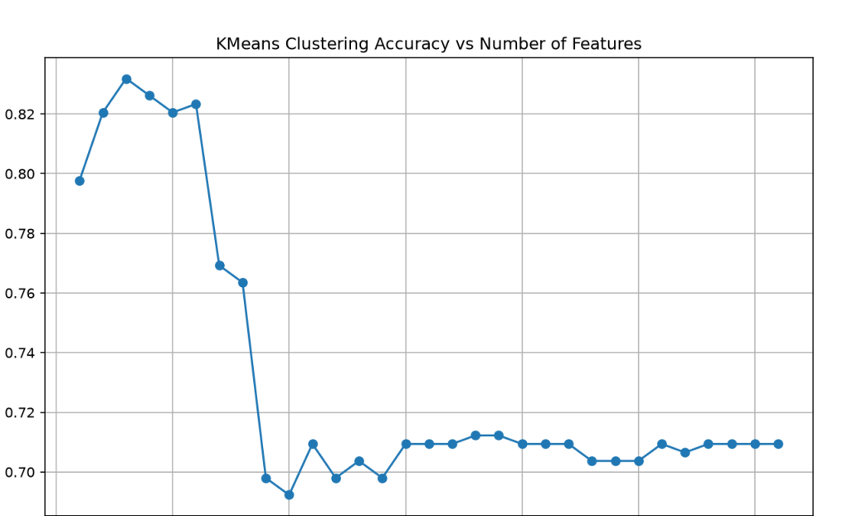
Result 8 · KMeans Unsupervised Clustering
02 Results & Analysis
Elbow curve: k = 2 is a reasonable choice (though not sharp)
Cluster–label agreement (purity) across feature counts
SSE drops most sharply from k = 1 to k = 2, making k = 2 a reasonable elbow choice;
With 2 clusters, accuracy reaches up to 83%; at k ≈ 10, it approaches random guessing.
Conclusion: KMeans can help reveal structure
CDS 535 · Data Mining · Group Project
8 / 10
Notes:
The final experiment asks whether unsupervised clustering can replace supervised classification. We apply KMeans with 2 clusters to standardized features and compare the clusters with true labels. Since cluster numbers have no intrinsic class meaning, both cluster–label mappings are tested and the higher agreement is reported as purity.
The left plot is the elbow curve: SSE drops most sharply from k = 1 to k = 2, making k = 2 a reasonable elbow choice. This suggests a natural two-cluster structure, although the elbow is not sharp.
The right plot shows purity across feature counts. With only the top 3 features, purity is about 0.83, well above the 0.64 majority-class guess, showing that cluster structure is related to good/bad labels. As more features are added, purity falls substantially and approaches random guessing around k = 10, as structures weakly related to class and noise enter the distance calculation.
Conclusion: KMeans can help examine the relationship between data structure and classes, but cannot replace supervised classification. One caveat: SelectKBest uses true labels here, so this is label-assisted exploratory analysis rather than a fully unsupervised result.

Slide 44
PART 03 · COMPARISON
Mushroom × Ionosphere Comparison Report
Dimension
Mushroom
Ionosphere
Scale
8,124 samples × 22 attributes
351 samples × 34 attributes
Attribute Type
All nominal (multi-valued)
Continuous numeric (17 × 2 complex pulses)
Class Distribution
51.8 : 48.2; nearly balanced
64 : 36; mildly imbalanced
Representative Methods
KNN · Apriori · ZeroR · Logistic Regression
RBF-SVM · J48 · Random Forest · KMeans
Best Results
J48-top9 / Logistic Regression / KNN: F1 = 1.000
SVM(smote) accuracy 0.943 | RF ROC-AUC 0.9497
Key Bottleneck
Feature redundancy — top-9 features suffice for perfect classification
Small-sample, high-dimensional nonlinearity — preprocessing and evaluation protocols matter significantly
Shared conclusion: both tasks use stratified 10-fold cross-validation (seed = 42); preprocessing and feature selection affect final performance more than differences among models.
CDS 535 · Data Mining · Group Project

Slide 45
PART 03 · TAKEAWAYS
Summary
01
Preprocessing Sets the Ceiling
For Mushroom, top-9 features suffice for perfect classification; for Ionosphere, feature selection and class balancing significantly change the performance of models such as SVM.
02
Match Models to Data Characteristics
KNN, association rules, and decision trees suit nominal data; RBF-SVM and Random Forest are more robust on small, high-dimensional continuous data.
03
Evaluation Protocols Must Be Consistent and Robust
Both groups use stratified 10-fold CV (seed = 42); Ionosphere is also verified with an 80/20 split, yielding consistent conclusions under both protocols.
04
Interpretability Also Matters
J48 information-gain ranking, Apriori's 104 strong association rules, and the agreement between the KMeans elbow at k = 2 and the true classes all provide supporting evidence.
CDS 535 · Data Mining · Group Project

Slide 46
Thank You · Q & A
CDS 535 · Data Mining · Group Project
A1 He Haodong | A2 Bei Xuecheng | A3 Gu Ruiqi | B1 Gong Tinglu | B2 He Mingen | B3 Hu Shuaishuai

